Slide 1
KNOWLEDGE TOPIC 8:
BURETTES AND TITRATIONS

Slide 2
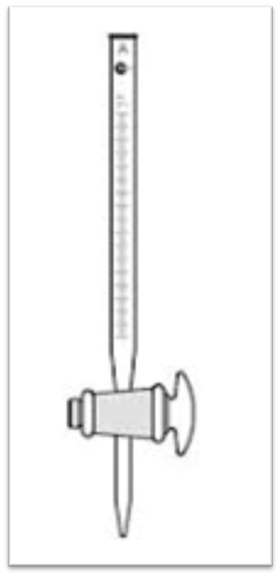
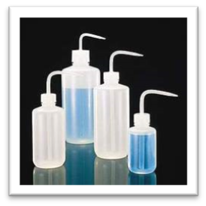
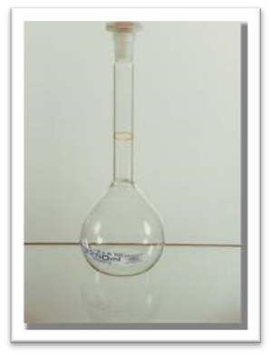
INTRODUCTION
A graduated cylindrical tube of uniform bore.
Has a stopcock at the bottom to control the flow through a narrow jet.
Used in the laboratory to deliver measured volumes of liquids.
Available in various capacities.
Are graduated according to their size and intended use.
Are usually subdivided into 0,1 cm³.
Used for titrations.

Slide 3
TITRATION
A titration is the controlled addition of a solution (in a burette) to a known volume of another solution (in an Erlenmeyer flask) until a definite endpoint is reached, showing that two chemicals have reacted completely.
Calculations can be performed using the results obtained from a titration.
The flask must be continuously swirled as solution is added.
A titre is the volume of solution delivered by a burette to reach the end-point (It is often the difference between two burette readings).

Slide 4
BURETTES
The accuracy with which any burette can deliver a measured volume is dependent on:
the accuracy of the graduation,
the temperature of the solution in the burette and
the method by which the burette is used.
Burettes are usually calibrated at a temperature of 20˚C.
Most modern burettes have a stopcock made of PTFE or Teflon.
This material does not need lubrication when not in use.
During storage the burette should be clamped in a stand with the stopcock uppermost to allow it to drain.
If it is to be stored for a long time, the stopcock nut should be loosened and the stopcock should be “popped” out of its barrel to prevent deformation due to pressure.

Slide 5
USE OF A BURETTE (1)
The burette must first be cleaned and rinsed with distilled water.
Rinse the burette three times with a portion of the solution to be used.
Drain through the stopcock and jet.
Make sure when rinsing that the entire surface of the burette is reached by the solution.
Using more solution than is necessary is wasteful.
Using a burette filling funnel, fill the burette to well above the zero mark.

Slide 6
USE OF A BURETTE (2)
Tap the burette sharply to allow air bubbles to rise to the top.
The air bubbles in the jet must be removed by allowing the solution to run out of the jet.
Remove this bubble first, top up if necessary, and then remove the funnel.
If the bubbles persists, the burette must be emptied, cleaned and the process repeated. NB. The filling funnel must be placed on a watch glass or in a small clean beaker.
When zeroing the burette, it must be clamped vertically in a burette stand using a burette clamp.

Slide 7
USE OF A BURETTE (3)
Wipe the entire outside of the burette with clean tissue to remove all traces of solution.
Run the solution into a waste beaker until the concave bottom of the meniscus coincides with the zero mark (Remember to keep your eye level with the mark).
Remove the drop adhering to the jet by bringing the inside of the waste beaker into contact with the tip of the jet. To accomplish this, the waste beaker should be held at an angle to the axis of the jet.
Check the zero setting again before starting titration.

Slide 8
USE OF A BURETTE (4)
The burette stopcock is operated with the left hand using the thumb, index and middle fingers. The thumb is placed on the front of the stopcock and the two fingers at the back of the stopcock. The nut faces the palm. By moving the two fingers it is possible to operate the stopcock, allowing 1 drop at a time to pass through the jet.
The right hand is then used to swirl the flask, the little finger being used to stabilise the Erlenmeyer flask as it is swirled.
It is also possible to set the tap quite loosely so that it can be “flicked” through 180⁰ resulting in small droplets being dispensed.

Slide 9
USE OF A BURETTE (5)
When the solution in the flask is about to change colour it may be desirable to dispense a “small” drop by opening the tap slightly, allowing a diminutive droplet to form at the tip of the jet and then transferring it to the Erlenmeyer flask by touching it with the side of the flask.
When titrating add about 2 – 5 drops of indicator to the solution in the Erlenmeyer flask.
Titrate until the colour starts to change, then add the solution dropwise until the end-point is almost reached.
Wash down the sides of the Erlenmeyer flask using a wash bottle.

Slide 10
USE OF A BURETTE (6)
It is vital that the flask be swirled, with direction changes throughout the titration, to ensure thorough mixing.
Remove the solution adhering to the burette jet by touching the flask to the jet. Swirl the flask to mix in this portion. This should change the colour, giving the end point. If not, carefully continue the titration.
Read the final volume immediately and write it down on your report. Use the same precautions as when reading the zero. The analysis should be repeated until duplicate titres are within 0,1 cm³ of each other.

Slide 11
USE OF A BURETTE (7)
After use the burette must be thoroughly cleaned before being stored. The burette must be allowed to dry naturally while clamped upside down.
Note: When reading the liquid level in a burette, estimate the second decimal place. For example 29.45 ml means that the level is half way between 29.4 and 29.5 ml scale divisions.
When handling the burette, every effort must be made to minimise touching the graduation area as this will cause the burette to warm up and hence affect its accuracy.

Slide 12
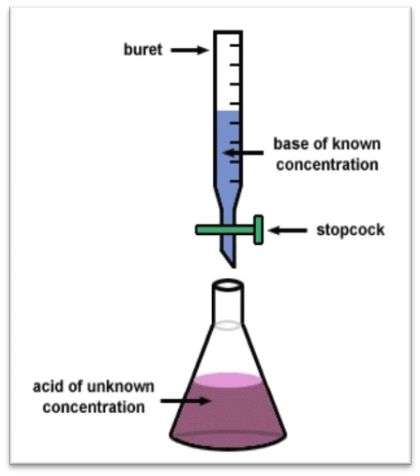
USE OF A BURETTE (8)
When repeating titration in order to get volumes within 0.1 cm³ of each other, you already have a very good idea of the end point, say 24.1 cm³.
About 23 cm³ can then be rapidly run into the Erlenmeyer by simply opening the burette fully.
However, allow about 15 – 20 seconds before completing the titration to allow solution adhering on the sides of the burette to run down.
All beakers containing reagents must be covered with watch glasses.

