Slide 1
KNOWLEDGE TOPIC 11:
PREPARATION OF SOLUTIONS AND CONCENTRATION CALCULATIONS

Slide 2
INTRODUCTION
If a solute (e.g. sugar) is mixed with a solvent (e.g. water) the result is called a solution.
A homogeneous mixture of two (or more) components.
Homogeneous means uniform i.e. the components cannot be told apart e.g. we cannot see the sugar dissolved in a sugar solution.
A heterogeneous mixture is a mixture of two or more components where it is possible to tell the components apart e.g. a mixture of sugar and sand.
A standard solution is a solution with a known concentration of chemicals.
A standard solution is necessary when doing most analyses so that the unknown can be compared with the known.
The accuracy of the final result of the analysis will thus depend on whether the solution was made correctly or not.

Slide 3
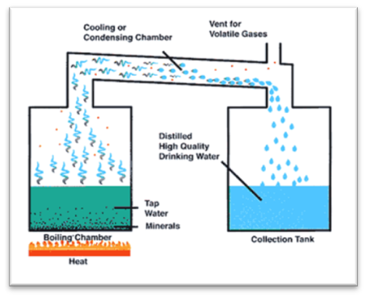
STANDARD SOLUTIONS
There are two ways of making up standard solutions:
  By massing / pipetting a known quantity and making to mark in a volumetric flask.
  By using an aliquot of concentrated standard solution and making to the mark.
In both cases distilled or de-ionised water must be used. NOT TAP WATER!
Definition of distilled water:
Distilled water is water that has had many of its impurities removed through distillation. Distillation involves boiling the water and then condensing the steam into a clean container.

Slide 4
PREPARATION OF STANDARD SOLUTIONS
A reagent solution is a solution which is used to react with another substance e.g. an indicator solution.
The first step involves massing and quantitatively transferring the solute to the flask.
Note that kohlrausch and sugar flasks are also volumetric flasks.
The second step involves making the contents of the volumetric flask up to the graduation mark.

Slide 5
PREPARATION OF STANDARD SOLUTIONS – STEP 1
Step 1: Transferring the solute to the flask
Read the procedure and obtain all the items required.
Make sure that all the equipment is clean.
Mass out the required quantity of chemical(s) into a nickel massing basin or beaker.
If heat is required to dissolve the solute, do this in a beaker first, then transfer the cooled solution to the flask.
Using the jet from a wash bottle, wash the final portion of the solute from the massing basin into the flask.
Note: To prevent the funnel from choking, wet the solute and swirl the massing basin to form a slurry. Also wash the outside of the spout into the flask.
If a funnel is used, wash that too into the flask.
NOTE: At this point all the chemicals must be in the flask, with none lost by adhering to the beaker, the massing basin or the funnel.
This is referred to as a quantitative transfer.

Slide 6
PREPARATION OF STANDARD SOLUTIONS – STEP 2
Step 2: Making to the mark accurately
The aim of this lengthy and precise procedure is that, at the end of the 23 steps, the analyst must be able to say, with complete certainty, that all the chemical measured out is contained in a certain volume of solution, with nothing having been lost anywhere. Note that loss could be in the form of a solid chemical (after massing and before dissolving) or in the form of solution.
Rinse the inside and outside of the funnel into the flask using the washing bottle (If the pipette was used to transfer an aliquot of solution and the pipette touched the side of the volumetric flask, this must be rinsed down).
Make up to the bottom of the neck and stopper the flask (This allows space for mixing)
Mix well by swirling the flask until there are no striations in the solution.
Wash the stopper into the flask (Do not lose chemical in drops adhering to the stopper). If the stopper is rinsed using a funnel, the funnel must be rinsed (both inside and outside) before it is removed.
Make up to 2cm below the mark.

Slide 7
PREPARATION OF STANDARD SOLUTIONS – STEP 2 (Cont.)
Stopper and swirl again. This is the last mixing until No. 22 below (When the flask is finally made up to the mark in step 20, the neck above the mark must be absolutely dry. Any drops in this area would increase the volume during the last mixing in step 22).
Rinse the stopper into the funnel again and rinse the funnel.
Rinse the neck of the flask (The level should be 0.5 cm below the mark).
Dry the stopper.
Dry the neck down to the mark with a roll of tissue / filter paper
Do not dip the tissue into the solution – this will lose solution.

Slide 8
PREPARATION OF STANDARD SOLUTIONS – STEP 2 (Cont.)
Replace the stopper.
Note the water bath temperature and ask the laboratory supervisor to adjust it if necessary.
Place a wash bottle and the flask into the water bath (time).
Remove the wash bottle and flask from the water bath (time).
Minutes in water bath: Minimum 30 minutes.
Do not allow the flask to float. Contamination of the neck above the graduation mark could occur.
Dry the wash bottle.
Dry the flask.

Slide 9
PREPARATION OF STANDARD SOLUTIONS – STEP 2 (Cont.)
By bringing the tip of a pipette or fine dropper close to the meniscus, carefully make to mark (No splashing or wetting of the neck above the mark). HINT: Hold the flask above the mark with the index finger placed over the mouth about half way. Keep the pipette against this finger to control it in the centre of the neck so as not to let it touch the side.
Replace the stopper (It should still be dry).
Mix well by inverting 20 times.
Store in a reagent bottle and label the bottle accurately.

Slide 10
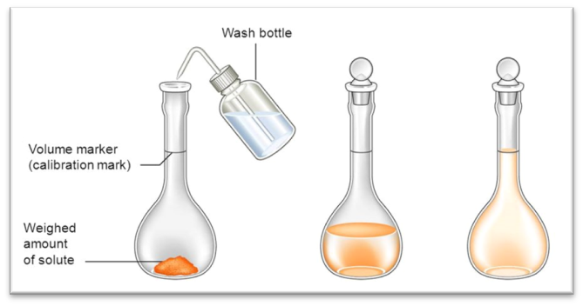
PREPARATION OF STANDARD SOLUTIONS FROM A SOLUTE
How to make a standard solution from a solute

Slide 11
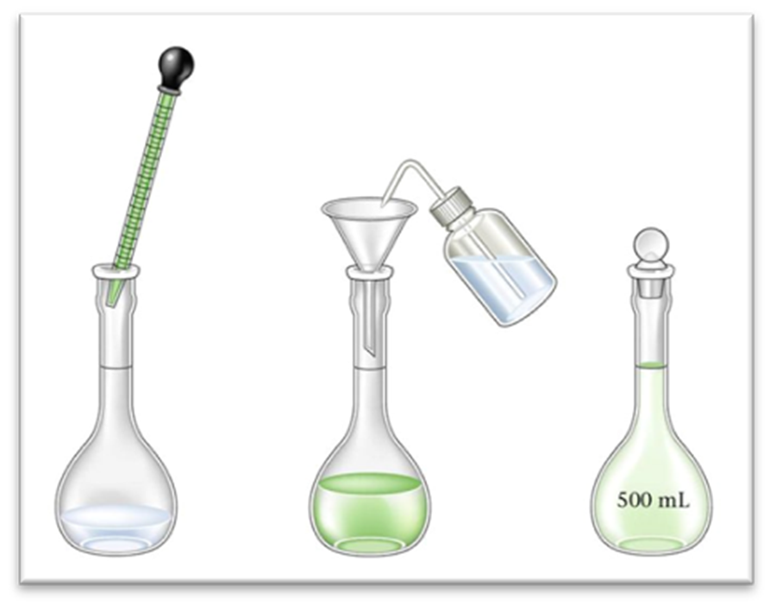
PREPARATION OF STANDARD SOLUTIONS FROM LIQUIDS
Process of making standard solution from liquids

Slide 12
STORAGE OF SOLUTIONS
It is usual to store solutions in reagent bottles with ground glass or polythene stoppers.
When storing alkaline solutions a polythene or rubber stopper must be used as a glass stopper will seize in the bottle.
The bottle must be clean and dry to prevent contamination
The bottle should be rinsed with a small portion of the solution before the solution is transferred to the bottle.
The bottle must be labelled and have a tight fitting stopper.

Slide 13
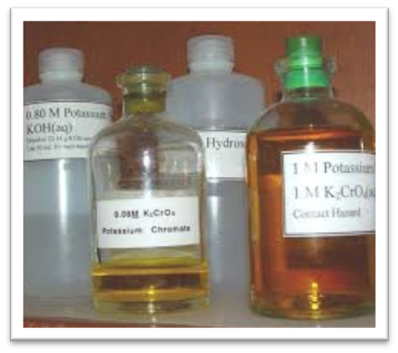
LABELLING SOLUTIONS
The label must contain the following information:
Name of the solution
Concentration of the solution
Name of the person who prepared the solution
Date when prepared
Expiry date (if applicable)
Special instructions (e.g. “store in fridge”) if applicable.

Slide 14
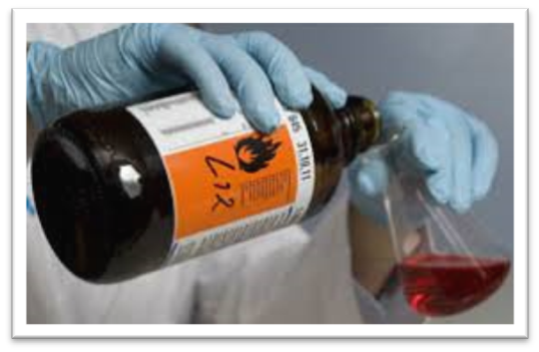
PROTECTING LABELS
In order to protect the label and the information on it, it is a good idea to cover the label with clear cellotape or other self-adhesive plastic.
Remember always to dispense liquid from the side opposite the label so as to not obliterate the information on it.

Slide 15
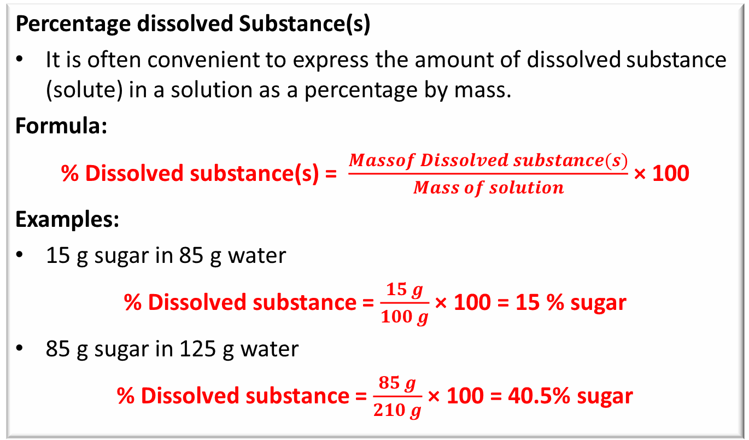
AMOUNT OF DISSOLVED SUBSTANCE(S)
      Percentage dissolved Substance(s)
It is often convenient to express the amount of dissolved substance (solute) in a solution as a percentage by mass.
Formula:
% Dissolved substance(s) = $\frac{Massof Dissolved substance(s)}{Mass of solution}$ × 100
Examples:
15 g sugar in 85 g water
% Dissolved substance = $\frac{15 g}{100 g}$ × 100 = 15 % sugar
85 g sugar in 125 g water
% Dissolved substance = $\frac{85 g}{210 g}$ × 100 = 40.5% sugar

Slide 16
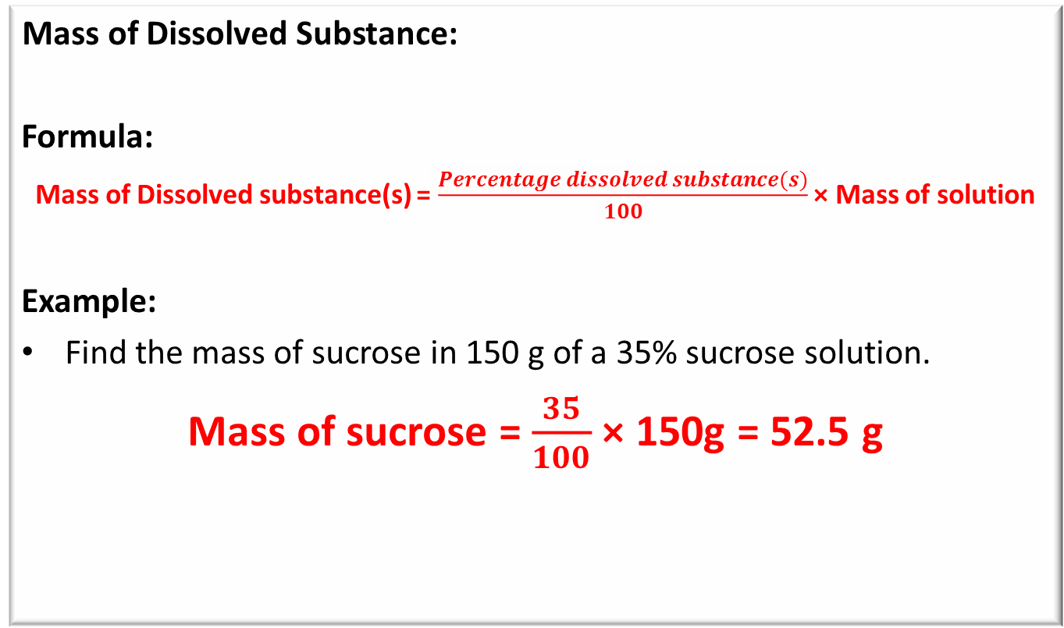
AMOUNT OF DISSOLVED SUBSTANCE(S)
      Mass of Dissolved Substance:
Formula:
Mass of Dissolved substance(s) = $\frac{Percentage dissolved substance(s)}{100}$ × Mass of solution
Example:
Find the mass of sucrose in 150 g of a 35% sucrose solution.
Mass of sucrose = $\frac{35}{100}$ × 150g = 52.5 g

Slide 17
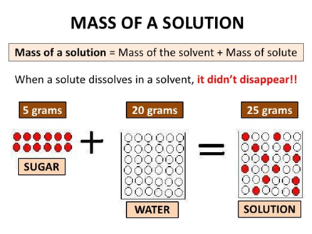
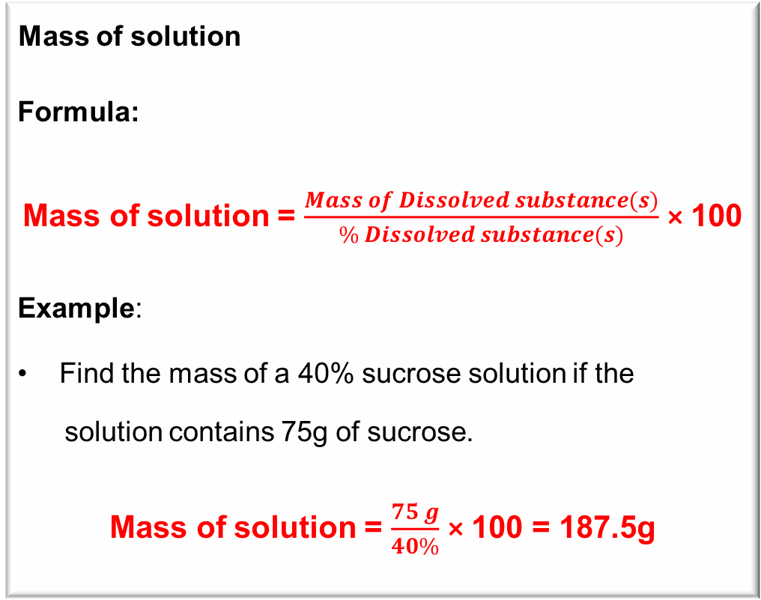
AMOUNT OF DISSOLVED SUBSTANCE(S)
      Mass of solution
Formula:
Mass of solution = $\frac{Mass of Dissolved substance(s)}{\% Dissolved substance(s)}$ × 100
Example:
Find the mass of a 40% sucrose solution if the
solution contains 75g of sucrose.
Mass of solution = $\frac{75 g}{40\%}$ × 100 = 187.5g

Slide 18
EXPRESSING CONCENTRATION
      The concentration of a substance in water can be expressed as a mass per certain volume of solution.
      The concentration is usually expressed as the mass of solute per litre of solution.
      Example:
      1 g per litre ; 7g per litre ; 11.3g per litre; 1 g per 1000 cm³
      It is important that the above is remembered as it simplifies the working out of different concentrations and volumes.
      Remember 1 litre is always the basis of the calculation i.e. 1 l or 1000 cm³ is the denominator in all cases.

Slide 19
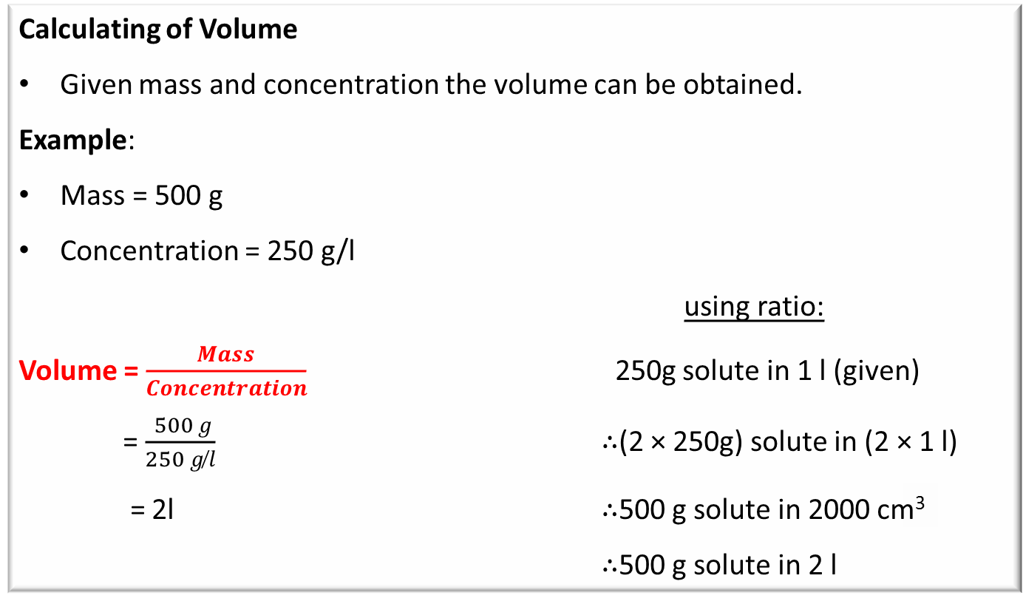
EXPRESSING CONCENTRATION
Calculating of Volume
Given mass and concentration the volume can be obtained.
Example:
Mass = 500 g
Concentration = 250 g/l
using ratio:
Volume = $\frac{Mass}{Concentration}$ 250g solute in 1 l (given)
= $\frac{ 500 g}{250 g ̸l}$ ∴(2 × 250g) solute in (2 × 1 l)
= 2l ∴500 g solute in 2000 cm³
∴500 g solute in 2 l

Slide 20
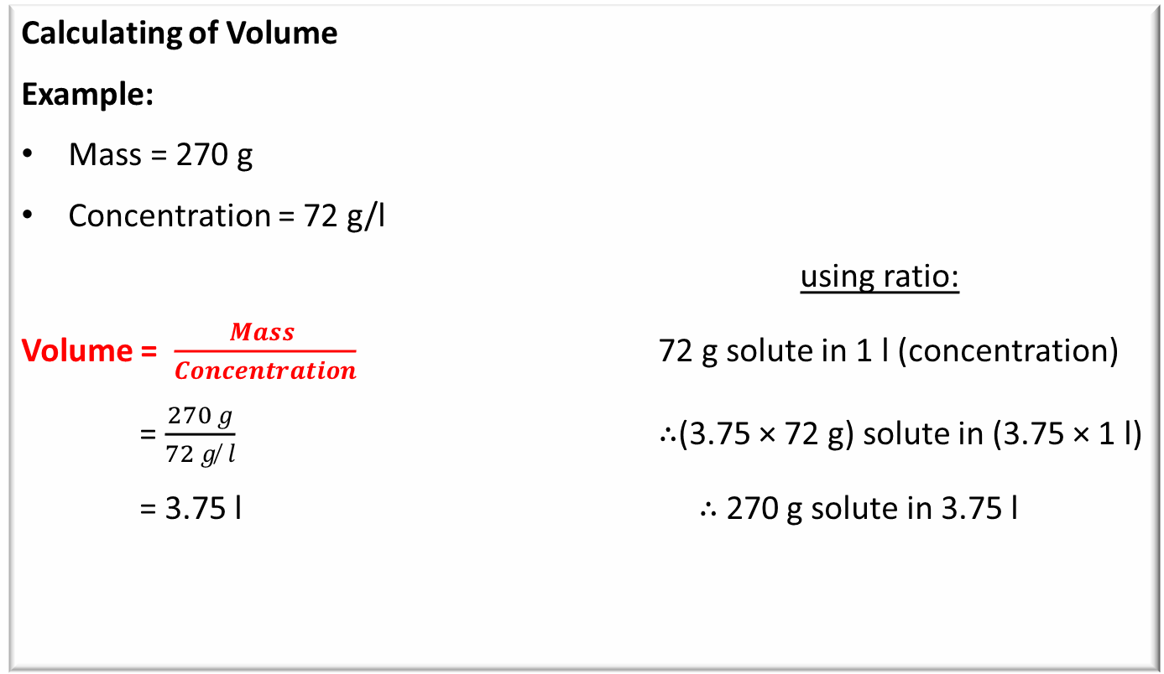
EXPRESSING CONCENTRATION
Calculating of Volume
Example:
Mass = 270 g
Concentration = 72 g/l
using ratio:
Volume = $\frac{Mass }{Concentration}$ 72 g solute in 1 l (concentration)
= $\frac{270 g}{72 g ̸ l}$ ∴(3.75 × 72 g) solute in (3.75 × 1 l)
= 3.75 l ∴ 270 g solute in 3.75 l

Slide 21
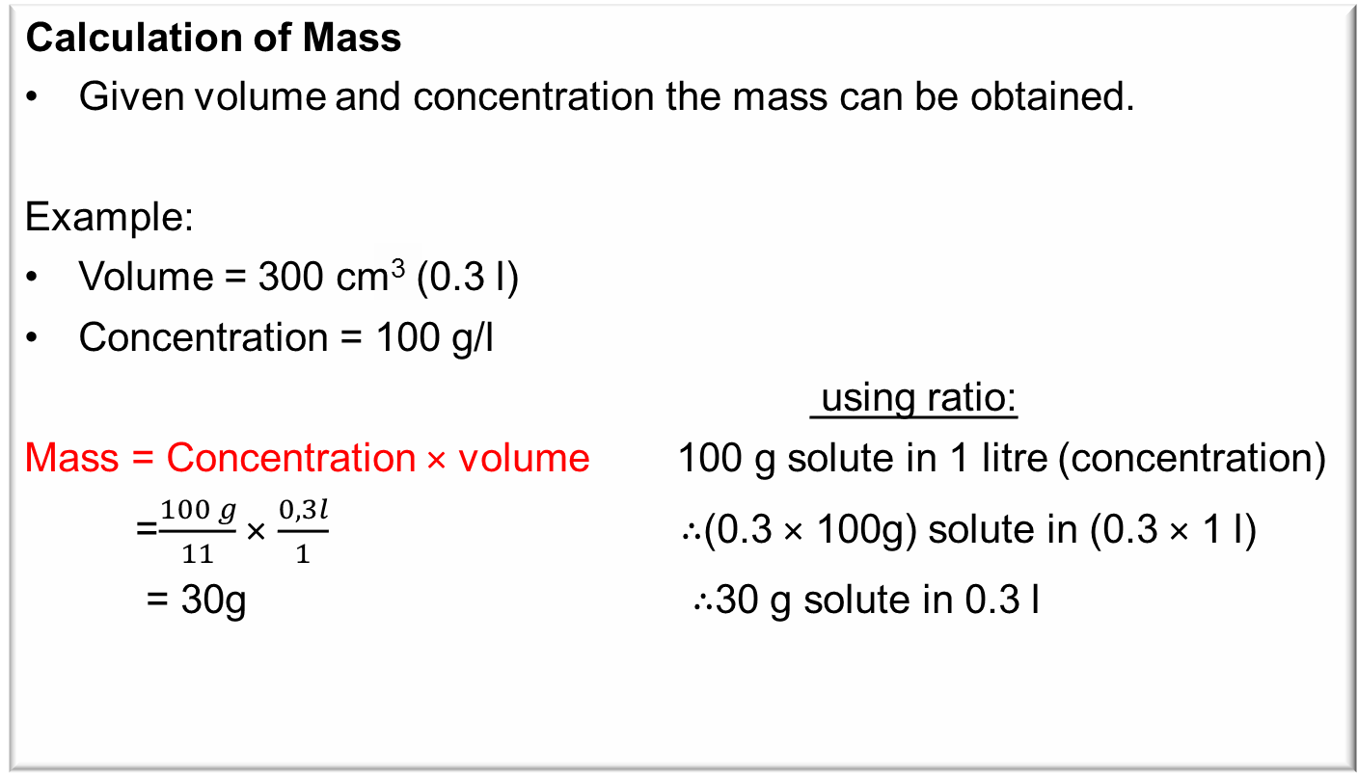
EXPRESSING CONCENTRATION
      Calculation of Mass
Given volume and concentration the mass can be obtained.
Example:
Volume = 300 cm³ (0.3 l)
Concentration = 100 g/l
using ratio:
Mass = Concentration × volume 100 g solute in 1 litre (concentration)
=$\frac{100 g}{11}$ × $\frac{0,3l}{1}$ ∴(0.3 × 100g) solute in (0.3 × 1 l)
= 30g ∴30 g solute in 0.3 l

Slide 22
REDUCING THE CONCENTRATION
When you wish to make a series of solutions of different concentrations from your original standard solution the following procedure is used.
Aliquot = (New Concentration ×New Volume)/(Old Concentration)
The aliquot is the volume of the original solution that must be taken and diluted.

Slide 23
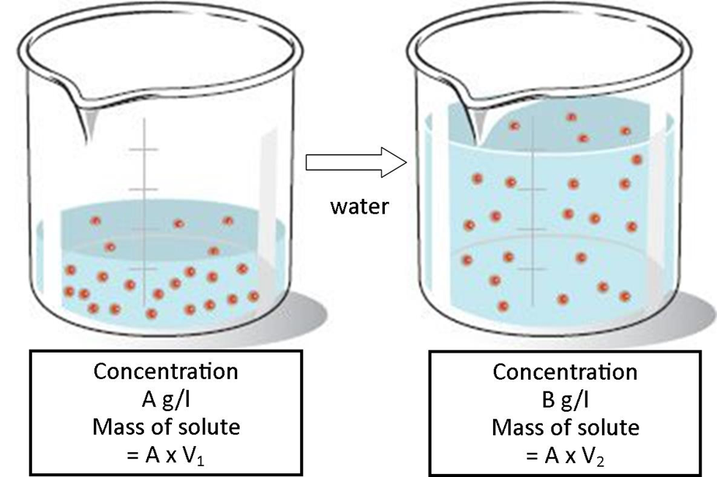
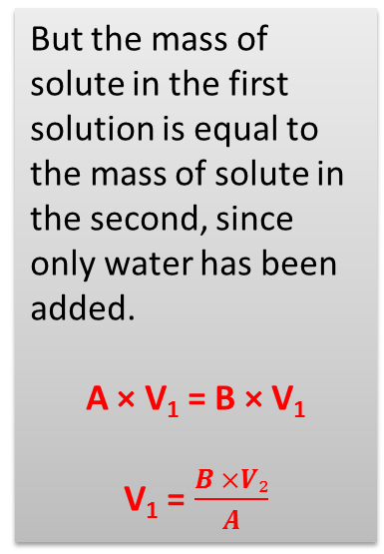
REDUCING THE CONCENTRATION
Why does this formula work?
Consider a volume V₁ of a solution of concentration A g/l and you want to change it into a new solution of concentration B g/l by adding water to get a new volume V₂.
But the mass of solute in the first solution is equal to the mass of solute in the second, since only water has been added.
A × V₁ = B × V₁
V₁ = $\frac{B ×V₂}{A}$

Slide 24
REDUCING THE CONCENTRATION
Example:
From a 500 g/l standard solution make up 200 cm³ with a concentration of 20 g/l.
Method 1: Using step by step reasoning:
You want to make 200 cm³ of solution with a concentration of 20 g/l.
The mass of solute present in the 200 cm³ (0.2l) must thus be:
Mass = Concentration × Volume
= (20 g)/1l × 0.2l/1
= 4 g solute present in the 200 cm3
Thus 4 g of solute must come from your original standard solution.
What volume of the standard solution will contain 4 g of solute?.
Volume = Mass/(Concentration )
= (4 g)/(500 g ̸ l)
= 0.008 l
= 8 cm3 of the original solution contains 4 g of solute
Pipette out a 8 cm3 aliquot of the original solution and make it up to 200 cm3 (0.2 l). This will give you a concentration of 20 g/l.
Concentration = (Mass )/Volume
= (4 g)/(0,2 l)
= 20 g/l

Slide 25
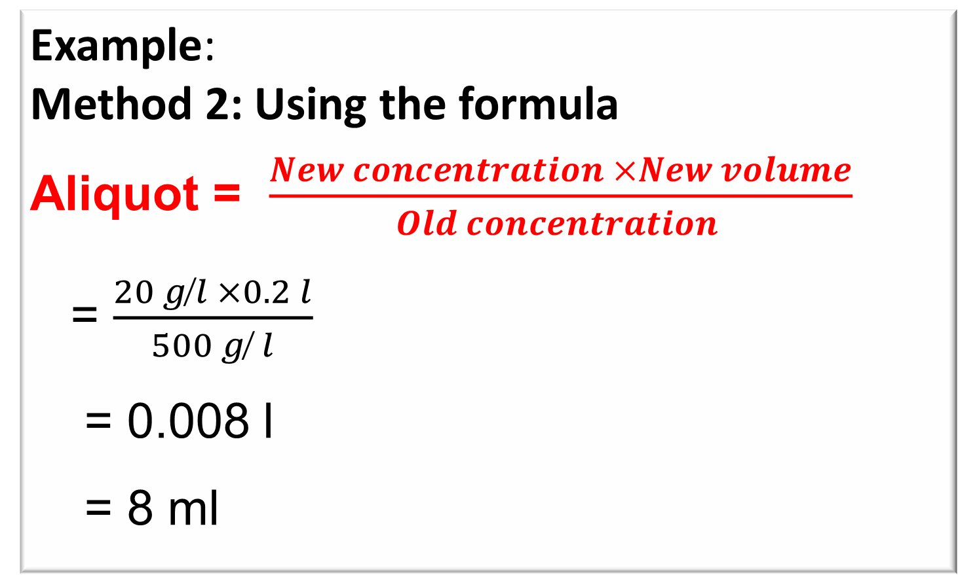
REDUCING THE CONCENTRATION
Example:
Method 2: Using the formula
Aliquot = $\frac{New concentration ×New volume}{Old concentration }$
= $\frac{20 g ̸l ×0.2 l}{500 g ̸ l}$
= 0.008 l
= 8 ml
Definition of aliquot:
A portion of a larger whole, especially a sample taken for chemical analysis or other treatment.

Slide 26
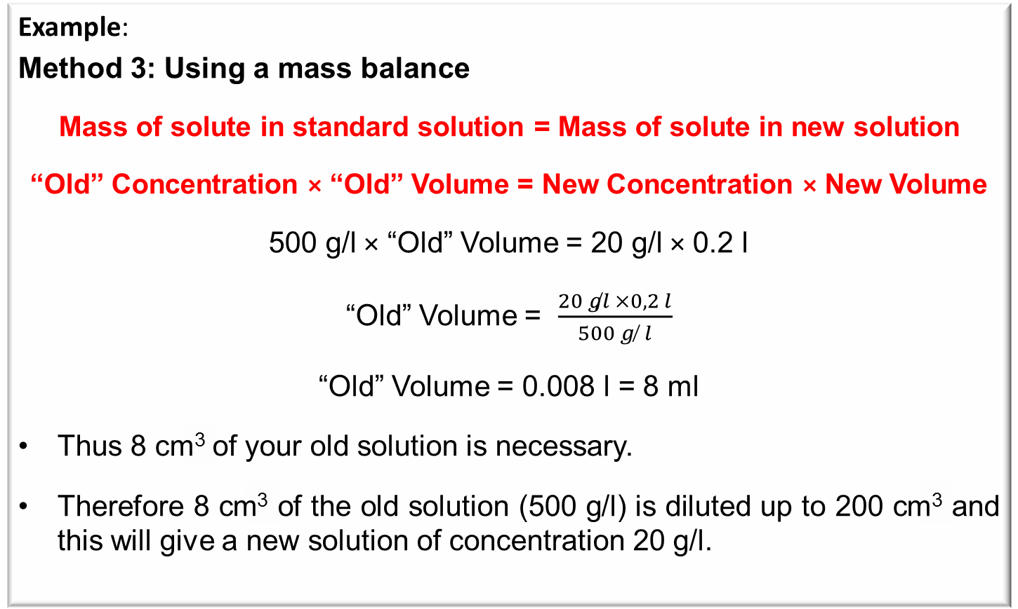
REDUCING THE CONCENTRATION
Example:
Method 3: Using a mass balance
Mass of solute in standard solution = Mass of solute in new solution
“Old” Concentration × “Old” Volume = New Concentration × New Volume
500 g/l × “Old” Volume = 20 g/l × 0.2 l
“Old” Volume = $\frac{20 g̸l ×0,2 l}{500 g ̸ l}$
“Old” Volume = 0.008 l = 8 ml
Thus 8 cm³ of your old solution is necessary.
Therefore 8 cm³ of the old solution (500 g/l) is diluted up to 200 cm³ and this will give a new solution of concentration 20 g/l.

Slide 27
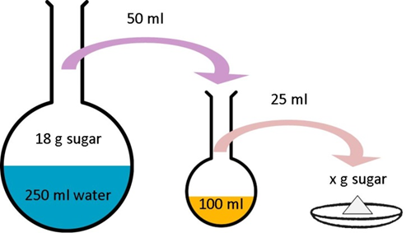
CALCULATIONS INVOLVING QUANTITATIVE TRANSFERS
Simple Dilutions
Example:
18 g of sugar is dissolved in 250 ml of water in a volumetric flask.
50 ml of the solution is pipetted out into a 100 ml volumetric flask and made to the mark.
25 ml of this solution is pipetted into an evaporating dish and evaporated to dryness.
What mass of dry sugar will be obtained?

Slide 28
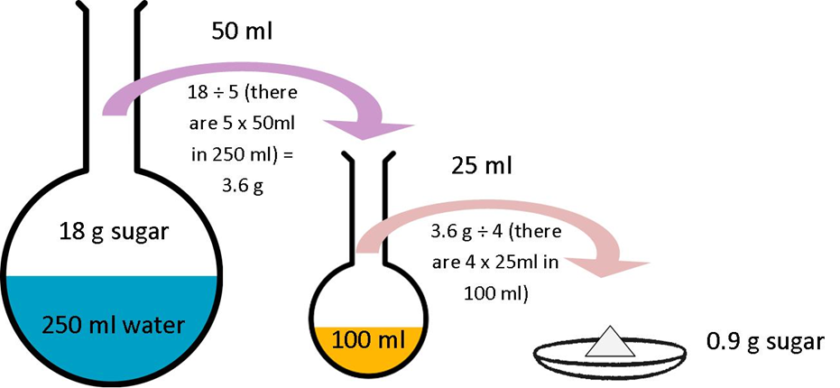
CALCULATIONS INVOLVING QUANTITATIVE TRANSFERS

Slide 29
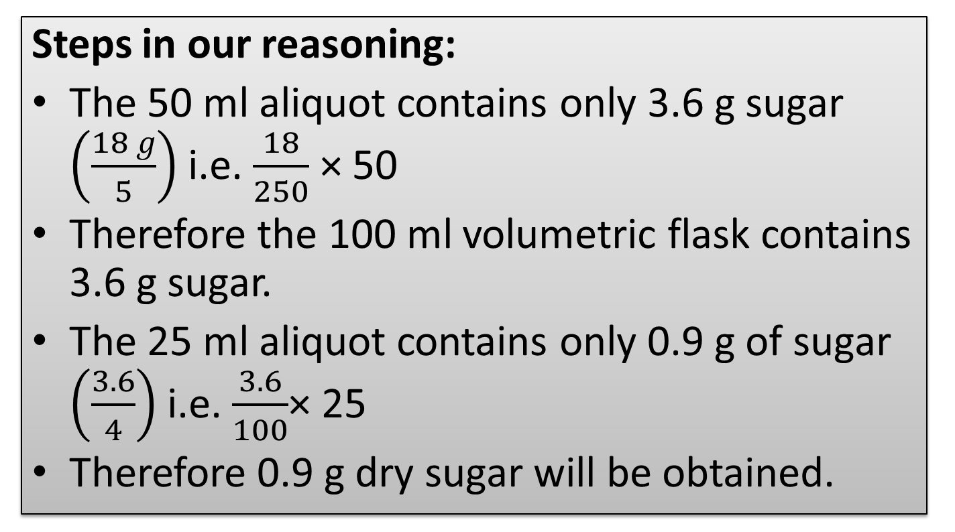
CALCULATIONS INVOLVING QUANTITATIVE TRANSFERS
Steps in our reasoning:
The 50 ml aliquot contains only 3.6 g sugar $\left(\frac{18 g}{5}\right)$ i.e. $\frac{18}{250}$ × 50
Therefore the 100 ml volumetric flask contains 3.6 g sugar.
The 25 ml aliquot contains only 0.9 g of sugar $\left(\frac{3.6}{4}\right)$i.e. $\frac{3.6}{100}$× 25
Therefore 0.9 g dry sugar will be obtained.

Slide 30
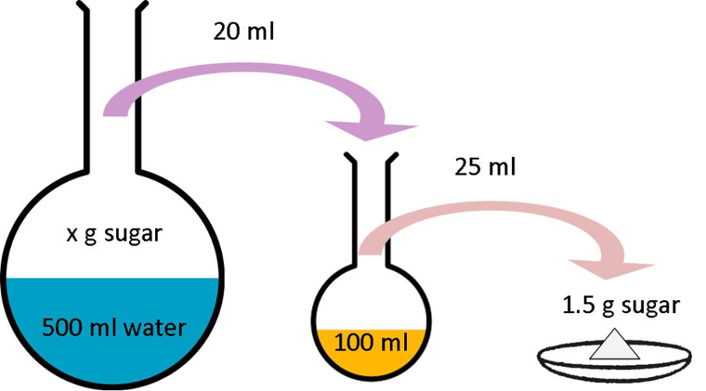
CALCULATIONS INVOLVING QUANTITATIVE TRANSFERS
Example:
A quantity of sugar is dissolved in 500 ml of water in a volumetric flask.
20 ml of the solution is pipetted out into a 100 ml volumetric flask and made to the mark.
25 ml of the solution is pipetted out into an evaporating dish and evaporated to dryness giving 1.5 grams of sugar.
What mass of sugar was initially placed into the 500 ml volumetric flask?

Slide 31
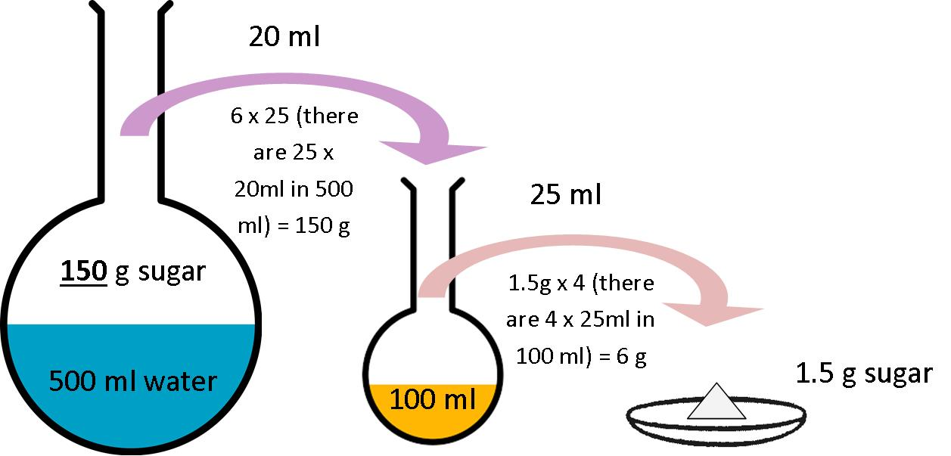
CALCULATIONS INVOLVING QUANTITATIVE TRANSFERS

Slide 32
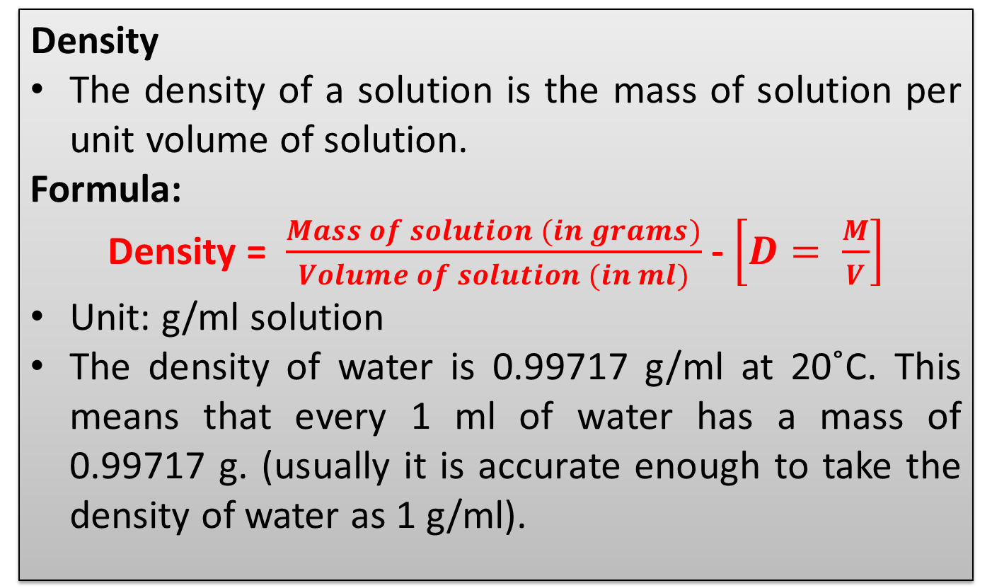
DENSITY OF SOLUTIONS
      Density
The density of a solution is the mass of solution per unit volume of solution.
Formula:
Density = $\frac{Mass of solution (in grams)}{Volume of solution (in ml)}$ - $\left[D= \frac{M}{V}\right]$
Unit: g/ml solution
The density of water is 0.99717 g/ml at 20˚C. This means that every 1 ml of water has a mass of 0.99717 g. (usually it is accurate enough to take the density of water as 1 g/ml).

Slide 33
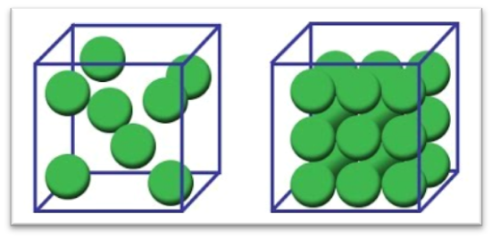
DENSITY OF SOLUTIONS
Density describes how closely particles are packed in a volume

Slide 34
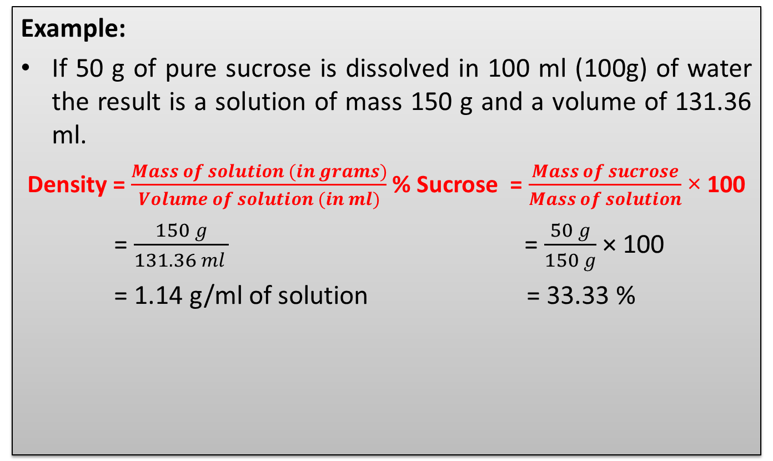
DENSITY OF SOLUTIONS
Example:
If 50 g of pure sucrose is dissolved in 100 ml (100g) of water the result is a solution of mass 150 g and a volume of 131.36 ml.
Density = $\frac{Mass of solution (in grams)}{Volume of solution (in ml)}$% Sucrose = $\frac{Mass of sucrose}{Mass of solution}$ × 100
= $\frac{150 g}{131.36 ml }$ = $\frac{50 g}{150 g}$ × 100
= 1.14 g/ml of solution = 33.33 %

Slide 35
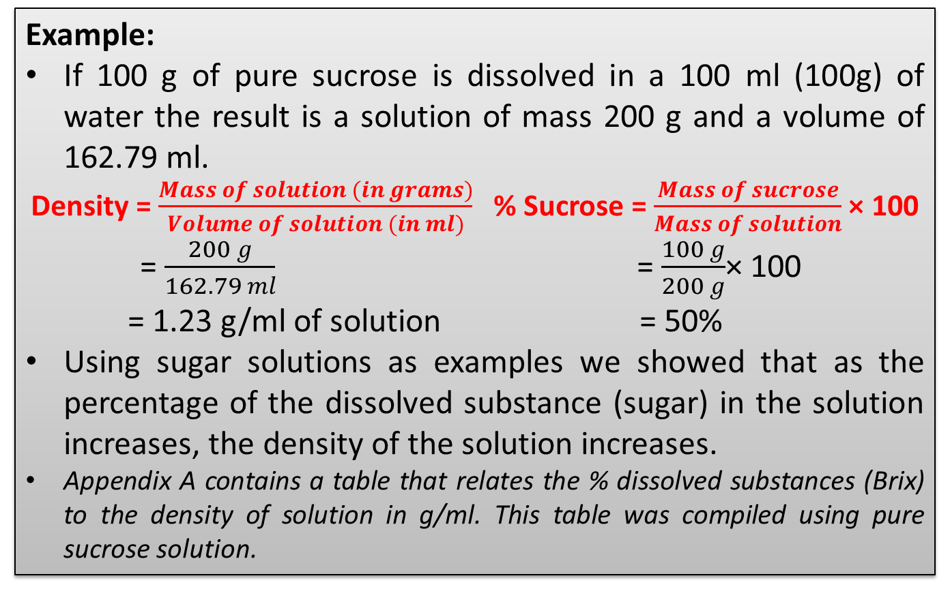
DENSITY OF SOLUTIONS
Example:
If 100 g of pure sucrose is dissolved in a 100 ml (100g) of water the result is a solution of mass 200 g and a volume of 162.79 ml.
Density = $\frac{Mass of solution (in grams)}{Volume of solution (in ml)}$ % Sucrose = $\frac{Mass of sucrose}{Mass of solution}$ × 100
= $\frac{200 g}{162.79 ml}$ = $\frac{100 g}{200 g}$× 100
= 1.23 g/ml of solution = 50%
Using sugar solutions as examples we showed that as the percentage of the dissolved substance (sugar) in the solution increases, the density of the solution increases.
Appendix A contains a table that relates the % dissolved substances (Brix) to the density of solution in g/ml. This table was compiled using pure sucrose solution.

Slide 36
OTHER USEFUL FORMULAE
Mass
Mass = Density × Volume (M = D × V)
Example 1:
Find the mass of 100 ml of solution of density 1.15 g/ml.
M = D × V
= 1.15 g/ml × 100 ml
= 115 g
Example 2:
Find the mass of 250 ml of a solution of solution of density 1.2 g/ml.
M = D × V
= 1.2 g/ml × 250 ml
= 300 g

Slide 37
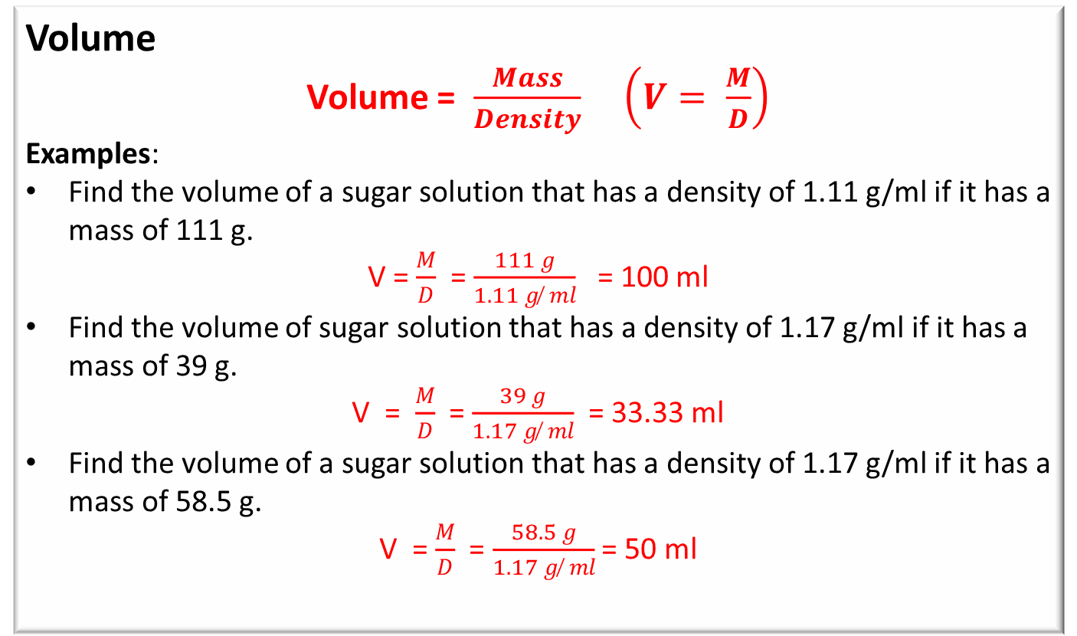
OTHER USEFUL FORMULAE
Volume
Volume = $\frac{Mass}{Density}$ $\left(V= \frac{M}{D}\right)$
Examples:
Find the volume of a sugar solution that has a density of 1.11 g/ml if it has a mass of 111 g.
V = $\frac{M}{D}$ = $\frac{111 g}{1.11 g ̸ ml}$ = 100 ml
Find the volume of sugar solution that has a density of 1.17 g/ml if it has a mass of 39 g.
V = $\frac{M}{D}$ = $\frac{39 g}{1.17 g ̸ ml}$ = 33.33 ml
Find the volume of a sugar solution that has a density of 1.17 g/ml if it has a mass of 58.5 g.
V = $\frac{M}{D}$ = $\frac{58.5 g}{1.17 g ̸ ml}$ = 50 ml

Slide 38
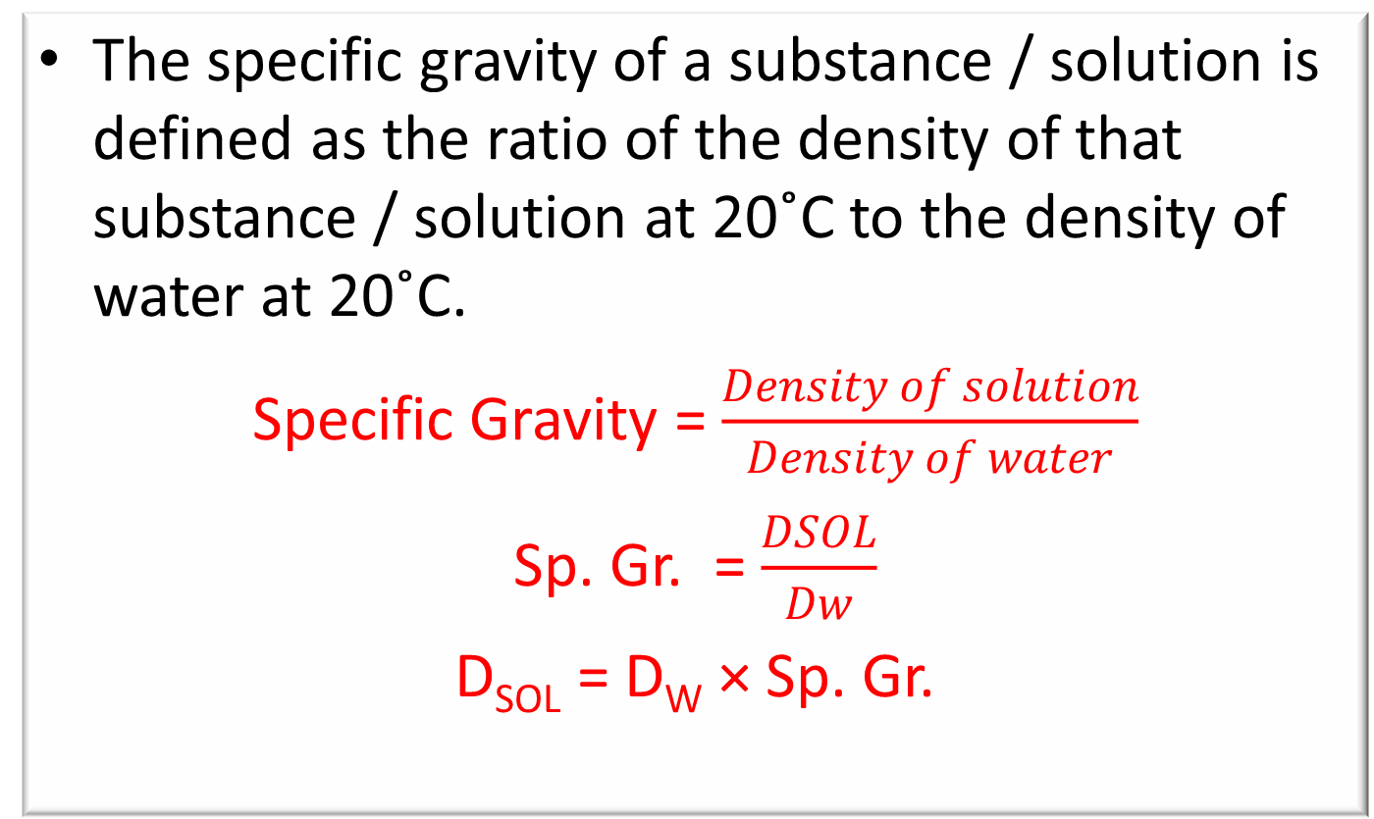
SPECIFIC GRAVITY
The specific gravity of a substance / solution is defined as the ratio of the density of that substance / solution at 20˚C to the density of water at 20˚C.
Specific Gravity = $\frac{Density of solution}{Density of water}$
Sp. Gr. = $\frac{DSOL}{Dw}$
D_{SOL} = D_{W} × Sp. Gr.

Slide 39
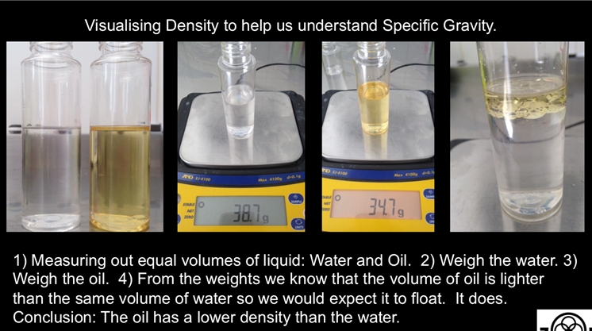
SPECIFIC GRAVITY

Slide 40
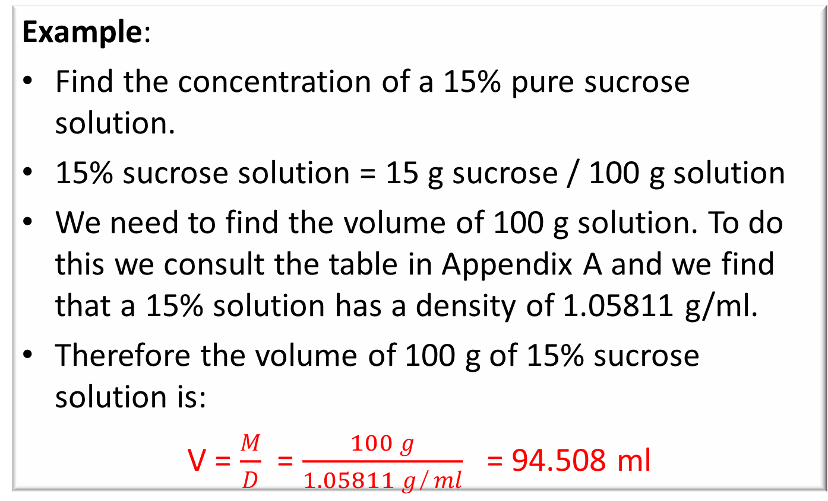
CONVERTING % DISSOLVED SUBSTANCE TO CONCENTRATION IN g/l
Example:
Find the concentration of a 15% pure sucrose solution.
15% sucrose solution = 15 g sucrose / 100 g solution
We need to find the volume of 100 g solution. To do this we consult the table in Appendix A and we find that a 15% solution has a density of 1.05811 g/ml.
Therefore the volume of 100 g of 15% sucrose solution is:
V = $\frac{M}{D}$ = $\frac{100 g}{1.05811 g ̸ ml}$ = 94.508 ml

Slide 41
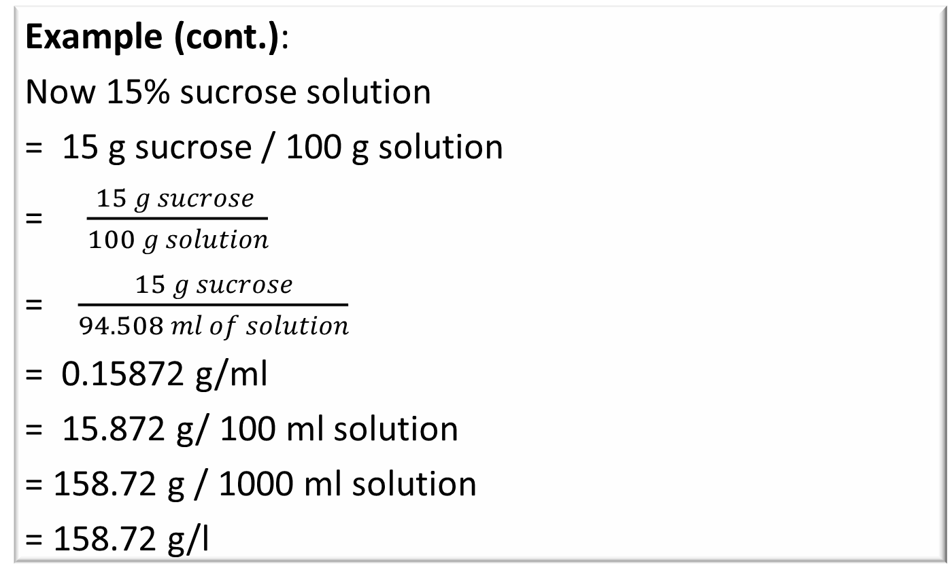
CONVERTING % DISSOLVED SUBSTANCE TO CONCENTRATION IN g/l
Example (cont.):
Now 15% sucrose solution
= 15 g sucrose / 100 g solution
= $\frac{15 g sucrose }{100 g solution}$
= $\frac{15 g sucrose}{94.508 ml of solution}$
= 0.15872 g/ml
= 15.872 g/ 100 ml solution
= 158.72 g / 1000 ml solution
= 158.72 g/l

Slide 42
CONVERTING % DISSOLVED SUBSTANCE TO CONCENTRATION IN g/l
Example (cont.):
Note: that we calculated the concentration of the 15% sucrose solution as 0.15872 g/ml which is equal to 15.872 g/100 ml solution.
This agrees quite clearly with the grams of sucrose (mass in grams) per 100 cm³ in vacuo given in the table in Appendix A which is 15.887 g/ml solution.
We could therefore use the table in Appendix A to directly convert 15% sucrose solution to 15.887 g/ml solution (i.e. without the above calculation).
Definition of “in vacuo”: “in a vacuum”

Slide 43
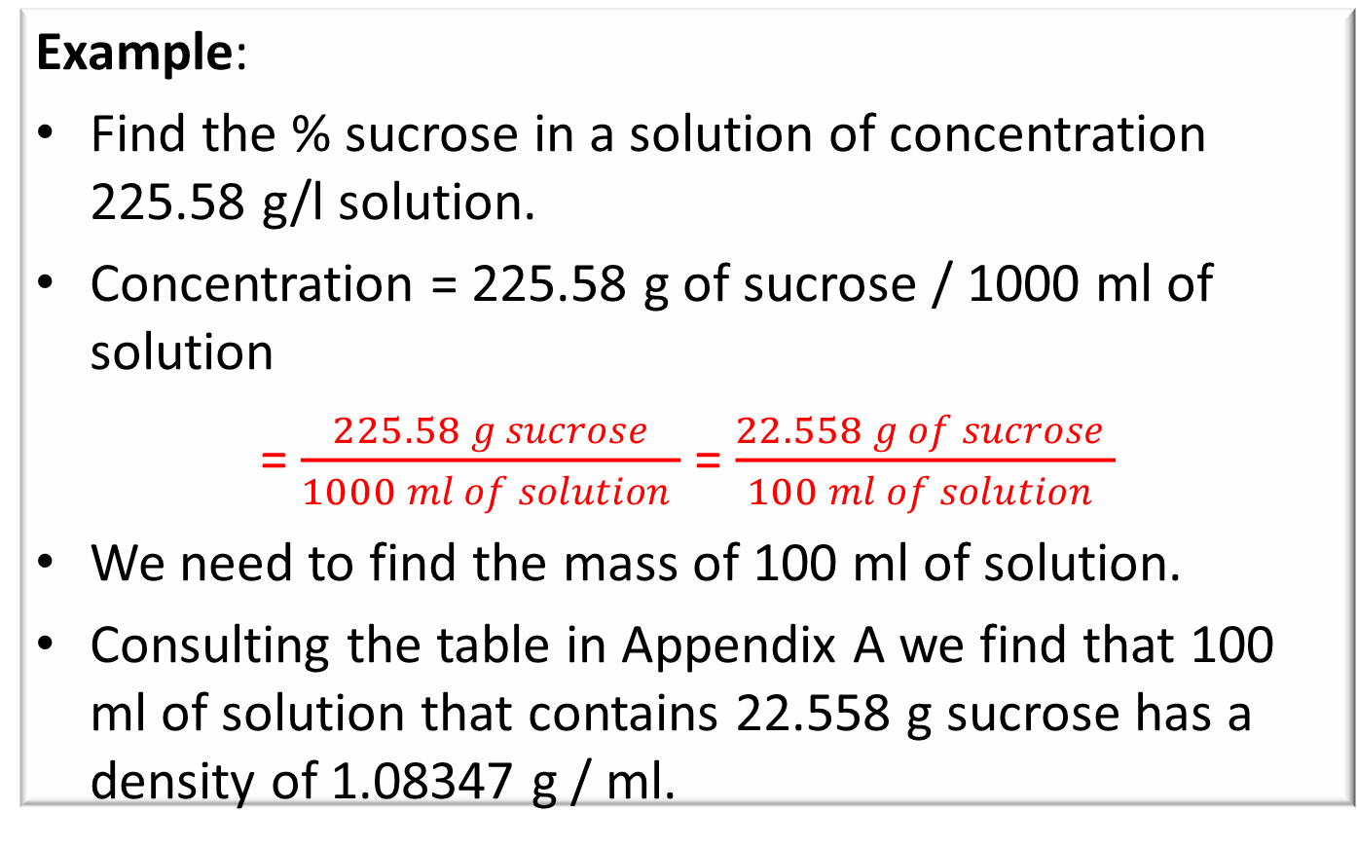
CONVERTING CONCENTRATION IN g/l TO % DISSOLVED SUBSTANCE
Example:
Find the % sucrose in a solution of concentration 225.58 g/l solution.
Concentration = 225.58 g of sucrose / 1000 ml of solution
= $\frac{225.58 g sucrose}{1000 ml of solution }$ = $\frac{22.558 g of sucrose }{100 ml of solution }$
We need to find the mass of 100 ml of solution.
Consulting the table in Appendix A we find that 100 ml of solution that contains 22.558 g sucrose has a density of 1.08347 g / ml.

Slide 44
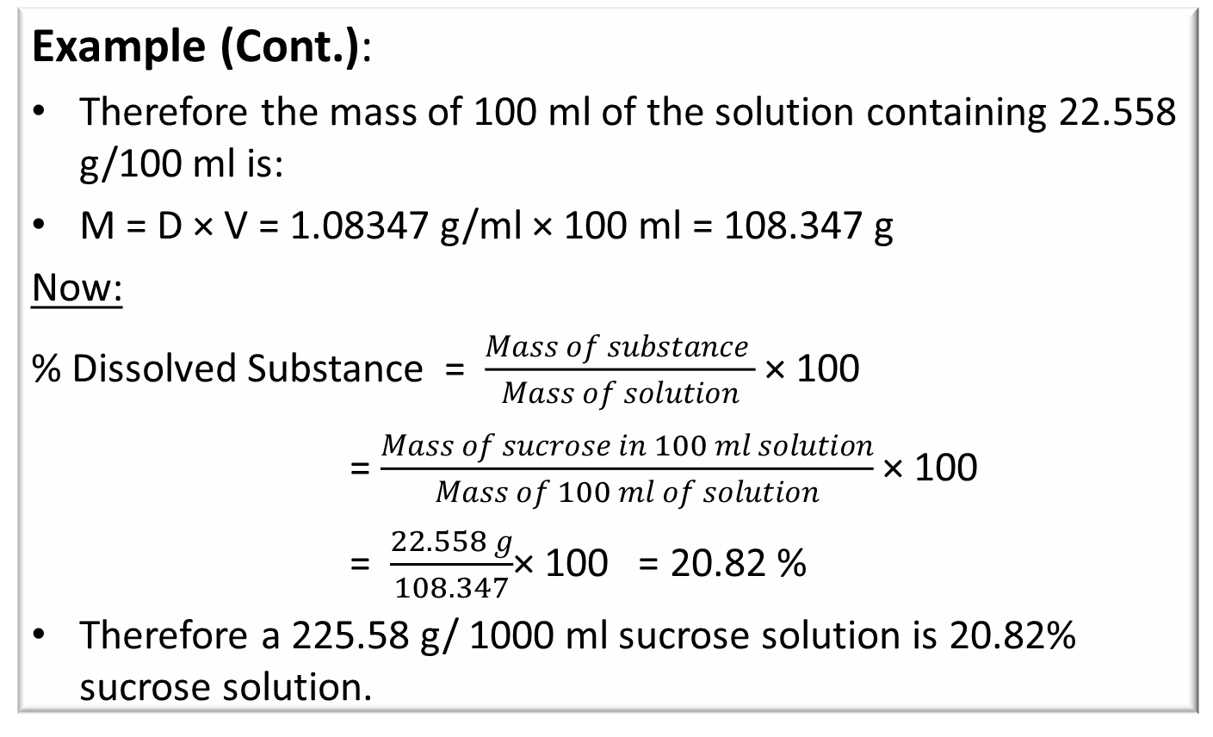
CONVERTING CONCENTRATION IN g/l TO % DISSOLVED SUBSTANCE
Example (Cont.):
Therefore the mass of 100 ml of the solution containing 22.558 g/100 ml is:
M = D × V = 1.08347 g/ml × 100 ml = 108.347 g
Now:
% Dissolved Substance = $\frac{Mass of substance }{Mass of solution}$ × 100
= $\frac{Mass of sucrose in 100 ml solution}{Mass of 100 ml of solution}$ × 100
= $\frac{22.558 g}{108.347}$× 100 = 20.82 %
Therefore a 225.58 g/ 1000 ml sucrose solution is 20.82% sucrose solution.

Slide 45
CONVERTING CONCENTRATION IN g/l TO % DISSOLVED SUBSTANCE
Example (Cont.):
Alternatively:
We can use the Table in Appendix A to directly convert a 22.558 g/ 100 ml sucrose to a percentage composition of 20.8%.

