Slide 1
KNOWLEDGE TOPIC 12: SAMPLING

Slide 2
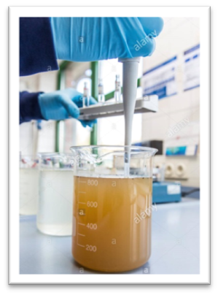
INTRODUCTION
Correct sampling techniques are of vital importance if meaningful results are to be obtained to effect proper factory control.
An analysis can be no better than the representivity of the sample being analysed.
It becomes meaningless and pointless to obtain and publish analytical results of samples that are not representative.
The following factors should be borne in mind when an analysis is done on a sample that is not representative.
Waste of time – another analysis could have been done
Waste of money – chemicals, filter paper.
Samples should be well mixed before an aliquot is taken for analysis

Slide 3
SUB-SAMPLING
Sub-sampling of samples sent to the laboratory must also be representative to ensure accuracy.
The importance of mixing the primary sample before sub-sampling cannot be over-stressed.
Sub-sampling is a procedure whereby a sample is divided up into smaller portions – each portion being representative of the original sample.
The person taking the sample (sample carrier) should not be interfered with while doing his job.
Operators have a tendency to tell the sample carrier when to take a sample (when the conditions are right).
This means that the sample taken is then biased and no longer representative.

Slide 4
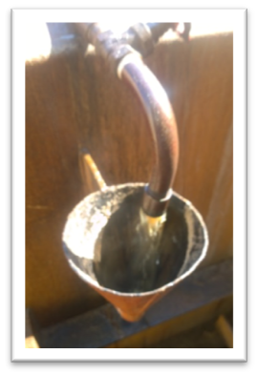
CONTINUOUS SAMPLING
Continuous sampling is necessary where great accuracy is required e.g. cane (DAC), mixed juice, sugar and final molasses.
The sample should be in proportion to the quantity produced during a specific period.
Samples are taken at many stages of the sugar milling process. Here at the diffusion stage….

Slide 5
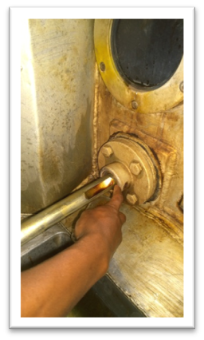
CATCH SAMPLING
Where great accuracy is not required, catch samples taken at fairly large time intervals or as required are adequate.
These are the samples required for routine quality control i.e. brix, pol and pH.
Catch sampling is also practiced when there is the possibility that a continuous sample will deteriorate during the sampling period.
Sampling to assess sugar crystal formation

Slide 6
SAMPLE CONTAINERS AND PRESERVATION OF SAMPLES
In order to obtain accurate results, cleanliness of sample receptacles is absolutely essential.
It is imperative that sample containers are cleaned and sterilised at regular intervals to prevent contamination of subsequent samples.
In the case of continuous samples, juice preservative (mercuric chloride) should be added to prevent possible deterioration.
It is general practice in laboratories to preserve composite samples of juice (mixed juice and clear juice) with mercuric chloride.
It is not necessary to preserve samples of high concentration (syrup, molasses, massecuites) although syrup samples must be placed in a fridge or deep freeze if they are to be stored for some time.
Duplicate sampling devices and containers are necessary.
Sample cans should be made of stainless steel or copper, be seamless and have covers to minimise evaporation losses and to prevent contamination and deterioration.
They should not have sharp corners.

Slide 7
SPECIFIC SAMPLING PROCEDURES AT A MILL
Each of the following components in the sugar manufacturing process has its own sampling procedure:
Cane
Prepared cane for direct analysis
Whole Stick cane
Bagasse
First expressed juice
Mixed juice
POL, BRIX and Sucrose
Insoluble solids determination
Reducing sugars and pH

Slide 8
SPECIFIC SAMPLING PROCEDURES AT A MILL (Cont.)
Clarified Juice
Filter Feed (Mud)
pH
BRIX, BAGACILLO and suspended solids% Feed
POL and insoluble solids
Filter Cake
POL and Moisture
Filtrate
BRIX and POL determinations
BRIX and MUD solids % filtrate

Slide 9
SPECIFIC SAMPLING PROCEDURES AT A MILL (Cont.)
Syrup
Remelt
A-, B- and C-Massecuite
Magma
A- and B-Molasses
Final molasses
B-, C1- and C2- Sugars
A-Sugar

