Slide 1
KNOWLEDGE COMPONENT: MODULE 1: SUGAR PROCESSING LABORATORY WORK

Slide 2
Background
In the organisational structure of every sugar mill (sugar processing plant) there is a specific department or division dedicated to QUALITY CONTROL.
The Sugar Mill Laboratory is responsible for providing the raw data that describes the quality of the sugar as it moves from one process to another through the factory.

Slide 3
Purpose of the Laboratory
The main purposes of the laboratory are:
Quality control of raw materials
Monitoring of production processes
Quality control of final products

Slide 4
The Needs of a Good Laboratory
In order to provide quality analytical services, a sugar mill laboratory needs:
Good physical infrastructure
Accurate and reliable equipment
Well-trained technical staff
An Efficient analysis plan

Slide 5
Types of Measurements
An on-site sugar laboratory measures:
• pol (sucrose) per cent in juice,
• brix (total soluble solids) per cent in juice,
• pol (sucrose) per cent in cane,
• brix per cent in cane,
• fibre per cent,
• commercial cane sugar (CCS),
• purity, and
• dissolved solids value.

Slide 6
How must these measurements be made?
Greatest speed
Least amount of error
Reliably
Repeatably

Slide 7
Stakeholders of Laboratory Results
Cane growers rely on the laboratory results for:
their cane payments
guidance on how to improve their production practices
guidance on how to improve their harvesting practices
guidance on how to improve their transportation practices
Cane processors rely on these laboratory results:
To determine whether the sugar can move onto the next stage of processing in the processing chain
To determine whether the equipment is functioning efficiently
To determine whether the final product is of the desired quality

Slide 8
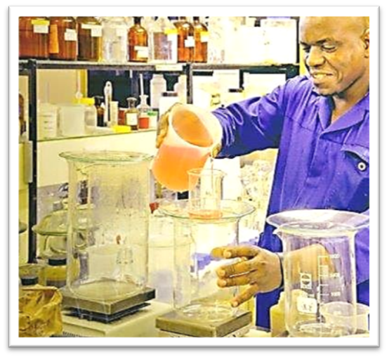
Characteristics of a good laboratory worker
Neat
Diligent
Precise
Providing quick and accurate results

