Slide 1
KNOWLEDGE TOPIC 1:
LABORATORY APPARATUS AND EQUIPMENT

Slide 2
Introduction
The analytical results from the laboratory are essential for the efficient operation of the sugar extraction and recovery processes. It is therefore critical that the laboratory results are accurate. The laboratory worker/ analyst thus has a very important and responsible task.
It is important that the laboratory worker knows the names and the uses of all the equipment at his disposal. This gives him a better understanding of his work and ensures that he uses his equipment correctly. Correct use of equipment plays an important role in achieving accurate analytical results.

Slide 3
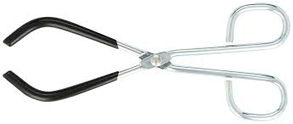
Beaker tongs
Used to handle hot beakers safely.

Slide 4
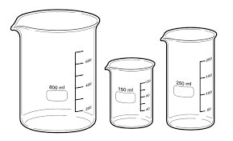
Beaker
These are cylindrical in shape and have a spout to enable liquid to be poured without spilling. Beakers are used for mixing, boiling, supporting a funnel and numerous other uses.
The volume of a beaker can be expressed to millilitres (ml) or cubic centimetres (cm³or cc) with 1 millilitre being equal to 1 cubic centimetre. We will use beakers of volume 50ml, 250ml and 600ml.
Note: The volume graduations on beakers may only be used to collect or disperse approximate volumes.

Slide 5
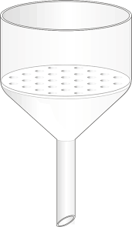
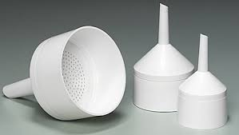
Buchner Funnel
Used to hold the filter paper when filtering under vacuum. Their sizes are indicated by their inner diameter i.e. 70mm, 85mm etc.

Slide 6
Bulb Pipette
These are a type of “volumetric” glassware. Volumetric glassware refers to glassware that is accurately marked to hold or deliver exact volumes under specified conditions.
A pipette is a volumetric vessel used to deliver a constant volume of liquid according to the size of the pipette. We will use bulb pipettes of volumes 100 cm³; 50 cm³; 25 cm³; 20 cm³; 10 cm³; 5 cm³; 2 cm³; 1 cm³.
Note: A pipette will only be accurate when both the pipette and the liquid inside the pipette are at the temperature marked on the pipette.

Slide 7
Bunsen Burner
A Bunsen burner uses propane and butane gas (LPG) to produce an intense flame. Glassware is usually not heated directly by the Bunsen but the glassware is placed on a wire gauze. However, during ashing the crucible is heated directly by the Bunsen burner.

Slide 8
Burette
A long volumetric cylinder used in titrations for accurately dispensing quantities of liquid between 0 and 50 cm3. When not in use a burette must be clamped upside down with the tap open and the bottom end of the burette clear from the stand.

Slide 9
Burette Brush
A long thin brush used for cleaning burettes.

Slide 10
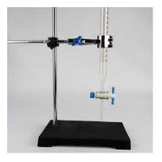
Burette Stand
This stand is used to hold a burette in an upright position. It can also be used to clamp other apparatus and is sometimes called a retort stand.

Slide 11
Burette Clamp
A clamp used to hold the burette upright on a retort stand.

Slide 12
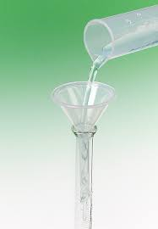
Burette filling funnel
A small funnel used when filling a burette with liquid.

Slide 13
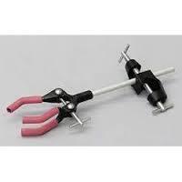
Bosshead
Used to attach a clamp to a stand. A bosshead must be attached to the retort stand in such a way that it supports the clamp even if the clamp is not firmly held by the screw of the bosshead.

Slide 14
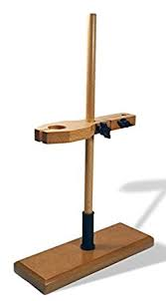
Clamp
Used to clamp (hold) glassware to a stand.

Slide 15
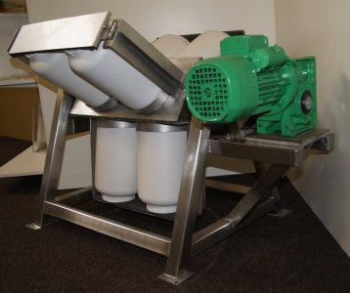
Cookie Jar
A plastic container used when tumbling cane for preparation index determination. They can also be used to store samples.

Slide 16
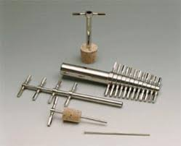
Cork borer
These come in different sizes (diameters) and are used to make holes in corks or rubber bungs for fitting glass tubing.

Slide 17
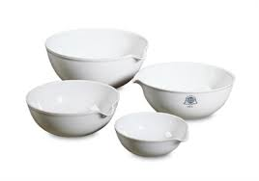
Crucible
A vessel used when heating a sample to a high temperature during “ashing”. Crucibles are usually made from porcelain which will withstand high temperatures.

Slide 18
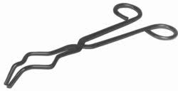
Crucible tongs
Used to remove crucibles from the Bunsen or muffle furnace.

Slide 19
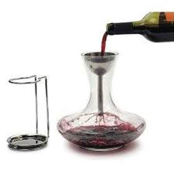
Decanting Stand
Used to hold a sieve steady when pouring samples of juices and extracts through it.

Slide 20
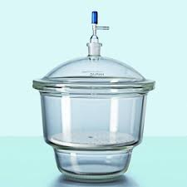
Desiccator
Used to cool objects in a dry atmosphere

Slide 21
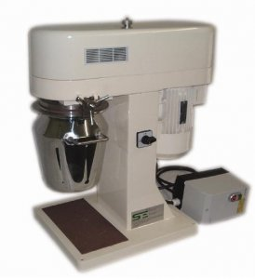
Digestor Bowl
The bowl that fits onto the cold digestor and which contains water and the sample of prepared cane that is to be disintegrated.

Slide 22
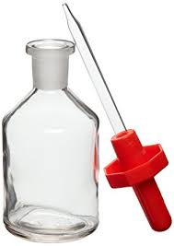
Dripping bottles
Used for adding indicator solutions dropwise.

Slide 23
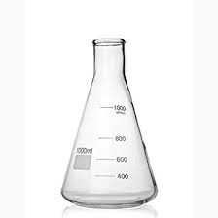
Erlenmeyer Flask/Conical Flask
A general purpose flask that can be heated and is used extensively during titrations. These flasks have graduations to give a rough indication of the volume of liquid contained.

Slide 24
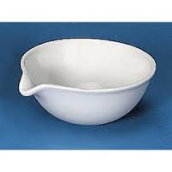
Evaporating Basin
Used on the steam bath (water bath) to evaporate solutions to dryness.

Slide 25
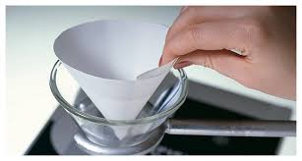
Filter Paper
Used to separate solids from liquids. The liquid travels through the paper leaving the solids behind.
The liquid (or solution) that goes through is called the filtrate, while the solids left behind on the paper is known as the residue.

Slide 26
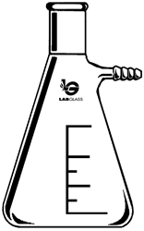
Filter Flask / Buchner Flask
Used to support the Buchner funnel and to catch the filtrate when doing vacuum filtrations. In order to withstand pressure variations these filter flasks are made from thicker glass than ordinary Erlenmeyer flasks. We will use 250cm3 and 500cm3 filter flasks.

Slide 27
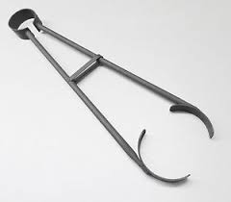
Flask tongs
Used to handle hot flasks safely.

Slide 28
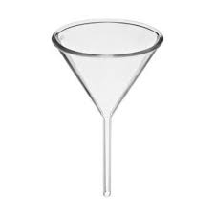
Funnel
Used to support filter paper during filtration or for pouring liquids into narrow-mouthed containers.

Slide 29
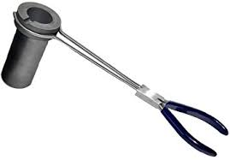
Furnace tongs
Used when removing hot items from the muffle furnace.

Slide 30
Glass Beads
Some glass beads placed into a boiling liquid will promote even boiling and prevent “bumping”

Slide 31
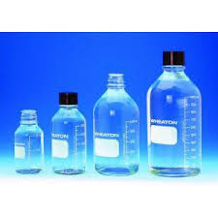
Glass bottles / Sample bottles
Used for mixing and storing samples.

Slide 32
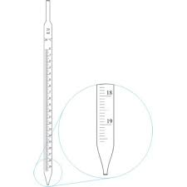
Graduated Pipette
A volumetric vessel used to deliver liquid according to the graduation on the pipette. We will use graduated pipettes of maximum volume 25 cm³, 10 cm³ and 5 cm³.

Slide 33
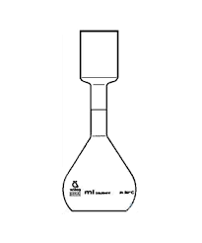
Kohlrausch Flask
A wide-mouthed volumetric flask used for the preparation of solutions of filter cake and sugar pol. It is useful for applications where it is difficult to get solids into the narrow neck of an ordinary volumetric flask.
Kohlrausch flasks are rarely used for pol determinations. “Sugar flasks” are preferred. These are similar to Kohlrausch flasks, but the neck is not as wide. We use 100 ml sugar flasks for sugar pol determinations.

Slide 34
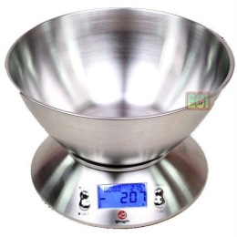
Large Massing Basin
Used when massing (weighing) bagasse or cane samples.

Slide 35
Magnetic Follower
Used with a magnetic stirrer hot plate to mix the contents of a beaker or flask. It consists of a small metal bar covered in plastic. Sometimes magnetic stirrers are also fitted to hot plates.

Slide 36
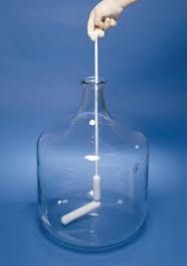
Magnetic Follower Retriever
Used to take the magnetic follower out of a beaker or flask.

Slide 37
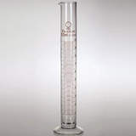
Measuring Cylinder
Used for measuring out liquids or solutions. Measuring cylinders are more accurate than beakers but not as accurate as pipettes or burettes (i.e. volumetric glassware).

Slide 38
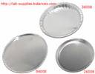
Moisture Dish
Used to hold sugar when drying sugar in an oven for moisture determination. It consists of a stainless steel dish with a cover / lid.

Slide 39
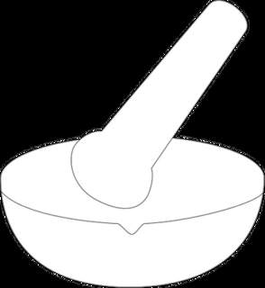
Mortar and Pestle
Used to grind samples or chemicals to smaller pieces or into a powder form.

Slide 40
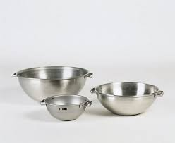
Nickel Massing Basin
Used for general massing (weighing) of small quantities. It has a wide top with a spout to facilitate transferring its contents into another container.

Slide 41
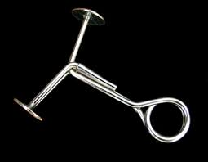
Pinch Clips
Used to clamp rubber tubing to act as a valve / seal.

Slide 42
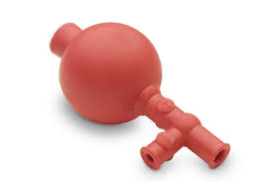
Pipette Filler
Used when filling a pipette with dangerous / toxic liquids. When in any doubt as to the nature of a liquid or solution, consider it as dangerous and use a pipette filler.

Slide 43
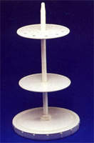
Pipette Stand
Used for storage of pipettes.

Slide 44
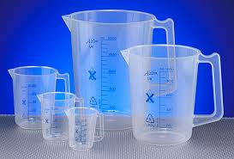
Plastic Jug
Used when massing (weighing) water or measuring out approximate quantities of water.

Slide 45
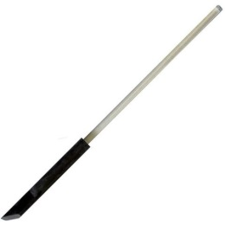
Policeman
A plastic or rubber sleeve that fits over a glass stirring rod and prevents chipping and other damage.

Slide 46
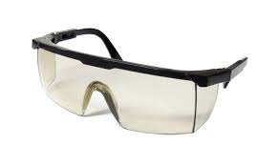
Protective Mask
To be used to protect the face and eyes against flying glass should there be the risk of explosion or implosion of glass.

Slide 47
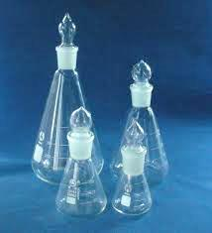
Quick Fit Erlenmeyer Flask
These are cylindrical in shape and have a spout to enable liquid to be poured without spilling. Beakers are used for mixing, boiling, supporting a funnel and numerous other uses.
The volume of a beaker can be expressed to millilitres (ml) or cubic centimetres (cm³or cc) with 1 millilitre being equal to 1 cubic centimetre. We will use beakers of volume 50ml, 250ml and 600ml.
Note: The volume graduations on beakers may only be used to collect or disperse approximate volumes.

Slide 48
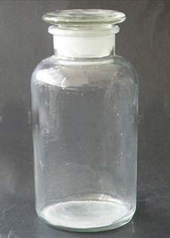
Reagent Bottle
Used to store chemicals and solutions. They must have tight fitting tops – either plastic or glass. Screw tops are not acceptable.

Slide 49
Reflux Condenser / Liebig Condenser
This apparatus fits snugly onto a quick-fit flask and is used to condense the vapour being released by the boiling solution in the flask. Its operation is very simple. Vapour moves up the central glass tube of the condenser, which is surrounded by cooling water drawn from a tap. The water enters at the bottom, swirls around the outer glass tube and exits at the top. Sometimes the cooling water flows through a coil in the centre of the condenser and the vapour is outside.

Slide 50
Rubber Cone
Used when connecting a filter flask and Buchner funnel to provide a vacuum seal. The rubber cone fits into the neck of the Buchner flask.

Slide 51
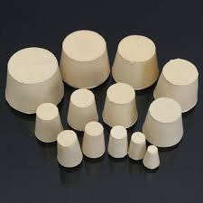
Rubber Stopper
Used to close and seal the openings of flasks and bottles.

Slide 52
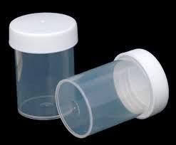
Sample Can
Used when collecting samples from the factory.

Slide 53
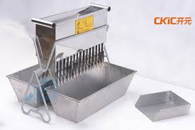
Sample Divider / Riffle
Used to divide a sample into two representative portions.

Slide 54
Sieve
Used in sets for sieving sugar, bagacillo and for separating solid matter from juice.

Slide 55
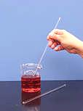
Stirring Rod
A glass rod used for mixing and stirring solutions.

Slide 56
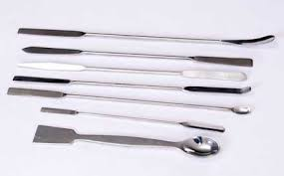
Spatula
A spoon like object used for dispensing chemicals. Under no circumstances must a spatula be used to stir solutions.

Slide 57
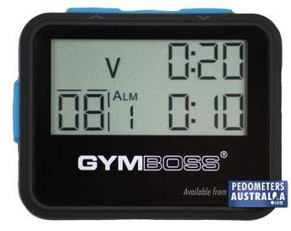
Stop Clock or Interval Timer
Used for timing a reaction or procedure.

Slide 58
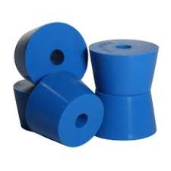
Strainer Stopper
A rubber stopper with a sieve on it. It is used to drain off the solution after a raw sugar has been washed with alcohol prior to grain size analysis.
A strainer stopper consists of a simple rubber stopper with a hole through its centre and a piece of centrifugal screen covering one end and held in place by a rubber sleeve. When assembled the smooth part of the screen must be on the outside.

Slide 59
Test Tube
Used when mixing or boiling small quantities of liquids or solutions.

Slide 60
Test Tube Brush
Used for cleaning test tubes.

Slide 61
Test Tube Holder
Used to hold hot test tubes.

Slide 62
Test Tube Rack
Used to hold a number of test tubes in an upright position.

Slide 63
Test Tube Stopper
Used to seal a test tube.

Slide 64
Thermometer
Used to measure temperature.

Slide 65
Transfer Funnel
Used to transfer cane or bagasse from the massing basin to the digestor bowl.

Slide 66
Tripod
Used to support equipment being heated by a Bunsen burner.

Slide 67
Tubing
Rubber or plastic tubing is used to connect air, vacuum or water supplies to apparatus as required.

Slide 68
Volumetric Flask
A volumetric vessel which, when made to the mark, will contain an exact volume of the liquid / solution. We will use volumetric flasks of volume 1000 ml, 500 ml, 250 ml, 200 ml, 100 ml and 50 ml.
Note: A volumetric flask must have a stopper that fits it properly.

Slide 69
Wash Bottle
Used to deliver water in small quantities when making to the mark or when washing and rinsing glassware, we generally need to wash either with water or alcohol and hence our wash bottles must be clearly labelled accordingly.

Slide 70
Watch Glass
A glass dish used to cover beakers and funnels to minimise evaporation. These are also used to hold stoppers removed from reagent bottles to prevent them from becoming contaminated.

Slide 71
Wire Gauze
Used to spread the heating effect of a Bunsen flame.

Slide 72
Wire Triangle (Clay Pipe Triangle)
Used to support a crucible on a tripod stand.

