Slide 1
KNOWLEDGE TOPIC 1:
LABORATORY APPARATUS AND EQUIPMENT

Slide 2
Introduction
The analytical results from the laboratory are essential for the efficient operation of the sugar extraction and recovery processes. It is therefore critical that the laboratory results are accurate. The laboratory worker/ analyst thus has a very important and responsible task.
It is important that the laboratory worker knows the names and the uses of all the equipment at his disposal. This gives him a better understanding of his work and ensures that he uses his equipment correctly. Correct use of equipment plays an important role in achieving accurate analytical results.

Slide 3
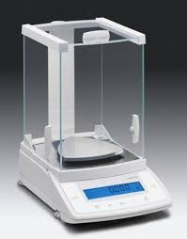
Analytical Balance
Used for accurate massing (weighing) to an accuracy of 4 decimal places. The balance is enclosed so as not to be affected by draughts and must be placed on a special table.

Slide 4
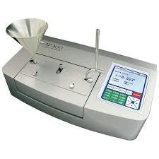
Automatic Polarimeter or Saccharimeter
Measures the angle of rotation of the plane of polarised light as it passes through a sugar solution (pol). The angle of rotation is proportional to the concentration of sugar in the solution.

Slide 5
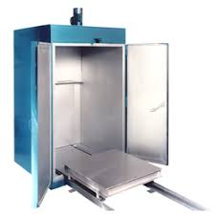
Cane Drying Oven
Used for drying cane and bagasse when determining their moisture content. The principle of operation is simple. The sample of prepared cane or bagasse is placed on a sieve and warm air blows from above through the sample.

Slide 6
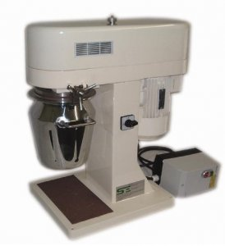
Cold Digestor
Used to disintegrate cane and bagasse before conducting pol and brix analyses.

Slide 7
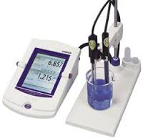
Conductivity Meter
Used to measure the specific conductance of a solution. Using a calculation the conductivity of a solution can be used to determine the amount of inorganic material dissolved in the solution (conductivity ash).

Slide 8
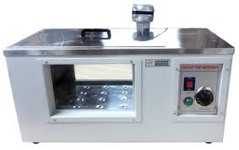
Constant Temperature Water Bath
A water bath that keeps water at a constant temperature.

Slide 9
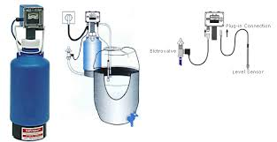
De-ionizer
Used for producing de-ionised water which is used for making up solutions and rinsing. It contains a resin that removes impurities (salts) from the water.

Slide 10
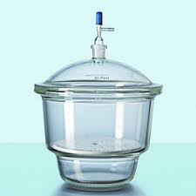
Desiccators
These are large glass vessels containing silica gel which absorbs moisture from the air inside the desiccator. Desiccators are designed to keep the samples dry by preventing them from absorbing moisture from the atmosphere. If the gel is blue it is dry and can be used, but when pink, the gel needs to be dried in a moisture oven.

Slide 11
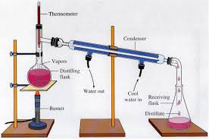
Distiller (Still)
Used for making distilled water which is used for making up solutions and rinsing. The still works on the principle of the Liebig Condenser.

Slide 12
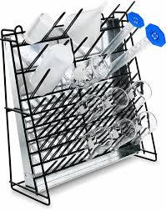
Drying Rack
A rack that allows the water to drain off apparatus that has been washed.

Slide 13
Electronic Calculator
Used for doing calculations

Slide 14
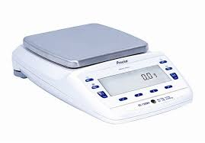
Electronic Top Pan Balance
A heavy duty balance which has the pan at the top and usually has a digital readout. It is used for massing (weighing) to 1 or 2 decimal places.

Slide 15
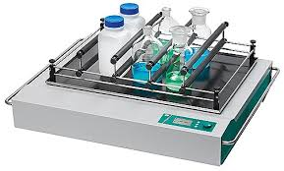
Flask Shaker
Used to shake flasks or bottles and mix the contents. It is also called a rotary motion shaker.

Slide 16
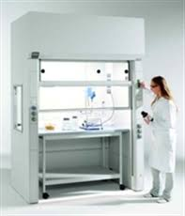
Fume Cupboard
Used to extract smoke, unpleasant odours and vapours when doing various analyses. The glass door also provides eye protection when working with possibly explosive reagents.

Slide 17
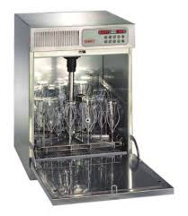
Glass Drying Oven
Used to dry glassware like beakers, watch glasses, test tubes, Erlenmeyer flasks etc. Volumetric glassware (pipettes, burettes and volumetric flasks) must never be placed in a glass drying oven.

Slide 18
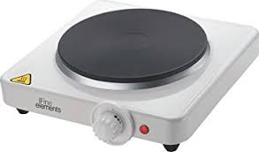
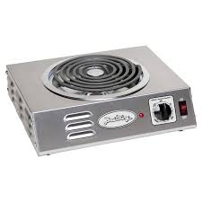
Hot Plate
Used for heating and boiling purposes.

Slide 19
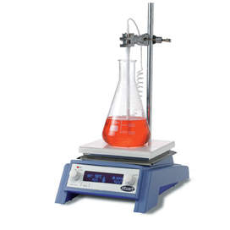
Magnetic Stirrer hotplate
Used for heating and stirring at the same time.

Slide 20
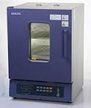
Moisture Oven
Used to dry samples of sugar and filter cake so that the moisture content can be determined. Air is circulated in the oven using a fan.

Slide 21
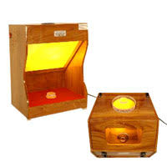
Monochromatic light source
A light source that gives off light of one wavelength. A yellow sodium lamp is used to illuminate the prisms of a refractometer.

Slide 22
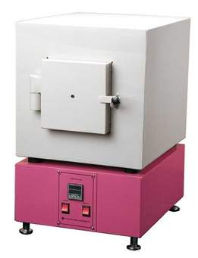
Muffle Furnace
Used to burn sugar, molasses cane, bagasse and coal completely so that the ash content can be determined. The vapours emitted are toxic hence the muffle furnace is placed in a fume cupboard.

Slide 23
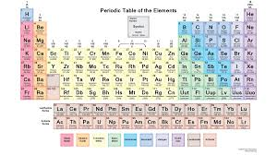
Periodic Table
A table that contains the elements according to their properties.

Slide 24
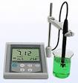
pH Meter
Measures the degree of acidity of alkalinity of a solution.

Slide 25
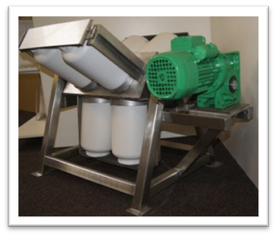
PI Tumbler or Grenfell Tumbler
Used to tumble the cookie jar when determining the preparation index (PI) on shredded cane. The PI is a measure of what percentage of the cane cells have been broken to allow for juice extraction.

Slide 26
Refractometer /Precision Refractometer
Measures the angle of refraction (bending) of light passing through a sucrose solution. We use the Zeiss precision refractometer. The angle of refraction is proportional to the concentration of dissolved substances in the solution (Brix).

Slide 27
Refrigerator
Used for keeping samples and solutions cool to prevent deterioration.

Slide 28
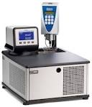
Refrigerator Water Bath
A bath fitted with a refrigerated cooler.

Slide 29
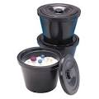
Sample Buckets
For collecting cane, bagasse etc. from the factory.

Slide 30
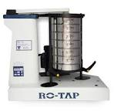
Sieve Shakers
Used for shaking sets of sieve to separate a sample into its different particle sizes.

Slide 31
Spectrophotometer
Measures the light absorbed by a solution. The spectrophotometer contains a prism that splits white light into its spectrum. By selecting a certain wavelength e.g. 460 mm you select a light colour which is then passed through the sample and the absorbance measured.
For example:
During determination of the phosphate content of a sample, chemicals are added that cause the solution to be coloured blue according to the phosphate content, the greater the phosphate content, the more blue the solution and hence the greater the amount of light absorbed by the solution. The spectrophotometer is also used for the determination of colour, starch and sugar traces.

Slide 32
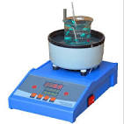
Steam Bath / Water Bath
A Steam bath / water bath is used to evaporate samples in an evaporating basin to dryness.
Note: When placing an evaporating basin in the water bath, just enough rings should be removed so that the basin sits snugly.

Slide 33
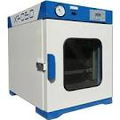
Vacuum Oven
Used to dry samples at temperatures lower than 100°C (Also known as a freeze dryer).

