Slide 1
KNOWLEDGE TOPIC 3:
MATHEMATICAL CALCULATIONS

Slide 2
Introduction
Elementary arithmetic deals with:
Numbers
Calculation rules
Structure of mathematics
Solving Problems

Slide 3
Terminology
5 is a DIGIT.
+, -, × and ÷ are OPERATION SIGNS
=, >, <, ≡ are RELATIONSHIP SIGNS

Slide 4
The number concept
A DIGIT is a SYMBOL, which is used to represent a number.
There are 10 symbols altogether. They are:
0,1,2,3,4,5,6,7,8,9
To write down the number 27 the digits 2 and 7 are used.
The representation of a number by digits is called a NUMERAL.
27 is a NUMERAL, 2 and 7 are DIGITS
NUMBER is a CONCEPT (an idea, notion, invention).

Slide 5
Writing Down Numbers
The value of a digit is determined by its position.
units - U
tens - T
hundreds - H
thousands - TH
ten thousands - TTH
and so on

Slide 6
Example:
In the number 2341
2 represents thousands
3 represents hundreds
4 represents tens
1 represents a unit

Slide 7
Calculations Rules
Calculations must always be done according to the priority of the operation sign. The order of priority is as follows:
(a) Brackets
(b) Of (means multiply)
(c) Division - working from the left
(d) Multiplication – working from the left
(e) Addition – working from the left
(f) Subtraction – working from the left

Slide 8
Example:
26 – ((6 ÷ 3) + 2)
= 26 – (2 + 2)
= 26 – 4
= 22
Without the second brackets this equation would be:
26 – (6 ÷ 3) + 2
= 26 – 2 + 2
= 26 – 0
= 26

Slide 9
Addition
The meaning of addition is the bringing together of objects of the same kind or calculating the sum.
Take the situation where there are 3 boys and 4 girls on bicycles. How many bicycles are there?
3 bicycles + 4 bicycles = 7 bicycles
But: 3 boys + 4 girls = 3 boys + 4 girls

Slide 10
Remember:
Only quantities of the same kind can be added or subtracted from each other. In our example above the 3 bicycles and 4 bicycles were added to give 7 bicycles. But the 3 boys and 4 girls will still give us 3 boys and 4 girls.
The order in which addition is done is as follows:
first add the units
then add the tens
then add the hundreds
and so on

Slide 11
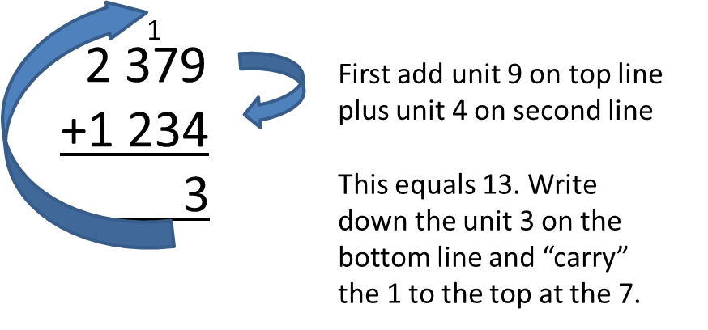
Example:
Calculate the addition of 2 379 and 1 234

Slide 12
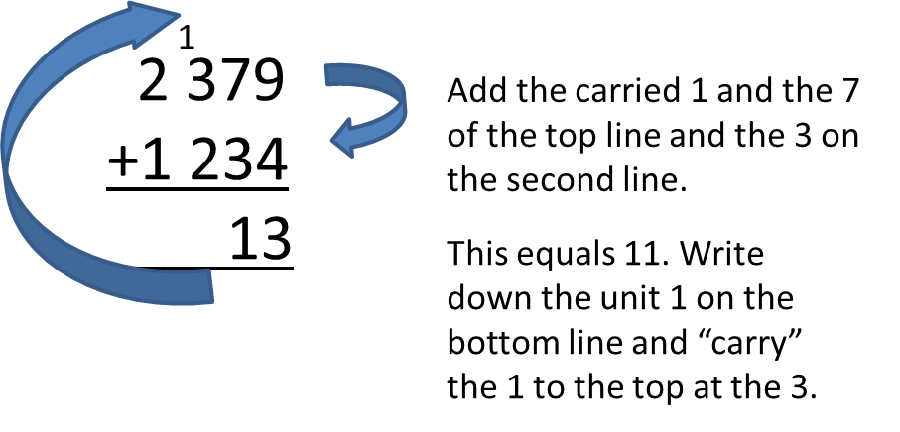
Example: Cont…
Then,

Slide 13
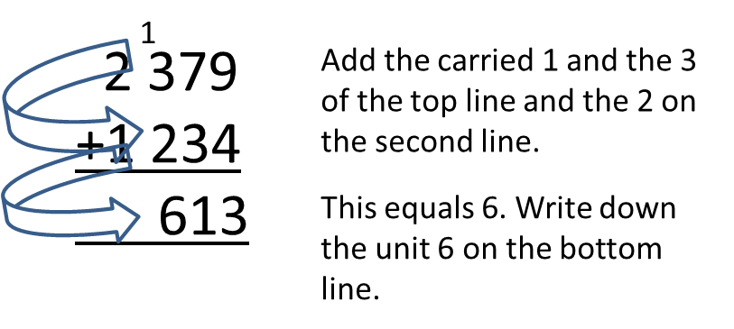
Example: Cont…
Then,

Slide 14
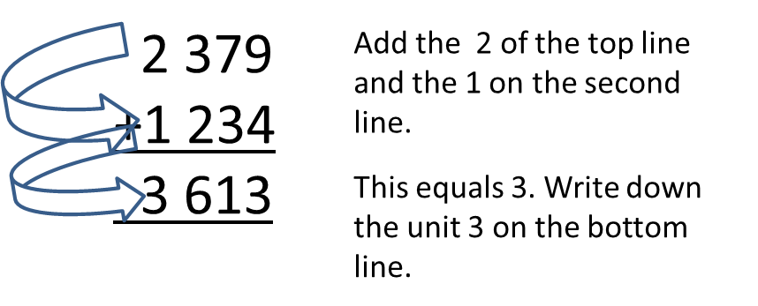
Example: Cont….
Finally,

Slide 15
Subtraction
Subtraction means “take away” or “separate” or “calculate the difference”.
Subtraction is the INVERSE OPERATION of addition.
11 – 3 = 8 (That means: 8 + 3 = 11)
Note that in subtraction only quantities of the same kind can be subtracted from each other as is the case with addition.
11 apples – 3 apples = 8 apples
11 apples – 3 pears = 11 apples – 3 pears

Slide 16
Integers
An integer is any number that is not a fraction or that is not a decimal number. In other words an integer is any whole number. There are numbers less than zero (i.e. -1, -2, -3….) known as negative numbers. These numbers can be represented as follows on a number line:
Note: When we write a positive number like +4 we usually omit the + sign and write just 4.

Slide 17
Integers Cont…
Think of positive and negative numbers as follows:
If you have a bank account and you have diligently saved R 500 you now have R 500 and this is indicated on your bank statement as +500 or just 500.
If you have no money in the bank, your balance on the statement is R 0.
If you borrow R 500 from the bank on your chequebook overdraft to go on a train trip, you will OWE the bank R 500 and this is indicated on your statement as –R 500.
You will then have to give the bank R 500 to get your account to zero.

Slide 18
Adding positive and negative numbers
Addition can be represented on the number line as follows:
Example:
(+5) + (-7)
(+5) + (-7) = -2
Or simply say: I have 5, I owe 7, so I still owe -2.

Slide 19
Subtracting positive and negative numbers
When we subtract a negative number, we change the sign of the number and then add that number:
For example:
5 – (+3) is the same as 5 + (-3) = +2
-5 – (-3) is the same as -5 + (+3) = -2
-5 – (+3) is the same as -5 + (-3) = -8

Slide 20
Multiplication
Multiplication is the repeated addition of the same number.

Slide 21
Multiplication terminology
Thus, the product of 5 and 4 is 20.

Slide 22
Important rules
0 multiplied by a number is ALWAYS 0 - i.e. 345 x 0 = 0
1 times a number is always that same number i.e. 2 345 x 1 = 2 345
If 2 × 3 = 6 then 3 × 2 = 6
A positive number (+) × a positive number (+) = a positive number (+) i.e. 4 x 3 = 12
A positive number (+) × a negative number (-) = a negative number (-) i.e. 4 x -3 = -12
A negative number (-) × a negative number (-) = a positive number (+) i.e. -4 x -3 = 12
Multiplication is important in our everyday work. Working in conjunction with division, we work out percentages (%).

Slide 23
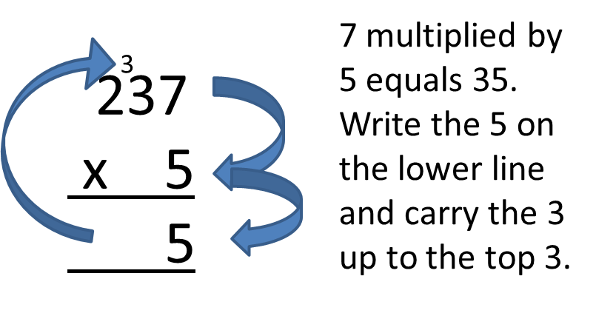
Multiplication examples:
237 multiplied by 5 is calculated as follows:

Slide 24
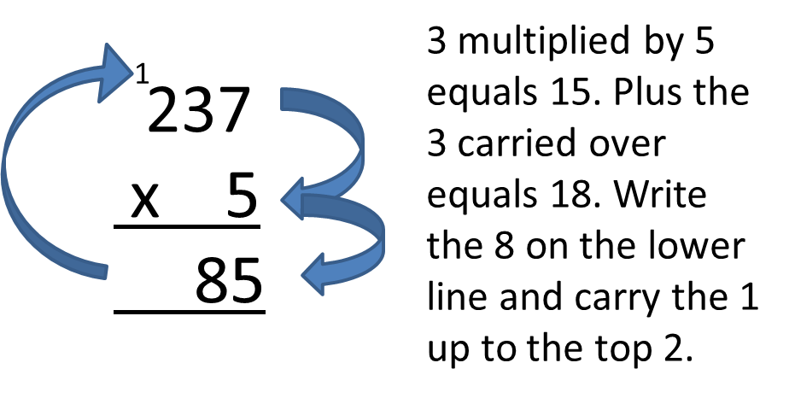
Multiplication examples: cont…
Then,

Slide 25
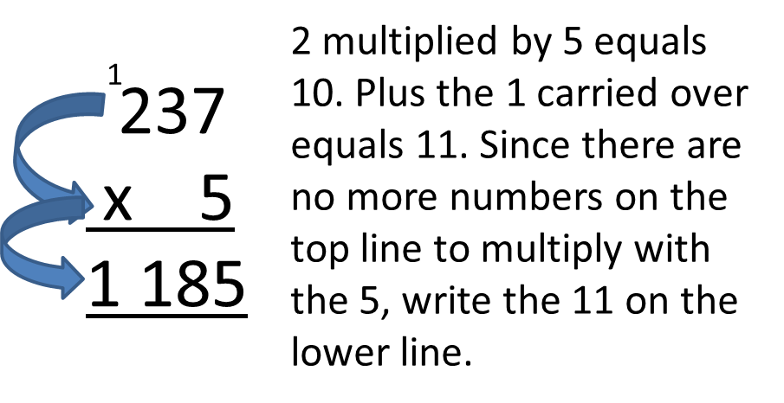
Multiplication examples cont…
Finally,

Slide 26
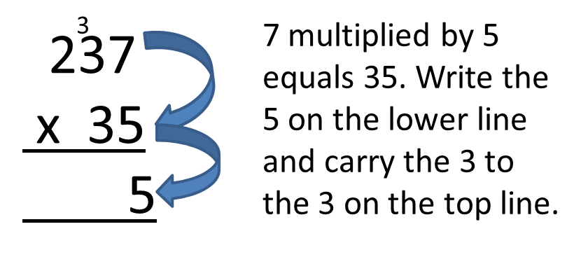
Multiplication examples cont…
Similarly, 237 multiplied by 35 is calculated as follows:

Slide 27
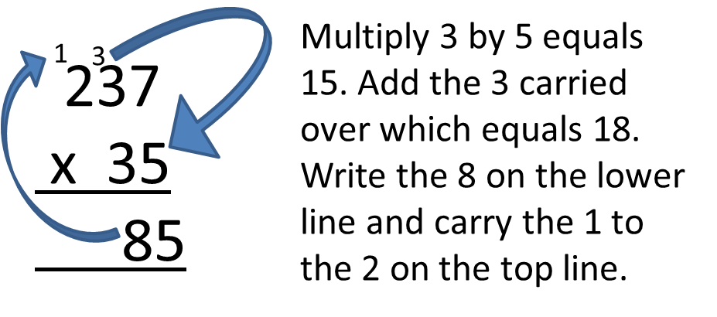
Multiplication examples cont…
Then,

Slide 28
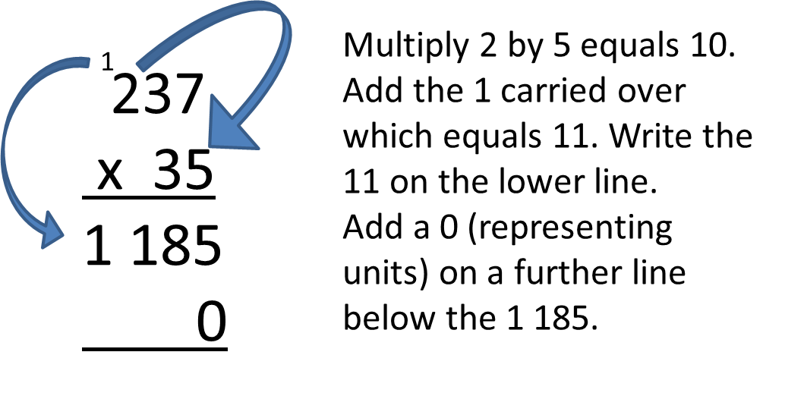
Multiplication examples cont…
And,

Slide 29
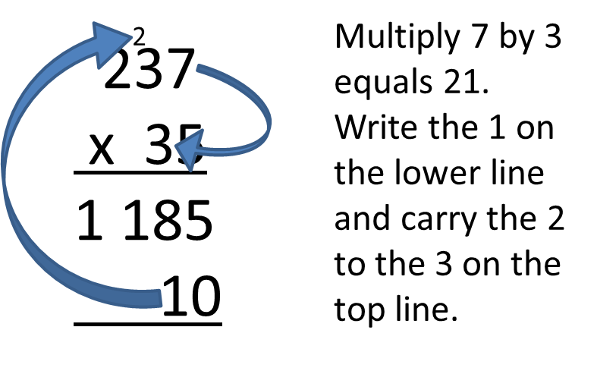
Multiplication examples cont…
Then,

Slide 30
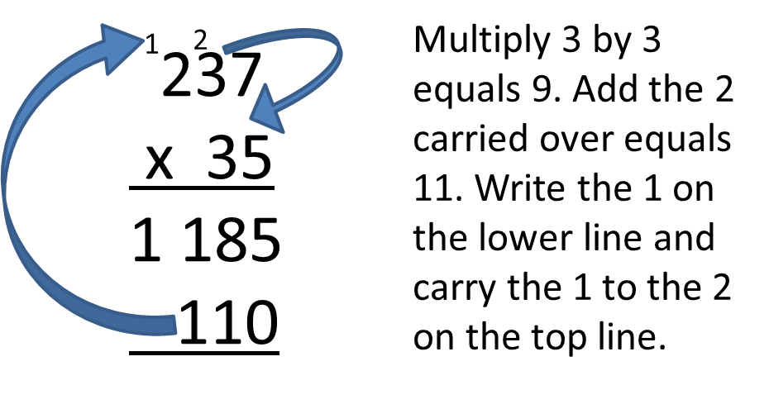
Multiplication examples cont…
And,

Slide 31
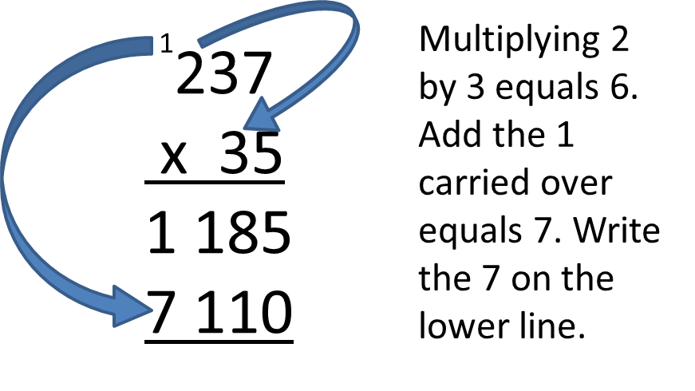
Multiplication examples cont…
Then,

Slide 32
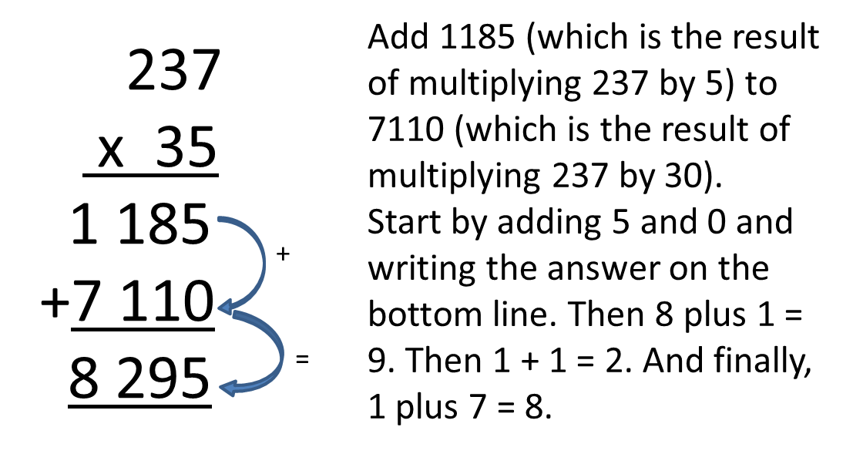
Multiplication examples cont…
Now,
…………..Thus: 237 x 35 = 8 295

Slide 33
Division
Division can be seen as a process whereby a number of objects are divided into equal parts or as repeated subtraction of the same number:
For example:
How many sweets will each child get if 8 sweets are divided equally among 4 children?
We have: 8 ÷ 4 = 2 or 8/4 = 2 or 4 can be subtracted from 8 twice
Each child therefore receives 2 sweets.

Slide 34
Division terminology
Important points
Any number divided by 1 gives that same number i.e. 495 ÷ 1 = 495
Division by 0 cannot be done. No number can ever be divided by 0.
All division can be placed into two groups.
If the divisor divides exactly – the divisor is a factor
If the dividend is not exactly divisible by the divisor – there is a remainder
Example:
Is 5 a factor of 11?
11 ÷ 5 = 2 remainder 1 This means that 5 is not a factor of 11.

Slide 35
Division terminology cont…
Division is the INVERSE OF MULTIPLICATION.
e.g. 4 × 2 = 8
Thus: 8 ÷ 4 = 2
And: 8 ÷ 2 = 4
This is important because:
A division operation can be viewed in terms of a multiplication operation.
e.g. How many times does 7 go into 56?
56 ÷ 7 = 8
Let us now change the question and ask by what number must 7 be multiplied to get 56?
7 × 8 = 56
To check the answer of a division operation, multiply the divisor by the quotient.

Slide 36
Division examples
2 947 ÷ 7 is calculated as follows:

Slide 37
Division examples cont…
Then,

Slide 38
Division examples cont…
And finally,

Slide 39
Division examples cont…
Similarly,

Slide 40
Division examples cont…
Then,

Slide 41
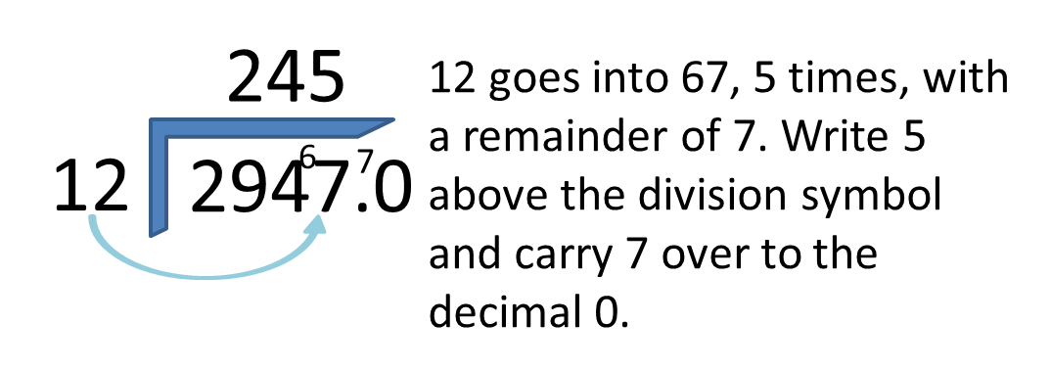
Division examples cont…
And,

Slide 42
Division examples cont…
Finally,
Thus, 2947 divided by 12 is equal to 245.5 (You can decide to which decimal place you would like to complete the equation. You can continue to 2, 3 or 4 or more decimal places depending on the accuracy required).

Slide 43
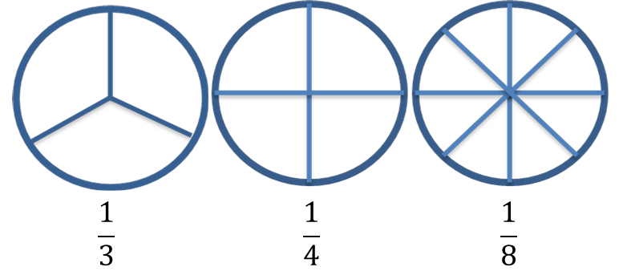
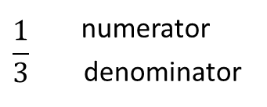
Fractions
If you have a cake and you cut it into 3 pieces and you eat 1 piece, you have eaten one out of 3 pieces i.e. a third. If the cake has 4 pieces and you eat one piece, then you have eaten a quarter. Likewise if the cake is cut into 8 pieces, each piece is one eighth.
Note:

Slide 44
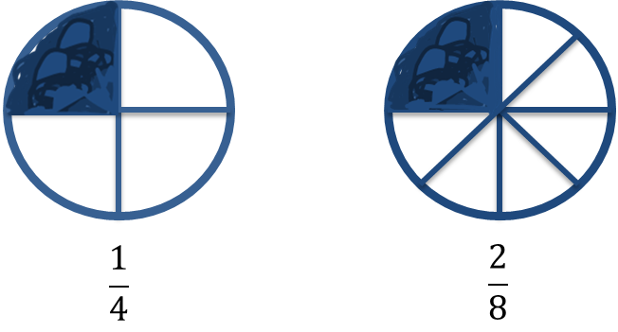
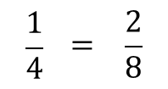
Fractions cont…
Converting fractions from one denominator to another:
Note:
To convert quarters to eighths, you follow the following method:
First, find the common denominator.
In this case….4 is a multiple of 8, or conversely, 8 is exactly divisible by 4
Thus, for the denominator, 4 x 2 = 8, then do the same with the numerator, i.e. 1 x 2 = 2.
Therefore:

Slide 45
Fractions cont…
Similarly,

Slide 46
Fractions cont…
And,

Slide 47
Fractions cont…
Proper and Improper fractions
Proper fraction: denominator is greater than the numerator
Example: $\frac{2}{3}$; $\frac{1}{2}$; $\frac{3}{5}$
Improper fraction: numerator is greater than the denominator
Example: $\frac{3}{2}$= 1$\frac{1}{2}$ ; $\frac{5}{4}$ = 1$\frac{1}{4}$ ; $\frac{8}{3}$ = 2$\frac{2}{3}$
Simplifying Fractions:
A fraction is simplified by ‘using’ the largest number that can divide into both the numerator and the denominator without a remainder.

Slide 48
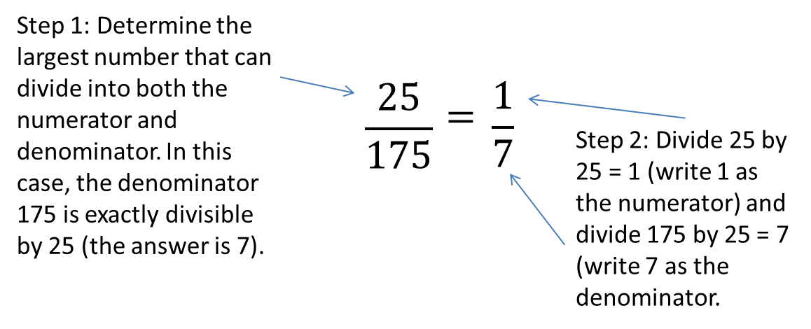
Fractions cont…
Examples:

Slide 49
Fractions cont…
And,

Slide 50
Fractions cont…
And,
To simplify the fraction further, divide 12 by 5 = 2 remainder 2, thus 2$\frac{2}{5}$

Slide 51
Decimals
Decimal fractions
The denominators of decimal fractions are the power of ten:
10 100 1000 etc.
Place values
The value of the digit is determined by its position
e.g. 2⁄10 tenths – t 0.2
2⁄100 hundredths – h 0.02
2⁄1000 thousandths – th 0.002
2⁄10000 and so on 0.0002

Slide 52
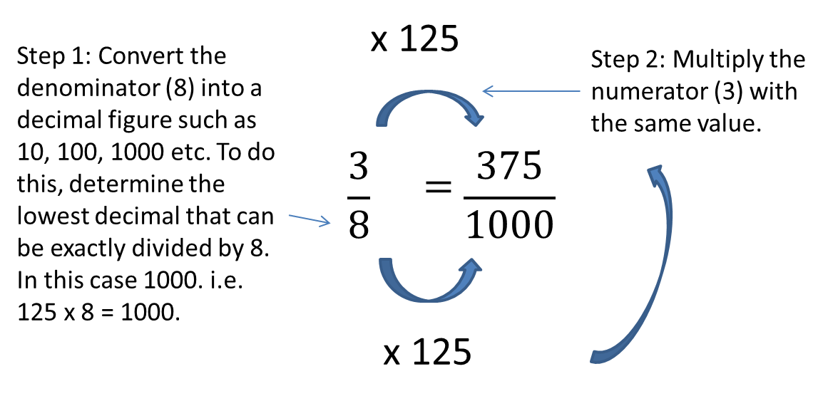
Decimals cont…
To convert $\frac{3}{8}$to a decimal fraction
= 0.375

Slide 53
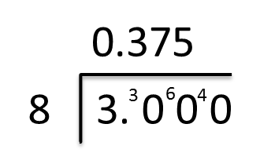
Decimals cont…
Or
Divide 3 by 8, as follows:
0.375
8 3.000
0
30
24
60
56
40
40

Slide 54
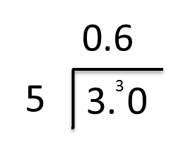
Decimals cont…
Or
Convert $23/5$ to a decimal fraction:
First convert 3/5 into a decimal number, by dividing 3 by 5 as follows:
Thus, 3/5 = 0.6
Add the 2
$23/5$ = $26/{10}$ = 2.6
0,6
5 3,0
0
30
30

Slide 55
Calculating with decimal fractions
The same rules apply as with whole numbers.

Slide 56
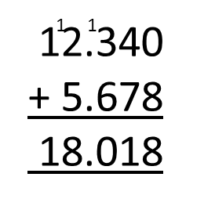
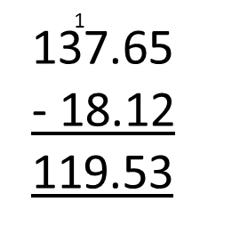
Addition and subtraction
Write the numbers down so that the decimal commas are aligned and proceed as for whole numbers:
and

Slide 57
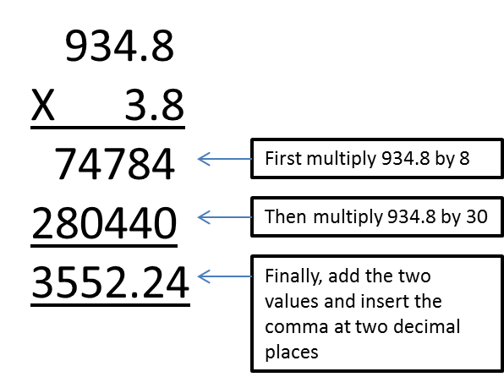
Multiplication
Ignore the decimal comma(s) and multiply as for integers. The product is then given the same number of decimal places as there are in the two numbers that have been multiplied.
Note: When multiplying by 10, 100 or 1000, the decimal comma moves 1, 2 or 3 places to the right respectively.

Slide 58
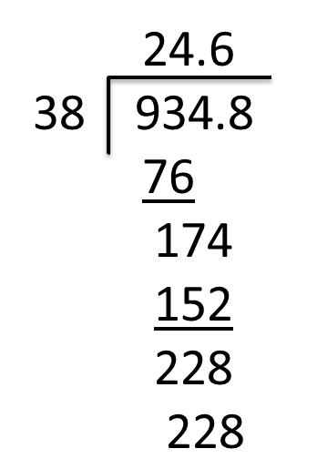
Division
Make the divisor a whole number by multiplying by 10 or 100 or 1000 and then multiply the dividend by the same number.
Example: 93.48 ÷ 3.8
= 934.8 ÷ 38
The answer (quotient) then has the same number of decimal places as the dividend.
When dividing by 10, 100, or 1000 the decimal comma moves 1, 2 or 3 places to the left respectively.

Slide 59
Squares and cubes
When a number is multiplied by itself the answer obtained is known as the square of the original number.
Example:
(I) 4 × 4 = 16 (4² = 16)
(II) 7 × 7 = 49 (7² = 49)
If a number is multiplied by itself and again by itself, then the product is called the cube of that number.
Example:
The cube of 5 is 5 × 5 × 5 = 125 (5³ = 125)

Slide 60
Square roots and cube roots:
√16 = 4 (4 × 4 = 16) ∛125 = 5 (5 × 5 × 5 = 125)
√49 = 7 (7 × 7 = 49) ∛27 = 3 (3 × 3 × 3 = 27)
√25 = 5 (5 × 5 = 25) ∛216 = 6 (6 × 6 × 6 = 216)

Slide 61
Mathematical signs:
> greater than Example: 8 > 2
< smaller than Example: 3 < 100
= equals Example: 2 = 2

Slide 62
Rounding off (Correcting)
Rounding off involves reducing the accuracy / precision of a number so as to reduce its complexity and make it easier to manipulate or record.
Wherever a decimal place to be discarded is represented by a number less than five, the preceding digit (that is the last to be recorded) shall remain as is stands but where the number to be discarded is greater than five, one shall be added to the preceding digit.
Where the number to be discarded is exactly five, the preceding digit shall be unaltered if it is an even number, but if it is an odd number one shall be added to it.

Slide 63
Examples:
12.733 rounded off to the 2nd decimal place is 12.73
12.735 rounded off to the 2nd decimal place is 12.74
12.725 rounded off to the 2nd decimal place is 12.72
12.726 rounded off to the 2nd decimal place is 12.73
12 733 rounded off to the nearest hundred is 12 700
(VI) 12 753 rounded to the nearest hundred is 12 800

Slide 64
Percentages
A percentage is a fraction with a denominator of 100.
Percentage means per 100 or out of 100.
e.g. ${20}/{100}$ = 20%
In a percentage 100 is always the basis of comparison.
Example 1:
30 km of the total distance of a 50 km journey is completed.
What % is completed?
$\frac{30 km}{50 km}$ = $\frac{3}{5}$ is completed
Notice how the zeroes and km cancelled out.

Slide 65
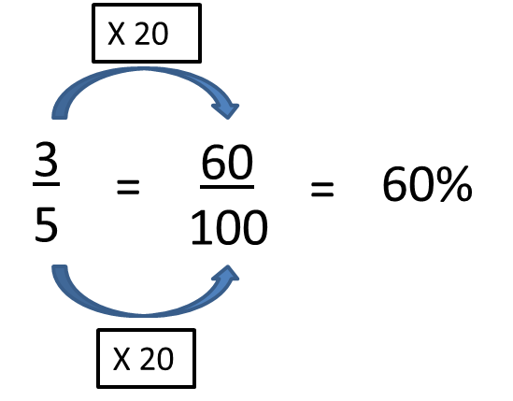
Percentages cont…
To convert this fraction to a percentage
or we multiply the fraction by 100: 3/5 × 100 = 60%
In 60% the basis of comparison is 100.
The comparison must always be based on measurements that are of the same kind. The numerator and the denominator must have the same units.

Slide 66
Percentages cont…
Example 2:
You invest R 1 000 at an interest rate of 15% per year. How much money do you have in the bank after one year?
Interest = 15% of R 1 000
But you also have your original R 1 000 in the bank.
The total in your bank account is thus R 1 000 + R 150 = R 1 150

Slide 67
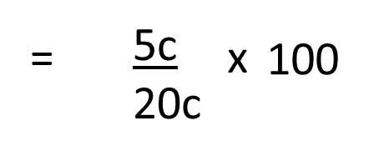
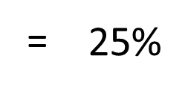
Percentages cont…
Example 3:
What is the % profit or loss if a dealer buys an article for 20c and sells it for 25c.
% Profit

Slide 68
Ratio
Example 1
In a school a certain class has 36 pupils. There are 24 boys and 12 girls.
There are 2 ways in which the number of boys can be compared to the number of girls.
By subtraction
There are 24 – 12 = 12 more boys than girls.
By division
For every 24 boys there are 12 girls. There are twice as many boys as girls, or the ratio of boys to girls is 2 to 1, or there are 2 boys per girl.
We write this ratio as 2:1 or $\frac{2}{1}$
We can also say: There are 2 boys per girl.
“Per” therefore means “for every”.
The ratio of girls to boys is 1:2 or $\frac{1}{2}$

Slide 69
Ratio cont…
Example 2:
There are 4 girls with 3 dogs each.
In total there are 4 girls and 12 dogs.
We also say: there are 3 dogs per girl (3:1) or for every girl there are 3 dogs.

Slide 70
Ratio cont…
What is the ratio of girls to dogs?
There are several answers, for example:
4 to 12 or 4 :12 or 4/12
1 to 3 or 1:3 or 1/3
2 to 6 or 2:6 or 2/6
3 to 9 or 3:9 or 3/9
Which answer is correct: $\frac{4}{12}$; $\frac{1}{3}$; $\frac{2}{6}$or $\frac{3}{9}$?
Since they are equivalent fractions:
$\frac{4}{12}$ = $\frac{1}{3}$ = $\frac{2}{6}$ = $\frac{3}{9}$ and therefore all are correct!
A ratio is usually given as the simplest fraction i.e. 1:3.

Slide 71
Division of quantity in a certain ratio
Example 1:
Divide 63 sweets between Andre and Albert in the ratio 3:4
This means that Andre gets 3 and Albert 4 out of every 7 sweets.
So Andre gets $\frac{3}{7}$and Albert $\frac{4}{7}$ of the sweets. So Andre gets $\frac{3}{7}$× 63 sweets = 27 sweets and Albert gets $\frac{4}{7}$× 63 sweets = 36 sweets.
Check: Andre + Albert = 63 sweets
27 + 36 = 63 sweets
27 : 36
3 : 4

Slide 72
Division of quantity in a certain ratio cont…
Example 2:
Divide a 36 m long rope in the ratio 3:4:5.
The total of the sections is 3 + 4 + 5 = 12
The ratio will therefore be: $\frac{3}{12}$ : $\frac{4}{12}$ : $\frac{5}{12}$
The sections will be:
$\frac{3}{12}$of 36 m $\frac{4}{12}$of 36 m $\frac{5}{12}$of 36 m
= $\frac{3}{12}$× 36 m = $\frac{4}{12}$× 36 m = $\frac{5}{12}$× 36 m
= 9 m = 12 m = 15 m
Check:
9 m + 12 m + 15 m = 36 m
$\frac{9}{36}$ : $\frac{12}{36}$ : $\frac{15}{36}$
= $\frac{3}{12}$ : $\frac{4}{12}$ : $\frac{5}{12}$

Slide 73
Rate:
The rate at which something takes place tells you how fast / slow it is happening.
Examples:
If you earn R 15 an hour at work, you are being paid the rate of R 15 per hour or R15/h
If you run 100 m in 20 seconds you are running at an average rate (speed) of $\frac{100 m}{20s}$ = 5 m per second or 5 m/s (5m.s­¯¹)

