Slide 1
KNOWLEDGE TOPIC 4:
GRAPHS

Slide 2
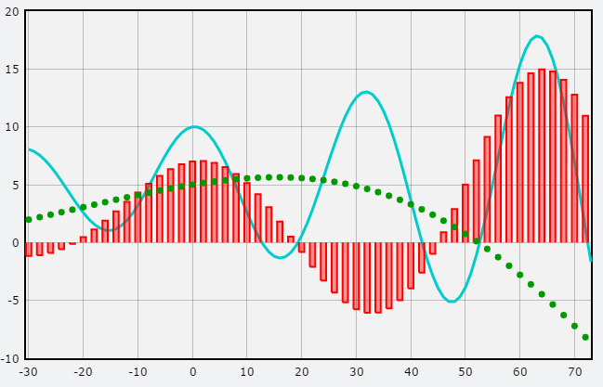
Introduction
A graph is a pictorial representation of two sets of conditions. These could vary from cigarettes smoked over a week or month or year to weekly Boiling House or Recoveries over a mill’s crushing season.

Slide 3
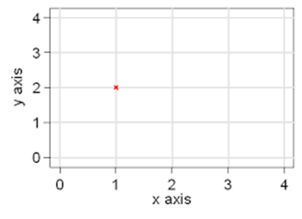
Axis
A graph has two axes. A horizontal axis and a vertical axis. Each axis is used for a particular set of conditions. Each axis must be labelled and the values for each particular set of conditions must be stated.

Slide 4
Information
When drawing a graph the following information must be put onto the graph paper.
Heading of the graph e.g. Standard Phosphate graph.
Date the graph was drawn – this is important as some chemicals deteriorate over a period of time and a new graph has to be drawn with freshly prepared chemicals.
Name of the person who drew up the graph – not everybody in a mill laboratory draws up a graph but a lot of people read a graph - if needed the person who drew up the graph can be consulted.
Any additional information may be written down on the back of the graph paper.

Slide 5
Standard Graphs
A standard graph is a reference graph of known concentration of a particular compound.
A series of standard solutions of the compound are prepared and analysed. The results obtained are plotted on a graph and this graph is now used as the reference for further analysis of unknown samples.
By using the standard graph we can determine the level of concentration in an unknown sample.
Remember: A standard graph is a reference graph – so extreme care must be taken when drawing up this graph. If a standard graph is incorrect, then all analyses that are done will give an incorrect result.

Slide 6
Rules for Drawing Graphs
Have both data sets.
Decide which axis should carry which data set.
Generally, the more complex data set with the greater range will go on the longer axis.
For each Data Set
Find the lowest and highest value (the range)
Spread this range over the “whole” axis working with convenient figures that cover this range.
Calculate the scale by:
20 mm : 0.050 mg (for example)
2 mm : x mg
20 × x = 2 × 0,050
X = (2 ×0,050 mg)/20
SCALE: 2 mm = 0,005 mg
Write down this scale near the axis.
Do not use scales with recurring decimals e.g. 2 mm = 0,0333…..

Slide 7
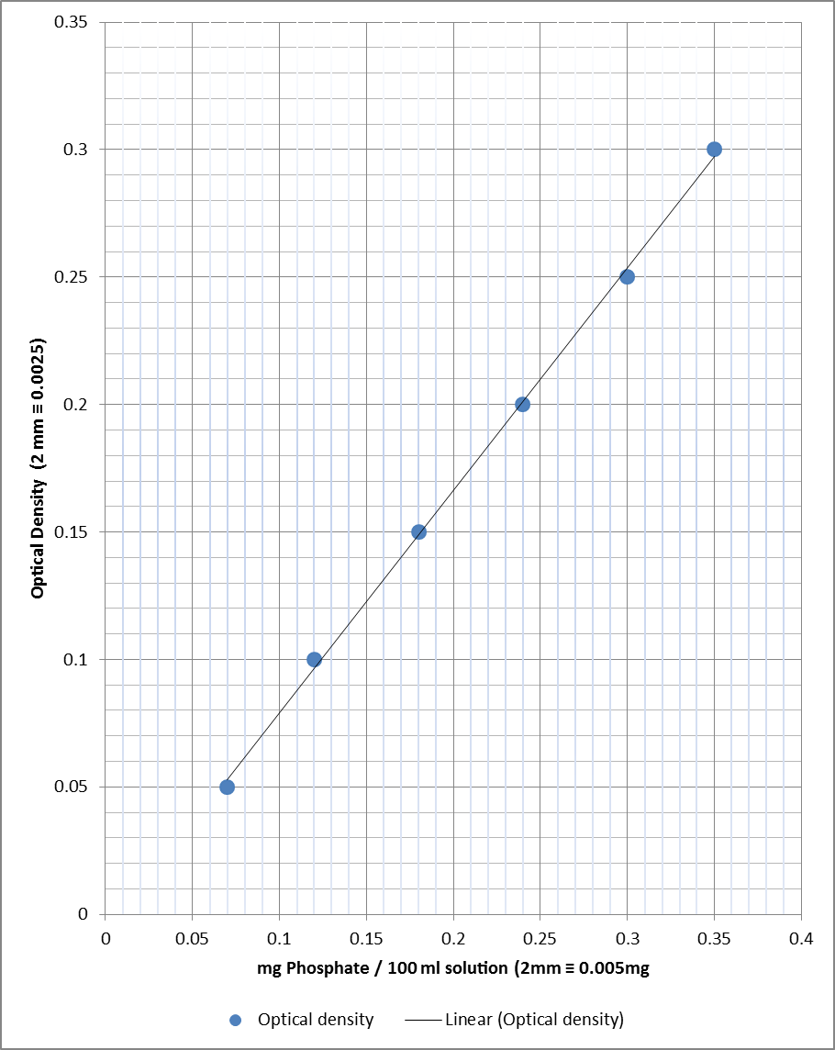
Example: Phosphate Standard Graph
mg Phosphate per 100 ml of solution | Optical density
0.07 | 0.05
0.12 | 0.10
0.18 | 0.15
0.24 | 0.20
0.3 | 0.25
0.35 | 0.30
If an unknown sample is read in the spectrophotometer and the optical density is 0.125, what is the concentration of phosphate per 100 ml of this sample?
Answer: 0.15 mg phosphate per 100 ml of solution (Read off the Phosphate Standard Graph by finding the point at which the arrow at 0.125 from the Y-axis intercepts with the graph line. Then read down to find the relevant value on the X-axis i.e. 0.15 mg Phosphate.

Slide 8
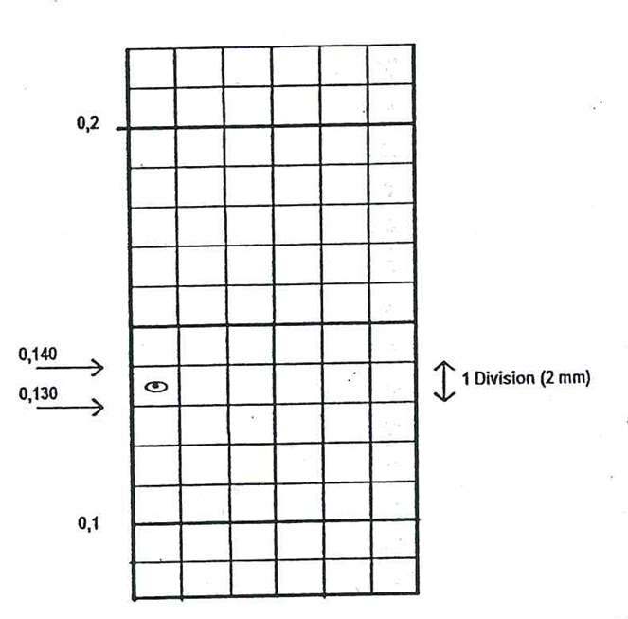
TO LOCATE A POINT EXACTLY
To locate 0.134 mg exactly, proceed as follows:
the 0.130 mg line is easily found.
To this value 0.004 mg must be added (0.134 - 0.130 = 1.004)
0.004 mg is: 0.004/0.01 = 0.4 Divisions
Locate this by using the graph shown here:
Θ represents the value of 0,134

Slide 9
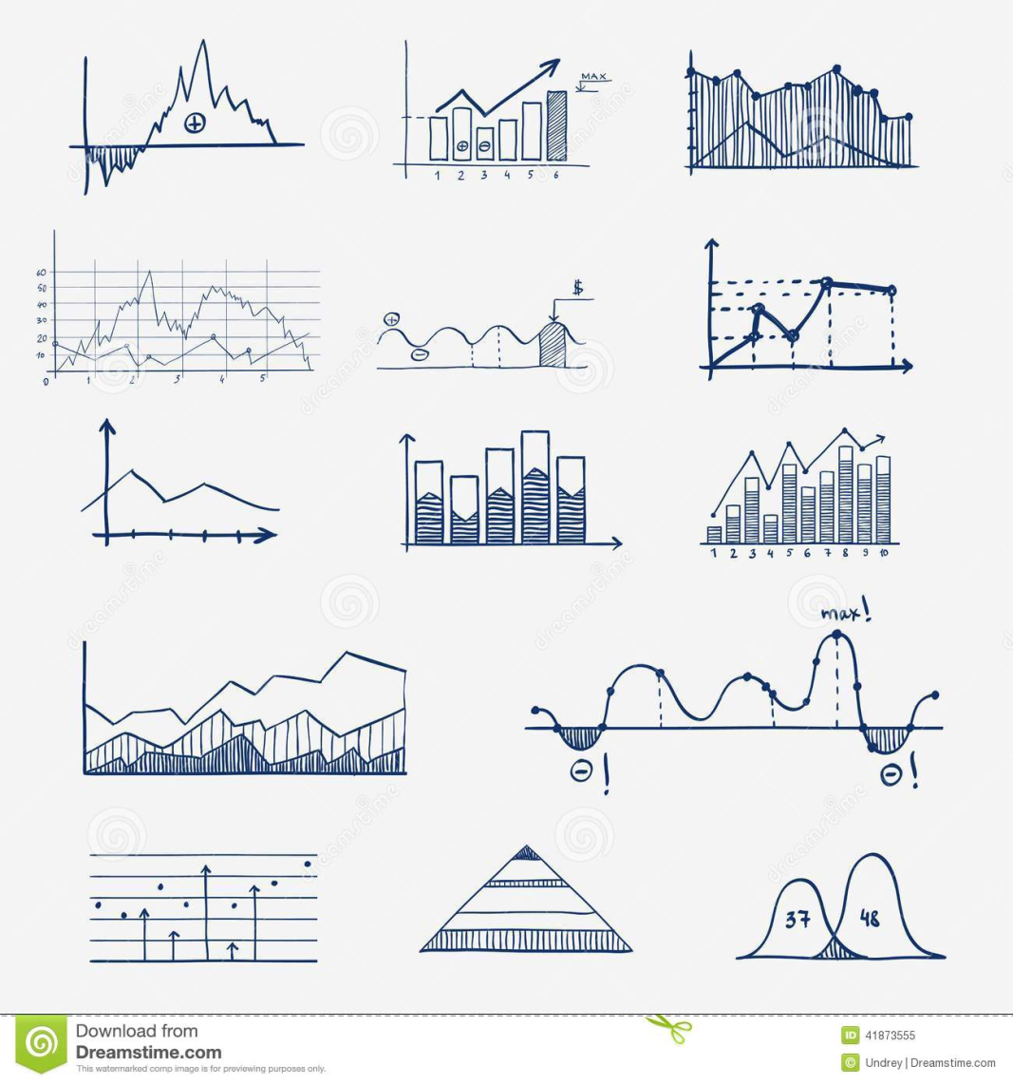
HOW TO DRAW A GRAPH
By hand
Use a sharp pencil and a good ruler.
Mark each point with a clear bold dot that is not too large and circle the dot boldly. Work neatly.
For straight line graphs (like the phosphate standard graph) draw an “average” straight line that:
goes through as many points as possible, and
has an equal number of points above it as below it.

Slide 10
HOW TO DRAW A GRAPH
Using Excel
If you have access to a computer you can also draw your standard curves on the Excel programme of Microsoft.
Type the data into the spreadsheet (The X-axis values in the first column and the Y-axis values in the second column. Put the titles of the X-axis and the Y-axis in the first row of each column.
Select the cells that contain the data that you want to use for the chart. Tip: If you select only one cell, Excel automatically plots all cells that contain data that is adjacent to that cell into a chart. If the cells that you want to plot in a chart are not in a continuous range, you can select nonadjacent cells or ranges as long as the selection forms a rectangle. You can also hide the rows or columns that you do not want to plot in the chart.
On the Insert tab, in the Charts group, do one of the following:
Click the chart type, and then click a chart subtype that you want to use.
To see all available chart types, click to launch the Insert Chart dialog box, and then click the arrows to scroll through the chart types.
c. Tip: A ScreenTip displays the chart type name when you rest the mouse pointer over any chart type or chart subtype.

Slide 11
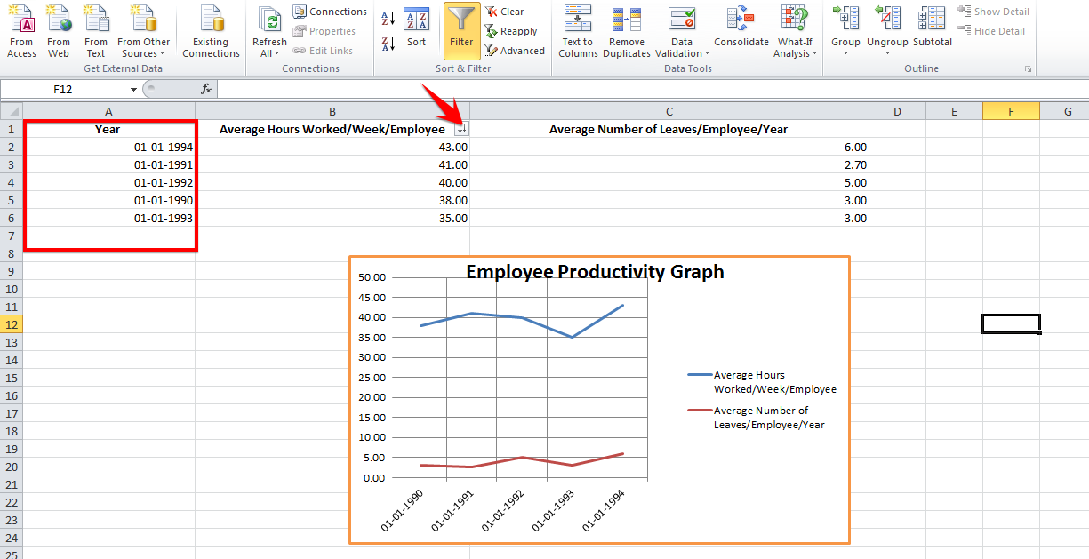
HOW TO DRAW A GRAPH
Using Excel (Continued)
Click on Insert Chart – Scatter Plot and further refine your graph by choosing Chart Layouts with a background grid.
Click the chart element for which you want to change the layout, or do the following to select it from a list of chart elements.
Click anywhere in the chart to display the Chart Tools.
On the Format tab, in the Current Selection group, click the arrow in the Chart Elements box, and then click the chart element that you want.
On the Layout tab, in the Labels, Axes, or Background group, click the chart element button that corresponds with the chart element that you selected, and then click the layout option that you want.

