Slide 1
KNOWLEDGE TOPIC 5:
MEASUREMENT OF QUANTITIES

Slide 2
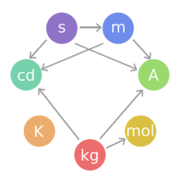
THE S.I. (SYSTEM INTERNATIONALE D’UNITES)
Seven basic units have been accepted internationally, and all other units are derived from these.
We will only be concerned with three basic units.
They are:
  Length – metre (m)
  Mass – kilogram (kg)
  Time – second (s)
Units of area and volume (capacity) are based on the unit of length, the metre.

Slide 3
DERIVED UNITS
Apart from time, all the derived S.I. units are decimal multiples of the basic unit and are named by the addition of prefixes.
Multiples and sub-multiples of a unit:

Slide 4
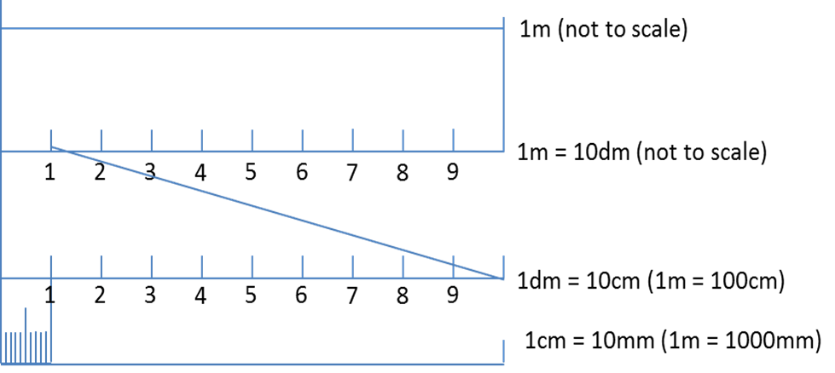
DERIVED UNITS: Length

Slide 5
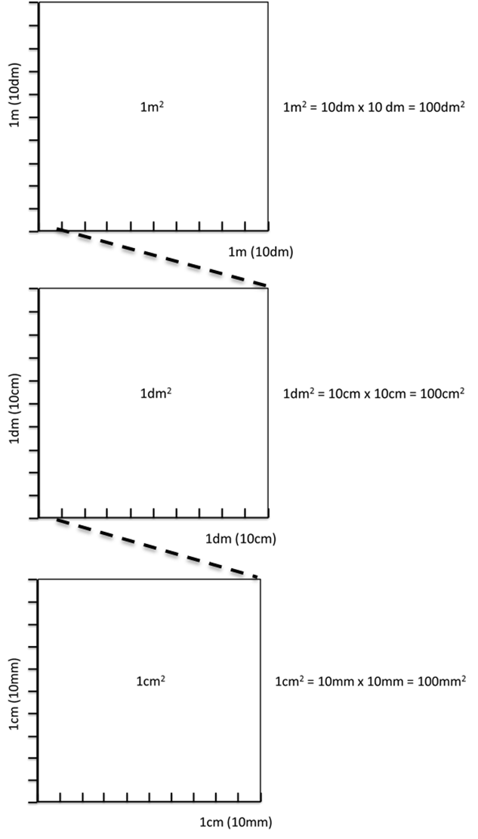
Derived Units: Area
m

Slide 6
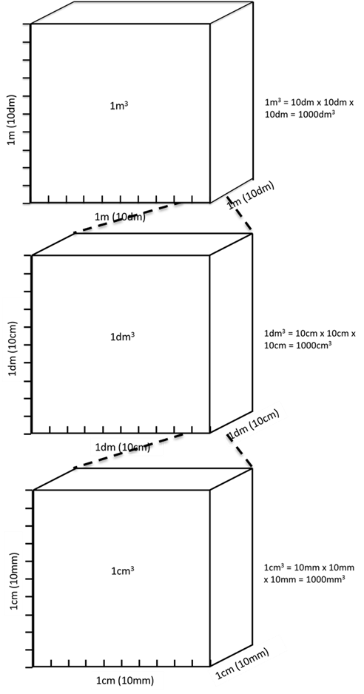
Derived Units: Volume
H

Slide 7
Note:
1 cm³ = 1 ml
1 dm³= 1l
1 km³ = 1 000 000 000 m³
1 m³ = 1 000 dm³
1 dm³ = 1000 cm³
1 cm³ = 1000 mm³

