Slide 1
KNOWLEDGE COMPONENT: MODULE 2: KNOWLEDGE TOPIC 1: THE SUGAR MANUFACTURING PROCESS

Slide 2
Background
Sugar Cane (Saccharum officinarum) belongs to the family of grasses
The sugar cane stalk is divided by nodes into several sections, called internodes.
The length and thickness of these internodes may differ considerably and is dependent on the cane variety, soil type and growing conditions.
Each node carries a bud, which is capable of producing a plant, from which shoots develop, forming a stool.

Slide 3
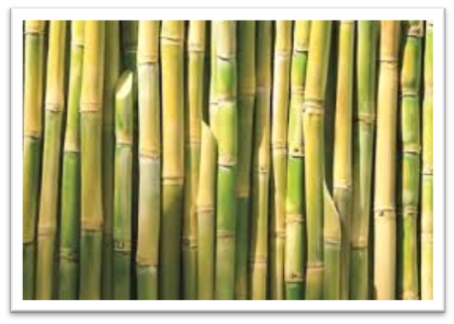
Background (cont.)
Planting a new cane field is done with seed cane or cuttings, i.e. short lengths of cane stalks with 2 nodes and buds
Leaves are attached to the nodes and consist of two parts, the sheath and the blade, of which the sheath envelops a piece of stalk.
The sugar is formed in the green leaves.

Slide 4
Background (cont.)
The green colouring matter is called chlorophyll.
In the presence of light the leaf absorbs carbon dioxide gas from the air through holes (stomata) and the chlorophyll has the ability to combine this gas with water (taken up by the roots of the plant) to produce sugar.
Certain cells of the plant transport the sugar to the stalk where it is stored.
All energy required for the process is delivered by sunlight.
This process is called photosynthesis.
Carbon dioxide + water → mono saccharide + oxygen
6CO₂ + 6H₂O + Energy → C₆H₁₂O₆ + 6O₂
Oxygen is liberated in this process.

Slide 5
Background (cont.)
The sugar is unevenly distributed through the length of the cane stalk, the top part having the lowest sugar content. The tops are therefore cut off in the field.
The cane stalk is composed of the following components:
Water – 65 – 75%
Sucrose – 11 – 19%
Non-sucrose – 0.5 – 1.5%
Fibre – 11 – 19%
Furthermore, there are small quantities
of starch, gums, waxes, pigments, organic
and inorganic substances.
Three common sugars—glucose, galactose, and fructose, share the same molecular formula: C6H12O6. Because of their six carbon atoms, each is a hexose. Although all three share the same molecular formula, the arrangement of atoms differs in each case.

Slide 6
Sucrose
C₁₂H₂₂O₁₁ is a disaccharide and is composed of two mono saccharides, glucose and fructose, each having the formula C₆H₁₂O₆.
When these two combine, one molecule of water is liberated.
C₆H₁₂O₆ + C₆H₁₂O₆ ↔ C₁₂H₂₂O₁₁ + H₂O
Glucose + Fructose → Sucrose + Water
This happens in the growing plant.
When the cane is cut, this building-up process stops and, under unfavourable conditions (high temperatures or high humidity because of rain), a decomposition process is started, and monosaccharides are formed again
It is therefore very important that we process the cane as soon as possible after it has been cut.

Slide 7
Sugar Production
Sugar manufacture consists of the different separation processes that take place within a sugar mill.
These include:
PROCESS | SEPARATION OF | EQUIPMENT
Juice extraction | Juice from fibre | Mill – diffuser
Juice purification | Suspended matter from juice | Clarifier
Juice concentration | Water from juice | Evaporator
Sugar crystallisation | Sugar from syrup | Vacuum pan
Crystal separation | Crystal from molasses | Centrifugal

Slide 8
Sugar Cane Harvesting
Sugar cane may be mechanically or manually harvested.
Cane is burnt before harvesting to get rid of the unnecessary “tops” or loose leaves – the part of the cane which contains the sugar is the stalk.
Burnt and/or chopped cane deteriorates quickly.
It is therefore essential to process this cane soon after it has been harvested.

Slide 9
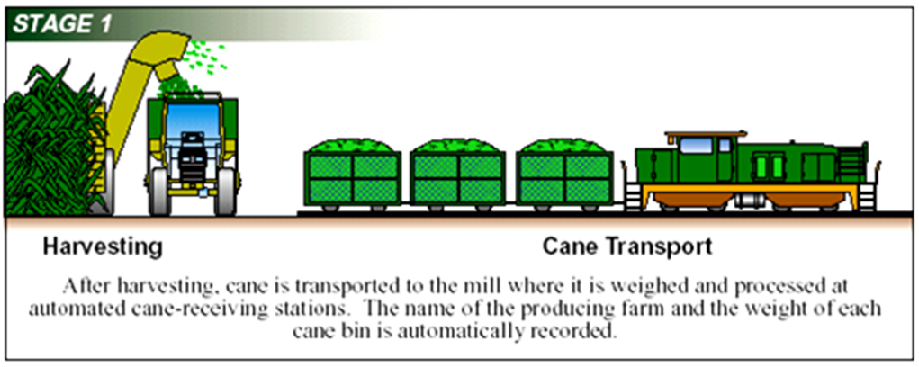
Cane Transport

Slide 10
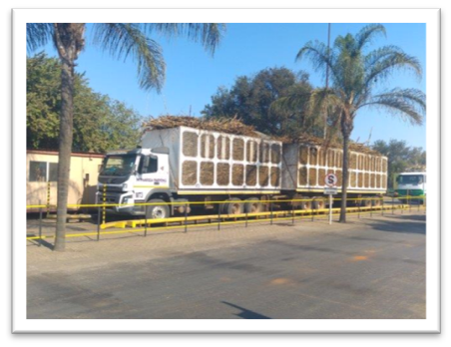
Cane Transport
In the fields, the cane stalks are loaded onto cane carts, “Bell” trailers (self-loaders) or side loading trailers
The cane is transported to the nearest mill where it enters the factory yard over a weigh bridge
Empty trucks are weighed again when they leave the yard
The Gross and Nett weight and the name of the grower is noted on the weighbridge ticket.

Slide 11
Unloading
The cane is mechanically unloaded onto an upward inclided cane table or spiller table
This is a chain or slat conveyor
The speed of the conveyor can be regulated by the operator
The excessive soil and rocks are removed by agitating conveyors
The cane is cleaned by flooding the carrier with warm water or spreading the cane on agitating conveyors that pass through strong jets of water and combing drums
The cane is now clean and ready to be milled

Slide 12
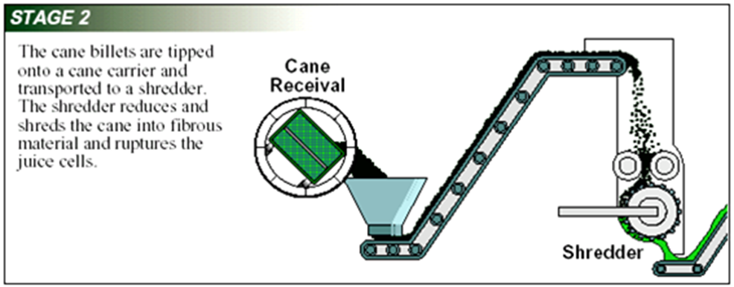
Cane Preparation

Slide 13
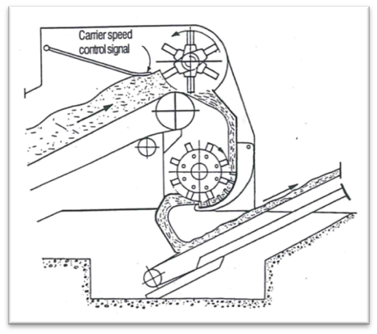
Cane Preparation
Cane knives chop the cane into short lengths
The cane enters a shredder. The shredder is a device that tears the cane apart using large metal bars known as hammers.
The task of the mills or diffuser (the next step) is to extract as much juice from the cane as possible – to do this the walls of these cells must be ruptured, before the juice can flow out. This is done by exerting pressure on the cane, between rollers.
This pressure must be exerted on all parts of the cane as evenly as possible which means that the blanket of cane entering the first mill should be of uniform thickness.
Shredder feeding arrangement

Slide 14
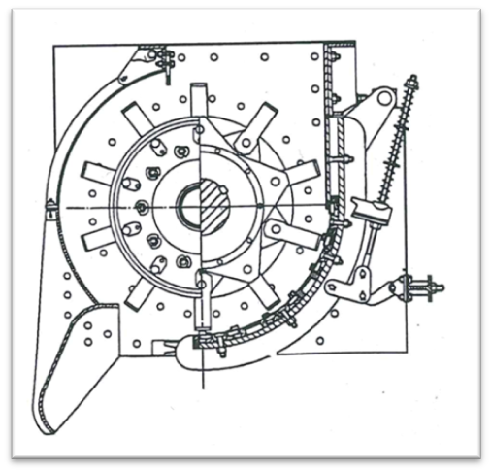
Cane Preparation
Good preparation of cane will rupture 90% of the juice-containing cells of the cane. No juice is extracted by the shredder.
The pulverised cane discharged by the shredder is called prepared cane and is fed to a diffuser (or milling train).
Section view of a shredder

Slide 15
Cane Testing Services
From each consignment of cane received, a representative sample is taken after the shredder, by Cane Testing Services, who analyse it for sucrose content in their laboratory.
CTS is a neutral body.
CTS also analyses the mixed juice and bagasse.
The total amount of sucrose is distributed among the cane suppliers in proportion to the sucrose content of their consignments.
Payments are based on this analysis.

Slide 16
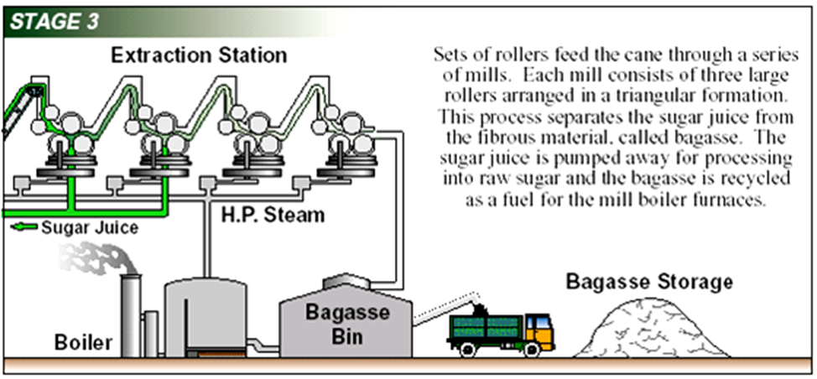
The Diffuser or Milling train

Slide 17
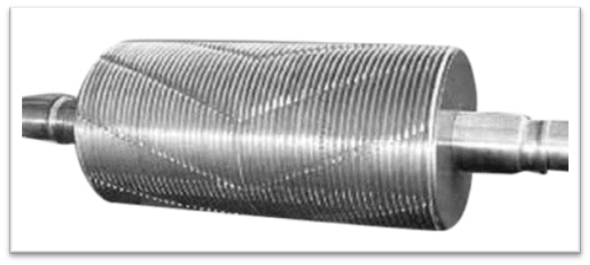
The Diffuser or Milling train
The extraction plant consists of six or seven roller mills called the milling train or tandem.
Each mill consists of three rollers.
The shells around the rollers have grooves – These can be either Messchaert or chevron grooves.
Grooves reduce slippage.
Milling essentially ruptures the storage cells of the cane and separates the freed juice from the fibre of the cane plant.
Chevron groove type

Slide 18
The Diffuser or Milling train (cont.)
Extracted juice is collected in a juice tray.
Juice from the first mill is mixed with juice from the second mill.
The juice is screened to remove fine bagasse particles (called bagacillo) and weighed.
The residue is called bagasse.
Bagasse is used to fire the boilers.
Bagasse has a moisture content of about 48%.
Bagacillo is removed by a screen as serves as filter aid in the rotary vacuum filter (later).

Slide 19
Diffusion (imbibation)
Imbibition water and dilute juice is sprayed onto the cane from above.
The water percolates through the bed of cane and dissolves the sugar.
The juice is collected in a hoper and pumped back onto the bagasse layer and the process repeated.
Diffuser (mixed) juice is then screened to remove fine particles and then pumped to the boiling house via a juice scale.
Bagasse from the diffuser is very high in water (85%) – it is transported to a de-watering unit consisting of two mills which squeezes out the water – then the bagasse gets used as fuel for the boilers.
Definition: Imbibition
Imbibition is a special type of diffusion when water is absorbed by solids-colloids causing an enormous increase in volume. Examples include the absorption of water by seeds and dry wood. Water potential gradient between the absorbent and the liquid imbibed is essential for imbibition.

Slide 20
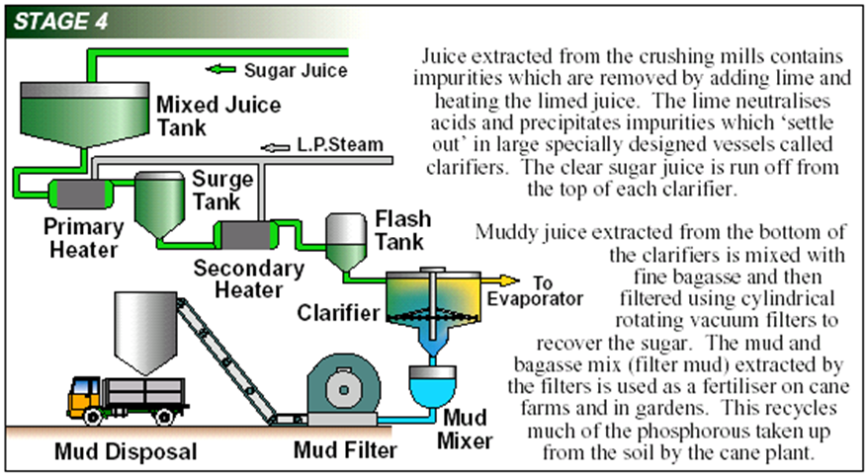
Juice purification

Slide 21
Juice purification
Crushed juice and mill juice are mixed and screened of bagasse particles and pumped to the mixed juice scales.
This is a cloudy, greyish or greenish foaming liquid.
This liquid contains sand particles, fine bagasse particles, cane wax and air bubbles.
These impurities must be removed.
A flocculant (lime) is added so that the “mud” can settle.
The clear juice is decanted.
The “mud” is filtered.
This process takes place in juice heaters.
Definition: Flocculant
A flocculant is a substance which promotes the clumping of particles.

Slide 22
Juice purification
Crushed juice and mill juice are mixed and screened of bagasse particles and pumped to the mixed juice scales.
This is a cloudy, greyish or greenish foaming liquid.
This liquid contains sand particles, fine bagasse particles, cane wax and air bubbles.
These impurities must be removed.
A flocculant (lime) is added so that the “mud” can settle.
The clear juice is decanted.
The “mud” is filtered.
This process takes place in juice heaters.
The process is controlled by:
  heat,
  pH and
  time.
Definition: Flocculant
A flocculant is a substance which promotes the clumping of particles.

Slide 23
Juice purification
Clear juice must be heated at a pH of 7.2 otherwise it will form invert sugar.
If it is heated at a pH of 7.6 or higher the reducing sugars will form coloured bodies and acids (which make production of white sugar difficult)
The precipitate (mud) consists of fine insoluble particles of calcium phosphate.
A layer of clear yellow juice forms.
Continuous settling occurs in the clarifier tank.
Lime is produced from limestone CaCo₃, which is heated and decomposed to CaO and CO₂. The burnt lime or quick-lime is slaked with water:
CaO + H₂O = Ca(OH₂)
In the sugar factory a suspension is used, which is known as milk of lime.

Slide 24
What happens to the “mud”?
Mud from the clarifier is mixed with bagacillo in a mud mixer.
This is processed using a vacuum filter.
The cake formed goes back to the cane fields as fertiliser.
The mud particles passing the screen are returned with the filtrate to the mixed juice and back into the clarification process.
Retention of 80% or higher on the screen as cake is considered good retention.

Slide 25
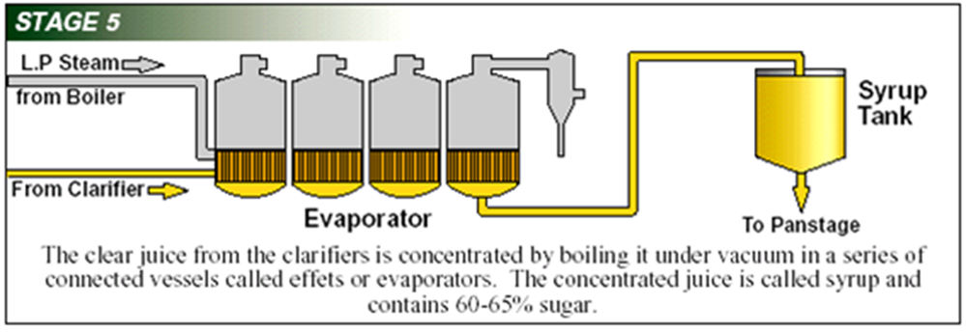
Juice concentration

Slide 26
Juice concentration (cont.)
The aim is to crystallise the sugar.
Clear juice from the top of the clarifier consists of
  12-14% sugar
  83 to85% water
  pH 6.8 to 7.0
Is pumped to the evaporators where steam is used to heat the juice.
Water is evaporated and the juice is concentrated until it is a thick syrup.
Concentration is done in two stages:
  Stage 1: Water is evaporated in evaporators
  Stage 2: Vacuum pans evaporate more water and sugar is crystallised

Slide 27
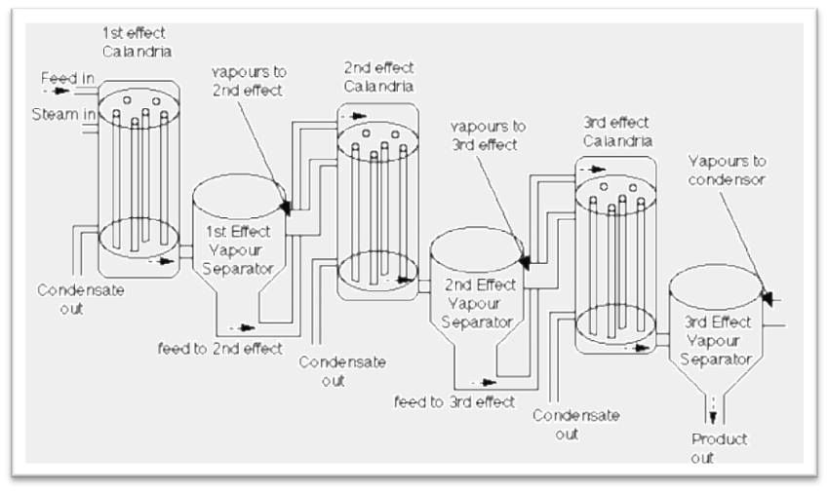

Juice concentration (cont.)
The evaporators are a cheaper (more cost effective) way to evaporate the water than in the vacuum pans.
The vapour coming off the evaporators are used to heat the juice again (thus saving on steam generation).
A lower pressure (high vacuum) results in lower and lower temperatures being necessary for the juice to reach boiling point in each subsequent evaporator.
This is called multiple effect evaporation.

Slide 28
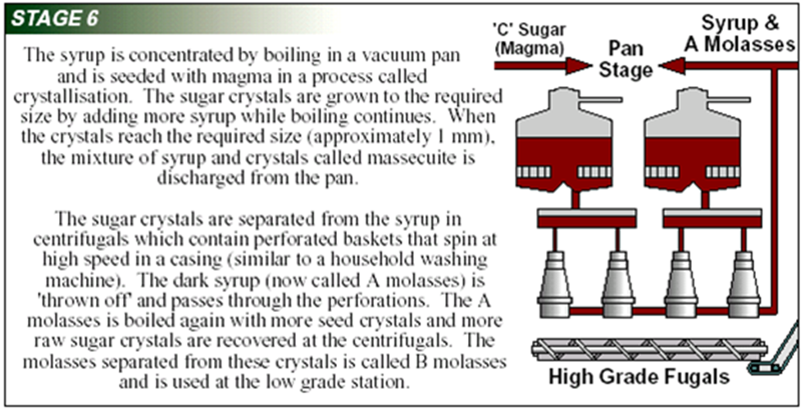
Sugar Crystallisation

Slide 29
Sugar Crystallisation (cont.)
From the evaporators, the syrup is sent to a multi-storage tank and from there to special feed tanks on the pan floor called vacuum pans.
In vacuum pans the sugar is forced to crystallize by evaporating more water and sugar crystals are grown.
The mixture of sugar crystals and mother liquor is known as “massecuite”.
When supersaturation is reached small crystals are formed in the solution.
These crystals grow as evaporation continues.
Each small crystal is the nucleus for a full-sized crystal.
Letting crystals form by themselves may result in too fine sugar crystals being formed.
To prevent this, a slurry of crystals – called seed grain - is introduced into the pan which forms the nucleus of crystals to form.
It is not possible to crystallise all the sugar in solution otherwise the mass in the pan becomes to tight to flow out of the pan.
The strike (as the contents of the pan is called) is dropped before it becomes too tight.

Slide 30
Sugar Crystallisation (cont.)
The liquid around the crystals (mother liquor or molasses) still contains a quantity of sugar.
It must be separated from the crystals.
This separation takes place in centrifugals.
The mother liquor is separated in this way three times – each time going back to a vacuum pan for more sugar crystals to be grown and removed.
Molasses removal is more efficient when:
  The time for spinning at high speed is longer
  The size of the crystals is uniform
  The crystals are bigger
  The viscosity of the molasses is low
  The thickness of the massecuite wall is smaller

Slide 31
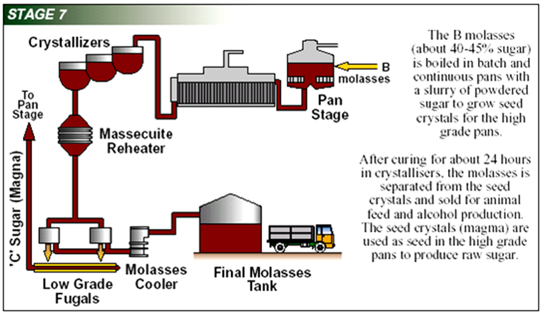
Sugar Crystallisation (cont.)

Slide 32
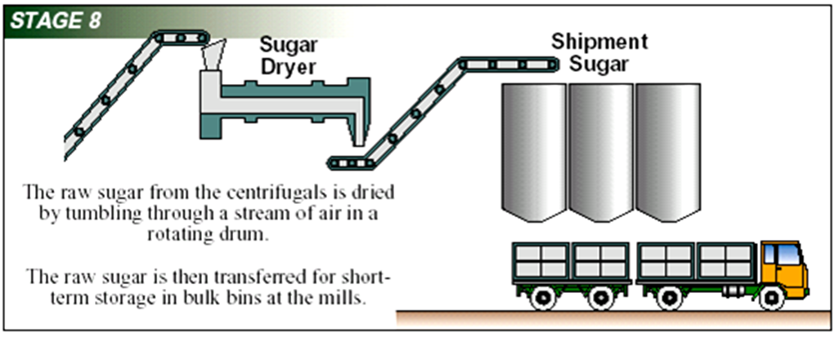
Sugar

Slide 33
Sugar
Sugar from the centifugals is dried and cooled to:
  Reduce microbiological activity
  Prevent caking
Sugar driers can be:
  The rotary cascade type
  The rotary louvre type
  Fluidised bed type
Sugar grains can be of different sizes:
  Mixed grain: Grains of different sizes
  Small grain: May be of the same size but smaller than required
  False grain: After the original grains have grown, new smaller grains form
Dry sugar is sent to the packaging plant

Slide 34
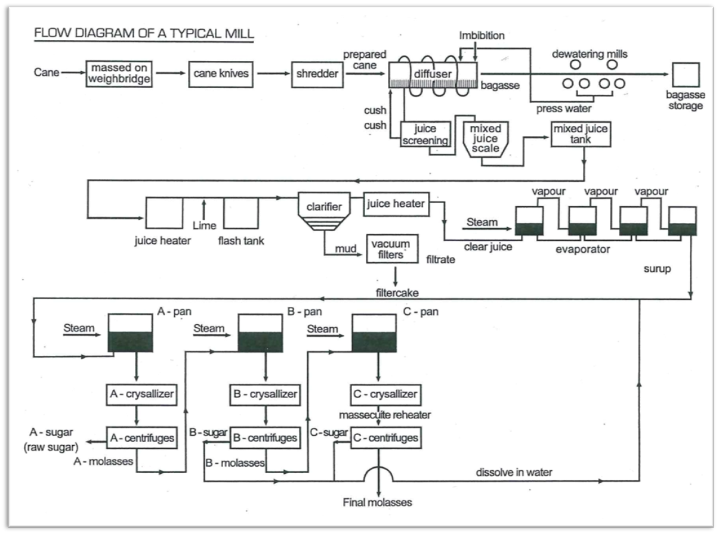
The Flow of Product through the Mill

Slide 35
Instrumentation and Process Flow
The steps in the production of sugar from sugar cane can be summarised as follows:
  Cleaning / Slicing / Juice extraction / Pressing / Purification / Evaporation / Crystallization / Refinery separation / Packaging
At each of these steps sampling and the observation and reading of meters, gauges and recorders are made to monitor the process.
Samples of bagasse, juices and massecuite are constantly taken and sent to the laboratory for analysis.
A well-run factory keeps records and uses these in daily, weekly and monthly reports. Records are kept of:
  Quantities of raw materials
  Processing agents
  Product losses
  Efficiencies of processing and of equipment
  Daily averages of production
  Performance figures

Slide 36
Instrumentation
Instrumentation is the art and science of measurement and control of process variables within a production or manufacturing area.
Process variables used are:
  Level - Pressure
  Temperature - Humidity
  Flow - pH
  Force - Speed
When a device is designed to operate without human intervention it is called automatic control.
The goal of instrumentation and control is to improve:
  Productivity - Optimisation
  Stability - Reliability
  Safety - Continuity
Sensors measure physical quantities and converts this into a signal which can be observed by an observer or by an instrument

Slide 37
Quality
Different measurements are taken at different stages of the process.
At the cane preparation stage:
  The flow rate of the cane towards the cutter – the flow rate will depend on the capacity of the cutter.
  The size of the pieces.
  The thickness of the cane blanket on the conveyor belt should be uniform.
  A representative sample of cane is taken after the shredder and analysed for sucrose content in the laboratory.
At the milling train:
  Before the milling train an electric magnet removes any metallic parts present in the raw material
  The steam pressure of the turbines
  The revolution of the engines (driven by electric motors)
  The lift of the top rollers (controlled by hydraulic devices)
  Mixed juices from the first, second and last mill are sampled and analysed
  Mixed juice (screened to remove fine bagasse particles) leaving the diffuser is massed in the mixed juice scale.

Slide 38
Quality (cont.)
At the juice clarification stage, the following is measured:
  Temperature (should not be too high because higher temperatures speeds up unwanted reactions such as inversion – at low pH – and destruction of reducing sugars – at high pH)
  pH (should always be kept at around 7.0 – 7.2)
  The concentration of the milk of lime is measured with a Beaume Spindle
  The temperature of the juice heaters is measured and recorded.
  The time that the juice remains in the clarifier is measured and recorded – the shorter the time in the clarifier the better.
  Clear juice is sampled and analysed.
  Filtercake is weighed and analysed.

Slide 39
Quality (cont.)
At the evaporators, the following is measured:
  Feed flow rate
  Syrup Concentration (composition)
  Temperature of the juice
  Pressure of the vapour
  Steam flow rate
  Vacuum in the pans
  Steam pressure in the steam chest
  The condensates must be checked for sugar (it is very dangerous to have sugar in the boiler feed-water)

Slide 40
Quality (cont.)
At crystallisation and centrifugal stage, the following is measured:
  Feed controlling
  Brix value
  Concentration (composition)
  Temperature
At the dryers, the following is measured:
  Feed flow rate
  Hot air flow rate
  Moisture

