Slide 1
KNOWLEDGE COMPONENT: MODULE 2: KNOWLEDGE TOPIC 3: SUGAR AND BY-PRODUCTS ANALYSIS

Slide 2
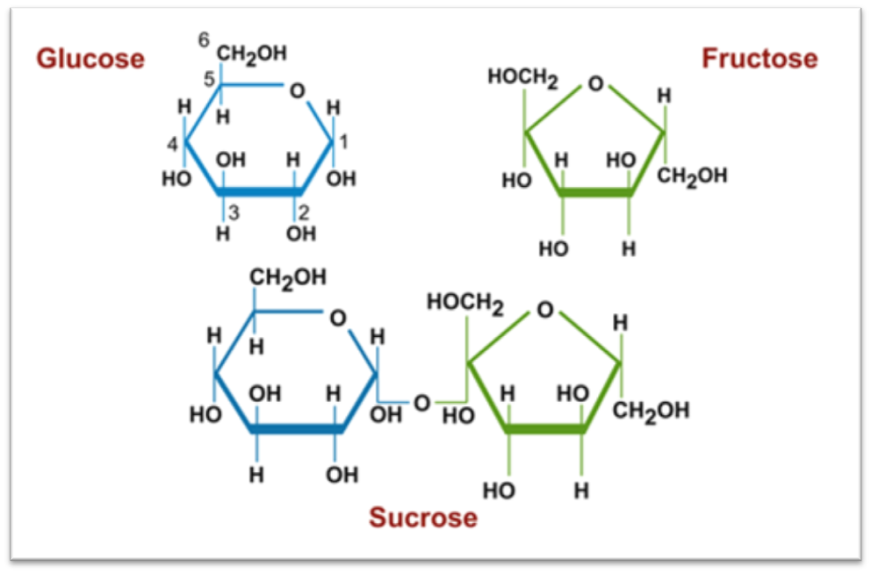
The Structure of Sucrose

Slide 3
Important chemical reactions
Inversion is when sucrose returns to glucose and fructose
Glucose and fructose are called invert sugars or reducing sugars
They cannot be changed back into sucrose and are lost in molasses.
The speed of inversion increases with:
  Increase in acidity
  Increase in temperature
  Increase in time of exposure to the above-mentioned conditions.
Difficult to control all three of the above at all times
A sugar factory is designed to control at least 2 of the 3 at all times

Slide 4
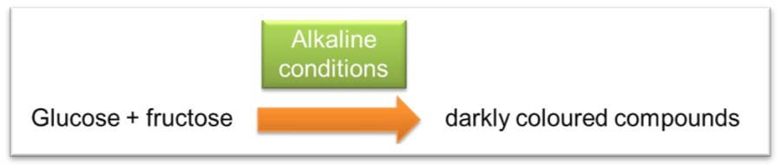
Important chemical reactions (cont.)
Alkaline degradation occurs when glucose and fructose undergo further degradation to yield darkly coloured compounds
These dark compounds result in darkly coloured sugar

Slide 5
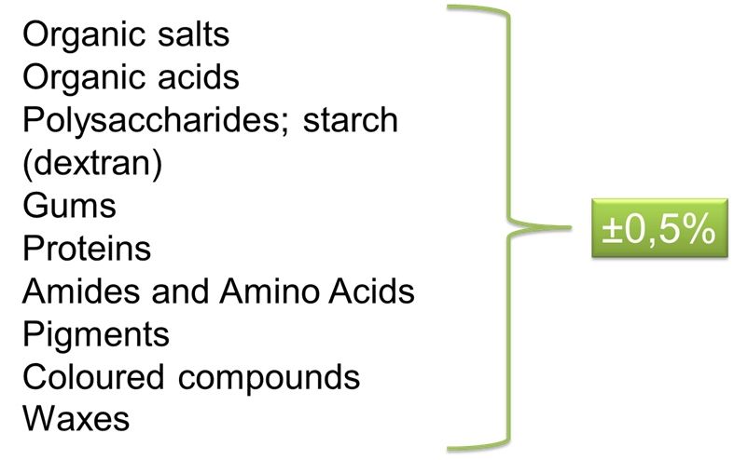
Constituents of Sugar Cane
15% Dissolved substances
15% Insoluble fibre (includes sand)
70% water
DISSOLVED MATTER
Sucrose ± 13%
Other substances ± 2%
OTHER SUBSTANCES:
Other sugars ± 0,9%
Inorganic salts ± 0,6%

Slide 6

% Dissolved Substances (BRIX)
For factory control it is important to know the amount of dissolved substances in every factory stream - juice, syrup, molasses etc.
These dissolved substances are referred to as dissolved solids
Definition: The amount of dissolved substances is given as the mass of dissolved substances per 100g of solution.

Slide 7
% Dissolved Substances (BRIX)
Example:
85g of sugar in 125g water
= 40.5 g of sugar is contained in 100g of solution

Slide 8

Measuring % dissolved substances
% dissolved substances by drying (Dry solids)
This involves evaporating all the water until only the substances contained remain behind in a dry state
Example: 35g of juice is evaporated to dryness leaving 5.25g of solids behind. Calculate the % dissolved substances
= 15% i.e. 15g of dissolved substance in 100g of solution
This is a very accurate method but is time consuming for practical process control purposes

Slide 9
Measuring % dissolved substances
% dissolved substances by refractometer
When light passes from one medium to another, the speed at which the light travels will change depending on the characteristics of the materials through which it travels.
The ratio or change in the speed of light is called the refractive index.
Instruments that measure refractive index are called refractometers
Refractive index of a liquid is related to its concentration
°Brix (Degrees Brix) (i.e. % sugar) is the unit measured

Slide 10
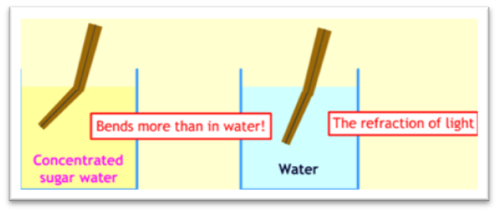
Measuring % dissolved substances
% dissolved substances by refractometer
When light passes from one medium to another, the speed at which the light travels will change depending on the characteristics of the materials through which it travels.

Slide 11
Measuring % dissolved substances
% dissolved substances by refractometer
The ratio or change in the speed of light is called the refractive index.
The change in the speed of light from one medium to another causes the light to change direction (it bends – like a straw in cooldrink)
Instruments that measure refractive index are called refractometers
Refractive index of a liquid is related to its concentration
°Brix (Degrees Brix) (i.e. % sugar) is the unit measured

Slide 12
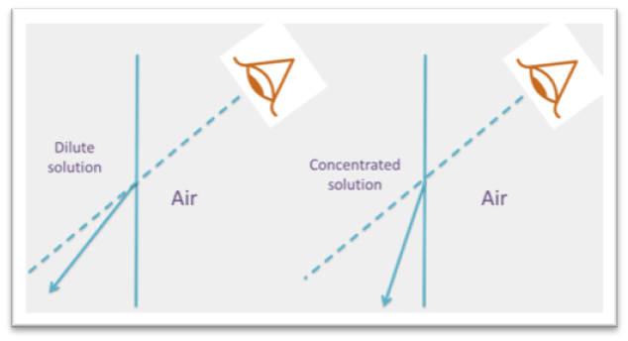
Measuring % dissolved substances
% dissolved substances by refractometer
When light travels from air into a solution the light is refracted towards the normal (the vertical)
The more concentrated the solution the more the light bends towards the normal

Slide 13
Measuring % dissolved substances
% dissolved substances by refractometer
The amount of refraction is proportional to the amount of dissolved substances in the solution
Because of this a scale can be set up using standard concentrations, and a sample compared to those standards
A refractometer can then be used to measure the Brix in unknown solutions
The calibration of a refractometer using standard solutions is explained in the text
Definition: Brix
Brix is the percentage by mass of total dissolved (or dissolvable) substances in a solution.

Slide 14
Measuring % dissolved substances
How Brix is used by factory staff:
Mixed juice brix gives an indication of the amount of imbibition water being used and of the cane quality.
Syrup brix gives an indication of steam pressure, mill crushing rate and the operation of the evaporator.
Massecuite brix will indicate the quality of the pan boiling.
Molasses brix will indicate the amount of water used in the centrifugals.
Brix is used to calculate purity.

Slide 15
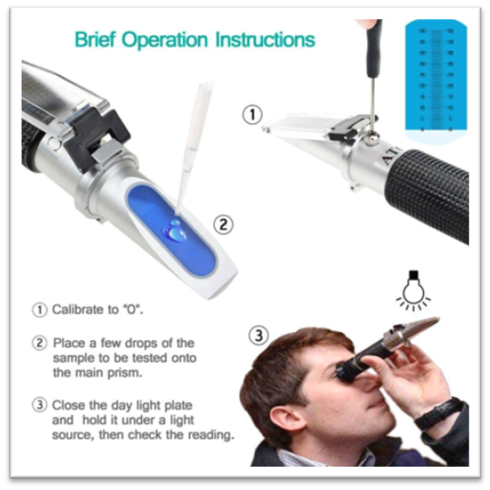
The Refractometer

Slide 16
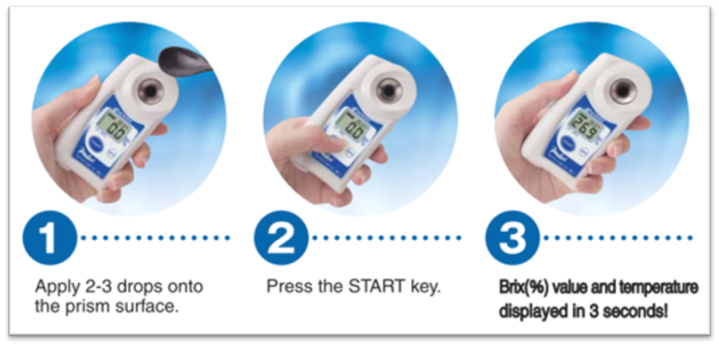
The Refractometer

Slide 17
Parameters affecting Brix
Depending on the solution being measured, treatment before measurement may be required. These include:
  Filtration
  Dilution
Readings must always be taken at 20°C – if not, a correction must be applied (utilising Table 2 of the Laboratory Manual – See Appendix C in the text)

Slide 18
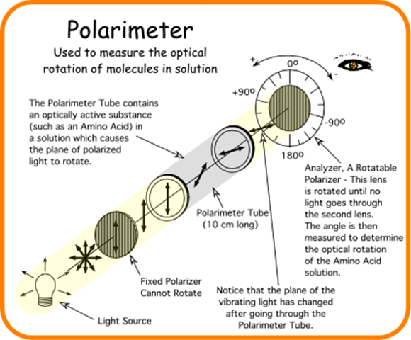
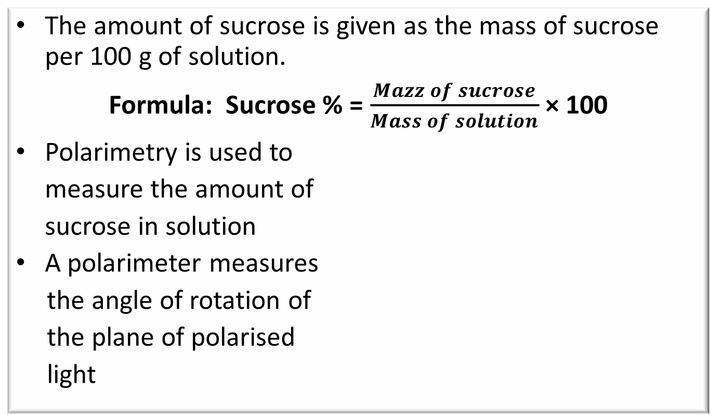
Percentage Sucrose
The amount of sucrose is given as the mass of sucrose per 100 g of solution.
Formula: Sucrose % = $\frac{Mazz of sucrose}{Mass of solution}$ × 100
Polarimetry is used to
measure the amount of
sucrose in solution
A polarimeter measures
the angle of rotation of
the plane of polarised
light

Slide 19
Percentage Sucrose
Many substances have the power to rotate the plane of polarisation
The angle of rotation depends on the amount of sucrose present in the solution
The greater the sucrose % the greater the angle of rotation
The angle of rotation is proportional to the sucrose %
Standard sucrose solutions can be prepared and used to calibrate the instrument
This allows unknown sucrose solutions to be read in the instrument

Slide 20
Percentage Sucrose
However, sugar solutions also contain a small amount of glucose, fructose and other substances which rotate light in different ways
These substances are, however, small, so the effect on the final reading is small
The final polarimeter reading is known as the “pol%”
Because of the presence of other substances the polarimeter reading is slightly lowere than the true sucrose %
Thus pol % is the “apparent sucrose” as given by a polarimeter

Slide 21
Percentage Sucrose
However, sugar solutions also contain a small amount of glucose, fructose and other substances which rotate light in different ways
These substances are, however, small, so the effect on the final reading is small
The final polarimeter reading is known as the “pol%”
Because of the presence of other substances the polarimeter reading is slightly lowere than the true sucrose %
Thus pol % is the “apparent sucrose” as given by a polarimeter

Slide 22
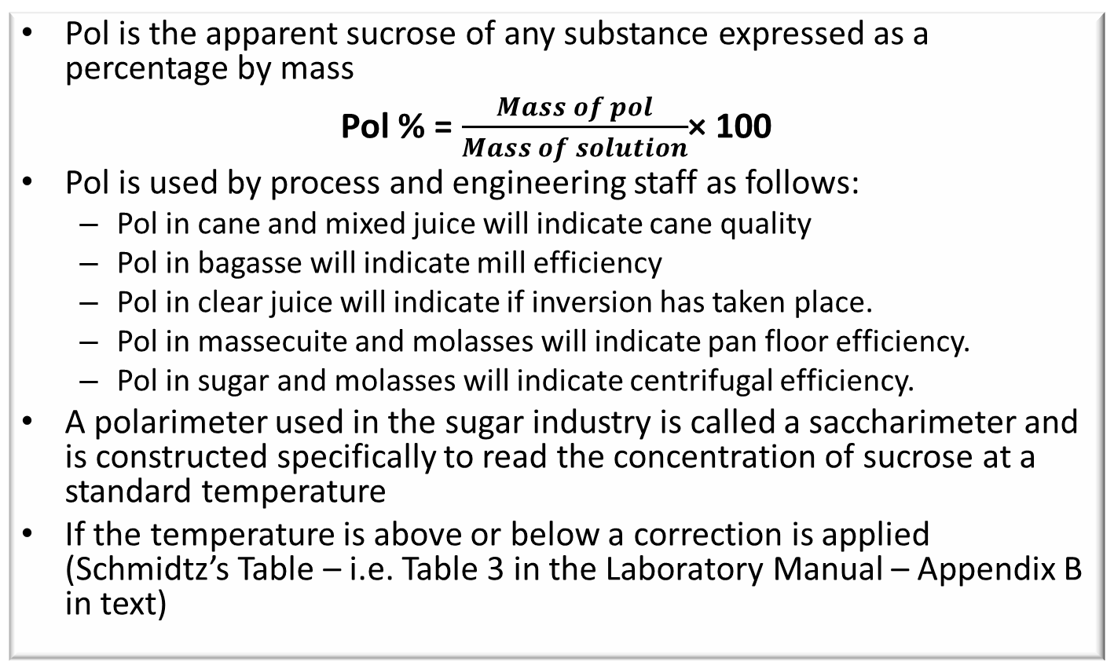
Percentage Sucrose
Pol is the apparent sucrose of any substance expressed as a percentage by mass
Pol % = $\frac{Mass of pol}{Mass of solution}$× 100
Pol is used by process and engineering staff as follows:
  Pol in cane and mixed juice will indicate cane quality
  Pol in bagasse will indicate mill efficiency
  Pol in clear juice will indicate if inversion has taken place.
  Pol in massecuite and molasses will indicate pan floor efficiency.
  Pol in sugar and molasses will indicate centrifugal efficiency.
A polarimeter used in the sugar industry is called a saccharimeter and is constructed specifically to read the concentration of sucrose at a standard temperature
If the temperature is above or below a correction is applied (Schmidtz’s Table – i.e. Table 3 in the Laboratory Manual – Appendix B in text)

Slide 23
Percentage Sucrose
All modern saccharimeters are calibrated in sugar degrees (°Z) which are established so that a “normal” weight of 26.000 g of pure sucrose in 100.00 ml of solution will read 100.00 sugar degree (100.00°Z) in a 2 dm tube.
The saccharimeter thus reads the percentage of 26 g of sucrose that is present in 100 ml of solution (i.e. g/100 ml). The saccharimeter therefore gives a mass / volume reading.

Slide 24
Percentage Sucrose
All modern saccharimeters are calibrated in sugar degrees (°Z) which are established so that a “normal” weight of 26.000 g of pure sucrose in 100.00 ml of solution will read 100.00 sugar degree (100.00°Z) in a 2 dm tube.
The saccharimeter thus reads the percentage of 26 g of sucrose that is present in 100 ml of solution (i.e. g/100 ml). The saccharimeter therefore gives a mass / volume reading.
However, we are not interested in the grams of pol (apparent sucrose) per 100 ml of solution. We require the pol % solution. We need to convert the g pol/100 ml solution to a pol % solution (g pol/100 g solution).
To do this conversion we will need to use the density (g/ml) of the solution.
The conversions required are shown in the text

Slide 25
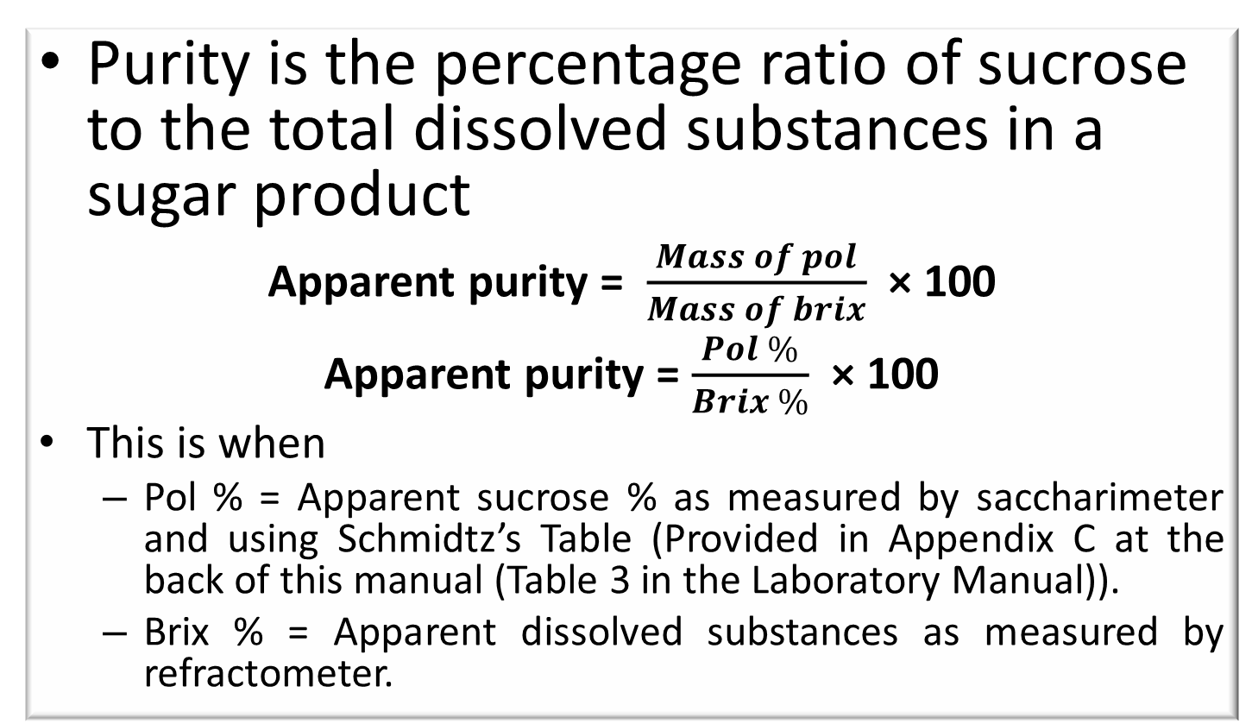
Percentage Sucrose
Purity is the percentage ratio of sucrose to the total dissolved substances in a sugar product
Apparent purity = $\frac{Mass of pol}{Mass of brix}$ × 100
Apparent purity = $\frac{Pol \%}{Brix \%}$ × 100
This is when
  Pol % = Apparent sucrose % as measured by saccharimeter and using Schmidtz’s Table (Provided in Appendix C at the back of this manual (Table 3 in the Laboratory Manual)).
  Brix % = Apparent dissolved substances as measured by refractometer.

Slide 26
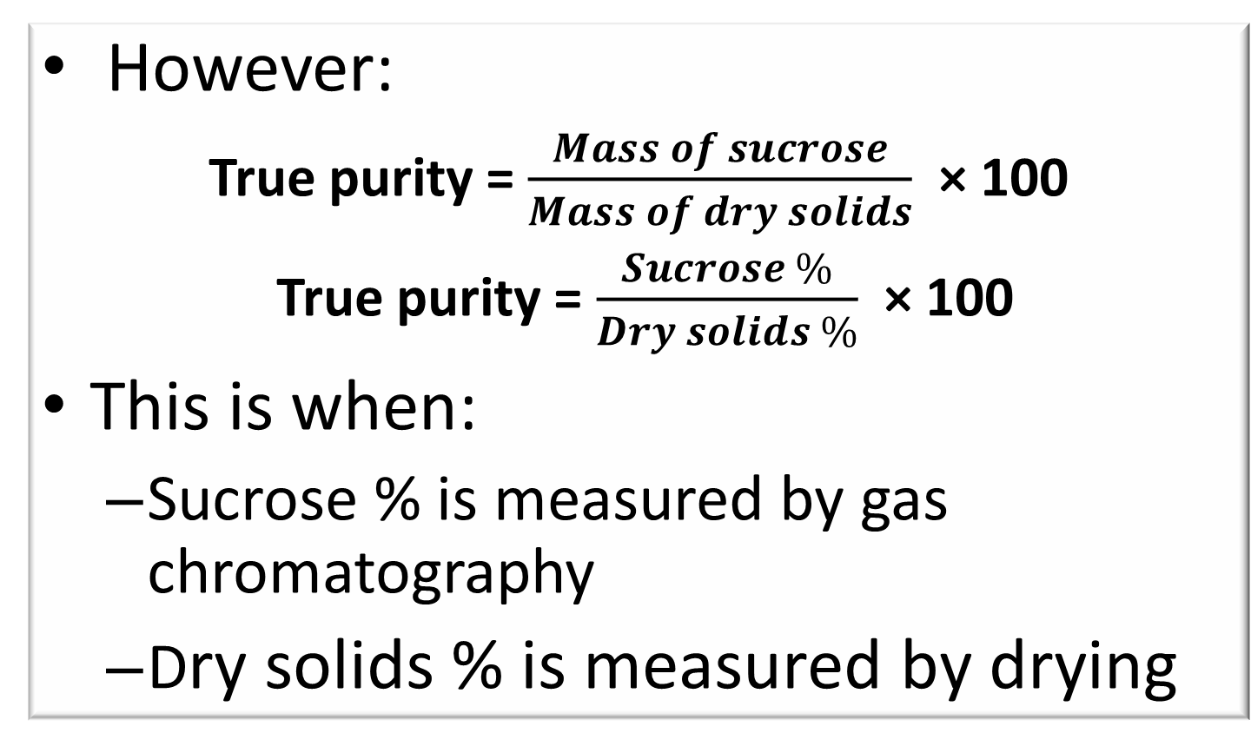
Percentage Sucrose
However:
True purity = $\frac{Mass of sucrose}{Mass of dry solids}$ × 100
True purity = $\frac{Sucrose \%}{Dry solids \%}$ × 100
This is when:
  Sucrose % is measured by gas chromatography
  Dry solids % is measured by drying

Slide 27
Pol Analysis
There are various methods:
  Pol analysis for raw sugars
  Pol determination for juice
These methods are described in the text and should be practiced in the laboratory

Slide 28
Moisture Analysis
All sugar products contain moisture of varying degrees
Approximate values are:
  Molasses (Final) - 18%
  Filter Cake - 78%
  Bagasse - 50%
  Sugar – 0.14%
The final moisture % of sugar is important since the greater the moisture content the greater the risk of spoilage during storage

Slide 29
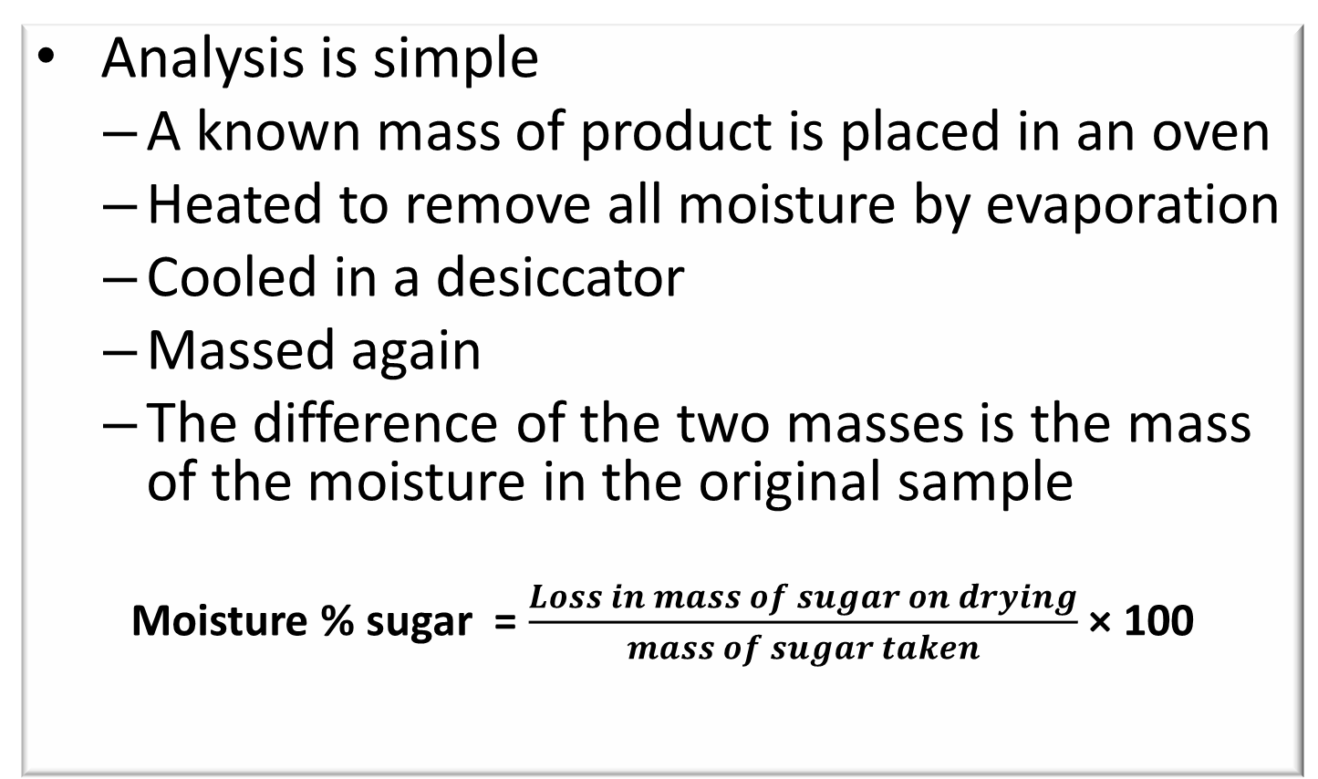
Moisture Analysis
Analysis is simple
  A known mass of product is placed in an oven
  Heated to remove all moisture by evaporation
  Cooled in a desiccator
  Massed again
  The difference of the two masses is the mass of the moisture in the original sample
  Moisture % sugar = $\frac{Loss in mass of sugar on drying}{mass of sugar taken}$ × 100

Slide 30
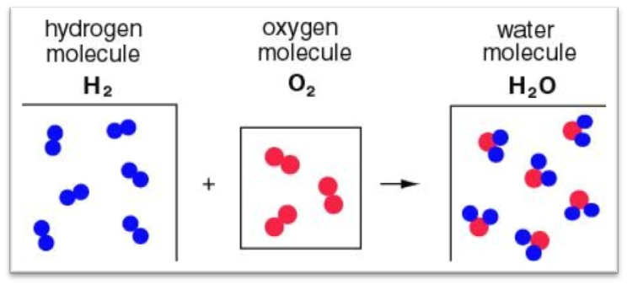
pH Measurement
An atom is the smallest particle of an element
Atoms combine to form compounds, for e.g.
Ions are atoms or combinations of atoms that carry an electric charge e.g. Na⁺ and Cl⁻ or H⁺
If an oxygen atom and hydrogen atom combine to form a hydroxide group and then gets a negative charge it becomes a hydroxide ion
This process is called ionisation

Slide 31
pH Measurement
Water consists of H₂O molecules, but it always contains some hydrogen ions and some hydroxide ions. Each molecule of water that is ionised forms one hydrogen ion and one hydroxide ion.
H₂O → H+ + OH-
In pure water there are equal numbers of H+ and OH-. When this happens the solution is said to be neutral.
When the concentration of hydrogen ions is greater than the concentration of hydroxide ions the solution is acidic.
When the concentration of hydroxide ions is greater than the concentration of hydrogen ions the solution is said to be basic or alkaline.

Slide 32
pH Measurement
The pH scale is a numerical scale from 0 to 14.
The numbers represent the relative acidity of the solution.
The mid-point is 7.0. A solution with a pH 7.0 is neutral.
A solution with a pH less than 7.0 is acidic. The lower the pH the more acidic is the solution.
A solution with a pH greater than 7.0 is basic or alkaline. The greater the pH the more basic/alkaline the solution (Basic means the same as alkaline).
Acids have a sour taste.
Bases / Alkalis have a soapy feel and are bitter.

Slide 33
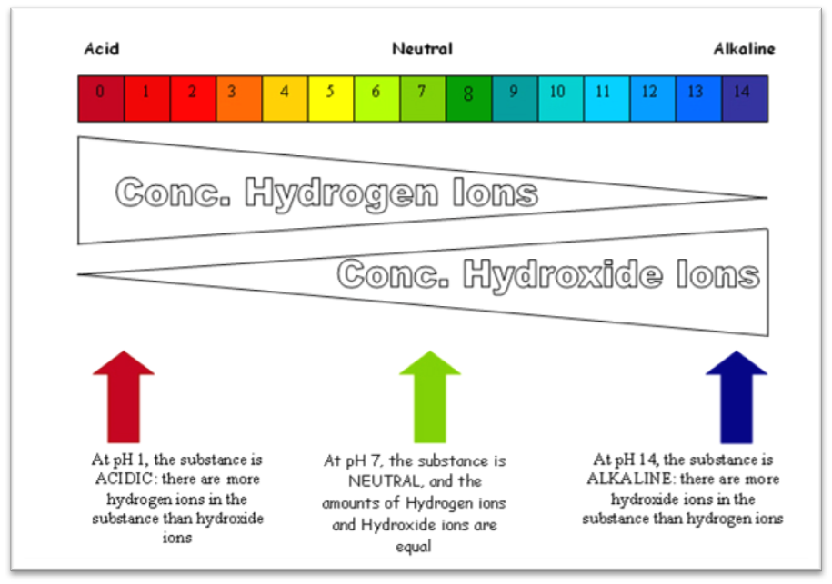
pH Measurement

Slide 34
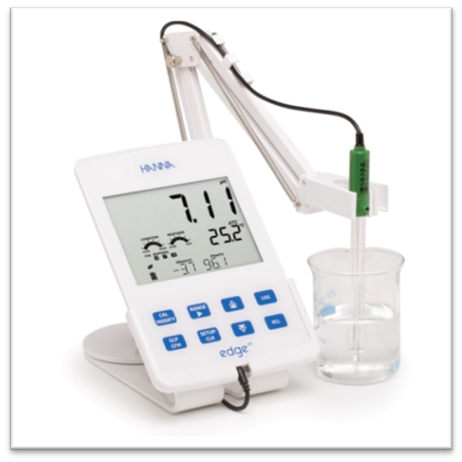
pH Measurement
There are 3 ways of measuring pH:
  Indicator solution
  Indicator paper
  pH meter

Slide 35
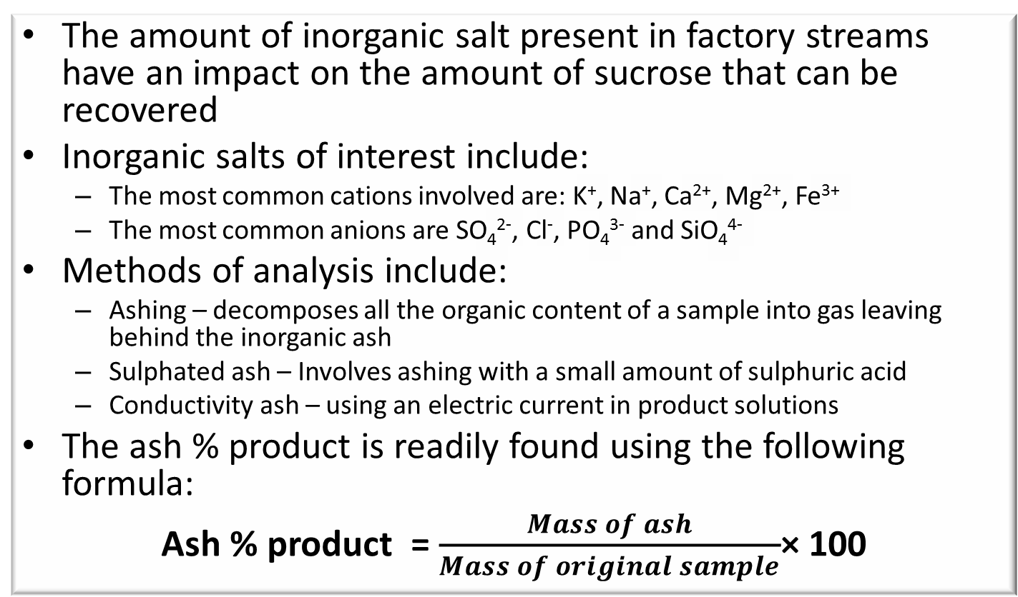
Ash Determination
The amount of inorganic salt present in factory streams have an impact on the amount of sucrose that can be recovered
Inorganic salts of interest include:
  The most common cations involved are: K⁺, Na⁺, Ca²⁺, Mg²⁺, Fe³⁺
  The most common anions are SO₄²⁻, Cl⁻, PO₄³⁻ and SiO₄⁴⁻
Methods of analysis include:
  Ashing – decomposes all the organic content of a sample into gas leaving behind the inorganic ash
  Sulphated ash – Involves ashing with a small amount of sulphuric acid
  Conductivity ash – using an electric current in product solutions
The ash % product is readily found using the following formula:
Ash % product = $\frac{Mass of ash}{Mass of original sample}$× 100

Slide 36
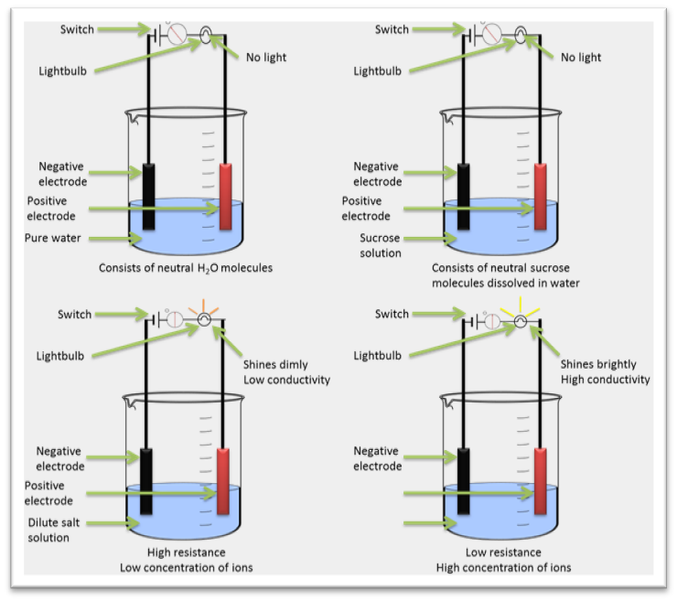
Conductivity Ash

Slide 37
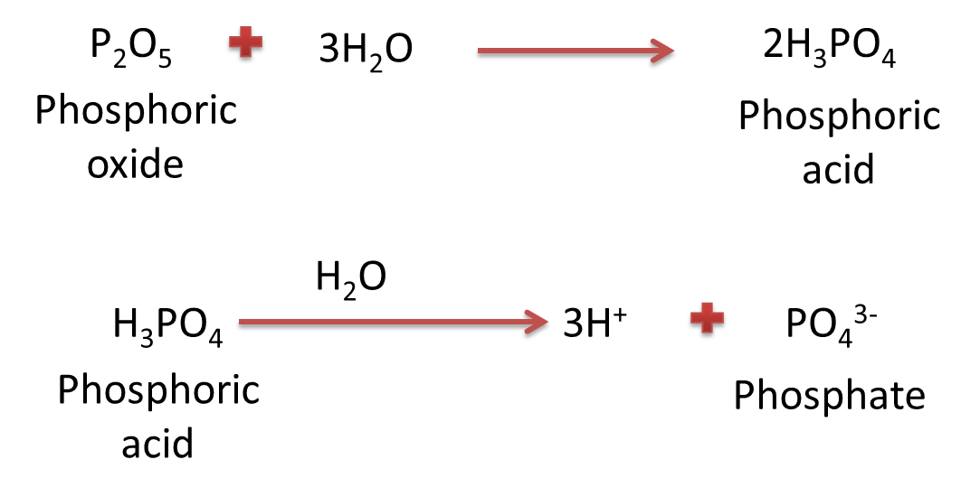
Phosphate Determinations
The phosphate content is the most important factor affecting efficient clarification.
If the phosphate content is below 200 ppm, addition of phosphate in the form of phosphoric acid (H₃PO₄) or phosphoric oxide (P₂O₅) is required.
Phosphoric oxide reacts with water to yield phosphoric acid which in turn ionises to give hydrogen ions and phosphate ions.
The phosphate content of juice (i.e. PO₄³⁻ content) is therefore usually referred to as P₂O₅ content.

Slide 38
Phosphate Determinations
Ammonium molybdate reacts with phosphate present in a solution forming a blue colour
The darker the blue the greater the concentration of phosphate
A standard graph can be prepared
The measurement of optical density using a spectrophotometer can be used to determine the phosphate content by reading off the standard graph

Slide 39
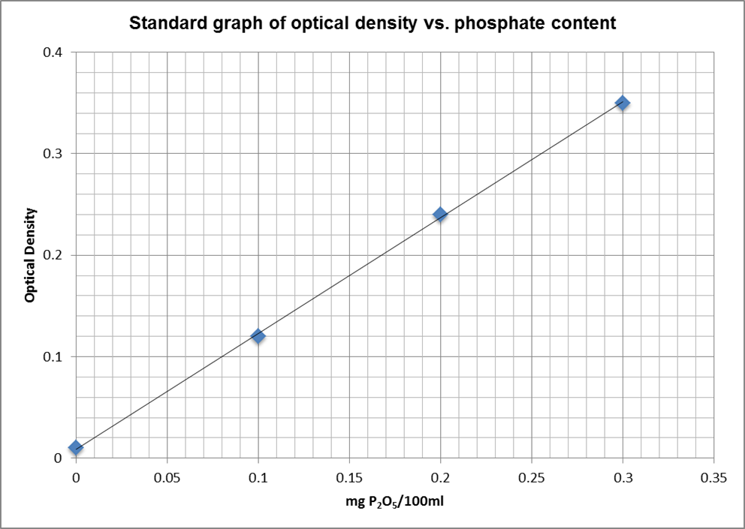
Phosphate Determinations

Slide 40
Colour and Turbidity
Measurement of colour and turbidity (cloudiness) is usually made in clarified juice
The result gives a measure of the effectiveness of the clarification process.
Colour measurements on raw sugars are important for two reasons.
  The raw sugar has to meet certain colour standards before it can be exported
  The higher the colour the greater the cost of refining the sugar
A spectrophotometer is used to measure colour

Slide 41
Colour and Turbidity
Factors affecting the colour of a solution
  Concentration of dissolved substances (Brix) – the more dilute the lighter the colour
  pH (colour can only be compared if measured in solutions with the same pH)
  Turbidity / Clarity (Solutiion must first be filtered to get rid of suspended particles)
  Wavelength of light used (The wavelength used for colour measurement in sugar is yellow – which is closest in the colour spectrum to brown)

Slide 42
Colour and Turbidity analysis
Methods are provided for analysing colour and turbidity in:
  Clear juice
  Unfiltered juice
  Raw sugar
    By spectrophotometer
    By membrane filtration
  Refined sugar

Slide 43
Starch measurement
Starch is a polymer molecule consisting of glucose molecules strung together.
Starch exists in two forms.
  Amylose which is composed of long straight chains containing 200 – 1000 glucose units.
  Amylopectin which consists of comparatively short chains of about 20 glucose units cross–linked (branched).
Starch is insoluble in cold water, but in hot water the granules gelatinise to form an opalescent dispersion.

Slide 44
Starch measurement
Starch is a significant impurity in cane since it persists through the process and is incorporated into the sugar produced.
This is problematic since.
  Penalties are introduced when the starch content of VHP sugar exceeds certain limits.
  Starch causes severe filtration problems in carbonation refineries.
To limit the amount of starch found in sugar, mills usually add an enzyme called amylase to the syrup before the third evaporation stage.
This enzyme decomposes the starch into simpler less problematic compounds.

Slide 45
Starch measurement
Starch content is measured by allowing extracted/precipitated starch to form a blue colour reaction with iodine
The intensity of blue colour is measured with a spectrometer
This absorbancy measurement is compared against a standard graph to determine the concentration of starch

Slide 46
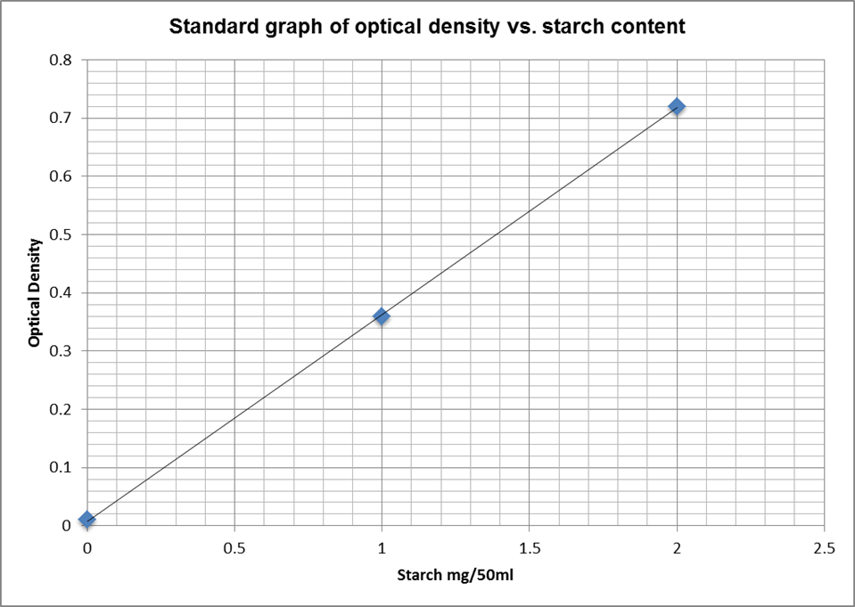
Starch measurement

Slide 47
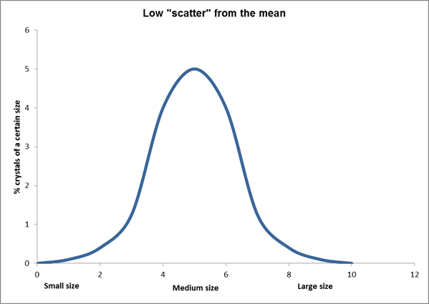
Grain size determination
Crystal sizes vary in any sugar sample

Slide 48
Grain size determination
Uniformity of crystal size is desirable because:
  Increases storage ability - The smaller grains filling the spaces lead to trapped moisture that negatively impacts on the keeping quality of sugar.
  Helps in emptying the centrifugals - Smaller grains fill the cavities between larger grains. Due to the molasses layer around crystals this will cause the crystals to stick together and results in caking.

Slide 49
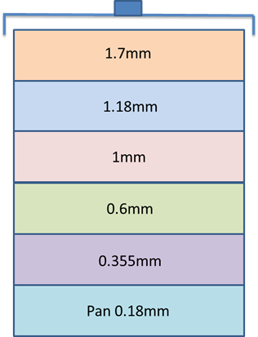
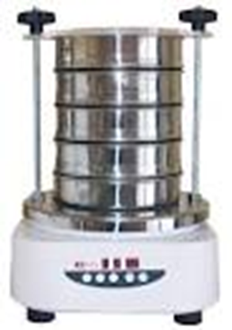
Grain size determination
During a grain size analysis of a sugar sample sieves of different sizes are used to separate the sugar into its different fractions.
The mass of each sieve section is determined by massing each sieve empty and later massing the sieve and sugar fraction it contains.
The mass of sugar on each sieve is then expressed as a fraction of the total mass of sugar.

Slide 50
Reducing Sugar Analysis
Reducing sugars are the products of the acid hydrolysis of sucrose to yield glucose and fructose.
C₁₂H₂₂O₁₁ + H₂O ↔ C₆H₁₂O₆ + C₆H₁₂O₆
Sucrose + Water → Glucose + Fructose
Reducing sugars
The principal chemical methods for determining reducing sugars are based upon the reducing action of these sugars on alkaline solutions of copper
The analysis is characterised by the reduction of blue Cu²⁺ in solution to Cu⁻ which exists as brown Cu₂⁺O²⁻⁻.

Slide 51
Reducing Sugar Analysis
Fehling’s solution is used in two methods:
  Volumetric methods based upon the complete reduction of a measured volume of standard solution that contain a known amount of copper.
  Method in which an excess of copper reagent is employed and either the reduced or unreduced copper determined, with or without previous filtration. In some methods, the reduced copper is estimated gravimetrically by titration or colorimetrically.
Lane and Eynon discovered that methylene blue can be used as an indicator of the end-point.
Thus, a titration is used to determine reducing sugars in juice

Slide 52
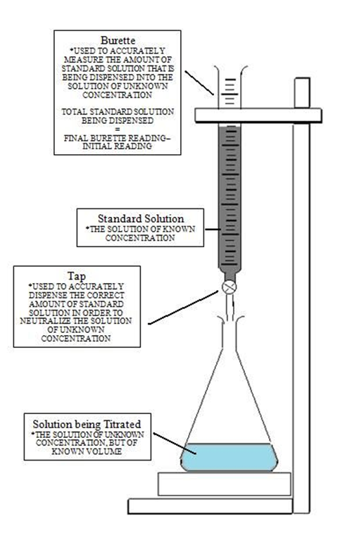
Reducing Sugar Analysis
Titrations are used to determine reducing sugars:
  In juice
  In syrup
  In molasses

Slide 53
Reducing Sugar Analysis to estimate Sucrose content
The only method to accurately determine the sucrose content of a sample is by using gas or liquid chromatography.
However, it is possible to obtain a very good / approximation by the following procedure:
  Determine the reducing sugars % sample.
  Invert all the sucrose in the sample by heating and acidifying
  Determine the reducing sugars % inverted sample
Sucrose % sample
= Reducing sugars % inverted sample – Reducing sugars% sample

Slide 54
Sugar Trace Analysis
Sugar can be lost in various ways in a sugar factory.
Any sugar lost is not recoverable and is a direct loss financially.
  Steam is used in heat juice, syrup and massecuites.
    In the vessels where this heating is done a leaking tube could mean that sugar would contaminate the condensate and be lost.
    If the condensate was to be used as boiler feed water damage could result to the boiler due to scaling and corrosion.
  The cooling tower water used to condense the vapour from the evaporator and pans could be contaminated by entrainment (carry-over).
    The presence of sugar in the cooling water leads to the growth of bacteria causing a loss of efficiency in the cooling tower.
  Spillages washed down the drain cause pollution of streams and rivers and fish and plant life die leading to environmental degradation and prosecution by the Government.
The checking of factory waters for traces of sugar is important and should be done regularly.

Slide 55
Sugar Trace Analysis
There are 3 different methods of analysis:
  The Alpha-naphthol test
  Qualitative method
  Quick and easy
  Ideal for routine checks
  Only to show whether sugar is present or not.
  The quantitative methods - give the actual amount of sugar present:
  The phenol-sulphuric acid method
  The resorcinol method.

