Slide 1
KNOWLEDGE COMPONENT: MODULE 4: SUGAR JUICE EXTRACTION: KT 1: DEFINITIONS AND COMPOSITION

Slide 2
Background
The receiving of cane and the extraction of juice is the first step in the process of sugar manufacturing from sugar cane.
The steps involved in sugar juice extraction include:
  Cane receiving, handling and conveying
  Cane preparation
  Milling
  Diffusion
  Juice screening
  Juice massing
  Bagasse handling

Slide 3
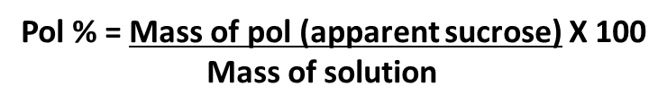
Definitions and Equations
CANE: The raw material delivered to the factory.
SUCROSE: A disaccharide with the formula C₁₂H₂₂O₁₁
BRIX : The percentage by mass of the dissolved substances in a sucrose solution.
POL %: The apparent sucrose content of a substance expressed as a percentage.
The pol % is not equal to the sucrose % but is easier to analyse and is used for routine control purposes. For mixed juice the pol % is very close to the sucrose %.
PURITY: The percentage ratio of pol to brix of a solution.

Slide 4
Anatomy of Cane
The cane stem consists of:
  Outer rind of thick walled cells
  Softer parenchyma tissue and vascular bundles within
The rind and vascular bundles constitute the fibrous portion of the cane stalk
Parenchyma tissue makes up the pith
The fibre and pith together make up the fibre as analysed in the laboratory
The parenchyma cells contain the rich juice
The lower purity juice is found in the relatively strong vascular bundles.
These vascular bundles carry nutrients between the roots and leaves of the plant

Slide 5
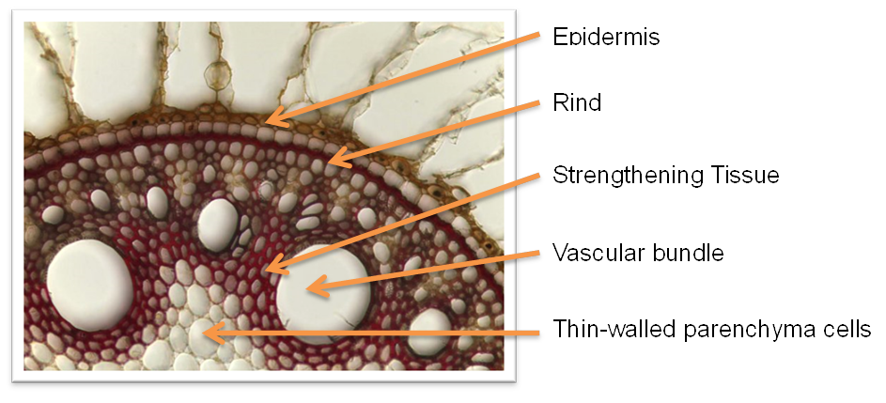
Microscopic cross-section of sugarcane

Slide 6
Composition of Cane
Dissolved substances - 15% (Brix %)
Insoluble substances - 15 % (Fibre %)
Water - 70% (Moisture %)
The insoluble substances include foreign matter like sand clinging to the cane.
The dissolved substances in cane can be divided into the following categories:
  Sucrose ± 13% (Pol %)
  Other substances ± 2% (Non-Pol %)
    Other sugars (mainly glucose and fructose) ± 0.9% (Reducing Sugars %)
    Inorganic salts ± 0.6 % (Ash %)

