Slide 1
KNOWLEDGE COMPONENT: MODULE 4: SUGAR JUICE EXTRACTION: KT 3: CANE PREPARATION

Slide 2
Cane Preparation
Cane is prepared by using cane knives followed by a shredder.
Transforms the bulky volume of cane to a mat of more uniform thickness.
Increases throughput and extraction.
Ruptures most of the cells and renders the juice available for extraction.
Diffusers require good shredder preparation to achieve good percolation
Coarse knifing and fine shredding are beneficial to good percolation - results in longer “string-like” fibres that promote percolation.
The role of the cane knife is that of a device to ensure that the shredder is evenly fed and that no conditions exist that could cause choking.
It is not a specific purpose of knifing to rupture cells.

Slide 3
Role of Cane Knife
Serves as levellers or pre-breakers in order to facilitate the operations of the shredder – just enough to prevent shredder chokes.
Knives have been removed completely where the incoming cane is very clean or uniform, such as in the case of burnt cane, or if it was chopper-harvested or both.
Knife sets used in South Africa varies between zero and three.
The cane knives as used in South Africa are therefore seen to have four different roles:
  Leveller mounted on the main cane carrier to facilitate feeding into the main cane knives.
  Primary knives to prepare the top layer of cane.
  Main knives to complete the knifing operation.
  Feed knives or “kicker” mounted above the shredder, to break up lumps in the feed and to accelerate the cane blanket into the nip of the shredder. It also probably assists the shredder by cutting the cane slightly more than the last knife.
No mills have all four types of cane knife together

Slide 4
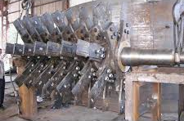
Cane knives
Consists of a horizontal shaft mounted across the cane carrier.
Which has keyed hubs (palms) to which the knife blades are attached (usually bolted).
Alternate hubs are usually offset by 60º giving a spiral effect.
The blades can be either fixed or swing blades. Swing blades are mainly used when there are a lot of rocks in the cane.
A set of cane knives consists of 40 to 80 blades spread at about 25 mm.

Slide 5
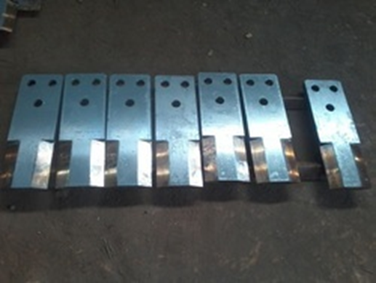
Knife Blades
Consists of a plate about 20 mm thick with a mass of between 12 and 20 kg.
A typical blade is roughly 400 mm x 100 mm x 20 mm.
The cutting edge is provided by forging or gas cutting a chamfer on the leading edge and the end.
The flat face of the knife is covered with a layer of hard facing which reinforces the cutting edge against wear.
As the steel backing wears away, the layer of hard facing remains to provide a fairly sharp edge.
The wear on the blades is considerable and depends very much on the sand in the cane.
Worn knives are replaced and subsequently refurbished.

Slide 6
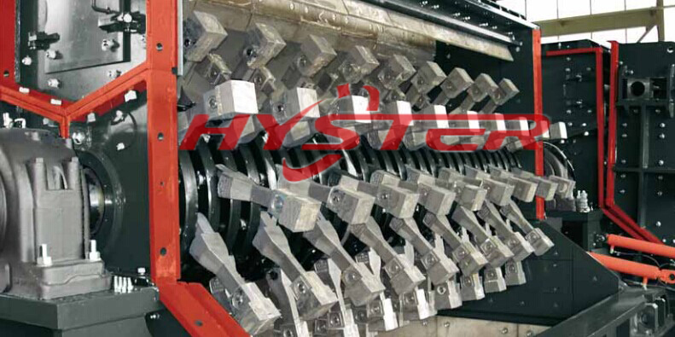
Cane Knives
A shredder hammer configuration

Slide 7
Types of Cane Knives
Cane leveller knives - Their purpose is to spread the peaks in the feed so as to maintain an even feed to the main cane knives.
First knives (Primary cane knives) -These knives do the initial preparation of the cane and they densify the feed to the main set of cane knives.
Heavy duty knives (Main knives) - These knives provide a close, even feed to the shredder with a minimum of large uncut stalks.
Kicker knives - These are involved in feeding the shredder with cane.

Slide 8
Cane Shredding
To maximise rupturing of sucrose bearing cells without “pulping” the cane fibres.
  To increase capacity of the extraction plant by increasing the bulk density of the feed.
  To assist extraction by breaking down the structure of the cane.
  To render the juice in the cane more available for the action of imbibition.
Tears the cane pieces coming from the knives into shreds without extracting any juice.
Can be fed directly to a milling tandem for juice extraction (shredding is far more efficient than milling at breaking down the structure of cane into fine particles).
In cane from the shredder, the sucrose % is higher in the fine particles (large pith) than in the large particles (including rind). However, by the end of the milling tandem the sucrose % in the fine particles is lower than in the larger particles. This shows that sucrose is more readily extracted from the fine particles. The same results hold true for diffusers.

Slide 9
Shredder Construction
A shredder consists of a shaft with a number of discs (profiled plates) attached.
Rods run through these discs parallel to the length of the shaft.
These rods carry the hammers.
The main shaft rotates at high speed and this makes the hammers stand out radially due to centrifugal force.
The cane pieces are shredded between the rotating hammers and a fixed washboard (gridplate) consisting of rectangular bars (grid bars).
Most South African shredders are 2130 mm wide (some are wider) with a swept diameter of either 1525 mm or 1780 mm.
Most have eight rows of hammers although some of the 1780 diameter units have ten rows.

