Slide 1
KNOWLEDGE COMPONENT: MODULE 4: SUGAR JUICE EXTRACTION: KT4: MILLING

Slide 2
Milling
Essentially a solid-liquid separation process.
The solids are fibre (i.e. insoluble material) and the liquid is a solution of brix in water called mixed juice.
The purpose of milling is to effect this separation as effectively and efficiently as possible.
Milling involves squeezing the prepared cane between rollers to remove the juice.
The process of separating cane into fibre and juice is termed extraction and this performance figure is calculated as follows:
EXTRACTION = Tons pol in mixed juice x 100
Tons pol in cane
Milling achieves extractions of 96 - 97 % of the Pol (apparent sucrose) in the cane.

Slide 3
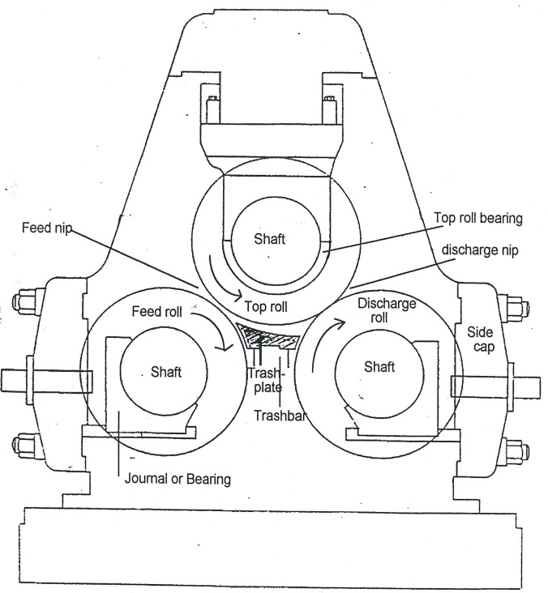
The 3-Roller Mill
Consists of 3 horizontal rollers arranged at fixed centres in a robust housing.
The shafts of the rollers rest in bearings located in the housing.
The 3 rollers are termed the top roll, feed roll and discharge roll.
Prepared cane/ bagasse is fed through the bagasse chute into the opening between the feed and top rolls for the first squeeze.
A trash-plate mounted on a trash bar (“dumbturner”) is located under the top roller and it turns the bagasse and allows the bagasse to enter the opening between the discharge and top rolls for a second squeeze.
The juice expelled is collected under the mill in a trough.

Slide 4
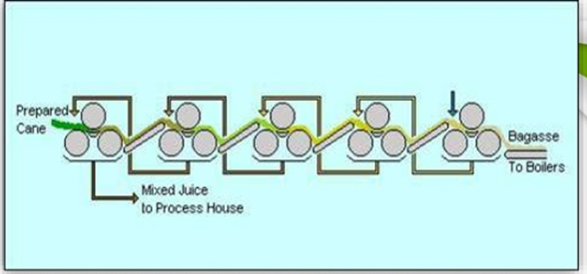
A Milling Arrangement – A Mill Train

Slide 5
Roller Grooving
The purpose of grooving is threefold:
  To increase the capacity of the mill by increasing the surface area.
  To break up the bagasse even more due to shearing/tearing effect of the rollers on the bagasse.
  To provide passages for juice drainage.
There are 3 types of roller grooving:
  Circumferential grooving
  Chevron grooving
  Messchaert or Juice Grooving
For the juice groove to function properly it must be kept free of bagasse. Scrapers are provided to keep the grooves clean. The scrapers are situated below the bagasse exit chute so that the fine, juice rich bagasse particles are dropped into the juice tray and are not removed with the bagasse.

Slide 6
Scraperplates
The top and discharge roll have scrapers fitted to clean the grooves of these rolls.
Scrapers are flat plates with teeth arranged to suite the roll grooving.
They are usually made from mild steel and are protected against wear by means of hard facing.
The angle of attack between scraper and roll should be about 13°.
A smaller angle runs the risks of flipping of the scraper.
Where juice grooves are being used special Messchaert knives are installed for the cleaning of these grooves.

Slide 7
Trashplate
Turns the bagasse into the discharge nip
Does not exert pressure on the bagasse.
The trash plate is mounted on a large beam which spans the width of the mill and which in turn is carried on adjustable supports so that the angle, height and horizontal position of the trash plate can be easily adjusted.
The top surface of the trash plate is hard faced by arc welding using proprietary rods or wire. The two factors that cause excessive wear are over-tightening and bad setting.
The trash plate keeps the grooves of the feed roll clear of fibre and this acts as a scraper for that roll.
The trashplate is supported and fixed on a tapered wedge.
The upward force exerted by the trashplate on the top roll makes a small angle of about 10º with the vertical towards the discharge side. This ensures a positive pressure from the trashplate onto the feed roll during operation.

Slide 8
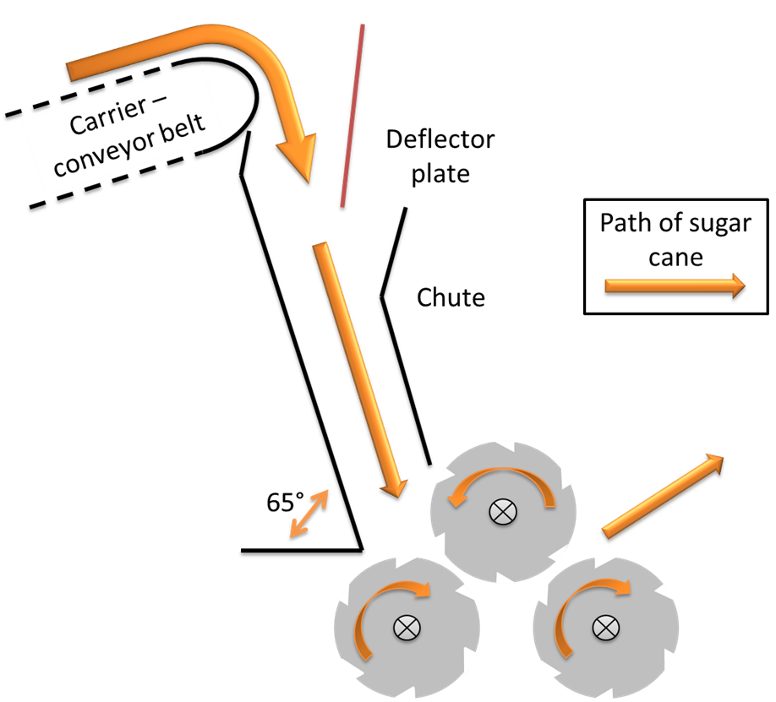
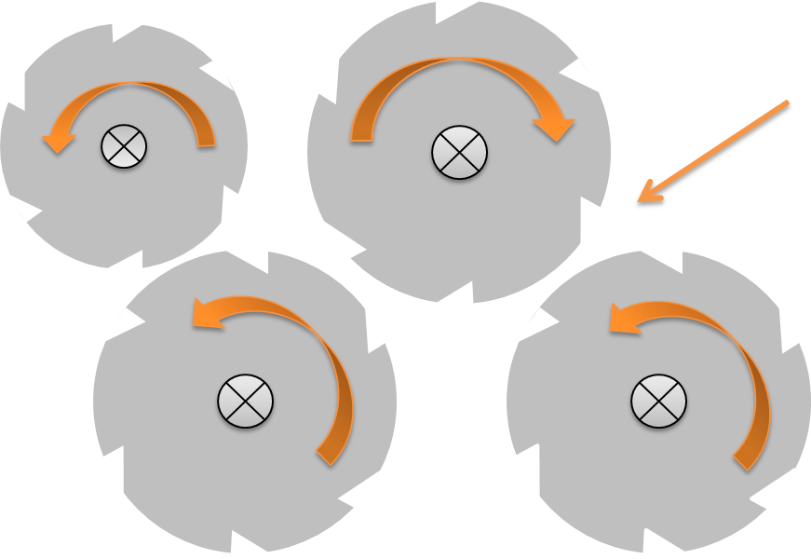
Feeding Devices
Donnelly chute Underfeed Roller

Slide 9
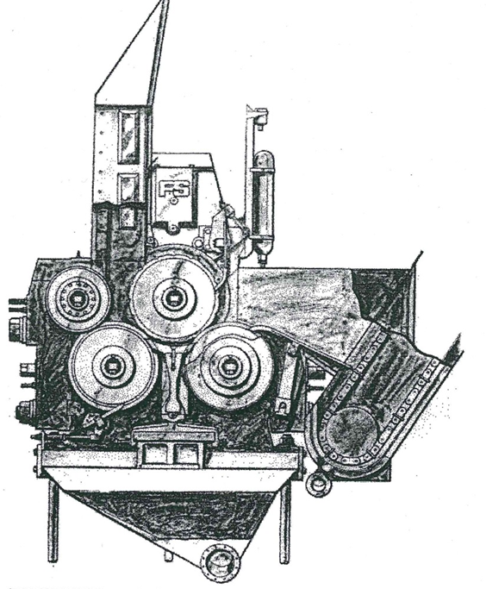
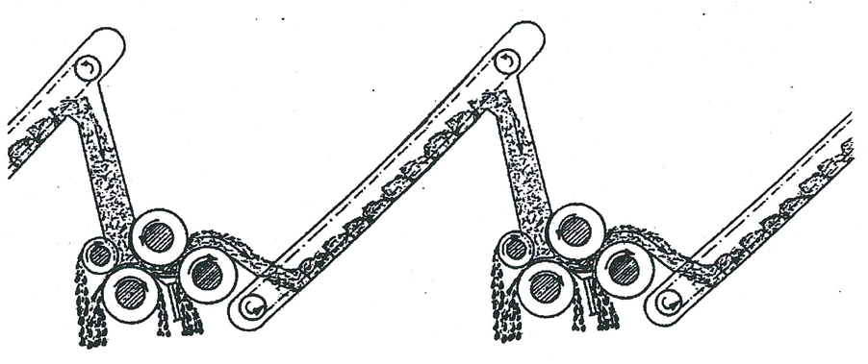
4 Roll Mills

Slide 10
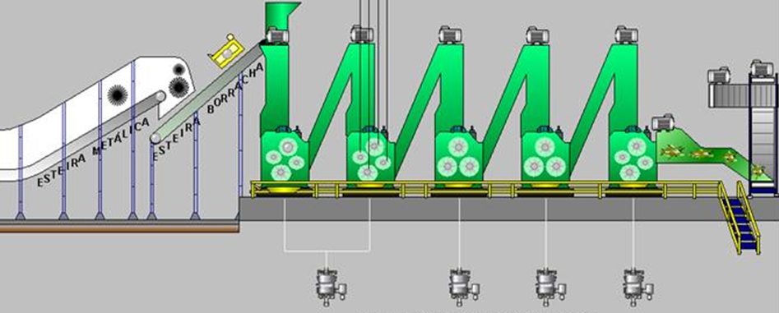
4 Roller Milling Train

Slide 11
Bearings
The bearings supporting the roller journals are of the hydrostatic or sliding type.
Made from bronze, or alloy made from copper and tin.
More recent bearings are made from steel with a bronze or white metal lining.
The bearing must be lubricated to minimise metal contact.
Oil is fed into the bearing via an oil groove situated about 45° ahead of the extreme pressure point.
Special oils (e.g. ASMR by Castrol) have been developed for the lubrication of mill bearings.

Slide 12
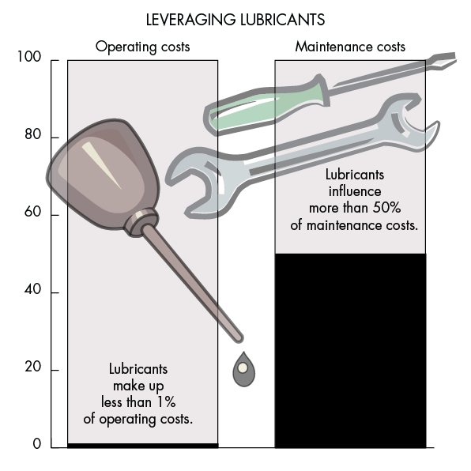
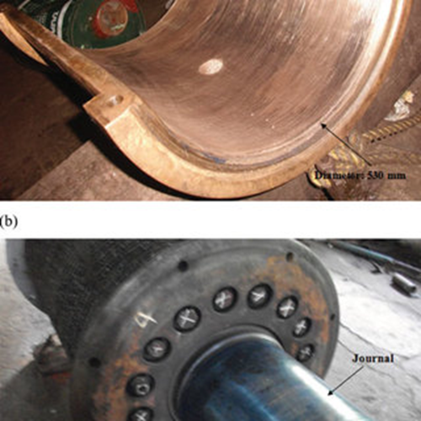
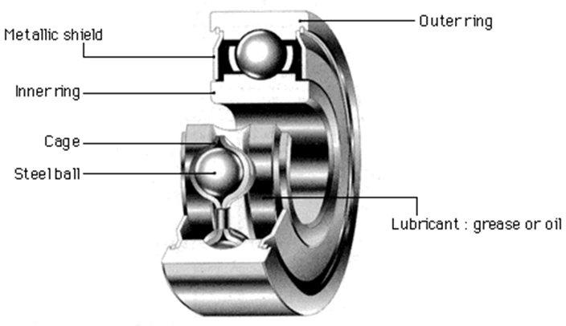
Bearings

Slide 13
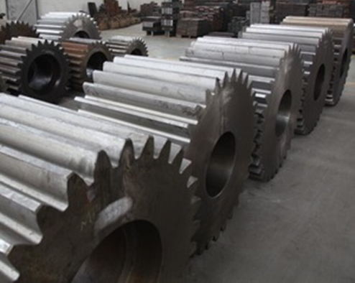
Settings
Mill lift
Mill speed
Pinion reaction
Mill settings
Settings on feeding devices
Trashplate settings

Slide 14
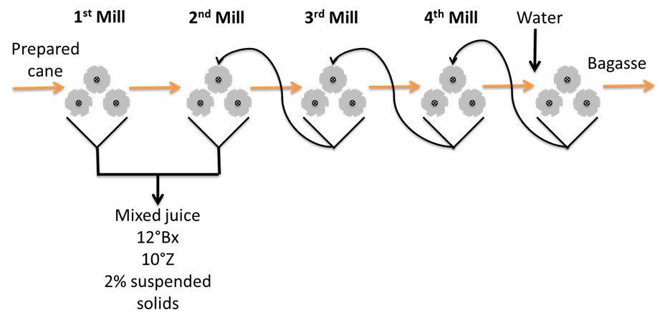
The Milling Tandem
In South Africa usually consists of 3, 6 or 7 milling units
Shredded cane is fed into the first mill and via intercarriers into the following units
Final bagasse leaves the last mill.
The expressed juice from the first and second mill is screened before it is pumped away as mixed juice for further processing.
The “cush cush” (insoluble solids from the juice screens) is usually washed into the number 1 intercarrier by the maceration juice from 3 mill.
The juice from the other mills is pumped into the intercarriers of the proceeding mills as imbibition juice.
Imbibition water is applied in front of the last mill.
The first and last mills are usually pressure fed mills while the mills between are usually 4 roll units.

Slide 15
Imbibition
Even after repeated squeezes the liquid (juice) in bagasse will be 40% at best.
This means that with dry crushing the limit of extraction is very soon attained and is not more than about 80%.
To improve on this extraction, water needs to be added to displace and dilute the liquid in the bagasse.
This process is called IMBIBITION.
If this water is added between each mill it is called simple imbibition.
This would however use a lot of water which later has to be evaporated in the evaporators.
To reduce the evaporator load, water is only added before the last mill while the expressed juice from the individual mills is pumped and added to the bagasse at a point in front of the preceding mills.
This is called compound imbibition.

Slide 16
Imbibition (cont.)
The imbibition rate is expressed as a percentage of fibre in bagasse and is, for a milling tandem, between 250 and 350%.
It is important to note that a 10% reduction in imbibition will reduce the quantity of mixed juice by only 3%.
The water must be distributed laterally across the bagasse in the last intercarrier.
The water and juice is usually applied using some sort of splash or deflector plate.
The water should be as hot as possible without causing a feeding problem (At high temperatures the fibre becomes “plastic”)
In this state it is easy to compress and so there will be better juice expression.
On the negative side high temperatures melt the waxes which cause slippage problems on feeding.

Slide 17
Imbibition (cont.)
The mixing of bagasse and water does not take place in the carrier.
Mixing is done in the feed opening as the increasing pressure forces the liquid into the fibre.
The process of adding water to the bagasse to improve extraction is sometimes wrongly called maceration.
Maceration is the process whereby the bagasse is totally immersed in water. Clearly this is not the case with imbibition.
Bagasse fibre is capable of absorbing ± 650% of its mass as liquid.
Under operating conditions it is not advisable to go above 350% on fibre as the improvement in extraction is negligible and the extra water overloads the clarifiers and evaporators.

Slide 18
Imbibition Efficiency
The water (or diluted juice) must be evenly distributed through the bagasse layer.
Maximum penetration of the layers must take place.
The bagasse must be finely prepared.
The first mill extraction must be good.
The weight of the water used varies from 45 to 60% of the weight of cane or 300 to 400% of fibre in cane. In practice the amount of imbibition is usually limited by:-
  The mill itself i.e. juice capacity, drainage etc.
  Juice heater and evaporator capacity.
  Steam balance of the factory.

Slide 19
Source of Imbibition Water
Provided by condensate from the lower level effects of the evaporator
Would be available at a temperature of 70 – 80°C
It is theoretically beneficial for extraction to use hot imbibition, because hot water will dissolve sugar more readily and will tend to break down cell walls to expose sugar inside the cells.
This does introduce some difficulties, such as slippage and excessive vapour, but they can be overcome.
The main reason that more mills are able to use hot imbibition is the improved roller roughening technique since the mid- 70’s, using a new type of welding rod developed in Australia.

Slide 20
Brix Gradient
The brix gradient down the milling tandem means that the imbibition applied at a point has a lower brix than the bagasse at that point.
To maintain this basic gradient it is important that the imbibition juices be pumped to the appropriate mill, with no by-passing or short circuiting occurring.
This would change the “dissolving effect” of the imbibition and performance (extraction) would suffer.

Slide 21
Capacity Rating of a Tandem
Expressed as the quantity of cane the tandem is able to crush per unit time (tons cane per hour)
Capacity is influenced by:
  Fibre % cane
  Dimensions and speed of rollers
  Length of the tandem
  Preparation equipment
  Imbibition
  Grooving and surface conditions of the rollers
  Hydraulic load
  Uniform feeding
  Drainage
  Design and condition of the plant
  Personnel

Slide 22
Control and Instrumentation
The following variables are visible to the operator on the control panel:
  Mill speed
  Donnelly chute feed height
  Roll lift
  Hydraulic pressure
  Steam pressures and temperatures
  Pump and conveyor motor amperages
  Feed conveyor speed
  Preparation equipment speeds amperages
  Imbibition water flow and temperature

Slide 23
Pumping and Circulation
Juice collected in the tray below each mill is pumped onto the bagasse being fed into the previous mill..
The juice collected in the trays is full of fibrous material coming from the cane, which would tend to choke pumps and piping if not dealt with properly.
Juice is collected in a “swirl tank” next to the mill, which keeps the material in suspension.
The pumps are “chokeless”, having simple, open impellers.
All the piping is designed to minimise choking.
The swirl tanks are provided with overflow channels so that they will overflow to a previous mill if the pumps cannot cope with the flow for any reason.
In this way, juice is not wasted.
If overflow occurs, the pumps must be quickly brought back into service, otherwise mill performance will suffer.

Slide 24
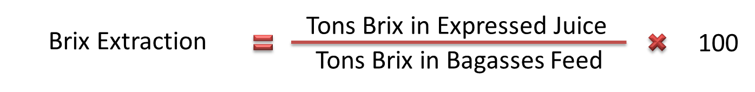
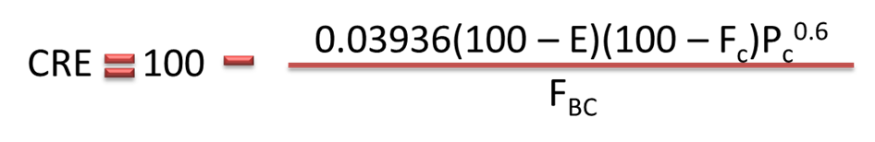
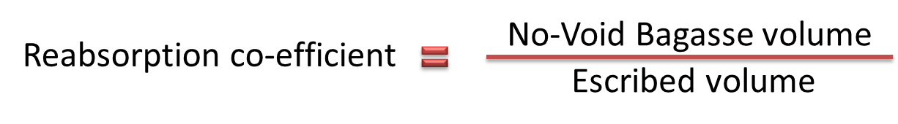
Performance Indicators
Brix Extraction
Corrected Reduced Extraction
Reabsorption

Slide 25
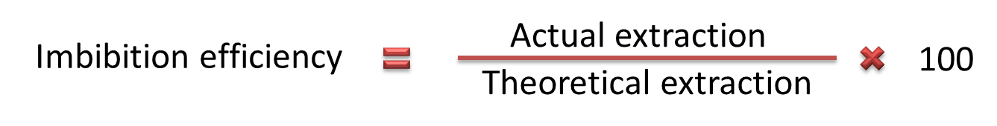
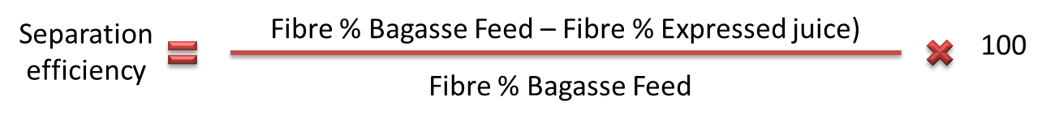
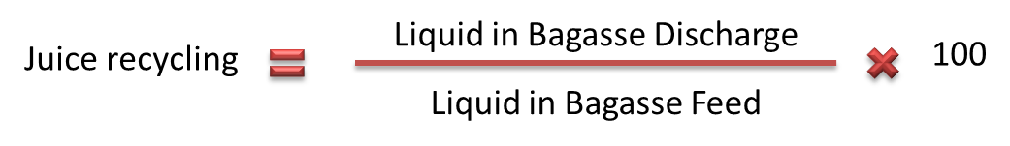
Performance Indicators (cont.)
Imbibition efficiency
Separation Efficiency
Juice recycling

Slide 26
General Milling Data
Description
Cane (t) | 250.00
Brix Cane (t) | 14.00
Fibre Cane (t | 15.00
Imbibition% Juice | 300.00
Brix Mixed Juice (%) | 12.05
Fibre Mixed Juice (%) | 0.98
Brix bagasse (%) | 1.65

Slide 27
Comparison of mixed juice and cane purity
The purity of mixed juice is about 86% as compared to cane at about 85%.
The purity of mixed juice is approximately 1% higher than that of cane because the sucrose in cane is more readily/easily extracted in relation to the non-sucrose.
The fact that sucrose is preferentially extracted is also clearly evident when we compare the purity of bagasse at about 50% with that of cane.
At moderation extractions the ratio of sucrose extracted to non-sucrose extracted is relatively large and the purity of the juice obtained will be high.
If the extraction is high, the amount of non-sucrose extracted relative to sucrose increases and the resultant purity decreases slightly.

Slide 28
Sucrose Degradation during Extraction
Sucrose stored in the cane cells is subject to degradation before it is crushed due to the action of naturally occurring enzymes in the cane stalk.
As soon as the cane is crushed the expressed juice comes into contact with adhering extraneous matter and becomes contaminated with soil bacteria.
These bacteria commence growing using the sucrose for their growth.
The first step in bacterial metabolism is the conversion of sucrose to reducing sugars using enzyme invertase.
The enzymatic breakdown of sucrose occurs primarily due to the invertase present in the cane juice and secondly due to enzymes secreted by the bacteria.
The rate of inversion due to bacteria depends upon:
  the number and activity of the bacteria,
  pH,
  temperature and
  oxygen content of the juice.
The number of bacteria is influenced by the cleanliness of the extraction plant and the condition of the cane brought to the factory.

Slide 29
Mill Sanitation
A clean extraction plant will ensure minimal microbial destruction of sucrose.
Extraction plant should be designed so that there are no dead corners in juice gutters.
Gutters and troughs should be sloped so that bagasse is not held up but flows with the juice stream.
All moving parts should be constructed to that they are easily accessible for cleaning.
Sucrose losses can be reduced by the use of high pressure water hoses (70 – 95oC) used every 3 to 8 hours. This will dislodge accumulated bacteria around strainers, gutters, elevators etc.
Spillage of juice and cane and leakage from the mill into inaccessible areas is a source of direct loss of sucrose and also sucrose destruction due to inversion and bacterial activity.
These losses are difficult to detect by the normal methods of milling control, but they will reveal themselves by:
  smell and
  by the slimy appearance of parts of the mill caused by “Leuconostoc” bacteria.
Regular inspection of the mills to detect leaks and sources of spills is essential.
Bactericides are available but are expensive, and should only be used when other methods have failed.

