Slide 1
KNOWLEDGE COMPONENT: MODULE 4: SUGAR JUICE EXTRACTION: KT5: DIFFUSION

Slide 2
Diffusion
True diffusion is the phenomenon by which two solutions of different concentrations located side by side or, for example, separated by a membrane, exchange particles (molecules) across the membrane.
If it is two solutions of the same substance, the exchange takes place until the concentration is the same on each side of the membrane.
True diffusion is therefore the phenomenon by which the cells of the cane, immersed in water, give up to that water part or all of the excess of dissolved substances that they contain.
This assumes that the membrane is permeable in relation to the substance dissolved.

Slide 3
Diffusion (cont.)
The permeability of a living cane cell wall is very low.
If the cell wall is killed by heat its permeability is increased but it still remains low in real terms.
If extraction was carried out by true diffusion alone it would take about 5 hours to remove ± 97 % of the sucrose.
In the cane sugar industry juice extraction via “diffusion” is actually affected by means of rupturing cells and by washing of the broken cells by the water or juice in contact with the ruptured cells.
The operation described as “diffusion” in the cane factory is actually one of lixiviation.
Lixiviation/ leaching is a combination of 3 mass transfer processes.

Slide 4
Diffusion (cont.)
Diffusion as applied in the cane industry is, in essence, a solid-liquid extraction process generally carried out in a continuous counter-current mode.
For diffusion to be successful the cane must be well prepared (shredded) so that most of the juice bearing cells are ruptured, thus making the juice in the cane available to the extraction liquid.
The first successful continuous diffusers were developed in the early 1960’s.

Slide 5
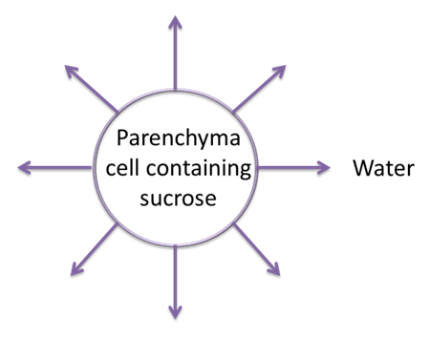
True Diffusion
True diffusion is the process whereby material moves from the cell, through the unbroken porous cell membrane to the surrounding liquid.
Heat is used to destroy the living cell membrane by removing its colloidal materials.
In the process the cell membrane dies and is left more porous/permeable.
However, the fraction of sugar extracted by the diffusion is very low, i.e. in the order of 3 %.

Slide 6
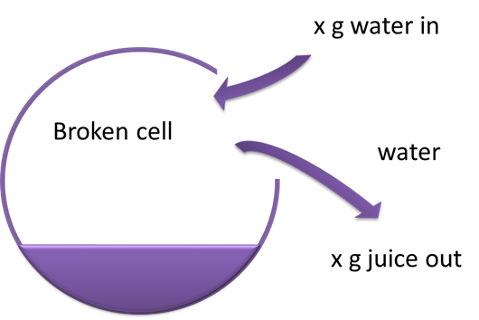
Displacement/Washing
Whereby water enters the broken cells and displaces an equal volume of juice out of the cell.
The juice displaced then mixes with the surrounding liquid.

Slide 7
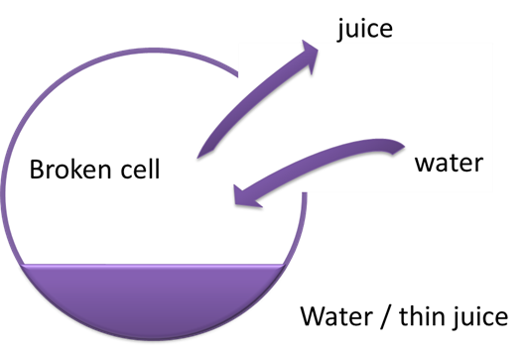
Mixing
Mixing involves the movement of water into broken cells and brix out of broken cells until the concentrations inside and outside the broken cells are equal.

Slide 8
Cane and Bagasse Diffusion
Two variants of the process:
  Bagasse Diffusion - Single mill ahead of the diffuser
  Cane diffusion - Accepts prepared cane directly into the diffuser
The basic difference between the two is that the cane diffuser requires more extraction stages as it is fed with material containing more sucrose.
In bagasse diffusion over 50% of the juice is squeezed off by the pre-extraction mill and the rest is subjected to the diffusion process.
Cane diffusers have generally shown themselves to be considerably more cost-effective, and are almost exclusively favoured in preference to bagasse diffusers in new installations.

Slide 9
Horizontal Bed Diffuser
Consists of a long rectangular vessel/tank of 50 – 60 m through which the prepared cane slowly moves while water and thin juice percolates through the bed to wash out the juice.
The diluted juice is applied to the bed of cane in anything from 10 – 18 stages.
The best known horizontal bed diffusers are the B.M.A and de Smet types. The main difference between the two is the type of conveyor used to move the bagasse.
  B.M.A. has a drag-type conveyor running on a fixed screen
  De Smet uses a moving screen consisting of an apron type conveyor made of screen sections. The conveyor moves at about 1 metre/minute which presents drive problems as it is difficult to maintain a constant speed so slow. The latest types of drives are variable speed electric motors with epicycle gears or hydraulic motors and gears.
The Huletts diffuser and the Australia Burnett Diffuser are also horizontal bed type diffusers.

Slide 10
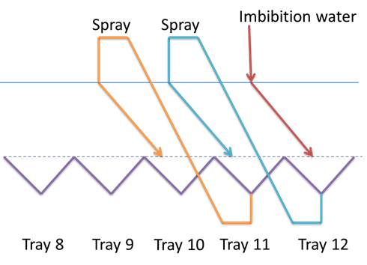
Moving Bed Cane Diffuser
Prepared cane is fed into the diffuser via a conveyor
Bed of cane of depth 1 – 1.5 m is formed
Under the perforated floor, the diffuser is divided into 12 stages/ trays, each stage analogous to a single milling unit
Imbibition water is added ahead of stage 12; dilute juice from stage 12 is recycled and sprayed onto the cane just ahead of stage 11
The slightly more concentrated juice from stage 11 is recycled and sprayed onto the cane just ahead of stage 10 and so on
The juice is withdrawn from stage 1 and is known as draught juice or mixed juice
The juice thus moves counter to the fibre

Slide 11
Moving Bed Cane Diffuser (cont.)
This method of recycling ensures that withdraws from a stage again percolates through the bed of cane and finds its way to the juice tray of the preceding stage.
Percolation through the fibre bed is critical in a diffuser.
Two banks of lifting screws are placed across the bed of cane – one set towards the front of the diffuser and one set towards the back of the diffuser.
These lifting screws disturb the bed, preventing any packing that may occur during its 1 – hour travel through the diffuser.
If the bed of cane becomes excessively compacted, it is “blinded” and results in juice travelling over the top of the fibre instead of through the bed of cane.
The diffuser is then said to be flooded.

Slide 12
Moving Bed Cane Diffuser (cont.)
Solids in the press water from the de-watering mills have been found to plug the cane bed where the press water is returned to the diffuser.
Early installations required a press water clarifier similar to a raw juice clarifier to remove solids.
Some presswater clarifiers are still in use, but it is more common now to use rotating lifting screws in the cane bed at the point at which the press water is returned, to mix the fine solids into the cane bed, and prevent the formation of an impermeable layer of fines.
Experience with moving bed diffusers has shown that more stable liquid percolation conditions are achieved if the prepared cane is fed to the diffuser dry, with scalding juice applied to the bed after it has been formed.
At the feed end of the diffuser, a portion of the stage 1 juice is heated up to about 90°C to heat the incoming cane to the required operating temperature as quickly as possible.
The amount of scalding juice is about 250% - 300% on cane.

Slide 13
Moving Bed Cane Diffuser (cont.)
In addition to scalding juice heating, press water and imbibition water are also heated, and vapour is injected directly into some of the stage trays to keep the entire vessel at above 80oC (± 85°C).
This serves two functions:
  It minimises bacterial activity (sucrose is lost when metabolised by bacteria) and
  It improves the extraction.
The discharge end of the diffuser is sealed by a rotating weighted drum which dewaters the cane to some extent.
A spiked rotor called a kicker breaks off chunks of the hot fibre that then falls onto a carrier.

Slide 14
Moving Bed Cane Diffuser (cont.)
Bagasse leaving the diffuser after stage 12 contains a great deal of water and this water is removed using one or two sets of dewatering mills.
Cane juice has a natural pH of 4.5 – 5.5.
At this pH, inversion will take place, as well as corrosion of diffuser parts.
The diffuser is therefore limed at points along its length to bring the pH to 6.0 – 6.5.
Liming at higher rates will cause precipitation of impurities which will hinder percolation through the bed.
The draught juice withdraw at stage 1, having been “filtered” several times through a mat of fibre, contains less than half the amount of suspended solids found in mill mixed juice i.e. 0.3 – 0.5 %.
Diffuser juice is sometimes not screened.

Slide 15
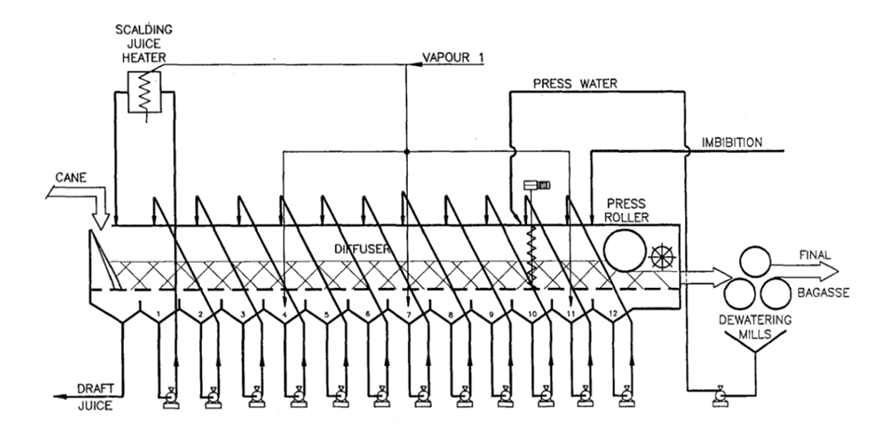
A BMA Cane Diffuser

Slide 16
Horizontal Bed Diffusers
Advantage: Can be lengthened to increase their capacity.
Disadvantages: The space that they occupy and the distance between inlet and outlet which necessitates long and numerous conveyors.
A comparison of the moving screen and fixed screen diffuser leads to the following considerations:
  Chains dragging cane across the fixed screen generally result in the formation of a more compact cane layer at the screen, which effect affects percolation.
  Because of this, suppliers of the moving screen diffuser claim that a higher bed height (up to 2 m) is possible compared to about 1.3 m on a fixed screen diffuser, leading to a smaller screen area for a given cane retention time. This has not been substantiated.
  The moving screen diffuser requires double the screen area as half the screen is inoperative in the return strand.
  Because of reduced friction, the drive power required on a moving screen diffuser is generally lower, typically 30 kW for a 300 ton/hr diffuser compared to 100 kW for a fixed screen diffuser.
  Discharge of cane from moving screen diffusers is by lifting screws (Silver Ring) or lifting drum (De Smet). Discharge from fixed screen diffusers is simpler: By gravity with a kicker to smooth out the flow.
  Fixed screen diffusers have a heavy press roller riding on the cane, which leads to a lower moisture content of the discharge bagasse.
  Perhaps because of the difficulty of sealing between the moving screen and the stationary side walls, juice from De Smet diffusers have a higher suspended solids content (typically 0.6% vs 0.1 % on diffuser juice).
  The moving bed type diffuser has captured the cane diffusion market to the exclusion of other types of diffuser, due to:
    their relatively low cost,
    simplicity of operation and
    ability to achieve very high extractions.

Slide 17
Factors Affecting Extraction Efficiency
Cane preparation
Imbibition rate
Number of stages
Percolation rate
Cane retention time
Temperature
Bagasse dewatering

Slide 18
Operating Conditions: Temperature
Temperature can affect the quality of the juice.
Below 70°C starch extraction is lower than milling but above 70°C it is the same.
Temperatures above 75°C restrict the activity of thermophilic bacteria and the formation of lactic acid.
As the temperature profile along a diffuser varies, it may be necessary to go as high as 90°C in some parts to maintain temperature profile.
Most diffusers have heaters to reheat press water and circulating juice.

Slide 19
Operating Conditions: pH
The pH of juice is controlled by the addition of milk of lime
Prevents corrosion and helps minimise inversion
Good pH control is achieved by automatic control of addition at a number of points
pH should be kept at about 5.8 to 6.0 in all stages of the diffuser to prevent corrosion
pH has no effect on sucrose extraction
pH is not allowed to rise too high in any one of the stages.
If the pH rises much above 7, the percolation characteristics of the cane bed are adversely and irreversibly affected, seriously reducing percolation velocities – Since higher pH softens the fibres and causes greater compaction.
Overliming of diffusers can lead to the production of acetic acid from the hemi-cellulose of the cane fibre.
The acetic acid may then be volatilized in the evaporators causing serious corrosion of V1 and V2 vapour lines, pan calandrias as well as condensate piping.
It is important to note that a stainless steel diffuser does not need to be limed.

Slide 20
Operating conditions: Imbibition rate
To improve extraction - increase the imbibition rate.
There is a limit to how much water can be used as it will affect evaporation and steam usage.
It will also affect the percolation rate which will cause flooding if exceeded.
A diffuser will react quickly to a reduction in imbibition rate.
There must be a minimum volume of juice at each stage so that there is always juice being sprayed on the bagasse mat from above to displace the juice in the bed.
Imbibition water is added at the last washing stage of the diffuser or in some installations part is added at the dewatering mills.
Adding water to the dewatering mills will improve extraction if the preparation is below standard.

Slide 21
Operating Conditions: Bactericides
Bactericides are very expensive
High temperatures are relied upon to control bacterial activity.

Slide 22
Operating conditions: Retention Time
Retention time can be varied by:
  Altering bed height
  Altering carrier speed.
Of these two it is preferable to alter the speed.
Changes in bed height can:
  Upset the juice flow between stages, and
  Affect performance.

Slide 23
Dewatering and Press Water
Bagasse in the last stages of a diffuser contains about 85% moisture.
Part of this moisture, called ‘easy moisture’, is easily removed by a light squeeze.
This is done by a light dewatering device in the final stage of the diffuser.
This device is able to reduce the moisture content to between 70 and 80%.
Heavy dewatering equipment is then necessary to reduce the moisture content to an acceptable level of +50%.

Slide 24
Light Dewatering Devices
The simplest dewatering device is the drum floating on the bagasse mat (B.M.A. and De Smet).
These drums are about 2 m in diameter and their length is the same as the internal width of the diffuser.
They can be filled with water to increase their mass and are free to float on the bed of bagasse and are rotated by the movement of the bed.
Their chief purpose is to break the surface of the bagasse mat and improve percolation and also to act as a weir to prevent juice from flooding out.
These drums have a low efficiency due possibly to the difficulty in pushing juice through the bed of bagasse several meters wide and over a meter deep.
A different light dewatering device consists of a concentric sleeve of perforated plate installed over the dewatering drum.
The annular space provided thus enables the juice that is squeezed out to drain out through the perforated side plates.

Slide 25
Dewatering Mills
Because of the high quantity of juice to be removed (diffuser bagasse has a moisture content of about 80%) and the high temperature of the juice in bagasse, the dewatering of diffuser bagasse was initially found to be a very difficult operation.
Slipping of bagasse in the mill (partially due to release of waxes) was a serious problem, but this has now largely been overcome by the development of suitable welding rods for use on roughening mill rolls.
Because of the large quantity of juice, the dewatering generally has to be in two stages.
Most diffusion plants use two 3 roller mills in series for dewatering.
If it is attempted with a single four roll mill it is generally found that there is considerable overflow of expressed juice over the top roll onto the bagasse.

Slide 26
Dewatering Mills (cont.)
An alternative arrangement that is commonly used is to attach a pressure feeder to the mill.
The pressure feeder is able to remove sufficient of the juice from the diffuser bagasse so that adequate bagasse moisture can be obtained in a single milling unit.
Low mill roller surface speeds are necessary if moistures below 50% are to be obtained.
In addition, larger grooving (above 50 mm) and feed/discharge work opening ratios - larger than in normal milling (3:1 or 4:1) - are required.
Analysis of current diffuser dewatering installations in South Africa shows clearly the dependence on dewatering mill capacity. In order to achieve 50% moisture, a total roller volume of about 0.4 m³/tfh is required.
Apart from reducing the moisture of the bagasse to acceptable levels, dewatering mills also increase extraction by reducing the pol lost in the bagasse.

Slide 27
Comparing Milling with Diffusion
Consider capital and maintenance costs
Consider effect on steam balance and pwer requirements
Consider effect on raw juice quality
Consider effect on overall sucrose recovery
Consider effect on operations

Slide 28
Advantages of Diffusers
Lower capital cost.
Lower power requirements
Lighter foundations
Easier and cheaper operation
Easier and cheaper maintenance
Less labour time required

Slide 29
Disadvantages of Diffusers
It requires more floor space
Uses more steam (about 3%)
The increased ash content of bagasse causes more wear of boiler tubes and fans
If the diffuser is not controlled properly as regards pH and temperature, it could affect the following processes:
  Percolation velocity,
  Corrosion,
  Inversion and
  Levels of bacteria
Increase in juice colour

Slide 30
Diffuser Control
Monitoring of efficiency of extraction
Analysis of cane and bagasse is important in order that extraction can be monitored on a routine basis.
Measurement of the moisture content of the bagasse from each dewatering mill is often also advantageous.
Various reduced extraction figures have been proposed so that the effects of cane quality can be compensated for.
The overall extraction of diffuser and dewatering mills should be monitored on a routine basis.
It is common practice to take juice samples from each stage in a diffuser on a regular basis, every hour or once a shift.
Dry substance (brix), temperature and pH of each sample is measured and a profile of these variables through the diffuser is plotted.

Slide 31
Diffuser Control (cont.)
Control of the feed cane:
The feed to a milling tandem is generally regulated by the speed of the first mill.
On the other hand, cane feed to a diffuser generally involves the control of the volume into the diffuser.
This can be done in three ways:
  Control of the speed of a belt conveyor feeding the diffuser, measuring the depth of cane on the belt and keeping constant the product of conveyor speed and height.
  Control of the mass flow rate of cane with a belt weigher on a variable speed belt conveyor ahead of the diffuser.
  Using the speed of feed rolls beneath a chocked feed chute feeding into a shredder ahead of the diffuser, as the means of controlling the feed rate.
Once the volumetric flow rate of cane is approximately constant, the diffuser bed speed is selected to give the required bed height.
It is important to keep the diffuser running at constant speed if good results are to be achieved.

Slide 32
Diffuser Control (cont.)
Control of the percolation in diffusers:
Flooding or percolation problems are often a feature of diffuser operation if the diffuser is not set up correctly.
Juice pumped from a stage tray does not all find its way to the preceding tray in a true stage-wise system.
Sideways dispersion leads to juice entering trays on either side of the preceding tray, as tracer tests have shown.
Because of the sideways dispersion of the percolating juice, it is inevitable that there will be some recycling and bypassing.
As the brix differences between adjacent stages are not large, other than in the first few stages, such sideways mixing does not have a serious adverse effect.
The direct-, recycle– and bypass percolation can be clearly seen from tracer tests.

Slide 33
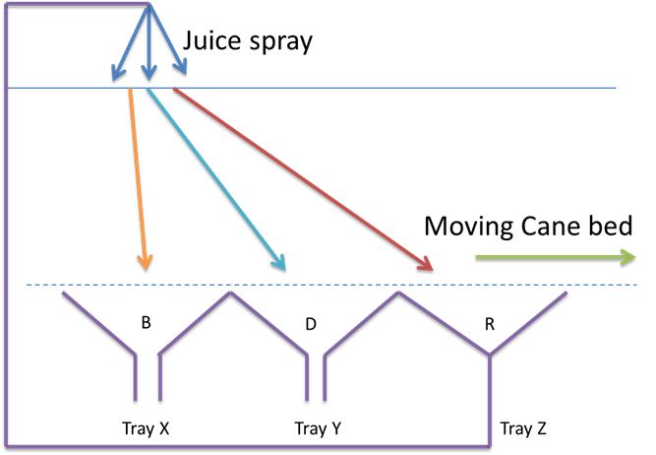
Diffuser Control (cont.)
Control of the percolation in diffusers (cont.):
It is desirable for the juice from tray Z to find its way to the previous tray i.e. tray Y for the maximum benefit of compound imbibition.
If juice from tray Z reaches tray Y the juice is said to have moved “directly” from the spray to tray Y.
If juice from tray Z reaches tray Z again, the juice will “recycle”.
If juice from tray Z reaches tray X it “bypasses” tray Y.

Slide 34
Diffuser Control (cont.)
Corrosion control:
The pH of juice is controlled by the addition of milk of lime
Prevents corrosion and helps minimise inversion
Good pH control is achieved by automatic control of addition at a number of points
pH should be kept at about 5.8 to 6.0 in all stages of the diffuser to prevent corrosion
pH has no effect on sucrose extraction
pH is not allowed to rise too high in any one of the stages.

Slide 35
Diffuser Control (cont.)
Corrosion control (cont.):
If the pH rises much above 7, the percolation characteristics of the cane bed are adversely and irreversibly affected, seriously reducing percolation velocities – Since higher pH softens the fibres and causes greater compaction.
Overliming of diffusers can lead to the production of acetic acid from the hemi-cellulose of the cane fibre.
The acetic acid may then be volatilized in the evaporators causing serious corrosion of V1 and V2 vapour lines, pan calandrias as well as condensate piping.
It is important to note that a stainless steel diffuser does not need to be limed.

Slide 36
Instrumentation and Electrical
All control systems are single loops.
The diffuser speed is set to correspond to the particular set point on the cane mass throughput rate controller.
The speed is chosen to give the required bed height.
Level indicators at the feed end of the diffuser indicate whether the desired level is being achieved.
If not, minor correction to the diffuser speed set point is required.

Slide 37
Instrumentation and Electrical (cont.)
All other controls on the diffuser are conventional PID (Proportional, Integral, and Derivative) control loops. These are:
  Two temperature controllers on the two scalding juice heaters which regulate V1 vapour flow to the heaters.
  Two pH control loops measure the pH in stages 2 & 7 and control the speeds of the peristaltic lime dosing pumps.
  Ten level control loops regulate liquid levels in the bed by adjusting the interstage juice sprays.
  The imbibition water controller admits water to the diffuser at the chosen rate.
  Two temperature controllers regulate V1 vapour to intermediate diffuser trays to maintain temperatures along the diffuser.

Slide 38
Instrumentation and Electrical
Electrical powers are low.
Power absorbed is of the order of 200kW per 100tch.
The major part of this is for the interstage juice pumps.
The diffuser drive motor(s) are nowadays generally variable speed AC motors.
Electrical interlocks which will prevent the diffuser from operating are typically:
  bed screw motor trip
  diffuser drive bearing lube pumps off
  bagasse conveyors downstream of diffuser tripped
  diffuser kicker trip
  chain tension detector activated (Tongaat-Hulett diffuser)

Slide 39
Maintenance of Diffuser
One of the major advantages of diffusion vs milling is the greatly reduced maintenance cost.
Very little routine weekly maintenance is required.
The following items generally need attention on an annual basis:
  Chain runners wear and generally need to be replaced every few years.
  Lifting screw flights wear in spite of hard-facing on the edges of the flights. They need periodic attention.
  Routine pump maintenance is required. Pumps generally run at low speeds (˂ 1000 rpm) to minimise wear due to sand.
  A check on corrosion of trays and structural steelwork, particularly at the feed end of the diffuser where pH’s are lower, is necessary.
  Chain pins and bushes need to be replaced. They have a life of between 5 and 20 years, depending on the materials and the type of design of chain.
  The diffuser driver (variable speed motor and reduction gears) need routine maintenance.

Slide 40
Microbiological Factors
Conditions favouring microbiological action:
  Low brix raw juices degrade readily as a result of micro-organism activity.
  At room temperatures a large range of organisms will ferment sugar juices.
  Perhaps the most evident micro-organism activity is shown by Leuconostoc sp., which are slime-forming bacteria.
  In diffusers where temperatures are considerably higher, mesophilic organisms are rendered inactive, but hyperthermophiles are active.
  They are generally lactic acid producing bacteria, and are active at temperatures up to 70°C.
  The pH range from 5 to 6.5 found in mills and diffusers do not have a significant effect on micro-organism activity.

Slide 41
Microbiological Factors (cont.)
Control of microbiological losses
  In diffusers, losses of sugar can be very high if temperatures are not kept well above 70°C.
  It is not considered feasible to operate diffusers at lower temperatures, as losses under these conditions can be severe.
  It is common practice to control diffusers at an average of about 85°C.
  This ensures that the temperature at no stage drops below 75°C, which is considered to be the minimum operating temperature.
  Sufficient heater capacity must be installed on scalding juice duty at the feed end of the diffuser, in order to achieve a bed temperature of at least 75°C within a stage.

Slide 42
Microbiological Factors (cont.)
Control of microbiological losses (cont.)
  Scalding juice is circulated through the heaters at the feed end of the diffuser at a rate of about 300% on cane.
  Under these conditions, raw juice leaving the diffuser is at a temperature of about 85°C.
  The use of biocides in cane extraction plants is very expensive, and has seldom proved to be cost-effective.
  Particularly in diffusers, the attainment of satisfactory levels of temperature is a much simpler, cheaper and effective means of microbiological control.

Slide 43
Microbiological Factors (cont.)
Measurement of losses:
  Measurement of microbiological losses in milling tandem is difficult to measure.
  Even when extensive losses occur, no significant reduction in apparent juice purity is evident.
  This is partly due to the fact that dextran produced in large quantities by mesophiles is strongly dextro-rotatory (i.e. stating to the right), artificially inflating the pol measurement.
  In general the extent of losses in milling tandems is unknown, since a means of measuring such losses routinely is not available.
  In diffusers, the situation is different since the major degradation product of hyperthermophiles is lactic acid which can be routinely measured.
  In addition, severe cases of microbiological losses will be evident in an accompanying drop in juice purity.

Slide 44
Microbiological Factors (cont.)
Measurement of losses (cont.):
  Experiments in the laboratory have established that = Each part of lactic acid formed in a diffuser corresponds to 2 parts of sucrose loss.
  The routine measurement of lactic acid in juice is recommended as a control measure.
  Average values of 300 ppm lactic acid on brix represents a realistic target for both mills and diffusers.
  The lactic acid content in mill raw juice can easily be twice that in diffuser juice.
  Based on the equivalence ratios between lactic acid and sucrose, the loss in mills is probably far more significant than in diffusers.
  Loss of sucrose can also occur by chemical inversion of sucrose to form glucose and fructose.
  This reaction is favoured by high temperatures and low pH’s and high residence times.
  This loss is generally considered to be insignificant under normal operations, particularly if pH adjustment with lime is undertaken.

