Slide 1
KNOWLEDGE COMPONENT: MODULE 4: SUGAR JUICE EXTRACTION: KT6: JUICE SCREENING

Slide 2
Juice Screening
Mixed juice from a milling tandem contains a large quantity of suspended material (sand and bagasse) which needs to be removed before the juice is massed and processed.
If not removed this material would cause choking problems in the juice heaters and scales and would overload the clarifiers.

Slide 3
Juice Screening (cont.)
Screening also aids in pumping and heating particularly when plate heat exchanges are used.
Diffuser juice, because of the screening effect of the cane bed itself, has less than half a percent of suspended solids and screening diffuser juice is optional - most factories screen while some diffusion plants have dispensed with screens.

Slide 4
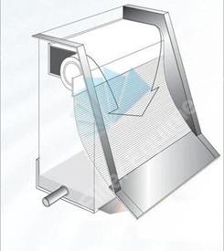
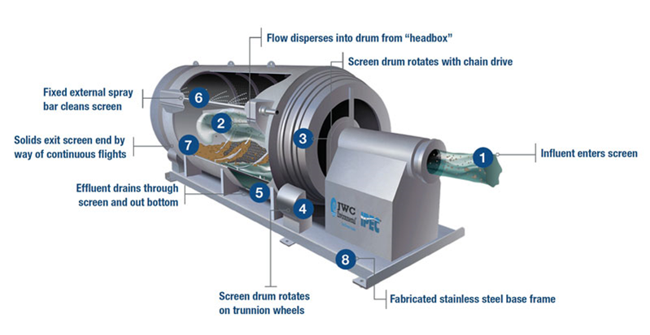
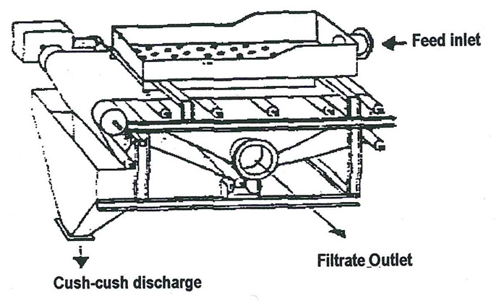
Juice Screening (cont.)
DSM screen
Rotary screens
Vibrating screens

Slide 5
Sand Removal
Sand settling tanks are not wise because the extra residence time can cause sugar losses.
In a diffuser, most of the sand remains in the bagasse and ends up in the boilers where it is disposed of with the boiler ash.
However, serious boiler erosion results due to the “sandblasting effect” of the sand in the bagasse.

Slide 6
Sand Removal (cont.)
Sand settling tanks are not wise because the extra residence time can cause sugar losses.
In a diffuser, most of the sand remains in the bagasse and ends up in the boilers where it is disposed of with the boiler ash.
However, serious boiler erosion results due to the “sandblasting effect” of the sand in the bagasse.

