Slide 1
KNOWLEDGE COMPONENT: MODULE 4: SUGAR JUICE EXTRACTION: KT7: JUICE MASSING AND CORRECTIVE MEASURES

Slide 2
Juice Massing Objectives
Accurate massing of mixed juice is critical to the South African industry for:
  Cane payment purposes
  Controlling performance in a factory

Slide 3
Juice Massing System
The batch weighing system usually employed in the South African sugar industry consists of:
  load cells
  holding tanks
  weighing bins
  processors
  valves and
  actuators

Slide 4
Juice Massing (cont.)
Due to the nature of the mechanism used, the system can be subject to frequent downtime because of:
  mechanical malfunctions
  electronic malfunctions.
Any errors or interruptions within the weighing system could result in:
  mixed juice weighing being suspended or
  the mill stopping until the problem is rectified.
During these periods, the unweighed mixed juice has to be estimated as accurately as possible.

Slide 5
Juice Massing (cont.)
The Cane Testing Service (CTS) has developed a number of methods for estimating the mass of mixed juice in such an event.
These methods usually involve the use of an assumed pol factor, the value of which may differ according to the amount of cane already crushed in the week.
Due to the indirect nature of such a correction, and the need for decision making at laboratory manager level, the correction of the mixed juice mass can be lengthy and disputes as to its validity can arise.

Slide 6
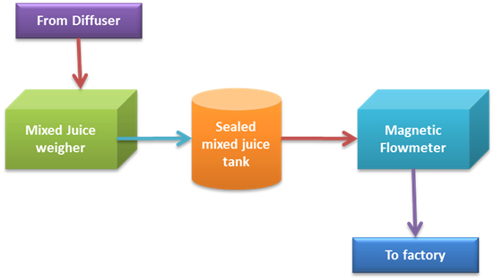
Juice Massing (cont.)
The juice weighing system at the Umzimkulu mill

