Slide 1
KNOWLEDGE COMPONENT: MODULE 5: SUGAR JUICE HANDLING AND CLARIFICATION: BACKGROUND

Slide 2
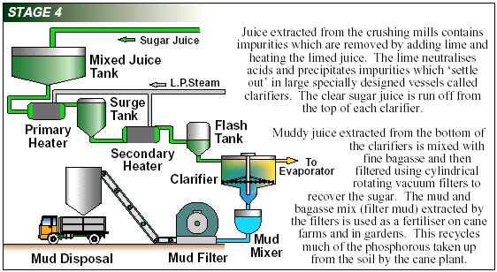
Sugar Cane Processing Steps: Juice Clarification

Slide 3
Mixed Juice
Crushed juice and first mill juice are mixed and screened of bagasse particles
This mixed juice is pumped to the mixed juice scales
Mixed juice:
  Is a cloudy, greyish or greenish, foaming liquid
  Has 80 to 84% water content
  Contains sand particles, fine bagasse particles, cane wax and air bubbles
Definition: Flocculant
A flocculant is a substance which promotes the clumping of particles.

Slide 4
Purification of Mixed Juice
Removal of impurities
Done by:
  Heating to +/- 104°C
  Liming (defecation process)
  Settling of mud
  Decanting of clear juice
  Filtration of mud

Slide 5
Heating
Mixed juice is weighed
Pumped to a surge tank
Pumped to the juice heaters
Heated in two stages
  Primary heating to 70°C (Using vapour from the first or second effect evaporator)
  Secondary heating to 104°C (Using exhaust steam)

Slide 6
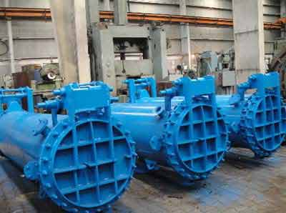
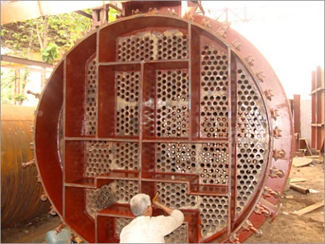
Juice heaters
A steam chest with tubes through which the juice flows and around which steam is present
Tube plates form compartments
Baffles force the juice to change direction to and fro
The juice is heated to about 104°C and limed to 7.5pH
Then passes through the in-line mixer to the
Flash tank where the juice is exposed to atmospheric pressure to remove air

Slide 7
Liming
Milk of lime is prepared by slaring burnt lime or quick lime in a slaker
Slaker consists of stirrers with cold water
Lime is present in suspension (and a small part in solution)
To prevent lime particles settling in the pipeline it is pumped around continuously
Milk of lime is kept in three buffer tanks
Milk of lime is continuously added to the hot juice in the perry tank with the pH controlled automatically

Slide 8
Purpose of Liming
Mixed juice is acidic (5.5pH)
Milk of lime addition causes a precipitate of calcium phosphate
This removes suspended solids from the juice
After settlin gof this precipitate (mud) a layer of clear yellow juice will be seen.
This precipitate is filtered and the filtrate returned to the mixed juice after the mixed juice scale.

Slide 9
The Purpose of the correct liming
If clear juice is heated at a pH below 7:
  Sucrose will be hydrolysed and form invert sugar
  Quantity of sugar inverted depends on:
    The pH (more sugar is inverted at a lower pH)
    The temperature (the reaction is speeded up, when the temperature is higher)
    The time

Slide 10
The Purpose of the correct liming
If clear juice is heated at above 7.6:
  The reducing sugars form coloured bodies and acids
  This affects the production of white sugar
Optimal pH is 7.2

Slide 11
Clarifiers
Two types of clarifiers in South Africa
SRI clarifier
  Juice enters tangentially from the sides
  Short retention time
Rapi-Dorr clarifier
  Operated on the counter-flow principle
  Juice enters from the top
  Long juice retention time
Flocculant is dosed continuously to the lime and heated juice before the clarifier
  Polyelectrolytes
    Separan R300
    Magnafloc LT27
    Talosep A3
  Forms polymers with attached (mud) particles

Slide 12
The Clarifier
From the perry tank the juice flows to a clarifier
Here continuous settling takes place
Consists of a cylindrical shell with four conical (sloping) trays
The clarifier fills from the bottom up
The hollow central shaft:
  Through which the juice enters the clarifier,
  Feeds the four compartments
  Slowly rotates
  Has 4 scraper arms
  Scrapes the mud from the sloping trays
  Mud is pushed into the mudwell by the scrapers
Clear juice is drained off from the top of the clarifier

Slide 13
Filtering of the Mud
Mud from the mudwell is pumped (or gravity fed) to the mud box
This flows to the mud mixer
It is mixed with bagacillo (which serves as a filter aid)
Processed using a vacuum filter drum
Undissolved dry matter in the mud is retained on a screen on the vacuum drum filter and is removed as cake
Mud particles passing the screens of the vacuum drum filter are returned with the filtrate to the mixed juice
Good filter operation depends on:
  Good retention
  Low pol% of filter cake

