Slide 1
KNOWLEDGE COMPONENT: MODULE 5: SUGAR JUICE HANDLING AND CLARIFICATION: KNOWLEDGE TOPIC 1: JUICE HEATING

Slide 2
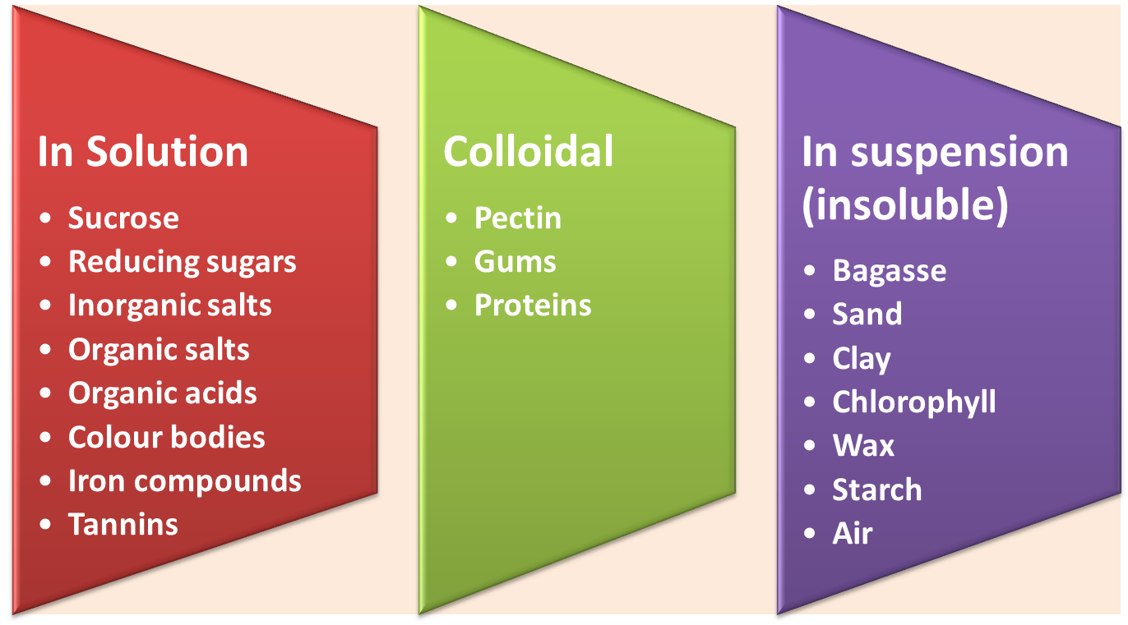
Properties of Mixed Juice
The major constituents of cane juice from the extraction plant are:

Slide 3
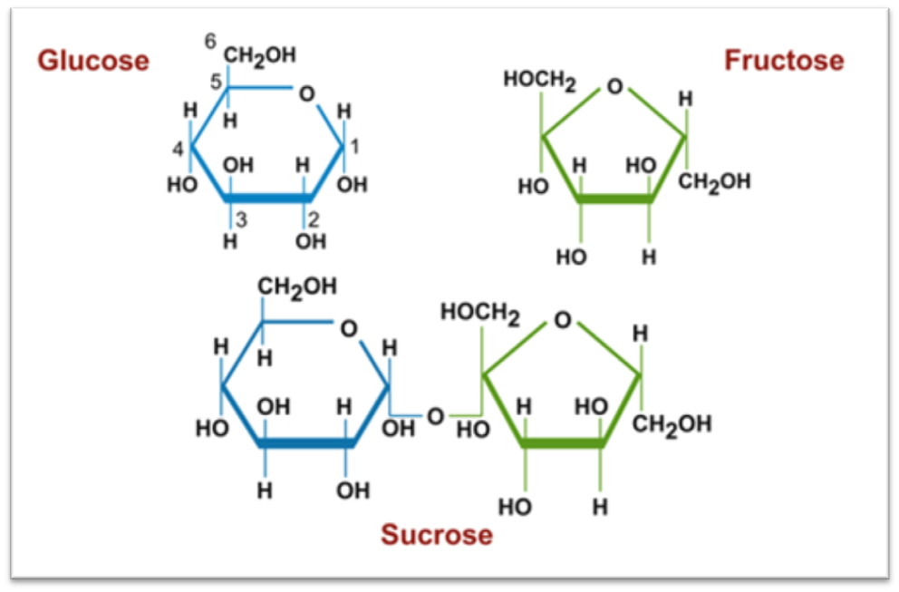
Sucrose
A disaccharide
One molecule of glucose plus one molecule of fructose

Slide 4
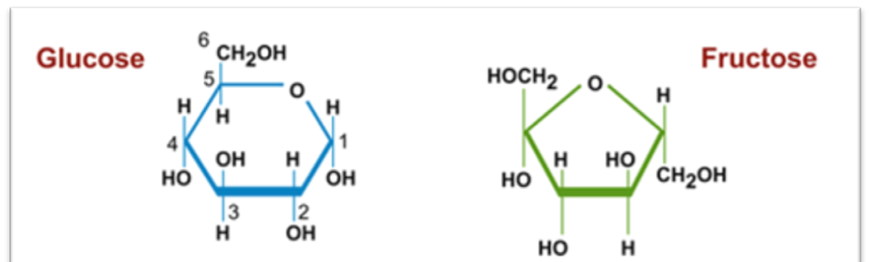
Reducing Sugars
Monosaccharides
Simple sugars
Glucose and Fructose
Not removed during clarification
Reaction products are highly coloured
Can be destroyed by heat under alkaline conditions
Degradation of reducing sugars must be prevented
Acids produced by reducing sugars must be neutralised by lime
Reducing sugars decreases the solubility of sucrose and increase sucrose recovery during pan boiling

Slide 5
Inorganic Salts (ash)
Combinations of positive and negative ions
Positive ions : K⁺, Na⁺,Ca²⁺,Mg²⁺,Fe⁺
Negative ions: Cl⁻,SO₄³⁻,PO₄³⁻ and SiO₄⁴⁻
Not removed in the clarifier
Precipitate as sacle in the evaporators
Ends up in final molasses
Increases solubility of sucrose – thus decreases the sucrose recovery during pan boiling

Slide 6
Organic salts
Glycollic, suxine, malic, oxalic, tonic, citric, acetic, and aconitic acids. A
All form soluble lime salts and are not removed by clarification.
Oxalic acid reacts to form calcium oxalate that normally precipitates at higher brixes in the last vessels of the evaporators - forming a hard scale.

Slide 7
Coloured bodies
Plant pigments
  Chlorophyll A and B (green)
  Carotene (yellow)
  Xanthophyll (yellow)
  Removed during clarification
Flavanols
  Polyphenols e.g. Anthocyanins (red, blue and violet)
  React with iron and oxygen to form dark coloured compounds in alkaline solutions

Slide 8
Iron compounds, Tannins and Pectins
Fe²⁺ and Fe³⁺ ions
Tannins consist of complexes of esters and ethers of various carbohydrates
  On hydrolysis gallic acid and glucose molecules are formed
Pectins
  Gelatinous carbohydrates
  Increases viscosity of solutions
  Increase the solubility of sucrose
  Slows down crystallization process
  Hydrolysed in alkaline solutions
  Precipitated and removed during clarification

Slide 9
Gums and Proteins
Gums
  Colloidal polysaccharides
  Pentosan units
  Increase the viscosity of solutinos
  Cane which is left standing in the field after cutting or diseased cane contains higher gum content than fresh cane
Protein
  Large molecules
  Made up of amino acids in chains to form peptides
  Originate from tops and trash
  Coagulated by heat and lime – removed by clarification

Slide 10
Wax
Found in the nodes and the rind of the cane plant
60 – 80% is retained in the bagasse
Wax removal is dependant on the temperature of the imbibition water
Physically removed with the mud during clarification and can be recovered from the filter cake
Some wax may remain in suspension and occlude into the sugar crystals

Slide 11
Starch (Amylose)
Starch is composed of glucose units strung together
An undesirable impurity in cane juice
Causes difficulties in refinery filtration
Insoluble in cane juice – becomes soluble above 70°C
Above 70°C the starch granules burst releasing colloidal starch into the juice
Small amount is removed during clarification
The remainder is occluded in the sugar crystal and slows down the crystallization rate
Removed using enzymes (amylase) which hydrolyses the starch to glucose and maltose
Amylase is added between the 2nd and 3rd effect evaporators.

Slide 12
Air
Interferes in any clarification process involving settling
Removed by heating and flashing prior to clarification
Solubility decreases with an increase in temperature

Slide 13
The Need to Remove Colloidal Substances
If not removed, results in:
  Increase in viscosity of syrup and molasses
  Slows down filtration
  Causes foaming
  Increases the colour
  Interferes with crystallization of sucrose
A particular problem group are the pectins, gums and proteins
After a severe frost the concentrations of pectins, gums and proteins increase
If cane is allowed to stand and go stale:
  Organic acids increase
  Gums increase
  Reducing sugars increase

Slide 14
The Problem of Reducing Sugars
Inversion involves the decomposition of sucrose into glucose and fructose
Glucose and fructose are called invert sugars or reducing sugars
Glucose and fructose cannot be converted back into sucrose
Glucose and fructose are lost in the molasses
The rate of inversion increases with:
  Increase in acidity (pH>7)
  Increase in temperature
  Increase in the time of the exposure to the above mentioned conditions
It is impossible to control all three things (above) at all times
The entire factory is designed to control at least 2 of these factors at all times

Slide 15
Effect of Clarification on Juice Colour
Colour normally increases in the clarification process
Dark colour of raw juice is cause by polyphenol derivatives – notably tannin in the presence of iron
If iron is absent the colour will be darker
The precipitate of calcium phosphate formed in liming absorbs some colour
The amount of colour absorbed increases with the phosphate content of the juice
The defecation process is used to rid the juice of suspended and colloidal matter but does not reduce colour

Slide 16
The Purpose of Heating
Heat is a form of energy – measured in joules
Heat moves from one place to another in three ways:
  Conduction
  Convection
  Radiation
Heating and boiling in the factory is done using conduction
Measurement of Heat Transfer
  Using the heat transfer co-efficient
    Heating surface
    Temperature difference
  Using the specific heat capacity
    Mass of juice
    Temperature change
    Specific heat capacity of the juice

Slide 17
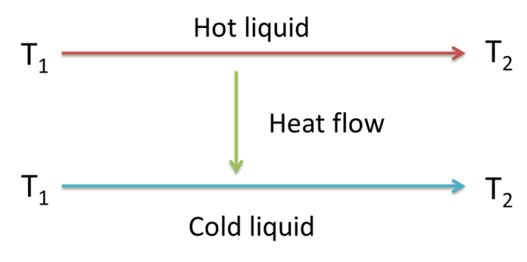
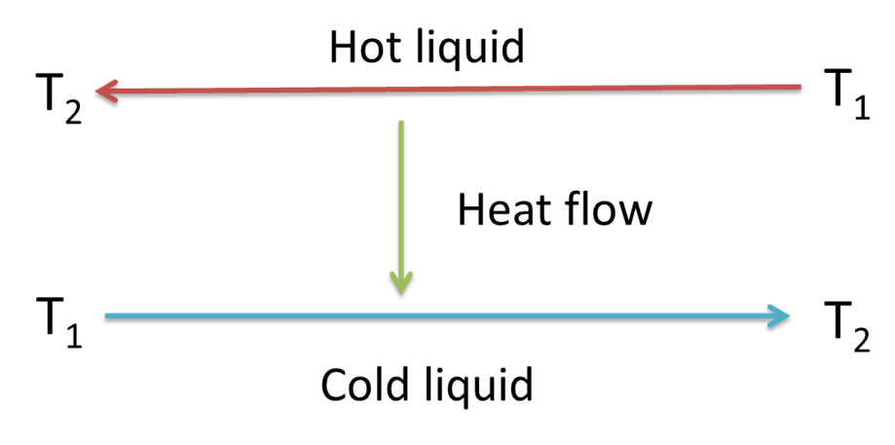
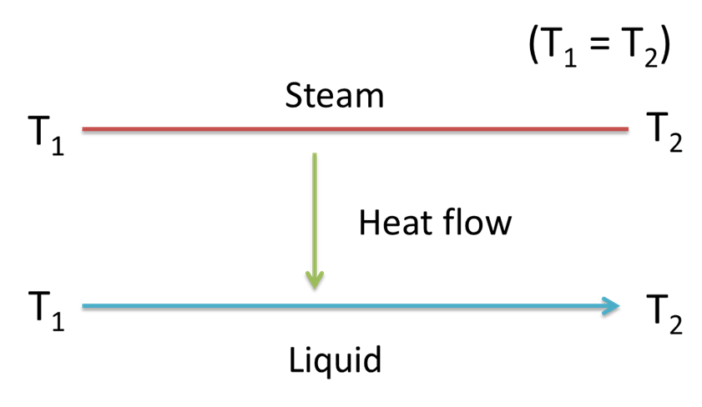
Types of Heat Flow
In a heat exchanger there can be three types of flow:
  Co-current flow
        Countercurrent flow
  Cross flow

Slide 18
Heat Calculations
Juice velocity and heat transfer
K=1.165 T_{v} (5+ v)
Pressure drop through a heater
P = 0.0245 x (v²C / D) x (1 + L)
Heating surface

Slide 19
Juice Heaters
Shell and Tube Heaters
  A cylindrical steel shell with brass or stainless tubes expanded into tube plates at the ends
  Vapour is fed around the tubes
  Juice is pumped through the tubes
Plate and Frame Heaters
  Consists of a bank of corrugated stainless steel places that hang in a frame
  The space between the plates is alternatively filled with juice and steam
Flashing and Flash Tanks
  Open to the atmosphere
  Juice under pressure at 105°C enters the flash tank and boils violently (i.e. flashes)
  Definition: Flashing is violent boiling caused by a pressure drop
  Rids the limed juice of entrained gases

Slide 20
Purpose of Juice Heaters
Scalding juice heaters
  Associated with diffusers
  To control microbiological losses and to facilitate sucrose extraction
Mixed juice heaters
  After the juice scales but before the clarifier
  Facilitates clarification by:
    Promoting coagulation of proteins
    Increases the rate of precipitation
    Removes air by flashing
    Controls microbiological losses
  Clear juice heaters
  Other heaters – used to heat:
    Intermediate juice
    Press water
    Imbibition water

