Slide 1
KNOWLEDGE COMPONENT: MODULE 5: SUGAR JUICE HANDLING AND CLARIFICATION: KNOWLEDGE TOPIC 2: CLARIFICATION

Slide 2
Why Clarify Mixed Juice?
Mixed juice contains many impurities
These are present as:
  Insoluble matter
  Colloidal matter
  Soluble matter
A clear juice MUST be produced:
  Of the correct pH
  Free of suspended and colloidal matter
  With minimal loss of sucrose or destruction of reducing sugars

Slide 3
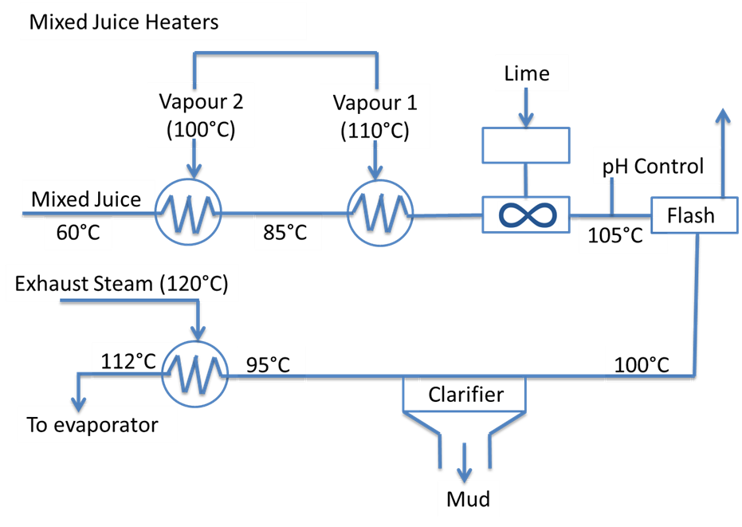
Summary of Clarification

Slide 4
The Defecation Process
Clarification is done using heat and lime
Liming produces an insoluble calcium phosphate precipitate:
  This traps the impurities
  Settles out
  pH of 7.0 to 7.2
Temperatures must be raised to a maximum 103 to 105°C
The mixture is then “flashed” to atmosphere and the precipitate settles out
Juice is removed from the top and the solids are removed from the bottom of the clarifiers
Defecation removes the insoluble matter (but not the soluble impurities)

Slide 5
Heating of juice
Increases the rate of the reaction between lime and the acids
Can be slow at low temperatures
Cause coagulation of the organic constituents (e.g. albumin protein)
Heating above boiling point allows for flashing
Flashing removes air
Heat destroys microorganisms and enzymes (reducing sucrose losses)

Slide 6
Liming
Causes coagulation of some colloids and thus, their precipitation
Neutralizes free organic acids
Causes change in pH from slightly acidic to neutral
Insoluble solids (sand and fine bagasse) are caused to settle out
Change in pH reduces investion
The precipitate contains:
  Insoluble lime salts ( e.g. Ca₃(PO)₂)
  Coagulated albumen (protein) and varying proportions of fats, waxes and juices.
  The flocculated precipitate carries with it most of the finely suspended material left in the juice.

Slide 7
Lime and Milk of Lime
Lime = CaO
Either as Milk of Lime or Lime Saccharate
Sources of lime include:
  Limestone
  Granular lime
  Powdered lime
Milk of Lime must be kept moving all the time

Slide 8
Sources of Lime
Hot liming
  Heating followed by liming
  Short retention time at 103°C
  Most used method in South Africa
Saccharate liming
  The objective is to form the most soluble salt (mon-calcium saccharate)
  Requires an excess of sucrose
  Temperatures below 58°C
  Rarely used in South Africa

Slide 9
Flashing
Removes air from the juice and flow
Causes particles of bagacillo to burst and sink with the solids
Results in a uniform and constant temperature in the limed juice
Uniform temperature prevents thermal currents and promotes good settling
Temperature of juice must be at least 103°C

Slide 10
System issues to Check when Flashing
Observe the way condensed vapour is given off the flash-tank vent pipe – no steam – something is wrong
The downward velocity of the juice in the juice/air volume of the flash tank should not exceed 500mm/min to allow escape of the bubbles
The diameter of the flash tank should be rated to that velocity
There should be no restriction in the exit path of the escaping air and vapour from the juice
The diameter of the pipe used should be such as to allow an upward velocity not greater than 1.7m/s

Slide 11
Settling
Allows precipitate to flocculate
Precipitate collects at the bottom of the clarifier
Clear juice is removed from the top
Flocculation and settling can be helped by addition of symthetic water soluble polymers
Good juice flow is vital
Large and sudden variations in juice dlow interferes physically with the contents of the clarifier – causing floc to contaminate the clear juice.

Slide 12
The Precipitate
An amorphous calcium phosphate (CaPO4)
Crystallises into hydroxyl apatite [(Ca5(OH)(PO4)3] which is more stable.
Attributed the amorphous phase the composition of tricalcium phosphate (Ca3(PO4)2).
Precipitation takes place in two stages:
  First small particles form
  Particles grow and rearrange into an intricate floc
The floc traps and absorbs all suspended solids.
Also included are the other non-sugars – These are precipitated by:
  the reaction change,
  by the heat,
  by the calcium and
  by the increase in pH.

Slide 13
The Role of Phosphates in Clarification
Phosphate must be above a certain amount
At least 300ppm (0.3%)
If below 300ppm phosphates must be added
Either:
  Phosphoric acid (H₃PO₄),
  Phosphoric acid paste or
  Mono calcium phosphate (CaHPO₄)

Slide 14
pH and pH control
Sucrose inversion is accelerated by acidic conditions and high temperature
Reducing sugars are destroyed at high pH and high temperatures
Both reactions are time dependant
Time cannot always be controlled, but pH can
pH can be controlled within a range
pH must be high enough to:
  Obtain complete phosphate precipitation
  Without producing excess soluble lime salts
Allow enough time between addition of lime and thorough mixing before measuring pH

Slide 15
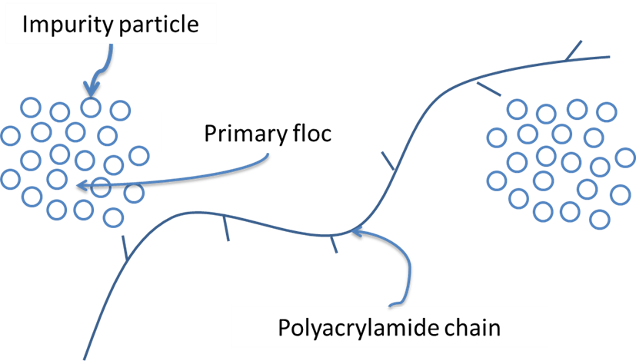
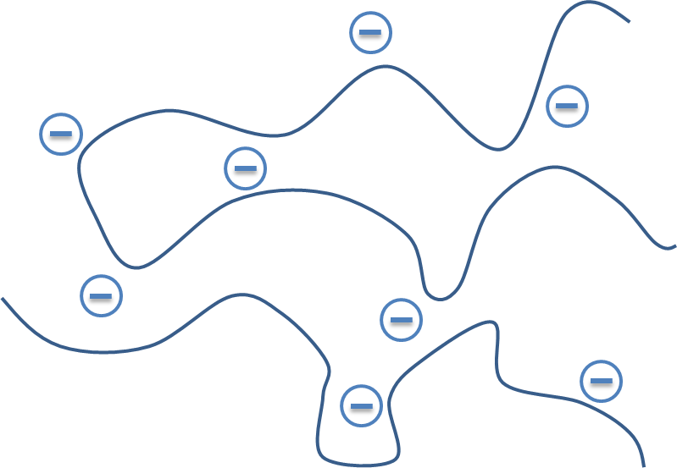
Flocculation
Primary flocculation
Particles in suspension with a negative charge
Reducing the pH neutralises the negative charge
Introducing a bridging mechanism allows for the formation of an inorganic precipitate
Secondary flocculation
High molecular mass polymers
Attach to adjacent impurity particles
Synthetic water-soluble polymers are used in SA
Good ones:
  Improves flocculation
  Increases settling rate
  Reduces mud moisture
  Decreases pol in cake
  Increases the clarity of the juice

Slide 16
Settling Theory
Floc is separated from juice in clarifiers.
Settling rate of particles depends on:
  The densities of the particles of the precipitate and of the liquid
  The size, shape and diameter of the particles
  The viscosity of the liquid
Not much can be done about the density and viscosity of the juice.
Thus only the size and shape of the particles can be controlled.
This highlights the need to avoid all damage to the floc after liming out and the addition of flocculants.

Slide 17
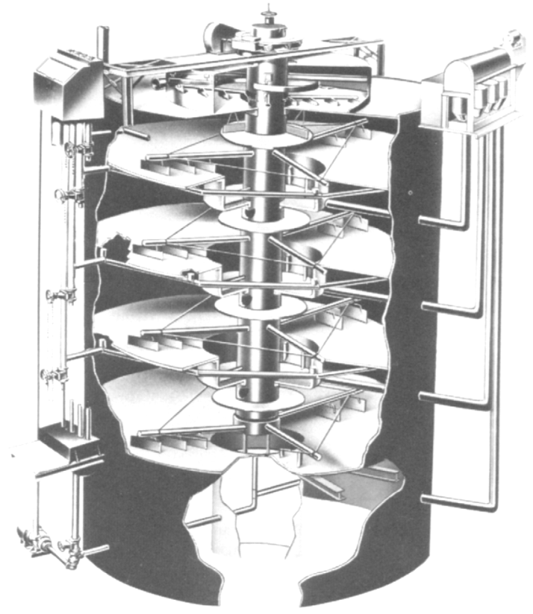
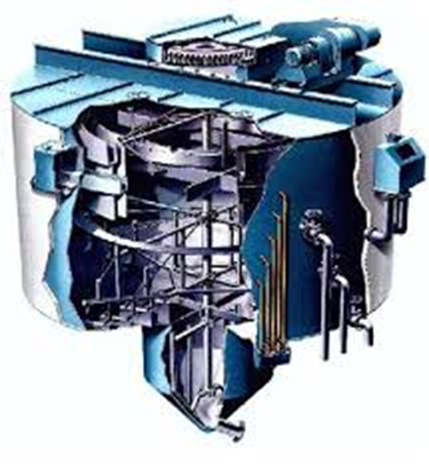
Types of Clarifiers
Rapid-Dorr Clarifier
            SRI Clarifier
Difference in arrangement of compartments

Slide 18
Filtration
Mud from a clarifier appears to be a thick fluid
Contains only 3 to 5% mud solids on a dry matter basis
90% of the mud is clear juice and must be recovered
The filter station separates the mud solids from the clear juice
Objective of filtration:
  The separation efficiency must be as high as possible
  Sucrose losses must be minimized

Slide 19
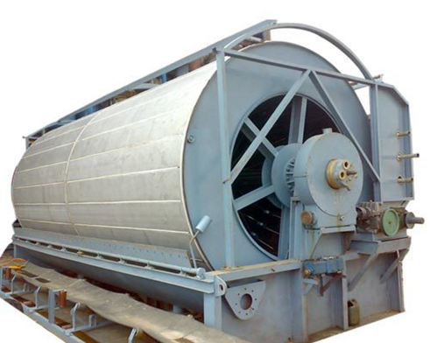
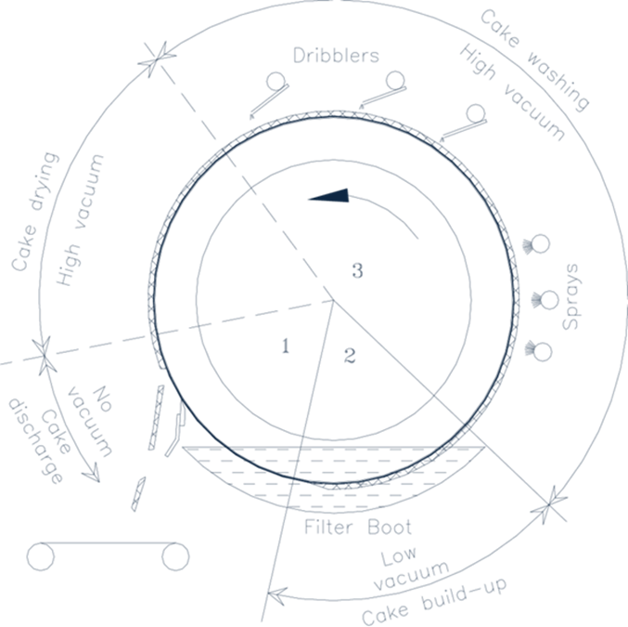
Filtration
Rotary Vacuum Filter

Slide 20
Rotary filters
Eliminates manual labour (compared to filter presses)
Filtrate not clear enough to go to the evaporates
Filtrate thus sent back to the mixed juice
Increases load in milling factories by 20%
Performance depends on:
  Mud solids concentration
  Retention
  Bagacillo ratio

Slide 21
Filter aids / Mud Conditioning
Cane muds do not filter well
Bagacillo is used as filter aid
  Is the fine bagasse particles separated from the bagasse by suction through inclined screens
  Forms a porous mat
  Traps mud solids
  Allows drainage of filtrate
Low filtration rate and long residence time reduces filtrate purity

Slide 22
Filter aids / Mud Conditioning
A flocculant (coagulant) is also added to improve filtration (different from the flocculant used for clarification)
Using polymers in mud filtration:
  Reduces the insoluble solids content of filtrates (0.4 - 2%)
  Reduces moisture content of filter cake (75 - 79%)
  Reduces percentage pol in filter cake (30%)

Slide 23
Filter Operation - Retention
Retention is defined as the mud solids in the filter cake as a percentage of the mud solids in the filter feed
If all the mud solids remained in the filter cake and all the juice was recovered as filtrate, then filter retention would be 100%
Retention can be maximised by controlling:
  Bagacillo quality
  Bagacillo quantity
  Mud solids concentration
  Pickup vacuum
  Filter speed

Slide 24
Filter Operation – Washing of the Cake
Filter drum speed rotation influences the formation of cake
Revolution should be 1 in 6 minutes
This slow revolution gives wash water time to displace the juice
Effective cake washing depends on:
  Effective reduction of the pol in filter cake
  Wash water equal to volume of juice in mud
Washing performance depends on:
  Wash water temperature
  Pick-up vacuum
  Dry bagacillo % feed
  Filter speed
  High vacuum
  Bagacillo quality
  Spray nozzles

Slide 25
Disposal of Filter Cake
Difficult due to:
  Transport costs
  Locations for dumping
Has some value as fertilizer
However, “smuts” (cane disease) are sometimes included with the filter cake making it unsuitable as fertiliser

Slide 26
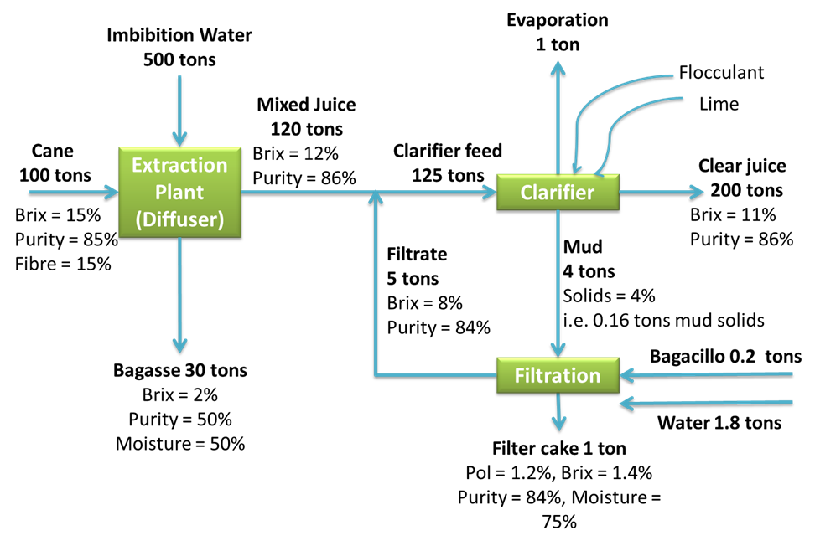
Mass Balance of Clarification and Filter Station

