Slide 1
KNOWLEDGE COMPONENT: MODULE 5: SUGAR JUICE HANDLING AND CLARIFICATION: KNOWLEDGE TOPIC 3: PROBLEM SOLVING

Slide 2
Heating – Problems and Corrective Measures
The purpose of heating:
  Promotes coagulation of proteins
  Increases the rate of the precipitation
  Removes air by flashing
  Controls microbiological losses
  Facilitates sucrose extraction
Heating is done between 65°C to 90°C in the first stage and 90°C to 105°C in the second stage
Above 105°C melted waxes emulsify and become difficult to remove
The velocity of the juice through the heater tubes should lie between 1.5 to 1.8m.s⁻¹ to:
  Get good turbulence and heat transfer
  To reduce incidence of scaling
  To reduce heating surface (smaller heaters are then possible)

Slide 3
Liming – Problems and Corrective Measures
At the milk of lime plant, there are three buffer tanks, where a supply of milk of lime is kept
The milk of lime is continuously added to the hot juice in the perry tank, pH being controlled automatically
pH and the temperature must be kept constant to obtain maximum purification
If the pH controller fails to control:
  It must be switched to manual
  Lime dosing is controlled manually with the aid of indicator paper
  Will turn a shade green for the correct pH
  If the colour turns yellowish, more lime must be added
Also used for manual pH control are
  Phenol red and bromothymol blue
  These indicators change colour at approximately pH 7
  Colour change is from yellow (acid) to red (alkaline) for phenol red
  Colour change is from yellow (acid) to blue (alkaline) for bromothymol blue

Slide 4
Liming – Problems and Corrective Measures – cont.
Use a Beaume Spindle for rough estimation of lime concentration
If the clear juice is heated at a pH below 7, sucrose will be hydrolysed and form invert sugar
Sucrose inverted depends on:
  The pH (more sugar is inverted at a lower pH)
  The temperature (the reaction is speeded up, when the temperature is higher)
  The time
At higher pH values:
  The reducing sugars will form coloured bodies and acids, These cause many troubles in the production of white sugar
It has been found that keeping the clear juice at about pH 7.2 is the optimal pH

Slide 5
Clarification – Problems and Corrective Measures
For proper clarification the following points should be kept in mind:
  An alkaline reaction causes:
    Destruction of reducing sugars
    Coloured products are formed
    Increased viscosity in massecuites and molasses, causing:
      Poor curing
      Lower exhaustion
      Negatively affects the quality of the sugar
  An acid reaction causes inversion of sucrose
Higher temperature speeds up the two reactions above
Short retention times are desirable, as the reactions above are time dependent

Slide 6
Clarification – Problems and Corrective Measures (cont.)
Filling and emptying the clarifier is critical and should be done slowly
Bypass gate must be fully open
Before starting the juice feed, start the scraper mechanism
Fill from the bottom up
Mud pump must be started soon after the juice starts flowing into the clarifier
To empty: The centre tube bypass valve must be opened and the unit emptied slowly
Once empty the clarifier must be thoroughly washed out with water

Slide 7
Clarification – Problems and Corrective Measures (cont.)
If the top compartment overflows – pump mud out faster
Lower compartment overflows – raise the overflow sleeve
If all compartments overflow
  Pump mud out faster
  Slow down the feed rate
  The settling properties of the floc may have changed. Check:
    pH
    Juice quality
    Temperature
No juice flow from lower compartments
  Feed might be below capacity
  Mud removal is too fast (thin mud). Slow down the pumping rate.
  Overflow pipe may be blocked. Clear blockage
  The juice in overflow pipe may have cooled which will raise its density. Lower the sleeve to regain flow, then raise to original position again. Or use an air or steam line in the juice pipe to lift the juice

Slide 8
Clarification – Problems and Corrective Measures (cont.)
Mud is thin
  Removal of mud is too fast – Slow down pumping rate
  Clarifier may be overloaded and does not have enough time to thicken
  Slow down the feed rate
Unable to pump mud
  Mud may be too thick – Flush the pipe with water and pump out faster
  Pump may not be working – Check and correct
  Pipe may be blocked – Try flushing with air and water

Slide 9
SRI Clarification – Problems and Corrective Measures
Flocculant dosing rates: Periodic settling tests should be done to ensure correct dosage rate
Flocculant must be distributed evenly
Check:
  Adjustment of flowmeters
  Strength of flocculant
  Pump operation
  Flocculant tank has flocculant in it
  Lumps in flocculant
  Right pH. Check the pH control system and dosing device

Slide 10
SRI Clarification – Problems and Corrective Measures (cont.)
Juice temperature entering the clarifier must be at least 100°C. Foam on the feed launder is an indication of air entrainment and poor flashing.
It is critical that the rate of feed to the clarifier not exceeds the settling rate. If the settling rate of the juice reduces, the action is taken in the following order.
  Add more flocculant or change the flocculant
  Add phosphoric acid to produce more precipitate
  Reduce the mixed juice flow rate by slowing down the mill

Slide 11
Juice Deterioration
Effect of pH
  Purity drip increases as pH falls below 7.2 at a temperature of 88°C over a 40-hour storage period
  If a longer storage period is expected, the pH must be increased
Effect of temperature
  Minimum purity drop between 71 and 74°C.
  Below this microbial activity increases – drop in purity
  Above this temperature chemical decomposition increases – inversion increases
Control deterioration as follows:
  Cold storage: Maintain a juice temperature below 71°C and treat the juice with a bactericide like formalin
  Hot storage: Maintain a juice temperature above 75°C and increase the pH by adding more lime
  Keep mud levels as low as possible during shut-down periods
  During weekend or emergency shut-down – liquidate the clarifier if possible

Slide 12
Clear Juice Quality
If clear juice quality is poor, check:
  Juice flow – Increased juice flow causes disturbances in the clarifier
  If the juice flow is steady check the pH and temperature
  Check on the brix of the incoming mixed juice
Incomplete settling may be due to:
  Small size of particles
  Protective colloid action
  Density of some particles not greater than that of the liquid
Slow settling may be due to:
  Viscosity of the liquid
  Large surface area of particles
  Small density difference between particles and liquid

Slide 13
Clear Juice Quality (cont.)
Large volume of settlings may be due to
  Large amount of precipitable material, particulary phosphate
  Low density of settlings
Low density settlings may be due to:
  Shape and size of particles
  Hydration of the particles

Slide 14
Filtration – Problems and Corrective Measures
The criteria of a good filter operation are:
Good retention, depending on:
  Properly adjusted distribution head
  No worn or broken screens
  The bagacillo ratio:
    The ratio between bagacillo and mud should be +/- 0.6 to 1.
  Bagacillo fineness
    Approximately 80% dried bagacillo should pass a 20 mesh screen.
  Rpm of the rotating drum
  High and low vacuum
Low pol % filter cake, depending on:
  Amount of water
  Proper distribution and spraying of wash water covering the whole surface of the drum
  Temperature of the wash water should be approximately 90°C
  Rpm of the rotating drum
  High and low vacuum, of which the ratio should be 2:1 with an optimum high vacuum of 50kPa

Slide 15
Mud Retention – Problems and Corrective Measures
Bagacillo quality:
  Must be fine (mostly pith)
  Free of long fibre
  Should pass through a 0.8mm screen (90%) and a 0.5mm screen (70%).
Bagacillo quantity:
  Dry bagacillo % feed - 3%
  More than 3% - mixing and pumping is difficult, and
  Wash water causes channeling with resultant poor washing
Mud solids concentration (MSC):
  With a low MSC (thin mud) a lot of filtrate passes through the filter screen before the filtering mat is formed - causing poor retention.
  With a MSC of 3% or less – poor retention
  With a MSC of 3%-4% higher retentions are possible provided the bagacillo ratio is correct.
  More bagacillo is required as the concentration of mud solids increase

Slide 16
Mud Retention – Problems and Corrective Measures (cont.)
Pickup vacuum:
  A low pickup vacuum allows the cake to build up gradually and form a porous cake that allows for effective washing
  The pickup vacuum should not exceed - 20 kPa.
  A high pickup vacuum results in cloudy filtrate due to the solids being sucked through the screen.
Filter speed:
  Speed of the filter drum influences the formation of the cake
  Maximum speed should be 1 revolution in 6 minutes
  Faster will reduce the retention
  Optimal speed will give the wash water sufficient time to displace the juice

Slide 17
Cake Washing – Problems and Corrective Measures
Wash water temperature:
  A low wash water temperature (below 70°C) reduces efficiency because of the solidification of waxes
  These waxes solidify behind the screen and the screen and the wash water has difficulty in draining away
  A too high water temperature can cause flashing at the filtrate pump
Pick–up vacuum:
  A low pick-up vacuum results in a porous cake with good washing properties. The pick-up vacuum must be less than -20 kPa gauge
Dry bagacillo % feed:
  If the dry bagacillo % feed exceeds 4% channeling of the cake will result which will reduce the washing efficiency
Filter speed:
  Low/slow filter speeds give the cake more exposure to the wash water which will improve the washing efficiency

Slide 18
Cake Washing – Problems and Corrective Measures (cont.)
High vacuum:
  A good vacuum (at least -60 kPa gauge) will draw water through the cake with a greater force - thus improving efficiency
  If the vacuum is too high (about -80 kPa gauge) there will be a possibility of flashing at the filtrate pump
Bagacillo quality:
  Fine bagacillo gives a cake through which the wash water will be easily drawn
  The water will not run off but go through the cake and improve the removal of pol
Spray nozzles:
  Blocked nozzles stop the flow of water with no washing of the cake
  Partially blocked nozzles cause the wash water to squirt out with considerable force
  This results in channeling, excessive washing of part of the cake and dilution of filtrate
  Nozzles should be checked regularly and cleaned whenever necessary

Slide 19
Filtration – Further Problems and Corrective Measures
Filter feed temperature should not be less than 85°C after bagacillo addition.
  Screen blinding may occur at lower temperatures through solidification of waxes.
The addition of feed to the filter trough should be continuous and proportional to the filtration rate.
  The mud level in the filter trough mud boot should be constant and evenly distributed over the length of the filter.
  Mud overflow into the overflow tank should be avoided and if it does occur the mud should be pumped back immediately to avoid cooling and fermentation.
The addition of flocculant at 4 - 5ppm can sometimes help filtration but is not essential.
The cake thickness will vary with filter speed.
  The thickness can be increased by slowing the filter and by increasing the bagacillo ratio.
  At the normal speed of 10 - 15 revs per hour the cake should be 5 - 6 mm thick.
  A thin cake will result in poor retention and blinding.
The pH of the feed should be adjusted after the clarifier to about 7.5 with milk of lime.

Slide 20
Sucrose losses – Corrective Measures
Sucrose losses in the filter cake are between 0.2 and 0.3% of the sucrose in cane – Acceptable
Sucrose losses in the filter station due to microbial activity is not acceptable
Associated with
  Low temperatures
  Long filtrate residence times in the filter station (should be 14 to 46 minutes)
Corrective measures:
  Reduce the heat loss which results from long retention times
  Increase wash-water temperatures to at least 80°C
  Reduce the heat loss caused by poor distribution and circulation of filter feed in the filter boots (check for “dead spots”) – modify feed piping and use steam sprayers in the boot
  Increase filtration rate, to reduce number of filters – thus reduce filtrate retention time
  Check mud pH – An indication of deterioration in the clarifier (Should be higher than clear juice pH because of the lime particles.)

Slide 21
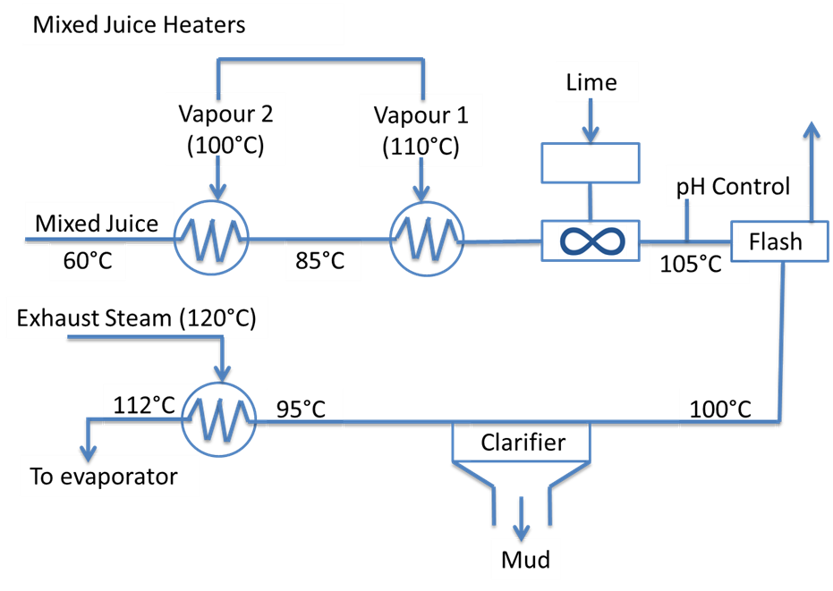
Summary of Clarification

