Slide 1
KNOWLEDGE COMPONENT: MODULE 6: EVAPORATION:
KT 1: EVAPORATION PRINCIPLES

Slide 2
Background
“Evaporation” is the removal of water from a solution by boiling the liquor in a suitable vessel and withdrawing the resulting water vapor.
Evaporation is thus carried out by adding heat to the solution to vaporize the water (solvent).
The evaporator in its simplest form, would be a closed pressure vessel divided into two sections by a pressure-tight divider. One section is connected to a steam source and the other is partially filled with a solution - juice. If the steam is at a temperature higher than the boiling point of the solution in the other section, two things will occur:
  The steam will condense and will transfer heat to the solution.
  The solution will boil which will drive off the solvent.
An evaporator is thus a heat exchanger that achieves a phase change on both sides of the heating surface.

Slide 3
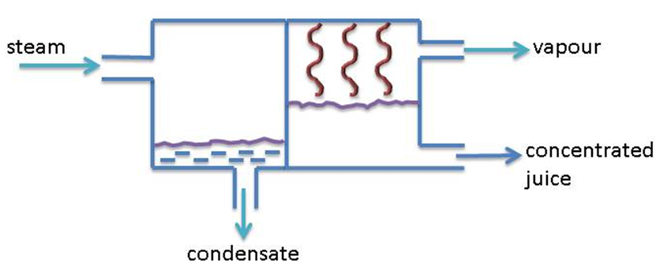
Background (cont.)

Slide 4
Evaporation Principles
Clarification removes materials that would interfere with subsequent processing
The next step is to eliminate the remaining unwanted component which is water, in order to recover the sucrose
As water is removed the sucrose and the other remaining impurities become more concentrated
When solution is saturated crystals will begin to appear in the liquid
Two stages are required for this process:
  Evaporation from initial brix of 12° to 65°
  Sucrose crystallizes – evaporative crystallisation

Slide 5
Boundary between evaporation and sugar boiling
Sugar begins to crystallise around 78 - 89°Bx
Evaporation can be carried out up to 72 - 75°Bx depending on impurities present
Sugar boilers require syrup capable of dissolving further sucrose so that false grain can be dissolved
Thus, a Bx of 72° is never exceeded
Evaporation continues up to 65 - 68°Bx

Slide 6
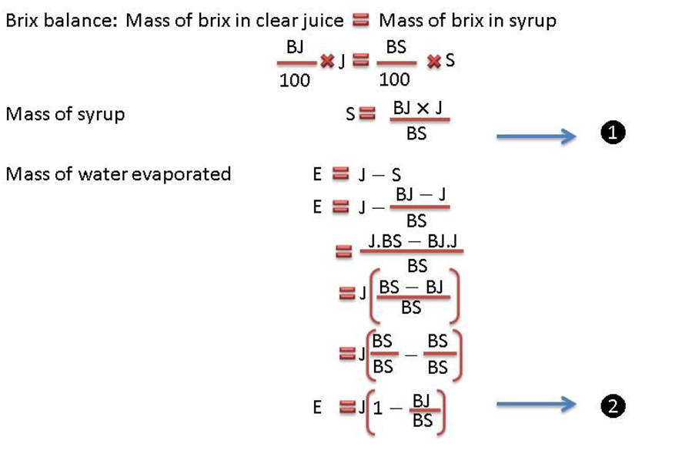
Quantity of H₂O to be evaporated
Let:
  BJ = brix of juice (°Bx)
  BS = brix of syrup (°Bx)
  E = mass of water evaporated (mass/time)
  J = mass of clear juice (mass/time)
  S = mass of syrup (mass/time)

Slide 7
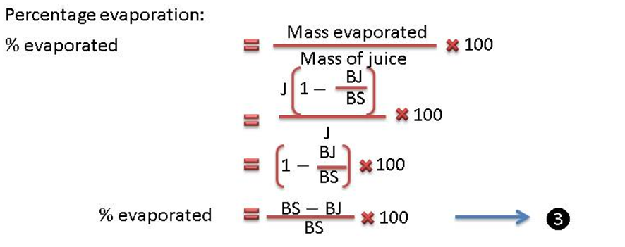
Quantity of H₂O to be evaporated

Slide 8
Pressure and Boiling Point
The temperature at which water boils is determined by the pressure on its surface.
The boiling point/temperature of a solution is increased by the amount of dissolved substances present in the solution.
  At 0°Bx pure water boils at 100°C under atmospheric pressure.
  A 70°Bx sucrose solution boils at 105.7°C under atmospheric pressure.
  The difference of 5.7°C is called the Boiling Point Elevation (B.P.E)
The specific volume of saturated steam at a certain pressure is the volume in cubic metres (m³) of 1kg of saturated steam under that specific pressure.
See Steam Tables

Slide 9
Energy Changes during Evaporation
At 0 k (-273°C) all substances have zero internal energy/heat.
As the temperature of a substance increases above 0 K, the internal energy of the substance increases.
The energy that a substance possesses due to its temperature above 0 K is called its sensible heat. At 5°C the sensible heat of water is 137.82kJ.kg⁻¹ and at 100°C the sensible heat of water is 419.04kJ.kg⁻¹.
The energy that a substance absorbs/releases when it changes phase is called its latent heat.
At 100°C the latent heat of evaporation of water is 2258.0kJ kg⁻¹.
  From 0 K (- 273°C) to 273 K (0°C) water exists as a solid (ice).
  From 273 K (0°C) to 373 K (100°C) water exists as a liquid.
  Above 373 (100°C) water exists as a gas (steam)

Slide 10
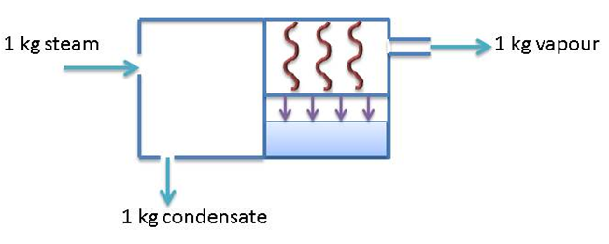
Single Effect Evaporation
Each kg of steam condenses and passes its latent heat to a boiling solution where it evaporates 1kg of water to produce 1kg of vapour.
“One-to-one” evaporation.
If the juice feed enters the evaporator below its boiling point, more than 1kg of steam will be required to evaporate 1 kg.
If the feed enters superheated, it is possible that the 1kg of steam would produce more than 1 kg of vapour.
But, latent heat of evaporation of water decreases as the pressure increases
Thus, high pressure steam contains less kJ of heat energy in terms of latent heat per kilogram of steam than the heat energy required to evaporate 1kg of vapour at the lower pressure.

Slide 11
Multiple Effect Evaporation
Vapour from a vessel of boiling juice is suitable for use as the source of heat for the next vessel.
The vapour from a vessel of boiling juice can thus be passed to the steam chest of a second evaporator, provided the boiling temperature of the contents in the second vessel is sufficiently below the temperature of the vapour to ensure an adequate temperature difference.
This is made possible by reducing the pressure and therefore the boiling point in the second vessel.
The use of two or more evaporators in series - the vapour outlet of the first vessel being the steam source for the second vessel - is known as multiple effect evaporation.
The juice flow is also from the first to the last vessel (forward feed).

Slide 12
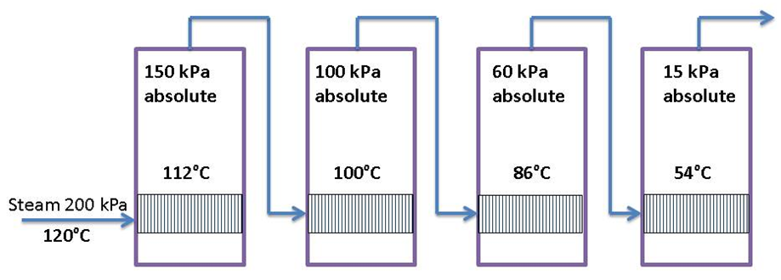
Multiple Effect Evaporation (cont.)
Quadruple effect evaporator

Slide 13
Multiple Effect Evaporation (cont.)
There is a limit to the number of effects it is possible to have.
In the sugar industry – this limit is usually five (quintuple effect)
  There is a practical limit to the vacuum that can be drawn using conventional barometric condensers.
  The temperature-sensitive nature of cane juice places an upper limit on the exhaust steam pressure (temperature) that can be used.

Slide 14
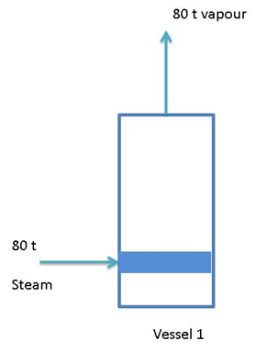
Practically…..Single effect
Consider the case where we wish to evaporate about 80t of water from 100t of juice to increase its brix from 12°Bx to 65°Bx.
This is a single effect evaporation. An amount of 80t steam condenses and evaporates 80t of water. The total amount of water evaporated is 80t and this required 80t of steam.

Slide 15
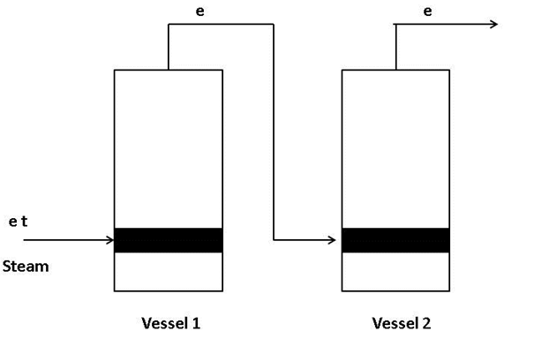
Practically…..Double effect
This is a double effect evaporation train.
To calculate how much vapour is evaporated in each vessel/effect, we start from the last evaporator and we reason as follows:
e tons of vapour is evaporated at Vessel 2, which means that e tons of vapour from vessel 1 was required.
Therefore e tons of vapour was evaporated from vessel 1, which means that e tons of steam was used in vessel 1.
The result is that the juice moves into vessel 1 where e tons of water is evaporated, after which the juice moves into vessel 2 a further e tons of water is evaporated from the juice.

Slide 16
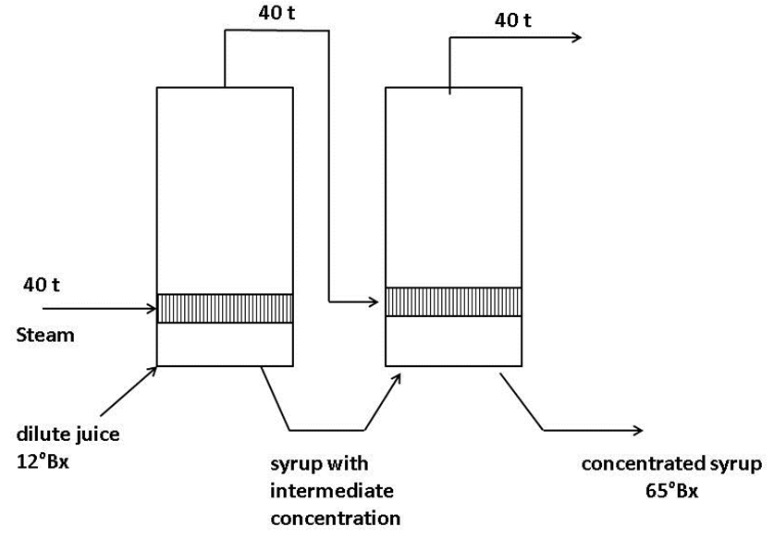
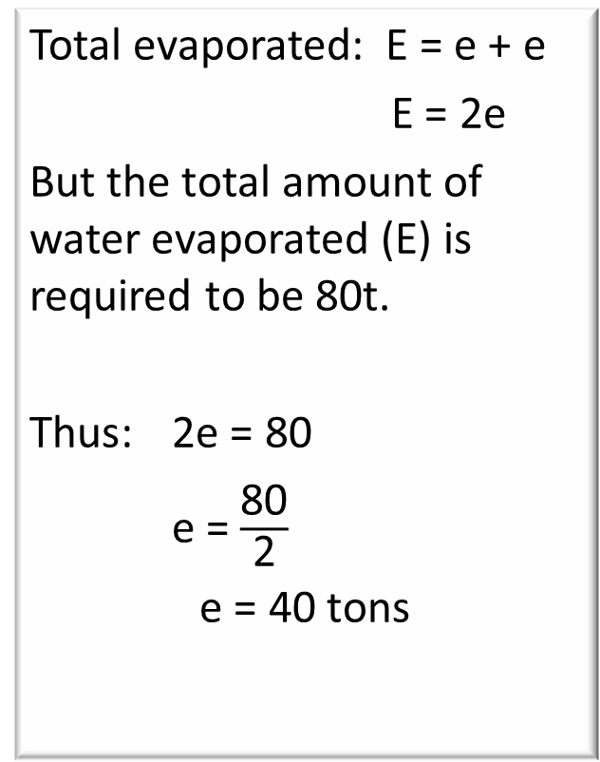
Practically…..Double effect (cont.)
Total evaporated: E = e + e
E = 2e
But the total amount of water evaporated (E) is required to be 80t.
Thus: 2e = 80
e = $\frac{\text{80}}{\text{2}}$
e = 40 tons
This information can be summarized as follows:

Slide 17
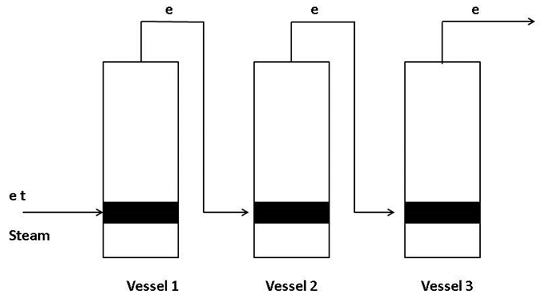
Practically…..Triple effect
This is a triple effect evaporator train.
To calculate how much vapour is evaporated in each vessel/effect, we start from the last evaporator and we reason as follows:
e tons of vapour is evaporated at vessel 3, which means that e tons of vapour from vessel 2 was required.
Therefore e tons of vapour was evaporated from vessel 2, which means that e tons of vapour from vessel 1 was required.
Therefore e tons vapour was evaporated from vessel 1, which means that e tons of steam was used in vessel 1.
The result is that the juice moves into vessel 1 where e tons of water is evaporated, then into vessel 2 where another e tons of water is evaporated and finally into vessel 3 where a further e tons of water is evaporated.

Slide 18
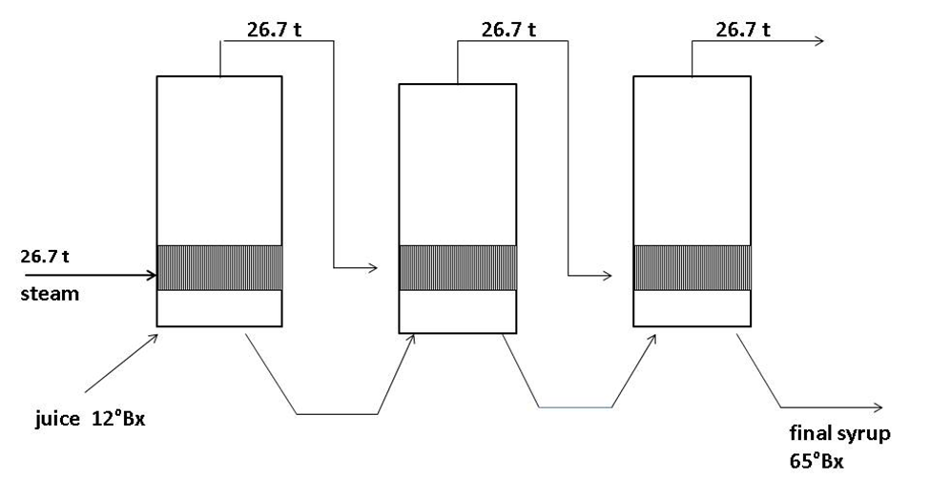
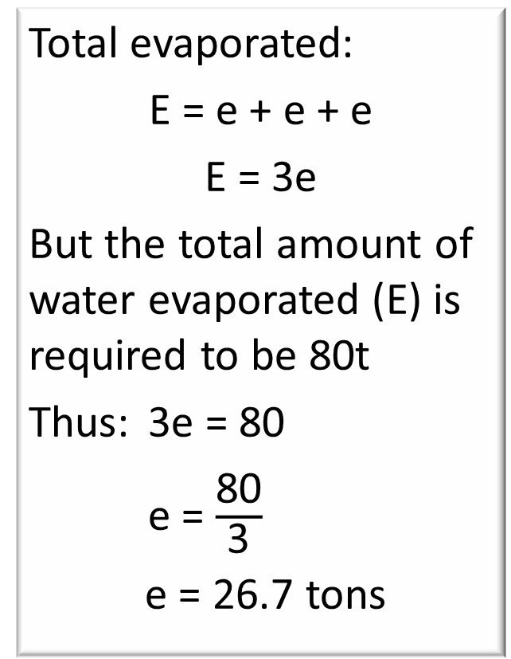
Practically…..Triple effect (cont.)
Total evaporated:
E = e + e + e
E = 3e
But the total amount of water evaporated (E) is required to be 80t
Thus: 3e = 80
e = $\frac{\text{80}}{\text{3}}$
e = 26.7 tons
This information can be summarised as follows:

Slide 19
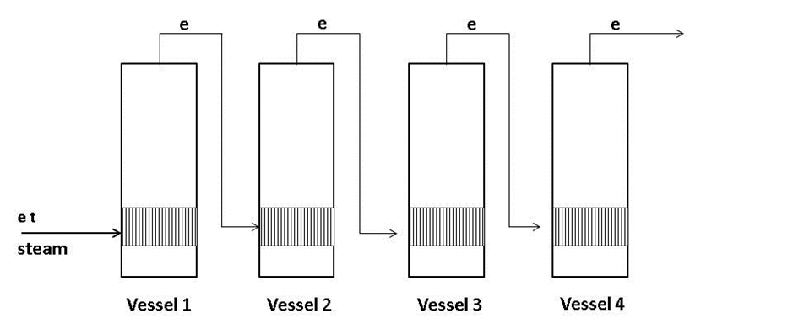
And so on…..
As the number of effects increases, the mass of steam required for the first effect decreases.

Slide 20
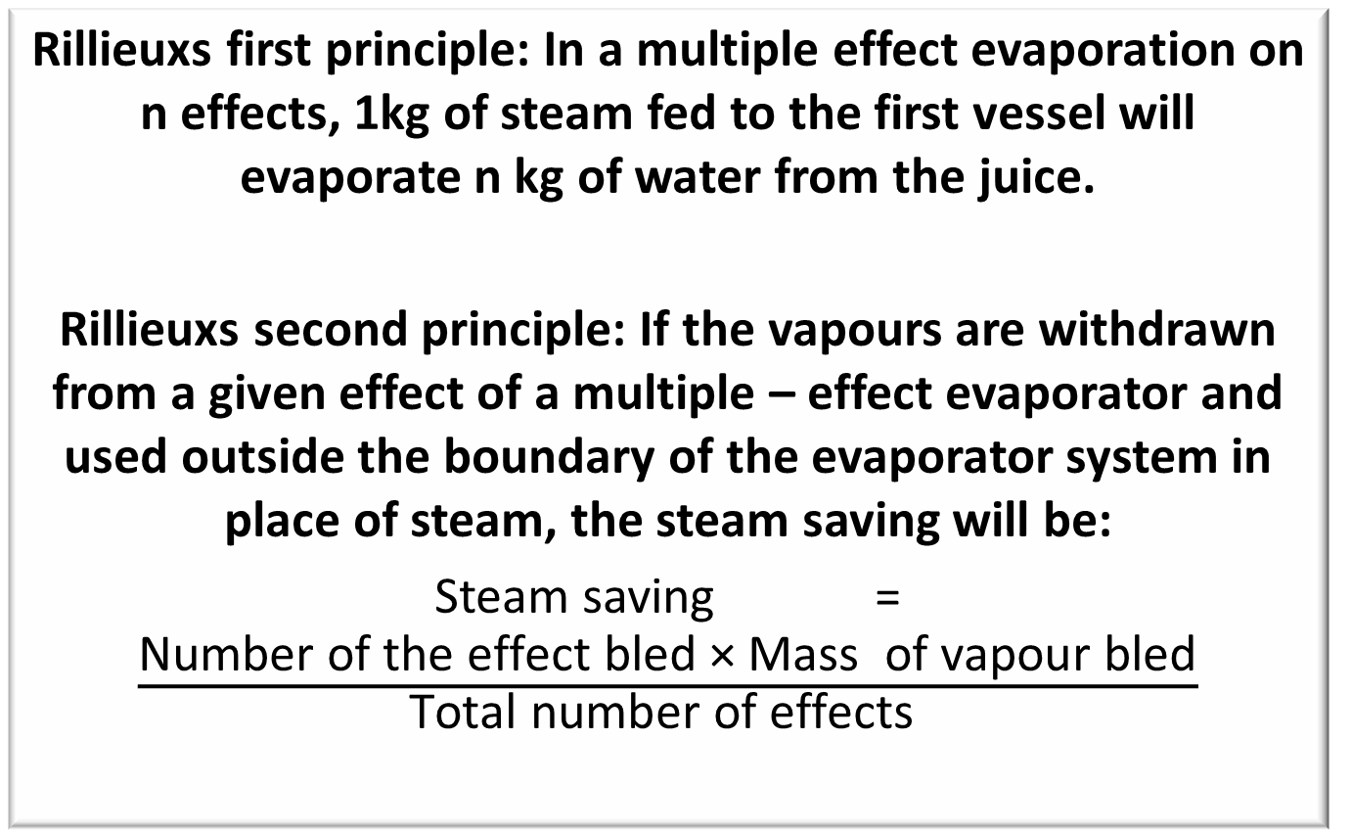
Rillieux’s Principles
Rillieuxs first principle: In a multiple effect evaporation on n effects, 1kg of steam fed to the first vessel will evaporate n kg of water from the juice.
Rillieuxs second principle: If the vapours are withdrawn from a given effect of a multiple – effect evaporator and used outside the boundary of the evaporator system in place of steam, the steam saving will be:
Steam saving = $\frac{\text{Number} \text{of} \text{the} \text{effect} \text{bled}\text{ × }\text{Mass} \text{of} \text{vapour} \text{bled}}{\text{Total} \text{number} \text{of} \text{effects} }$

Slide 21
Principles in practice…..
Rillieuxs first principle: In a multiple effect evaporation on n effects, 1kg of steam fed to the first vessel will evaporate n kg of water from the juice.
Under factory conditions this principle is not totally accurate as there are some factors which cause deviations from the principle.
Heat is required to raise the temperature of the juice to boiling point.
Hence some vapour is condensed without causing an equivalent amount of evaporation.
An increase in the latent heat of the vapour as the boiling temperature decreases (i.e. the pressure decreases).
The latent heat required to evaporated 1 kg of vapour in the last effect is thus greater than in the first effect.

Slide 22
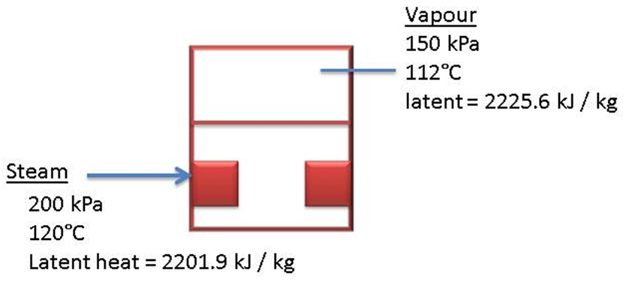
Example…..
Consider the first effect……
Therefore 1kg of steam condensing does not release enough energy to evaporate 1 kg of water.
A decrease in the specific heat of the juice as it is concentrated.
This means that less energy/heat is required to raise the temperature of more concentrated syrup by 1°C.
Flashing of the juice as it enters a lower pressure vessel causing some evaporation without vapour needing to be condensed to produce the vapour.
Flashing of the condensate.
Heat lost by radiation and by removal of incondensible gases.

Slide 23
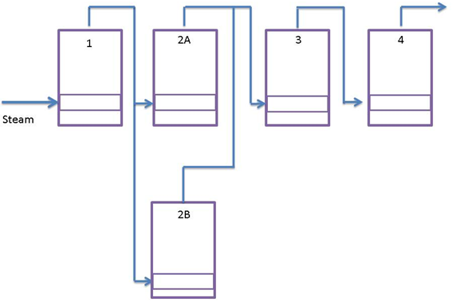
Defining the different effects in an evaporator train
A number of vessels may make up a single effect if they are in parallel on the steam side i.e. they share common steam and vapour mains.
In this case the juice flow may be either in series or parallel between the vessels in the effect.

Slide 24
Defining the different effects in an evaporator train (cont.)
Since evaporators 2A and 2B both receive vapour from the first effect, evaporators 2A an 2B together constitute the second effect.
Juice from evaporation 1 can either:
  Flow into 2A, then into 2B and subsequently to evaporation 3
  or
  Split with part flowing into 2A and the rest into 2B.
  The juice from 2A and 2B is then combined before flowing to evaporation 3.

Slide 25
Heat Transfer
Depends on the temperature difference between the vapour and the juice.
The first vessel steam chest/calandria temperature depends on the exhaust steam temperature and is limited by the risk of inversion at high temperatures.
The temperature of the syrup in the last vessel depends on the vacuum created in the condenser (Temperature of the cooling water).
This is usually limited to 55°C as below this the high viscosity of the syrup causes poor heat transfer.
High vacuum and low temperatures increase the risk of entrainment due to the increased volume of vapour.

Slide 26
Heat Transfer (cont.)
Low temperatures also increase the supersaturation coefficient which could cause crystal formation.
If the exhaust steam at 200kPa absolute pressure has a temperature of 120°C (no superheat) the temperature drop across the evaporator station would be 65°C (120°– 55°).
In a quadruple effect the average temperature drop per vessel would be 16°C which is good.
A quintuple effect would have an average temperature drop of 13°C which is border line.
Six vessels would not be a proposition as there would not be enough temperature difference for good heat transfer.
Note that the temperature differences between incoming vapour and boiling juice (ΔT) increases towards the final effects of an evaporator train.

Slide 27
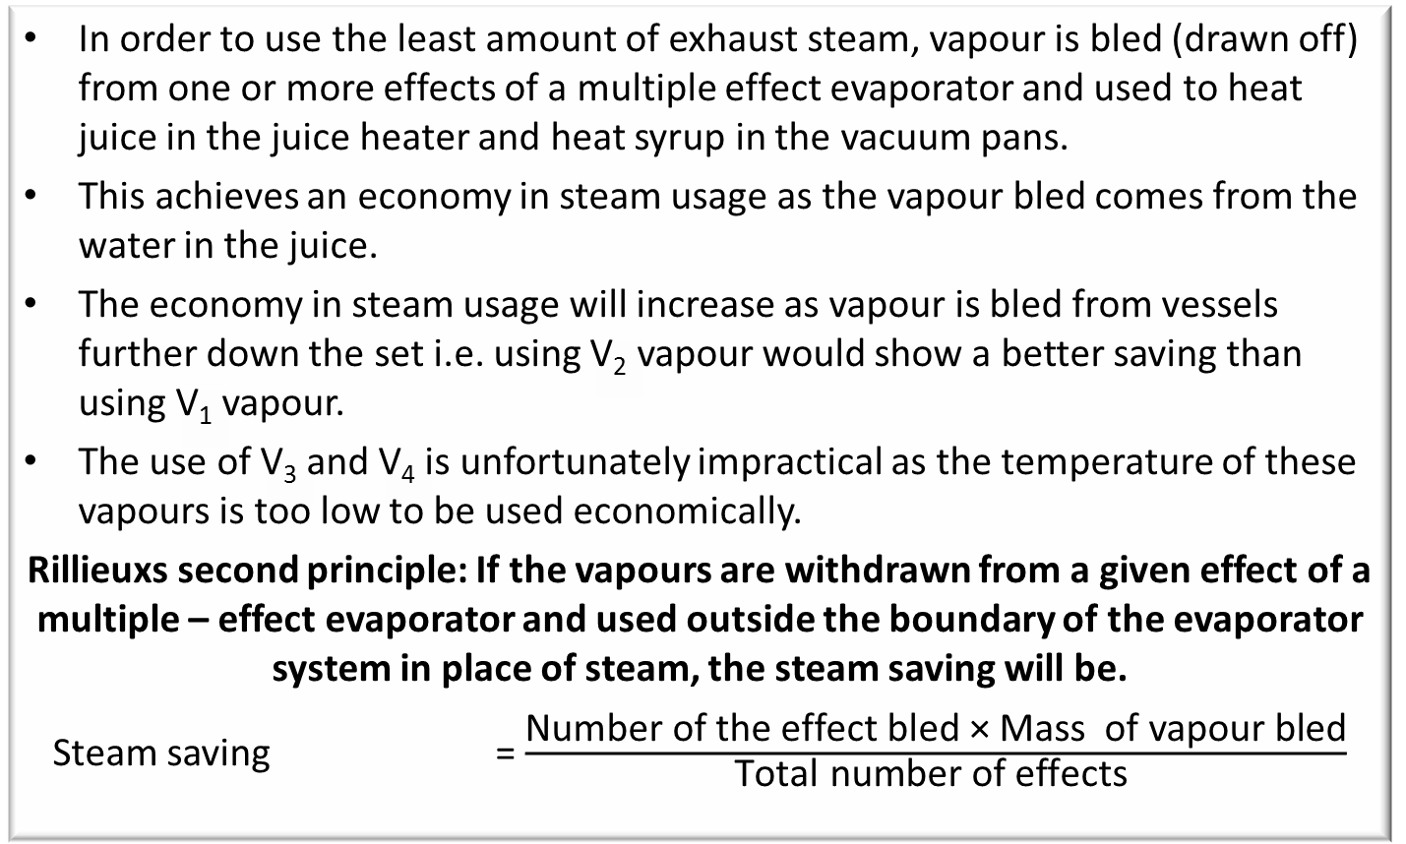
Vapour Bleeding
In order to use the least amount of exhaust steam, vapour is bled (drawn off) from one or more effects of a multiple effect evaporator and used to heat juice in the juice heater and heat syrup in the vacuum pans.
This achieves an economy in steam usage as the vapour bled comes from the water in the juice.
The economy in steam usage will increase as vapour is bled from vessels further down the set i.e. using V₂ vapour would show a better saving than using V₁ vapour.
The use of V₃ and V₄ is unfortunately impractical as the temperature of these vapours is too low to be used economically.
Rillieuxs second principle: If the vapours are withdrawn from a given effect of a multiple – effect evaporator and used outside the boundary of the evaporator system in place of steam, the steam saving will be.
Steam saving = $\frac{\text{Number} \text{of} \text{the} \text{effect} \text{bled}\text{ × }\text{Mass} \text{of} \text{vapour} \text{bled}}{\text{Total} \text{number} \text{of} \text{effects} }$

Slide 28
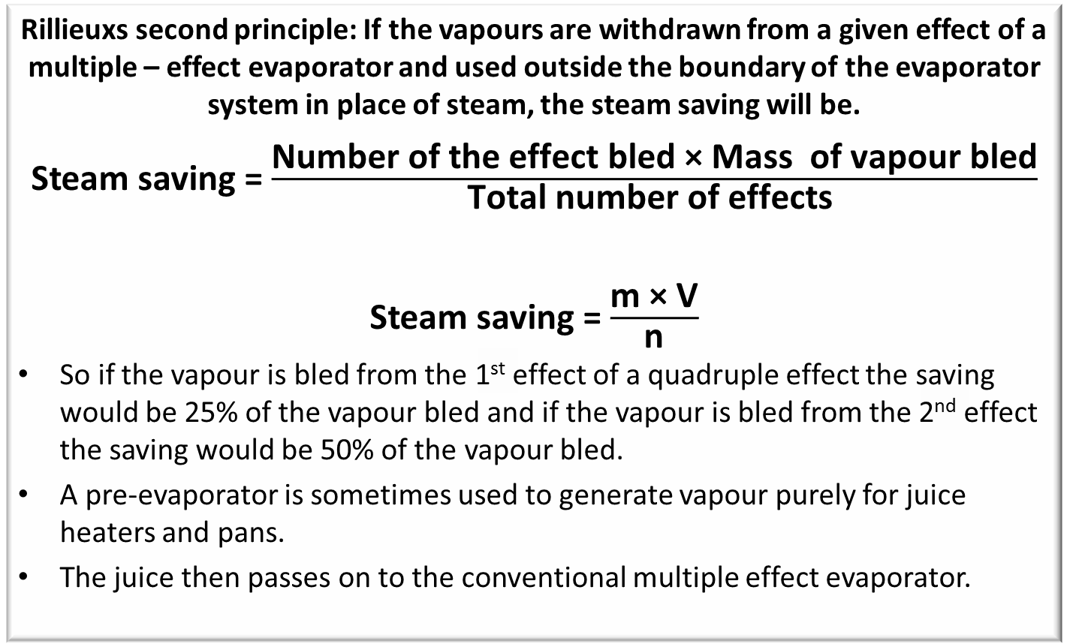
Vapour Bleeding (cont.)
Rillieuxs second principle: If the vapours are withdrawn from a given effect of a multiple – effect evaporator and used outside the boundary of the evaporator system in place of steam, the steam saving will be.
Steam saving = $\frac{\text{Number} \text{of} \text{the} \text{effect} \text{bled}\text{ × }\text{Mass} \text{of} \text{vapour} \text{bled}}{\text{Total} \text{number} \text{of} \text{effects} }$
Steam saving = $\frac{\text{m}\text{ × }\text{V}}{\text{n}}$
So if the vapour is bled from the 1st effect of a quadruple effect the saving would be 25% of the vapour bled and if the vapour is bled from the 2nd effect the saving would be 50% of the vapour bled.
A pre-evaporator is sometimes used to generate vapour purely for juice heaters and pans.
The juice then passes on to the conventional multiple effect evaporator.

Slide 29
Calculation to do: …….
A quadruple effect evaporator train is required to evaporate 80t of water from 100t of juice to concentrate the juice from 15°Bx to 65°Bx
Calculate the amount of exhaust steam required by the first effect if no vapour bleeding is used. In addition 10 tons of exhaust steam is required for various heating purposes in the factory.
Calculate the total amount of exhaust steam required to supply the heating needs of the factory if no vapour bleeding was used.
Calculate the total amount of exhaust steam required if the 10 tons are bled from the first effect evaporator.
Calculate the total amount of exhaust steam required if the 10 tons is bled from the second effect evaporator.
Calculate the total amount of exhaust steam required if the 10 tons is bled from the first effect and 10 tons is bled from the second effect.

Slide 30
Chemical changes during evaporation
Increase in purity
Reducing sugar ration (the ratio of reducing sugars to pol)
Precipitation of non-sugars
Sucrose decomposition : Inversion
Degradation of reducing sugars
Colour formation
Change in pH

Slide 31
Chemical changes: Increase in Purity
Under normal conditions there should be a slight increase in purity from clear juice to syrup.
This increase in purity is as a result of:
  A change in the specific rotation of certain non-sucrose components specifically reducing sugars under the influence of temperature
  Precipitation / removal of some non-sugars.

Slide 32
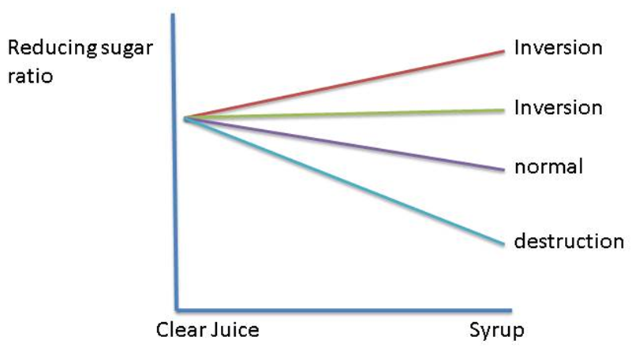
Chemical changes: Reducing sugar ratio
Under normal conditions, a clear juice with a good pH (7.0 – 7.4) will record a small decrease in the reducing sugar ratio of between 4 – 6% from clear juice to syrup.
Decrease is greater when the juice has been over-limed during the clarification stage.
Large decrease in the reducing sugar ratio indicates destruction of reducing sugars.
Increase in the reducing sugar ratio or a reducing sugar ratio that remains constant indicates inversion.
CHANGE IN REDUCING SUGAR RATIO

Slide 33
Chemical changes: Precipitation of non-sugars
The syrup, if diluted, has an increase in turbidly over that of clear juice.
Due mainly to the post precipitation of certain non-sugars because of the high temperatures in the first evaporator vessel.
Non-sugars include silica and organic compounds.

Slide 34
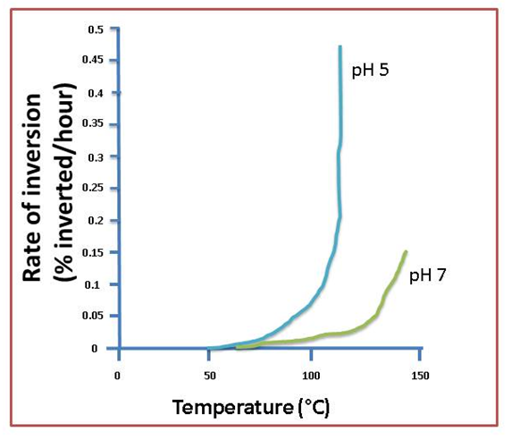
Chemical changes:
Sucrose decomposition : Inversion
Inversion is the thermal and/ or acid decomposition of a sucrose solution to yield a mixture of glucose and fructose.
More marked the higher the temperatures, lower pH and the longer the time of exposure.
Rate is affected by pH, temperature and time.
Directly proportional to the time.
Proportional to the H⁺ ion concentration (acidity).
The rate increases tenfold for every 1 unit decrease in pH. At 100°C and pH of 7.0 the rate is 0.021% inverted per hour. At pH of 6.0 the rate will increase to 0.21% inverted per hour.
Icreases rapidly with increase in temperature. If the inversion at 100°C is 1.00 then the the rate at 120° is 5.23 times faster.

Slide 35
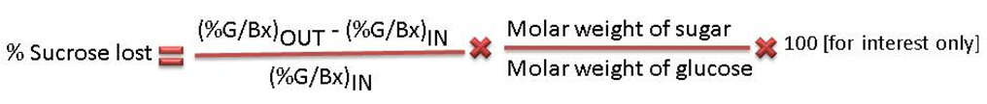
Chemical changes:
Sucrose decomposition : Inversion (cont.)
See Temperature and Time Inversion Tables
Under normal operating conditions it is difficult to determine analytically the exact amount of sucrose that has been inverted as the process steams already contain amounts of reducing sugars.
An increase in the reducing sugars ratio would normally be indicative of sucrose destruction by inversion.
An assessment of the potential sucrose losses where no information on operating temperature or pH (measured at operating temperature) is available, is possible using changes in the reducing sugar ratio, preferably the glucose ratio.
Acid juice and high temperatures in the first and second vessels are conducive to inversion of sucrose to glucose and fructose.

Slide 36
Chemical changes: Degradation of reducing sugars
Is a function of pH, temperature and reaction (retention) time.
Alkaline juice and high temperatures in the first and second vessels are conducive to the degradation of glucose and fructose and the formation of organic acids and dark coloured compounds.
These products cause viscosity problems later on in the process.
A decrease in the reducing sugar ratio results mainly from the destruction of reducing sugars.
Destruction increases with temperature, increases with the time and increases as pH increases.

Slide 37
Chemical changes: Colour Formation
Main sources of colour in evaporator syrup are formed in the sugar cane itself
The amount present is dependent on cane age, level of stress (drought) and the amount of extraneous matter crushed.
The darkening of final syrup is largely a result of concentrating the colour bodies already present.
A certain amount of colour can be formed in the evaporator by the degradation products of reducing sugars.
This is evident by the increase in colour observed in diluted syrup.
Colour formation occurs mainly in the first vessels of the evaporator which correspond to high temperatures and slightly alkaline or neutral conditions.
Suitable pH control and short retention times in these effects have brought this under control.
Under alkaline conditions, reducing sugars break down to form colour compounds (melanoidin pigments)

Slide 38
Chemical changes: Change in pH
During evaporation pH decreases from a value typically around 7.0 to 7.2 to a value of 6.3 to 6.5 but may in some cases drop as low as 5.5.
This drop in pH is due to the following factors:
As evaporation progresses, the existing acids become more concentrated, making the solution more acidic.
Decomposition of reducing sugars to form organic acids.
Loss of alkaline volatiles such as ammonia.
Thus, a combination of high concentration and high temperature will produce conditions of low pH and thus increased inversion.

