Slide 1
KNOWLEDGE COMPONENT: MODULE 6: EVAPORATION:
KT 2: EVAPORATION DESIGN AND TYPES

Slide 2
Background
The evaporator station can be regarded as the “heart” of a sugar factory.
  It removes most of the water from the juice - preparing it for crystallization.
  It condenses the major portion of steam to provide boiler feed water
  It provides vapour to heat the pans, juice heaters, diffuser and other ancillaries.
Evaporator vessels are:
  shell and tube heat exchangers
  mounted vertically and
  provided with an efficient means of circulating juice and separating the vapour from the concentrated juice.
The tube and plate part (steam chest) is called a calandria.
The vapour separation is achieved by arranging a large space above the top tube plate or in a separate vessel where the velocity of the vapour can be maintained at a low level in order in for the droplets of juice to coalesce and fall to the bottom of the vessel.
Additional droplet elimination devices are usually provided before the vapour outlet.

Slide 3
Capacity
Capacity of an evaporator station is rated on the amount of water removed
Capacity is determined by:
  Area of the heating surface
  Number of effects
  Location and extent of vapour bleeding
System is self-balancing - the capacity is determined by the least productive unit.
If the last effect suffers from scaling and high viscosities - not possible for that effect to use all the vapour produced by the preceding effect.
Pressure builds up in the vapour space of the second last unit and evaporation there slows down.
This happens down the line until the system is balanced again.

Slide 4
Capacity (cont.)
Effect from which the vapour is bled must have an increased surface area to provide extra vapour.
All vapour generated for bleeding, must be withdrawn or the pressure will increase and capacity will suffer - vapour not used in heaters or pans must be vented if the evaporation rate is to be maintained.
Evaporation rate will suffer if too much vapour is used by the pans and heaters - evaporation can be maintained by adding make-up steam to the system.
Capacity is influenced by the temperature of the juice entering the first vessel - If low, then the heat has to be used to bring the temperature up to boiling point without generating any vapour.
When juice flows to a vessel of a lower pressure and temperature, it flashes (fast evaporation) which improves the steam economy.
Excess flashing results in poor juice distribution and lower capacity - limit to the use of this phenomenon.

Slide 5
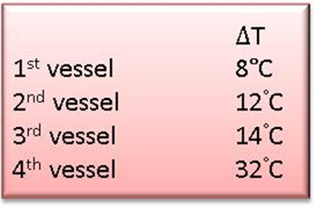
Evaporator Temp and Pressure
In a quadruple effect the exhaust steam enters the 1st vessel normally at 100kPa gauge (200 kPa absolute) and 120°C (assuming no superheat).
Vapour in the 4th vessel is at -84kPa gauge (16 kPa absolute) and 55°C.
The temperature drop is not even across the station but is as follows:
In a quintuple effect the temperature-pressure profile is different and although a steam saving is achieved the capacity of the station is NOT increased by just adding on another effect/vessel.

Slide 6
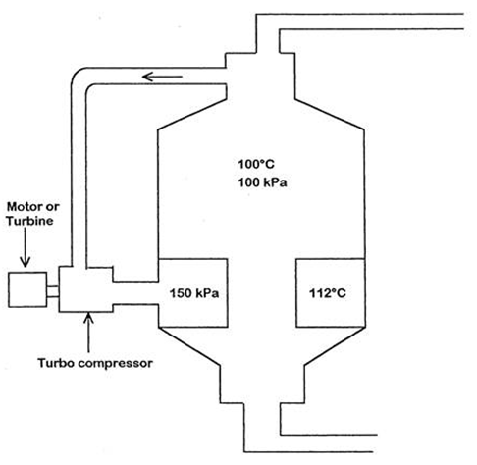
Vapour Recompression
Involves drawing off a portion of the vapour evaporated in an evaporator and mechanically recompressing this vapour to the same pressure as the steam/vapour being fed to the calandria of the particular evaporator.
Compressed vapour can then be used to supplement the vapour being fed to the evaporator - practiced to achieve steam savings.
Recompressor is driven by a turbine or electric motor.
Turbine requires steam and an electric motor requires the generation of electricity from steam
However, the turbine or alternator feeding the motor utilizes steam much more efficiently than the evaporators and hence mechanical vapour recompression leads to steam savings.

Slide 7
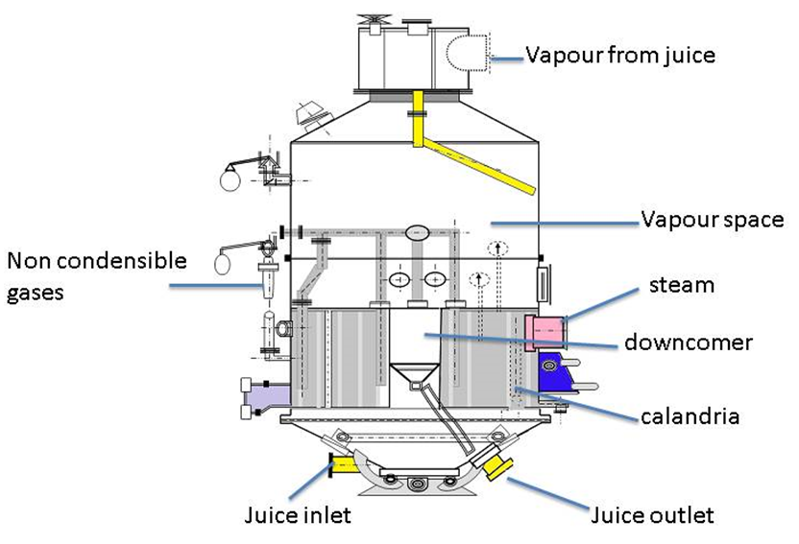
Different Types of Evaporators
Roberts Vessel Type

Slide 8
Roberts Type Evaporators
Dimensions:
Height - above the tube plate is between 2.7 and 3.7m (minimises entrainment).
Provides for droplets to coalesce and fall back into the juice in the vessel.
Diameter of the vessel also has an effect on entrainment.
The bigger the diameter; the lower the vapour velocity therefore the lower the entrainment.

Slide 9
Roberts Type Evaporators (cont.)
The calandria
The vessel where the heat transfer takes place.
Consists of vertical tubes 1- 2m in length held between an upper and lower tube plate.
Distribution of vapour to the calandria should be as uniform as possible so as to obtain a good heat transfer. Baffles are normally used to obtain this uniform distribution.
The calandria in a Roberts vessel is provided with a large central tube called a downtake.
This downtake can be connected to the outlet (“sealed”) with some holes cut through it (“semi-sealed”) or end at the bottom tube plate (“open” or “conventional”).
  Open downtake promotes maximum recirculation
  Sealed downtake promotes “plug” flow.

Slide 10
Roberts Type Evaporators (cont.)
The calandria (cont.)
Evaporator tubes are made from mild steel or stainless steel (old ones of copper or brass).
Stainless steels can be either austenitic (non-magnetic) or ferritic.
Tubes are manufactured by rolling a strip of steel lengthwise through shaping rolls, and squeezing it between side rolls at a point where a high amperage current (usually at a very high frequency) is passed through the steel.
The current causes local heating of the steel and the squeeze rolls apply pressure to the steel to weld it along the seam.
Stainless welding is carried out in an inert gas, sometimes with a filler wire, which then slows down the process.

Slide 11
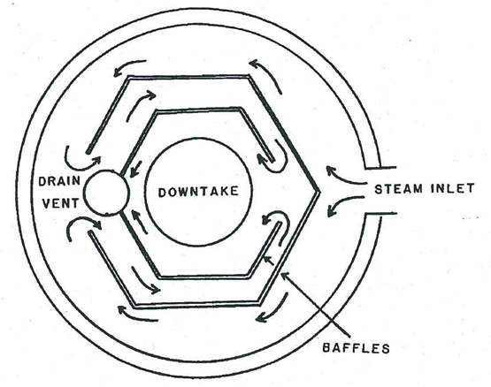
Roberts Type Evaporator (cont.)
Arrangement of downtake tube:

Slide 12
Roberts Type Evaporator (cont.)
Feeding arrangement:
The feed is taken in below the calandria of the vessel.
Flashing often occurs.
Care must be taken however, that this is not localized or heavy entrainment could occur.
The juice is fed into the vessel in such a way that the distribution over all the tubes is as even as possible.
Most evaporators are provided with a juice distribution ring inside the vessel below the bottom tube plate, with a number of holes each provided with a baffle.
This ring is connected to the juice manifold through the bottom dish of the vessel by two or more branches.
The flow of juice from one vessel to another is best regulated by means of a valve.

Slide 13
Roberts Type Evaporator (cont.)
Incondensible gas vents:
Vapour from juice contains gases such as air, ammonia and carbon dioxide
Continuous removal of these gases is essential - ensures good heat transfer
Gases under pressure can be vented to the atmosphere, while gases from calandria under vacuum can be vented to:
  The vapour space of the same vessel or
  To the vapour pipe leading to the condenser.
By venting to the condenser the gas does not enter the following calandria
  Requires a good control by means of valves to prevent undue vapour losses.
  Monitoring the temperature of the vented gas can tell whether vapour is being lost.
Gases should be vented from the top and bottom of the calandria opposite the vapour inlet.
Elaborate gas scavenging manifolds are therefore necessary in the steam space of the calandria.

Slide 14
Roberts Type Evaporator (cont.)
Condensate removal:
Condensate must be removed as soon as it is formed to avoid reducing the effective heating surface.
Must be removed by multiple outlets spread over the bottom of the calandria.
Achieved by using a steam trap, U-leg or level controlled flash vessel connected to a lower pressure outlet.
Is easily removed with a steam trap
  A device that allows condensate to pass through but not steam/vapour.
  Operate on the pressure or temperature difference between the steam/vapour and the condensate outlet.
Condensate from a calandria under vacuum must be pumped out or a U-leg can be used.
  When a U-leg is used for condensate flow control, the effective length of the U should be about 1.5 times the theoretical minimum to allow for surging.
  The condensate can be removed separately or together.
  Advantage: Simple installation.
  Disadvantage: All condensates are cooled to the temperature of the last vessel condensate and in the event of any vessel entraining, all the condensates will be contaminated.

Slide 15
Roberts Type Evaporator (cont.)
Condensate removal (cont.):
Condensate from the first vessel is normally used as a boiler feed water as it is uncontaminated and of high temperature.
The high temperature is important as it means that the condensate will absorb less oxygen, which would have had to be removed (de-aerated) before it could be used.
Condensates from the other vessels are used as factory hot water (mainly imbibition) as they have the possibility of being contaminated with sugar
2nd vessel condensate can sometimes be used as boiler feed water.

Slide 16
Roberts Type Evaporator (cont.)
Flash vessel:
When condensate is removed from the calandria it contains some potential energy in the form of latent heat which can be removed by allowing it to flash (boil) to a lower absolute pressure.
Flashing allows some additional vapour to form that can be used for heating.
When flashing condensate from one evaporator to the calandria of the next evaporator, the condensate flashes (boils rapidly) and assumes the temperature corresponding to the pressure in the calandria to which it is flashed.
The flash vessel is usually a simple pressure vessel with height equal to about 1.5 times the diameter, with the condensate inlet near the bottom and the flash outlet at the top.

Slide 17
Roberts Type Evaporator (cont.)
Entrainment and entrainment separators:
The carrying over of droplets of juice with the vapour from one effect to the calandria of the next (or to the condenser).
Results in a loss of sugar and contamination of condenser water.
Increased by sudden changes in flow, pressure, temperature or vacuum.
Controlled by means of louvre-type separators either on their own or in conjunction with stainless steel mesh screens known as demisters - Should be carefully fitted to avoid any holes which can actually aggravate entrainment due to high velocities.
Should be piped outside the vessel through a sight glass so that the effectiveness of separation can be continuously monitored.
Velocity of vapour leaving the tubes increases from vessel to vessel:
  Maximum in the last vessel due to the high vacuum and high specific volume of the vapour
  Could reach 18m.s⁻¹ which is +/-100 times greater than the 1st vessel.
Efficient separation in the last vessel is essential to minimise entrainment.
The separators operate on the principle of impinging droplets on a surface from which they can be reclaimed.
Keep separators clean - A dirty separator is ineffective due to increased velocities through the restricted openings.

Slide 18
Roberts Type Evaporator (cont.)
Retention time:
Reduction in a vessel will :
  Minimise scaling
  Prevent inversion and degradation at high temperatures.
Factory extensions normally require more vapour to be bled from the vessels. This requires more heating surface with an associated longer retention time.
Longer retention time:
  Encourages colour formation and
  Inversion.
Can be reduced by using a long tube evaporator or Kestner.
  The Kestner has tubes +/-7m long and the high juice velocities improve the heater transfer rate and reduce scaling.
  The retention time is 25 to 33% less than a conventional vessel of the same evaporation capacity.
  Low fouling results in a good Heat Transfer Co-efficient (HTC).
  The low fouling is mostly a result of good wetting of the heating surfaces.

Slide 19
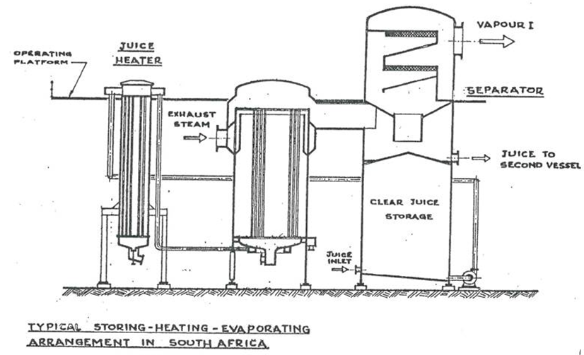
Kestner Type Evaporator
Also called “long tube climbing film evaporator”
Popular for the first and second effects in South Africa
Has tubes almost 7m long
Vapour separation is performed in a “separator” adjacent to the main vessel.

Slide 20
Falling Film Evaporator
A thin film of liquid at relatively high velocity, which is beneficial to good heat transfer, can also be obtained by carefully pouring the liquid into the top of a long tube.
Have same advantages as the Kestner type, but with the added feature that the film is “mechanically” established, and therefore more under the control of the operator.
Disadvantage:
  The distribution weirs and trays for “pouring” in the juice have to be dismantled and removed to get access to the tubes from the top.
  Necessary to recirculate juice to ensure complete wetting of the tubes at all times.
    The recirculation can be as high as 4 to 5 times the inlet juice quantity.
    Recirculation is not a problem if the Heat Transfer Co-efficient (HTC) is good.
The main problem is good field distribution on the top tube plate.

Slide 21
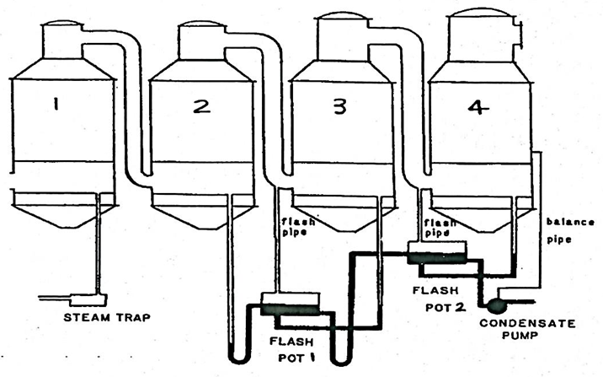
Condensate Removal and Flash Systems
A combined condensate removal system utilizing U-legs.

Slide 22
Condensate Removal and Flash Systems (cont.)
Refer to the previous diagram:
Evaporator 1 is under pressure hence condensate is drained via a steam trap.
Evaporator 2, 3 and 4 are all under vacuum with the vacuum increasing from evaporator 2 to evaporator 3 and is greatest in evaporator 4. In other words, the pressure decreases from evaporator 2 to evaporator 3 and is the lowest in evaporator 4.
The condensate from evaporator 2 drains to the flash pot via a U-leg.
The difference in liquid levels in the two sides of the U-leg compensates for the pressure difference between the calandria of the second evaporator and the calandria of third evaporator.
The U-leg acts as a seal and prevents the higher pressure in the calandria of evaporator 2 from forcing/blowing all the condensate into flash pot 1 and hence allowing vapour to escape.

Slide 23
Condensate Removal and Flash Systems (cont.)
Refer to the previous diagram (cont.):
Since flash pot 1 is connected to the calandria of evaporator 3, it is at a lower pressure than the calandria of evaporator 2.
The condensate from evaporator 2 thus flashes and produces vapour that is piped to the calandria of evaporator 3.
Since flash pot 1 and the calandria of the evaporator 3 are at the same pressure, condensate from evaporator 3 is also allowed to drain into flash pot 1.
As condensate accumulates in flash pot 1 it is drained to flash pot 2 via a U-leg.
The difference in liquid levels in the two sides of the U-leg compensates for the pressure difference between flash pot 1 ( connected to the calandria of evaporator 3) and flash pot 2 (connected to the calandria of evaporator 4).

Slide 24
Condensate Removal and Flash Systems (cont.)
Refer to the previous diagram (cont.):
Since flash pot 2 is connected to the calandria of evaporator 4, it is at a lower pressure than the calandria of evaporator 3.
The condensate from flash pot 1 thus flashes and produces vapour that is piped to the calandria of evaporator 4.
Since flash pot 2 and the calandria of evaporator 4 are at the same pressure, condensate from evaporator 4 is also allowed to drain into flash pot 2.
As condensate accumulates in flash pot 2 it is pumped away using a pump.

Slide 25
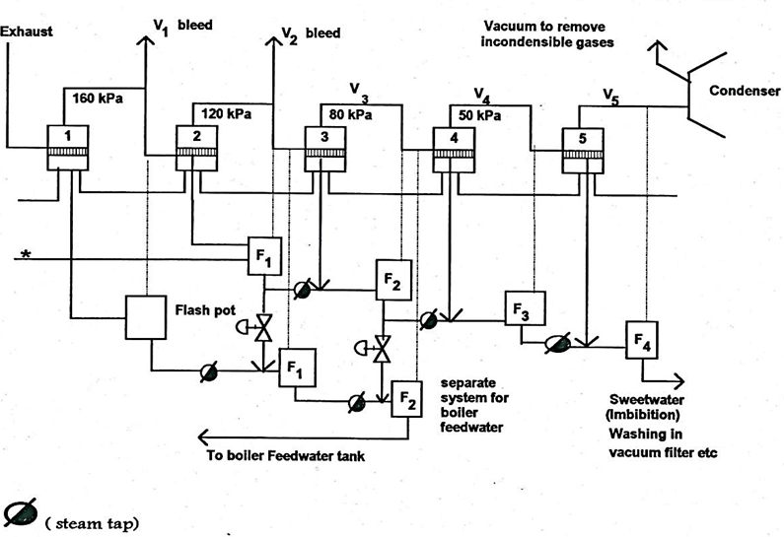
Condensate Removal and Flash Systems (cont.)
A cascade condensate removal system using steam traps

Slide 26
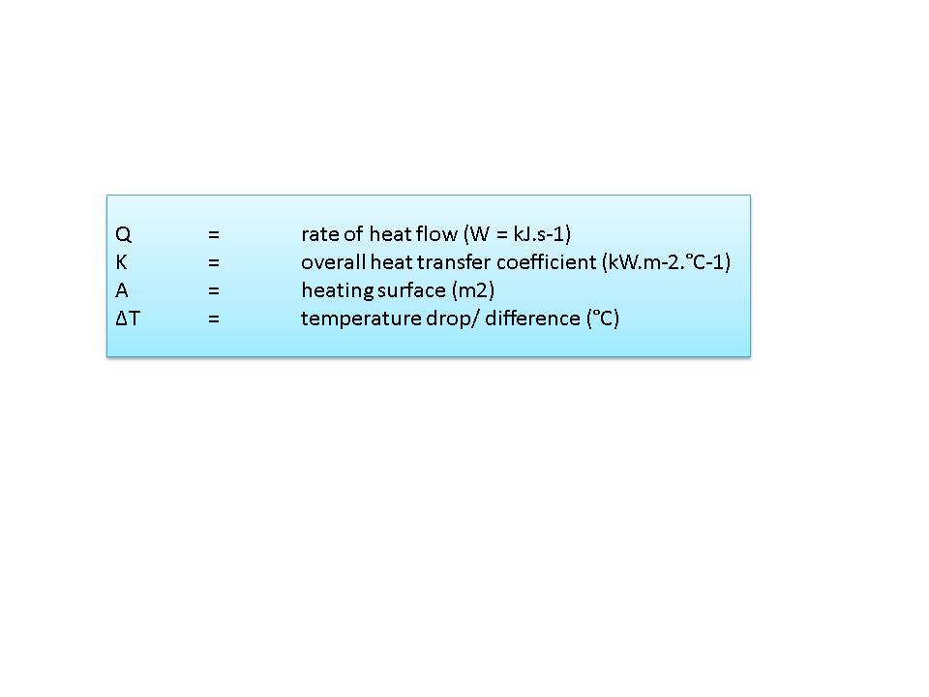
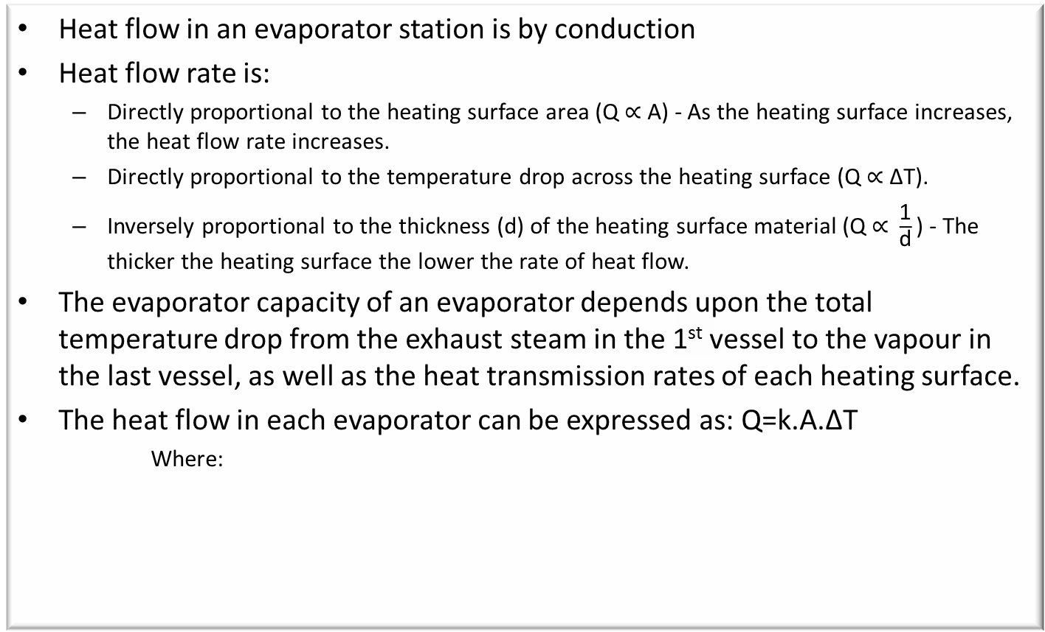
Heat Transmission
Heat flow in an evaporator station is by conduction
Heat flow rate is:
  Directly proportional to the heating surface area ($\text{Q}\text{ ∝ }\text{A}\text{)}$ - As the heating surface increases, the heat flow rate increases.
  Directly proportional to the temperature drop across the heating surface $\text{(}\text{Q}\text{ ∝ ∆}\text{T}\text{)}$.
  Inversely proportional to the thickness (d) of the heating surface material $\text{(}\text{Q}\text{ ∝ }\frac{\text{1}}{\text{d}}\text{)}$ - The thicker the heating surface the lower the rate of heat flow.
The evaporator capacity of an evaporator depends upon the total temperature drop from the exhaust steam in the 1st vessel to the vapour in the last vessel, as well as the heat transmission rates of each heating surface.
The heat flow in each evaporator can be expressed as: $\text{Q}\text{=}\text{k}\text{.}\text{A}\text{.∆}\text{T}$
Where:

Slide 27
Heat Transmission (cont.)
Resistance to heat flow resulting from the stagnant layer of juice, caused by insufficient juice velocity
Higher juice velocity will result in turbulence that will disrupt the stagnant layer and improve heat transfer
Viscosity effects circulation
  Use Kestner evaporators as first effect – juice is less viscous
  Use (short tube) Roberts evaporators from second effect onwards – juice is more viscous
Hydrostatic head – caused by pressure and thus temperature differences between the juice at the top and the bottom of the calandria

Slide 28
Scale Formation and Removal
Scale formation results in a resistance to heat transfer
Scale is formed when:
  Juice in the evaporator increases in concentration (brix)
  Non-sugars to become insoluble
  Non-sugars are deposited on the heating surface
  Builds up gradually
  Heavier at the bottom of the tubes
Scale formation will be reduced by:
  Ensuring adequate wetting of the heat transfer surface.
  With a high sustained velocity/ flow rate.
Slow crushing and short stops increase the formation of scale due to low juice velocities.
A high HTC is the result of low scale formation.

Slide 29
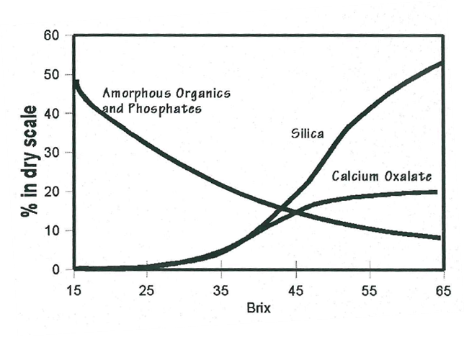
Composition of Scale
Varies according to the concentration
Organic material and phosphates mainly precipitated in the first vessels. Due to:
  Slow reaction rate of the formation of calcium phosphates during clarification
  Carry over into the clear juice
  Due to the high temperature and
  Increase in concentration.
Silica and oxalates are deposited in the latter vessels.
Juice quality will also affect the type of scale formation.

Slide 30
Removal of Scale
Mechanical removal
Mechanical cleaning is usually carried out with toolheads mounted on flexible shafts driven by electric motors.
Expensive in equipment maintenance and labour costs and with hard scale
Tube damage is common.
Chemical cleaning
Reagents and methods used must be suited to the type of scale.
The most common method is alkali-acid cleaning.
Boil a caustic soda solution or a caustic soda/soda ash solution, then wash thoroughly with water and then boil or occasionally spray sulphamic or phosphoric acid.
One chemical is not enough to remove different types of scales
Caustic attacks silicates and silica
Acids attack phosphates, oxalates and carbonates

Slide 31
Evaporator Operation and Control
Primary aims:
  To obtain a uniform syrup brix from the last evaporator
  To get adequate V₁ and V₂ vapour bleeding
Parameters measured:
  Brix of the syrup leaving the last evaporator using RF probes, conductivity meters or nuclear density meters.
  V₁ and V₂ vapour pressures.
  Exhaust steam pressure.
  Juice flow entering the first evaporator.

Slide 32
Evaporator Operation and Control (Cont.)
How is evaporator’s performance altered?
If the brix of the syrup leaving the last evaporator is too high, the performance of the evaporator train must be reduced.
On the other hand, if the brix of the syrup leaving the last evaporator is too low, the performance of the evaporator train must be increased.

Slide 33
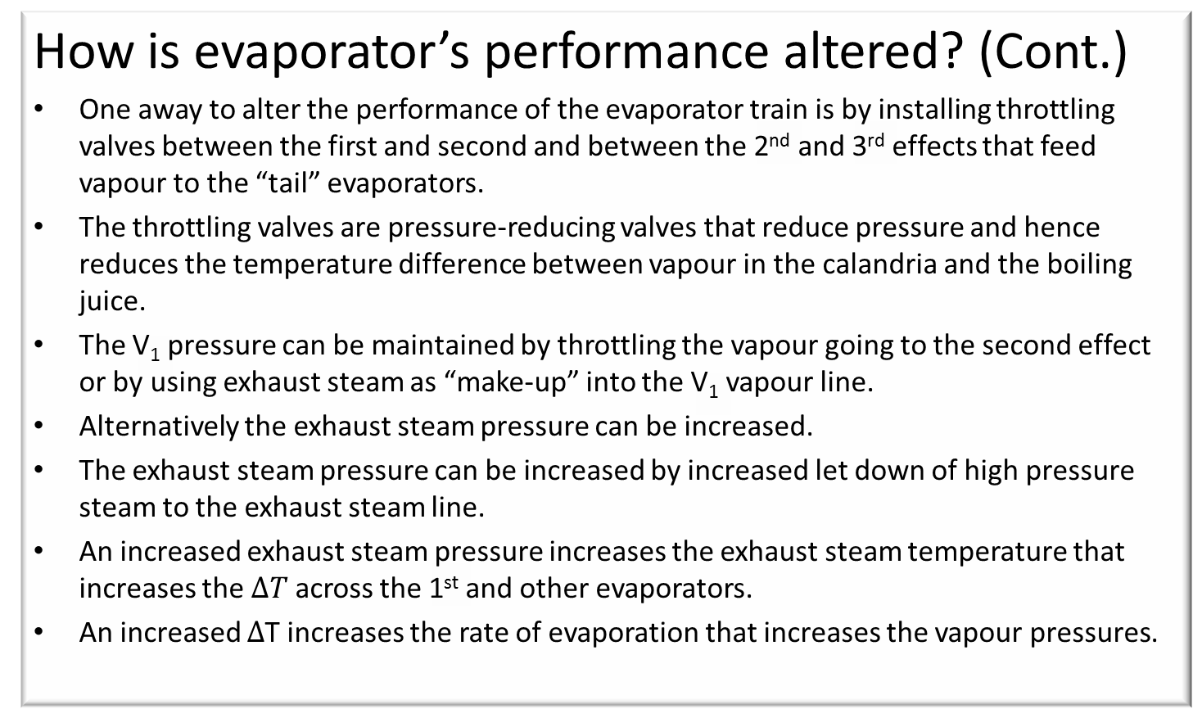
Evaporator Operation and Control (Cont.)
How is evaporator’s performance altered? (Cont.)
One away to alter the performance of the evaporator train is by installing throttling valves between the first and second and between the 2nd and 3rd effects that feed vapour to the “tail” evaporators.
The throttling valves are pressure-reducing valves that reduce pressure and hence reduces the temperature difference between vapour in the calandria and the boiling juice.
The V₁ pressure can be maintained by throttling the vapour going to the second effect or by using exhaust steam as “make-up” into the V₁ vapour line.
Alternatively the exhaust steam pressure can be increased.
The exhaust steam pressure can be increased by increased let down of high pressure steam to the exhaust steam line.
An increased exhaust steam pressure increases the exhaust steam temperature that increases the $∆T$ across the 1st and other evaporators.
An increased $∆$T increases the rate of evaporation that increases the vapour pressures.

Slide 34
Evaporator Operation and Control (Cont.)
How is evaporator’s performance altered? (Cont.)
If the clear juice level gets too low, water can be added to clear juice tank to allow the evaporator to function at full capacity, thus supplying the required V₁ and V₂ bleeds.
In the event of the clear juice tank level getting too high, the mill must be slowed down to be able to reduce the juice flowrate.

Slide 35
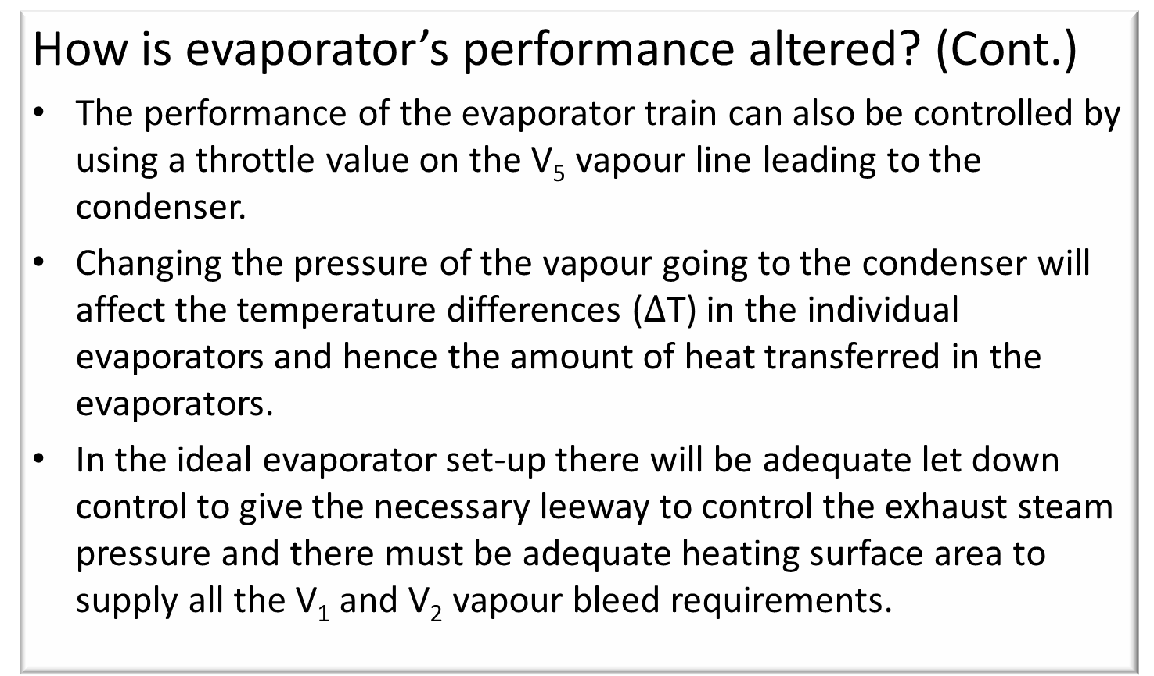
Evaporator Operation and Control (Cont.)
How is evaporator’s performance altered? (Cont.)
The performance of the evaporator train can also be controlled by using a throttle value on the V₅ vapour line leading to the condenser.
Changing the pressure of the vapour going to the condenser will affect the temperature differences ($∆$T) in the individual evaporators and hence the amount of heat transferred in the evaporators.
In the ideal evaporator set-up there will be adequate let down control to give the necessary leeway to control the exhaust steam pressure and there must be adequate heating surface area to supply all the V₁ and V₂ vapour bleed requirements.

Slide 36
Overall Evaporator Control
Action taken if the brix exceeds its limits:
If the brix exceeds its limits, the PLC controller reduces the pressure of the vapour going to the third effect.
If the Brix still exceeds its limit, the PLC controller reduces the pressure of the vapour going to the third effect.
If the Brix still is too high the exhaust pressure is reduced.
Alternatively the juice feed rate can be increased.

Slide 37
Overall Evaporator Control (Cont.)
Action taken if the brix of the final syrup is too low:
Method 1: Cut the flow rate of juice\syrup through the evaporators. This is done by reducing the flow rate from the tail evaporators and working towards the front of the evaporator train. However it is important to maintain the correct syrup levels in the evaporators. This method of control is called “feedback control”.
Method 2: Set the desired flowrate and use the steam pressures to control the brix of the final syrup. The final brix is increased by increasing the evaporation rate in 2 ways.
Increasing the exhaust steam pressure to the first effect by increased letdown.
Increasing the vapour pressure to evaporator 3 also by letdown into the V₂ line.

Slide 38
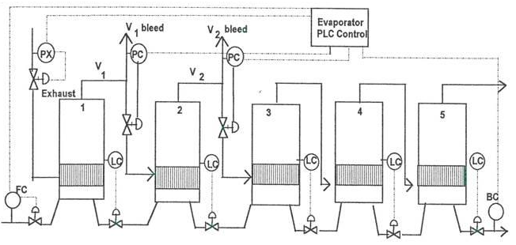
Level Control
Level control in individual evaporators is very important for effective evaporation.
Each evaporator is fitted with a level controller that opens/closes the valve in the juice line leading to the next evaporator.
The diagram below shows feed forward level control, where the level is measured and the outflow is adjusted.

