Slide 1
KNOWLEDGE COMPONENT: MODULE 6: EVAPORATION:
KT 3: PRESSURE AND VACUUM

Slide 2

Background
Pressure is defined as the force per unit area.
Formula:
Unit: Pascal (Pa), where 1 Pa = 1N/m²
Liquid and gases exert pressure on the sides of their containers. In the case of a gas the pressure exerted by a gas depends on:
  The amount of gas particles present in the container. The greater the number of gas particles, the greater the number of collisions per unit area and hence the greater the pressure
  The temperature of the enclosed gas. The greater the temperature the faster the gas particles move that result in more frequent and more violent collisions with the sides of the container, which also increases the pressure.
The air that surrounds us exerts a pressure called atmospheric pressure of ±100kPa (at the coast).
The word vacuum is used to designate an absence or lack of pressure.
Vacuum is measured relative to the surrounding atmospheric pressure. When the pressure inside a container/ vessel is 100 kPa then there is no vacuum in the container. As the pressure in the container decreases below the atmospheric pressure, the vacuum increases.

Slide 3
Terms used to express pressure
Gauge pressure versus absolute pressure
The terms gauge and absolute pressure are commonly used.
Absolute pressure is the pressure measured from a 0 kPa
Gauge pressure is measured from 100kPa (i.e. from atmospheric pressure).

Slide 4
Creating a Vacuum
Vacuum is essential for the operation of the evaporator station.
Vacuum is created and maintained by the action of condensing larger volumes of vapour in a condenser to produce small volumes condensate.
A space is thus provided that is deficient in gas particles.
This “empty” space is called a vacuum.
At 100 kPa 1kg of vapour occupies 1.694 m³. This vapour can only be condensed by 15kg of water. The resultant condensate only occupies 0.001 m³.
The volume has thus been made 1694 times smaller.
If we continue to reduce this space by this factor we will create and maintain a vacuum.
This is the function of a condenser.

Slide 5

Benefits of Boiling under Vacuum
Improved heat transfer
  As the pressure above a liquid decreases (i.e. increase in vacuum), the boiling point of the liquid decreases.
  This increases the temperature difference ($∆T$) between the vapour and the boiling liquid thus improving the rate of heat transfer.
Reduction of inversion and destruction of sucrose
  A reduced boiling temperature will minimise any sucrose destruction.

Slide 6
Condensers
A device used to condense vapour to liquid.
In sugar factories done in a counter current condenser vessel.
Action of cold water on hot vapour makes condensation take place.
The condenser is made up of series of baffles or perforated plates which cause the water entering at the top of the condenser to form a series of showers or fine rain-like droplets - Gives efficient condensing of the vapour entering at the bottom of the condenser.
More complete or efficient if the contact between the vapour and water is close. Closeness depends ons:
  Area of contact - Depends on the path of the water and the size of the drops
  Time of contact - Depends on the length of the condenser, the number of baffles or the efficiency of the rain plate.
The condenser water enters at the top of the condenser and falls under gravity to the outlet - the tail pipe or barometric leg.
The vapour is sucked into the condenser at the bottom by the vacuum created by the condensation taking place and is drawn up through the falling water and condensed.
Some of the vapour cannot be condensed (incondensible gases) and these gases are removed by the air pump (vacuum pump).
Condenser design is based on the amount of vapour and its temperature.

Slide 7
Condensers (Cont.)
Vacuum is controlled by adjusting the amount of water entering the condenser.
  An increase in the amount of water decreases the pressure (i.e. increases the vacuum), which in turn decreases the boiling temperature of the solution.
  This increases the rate of evaporation due to a higher temperature difference between the heating vapour and boiling solution.
  A decrease in the amount of water increase the pressure (i.e. decreases the vacuum), which in turn increases the boiling temperature of the solution.
  This decreases the rate of evaporation due to a smaller temperature difference between the heating vapour and the boiling solution.

Slide 8
Condensers (Cont.)
As the last evaporator vessel and condenser is under vacuum and the water in the sealing well is at atmospheric pressure there must be a seal to prevent the water in the sealing well from being sucked into the evaporator.
This is done by means of a barometric leg or tail pipe.
This tail pipe must be at least 10.4 m long to balance the difference in pressure.
If the barometric leg is too short the condenser will fill up with the water and possibly flood back into the evaporator.
The length of the sealing leg should be greater than the hydrostatic head to allow for a driving head to maintain flow, plus a small safety margin.

Slide 9
Condensers (Cont.)
A condenser is said to be working well if the approach temperature is low.
The approach temperature is the difference between the inlet vapour temperature (t_{v}) and the outlet temperature (t_{o}) i.e. (T_{v}-T_{o}).
The more water is used the lower t₀ becomes. This increases the approach temperature and lowers the condenser efficiency.
Strict control of the condenser water will ensure that the condenser is working efficiently.
The water discharged by the condenser is cooled in cooling towers or cooling ponds before being recycled for re-use in the condenser.
As the temperature of the water fed to the condenser increases, so the quantity of water required increases.
This can lead to a shortage of water which would mean that the condenser cannot be supplied with water at the required rate.
When this happens the pressure increases (i.e. the vacuum decreases), causing boiling to slow down and results in mixed juice and clear juice tanks filling up.

Slide 10
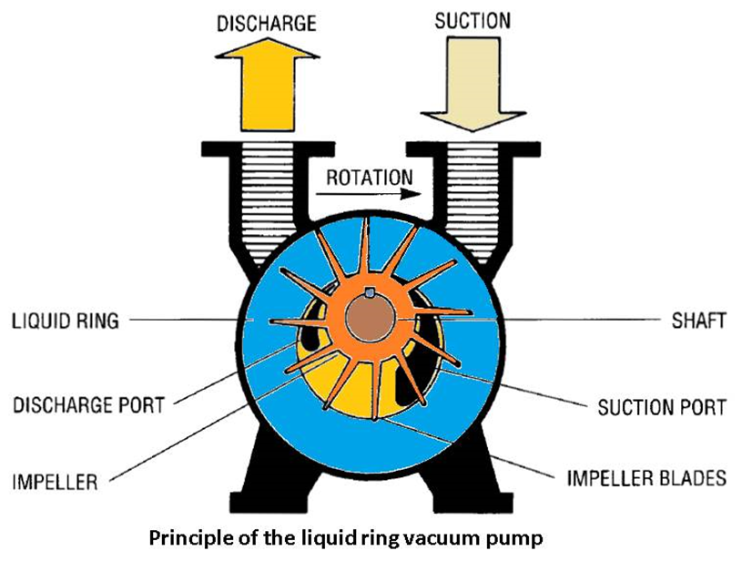
Vacuum Pumps
Required to remove the incondensible gases from evaporator and pan condensers.
The most common type used is the liquid ring type

Slide 11
Vacuum Pumps (cont.)
The pump consists of a chamber fitted with a rotor and partially filled with water.
At one side of the chamber there is a gas inlet and outlet.
When the rotor spins the water is flung to the outside to form a ring around the periphery of the chamber.
At the gas inlet the gap between the rotor and liquid ring increases, thus sucking gas in.
This gas is then compressed as the gap between rotor and liquid ring decreases.
The compressed gas is then expelled via the vapour outlet.

Slide 12
Vacuum Pumps (cont.)
The pump has been chosen because it is easy to maintain in good condition having no fancy seals to worry about.
One disadvantage is that the cooling water becomes contaminated with entrained compounds, mainly sugar, and must therefore be suitably treated.
It is not wise to use water from the main cooling tower for this purpose because it is too dirty.
Air leaks can be measured by the simple technique of timing the pressure rise in a vessel which is sealed under a known vacuum.

Slide 13
Vacuum Pumps (cont.)
Empirical rules for vacuum pump sizing have been applied for years, which seem to work.
According to Hugot, the following may be used:
  Central condenser: 100 – 100 litres/kg of vapour
  Multiple effect evaporator: 80 – 100 litres/kg of vapour
  Vacuum pans: 20 – 25 litres/kg of vapour
Should each pan have its own vacuum pump, or should there be one system for all pans?
  At one time when it was more economical to buy large steam engine driven pumps, the latter system was preferred.
  However, the ease of control and maintenance of individual pumps has now made the former system almost standard practice.

Slide 14
Cooling Systems
Effected by spray ponds and mechanical draft cooling towers.
Sometimes mills still have access to rivers or irrigation canals from which water can be pumped for use in condensers and then released into the river again.
  This is only possible where the quality of the returning water is within specification
  Such installations are likely to be replaced with cooling towers
Most cooling towers are of the induced draught type, in which water is sprayed from the top over a pack which breaks it down to small droplets or to a film to promote evaporation.
Air is drawn into the sides of the tower and out though an induced draught fan at the top of the tower.
Most modern towers are now filled with what are called “splash” packs consisting of plastic or stainless steel trays designed to break up the spray of water into small droplets by impingement.

