Slide 1
KNOWLEDGE COMPONENT: MODULE 6: EVAPORATION:
KT 4: EVAPORATION PROBLEM SOLVING

Slide 2
Evaporation Problems and Corrective Measures
Slack syrup produced by the evaporator could be caused by:
A low steam pressure in the calandria of the first vessel. If this pressure is inadequate the total evaporating process throughout the set is slowed down.
Inadequate vacuum in the last vessel. A poor vacuum in the last effect affects the performance of the preceding vessels. A poor vacuum may be due to:
  Leaks in the evaporator body and related vacuum piping.
  Poor functioning of the vacuum pumps ( incondensible gas pumps).
  Insufficient condenser water, which could be due to a shortage of water, or malfunctioning of the condenser water supply pumps.
  High condenser water temperature.

Slide 3
Evaporation Problems and Corrective Measures (cont.)
Slack syrup produced by the evaporator could be caused by: (Cont.)
The condensate formed in the calandria is not being removed.
  Poor heat transfer results from a calandria with accumulated condensate.
  This condition is normally easily identifiable by the hammering of the water in the calandria or outlet piping.
An accumulation of incondensible gases causes a loss in delta T, which reduces the rate of heat transfer. Incondensible gases should therefore be effectively removed.
The juice or syrup not flowing freely from one vessel to the next.
  Any obstruction between two vessels can be easily detected by a rise in juice volume in the evaporator preceding the obstruction.
  In addition, there will be a decrease in the vacuum of the vessel concerned.
  The increased juice volume causes an imbalance in ratio of juice volume to heating surface, and the evaporation rate reduces in consequence.

Slide 4
Evaporation Problems and Corrective Measures (cont.)
Slack syrup produced by the evaporator could be caused by: (Cont.)
The vessels being boiled on too high or more often too low a juice volume which will cause a decrease in evaporation rate.
Scale on the evaporator tubes.
  This reduces the rate of heat transfer.
  Thorough, regular cleaning is essential.
A saveall blocked with accumulated sugar.
  This will slow down the vapour flow to the condenser and will affect the vacuum.
Poor operation (irregular or erratic flows etc.).

Slide 5
Evaporation Problems and Corrective Measures (cont.)
Bleed pressure control through:
Floating bleed pressures
Let-down from exhaust
Adjustment of exhaust pressure
Throttling of tail

Slide 6
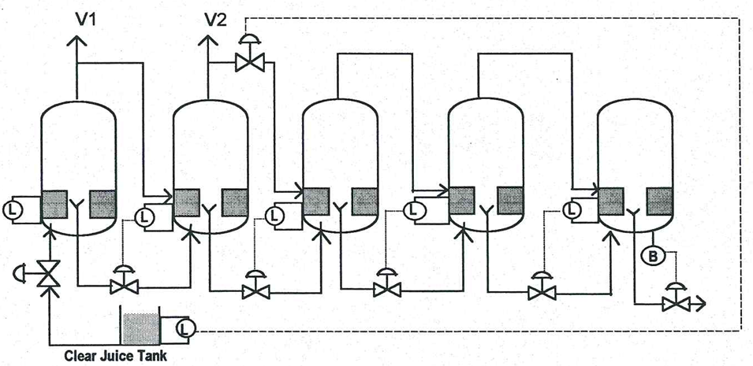
Evaporation Problems and Corrective Measures (cont.)
Bleed pressure control through “Cascade Back” Control
Roberts Vessel

Slide 7
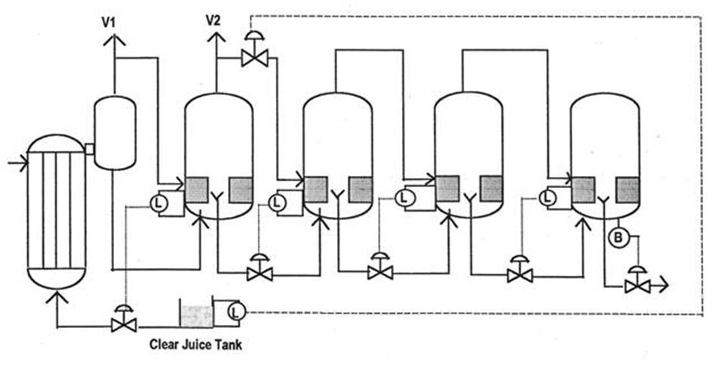
Evaporation Problems and Corrective Measures (cont.)
Bleed pressure control through “Cascade Back” Control
One Kestner + Roberts vessel

Slide 8
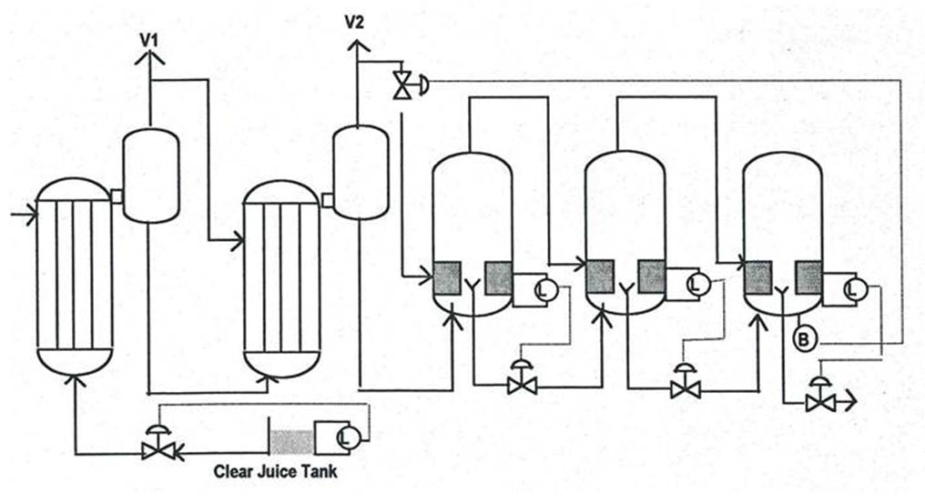
Evaporation Problems and Corrective Measures (cont.)
Bleed pressure control through “Cascade Forward” Control
Two Kestners + Roberts vessels

