Slide 1
KNOWLEDGE COMPONENT: MODULE 7:
PAN BOILING:
KT 1: THEORY OF CRYSTALLISATION

Slide 2
Introduction
The central technique used to recover sugar in the raw house and the refinery is crystallisation of sucrose from concentrated sucrose solution.
The process whereby sugar is recovered via heating and the resulting evaporation of water is called pan boiling.
The raw material from which crystalline sugar is obtained is a syrup of about 65°Bx and a purity of 85%.
Crystallisation not only removes dissolved sucrose from solution and recovers it as solid sucrose crystals, but it also a very powerful purification process.

Slide 3
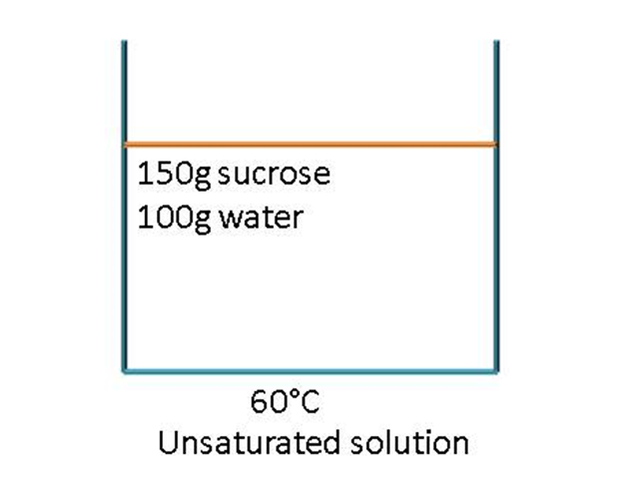
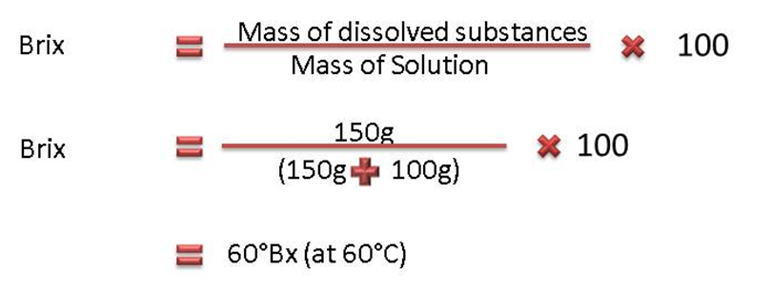
Solutions
Sucrose is very soluble in water and dissolves readily.
Example: 150g of sucrose dissolves easily in 100g of water at 60°C to give a solution of 60°Bx.
Since the solution is able to dissolve more sucrose at 60°C, the solution is said to be unsaturated.

Slide 4
Solutions (cont.)
An unsaturated solution is one that contains less than its maximum amount of dissolved substance (solute) at a particular temperature.
Sucrose can be added to the above 150g sucrose/100g water solution and it will dissolve.
However, a point is reached where the solution contains the maximum amount of sucrose possible at 60°C and the solution is then said to be saturated.
A saturated solution is one that contains the maximum amount of dissolved substances (solute) at a particular temperature.
At 60°C the saturation point is reached at approximately 290g sucrose/100g water. The brix of the saturated solution at 60°C is 74.4°Bx.

Slide 5
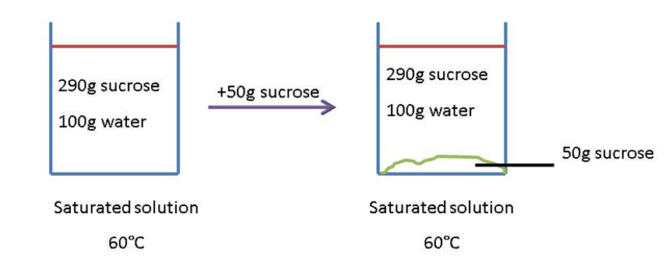
Solutions (cont.)
If any additional sugar is added to the saturated solution at 60°C, it will not dissolve but will simply lie at the bottom of the container.
It is possible to prepare a supersaturated solution that contains more solute at a certain temperature than a saturated solution at this temperature.

Slide 6
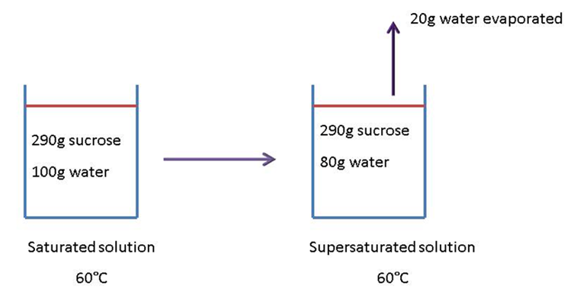
Solutions (cont.)
A saturated solution can be prepared by evaporating water from a saturated solution.
When 20g of water is evaporated from a 290g sucrose/100g water saturated sucrose solution at 60°C, a supersaturated solution of 78.4°Bx is formed.
This new supersaturated solution is unstable since it contains more dissolved sucrose than a saturated solution at the same temperature.
This solution will seek to return to its saturated state by expelling the “extra” sucrose it contains.

Slide 7
Solutions (cont.)
The saturated solution contains 290g sucrose/100g water.
The supersaturated solution contains 290g sucrose/80g water which is equivalent to 363.5g sucrose/100g water.
Reason:
290g sucrose in 80 g
= (290 x 1.25)g sucrose in (80 x 1.25)g water
= 362.5g sucrose in 100g water
The supersaturated sucrose solution (362.5g sucrose/100g water) thus contains 72.5g more sucrose for every 100g of water than the saturated solution (290g sucrose/100g water) at 60°C.
If some small sugar crystals are added to the supersaturated solution, it will return to its saturated state by depositing sucrose onto those crystals and in the process the crystals will grow.
However, if the supersaturation is increased too much, then the solution expels sucrose spontaneously as many tiny crystals instead of just growing existing crystal.

Slide 8
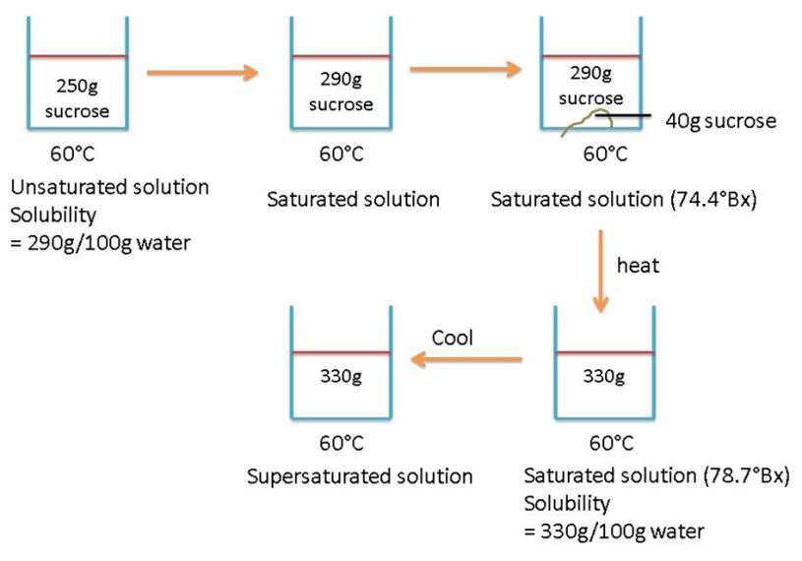
Solutions (cont.)
It is also possible to prepare a supersaturated solution by cooling a saturated solution.
Example:
At 60°C a saturated sucrose solution contains 290g sucrose/100g water and 70°C a saturated sucrose solution contains 320g sucrose/100g water.
If a saturated sucrose solution at 60°C is heated to 70°C it will be able to dissolve 40g more sucrose per 100g of water before it again becomes saturated at the new temperature of 70°C.
Note that in this the supersaturated sucrose solution holds 330g sucrose/100g water instead of 290g sucrose/100g water.

Slide 9
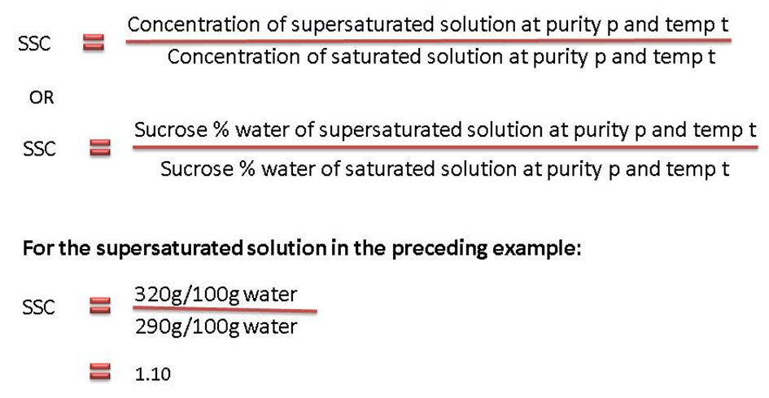
Solutions (cont.)
The degree of supersaturation is defined by the supersaturation co-efficient (SSC).
A solution with a SSC of 1.1 at 60°C contains 1.1 times the amount of sucrose that it would have contained had it been saturated at 60°C.
The supersaturated coefficient is the “driving force” in sugar boiling.
Supersaturation is a state of tension and the solution strives to return to its saturated state by expelling sucrose - that is - by forming new crystals or by depositing sucrose onto existing crystals.

Slide 10
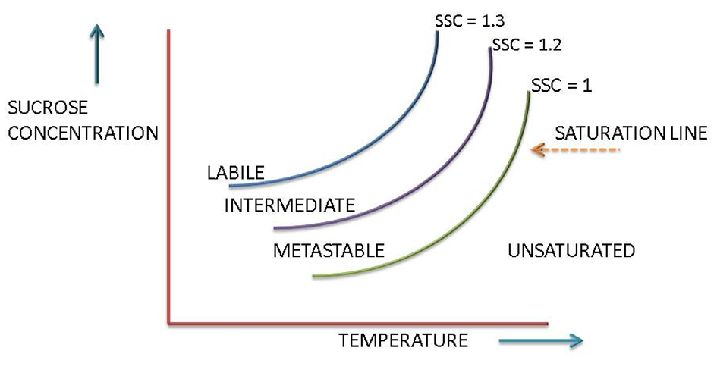
Solutions (cont.)
Different supersaturation zones exist that are determined by the sucrose concentration (i.e. sucrose/100g water) and by the temperature of the solution.
ZONES OF SATURATION

Slide 11
Solutions (cont.)
Three zones of supersaturation are defined for pure sucrose solution:
Unsaturated or stable zone (SSC<1.000) : Crystals dissolve and all sucrose is in solution.
Metastable zone (1.00<SSC<1.20) : At concentrations that fall in the metastable zone any sucrose crystal present will continue to grow until the concentration falls to the level at which the solution is just saturated.
Intermediate zone (1.20<SSC<1.3) : At concentrations that fall in the intermediate zone crystals will not only grow, but new crystals will form in the presence of other crystals.
Labile zone (SSC>1.3) : At concentrations which fall in the labile zone, new crystals will from spontaneously. Crystal growth will be rapid.

Slide 12
Affect of Purity on Saturation
For pure sucrose solutions the approximate widths of the zones of supersaturation are:
Metastable zone 1.00<SSC<1.20
Intermediate zone 1.20<SSC<1.30
Labile zone SSC>1.3
In the case of impure sucrose solutions the band widths are larger. The presence of other compounds in a sucrose solution may increase or decrease the solubility of the sucrose.
In the case of invert sugar, which consists of equal amounts of glucose and fructose, the solubility of sucrose is reduced. This means that less sucrose is able to dissolve before saturation is reached.

Slide 13
Affect of Purity on Saturation (cont.)
Inorganic salts increase the solubility of sucrose in aqueous solution - more sucrose is able to dissolve before saturation is reached.
The concentration of sucrose at saturation point is thus greater if inorganic salts are present in solution.
Cane sugar solutions are of this type where the impurities present increase the solubility of the sucrose.
Such solutions require a higher sucrose concentration than pure sucrose solutions to reach the same zone of supersaturation.
In other words, sucrose solutions containing inorganic salts require a higher sucrose concentration to bring about the same crystallisation phenomena.

Slide 14
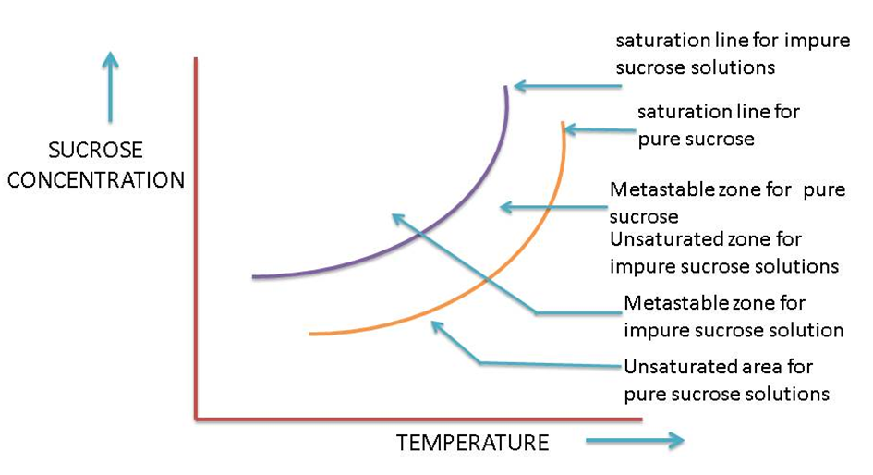
Affect of Purity on Saturation (cont.)

Slide 15
Affect of Purity on Saturation (cont.)
In the preceding slide’s graph the SSC’s of both lines =1.
  For pure sucrose solutions the metastable zone lies between a supersaturation of 1.00 and 1.2.
  For sucrose solutions of purity 70 - 73% the metastable zone lies between a supersaturation of 1.00 and 1.35.
  However, between 1.00 and 1.3 the rate of crystal growth is too low for practical boiling and hence the practical metastable zone starts above the 1.30 supersaturation.
  The zone for introducing slurry and growth of seed nuclei is therefore between a supersaturation of 1.30 and 1.35.
With proper control of concentration (Brix) of a supersaturated solution the degree of supersaturation can be controlled and the solution can hence be kept in the metastable zone.
Here existing crystals will grow without the new crystals forming.

Slide 16
Affect of Purity on Saturation (cont.)
To boil a pan the following information is important:
At what temperature will the pan be boiled?
This is found from the saturated vapour pressure in the pan.
The concentration of sucrose (Brix) needed to give the required supersaturation coefficient at the temperature concerned.

Slide 17
Crystal Growth Rate
Rate of crystal growth is called crystallisation velocity.
Measured in milligrams of sugar deposited per minute per square metre of crystal surface (mg/min/m²).
In a massecuite crystal growth is greater the larger the crystal surface are i.e. the smaller the crystals (The total surface of a lot of small crystals is greater than the same mass of big crystals).
Involves two separate stages viz.
  migration of the sucrose molecules from the solution to the surface of the crystal, and
  orientation of the molecule on the surface of the crystal prior to its incorporation into the crystal (rate controlling step).

Slide 18
Crystal Growth Rate (cont.)
Crystallisation velocity is determined by:
  the rate at which sucrose molecules arrive at the thin stationary layer of saturated solution surrounding the crystal. This depends on the relative speed of the movement of the crystal through mother liquor i.e. the rate of circulation in the pan;
  the rate at which sucrose molecules will diffuse through the film which surrounds the crystal. This depends mainly on the viscosity of the film and on the degree of supersaturation of mother liquor in contact with it;
the rate at which sucrose molecules are deposited on the crystal surface. This is influenced by presence in mother liquor of some impurities like raffinose and other oligosaccharides which interfere with incorporation of sucrose molecules into the crystal lattice.

Slide 19
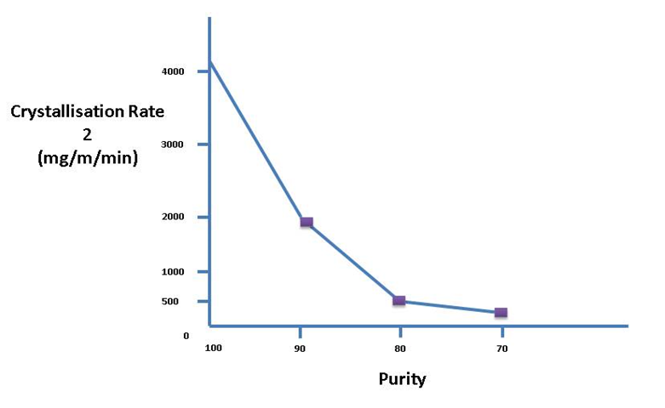
Factors that affect the rate of crystallisation
Purity of Massecuite
Crystallisation rate decreases as purity decreases.
The rate of crystallisation in the raw house is thus slow too very slow compared to crystallisation in a refinery.

Slide 20
Factors that affect the rate of crystallisation
Degree of Supersaturation
This is the main driving force for crystallization.
  An increase in supersaturation has the following effects on crystallisation:
  Increases the rate of attachment of sucrose molecules onto the crystal that increases the rate of crystal growth.
  Increases the viscosity of the solution that reduces the rate of sucrose diffusion.
  Increases the rate of diffusion because of the big difference in concentration between the mother liquor and the film of mother liquor around the crystal.
The rate exhaustion of sucrose from solution by crystallisation is proportional to the square of the supersaturation coefficient. So, in practice, for pure sucrose solutions, a supersaturation coefficient of 1.44 (i.e. 1.20²) should not be exceeded as crystallization becomes uncontrollable and false grain results.

Slide 21
Factors that affect the rate of crystallisation
Viscosity of massecuite
Viscosity is very important because it affects the mobility of the sucrose molecules.
A more viscous massecuite offers more resistance to the movement of sucrose molecules as they migrate towards the crystals.
Massecuite viscosity decreases with increase in temperature and increases with decrease in purity.
Viscosity also affects the mixing between mother liquor and crystals.
Viscosity is the measure of resistance to sheer or angular deformation.
The metric unit is the poise (dyne second/cm²), while the SI unit is Pascal second (Pa.s = Centipoise x 10⁻³).
Viscosity in centipoise at different temperatures and saturations is provided in the table in the learning material.

Slide 22
Factors that affect the rate of crystallisation
Viscosity of massecuite (cont.)
Because crystallisation velocity to a large extent depends on diffusion velocity, which is governed by supersaturation, viscosity and temperature, a pan boiled at high temperature and supersaturation will produce better crystallisation velocities.
The table provided in the learning material illustrates this.
At 90°C (supersaturation 1.30) the viscosity is lower than at 30°C (supersaturation 1.10).
If the mobility of the sucrose molecule is impeded by high viscosity, and the supersaturation level is high, false grain formation will occur.
This can be prevented by increasing the amount of crystal in the pan, thereby increasing the surface area available for the sucrose molecules to crystallise onto.

Slide 23
Factors that affect the rate of crystallisation
Temperature
Sucrose crystals grow faster the higher the temperature.
However, a higher temperature reduces the supersaturation which is the main driving force of crystallisation.
The higher the temperature, the higher the concentration required to maintain the same rate of crystallisation.

Slide 24
Crystal Formation
Mechanism of crystal formation and growth: A crystal is a regular, uniform and reproducible arrangement of molecules in a solid form.
In supersaturated solutions crystallisation begins with the nucleation mechanism by which a small crystal forms.
In homogeneous liquids the process starts with random association of soluble molecules occurring by normal molecular motions.
In some cases additional molecules join the cluster which begins to assume a regular spacing of molecules and is called an embryo.
The embryo is usually short lived, but in a sufficiently concentrated solution more molecules join the embryo which grows and stabilises to become a crystal nucleus.
Thermodynamics of surfaces show that the solubility of crystals decreases as their size increases.

Slide 25
Crystal Formation (cont.)
Thus, once a crystal nucleus is formed it tends to grow.
The formation of crystal nuclei in supersaturated solutions by aggregation of molecules is called primary nucleation.
Only a small portion of crystalline material is formed by primary nucleation.
Most of the solid formation is due to precipitation of the solute (sucrose) onto surfaces of existing crystals.
Secondary nucleation refers to sugar crystals formed in a supersaturated sucrose solution in which sugar crystals are already present.
The occurrence of both primary and secondary nucleation is a function of the supersaturation and purity of the sugar solution.

Slide 26
Crystal Formation (cont.)
High purity sucrose solutions (Purity above 85%)
  Primary nucleation occurs at a supersaturation above 1.3 (labile zone).
  Secondary nucleation occurs at a supersaturation between 1.2 and 1.3 (intermediate zone).
Impure sugar solutions (Purity 75%)
  Primary nucleation occurs at a supersaturation above 1.6 (labile zone).
  Secondary nucleation occurs at a supersaturation between 1.35 and 1.6 (intermediate zone).
It is thus easier to grain (i.e. add very small crystals) at 70 - 72% purity in order to grow crystals than it is to grain on syrup of 85% purity as false grain is easily formed.

Slide 27
Crystal Formation (cont.)
Mechanism of crystal growth is as complex a process as nucleation.
Growth occurs at dislocation found on crystal surfaces.
The dislocation is self-perpetuating and crystals grow in a spiral as a result of surface forces.
The deposition of sucrose molecules on a solid crystal can only occur if the concentration of the bulk fluid is greater than saturation.
A perfect crystal generally has 12 faces or sides.
The crystal does not always have a perfect shape as there are many factors that make some faces grow faster than causing odd shaped crystals.

Slide 28
Crystal Formation (cont.)
Once the habit or shape of the sucrose crystal has been established it remains more or less the same as the crystal grows.
For example, if the crystal formed had a twin or needle or flat shape this shape would stay and the full-grown crystal would have the same shape.
In a commercial process unhindered crystal growth seldom occurs:
  Crystals agglomerate,
  impurities are occluded,
  nucleation occurs both in solutions and at crystal surfaces and
  crystals are broken by pumps and agitation.
The net result of all these factors is spoken of as the habit of crystal growth.
The habit may affect the product purity, appearance and behaviour and therefore may seriously influence the product quality.

Slide 29
Effect of Impurities on Crystal Formation
Impurities slow down the rate of crystallisation (e.g. starch).
Different impurities have different effects.
Rate of crystallisation is affected by:
  the concentration of impurities and
  the type of impurity.
During crystal growth in the pan there is competition for growing crystal surfaces between the sucrose molecules and the impurities.
Impurities can determine the shape of the crystal (e.g. twin crystals are common where reducing sugars are present at high supersaturations).
Colour of sugar is affected by coloured non-sugars which are absorbed by the sucrose crystal (Occlusion (entrapment) of dark coloured impurities is especially noticeable when a dark seed sugar is used in “A” boilings. A layer of light coloured sucrose can be seen covering the dark seed crystal).

Slide 30
Boiling Point Elevation – Due to Pressure
From steam tables one can see that the temperature at which water would boil at different pressures above and below atmospheric pressure varies.
In a batch pan the hydrostatic head due to the height of massecuite causes the pressure at the bottom of the massecuite to increase as the level in the pan rises.
This causes an increase in the boiling point of the massecuite at the bottom.
In a batch pan the boiling temperature is thus a function of the height.
The hydrostatic head also causes the massecuite at the bottom of the batch pan to be more viscous.
This necessitates the use of movement water to ensure circulation.
The effect of hydrostatic head limits the height of massecuites in batch pans to 1.35m.
The movement water used is at a temperature such that it will flash (boil violently) as it enters the pan, thus causing turbulence and promoting circulation.

Slide 31
Boiling Point Elevation – Due to Brix
Sugars and salts dissolved in water always raise the boiling point.
This boiling point elevation is dependent on the quantity of dissolved material and is independent of pressure.
The Boiling Point Elevation Table shows the increase in the boiling point of cane juices at different brixes and purities.
Using the boiling point vs. pressure table and the boiling point elevation table the boiling point of any sugar solution can be found.
Example:
What is the boiling point of 80°Bx massecuite of 50% purity at 25kPa?
Boiling point of water @ 25kPa = 65°C
BPE due to Brix = 13.1°C
Boiling point of massecuite = 65°C + 13.1°C = 78.1°C

Slide 32
Measurement of Super Saturation
For good crystal growth the supersaturation coefficient (SSC) of the sugar solution must be known.
Instruments used to control a boiling measure some property of the solution which is related to Brix and then to SSC i.e. the SSC is measured indirectly.
Using Conductivity
SSC can be obtained indirectly by measuring the conductivity of solution or massecuite.
Sucrose itself does not conduct but some of the impurities present do, especially the salts present.
For concentrations up to 30 Brix the conductivity of solution increases due to an increasing concentration of ions.

Slide 33
Measurement of Super Saturation (cont.)
Using Conductivity (cont.)
Above 30 Brix the conductivity reaches a maximum before falling due to the effect of viscosity reducing the mobility of the ions.
The part of the curve which applies in sugar boilings is indicated. It is clear that increases in supersaturation correspond with decreasing conductivity.
The conductivity between a pair of electrodes mounted in the wall of a pan is measured in milliamps when a constant low potential (32V AC) is applied to them.
As the brix of a sucrose solution increases, the density and viscosity of the sucrose solution increases, and the electrical conductance decreases due to the restriction of free ions.
This can be used as an indirect method to measure the supersaturation coefficient.

Slide 34
Measurement of Super Saturation (cont.)
Using Conductivity (cont.)
Several trial boilings are done and a conductivity curve is plotted that will maintain the correct supersaturation for good crystal growth.
Once the curve is drawn, a massecuite can be boiled according to conductivity.
As the Brix increases the conductivity is kept as prescribed by the curve by regulating the feed or – in emergency feeding - with water.
To draw a conductivity curve, conductivity readings must be related to supersaturation coefficient.

Slide 35
Measurement of Super Saturation (cont.)
Using Conductivity (cont.)
The conductivity is noted:
  Where crystals in a massecuite just start to dissolve. This is detected by rounding edges and corners of crystals - this is the conductivity of the saturated solution.
  When false grain (i.e. new crystals) start to form in the presence of other crystals- this is the lower limit of the intermediate zone.
  When a solution without crystals present starts to crystallise spontaneously - this is the upper limit of the intermediate zone and hence the start of the labile zone.
The conductivity probe consists of a cylindrical outer electrode insulated from a second electrode placed inside.

Slide 36
Measurement of Super Saturation (cont.)
Using Conductivity (cont.)
Advantages:
  Useful for massecuite strikes of below 95% purity (i.e. Raw House pans)
  Price of equipment and maintenance is low.
  Variation with temperature is very small for constant supersaturation. On increasing the temperature of a crystal/liquor mixture the tendency towards increase in conductivity is compensated for by an increase in Brix due to solution of part of the crystals. Such a mixture is in a constant state of saturation and shows small fluctuations in conductance with temperature variations.
  Measurement is quick and simple.

Slide 37
Measurement of Super Saturation (cont.)
Using Conductivity (cont.)
Disadvantages:
  Unsuitable for high purity boilings such as refined boilings because of the low ion concentration.
  Scale build-up and metal corrosion due to electrolytic action makes frequent recalibration and cleaning necessary.
  The measurement is sensitive to temperature fluctuation
  Boiling house products in cane sugar mills with a purity between 69 and 85%, and temperature 65 to 75°C, show the following relation between conductance and supersaturation:
Milli-amperes | Supersaturation
88 | 1.00
70 | 1.10
54 | 1.20
44 | 1.30

Slide 38
Measurement of Super Saturation (Cont.)
Using Boiling Point Elevation
When sugar is dissolved in water the boiling point of the water is higher than that of pure water.
The higher the Brix, the higher is its boiling point above the corresponding boiling point of water (at the same pressure).
The difference between the boiling point of a sugar solution and the boiling point of pure water is called the boiling point elevation (BPE) and its value changes with the temperature at which the solution is boiling.

Slide 39
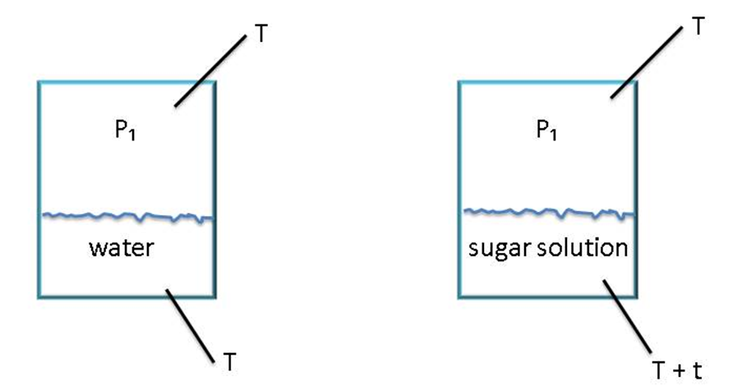
Measurement of Super Saturation (Cont.)
Using Boiling Point Elevation (cont.)
At a pressure P₁ water boils at T°C and the water and vapour temperature is T°C.
At the same pressure P₁, a sugar solution has to be heated to higher temperature before its vapour pressure is to P₁ and it boils.
The temperature of the solution is thus (T + t) °C, while the temperature of the vapour above the solution remains T°C.

Slide 40
Measurement of Super Saturation (Cont.)
Using Boiling Point Elevation (cont.)
The BPE of a boiling sugar solution can be correlated with the concentration and hence SSC.
Since boiling is carried out at a reduced pressure, it is necessary to compare the elevated boiling point under exactly the same pressure.
The BPE is practically found by inserting one temperature probe in the massecuite and another in the vapour steam above it.
Advantages of using Boiling Point Elevation:
Can be used on all solutions.
It is particularly applicable to pure solutions.

Slide 41
Measurement of Super Saturation (Cont.)
Using Boiling Point Elevation (cont.)
Disadvantages of using Boiling Point Elevation:
Constant vacuum is essential to get a good measurement
The changing level in the pan complicates the measurements thus requiring compensation.
With impure substances the BPE only measures the dry substance (Brix), not the sucrose concentration of the mother liquor; therefore supersaturation cannot be defined accurately.

Slide 42
Measurement of Super Saturation (Cont.)
Using a Radio Frequency Probe
Conductivity measurements generally work well for raw sugar boilings but not for refined sugar boilings.
Measures the electrical properties of massecuite i.e. the resistance and capacitance at radio frequencies.
Either one of the signals can be related to the SSC and hence used to control the pan.
The RF signal combines the conductivity and capacitance of the massecuite and the magnitude (size) of the RF readings increase with increase in supersaturation coefficient.
Advantage: Can be used on impure solutions (resistance signal) and pure solutions (capacitance signal). Control of supersaturation in refinery pans is usually done using RF probes, in A-pans by RF probes and in B - and C - by conductivity.
Disadvantage: Encrustation and scaling occurs in raw sugar pans.

Slide 43
Measurement of Super Saturation (Cont.)
Using Stirrer Torque
This method makes use of measuring the stirrer motor power consumption.
The Torque required to turn the stirrer in a solution increases with increase in concentration.
Advantages:
  It can be used on all purities.
  It is particularly useful for determining the end point of a boiling.
Disadvantages:
  The measurements are very much dependent on the crystal content.
  When there is little or no crystals as around seeding point, the sensitivity of the signal is low and very temperature dependent.

Slide 44
Measurement of Super Saturation (Cont.)
Using a Crystal Scope
Good instrument for observing the crystal growth and its uniformity in the pan during sugar boiling process.
Crystal size
  False grain affects the crystal size distribution.
Crystal type (Crystal Habit)
Crystals can be deformed in many ways:
  Conglomerates (multiple crystal joined).Two types are:
    Twinning: This is the phenomenon whereby two or more crystals share a common face or edge.
    Aggregate: This refers to a “starry” mass of crystals.
  Elongated crystals formed (Due to the presence of dextran, small polysaccharides i.e. kestoses (Glucose-Glucose-Fructose), and Theanderose (Fructose-Fructose-Glucose).
  Impurities are trapped in crystal (occluded impurities).
Perfect crystals will only be formed if there is a slow rate of growth at a low supersaturation.

