Slide 1
KNOWLEDGE COMPONENT: MODULE 7:
PAN BOILING:
KT 2: EQUIPMENT DESIGN AND OPERATION

Slide 2
Introduction
Further evaporation of water and the formation of crystals is done in a vacuum pan.
A vacuum pan is an evaporative crystalliser or single effect evaporator designed to handle highly viscous material.
A device for starting and controlling the crystallisation of sugar by the evaporation of water from the concentrated sucrose solution (mother liquor) to maintain the desired concentration.
At the correct supersaturation the pan is “grained” i.e. small crystals are added.
These crystals are grown and the mixture of crystals and mother liquor is a called a massecuite.
A massecuite containing partially grown crystals is called a “seed” massecuite since it is the starting material from which a massecuite is grown that contains crystal of the required size.
The effect of vacuum is to reduce the boiling point of the solution. This has two main advantages.
It reduces sucrose decomposition due to high temperature and
Improves the heat transfer by maintaining sufficient temperature difference between the steam/vapour and the boiling liquid, thereby maintain a good evaporation rate.
Sugar boiling was traditionally carried out in batch pans, but the modern trend is to use continuous pans.

Slide 3
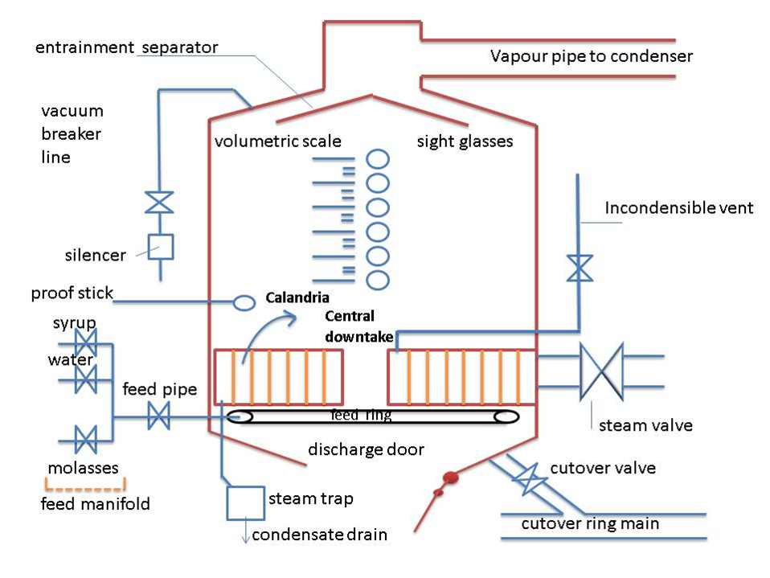
Batch Pans
Modern batch vacuum pans are vertical welded steel cylinders.
The walls of the pans are lagged to minimise heat loss.

Slide 4
Batch Pans – The Calandria
Heating element of the pan
Consists of a large number of cylindrical tubes fixed to a top and bottom tube plate.
Tubes have a diameter of about 100mm with their length being in the order of 1000 - 1500mm.
Tubes usually made of stainless steel.
The steam which supplies the thermal energy is separated from the boiling massecuite by the metal surfaces of the tubes while the massecuite boils inside the tubes.
The number and size of the tubes determines the area of the heating surface.

Slide 5
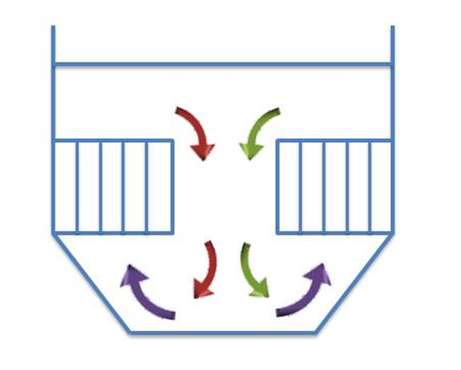
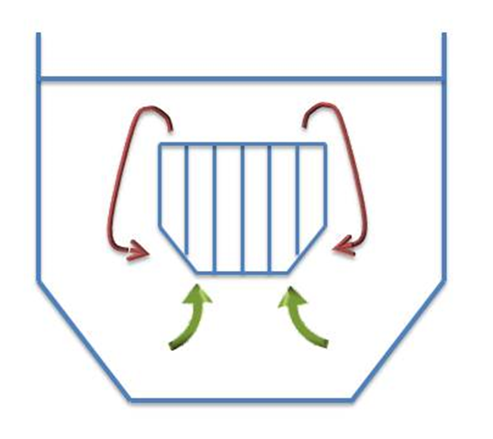
Batch Pans – The Calandria (cont.)
Two versions of the tube calandria in use
The fixed calandria – tube plates attached to the sides of the pan and a central downtake.
The floating calandria – supported in the middle of the pan with an annular downtake. The bottom tube plate is usually stepped.

Slide 6
Batch Pans – The Calandria (cont.)
Steam
Steam is the energy used to heat the massecuite.
V1 vapour is bled from the first effect evaporator.
The driving force is the temperature difference between the massecuite and the steam.
The temperature difference causes the steam to condense (give up its latent hear).
The condensate is forced out of the condensate pipe and through the steam trap by the pressure of the steam inside the calandria.
The rate of steam usage and condensate production is dependent on the temperature difference between the massecuite and steam.

Slide 7
Batch Pans – The Calandria (cont.)
Steam (cont.)
When the pan is first charged the temperature difference is greatest and because of this the steam valve must be opened slowly to warm up the calandria and reduce this temperature difference.
If this is not done a vast amount of condensate will be produced which could cause the calandria to water log, because it cannot drain away fast enough.
The sudden heat change could also damage the calandria.

Slide 8
Batch Pans – The Calandria (cont.)
Vacuum system - Condensers
As the massecuite boils in the pan, a large quantity of water vapour is generated.
In order to maintain the vacuum (low pressure) in the pan this water vapour must be continuously removed.
Done using a condenser.
A condenser is a vessel used to condense vapour to liquid.
The condenser is either connected to or is enclosed in a vacuum pan.
Once the vapour is inside the condenser, cool water (condenser water) is sprayed on it causing the vapour to condense.
The purpose of a condenser is not simply to condense vapour but to use this condensation to create a vacuum which can then be controlled by the condenser water.

Slide 9
Batch Pans – The Calandria (cont.)
Vacuum system – Condensers (cont.)
At -80kPa vacuum (20kPa absolute) 1kg of vapour occupies 6,6m³ of space.
This vapour can be condensed by 15 kg of water to 0.001m³ of condensate.
Condenser made up of a series of baffles or perforated plates which causes the water entering at the top of the condenser to form a series of saturating showers or fine rain-like droplets.
Gives efficient condensing of the vapour entering at the bottom.
Condenser water enters at the top and falls under gravity to the outlet – (the tail pipe or barometric leg).
The vapour is sucked into the condenser at the bottom by the vacuum created from the condensation taking place and is drawn up through the falling water and condensed.
Some of the vapour cannot be condensed (incondensable gases) and these gases are removed by the air pump (vacuum pump).

Slide 10
Batch Pans – The Calandria (cont.)
Vacuum system – Condensers (cont.)
The vacuum can be controlled by adjusting the amount of water entering the condenser.
An increase in the amount of water increases the vacuum (to a maximum of approximately- 90kPa).
A decrease in the amount of water decreases the vacuum (i.e. increases the absolute pressure).
An increase in vacuum (reduced absolute pressure) reduces the massecuite boiling temperature and increases the rate of evaporation.
A decrease in vacuum (increase in absolute pressure) increases the massecuite boiling temperature and decreases the rate of evaporation.
Taking this information into consideration it is easy to see why it is easy to raise vacuum in a hot pan and extremely difficult to raise vacuum in a cold pan.

Slide 11
Batch Pans – The Calandria (cont.)
Vacuum system - Barometric Leg
As the pan and condenser is under vacuum and the water in the sealing well is at atmospheric pressure there must be a seal to prevent the water in the sealing well from being sucked into the pan.
This is done by means of a barometric leg or tail pipe.
The tail pipe must be at least 10.4 metres long to balance the difference in pressure between – 80kPa (gauge pressure) in the condenser and the atmospheric pressure at sealing well.
If the barometric leg is too short the condenser will fill up with water and possibly flood back into the pan.

Slide 12
Batch Pans – The Calandria (cont.)
Vacuum system - Approach Temperature
A condenser is said to be working well if the approach temperature is low.
This approach temperature is the difference between the inlet vapour temperature and the outlet water temperature (tv – t₀).
The more water used the lower t₀ becomes.
This increases the approach temperature and the condenser becomes less efficient.
Water control is thus important to ensure that the condenser is working efficiently.

Slide 13
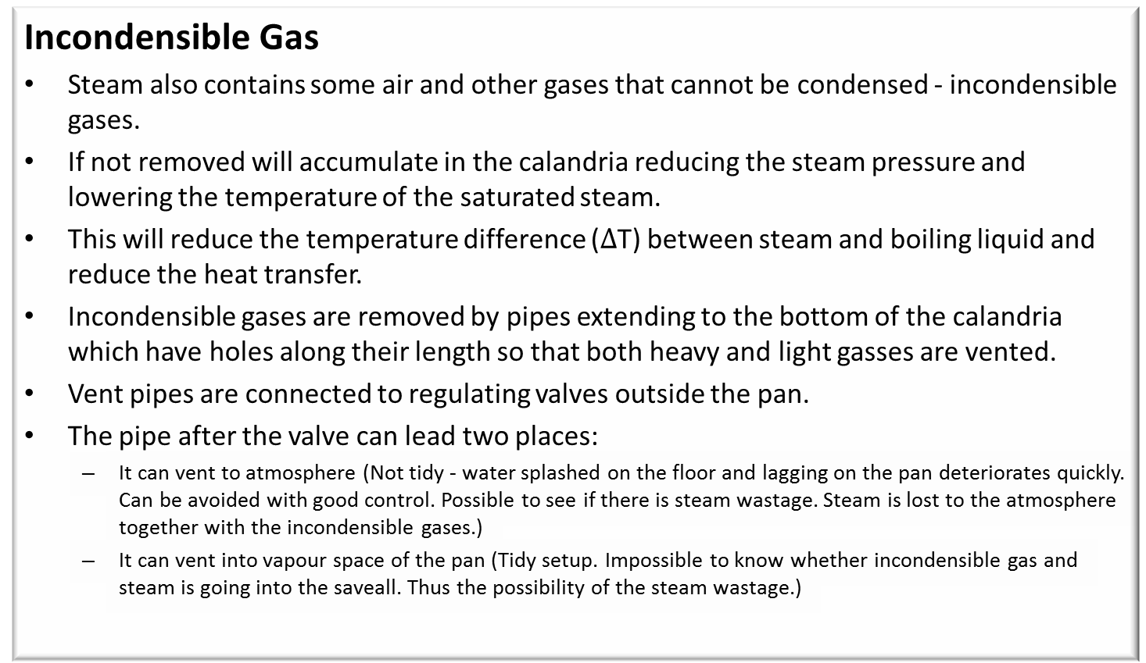
Batch Pans – The Calandria (cont.)
Incondensible Gas
Steam also contains some air and other gases that cannot be condensed - incondensible gases.
If not removed will accumulate in the calandria reducing the steam pressure and lowering the temperature of the saturated steam.
This will reduce the temperature difference ($∆$T) between steam and boiling liquid and reduce the heat transfer.
Incondensible gases are removed by pipes extending to the bottom of the calandria which have holes along their length so that both heavy and light gasses are vented.
Vent pipes are connected to regulating valves outside the pan.
The pipe after the valve can lead two places:
It can vent to atmosphere (Not tidy - water splashed on the floor and lagging on the pan deteriorates quickly. Can be avoided with good control. Possible to see if there is steam wastage. Steam is lost to the atmosphere together with the incondensible gases.)
It can vent into vapour space of the pan (Tidy setup. Impossible to know whether incondensible gas and steam is going into the saveall. Thus the possibility of the steam wastage.)

Slide 14
Batch Pans – The Calandria (cont.)
Incondensible Gas (cont.)
Vapour evaporated from boiling massecuite contains gasses like air that cannot be condensed in the condenser.
These incondensible gasses must be removed.
Air pumps are used to extract incondensible gasses from vacuum pans via the condenser.
These pumps do not pump vacuum so technically their usual name of “vacuum pump” is wrong.
Liquid ring air pumps are universally used.
Consists of a shaft carrying radial vanes rotating in a drum.
Shaft is eccentric to the drum and in this way, as the vanes rotate, they enclose a space increasing for suction and then decreasing for compression of air and delivery.
Space in the pump is limited by an annular ring of water lining the drum and held against the walls by centrifugal force.
Liquid ring pumps take up little space and require little attention.

Slide 15
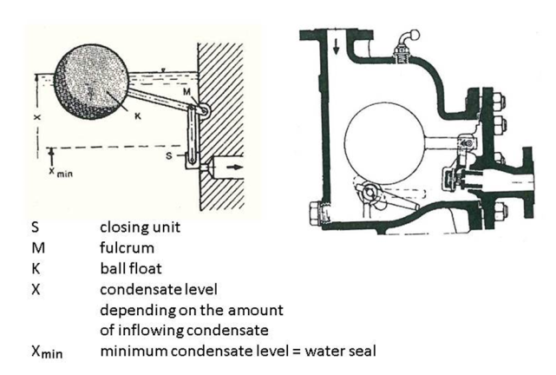
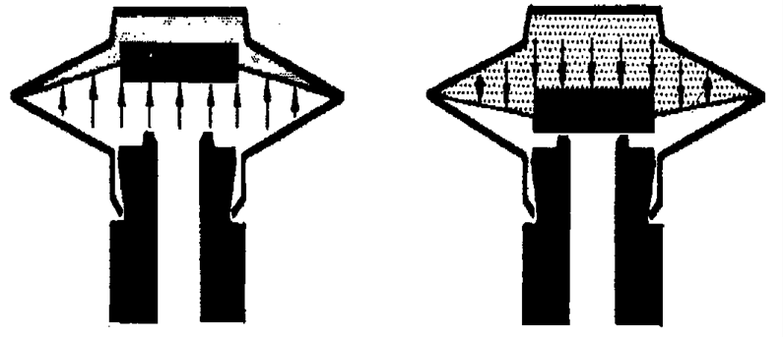
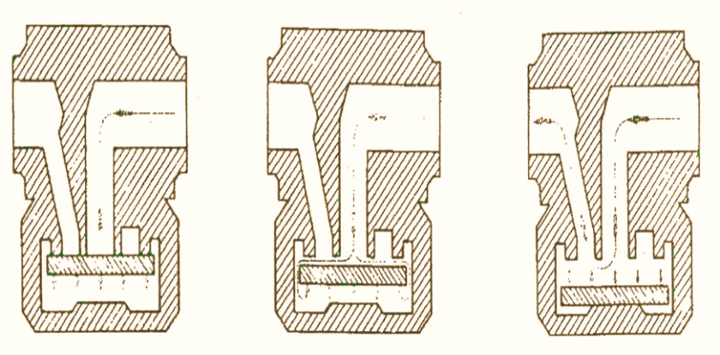
Batch Pans – The Calandria (cont.)
Condensate Removal using steam traps
Float type traps
Thermodynamic traps with valve disc
Thermostatic traps

Slide 16
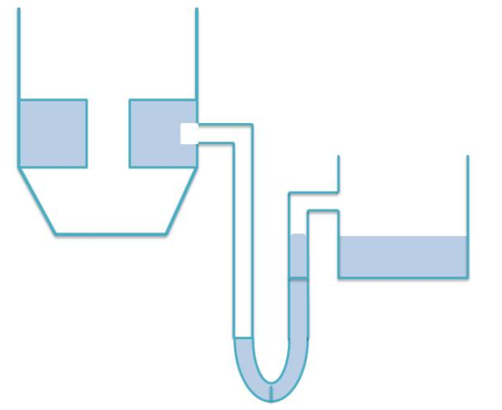
Batch Pans – The Calandria (cont.)
Condensate Removal using U-leg
Consists of a long U-shaped pipe.
Top of one leg is connected to the calandria drain
Top of other leg is connected to the condensate tank.
Bottom of the “U” as low as the ground level will permit.
“U” acts as a seal between calandria pressure and atmospheric pressure.
If “U” is not long enough to balance this pressure difference, water will be forced out of the “U” allowing steam to escape.

Slide 17
Batch Pans – The Calandria (cont.)
Pan Feed System
Objective is to give an even, unrestricted flow of feed into the pan.
The best place for this to be done is under the calandria.
Here the feed blends in with the natural circulation and good mixing is achieved as the massecuite rises up the tubes.
The feed ring or distribution pipe under the calandria should ideally be connected to the feed valve by a pipe entering under the calandria.
The feed ring can be attached to the side of the pan, be halfway between the downtake and side of pan, or have a star arrangement.

Slide 18
Batch Pans – The Calandria (cont.)
Circulation
Good circulation critical for good/effective pan boiling.
Promoted by bubbles of vapour agitating or mixing the massecuite as they lift it towards the surface.
Massecuite boils and rises in the tubes and then moves down the central downtake to the bottom of the calandria.
Heating thus causes circulation.
Circulation can be said to be good if the difference in temperature between the massecuite under the calandria and 40mm above the calandria is not more than 3˚C when the pan is nearly full.

Slide 19
Batch Pans – The Calandria (cont.)
Circulation (cont.)
Hindered by the resistance of the shape and position of the tubes and by obstructions in the downtake.
Important for bringing new mother liquor into contact with the crystal surface thus assisting crystallisation.
Stirrers are used in pans to improve the circulation (especially white sugar).
Stirrer speeds about 50rpm are used.
Helps to minimise the formation of clusters of crystals (known as conglomerates).
Advantages:
Shorter boil times
Lower steam pressure requirement
Lower temperature requirement
Less colour formation due to lower temperature
Stirrer current requirement can be used as an indication of the strike point.

Slide 20
Batch Pans – The Calandria (cont.)
Entrainment separators: Savealls or Catchalls
Small drops of mother liquor and/or crystals are thrown up into the vapour steam when massecuite boils - Called entrainment.
If not saved they will be lost causing pollution and money loss.
Saveall is used to trap these entrainment particles – can be internal or external
Design principle involves:
A rapid change in droplet direction
A reduction in droplet velocity
Can only work well if clean – should be cleaned weekly
De-mister screens can be used to minimise entrainment.
A seal prevents vapour droplets from by-passing the separator. Common systems in use include:
J tubes,
bayonet clip pots and
U legs.

Slide 21
Batch Pans – The Calandria (cont.)
Cut-over Pipe
Large bore pipe of 250 - 300mm
Connects the pans, seed receivers and magma tank together.
Purpose: To cut/transfer the product (seed and magma) between pans and receivers.
Makes the pan floor more versatile as pans can be used for more than one duty.
Seed is transferred from pan to pan by a difference in vacuum.
Co-operation between pan boilers is necessary to prevent the mixing of seed.
Must be thoroughly steamed out and drained after use.
Flanges are connected to a low pressure steam supply (V₁ vapour) to flush the line.
The pipe must be cleaned to prevent a massecuite build-up and possible blockage and also to prevent the mixing of different sized grains which will affect the final sugar quality.

Slide 22
Batch Pans – The Calandria (cont.)
Sight Glasses
Port hole-like windows up the side of the pan
Allow the pan boiler to see the level of boiling massecuite in the pan.
Good illumination is provided and a scale calibrated in m³ gives an approximate measure of the volume of massecuite in the pan.
A wash line (either hot water or steam is used) to wash the inside windows – sometimes manual cleaning is necessary.
Rubber seals ensures no air can leak into the pan.
Scale is removed with hydrochloric acid.

Slide 23
Batch Pans – The Calandria (cont.)
Breaking Vacuum
The vacuum breaker valve is a valve isolating the air space of the pan from atmosphere.
The purpose of the valve is to allow air into the pan to fill up the space under vacuum.
This is necessary when the pan is ready to strike (be emptied).
The condenser water valve should be closed and the air pump stopped before the vacuum is broken or sugar could be entrained.
The vacuum breaker line is fitted with a silencer to reduce the excessive noise experienced by air rushing through the line when vacuum is broken.

Slide 24
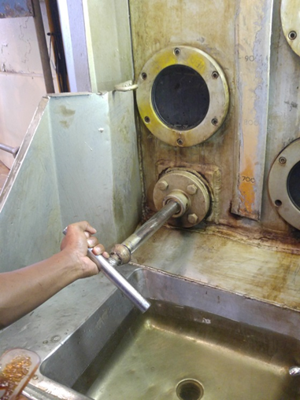
Batch Pans – The Calandria (cont.)
Proof Stick
A device for withdrawing a sample of the boiling massecuite from the pan whilst the pan is under vacuum.
Mounted above the calandria and, below it on the side of the pan, there is a wash basin.
Important that the proof stick be clean before pulling a sample - Pulled out and washed clean, allowed to return into the pan and withdrawn again with the sample.
Should be held and guided back into the pan, not released and allowed to go back on its own.
If allowed to return on its own it can be sucked in quickly with the possibility of breaking or damaging the handle.

Slide 25
Batch Pans – The Calandria (cont.)
Manways
Also called manhole
Provides access to the inside of the pan.
Rubber seal ensures that the door is air tight when closed.
Before closing the door:
Ensure that the seal is clean as any dirt or sugar on the seal could cause an air leak which would make vacuum control difficult.
Make sure all equipment is removed and
Make sure nobody is inside before closing the door.
Do not overtighten the door.
Overtightening will
make it difficult to open and
could also damage the threads on the locking bolt making it impossible to open or close

Slide 26
Batch Pans – The Calandria (cont.)
Pan Discharge Door
Used for emptying out the massecuite on completion of a boiling
Has a diameter in the order of 0.75 metres.
Can be manually or hydraulically operated.
Can include lights to show when the door or valve is fully opened or closed (These lights can be operated by pressure switches or limit switches).
Non-return valves used to prevent the door or valve moving in the case of an oil leak in the piping.
Leaks must be repaired promptly.
The cylinder controlling the operating of the discharge door can be :
Underneath the pan where maintenance is difficult, or
On top of the pan with a long shaft running through the pan and downtake to the door.

Slide 27
Batch Pans – The Calandria (cont.)
Steaming Out
Steaming out valve isolates the vapour 1 steam line from the air space of the pan.
Purpose: To admit steam into the pan after it has been struck to melt all traces of the grain left behind.
The steaming should be sent to an appropriate tank and not dropped onto the just-struck massecuite.
Steaming out of a pan makes raising vacuum easier because there is a lot of hot vapour available to condense in the condenser.
Possible to break the vacuum in the pan by opening the steaming out valve.
This practice, although time saving, can cause problems. Because of the big pressure difference there would be a waste of steam and the steam could also melt the grain on the top of the strike as it is discharging.

Slide 28
Batch Pans – The Calandria (cont.)
Pan Instrumentation
Funnel
Mounted on side of the pan.
Used for adding slurry when graining the pan.
A thermometer
A vacuum gauge
When pairs are automatically controlled:
A vacuum controller
A massecuite level measuring device such as a DP cell or one measuring the capacitance of a wire partially immersed in the massecuite
An indirect measure of supersaturation coefficient such as boiling point elevation conductivity or radio frequency.

Slide 29
Other Pan Floor Equipment
Molasses Blow-up Tanks
Used to supply conditioned molasses to the pans.
Stirred vessels fitted with direct injection steam as a means of temperature control
Usually small and mounted above floor level.
Function of the molasses blow-up tank is two-fold:
The molasses is heated so that it has a temperature higher than that of the pan into which it will be introduced. This has the advantage that the molasses will flash when entering the pan, thus promoting circulation.
The molasses is diluted with steam hot water to have a 70°Bx. The brix is measured by a conductivity meter that operates a valve to feed water/steam.
Contents must be well mixed by a stirrer (or by a steam jet mixer) to prevent local hot spots with possible deterioration of the molasses.
Only the required amount of molasses is conditioned at any one time.

Slide 30
Other Pan Floor Equipment (cont.)
Strike Receiver
Mounted below the discharge valve of a vacuum pan
A launder or pipe to transport the massecuite to the strike receiver when the pan is struck (emptied).
Strike receivers are special surge vessels designed to receive the massecuite as it falls from the pan.
The strike receivers are fitted with stirring devices to keep the crystals in suspension and prevent them from settling on the bottom of the strike receiver.

Slide 31
Other Pan Floor Equipment (cont.)
Seed Receiver
Immature (partially grown) massecuite that contains small crystals that require further growth is called a seed massecuite.
Seed receivers are:
Usually totally enclosed cylindrical tanks with stirrers.
Connected to the pans by the cut-over line, and
Used for the storage of seed.
Sight glasses are provided.
To cut or transfer a seed between a pan and a receiver there must be a difference in vacuum between the two vessels.
Should be steamed out as often as possible
To prevent mixed grain being used as seed
To stop any decomposition and fermentation that could take place.

Slide 32
Valves
A valve is used to isolate or regulate flow in a pipe line.
There are many different valves available for many different uses.
Diaphragm valve
Gate valve
Butterfly valve
Slide valve
Steam valve
Ball valve
Float valve
Non-Return valve
Safety valve

Slide 33
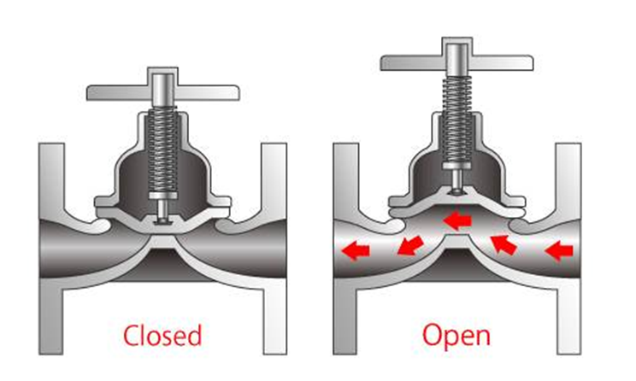
Valves (cont.) – Diaphragm valves
Most common type is the Saunders valve.
Regulation by a rubber diaphragm that acts against a ridge in the path of flow.
Good seal is provided.
Easy to overhaul and does not have to be removed from its position in the pipe line to be overhauled.
Has no glands so there are no leaks unless the diaphragm ruptures.
Grease is not compatible with rubber so when overhauling, the spindle area must not overfilled with grease.

Slide 34
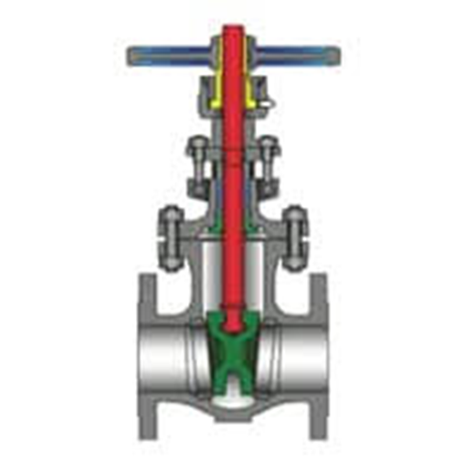
Valves (cont.) – Gate valves
Relatively expensive.
Contain many moving parts
Not particularly reliable
If not treated/worked properly they will not seal off tightly.
Spindle turns in a gland that frequently leaks - either liquid out of the valve or air into the valve if it is under vacuum.
Frequently used to regulate feed to pans and to control the cut-over line.

Slide 35
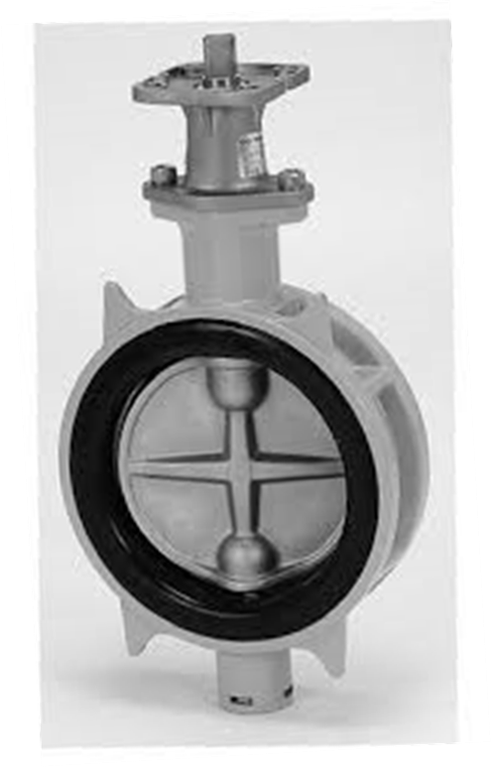
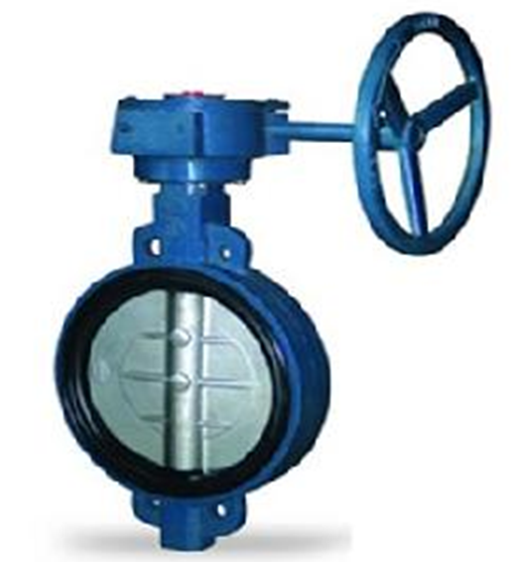
Valves (cont.) – Butterfly valves
The most common use is for the automatic control of condenser water.
Problems can be caused by:
A loose blade,
A worn shaft and
Gland leaks.
Prone to jamming is closed too tightly.
New designs are extremely reliable
Can be used as cut-over valves and as discharge valves.
Extensively used on pipes carrying massecuite, syrup, molasses etc.

Slide 36
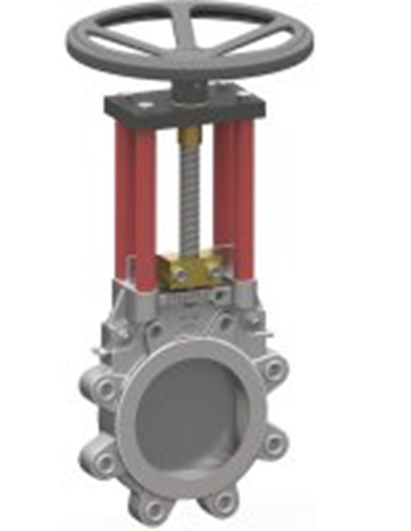
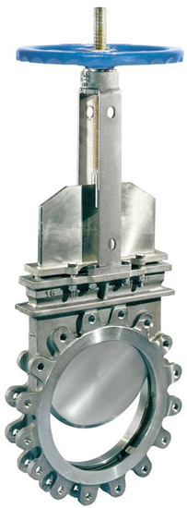
Valves (cont.) – Slide valves
Most common type are Stafsjo valves.
Are good for massecuite and magma as the tongue or slide is smooth.
Tendency for crystals to pack at the bottom of the slide causing leaks.
Glands can also leak.
Steaming out points on the valve is advisable to clear stuck massecuite and free the slide if it jams with cold massecuite.
There are self- cleaning slide valves available which do not have the problem of leaking due to crystal build up, but they have an extra gland which is another possible source of leakage.

Slide 37
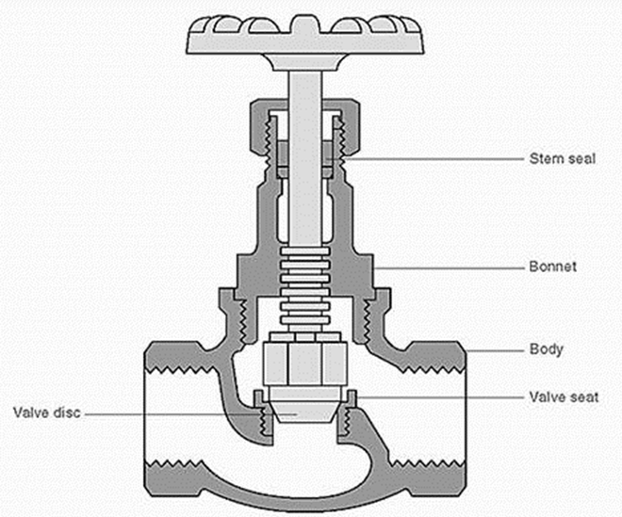
Valves (cont.) – Steam valves
Steam valves, globe valves or plug and seat valves are tight sealing valves suitable for high pressures.
Reliable
Glands can leak.
Not suitable for liquids with suspended matter as this could damage the sealing surfaces.
Actuators can be fitted to this type of valve for automatic control.

Slide 38
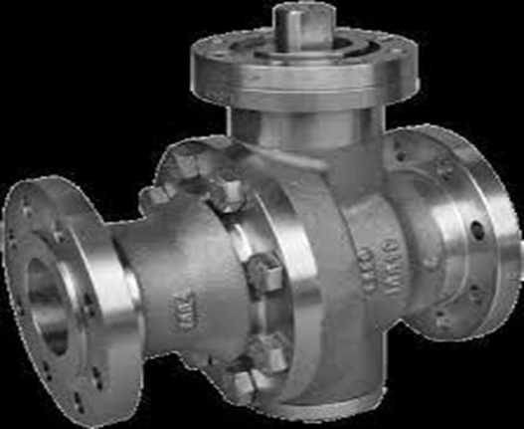
Valves (cont.) – Ball valves
Quick acting valves.
Only real use on the pan floor is on the graining funnel.
Very little maintenance is necessary.

Slide 39
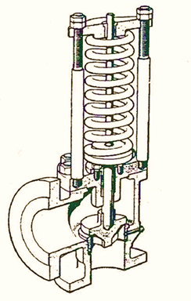
Valves (cont.) – Safety Valves
Can be fitted either to the calandria or the body of a pan.
Fitted in the calandria in case there is a build-up of pressure.
Only likely to happen when the normal vapour pressure is exceeded due to malfunction of make-up valve from the high pressure steam line.
Guards against excessive pressure inside the pan. This would only happen if:
the discharge door was closed,
condenser water closed,
air pump stopped and
the steaming-out valve opened.
With no safety valve the sight glasses would break causing possible personal injury.
To be effective it must be regularly overhauled.
Overhaul should not consist only of a coat of paint because excess paint will jam the moving parts making the valve inefficient or inoperative.

Slide 40
Valves (cont.) - Others
Float valve
Used to maintain a fixed level of liquid in a tank.
Non-Return valve
Inserted in a pipe line to prevent liquid flowing back along the pipe.
The most common type uses a pivoted flap which falls over an opening preventing reverse flow.
The Saunders non-return valve uses a rubber flap while other makes use of brass or cast iron flaps.

Slide 41
Starting a Batch Pan
Before starting up a batch pan a number of checks should always be made.
These include checking that:
The pan is empty
There is nobody in the pan
The manhole doors are securely closed
The calandria has been drained of water- especially after testing for leaks
The calandria steam valve is closed
The condenser water valve is shut
The vacuum pump is off
The incondensible gas valve is closed
The steaming drain and/or discharge door closed
The cut-over valve is closed
The vacuum breaker valve is closed.

Slide 42
Starting a Batch Pan (cont.)
After the checks the pan is ready for vacuum to be raised.
Possible to raise vacuum in a pan using the vacuum pump
This is a very slow process
May take about half an hour.
The best way is to fill the pan with steam and after closing the discharge door, to condense this steam by opening water to the condenser.
The sequence of steps involved is as follows:
open the discharge door (or drain valve)
open steam into the pan body (not the calandria)
wait until the pan temperature has reached 90-95°, then :
shut the discharge door (or drain line)
shut the steam valve
open the condenser water valve.
Full vacuum will be obtained within one minute.
Note that the steaming out operation heats up the body of the pan which is desirable for boiling a massecuite.

Slide 43
Starting a Batch Pan (cont.)
Problems
Should a pan not reach, or fail to maintain, vacuum, a leak is indicated on the pan.
The items to check are:
Joints between flanges on the pan or lines connected to pan flanges
The discharge door seal on the pan and other valves, viz. vacuum valve, vacuum breaker, cut-over valve.
No injection water or else hot injection water. The latter happens when the cooling tower fans trip.
A leak on the condenser tail pipe often at the water level in the sealing wall.
The calandria may have broken tubes or tubes may need to be re-expanded. Sometimes it is necessary to blank off leaking Calandra tubes if there is insufficient time to replace them.
The glands on stirrer motor shafts.
Collapsed trays in condensers.

Slide 44
Starting a Batch Pan (cont.)
Problems (cont.)
Calandria are tested for leaks by filling with cold water and looking underneath the calandria for leaks.
If difficulty is experienced in locating a leak on a pan, the pan may be either:
filled with steam, or,
in extreme cases, filled with water.
At the start of a new season it is good practice to test all pans for possible leaks by raising vacuum, then shutting the vacuum line and observing the rate of fall of vacuum over, say, half an hour.
Modern welded pans should show less than a change of vacuum of 3kPa in 30 minutes.

