Slide 1
KNOWLEDGE COMPONENT: MODULE 7:
PAN BOILING: KT 3: GRAINING A PAN AND GROWING A MASSECUITE

Slide 2
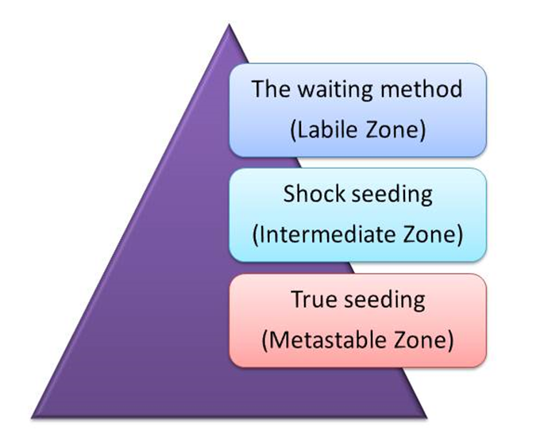
Grain Formation
Three basic methods of grain formation

Slide 3
The Waiting Method
In the labile zone primary nucleation takes place.
The mother liquor is concentrated into the labile zone and is kept there until sufficient crystals are formed.
The boiling solution is then diluted into the metastable zone
Kept there until the end of the strike.

Slide 4
Shock Seeding
Solution is concentrated into the intermediate zone where secondary nucleation will take place.
Small amount of powdered sugar is added and this induces the formation of further nuclei.
Supersaturation must be higher than normal and is normally done in refineries.
Once tiny crystals have formed throughout the solution the pan boiler is washed (with water or diluted feed) to get the correct number of crystals.
When there are sufficient crystals present the solution is brought into the metastable zone and kept there until the end of the strike.
Can be practised in refineries, but not in the raw house because the bands of supersaturation are higher for impure sugar solutions, so the solution needs to be concentrated more to get the correct supersaturation.

Slide 5
True Seeding
Relies on the fact that in the metastable zone existing crystals will grow and no new ones will form.
Mother liquor is concentrated to the upper part of the metastable zone (SSC 1.25 - 1.35)
The required number of seed crystals is added in the form of a slurry.
Important to keep the supersaturation constant during this procedure.
Boiling is continued in the metastable zone until the end of strike.
With true seeding the number of nuclei will depend on the amount of slurry used.
Grain does not appear immediately upon the introduction of the slurry and can take anything between 5 -10 minutes.
In the meantime, the pan is kept boiling vigorously with the steam full on.
From then on the instrument keeps the supersaturation constant by controlling the water addition.
The grain grows and must be allowed to do so until the voids are filled and the grain is close together.
Only when one is sure that this stage has been carried out that feed is introduced and the boiling of the massecuite proper is started.

Slide 6
True Seeding (cont.)
In order to ensure that full seeding is actually taking place, it is necessary to keep the boiling in the upper regions of the metastable zone.
In order to determine this in a practical way, the following method may be used:
  With enough A molasses in the pan allow boiling to proceed until the molasses start to thicken, then take frequent samples with the proof-stick and examine a smear under the microscope.
  Carry on boiling and at a certain time microscopic crystals will appear almost at once.
  Note this point. This is the lower limit of the labile zone.
  Now open the wash water valve, dilute the molasses while taking samples with the proof stick.
  It is apparent after a while that the grains start to dissolve.
  This is the start of the undersaturated region.
  Note this point.
Take the distance between these 2 points and at a position between ½ and ⅔ of the distance from the saturation point is the region to grain.
With trial and error this graining point can be very precisely obtained.

Slide 7
Slurry
Slurry is ideally made by grinding refined sugar in a miniature ball mill with an organic fluid in which sucrose is insoluble.
The method of manufacture differs quite considerably from factory to factory and the standard method of manufacture is difficult to enforce.
The S.M.R.I. recommended method is:
  800g of refined sugar and 2 litres of methanol are tumbled for 12 hours.
  The ball jar should contain 2500 10mm steel balls and should rotate at 74 r.p.m.
  After 12 hours the ball jar should be diluted to 6 litres with methanol.
If the slurry is made the same way all the time, uniform, uniform size slurry will be made.
If the correct amount of slurry is used when seeding the crystal size and content of the final massecuite will be uniform.

Slide 8
Slurry (cont.)
It can be calculated how much slurry is needed to produce a certain volume of massecuite of a fixed crystal size.
The quantity of grain in the slurry will determine the size of the final grain and the exhaustion of the massecuite.
If a significant change in the final grain size is desired starting from a normal size of 0.30mm, it is necessary to change the amount of slurry by not less than 20% of the original volume.
The amount of slurry used for C boiling is about 1000mm/35m³ of massecuite and about half that for B-boilings.

Slide 9
Graining a Pan
How to grain the pan.
This means introducing small crystals that are subsequently used as nuclei to grow the main sugar crystals.
The steps involved are as follows:
  Raise vacuum in the pan as described before.
  Draw liquor of purity 75% (mixture of molasses and syrup) into the pan by opening the feed valve.
  The vacuum sucks the liquor into the pan.
  Shut the feed valve when the level in the pan is about 250mm above the top tube plate.
  Open steam to the calandria so that the liquor boils.
  Follow the progress of the boiling on the conductivity chart.

Slide 10
Graining a Pan
How to grain the pan (cont.)
Open the water feed until the conductivity indicates that the liquor is unsaturated.
This water “wash” is important to dissolve any small/fine crystals that are present in the liquor.
The conductivity of the liquor increases due to increased mobility of the ions present.
Draw a sample of liquor using the proof stick and check that no small crystals are present.
Allow the liquor to boil so that its concentration increases.

Slide 11
Graining a Pan
How to grain the pan (cont.)
Conductivity decreases indicating increasing concentration due to evaporation during boiling.
The conductivity should be such that it indicates that the liquor has a supersaturation co-efficient of 1.30 and is within the metastable zone for a purity of 75%.
Water feed is opened so that the addition of water just counter-balances the rate of evaporation.
When the reading is steady at the desired conductivity value (i.e. the metastable zone), the predetermined quantity of slurry is added through the funnel on the side of the pan.
Slurry is added.

Slide 12
Graining a Pan
How to grain the pan (cont.)
Crystals at this stage are microscopic and very widely dispersed, so that that local rises in supersaturation can easily occur with an excessive evaporation rate.
These local rises in supersaturation can be ascribed mainly to the greater diffusion paths of the sucrose molecules because of the sucrose crystals being so widely dispersed.
For this reason it is endeavoured to grow the crystals so that they practically fill the spaces occupied by the syrup or mother liquor before the volume of the massecuite its increased.

Slide 13
Graining a Pan
How to grain the pan (cont.)
At this concentration the crystals present in the pan will grow and become larger while the total volume of liquid remains the same.
This reduces the distance between crystals.
This step is called “bringing together” and is very critical in pan boiling.
It must be well done so that, before going on to the next step, the crystal content has increased to a high level which can be assessed visually.

Slide 14
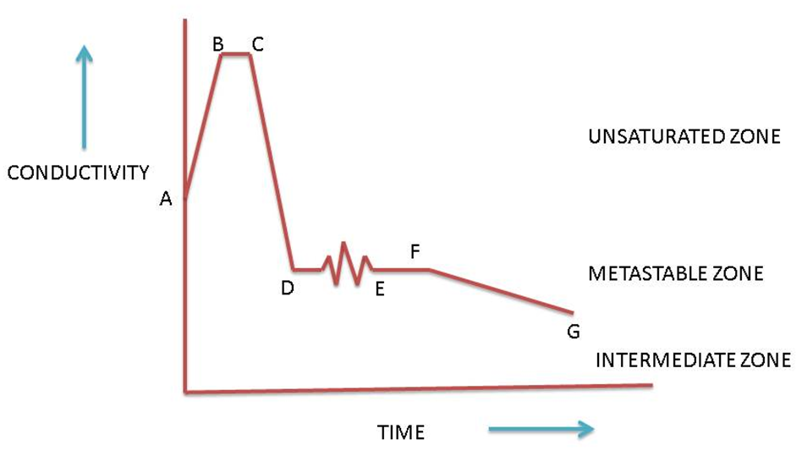
Graining a Pan
How to grain the pan (cont.)

Slide 15
Graining a Pan
How to grain the pan (cont.)
Bringing the grain together takes place from E to F.
The level of supersaturation is controlled by careful boiling, supplying sufficient water to replace the water being evaporated.
Steam supply is also kept constant.
This boiling is merely to ensure circulation so that each grain is presented with fresh liquor.
Bringing the grain together may take ½ to 1 hour.
Diffusion of the sucrose molecule is improved by the crystals contacting each other and replacing the exhausted layers of mother liquor around the crystal with fresh liquor.

Slide 16
Graining a Pan
How to grain the pan (cont.)
Diffusion rate in high purity boilings can be increased by raising the temperature by reducing the vacuum.
Increasing the temperature will:
  Lower the supersaturation
  Increase the crystallization rate
  Reduce the viscosity
  Increase the mobility
This should not be done with low purity massecuites due to the risk of reducing sugar decomposition at high temperatures.
When bringing together is complete the water feed is shut off (at F) and the pan feed valve opened (syrup/molasses).
From F to G the grain is grown and the pan gradually fills up to the strike level at which stage the pan feed is shut off (at G).

Slide 17
Graining a Pan
How to grain the pan (cont.)
Under ideal conditions the liquor feed (syrup/molasses) should be fed into the pan continuously.
If this is not possible it is better to give short regular feeds rather than long ones.
Shorter, more regular feed, will not cause such a big change in supersaturation.
From F to G the seed massecuite is grown.
Since the crystals grow because of sucrose deposition from the mother liquor; the impurities remain and accumulate in liquor.
The purity of the liquor is thus decreased.

Slide 18
Graining a Pan
How to grain the pan (cont.)
As mentioned before, this decrease in purity increases the solubility of the sucrose.
To maintain the liquor in the metastable zone, i.e. to maintain the correct supersaturation coefficient the concentration of the liquor (Brix) must be increased, hence the decrease in conductivity.
Furthermore, when growing the crystals and keeping the supersaturation of the mother liquor constant (1.3), the conductivity will also naturally decrease due to the changed ratio of crystal volume to mother liquor volume.

Slide 19
Graining a Pan
How to grain the pan (cont.)
Depending on conditions in the pan, the feed during the growing phase can be syrup/molasses, a mixture of syrup/molasses and sweetwater alone.
The pan now contains a mixture of small partially grown crystals and mother liquor known as SEED because it will be used to start off massecuite boiling proper.
At this stage:
  Steam to the calandria is shut off
  Water to the condenser is stopped
  The vacuum valve is closed
  The vacuum is broken.
The seed may then be transferred to the seed tank (using vacuum on the seed tank) or part may be transferred to another pan to start up a new boiling.
It is very important to note that the increase of brix during the boiling stage of a seed massecuite is very slight.

Slide 20
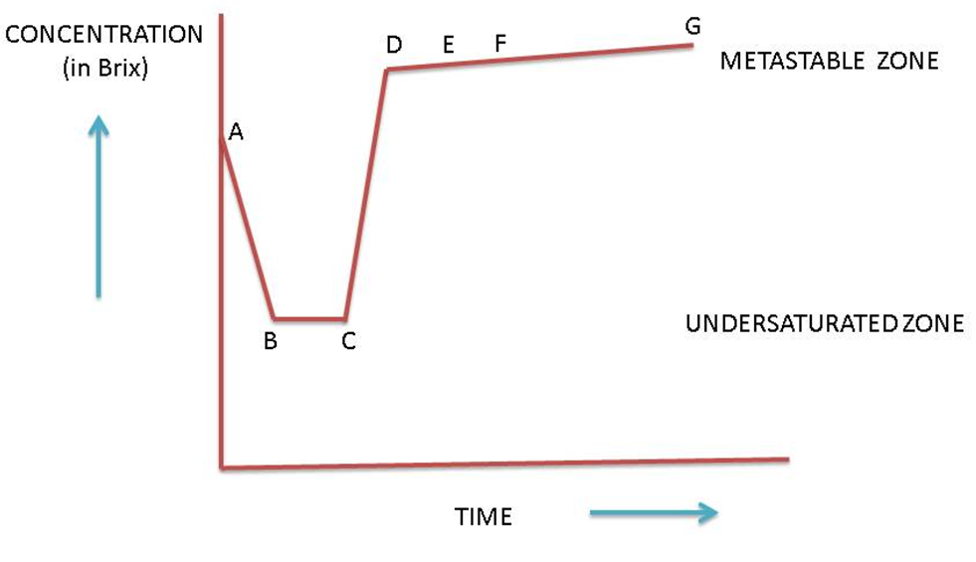
Graining a Pan
How to grain the pan (cont.)

Slide 21
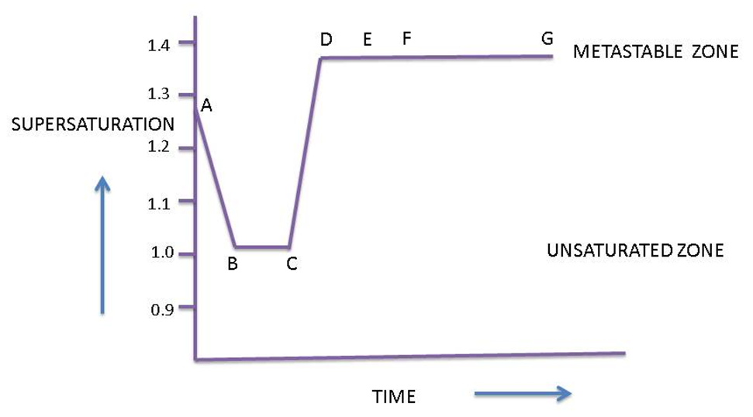
Graining a Pan
How to grain the pan (cont.)

Slide 22
Control of Super Saturation
For effective pan boiling it is essential that the vacuum remains constant throughout the boiling process.
Tampering with the vacuum can easily cause fluctuations in supersaturation that can cause grain to dissolve or false grain to form.
When the vacuum remains constant the temperature and hence the total rate of evaporation of water vapour from the massecuite remains constant.
How is the rate of evaporation controlled?
The rate of evaporation is controlled by varying the amount of water that is available for evaporation.
This is done by varying the amount of water fed by varying the amount of syrup/molasses feed supplied to the pan.

Slide 23
Control of Super Saturation (cont.)
If we wish to reduce the rate of evaporation from the massecuite in the pan, we can take the following action:
Add water : When this water is evaporated, the rate at which water is evaporated from the massecuite itself effectively decreases since the total rate of evaporation remains constant.
Increase the syrup/molasses feed rate : The water present in the feed has the same effect as described above.
If we wish to increase the rate of evaporation from the massecuite in the pan, we can take the following action:
Reduce the water added : Since this is now not available for evaporation, the rate at which water is evaporated from the massecuite itself effectively increases since the total rate of evaporation remains constant.
Decrease the syrup/molasses feed rate : Reducing the feed reduces the amount of water entering the pan which has the same effect as described above.

Slide 24
Control of Super Saturation (cont.)
When the crystals are small and the absorbing surface is small, water is used to adjust the rate of evaporation.
As the crystal grows and the absorbing surface increases the water feed is reduced and finally stopped.
The rate of syrup/molasses feed is then used to control the rate of evaporation.

Slide 25
Control of Super Saturation (cont.)
Should the evaporation rate prove excessive, causing the supersaturation to rise to a dangerous level, remedial action can take the form of the following:
Feeding water to the pan to maintain an acceptable level of supersaturation. This water, known as movement water, can be reduced as the crystal surface increases, and finally closed off. This procedure is widely used in many countries and is advantageous in as far as there is no disturbance of the vacuum. The amount of water required is generally insignificant.
Feeding liquor to the pan to achieve the same results as when adding water.
Lowering the vacuum (i.e. increasing the absolute pressure) by approximately 10kPa will raise the temperature by roughly 10,6°C, which will, in turn, lower the level of supersaturation to within that of the metastable zone. Crystal growth will increase ±100% and the evaporation rate will decrease by approximately 1/3.
Only reducing the steam supply to the calandria is likely to be the first reaction of the uninformed, as under atmospheric conditions, reduction of heat supply to a boiling solution will reduce the evaporation rate.

Slide 26
Control of Super Saturation (cont.)
In the case of a vacuum pan, attempts at lowering the evaporation rate by reducing the steam supply, lowers the production of vapour thus producing an increase in vacuum due to an increase in the condenser water to vapour ratio.
This results in a consequent increase in the evaporation rate.
To prevent this in practice, when the steam supply/pressure to the calandria drops (or is reduced) then immediately adjust the condenser water to maintain the normal pressure (vacuum) and boiling temperature which will prevent the supersaturation from rising further.
Controlling a pan by varying the steam supply is best left to pans having automating vacuum control installed.

Slide 27
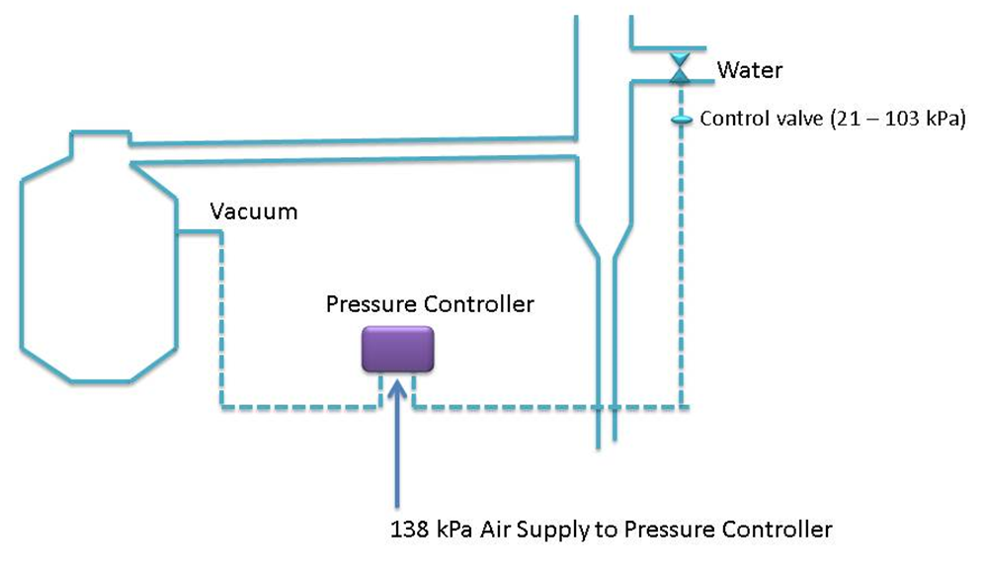
Automatic Vacuum Control

Slide 28
Automatic Vacuum Control(cont.)
The pressure controller senses the vacuum in the pan and adjusts the water control valve accordingly.
With increasing vacuum (i.e. decrease in absolute pressure) in the pan, the water supply to the condenser is decreased thus decreasing the vacuum (i.e. increasing the absolute pressure) in the pan.
This arrangement thus automatically compensates for variations in vacuum should the steam supply to the calandria be changed.
The controller keeps the vacuum in the pan constant.
The pressure controller is supplied with air at 138 kPa and it operates the pneumatic water controlled valve with an air pressure of 21-103 kPa.

Slide 29
Boiling of a Massecuite
Starts off similarly to graining a pan except that instead of covering the calandria with liquor the pan is filled with seed to a level such that the top tube plate of the calandria is just covered.
When the pan is started up it is sometimes necessary to boil it on water initially to bring it together and also dissolve any unwanted tiny crystals which may have formed in the seed tank.
It is then fed on liquor and the concentration of the mother liquor maintained in the metastable zone so that the crystals grow as the pan level rises.

Slide 30
Boiling of a Massecuite (cont.)
When the pan is full the average size of the sugar crystals can be estimated by observing a sample from the pan proof stick under the microscope.
If the size of the crystals is too small the pan can be cut to another pan and the boiling continued.
Cutting means taking part of the contents of one pan to another.
When this is done the level of partially boiled massecuite must always cover the top tube plate of the calandria otherwise charring of massecuite may occur when steam is opened to the calandria.

Slide 31
Boiling of a Massecuite (cont.)
Cutting may be carried out more than once and boiling continued until the appropriate size of sugar crystals has been achieved.
When the crystals are big enough the pan is struck i.e. the massecuite is emptied out.
There are 9 distinct procedures involved in boiling a massecuite.

Slide 32
Boiling of a Massecuite (cont.)
9 Procedures of boiling a massecuite:
Washing the syrup/molasses while the footing is gently boiling. This is to dissolve any small crystals/grains.
Concentrating the syrup/molasses to the metastable zone
Formation of the grain slurry seeding. This is unnecessary if B-magma footing is introduced into an A- pan as a footing. The footing is also washed to remove very small grain and then normal boiling procedures take place.
Bringing the grain together

Slide 33
Boiling of a Massecuite (cont.)
9 Procedures of boiling a massecuite:
Growing the grain by the supersaturation in the upper part of the metastable zone to encourage rapid crystal growth. The pan boiler must check regularly for the formation of false grain.
Cutting the seed across to another pan to split the seed equally between two pans.
Boiling the massecuite. This involves growing the crystals further.
Brixing up
Striking

Slide 34
Brix of the Pan Feed
The brix at which the liquor (syrup/molasses) is fed to the pan has marked effects on steam consumption.
It can be proved by calculation that nearly twice as much steam is needed when using a molasses of 55°Bx than when using a molasses of 70°Bx.
High brix feed does have its limitations:
  In the case of syrup, excessive scaling can result in evaporation tubes if the syrup brix is too high
  High brix molasses means a high level of sucrose saturation which can increase the presence of unwanted crystals (false grain)
  Circulation in the pan can also be reduced by excessive viscosity caused by high brix.
To minimise steam consumption and prevent a loss of time, molasses should not be conditioned to below 70°Bx.

Slide 35
Influence of Hydrostatic Head
Hydrostatic head is the pressure experienced at the bottom of a massecuite due to the height of massecuite above.
This increased pressure prevents the massecuite at the bottom from boiling.
In effect, boiling takes place only in the upper layers of the massecuite, whilst circulation in the tubes below is provided by convection currents.
The hydrostatic head causes the bottom of the massecuite to be at the higher pressure than the top of the massecuite.
The result is that the boiling point of the lower layers of massecuite is higher than the top.

Slide 36
Influence of Hydrostatic Head (cont.)
Theoretically (see table provided), the temperature difference between the upper and bottom layers is 33.1°C.
Such a large temperature difference is not recorded in practice.
Furthermore, heating a liquor of 1.20 supersaturation at 58.6°C to a temperature of 91.7°C would result in the solution being undersaturated, thus able to dissolve the grain.
There is no evidence of this occurring.
In reality, boiling takes place in the upper 40cm of the massecuite, whilst only heat transmission takes place in the calandria.
The heated massecuite is circulated throughout the pan.

Slide 37
Influence of Hydrostatic Head (cont.)
The average temperature difference between the top and layers of massecuite is from between 2 and 3°C, depending on pan design.
Any false grain formation is thus likely to take place in the upper layers of the boiling massecuite and the higher the head of massecuite, the greater will be the boiling temperature of the massecuite in the tubes under equal conditions.
The better the circulation, the more uniform will be the temperature distribution.

Slide 38
Influence of Hydrostatic Head (cont.)
It is preferable to have:
  the massecuite restricted to 1.37-1.52m above the tubes
  a pan designed to give maximum circulation
  mechanically augmented circulation (stirring)

Slide 39
Striking a Pan – The Steps involved
Brix up the pan.
This involves shutting off the feed to the pan and allowing evaporation to continue.
The supersaturation of the mother liquor will increase and crystallization continues giving improved crystal yield.
The final brix is assessed via instruments (e.g. conductivity meter) or in the absence of instrumentation this is determined by taking a sample from the proof stick and forming a cone or a ball in the palm and noting how quickly it flattens.
Note that overbrixing will make the massecuite too viscous and it will not flow from the pan.
Should this happen the pan must be restarted by shutting the discharge door, raising vacuum with the vacuum pump and diluting the massecuite to make it fluid enough to be discharged.
Under these circumstances entrainment is likely to occur.

Slide 40
Striking a Pan – The Steps involved (cont.)
When brixing is complete shut off steam to the calandria.
Close the vacuum valve.
Shut off the injection water to the condenser.
Open the vacuum breaker valve.
When the pan has reached atmospheric pressure open the discharge door.
Control the rate of discharge to prevent massecuite spillage.
When the pan is empty, open the steaming out valve and observe the pan discharge.

Slide 41
Striking a Pan – The Steps involved (cont.)
When the pan runnings have changed from massecuite to a consistency of syrup (a subjective evaluation) direct the pan runnings to the steaming tank.
As soon as steaming is complete, raise vacuum in the pan as described previously or leave the pan if it is not required for further boiling.

Slide 42
Highly Viscous Massecuite
When the mother liquor of a massecuite has a very high no-pol content, the massecuite will have an abnormally high viscosity i.e. a viscosity in excess of that dictated by the brix of the massecuite.
When dealing with very viscous massecuite the following points must be borne in mind:
  Boil these viscous massecuites relatively slowly using movement water. This will ensure good circulation to compensate for the slow rate of diffusion. Localised rises in supersaturation and resulting false grain will be prevented.
  Do not reduce the steam supply to the calandria as the massecuite could easily lose its fluidity and become too viscous to handle.
  Care should be taken when raising the temperature of the massecuite as the increased evaporation rate could easily cause localised increased supersaturation with resulting false grain formation.

