Slide 1
KNOWLEDGE COMPONENT: MODULE 7:
PAN BOILING: KT 8: MIXTURE CALCULATION

Slide 2
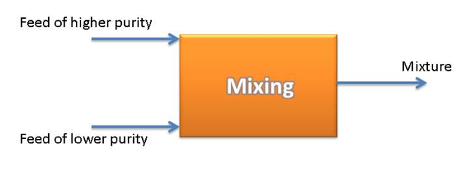
Introduction
As mentioned previously a purity of about 72% is ideal for graining a pan.
When it is desired to mix two liquors of different purities to obtain a mixture of given purity, the relative quantities need to be calculated using mixture calculations.
Consider the case where a feed of high purity is mixed with a feed of lower purity to give a mixture of a certain purity.

Slide 3
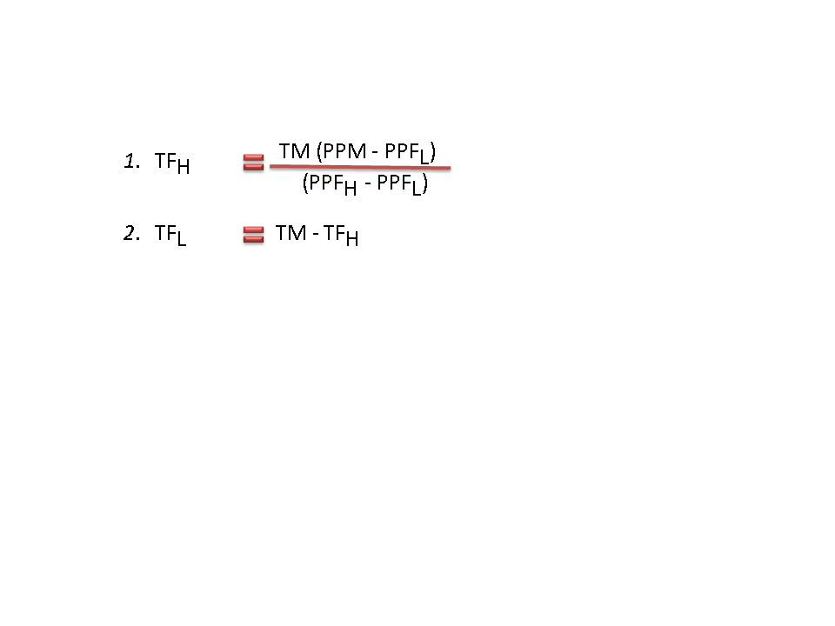
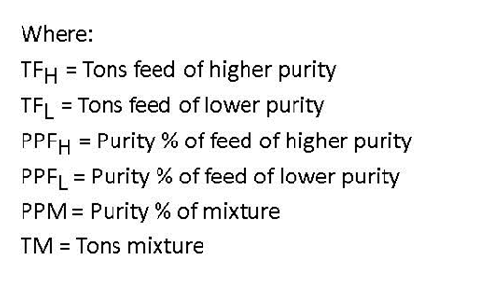
Using Formulae
The following formulae apply:

Slide 4
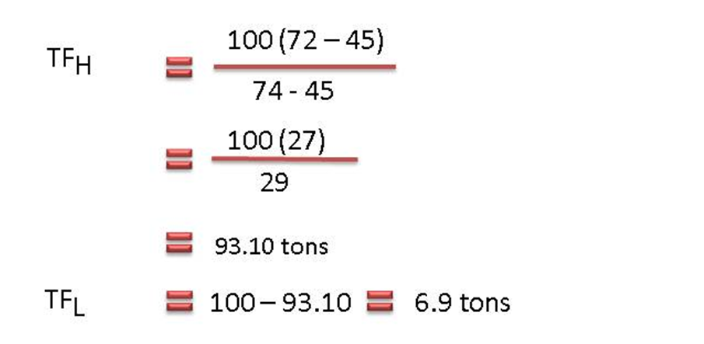
Example: Using Formulae
A molasses of purity 74% and B-molasses of purity 45% must be blended to prepare 100 tons of mixture at 72% purity. Find the amounts of each molasses required.

Slide 5
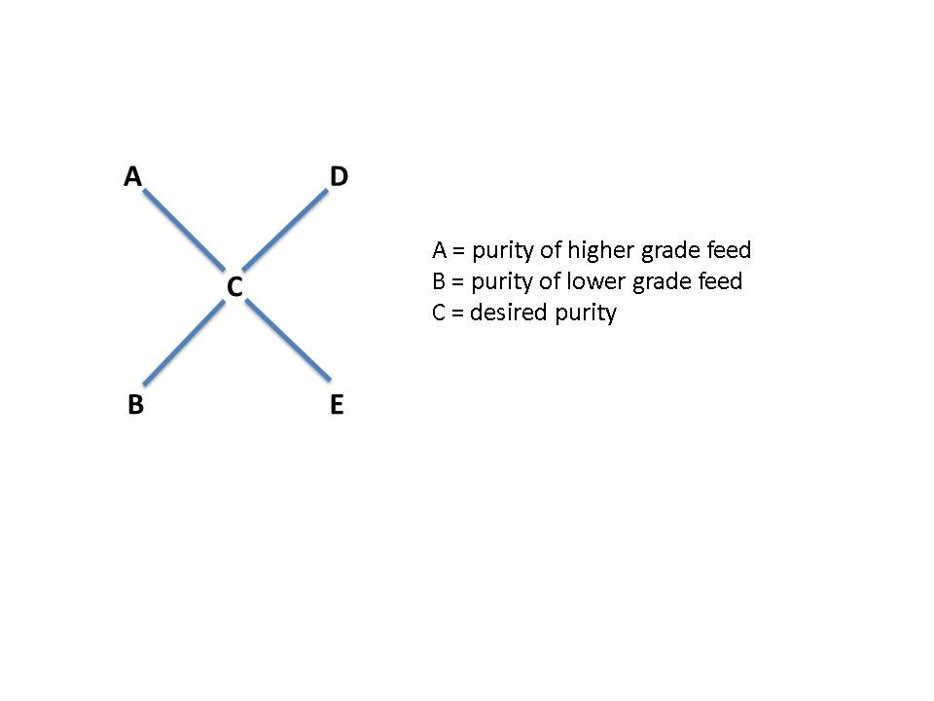
Using the Cobenz Diagram
The Cobenz diagram conveniently summaries the calculation performed in 7.2 above.
Thus: D = C – B (D = higher grade feed relative quantity)
E = A - C (E = lower grade feed relative quantity)

Slide 6
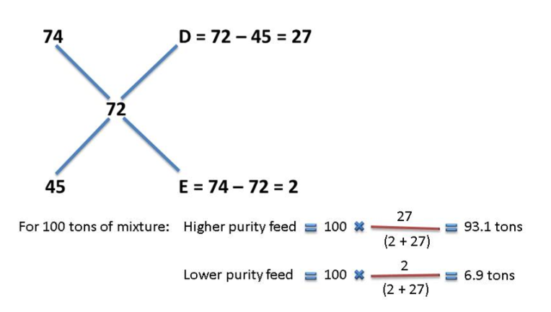
Example: Using the Cobenz Diagram
A-molasses of purity 74% and B-molasses of purity 45% must be blended to prepare 100 tons of mixture at 72% purity. Find the amounts of each molasses required.
Instead of the mass of mixture that needs to be prepared we can use the volume of mixture that must be prepared. Using the Cobenz diagram we will determine the relative volumes of feed that must be combined.

