Slide 1
KNOWLEDGE COMPONENT: MODULE 8:
CRYSTALLISATION, CENTRIFUGING AND DRYING: KT 2: CRYSTALLISER DESIGN AND LAYOUT

Slide 2
Basic Design – Older Versions
Usually horizontal, cylindrical or U-shaped vessels
Simple stirrers rotating at + ½ r.p.m.
Depended entirely on air cooling from the sides of the crystalliser and from the massecuite surface.
Usually situated immediately below the pans where the ambient temperature is always high, with little air circulation, there was little cooling effect.

Slide 3
Basic Design – Modern Versions
Horizontal and vertical water cooler crystallisers are now in use.
Simplest water cooled crystalliser is the Blanchard type
Consists of a hollow shaft about 250mm diameter with radial stubs welded to the shaft and closed at the end.
Water is introduced into the central hollow shaft so that the radial arms fill up with water during the lower half of their revolution and then drain back as the arms rise above horizontal.
Far more sophisticated cooling elements (normally finned tubes) are now used which offer better heat transfer rates.

Slide 4
Basic Design (cont.)
Originally all crystallisers were of the batch type: Each crystalliser being capable of taking one strike.
Modern installations usually consist of a strike receiver and continuous crystallisers.
The function of a strike receiver is, as the name implies, to receive the strike from the pan and supply a continuous steady feed to the crystallisers.
The crystallisers are interconnected by ducting and the massecuite flows progressively from one crystalliser vessel to the next towards the centrifugal.

Slide 5
Basic Design (cont.)
Each crystalliser has cooling elements which are fed with water independently or in series.
The cooling must be uniform and gradual without any local “coldspot”.
Local overcooling can happen with individual cooling water but is less likely if cooling water is fed in series from the coolest to hottest crystalliser.
Where possible crystallisers should be fed by gravity from the pans and/or strike receivers and again gravity feed should be used to the centrifugal. P
umping can damage crystals and if pumping is necessary the massecuites should be hot.

Slide 6
Basic Design (cont.)
The modern trend is to install vertical crystallisers at ground level.
Vertically mounted crystallisers have the advantage of space saving but since they are usually mounted at ground floor level, a liquidation pump is required for the liquidation of the massecuite at the end of the season.
When cooling is applied to a massecuite the crystal content may increase to a level where the massecuite loses its fluid characteristics i.e. the massecuite becomes too viscous to be stirred.
To prevent this from happening, molasses from the centrifugal is added to the crystalliser to lubricate the massecuite.

Slide 7
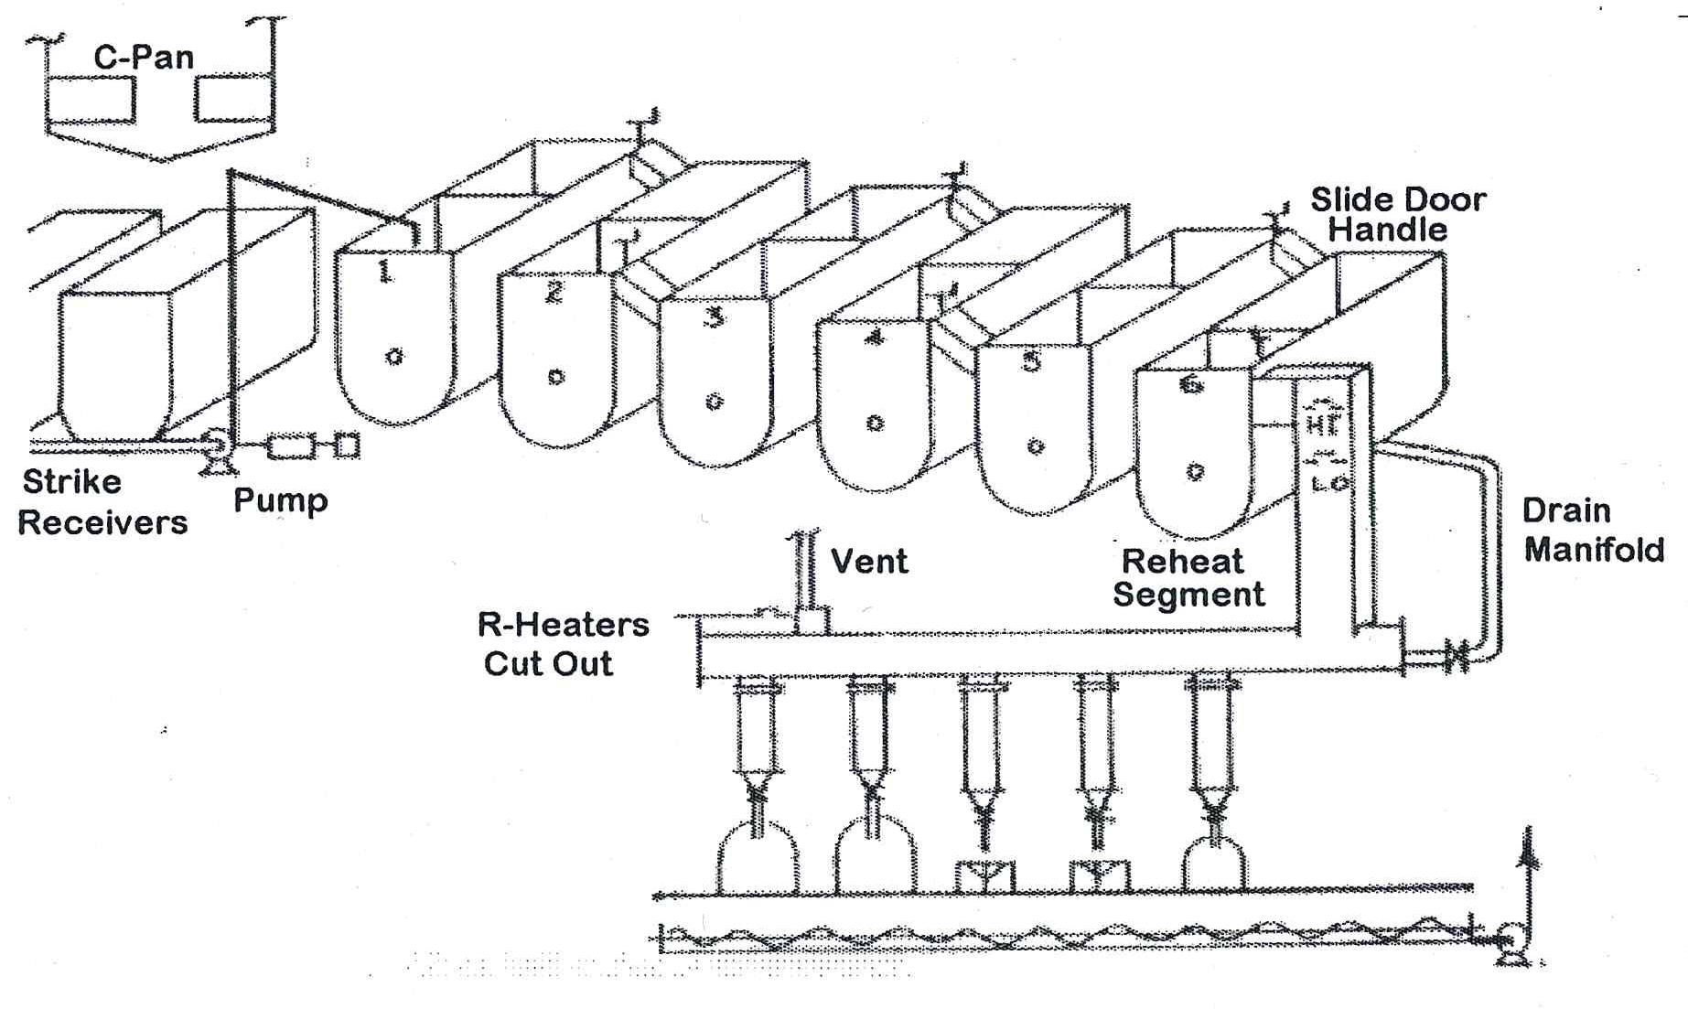
Layout of a typical C-crystalliser station
For a 375 tons cane per hour factory 6 x 100m³ water cooled C-crystallisers would typically be required.

Slide 8
Heat Transfer
Heat transfer from the hot massecuite to the cooling water contained in the stirrer elements/fins is slow.
Due to the viscosity of the massecuite that limits turbulence and mixing in the massecuite.

Slide 9
Speed of Rotation
Crystalliser speeds are low due to the high viscosity of massecuites and are of the following orders of magnitude.
  A–massecuite 0.75 rpm
  B–massecuite 0.5 rpm
  C–massecuite 0.25 rpm
An increase in speed does little to improve crystallisation rate.
This is fortunate as the load on the driving gear at increased speeds would be excessive.

Slide 10
Crystalliser Drives
Crystallisers are usually driven by electric motors (typically 100 kW) through reduction gears.
Hydraulic drives which are capable of high torque (turning force) at slow speeds are also used.

Slide 11
Cooling Element Corrosion
Dissolved oxygen in the cooling water will cause corrosion of metal cooling surfaces.
If the cooling element is not always full of water (Blanchard type) then the corrosion is worse.
A closed cooling system treated with chemicals is advisable to minimise corrosion.
Keeping the pH above 10 with caustic or the use of potassium dichromat will help.
Heat transfer is reduced when corrosion occurs and leaks might eventually develop with resultant dissolution of sugar in the massecuites.

