Slide 1
KNOWLEDGE COMPONENT: MODULE 8:
CRYSTALLISATION, CENTRIFUGING AND DRYING:
KT 4: THEORY OF CENTRIFUGING

Slide 2
Introduction
After pan boiling it is necessary to separate the crystals from its mother liquor.
The best known method at this time is to load the massecuite into a basket lined with a finely perforated screen and spin the basket at high speed to throw the molasses off the crystals.

Slide 3
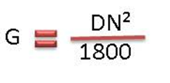
Theory
The single most important factor in centrifuge performance is the force generated when spinning the basket at full speed.
This is the force necessary to strip the molasses off.
For convenience we express this force as a “Gravity factor” which is the number of times that this force exceeds the force due to gravity.
Where:
G = Gravity factor, D = diameter in meters, N = revolutions per minute
At maximum speed the “G force” is about 1500.

Slide 4
Separational Effect
The separational effect does not depend only on the gravity factor but also on the time the centrifugal force is exerted, the viscosity of the molasses, the thickness of sugar layer and the quality of the massecuite.
In this context quality of massecuite refers to the complex of crystal habit and crystal size, as well as to the presence or absence of false grain and conglomerates.
The quality of the massecuite is the main factor which determines the separational effect.

Slide 5
Separational Effect (cont.)
The different factors affecting the separation of crystals from molasses are:
  Gravity factor
  Time
  Viscosity of mother liquor
  Thickness of Sugar Layer
  Massecuite Quality
  Use of Steam and Water
  Screen Condition
  Machine Condition
  Competency of operator

Slide 6
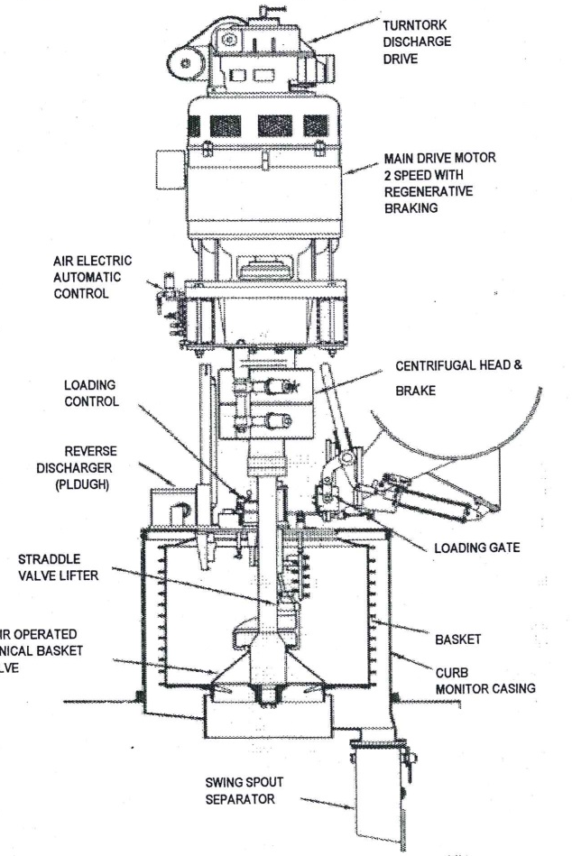
Batch Centrifugals
Typical Batch Machines
A typical batch centrifuge is a large perforated drum with an internally fitted, perforated screen, all suspended at the bottom of a vertical spindle.
The spindle is mounted in bearings and a flexible suspension at the top.
The suspension and buffer assembly are in turn supported in the main frame of the machine upon which stands the drive arrangement.
The basket rotates within a monitor casing which catches the molasses as it is separated from the crystals.
The basket is lined with a backing screen and a liner.
The thickness of the sugar layer in the basket is about 10cm.

Slide 7
Removal of Molasses
The removal of molasses from the massecuite takes place in 3 stages:
  Removal of the excess liquid
  Draining of the molasses between the crystals except for a thin film on the crystal
  Reduction of the film thickness
Removal of molasses is fast during stage 1 and very slow during stage 3.

Slide 8
Centrifugal Components – The Basket
The centrifugal basket is usually made of stainless steel and is of welded construction.
The basket is reinforced with hoops which provide a safeguard against bursting forces which could destroy the basket and its surroundings.
As an extra safeguard the basket should be examined at regular intervals to detect any wear or stress damage.
Modern machines tend to have far bigger than their predecessors, especially as far as depth in concerned.
The basket diameter is about 1370 mm and the depth approximately 1065mm.
With a massecuite layer of 250 mm this results in a capacity of ± 1m³ of massecuite with a mass with a mass of about 1.6 tons.
The perforations in the basket are usually about 6mm in diameter and vary in number from 360-3500.
The discharge valve could be a flat plate which has to be lifted, a cone which is either raised, raised and titled, or a cone valve which is lowered.
The cone which is lowered will give a clean discharge and does not obstruct the sugar flow.

Slide 9
Centrifugal Components – Screens
The norm in batch machines is to have two screens in the basket.
The outer screen being a supporting screen of course mesh to prevent the inner finer sugar screen from physically blinding the drainage holes in the basket.
There are a few manufacturers that offer 3 screens.
A typical arrangement would be:
  Backing screen
  Intermediate
  Sugar screen - 0.5mm
  Open Area - 24%
Screen material is either stainless steel or brass.
The sugar screen is slotted at one end and “tongued” at the other, to allow the two ends to be laced.

Slide 10
Centrifugal Components – Charging
Normal method of charging a batch centrifugal is to introduce the massecuite from a spout at the rear of the machine and allow centrifugal force to draw it up the vertical side of the basket.
Optimum speed must be selected to ensure the basket fills to the top flange but not so fast that imbalance is created.
Due to massecuite’s high viscosity, charging speed is usually about 300rpm in order to get as near vertical a wall of massecuite as possible.
The control of how full the basket gets is an electro-mechanical device consisting of a “feeler arm” and limit switch or a “spiny” wheel which, when it touches the surface of the massecuite, spins and generates a signal.
The more modern machines on the market today have PLC’s which memorises the previous 3 or 4 charging period times and adjusts the rate of opening the feed valve and closing it.
Thus shortening the time required and improving the cycle time of the machines.

Slide 11
Centrifugal Components – Ploughs
Used to break up the wall of sugar in the basket after curing and guide it towards the discharge.
Can either be parked inside the basket or on top of the monitor casing.
Plough’s geometry and adjustment is the most critical item on the centrifuge.
When “ploughing out” sugar it must be extremely close to the screen.
“Trailing geometry” has been designed into the plough such that, should it touch the basket, the plough will twist away from the screen and not dig in.
This design also has a soft tip on the plough to preferentially wear, thus protecting the screen.

Slide 12
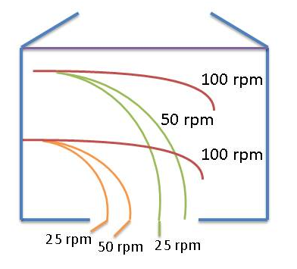
Centrifugal Components – Ploughs (cont.)
The sketch below shows the calculated trajectories at 25, 50 and 100 rpm from a basket of 1050mm diameter and 600 mm deep
Obviously the basket speed during plough-out must be below 50/60 rpm if you want to clear the sugar out comfortably.

Slide 13
Centrifugal Components – Wash Water and Steam
Washing devices are usually of the fixed spray design with either a single nozzle or several nozzles arranged to give full coverage of the sugar wall.
The individual sprays can be adjusted to give greater concentrations in certain areas of the basket if required.
The spray nozzles are mounted on a pipe, inserted through the top of the monitor casing.
The pipe should have facilities for vertical and rotational adjustment.
The timing of the wash and the quantity of water used is important.
The control of the wash is set by a timer and two or more applications of varying duration may in some cases be used.
Hot water is used and in some cases it is superheated above 100ºC.
The superheating is done in a heater.
The flash from the water develops an atmosphere of vapour inside the basket.
This increases the temperature of the sugar and aids the drying of the sugar after discharge.

Slide 14
Centrifugal Components – Wash Water and Steam (cont.)
A separate steam inlet is also usually fitted, which keeps the massecuite temperature up, which reduces the molasses viscosity and makes the separation easier.
Process requirements sometimes demand that the initial molasses runoff be separated from the physical washing of the sugar.
This can be determined by having an automatic diversion valve or a flip-flop plate activated by the timer which brings the wash water into action.
If syrup is used for the wash instead of water, there is an even greater need for this “clairce” to be returned to syrup rather than joining “A” molasses for further low grade boillings.

Slide 15
Centrifugal Components – Drives
Modern batch machines are driven by AC variable speed drives either current modulated or voltage pulse width accelerated drives.
A further drive is the pole changing unit where the motor was wound in such a way that by changing the pole connections it is possible to select one of 3 or 4 fixed speeds.
The AC variable speed drives with solid state invertors are the most energy efficient drives at this time, with relatively inexpensive squirrel cage motors and the facility of regenerative braking.

Slide 16
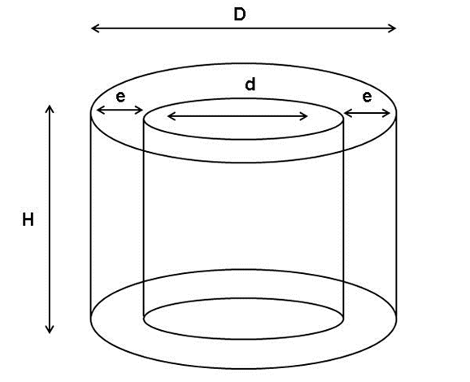
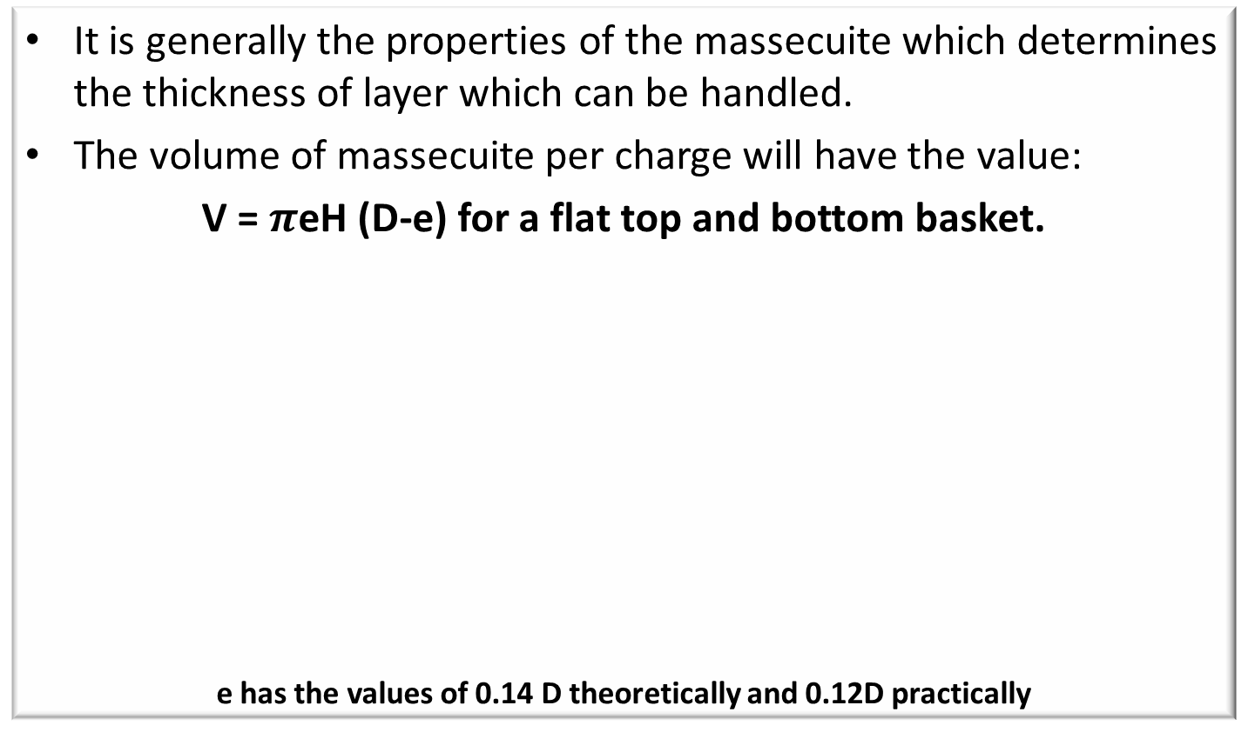
Centrifugal Components – Drives (cont.)
It is generally the properties of the massecuite which determines the thickness of layer which can be handled.
The volume of massecuite per charge will have the value:
V = $π$eH (D-e) for a flat top and bottom basket.
e has the values of 0.14 D theoretically and 0.12D practically

Slide 17
Centrifugal Components – Drives (cont.)
Derivation
V = Volume of massecuite corresponding to the thickness “e” of massecuite (expressed in dm³)
e = thickness of the massecuite (in dm)
H = interior height of the centrifugal basket (in dm)
D = inside diameter of the basket (in dm)
Volume of massecuite = Volume of outer cylinder – Volume of inner cylinder

Slide 18
Centrifugal Components – Control Systems
Control systems have improved over the years.
The first electric controls used complicated electro-mechanical devices which sufficient from mechanical wear and deterioration.
The newer control systems use solid-state timing for all operations.
This type of equipment has no moving parts, does not deteriorate with age and so can be expected to have a long life.
Defects can be corrected quickly by replacing a card.

Slide 19
Centrifugal Components – Windage
To overcome windage the top of the machines are sealed.
Windage can cause the molasses to harden somewhat due to its cooling effect.

Slide 20
Centrifugal Components – Drip Trays
The slide valve for charging the machine is extremely difficult to seal 100% so that there are almost always drips of massecuite coming.
To prevent these drips getting into the basket after the high speed purging is completed, particularly during plough-out, a drip tray slides into position.

Slide 21
Typical Operational Cycle
accelerates to charge speed of 200 -500 rpm (5 seconds)
charge of massecuite is loaded (10 seconds)
accelerates to 1000 – 1500 rpm (30 seconds)
during acceleration a water wash and steam wash may be used to improve drainage.
full speed is held (40 seconds)
deceleration using mechanical brake or regenerative braking (40 seconds)
held at 40 – 90 rpm

Slide 22
Typical Operational Cycle (cont.)
discharge valve opens
ploughing mechanism is engaged
sugar ploughed onto conveyor belt
basket accelerates to charging speed and is washed to remove molasses and fines
cycle is repeated

Slide 23
Typical Operational Cycle (cont.)
Before the conclusion of the acceleration period, washing with steam and water should start as waiting until top speed is obtained will result in the molasses film surrounding the crystal becoming “tough” owing to the cooling and drying of the air rushing into the basket.
Admitting steam immediately, charging faster and closing of the covers all reduce the cooling and drying out of the molasses film around crystals.
Moreover, the higher temperature and the diluting action of the condensing steam will reduce the viscosity of the molasses film, and will increase the purging effect.
The steam will also raise the temperature of the sugar which is important with regard to the subsequent drying of the sugar.

Slide 24
Continuous Centrifugals
Continuous machines are used mainly on low grade B- and C- massecuites with smaller more irregular grain size and shape and greater molasses viscosity.
These all make the separation of molasses and crystals more difficult and it is therefore an important advantage of continuous machines that their G-factor is usually somewhat higher than for high grade batch units – going from 1 500 units in batch machines to 4 000 units at the rim of large continuous machines.
The sugar layer in continuous machines is only 0.5 to 1.0 cm thick.
Continuous centrifugation has the following advantages:
  Reduced power demand
  Reduced initial cost
  Better safety
  Easier maintenance
Most continuous centrifugals run at a speed of 2000 – 3000rpm

Slide 25
Continuous Centrifugals – Basic Operation
This machine consists of a conical basket with an angle of ±30º, with its larger diameter facing upwards.
The basket is underdriven by ‘V’ belts from a motor placed alongside the machine.
The machine is fed by gravity into or near the centre of the basket and the discharge is both continuous and automatic without any special loading or discharging devices.
The basket rotates at a uniform speed, which reduces the power load, but the massecuite has to be accelerated to the full angular velocity of the basket.
There is thus a difference in the relative motions between the massecuite and the basket until the massecuite attains the speed of the basket.

Slide 26
Continuous Centrifugals – Basic Operation (cont.)
The massecuite is accelerated again as it moves up the screen and the basket diameter increases.
This motion involves wear of the screen and associated parts.
The sugar leaves the screen at the full peripheral speed of the basket and the crystals strike the monitor casing after being slowed down slightly by air resistance.
The motion between crystals and screen and discharge velocity causes breakage of the grain.
The forces acting on the sugar, give rise to a nett upward force provided the crystal is covered by a lubricant (mother liquor).
This will displace the sugar upwards.
The centrifugal is thus self-discharging provided massecuite continues to be fed in.

Slide 27
Continuous Centrifugals – Basic Operation (cont.)
If the feed is stopped the large nett upward force becomes smaller as the lubricant film is removed.
The result is:
  The movement of the sugar is reduced
  The retention time is increased
  More molasses is removed
  The rate of movement is further reduced
Under practical conditions the sugar discharge stops as the feed is stopped.

Slide 28
Continuous Centrifugals – Basic Operation (cont.)
While operational a thin film of massecuite covers the whole screen, unpurged at the bottom and being progressively more purged towards the top.
The film of massecuite will move according to the rate of feed.
Any increase in the massecuite film thickness will result in flow forces which will cause the excess massecuite to spread over the screen.
When this happens the sugar quality will drop and to improve quality, the input rate will have to be reduced.
The massecuite film thickness is thus self-correcting to comply with the required quantity/quality.

Slide 29
Continuous Centrifugals – Basic Operation (cont.)
The maximum achievable throughput rate for a machine with a given screen area, screen open area and gravity factor will depend on the massecuite viscosity.
Viscosity will have less effect on the curing than it has in a batch machine.
The same applies to a small or mixed grain size, as the massecuite layer is so thin.
Provided the massecuite retains fluidity a continuous centrifugal should be to cope with poor quality massecuites.
Lower throughputs generally give higher sugar purities and hence improved sugar quality.
The reason for this is that lower throughputs result in a thinner massecuite layer which purges (loses its molasses) more easily.

Slide 30
Continuous Centrifugals – Basic Operation (cont.)
A decrease in throughput does not necessarily increase the sugar quality above that normally achieved.
This is because at low throughputs the molasses is removed from the crystal while the crystal is still some away from the top of the basket, and screen area is not being utilized.
Wash water should be applied at a rate such that it will only dilute the molasses film on each crystal, without any significant dissolution of the crystal.
The dilution of the molasses film will lower its viscosity so that better curing will be achieved.

Slide 31
Continuous Centrifugals – Basic Operation (cont.)
The molasses (and water) will be rapidly removed from the crystal surface without raising the molasses purity.
By reducing the massecuite wall thickness the filtering effect of the crystals is reduced and the separation of crystals from molasses is then carried out solely by the holes in the screen.
Any smaller-than-hole crystals will not be retained by the bridging of larger crystals across the screen.
Screen selection is thus extremely important as the screen must have a very small aperture with maximum possible screen open area and good wear characteristics.

Slide 32
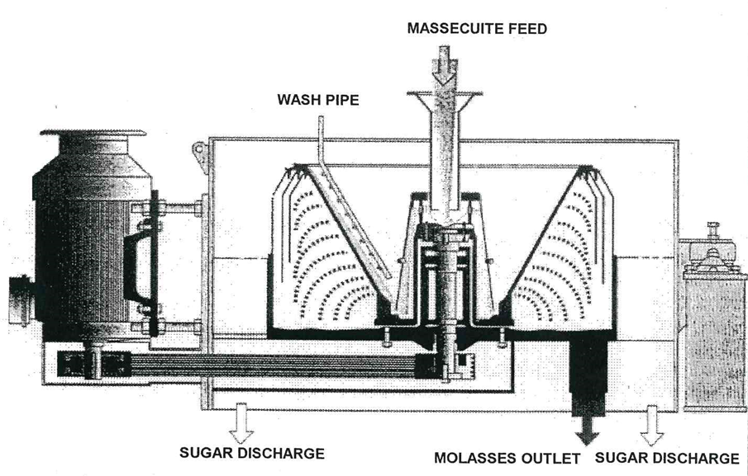
Types of Continuous Centrifugals
    The BMA continuous centrifugal

Slide 33
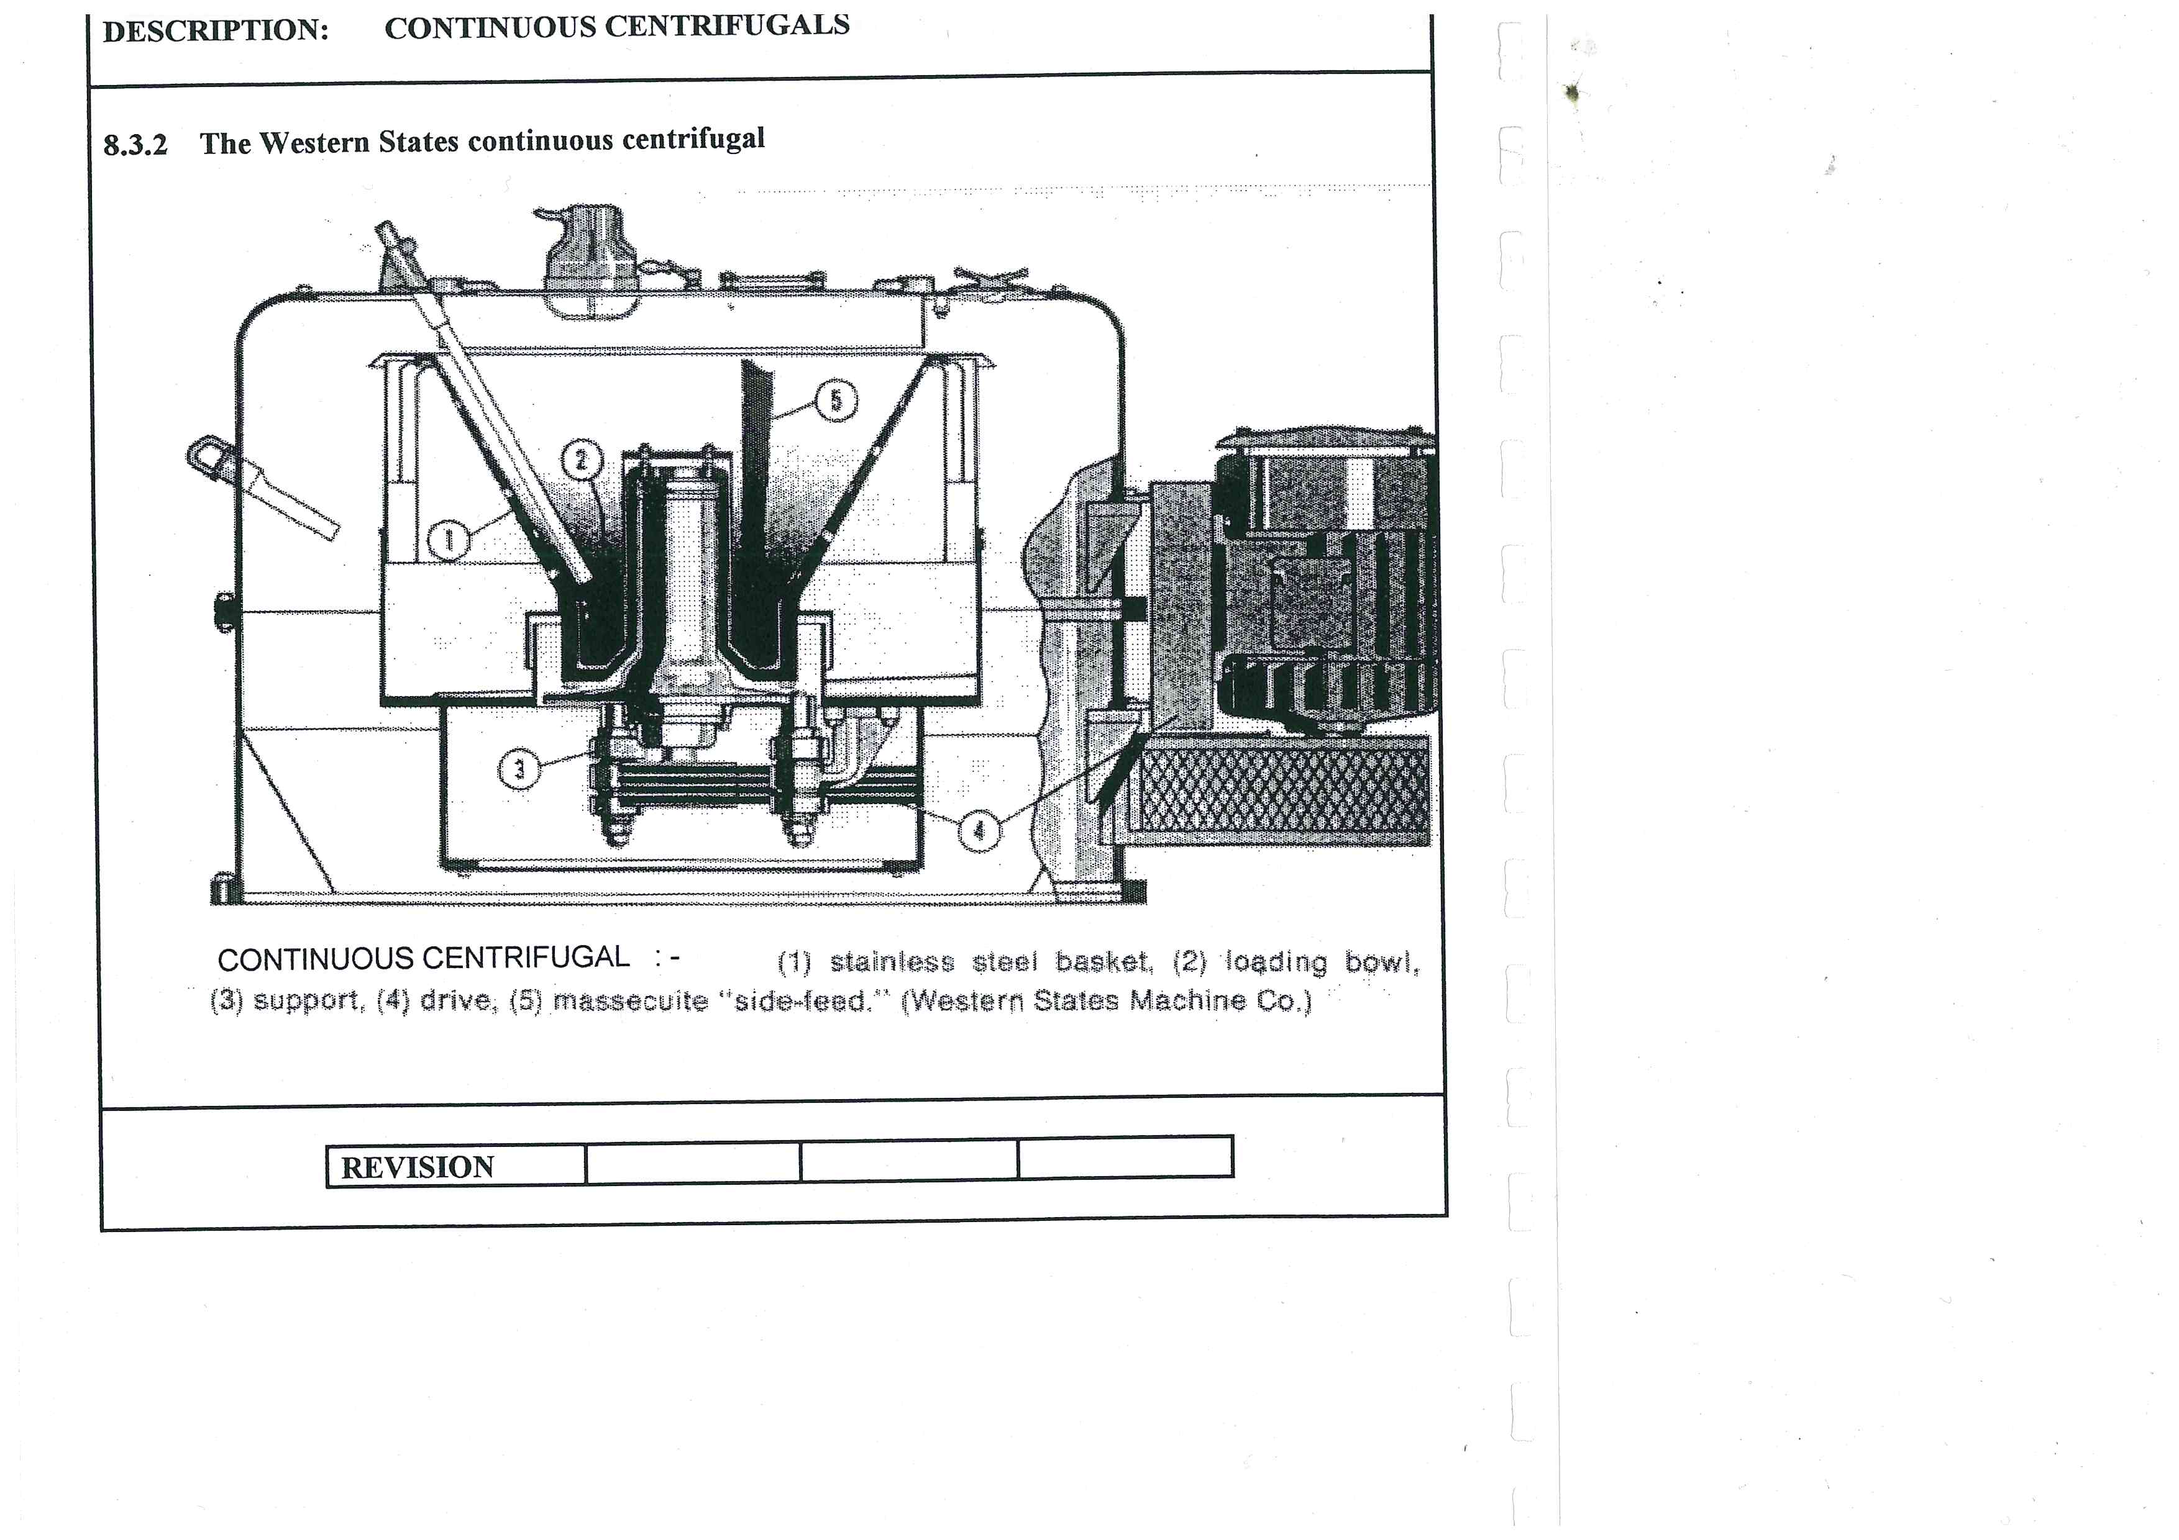
Types of Continuous Centrifugals (cont.)
    The Western State continuous centrifugal

Slide 34
Machine Design
A continuous centrifugal consists of the following basic parts:
  The basket
  The acceleration cup
  The screen
  The feed system
  The sugar–collecting monitor casing
  The molasses–collecting casing
  The drive system and various controls

Slide 35
Machine Design – The Basket
The basket must have a specific cone angle to suit the massecuite to be cured.
Basket angles have been standardized on 30° and 34° is normally used for low grade massecuites.
Basket diameters are 1000, 800 and 600 mm.
The basket must be strong enough to resist the large pressures and forces developed as the basket rotates at high speed.
The basket can be either fabricated or a single piece casting.
The fabricated basket is made of radial ribs and a series of concentric rings welded to the ribs.
A backing screen substructure is needed to support the centrifugal screen and this is usually made from a punched plate or from woven wire.

Slide 36
Machine Design – The Basket (cont.)
Stress failure of a fabricated basket will normally be in the form of distortion with weld cracks.
Sudden failure is unlikely.
Baskets should be inspected regularly and any increase in vibration should be taken as a sign of possible distortion.
The solid basket is normally a one-piece stainless steel casting with machined drainage holes and channels.
Heat treatment before and after machining relieves any stresses.
The solid basket has the advantage of a smooth outline which reduces air resistance and windage.

Slide 37
Machine Design – The Basket (cont.)
A backing screen of ground-flat woven wire is used to support the working sugar screen and allow molasses drainage.
With correct heat treatment the solid basket is extremely strong, but any failure would be a sudden bursting with little warning.
Although this risk is small, regular checks for hairline cracks from the drainage holes should be carried out.
The coupling of the basket to the drive system should be safe but simple enough to facilitate easy basket removal for machine overhaul.

Slide 38
Machine Design – Acceleration Cup
The massecuite that enters the machine has to be accelerated into a circular path and to a high velocity.
This must be done before the massecuite moves across the screen.
It is also important that the distribution over the screen is even if good curing, and no vibration is to be attained.
This is done by means of a cup, cylinder or disc at the lower end of the basket.

Slide 39
Machine Design – Acceleration Cup (cont.)
The massecuite that is fed to the cup or disc is accelerated by frictional forces and flows under centrifugal force up the sloping sides of the cup and forms a thin uniform layer on the screen.
The design of the cup has changed over years.
  The first ones were shallow and not very effective. The shallow cup could not effectively accelerate the massecuite, so distribution suffered with poor screen utilization and vibration.
  Newer designs either on-centre or off-centre have deeper, larger cups which sometimes have grooves or patterns inside to assist in massecuite pickup.
BMA uses a small cup supported on top of the bearing housing.
From there the massecuite flows down an outer “bell” shaped acceleration cone, discharging horizontally outwards into the main distribution ring and then onto the screen.

Slide 40
Machine Design – Screens
The design is important for good performance.
Must have a hard surface to withstand the large forces generated by the continuous sliding of the massecuite and crystals across its surface.
Must also be strong enough to resist deformation with the minimum amount of support from the basket.
Too much support affects drainage of molasses.
Must be held securely in the basket or it will be ejected with the sugar.
Main clamp has to be at the bottom keeping the screen in tension and preventing any upward crumpling.
A clamping ring can be used at the top of the basket or a number of small clips used instead.

Slide 41
Machine Design – Screens (cont.)
The screen has numerous small precision-formed holes formed by photo-etching.
The holes can be either circular or rectangular.
Rectangular holes are favoured in South Africa.
B–massecuite machines have screens with slot width 0.09mm and length between 1.8 and 2.8mm.
C massecuite machines have slots of similar length but are 0, 06 mm wide.
The whole size is related to grain size and molasses viscosity.
The slots are tapered to reduce blinding. In some cases the bottom edge of the screen may be kept free of holes or have a reduced number of holes to give extra strength in the clamping region.

Slide 42
Machine Design – Screens (cont.)
Percentage open area is important for molasses drainage and throughput and is limited by mechanical strength.
The larger the percentage open area, the greater the capacity of the machine.
Open areas of B screens will vary from 7 – 15% whilst C screens have open areas that vary between 5 and 10%.
To extend screen life a trap or mesh in the feed system can be used to prevent large objects from reaching the screen.
The risk of screen damage in a continuous machine is far greater than in a batch machine.

Slide 43
Machine Design – Screens (cont.)
Must be made from material that will resist possible chemical corrosion and also electrolytic action between the dissimilar metals of basket and screen.
Screen material is a nickel alloy base with a hard chrome layer on top or a stainless steel screen with laser cut slots.
Sugar screens for continuous centrifuges are usually in four or five triangular segments which overlap one another and are mechanically clamped into the basket at the bottom.
The working sugar screen is supported by one or two backing screens.

Slide 44
Machine Design – Feed System
The feed can be introduced either centrally or off-centre depending on the type of accelerating cup used.
Centre feed, being symmetrical gives a more uniform massecuite distribution and minimises vibration.
The feed valve is usually an iris valve which gives sensitive control and always feeds the massecuite on the valve centre line, which helps to ensure a uniform flow and action of the accelerating cup.
The application of water and steam wash varies according to the manufacturer.
The wash water pipe usually runs down the slope length of the basket and either has a number of small holes facing the screen or spray nozzles may be used to cover a wider area.
The application of water is controlled via a valve and flow-meter which gives an indication of flow rate.

Slide 45
Machine Design – Feed System (cont.)
The massecuite leaves the feed spout some 400 – 500 mm above the steam/water mixer, narrowing as it falls to strike the distributor cap.
In passing through the mixer, the water addition reduces the viscosity whilst the steam addition in raising the temperature assists in doing the same.
The mixer usually consists of a ring of pipe + 100mm diameter fabricated from 12 – 15 mm before tubing at the top, with 1.5 to 2.00 mm holes drilled at regular intervals to spray water onto the “rope” of massecuite.
Steam addition is done through a double walled pipe drilled on the inner circumference and length and either open or sealed at the lower end.

Slide 46
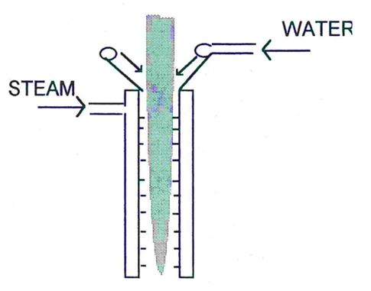
Machine Design – Feed System (cont.)
Water can also be added with a ‘lubrication rod’ which is a short length of pipe fitted vertically into the massecuite stream through the iris valve.
The pipe is perforated and it is claimed that the water mixes readily with the massecuite, reducing the viscosity.
Low pressure steam can also be blown into the basket to maintain a warm humid condition which improves the movement of sugar across the upper part of the screen and reduces molasses viscosity.
A steam jacket on the feed pipe can also be used to warm up the massecuite and reduce velocity before acceleration.

Slide 47
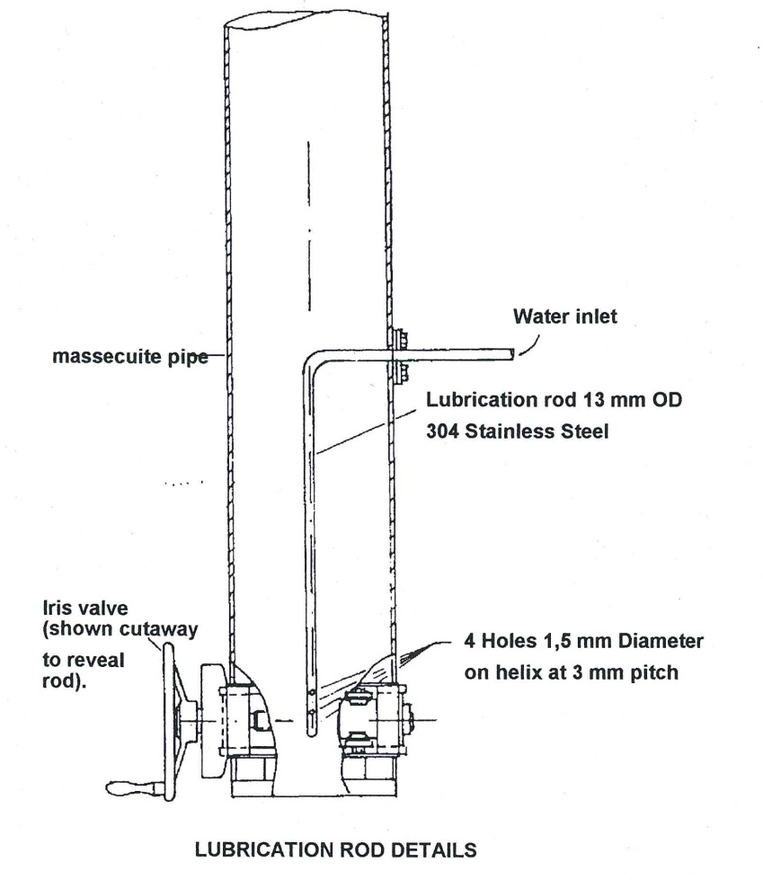
Machine Design – Feed System (cont.)

Slide 48
Machine Design – Sugar Collecting Monitoring Casing
This monitor casing will contain the sugar as it is spun tangentially over the rim of the basket and decelerate it so that it will fall under gravity to the bottom of the casing.
The bottom of the casing must be attached to a chute to discharge the sugar to a conveyor or melter.
The design of the casing must take into account the abrasive effect of the high velocity crystals impinging upon a narrow band of metal and also the corrosion caused by hot, humid acid conditions.
The casing should also be fitted with some sort of sugar sampling device.

Slide 49
Machine Design – Molasses Collecting Monitor Casing
The molasses casing is an annular ring around the basket inside the sugar casing.
The cured molasses is flung from the basket into this space.
Again due to conditions, corrosion is a problem.
These should be some sort of labyrinth seal at the top to prevent molasses entering the sugar casing.
The bottom of the casing will have an outlet for molasses drainage with some sort of liquid seal to prevent ‘windage’ problems.

Slide 50
The BMA Continuous Centifugal

Slide 51
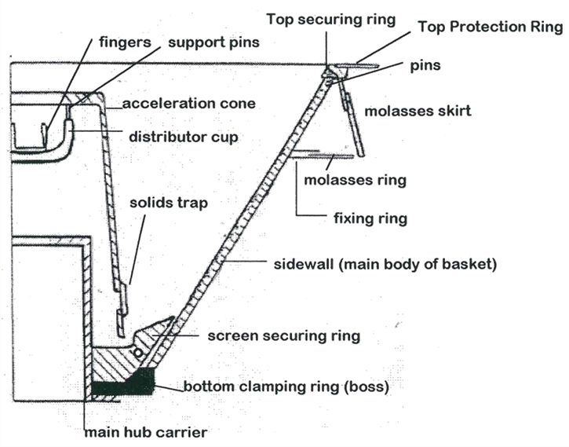
The BMA Continuous Centifugal (cont.)
The basket and its fittings

Slide 52
BMA Continuous Centifugal - Features
Fingers
These fingers of which there may be 4 to 6 or 8 are installed in the distribution cup to improve the mixing of water, steam and massecuite in an attempt to raise the temperature and lower the viscosity at the last possible moment in order to reduce the potential of crystal dissolution.
The fingers also catch the massecuite, accelerate it and throw it to the outer wall of the distributor cup.
Distributor Cup
The distributor cup starts the massecuite spinning
As it climbs the vertical wall of the cup it is evenly spread around the periphery before passing the 6/8 pins holding the acceleration cup to the acceleration cone.

Slide 53
BMA Continuous Centifugal – Features (cont.)
Acceleration Cone
The sole purpose of this cone is to further distribute the massecuite to a very thin layer and to accelerate it to as near the same angular velocity as the bottom of the main body of the basket as possible.
The cone must also discharge below the top of the securing ring so that crystals do not impinge directly onto the screen.
Screen Security Ring
The ring clamps the lower end into the cone. It also has the function of gradually accelerating the product to the velocity of the screen itself.

Slide 54
BMA Continuous Centifugal – Features (cont.)
Side wall
This cone is the support for the working screen. The drainage is achieved through the side wall.
Baskets are produced at an angle of 30° off the vertical.
Basket Support
In most cases the basket is bottom supported on a relatively large diameter flange and is coupled to the drive shaft by several flexible buffers.

Slide 55
The Drive System
The basket shaft is supported by bearings which can either be force-fed oil lubricated or grease packed.
The bottom of the shaft carries the pulley for the vee belt drive from the vertically mounted motor.
Compared to a batch machine the motor is small and there is no provision for speed variation.
The basket shaft is mounted on rubbers to damp out vibrations caused by irregular feeding and curing.
The drives are straight forward squirrel cage motors with star/delta starters.
The installed power can vary from 30kW to 100kW. “B” machines will draw more power because the less viscous massecuite allows a greater mass to be fed to the centrifuge.
The transmission from motor to basket is a “gear up” belt drive to 2200 rpm.

Slide 56
Continuous Centifugal Operation
The machine is brought up to speed, checked for abnormal vibration and then the massecuite isolation valve is fully opened (usually a knife gate valve).
The iris valve or volumetric control valve is then opened until predetermined load on the motor (amps) is obtained.
The water and steam to the feed nozzle must be adjusted and set to obtain an even and smooth flow of massecuite into the distributor cup to obtain the quality of sugar required.
Periodic checks (hourly) should be visually made on the sugar in the sampler and laboratory analysis of the molasses will give an indication of machine performance.
Regular checks using a stroboscope should be done (say 4 hourly) to visually check the crystal movement up the cone.
If “fingers” of massecuite are seen then there is fouling of the distributor cup or acceleration cone, or the sugar screen or support mesh is beginning to blind, reducing the opportunity to drain molasses off the crystals.

Slide 57
Flexibility of Continuous Centifugals
As the residence time of the sugar is a matter of a few seconds the application of steam and/water hardly dissolves sugar and therefore does not raise the purity of the molasses significantly.
If applied reasonably they act as lubricants only.
Due to the thin layer of massecuite in the basket, the continuous machine is capable of curing massecuite of much higher density.
A poor quality strike which is difficult to process in a batch type centrifugal may cure reasonably well in a continuous machine.
The disadvantage of the continuous machine is the attrition of the crystals.
When low grade sugars are cured continuously the crystals are protected over the whole length along the screen by the molasses film surrounding them.

Slide 58
Flexibility of Continuous Centifugals (cont.)
In the case of high grade sugar however the molasses film is removed at the beginning and the larger crystals are scratched and crushed when (largely free from protecting molasses film) they come into contact with edges of the perforation of the basket.
For the curing of B-sugars a different type of basket is used than for low grade sugars i.e. a basket with a wider top angle.
The arrangement accelerates the speed of the crystal along the screen surface.
As there is less time for drainage of the molasses the crystals move only a very short distance unprotected by their molasses film.
In addition to crystal attrition due to the contact between crystal and screen we have to reckon the more important damage done to the crystal after they have left the basket and hit the surrounding monitor casing.

Slide 59
Batch or Continuous?
Batch machine
Batch machine is more expensive than the continuous machine.
Use for A-massecuite.
Continuous machine
The continuous machine will not give you the quality specifications sugar required for VHP since it is not capable of “cleaning up” the A-crystal to meet 1350 units of colour without a great deal of washing.
Crystals leaving the basket at high speed shatters on impact with the monitor casing, resulting in very high “fines” content.
Use on B and C duty where the crystals go to remelt or magma where they are “cleaned” by dissolving the substandard particles.

Slide 60
Batch or Continuous? (cont.)
Continuous machine
Many mills use special continuous centrifuges with very large monitor casings for B sugar curing.
The large monitor casing allows the crystal a longer trajectory so it slows down sufficiently to prevent damage.
These crystals are then used to prepare magma as they are undamaged and are uniform in size and shape.
This results in less wash water being required in the pans.
An Australian company has also developed a continuous machine for A-massecuites.
It utilizes a deflector to deflect crystals downward.

Slide 61
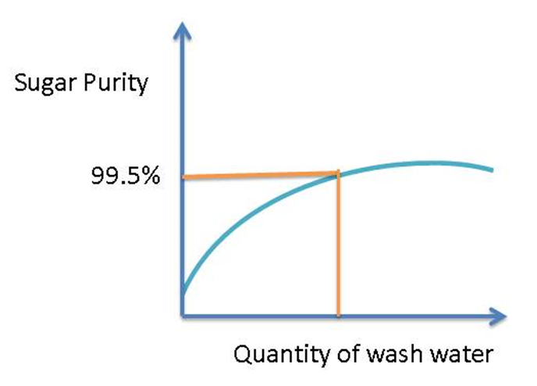
Relationship between Wash Water and Sugar Quality
There is an optimal purity.
To increase the purity further requires large amounts of water.
This is undesirable because it dissolves crystals.
Crystals can be washed with syrup, but this does not work too well.
In a refinery jet 4 (final molasses) can be diluted and used to wash crystals in the centrifugal.
This has a colour of about 400 – 1000 and hence the diluted molasses wash is followed by a very short water wash.

Slide 62
Different Makes of Continuous Centrifugal
Silver Weibull (USA)
Fives-Lille (France)
BMA (Germany)
Western States (USA)
Broadbent (England)

Slide 63
Centrifugal Performance
The sugar and molasses must be regularly monitored both visually and by obtaining molasses purity data from the laboratory.
Careful monitoring can reveal the following:
  Excessive washing with water/steam
  Holes in the screens
  False grain
  Massecuite reheater problems (i.e. massecuite is too viscous)

