Slide 1
KNOWLEDGE COMPONENT: MODULE 8:
CRYSTALLISATION, CENTRIFUGING AND DRYING:
KT 5: EXHAUSTION

Slide 2
Theory and Calculations
Sucrose lost in final molasses constitutes the greatest loss of sugar in the factory.
The composition of non-sugars in final molasses has the biggest influence on exhaustion. The two main non-sugars are reducing sugars (glucose and fructose) and ash.
Sucrose solubility is decreased by reducing sugars.
AND
Sucrose solubility is increased by ash.

Slide 3
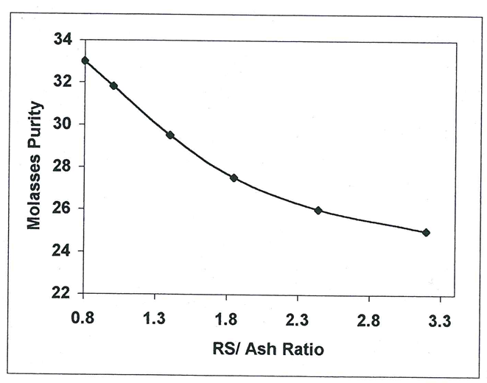
Theory and Calculations
From the radio of the above two non-sugars (the RS/Ash ratio) it can be shown that molasses purity will decrease as the RS/Ash ratio increases.
The exhaustion of molasses thus increases as the RS/Ash ratio increases i.e. the sucrose recovered as crystals increases as the RS/Ash ratio increases.

Slide 4
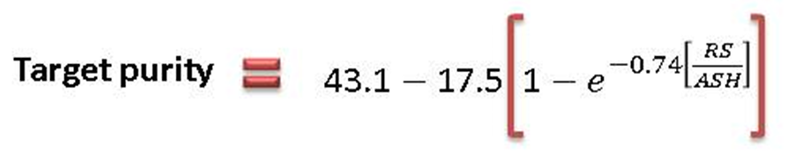
Target Purity
The molasses is analysed to obtain its reducing sugar to ash ratio and the target purity is then calculated.
This target purity represents the lowest possible purity of molasses that can be obtained for the given RS/Ash ratio.
If the ash content increases relative to the reducing sugars content, the RS/Ash ratio increases and the target purity decreases.
When the reducing sugars increase relative to the ash content, the RS/Ash ratio increases and the target purity decreases.

Slide 5
Target Purity (cont.)
A target purity difference (TPD) is calculated to give factory staff an idea of the extent to which the molasses has been exhausted of its sucrose.
The TPD thus gives an indication of the performance of the C-station.
TPD = Purity of final molasses – Target purity of final molasses

