Slide 1
KNOWLEDGE COMPONENT: MODULE 8:
CRYSTALLISATION, CENTRIFUGING AND DRYING:
KT 6: THEORY OF DRYING

Slide 2
Introduction
The moisture content of the sugar leaving the centrifugal is too high for convenient handling and storage.
The moisture content must be reduced to a value low enough to prevent the growth of micro-organisms which would cause deterioration and loss of sugar during storage.
A sugar will not deteriorate in storage if it:
  Is comparatively free from insoluble matter
  Has hard uniform and fair sized grain free from conglomerates
  Has a moisture content in relation to its pol to conform to certain “factors of safety”
  Is an “unwashed sugar” (i.e. the crystals are surrounded by their original film of molasses)?
  It has been manufactured under sanitary conditions to keep contamination by fungi, yeasts and bacteria to a minimum.

Slide 3
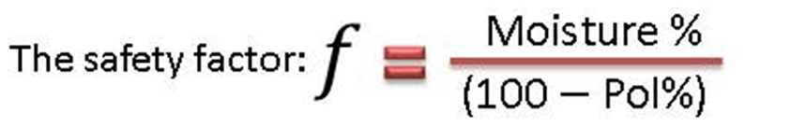
Moisture Content and Safety Factors
The commercial sugar leaving the centrifugal, which is to be packed for sale or export, generally has a moisture content of 0,5 – 2%.
Moisture is very detrimental to the keeping qualities of the sugar when it exceeds a certain limit and particularly when it rises above 1%.
Since the micro-organisms that cause deterioration cannot develop in solutions of high density, the ratio of non-sucrose (non-pol) to the water in the molasses film surrounding the crystals is the determining factor in sugars of normal composition.
The safety factor should be less than 0.23.
The safety factor/limit depends on the proportion of impurities present in the sugar. A given % of water is more detrimental with a sugar of higher purity.

Slide 4
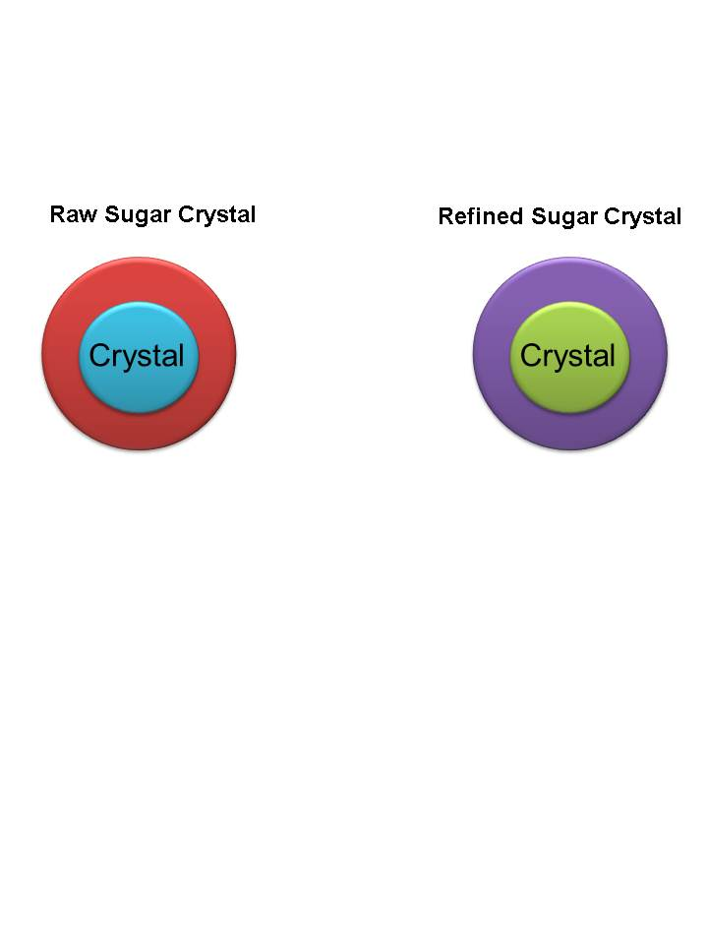
Comparing Raw and Refined Sugars
Why is a given moisture % more detrimental to the keeping quality of a refined sugar than for a raw sugar?
Surrounded by its original molasses layer | Has had its original molasses layer washed away. Surrounded by a saturated sugar solution
The molasses layer has a relatively high non-sucrose concentration (Fructose, glucose and salts). | The saturated sugar solution has a low concentration of non-sugars (Fructose, glucose and salts)
The molasses layer has a relatively high density (High brix). | The saturated solution has a relatively low density (lower brix).
Microorganisms cannot develop properly in the high density solution. | Microorganisms can develop easily.

Slide 5
Washed Sugars
The safety factor is valid only for sugars carrying their original film of molasses because washing a raw sugar reduces the density of the molasses film.
In general, composition after washing must approximate to that of an unwashed sugar if a stable sugar is to be obtained.

Slide 6
Micro-Organisms
The loss of polarisation during storage of raw sugar is caused by the action of certain micro-organisms in the film of molasses surrounding the crystals.
Three significant groups of micro-organisms that may cause deterioration are:
  The Mould Fungi:
    These cause the commonest and most serious deterioration in storage. T
    here are over 20 of these species of invertase producing moulds occurring in raw sugars.
  Osmophilic Fungi (frequently Torulae):
    They have a selective action for the levulose (fructose).
    They cause the reducing sugars to decrease with a corresponding increase in pol.
  Sporangeous Bacteria:
    Particularly the Mesentericus group.
    They originate on the cane or in the juice and are the least important factor in deterioration, as they are active only in relatively dilute molasses films (50 to 60°Bx)
The moulds and yeasts enter the sugar after manufacture, frequently by contamination of the centrifugal.

Slide 7
Chemical Treatment
Deterioration can be prevented by chemical treatment.
0.5% Sodium Chloride by weight completely prevents deterioration of a sugar with a safety factor of 0.43.
Alternatively 50ppm of paraformaldehyde can be used.
This is in the form of a fine powder that depolymerizes in 10 – 12 days releasing formaldehyde gas in the sugar.
These chemical germicides are effective but with reasonable close control of moisture in the sugar at the centrifugal and fair storage conditions they appear unnecessary except under abnormal conditions.

Slide 8
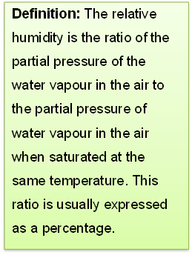
Moisture Control During Storage
The two controlling factors determining deterioration of raw sugars are:
  Action of micro-organisms in the molasses film surrounding the crystal.
  Sufficient moisture in the film to permit the microorganisms present to propagate (“effective Moisture level”).
Control of the moisture content of the sugar by safety factor is effective for the sugar as made, but moisture absorbed during storage is as detrimental as moisture left in the sugar at the centrifugal.
Many studies of the atmospheric conditions best for storage have been made and the consensus is that relative humidities (RH) of 60 to 70% is critical.
At 35 to 40°C absorption of moisture is very slow below 75% RH.

Slide 9
Moisture Control During Storage (cont.)
In general moisture increases were closely related to humidity and temperature, but sugars with high reducing sugar content absorb moisture much more rapidly than those low in reducing sugars.
Webster’s graphs of moisture content against RH for three temperatures show rapid increase in moisture with increased humidity and temperature when reducing sugars content is high, but relatively small changes if the reducing sugar content is low.
When sugar is stored in a well-constructed warehouse which can be tightly closed the moisture content (of the air) soon reaches an equilibrium with the sugar present and no further gain or loss of moisture by the sugar occurs.
Large compact stacks are also an essential part of this plan.

Slide 10
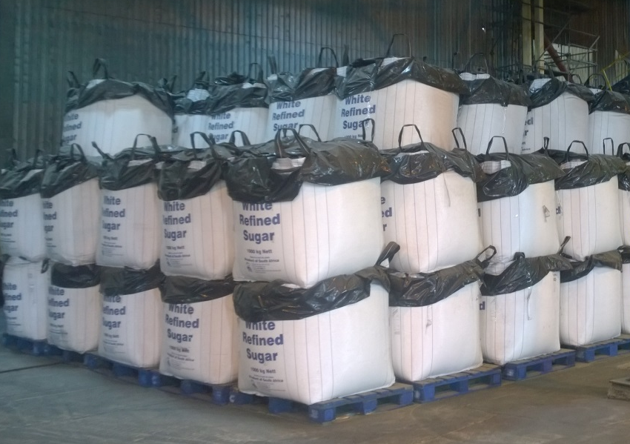
Deterioration in Bulk Storage
It is generally recognised that little or no deterioration takes place in bulk piles.
Bulk sugar keeps better than bagged sugar during long periods.
The bulk sugar becomes moist on the surface at night when humidity is high and crusts over in the day when humidity is lower.
The opposite is true with bagged sugar where the bag acts like a wick.
All this presupposes a well-made raw sugar of suitable safety factor.

Slide 11
Equilibrium Relative Humidity (ERM)
ERH is used as an indicator/measure of the moisture absorptive qualities of different sugars.
Present evidence indicates that as the ERH of raw sugar rises above 65%, it is increasingly liable to give trouble in storage – both in deterioration and caking.
Between 10 and 30°C the keeping qualities of sugar are independent of temperature.
Between 31 and 40°C and at humidity ranging from 50 – 78% it is only at the lowest humidities and temperatures that the safety factor is valid.
The value of the critical humidity varies from 50 – 75% and is dependent largely on the reducing sugar content.
Equilibrium relative humidity is defined as that relative humidity of the atmosphere at which sugar neither absorbs nor loses moisture at constant temperature.

Slide 12
Changes in Storage other than POL loss
Increases in colour can be very significant.
There is a direct relationship between darkening and nitrogen content which is related to the Maillard or “browning reaction” between amino acids and degradation products or reducing sugars.
The increase in colour during storage not only increases the colour in the molasses film surrounding the crystal but also increases the colour inside of the crystal.
Raw sugars should be properly cooled before warehousing.

Slide 13
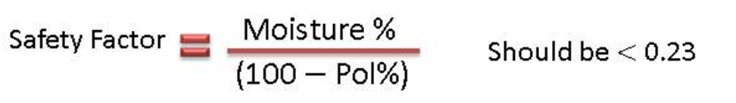
Why Dry Sugar?
Reduce microbiological activity
Prevent caking by:
  Drying
  Cooling

Slide 14
Sugar Drying Theory
What is wet sugar?
Sugar discharged from centrifugal has:
  Inherent Moisture:
    Moisture occluded in the crystals.
  Surface Moisture:
    Saturated “molasses” (sucrose) solution on the crystal surface.
Drying is concerned with removing the Surface Moisture.

Slide 15
Drying Stages
Classical Theory
Constant-rate period:
  Moisture evaporates from the surface.
Falling-rate period:
  Moisture migrates to the surface and evaporates.
Applied to sugar
Constant-rate period:
  Moisture evaporates from the surface supersaturating the solution and causing crystallisation.
Falling-rate period:
  Increased supersaturation slows evaporation (Raoult’s Law)
  Crystallisation begins forming an amorphous sugar layer on the crystal which hinders evaporation increasingly as the layer grows.
Moisture available on the surface is called FREE MOISTURE.
Moisture trapped under the layer is called BOUND MOISTURE

Slide 16
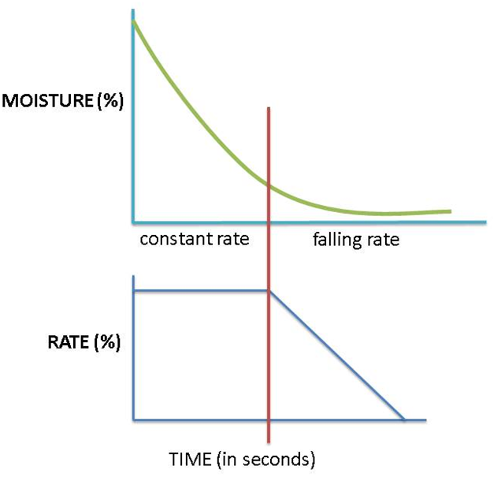
Drying Stages (cont.)

Slide 17
Drying Mechanism
    Evaporation
Free water in the exposed surface film evaporates if the partial pressure of water in surrounding air is low enough.
    Diffusion
Bound water diffuses through the amorphous layer due to water concentration gradient.
    Crystallisation
Sucrose in the bound film crystallises due to supersaturation making water available for diffusion.
Rapid drying: Crystallisation occurs on amorphous layer.
Slow drying: Crystallisation takes place on crystal surface.

Slide 18
Moisture Analysis
    Oven drying
Drying for 3 hours at 105°C – measures Free and some bound moisture.
Used for analysis of raw and refined sugars.
Drying for several hours / several days: Measures Free and Bound Moisture.
    Karl-Fischer Titration
Using methanol: Measures free and bound moisture
Using formamide: Measures Free, bound and inherent moisture (occluded moisture).
Used to analyse refined sugar that has been conditioned.

Slide 19
Typical Figures
Raw Sugar:
Wet: Moisture 0.5% - 1.00%
Temperature 60°C
Dry: Moisture 0.1%
Temperature 40°C
Refined Sugar
Wet: Moisture 0.5% - 1.00%
Temperature 70°C
Dry: Moisture 0.03%
Temperature 50°C

