Slide 1
KNOWLEDGE COMPONENT: MODULE 8:
CRYSTALLISATION, CENTRIFUGING AND DRYING:
KT 7: SUGAR DRIERS

Slide 2
Introduction
A sugar drier consists of an arrangement for passing heated air with the flow of sugar to dry the sugar.
The sugar is kept in motion so as to give efficient contact of the air with the sugar crystals.

Slide 3
Calculations
Drying by contact with hot air involves heating the air to increase its capacity for absorbing water and bringing it into intimate contact with the sugar, from which it evaporates the moisture.
There are two possible methods of circulation.
  Countercurrent flow where the air flows in the opposite direction to the sugar.
  Parallel flow where the air and the sugar flow in the same direction.
For safety, the calculation is based on the most unfavourable condition, that is, it is assumed that the ambient air is saturated before being heated.
On the other hand, the air leaving a dryer is generally not saturated; it is assumed that it has absorbed only – in the case of concurrent flow – two thirds of the quantity of water which it could have absorbed if it had left in a saturated condition.

Slide 4
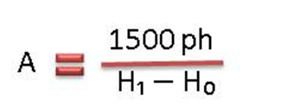
Calculations (cont.)
Where:
A = mass of air to be passed through the dryer (in kg/h)
P = mass of sugar to be dried (in kg/h)
h = moisture content of sugar relative to unity
H₀ = mass of water vapour contained in saturated air at the temperature t₀ (ambient temperature) of entry air to the heater (in kg/1000kg)
H₁ = mass of water vapour contained in saturated air at the temperature t₁ of exit air from the dryer (in kg/1000kg)
H₁ and H₀ are taken from a graph.

Slide 5
Types of Sugar Driers
Rotary cascade
Rotary louvre
Fluidized bed

Slide 6
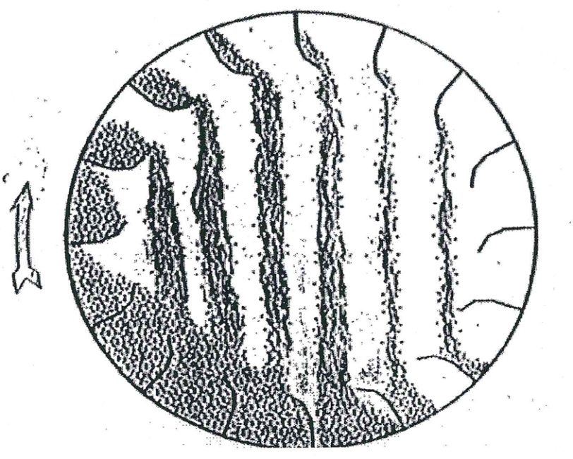
Rotary Cascade
The rotary cascade drier is the most common type of drier and consists of a rotating drum mounted at a small angle to the horizontal.
Inside the drier are fixed vanes which pick up the sugar and drop it repeatedly from the top to bottom of the drier in a shower which should be as uniform as possible.
The sugar moves down the drier while air is blown or drawn through the drier either counter-current or co-current to the flow of sugar.
Advantages: | Disadvantages:
Simple construction and operation | Crystal damage is a risk
Good air/sugar contacting
High turndown possible
May be Co-or Counter-current

Slide 7
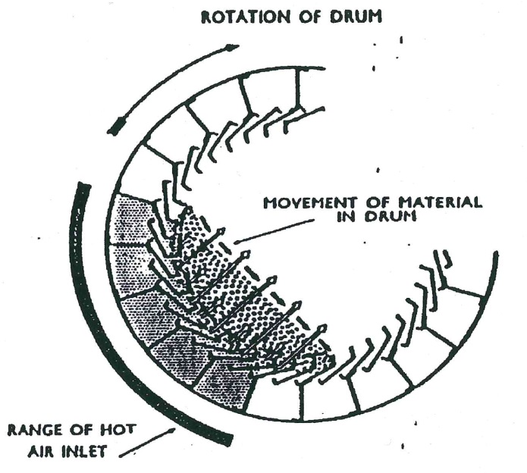
Rotary Louvre
Here the sugar is held in a special “drum” consisting of louvres.
The sugar lies at the bottom and is tumbled as the drum rotates. Hot air is blown through the sugar from the louvres below.
Advantages: | Disadvantages:
Low risk of crystal damage | Lower turndown without possible modification
Split air flows possible
Good air/sugar contacting if properly operated

Slide 8
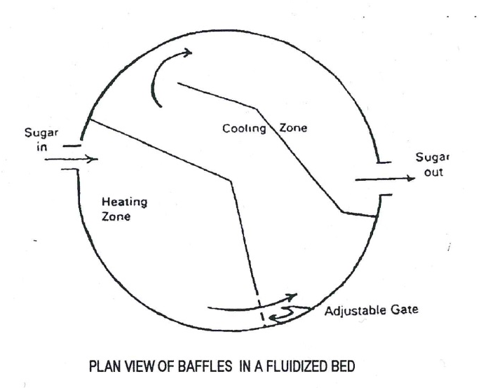
Fluidized Bed
A fluidized bed drier/cooler is a vertical cylinder divided into an upper and lower compartment by a perforated plate.
Both of these compartments are sub-divided vertically to give separate drying and cooling zones.
A forced draught fan supplies air, some of which goes through a heat exchanger to provide hot air for drying.
The wet sugar enters the drying zone and is fluidized by the hot air passing through the perforated plate.
After drying the sugar passes through to the cooling zone where it is again fluidized by ambient air.
Advantages: | Disadvantages:
Lower floor space requirement | Feed sugar quality control necessary (recirculation).
Slower drying possible | Higher retention time allows sugar to cool excessively

Slide 9
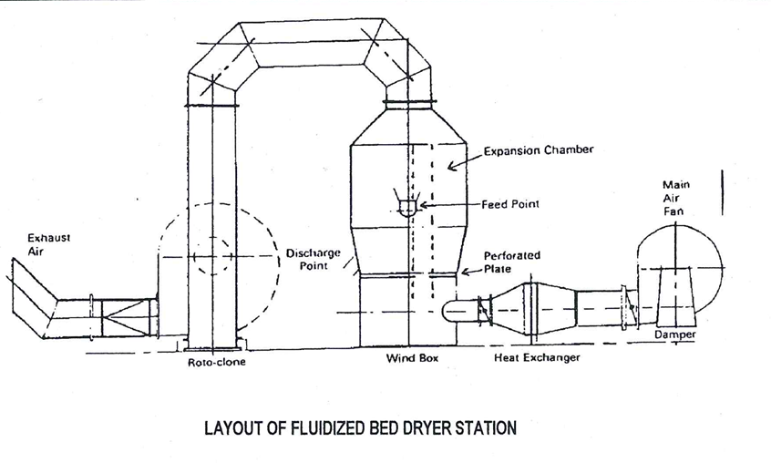
Fluidized Bed (cont.)

Slide 10
Operating Considerations
Air Flowrate
Air Temperature
Sugar Temperature
Sugar Retention Time
  Drier speed
  Drier slope
  Bed depth

Slide 11
Dust Separators
The air drawn through the drier picks up a certain amount of fine sugar dust.
This dust would be lost if a separator was not used.
The separator could be either a centrifugal or cyclone type which separates the crystals either dry or dissolved in water.
The air should be drawn through the separator rather than blown through, as any leaks would then be inwards instead of blowing sugar dust out.
If a wet separator is used precautions must be taken to prevent the growth of micro-organisms in the water as this can also constitute a loss of sugar.
Chemicals can be used to kill the bacteria or a once through system could be used.

