Slide 1
KNOWLEDGE COMPONENT: MODULE 8:
CRYSTALLISATION, CENTRIFUGING AND DRYING:
KT 8: SUGAR CONDITIONING

Slide 2
Why does Dry Sugar Cake?
    Equilibrium Relative Humidity:
Refined sugar has an ERH of 76%.
If the atmospheric humidity is above this, the sugar will absorb moisture.
If the atmospheric humidity later drops below 76% the sugar will lose excess moisture, resulting in caking
    Moisture Migration
Temperature gradients in sugar cause moisture to migrate to cold areas.
Moisture loss results in:
  Surface crystallisation
  Intercrystalline bridging
  Caking

Slide 3
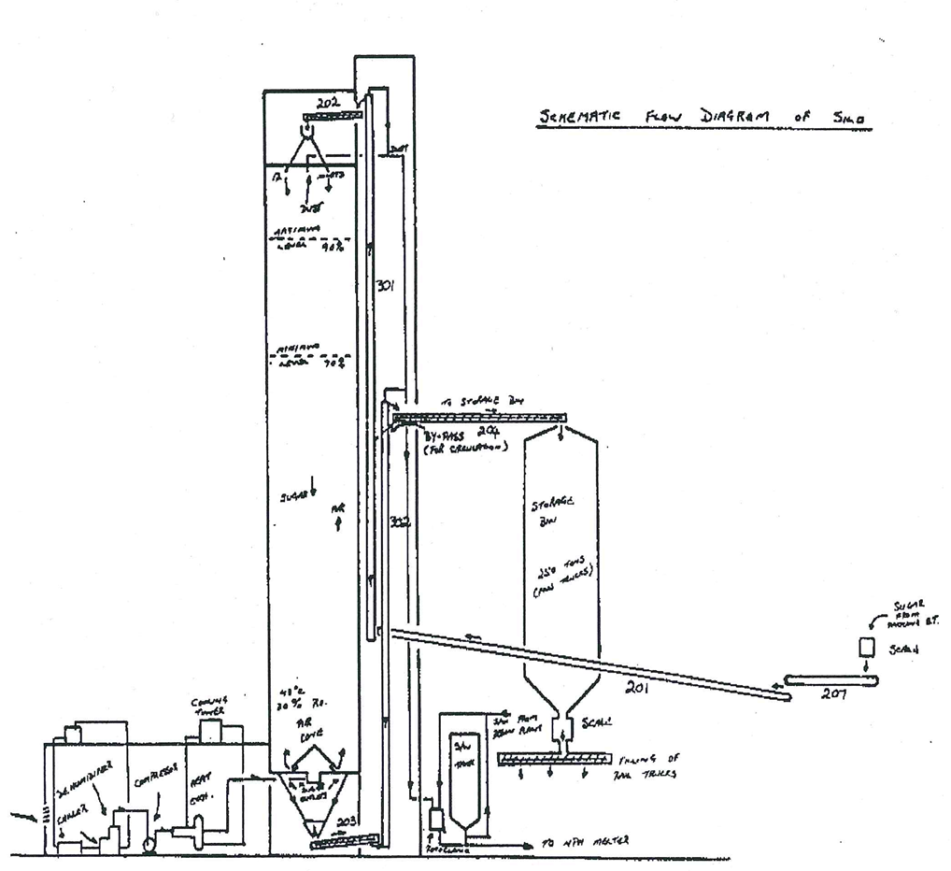
Sugar Conditioning
Sugar conditioning is practised to reduce the moisture content of refined sugar so as to prevent caking during transport/storage.
Sugar is conditioned in a silo where a bed of sugar moves from top to bottom while warm air is passed from the bottom to the top.

Slide 4
Conditioning Data
Unconditioned sugar from the sugar drier
Oven moisture = 0.03% (Measures the Free and some of the Bound Moisture)
Karl-Fischer Moisture = 0.05% - 0.10% (Measures: Free, Bound and Inherent Moisture)
Conditioned sugar
Karl-Fischer Moisture ˂ 0.05% (Total Moisture)
Conditioning Air
Temperature = 42°C - 48°C
Relative Humidity ˂ 20%
Flowrate = 50 litres.min⁻¹.ton sugar⁻¹

Slide 5
Conditioning Data (cont.)
Typical silo
Sugar hold up = 1200tons
Retention time = 48 – 72 hours
Performance measures
Test tube caking test
Karl Fischer moisture
Conditioning removes BOUND moisture

Slide 6
Factors Affecting Conditioning
    Temperature
Temperature enhances diffusion and crystallisation.
    Air Flow & Condition
Good distribution is required without overloading the dust extraction system.
    Crystal Size & Distribution
Smaller crystals conditions faster but cake easier.
Refiners in USA sieve their sugar to remove fines for this reason.
Low co-efficient of Variation improves conditioning and lowers caking propensity (i.e. tendency to cake).
Low conglomerate count also aids conditioning.
    Feed Sugar Moisture
The quantity of bound moisture and the nature of the amorphous layer in the feed sugar determines the conditioning rate.

Slide 7
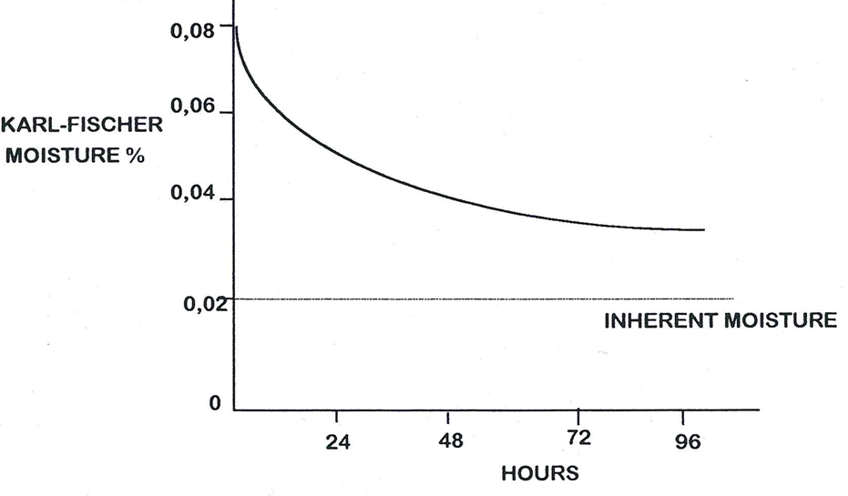
Factors Affecting Conditioning
A Typical Conditioning Curve

