Slide 1
KNOWLEDGE COMPONENT: MODULE 9:
WATER AND EFFLUENT TREATMENT: INTRODUCTION

Slide 2
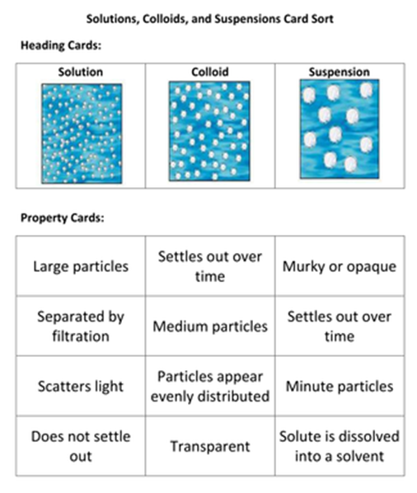
Understanding Mixtures
A mixture is anything made up of two or more elements or compounds that are physically combined in no particular proportion by mass.
Two substances can be mixed together in almost any ratio.

Slide 3
Sources of Water
Surface waters
  Water with low colour and turbidity :
    Most inland waters fall into this category.
    During floods, large quantities of suspended material are carried by rivers.
    Coarse material settles as soon as the flow rate decreases, but the colloidal or semi-colloidal material remains in suspension indefinitely.
  Water of high colour and low turbidity:
    Water in the coastal regions fall into this category.
    Colour is due to both dissolved and colloidal organic matter.
    Often contain very little inorganic salts, making them corrosive.
Underground waters
  Has percolated through soil and is free from suspended matter.
  Does leach (dissolve) out minerals from the soil.
  Simple disinfection to destroy bacteria is usually enough to make the water potable (drinkable).

Slide 4
Evaluation of Water Supply
Each water supply should be thoroughly investigated before being used for a specific purpose.
Two waters with similar chemical properties may react in different ways to the same flocculant, requiring different purification processes.
The use to which the water will be put (e.g. drinking, industrial and agricultural) will determine the treatment / purification process that will be used.

Slide 5
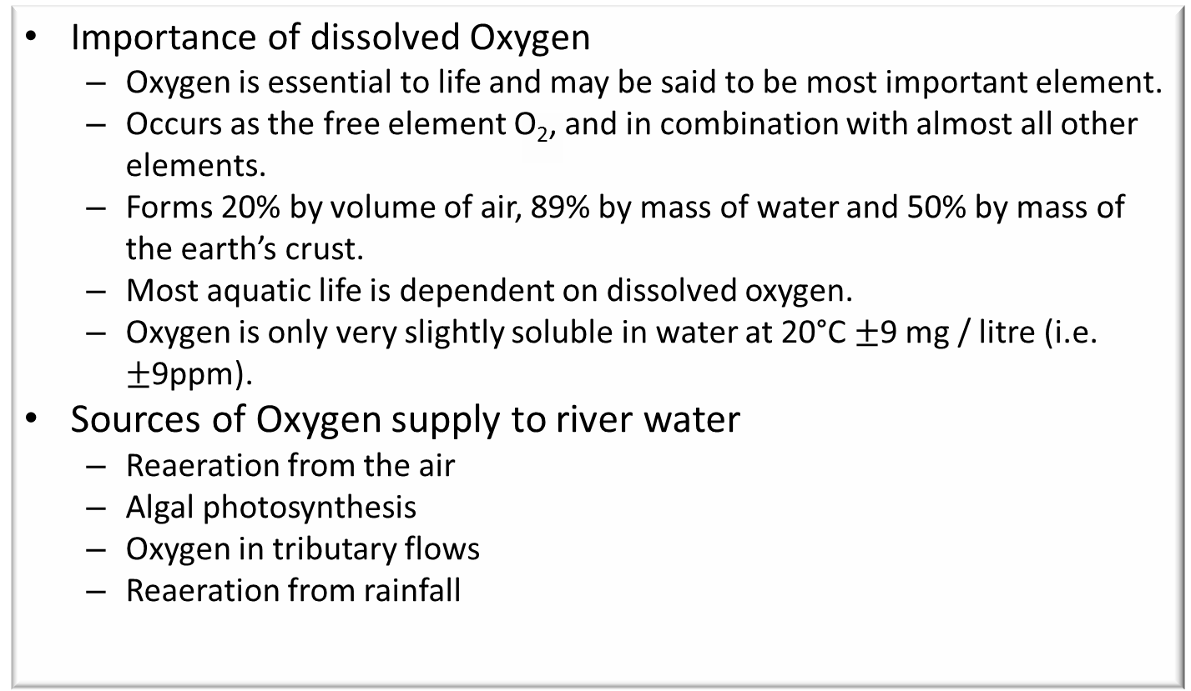
Evaluation of Water Supply (cont.)
Importance of dissolved Oxygen
  Oxygen is essential to life and may be said to be most important element.
  Occurs as the free element O₂, and in combination with almost all other elements.
  Forms 20% by volume of air, 89% by mass of water and 50% by mass of the earth’s crust.
  Most aquatic life is dependent on dissolved oxygen.
  Oxygen is only very slightly soluble in water at 20°C $±$9 mg / litre (i.e. $±$9ppm).
Sources of Oxygen supply to river water
  Reaeration from the air
  Algal photosynthesis
  Oxygen in tributary flows
  Reaeration from rainfall

Slide 6
Evaluation of Water Supply (cont.)
Users of Oxygen from River Water
  Biological oxidation of organic matter.
    Bacteria, feeding on (oxidising) organic foodstuffs, consume oxygen.
  Respiration (breathing) of certain aquatic plants will remove oxygen from the water, as will the growth of sewage fungus.
  Bottom deposit processes.
    The upper layer will absorb oxygen from the air, while anaerobic products from the lower layers, released into the water, will consume oxygen there.
  Industrial waste that contains chemicals that react with oxygen or that support bacteria that in turn consume oxygen.
    Thus sugar, though non-toxic by itself, kills aquatic life indirectly by supporting bacteria that deoxygenate the water.

