Slide 1
KNOWLEDGE COMPONENT: MODULE 9:
WATER AND EFFLUENT TREATMENT: KT 1: Potable Water Technology

Slide 2
Drinking Water Specifications
Constituent (Values in mg/l⁻¹) | SABS (1971)
pH | 6-9
Total Dissolved solids | <500
Iron (Total) | <0.3
Calcium | N.S.
Magnesium | <100
Total Hardness (CaCO₃) | 20-200
Chloride (Cl⁻) | <250
Sulphate (SO₄³⁻) | <250
Manganese | <0.1
Nitrate (NO₃⁻) | 10 as N
Fluoride (F) | 1.0 – 1.5
Aluminium (Al³⁺) | N.S.
Values in µgl⁻¹
Arsenic | <50
Copper (Cu²⁺) | <1 000
Cyanide (CN) | <10
Lead (Pb²⁺) | <50
Mercury (Total)(Hg²⁺) | N.S.
Phenol compounds | <1
Zinc (Zn²⁺) | <5 000
Bacteria | Nil / 100ml
Viruses | N.S.

Slide 3
Purpose of Water Purification
Water is made aesthetically acceptable. “It looks good”.
Bacterial content is removed.
Particulate matter is removed.
Sediment that may deposit in pipework is removed.
Taste is made acceptable.

Slide 4
Coagulation and Flocculation
Natural waters contain:
  Colloidal clays
  Colloids from domestic and industrial waste
  Live and decayed algae.
  Bacterial cells.
  Organic matter.
  Colour colloids
Colloids can be destabilised (made to settle) by coagulation or flocculation.

Slide 5
Coagulation and Flocculation (cont.)
Coagulation
  This process neutralises the charges that keep colloidal particles apart, thus enabling them to “lump” together to form bigger particles that will settle.
Flocculation
  This process “absorbs” colloids into a precipitate formed by a reaction.

Slide 6
Removal of Solids - Sedimentation
Original form of settling tank was the horizontal flow type.
Modern tanks include a flocculating zone and mechanical sludge removal, or a sludge drain.
Clarifier settling tank has a built-in flocculation chamber and automatic sludge extraction.
Mostly used for plants with a capacity above 5 million litre / day.
The factors that influence sedimentation are:
  Size, shape and mass of particles.
  Viscosity (and consequently temperature) of the water.
  Surface area of the tank
  Water flow rate
  Depth of the tank
  Retention time, or time available for settling
  Design of inlet and outlet systems

Slide 7
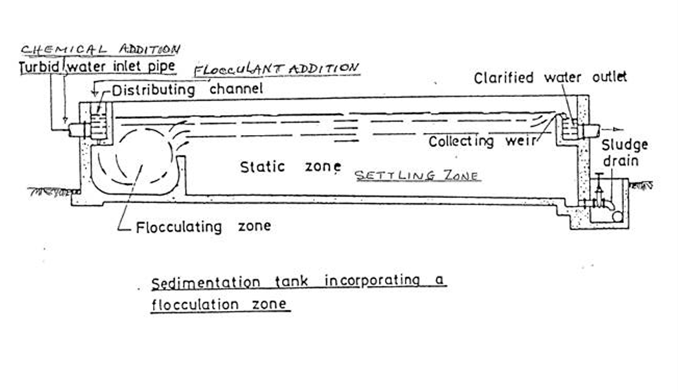
Removal of Solids - Sedimentation

Slide 8
Removal of Solids - Filtration
A filter is a bed of granular material that physically removes suspended matter from the water passing through it.
The only change in water quality is therefore a reduction in its suspended solids content.
Open manually operated filters have been substituted for semi-automatic gravity filters.
Pressure filters are used where the supply is already being pumped.
Two mechanisms are involved where a dilute suspension is filtered through porous media.
  Adhesion: Particles stick to the grains of the filter medium. This is the more important mechanism.
  Straining: Particles are caught in openings that are too small to let them pass through.
Sand filters have been used for many years to treat water.

Slide 9

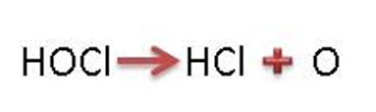
Disinfection
Chlorine is the most commonly used disinfectant for potable water.
When chlorine gas is mixed with water, it forms two acids: hypochlorous (HOCl) acid and hydrochloric acid (HCl).
The hypochlorous acid is unstable and readily decomposes to yield hydrochloric acid and atomic (nascent) oxygen.
The atomic oxygen is very reactive. It attacks bacteria and viruses and bonds to them destroying them in the process.
Chlorination is carried out at a pH of 6.5 to 7 as this ensures minimal corrosion.
Residual Chlorine refers to the amount of unreacted (extra) chlorine in the water and, between pH 6 and 8, 0.2ppm residual chlorine is sufficient to ensure protection.

Slide 10
Disinfection (cont.)
Efficient chlorination depends on:
  Uninterrupted dosing
  Uniform distribution to all parts of the water mass
  Matching the chlorine dosage to the bacterial content of the water.

Slide 11
Disinfection (cont.)
The efficiency of chlorine as a disinfectant is influenced by several factors.
  Suspended matter may envelop (surround) bacteria, shielding them from chlorine attachment/attack.
  Chlorine may react with organic substances, thus being wasted.
  Chlorine reacts with ammonia, forming chloramines that are less effective as a disinfectant.
  High temperatures increases the rate of disinfection, but chlorine is more stable at low temperatures.
  Sufficient contact time (10 to 15 minutes, but preferably several hours) ensures effective disinfection.
  Hypochlorous acid (HOCl) is rapidly decomposed by sunlight and is lost during aeration.
Disinfectants other than chlorine include ozone, ultra-violet radiation, and heat.

