Slide 1
KNOWLEDGE COMPONENT: MODULE 9:
WATER AND EFFLUENT TREATMENT: KT 2: Cooling Water Technology

Slide 2
Introduction
A factory processing 100 tons cane produces 120 tons of clear juice and over 100 tons of water needs to be evaporated from the clear juice to produce syrup.
If this is done in a quintuple effect evaporator station, 1/5 of this vapour would have to be condensed i.e. 20 tons.
About 20 times more water is required than vapour i.e. about 400 tons.

Slide 3
Introduction (cont.)
Condensing vapour from the evaporator train is the major user of condenser water in a sugar mill.
Condenser water is also used in:
  vacuum pans
  the rotary vacuum filters
  air extraction pumps (sealing water),
  bearings (for cooling) and
  crystallisers
During the process of condensing vapour the water’s temperature increases and this water then has to be cooled before it can be reused.
Several unit operations in the factory produce hot water. The main sources of hot water in a factory are the evaporators and pans, juice heaters and boiler blowdown.

Slide 4
Types of Cooling Systems
Open evaporative cooling systems
Closed systems
Once-through systems

Slide 5
Open Evaporative Cooling Systems
Cooling Ponds
  Water is introduced into the pond and cooling is by natural evaporation, convection and radiation.
  Because cooling is very slow, the ponds have to be large.
  However, they consume less water than cooling towers as they dissipate only 55% of the added heat by evaporation, whereas the figure for cooling towers is 80%.

Slide 6
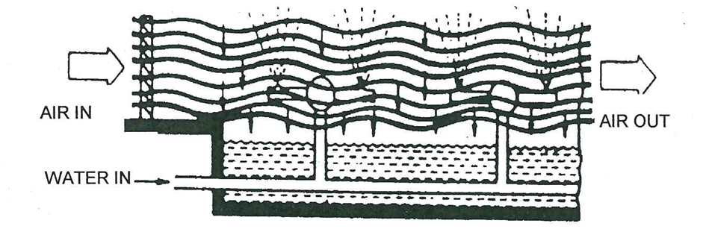
Open Evaporative Cooling Systems
Spray ponds
  The addition of piping and nozzles to a cooling pond allows water to be sprayed into the surrounding air, thus increasing the rate of evaporation, and enabling the use of smaller ponds.
  Windage losses range from 1-5% of the circulation rate and impurities from the surrounding area can easily enter the pond.

Slide 7
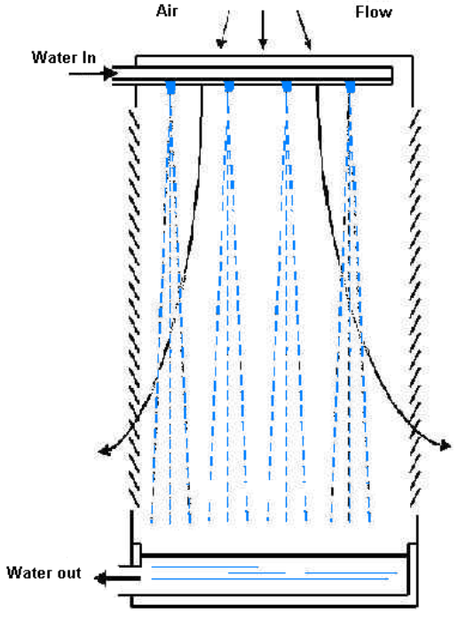
Open Evaporative Cooling Systems
Cooling Towers
A cooling tower is a partially enclosed space (air must be allowed entry) in which cooling by evaporation takes place.
Several types are in use.
Atmospheric Spray Filled Tower

Slide 8
Open Evaporative Cooling Systems (cont.)
Atmosphere spray-filled towers
  Have nozzles spraying water downward through a cross-flow of wind driven air.
  Air enters and leaves through louvres.
A packed atmosphere tower
  Sprays water downward over packing or filling.
  The filling breaks up the flow of water, exposing more wetted surface, thus increasing the cooling efficiency.
  Mechanical draft towers use fans to move large quantities of air through the unit.
  In forced draft towers, the fan pushes atmospheric air through the packing, while in induced draft towers the fan draws moisture-laden air through the packing.

Slide 9
Open Evaporative Cooling Systems (cont.)
Counterflow towers
  Have air moving counter to water while in crossflow towers air moves horizontally through water that falls vertically.
  Drift eliminators (like entrainment separators) remove water from the air before it leaves the unit.
Hyperbolic towers
  Are natural draft units built of concrete.
  They are a few hundred meters tall, and have a shape that optimises air flow and gives structural stability.
  They are very expensive to build but are cheaper to run due to the absence of the fans.

Slide 10
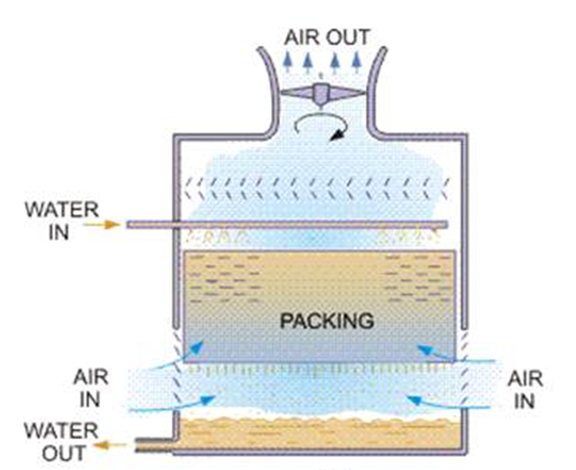
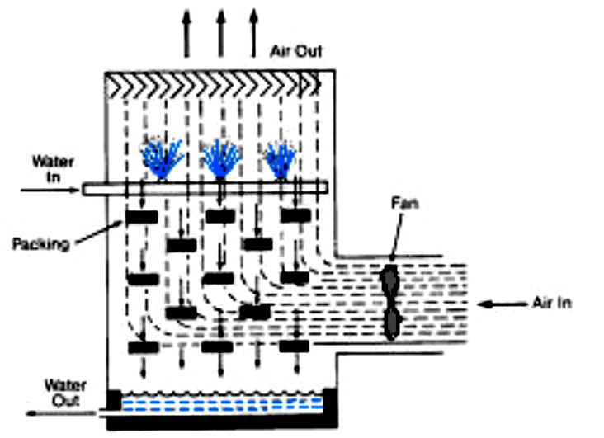
Open Evaporative Cooling Systems (cont.)
Packed Atmospheric Tower
Forced Draft Tower

Slide 11
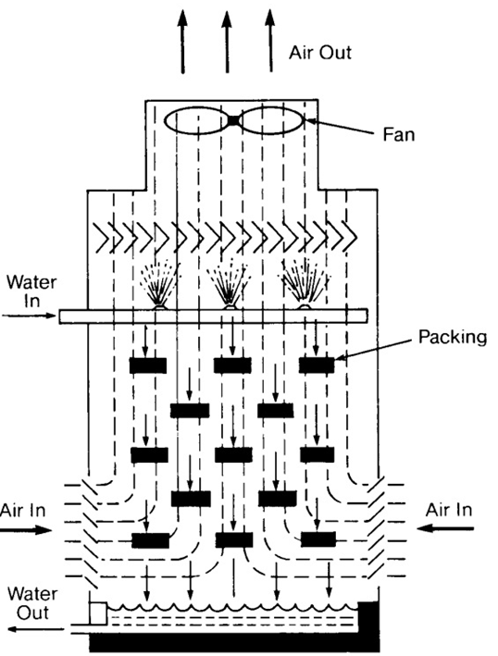
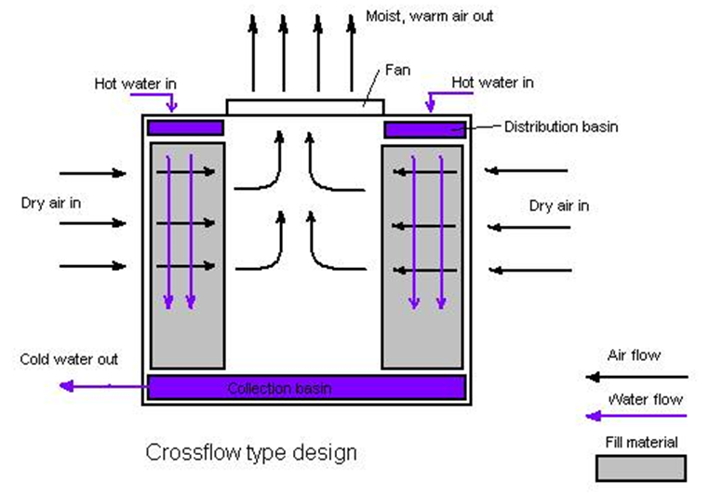
Open Evaporative Cooling Systems (cont.)
Induced Draft Counterflow Tower
Crossflow Induced Draft Tower

Slide 12
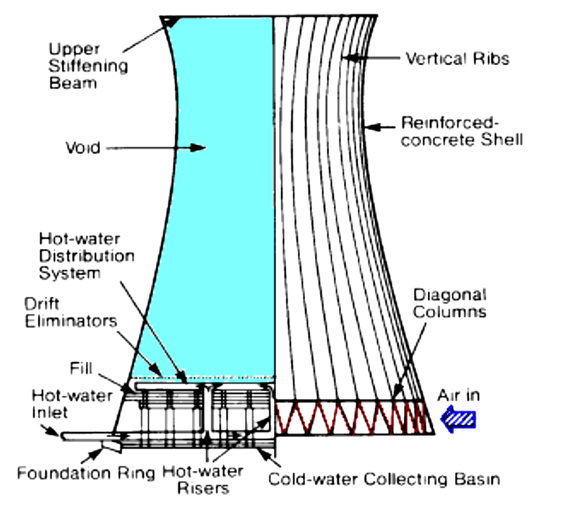
Open Evaporative Cooling Systems (cont.)
Counter Hyperbolic Tower

Slide 13

Corrosion Control
Corrosion is a process in which a difference in electrical potential develops between two metals in contact or between different parts of a single metal due to temperature differences or differences in oxygen content of the water.
At some parts of the metal, the metal dissolves and goes into solution as metal ions.
In the process of going into solution as ions the metal atoms lose electrons.
Losing electrons is called oxidation and the place where oxidation occurs is called the anode.
The reaction is as follows:

Slide 14
Corrosion Control (cont.)
The electrons move to another part of the metal where these electrons are used and cause other reactions to occur.
When a substance takes up electrons the process is called reduction and the place where reduction occurs is called the cathode.
Electrons thus move from the anode (where they are released) to the cathode where they are used.

Slide 15
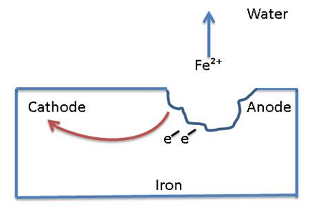
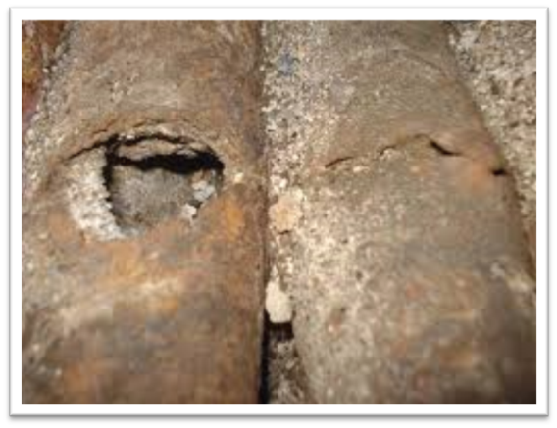
Corrosion Control (cont.)
If the metal is exposed to the air, the Fe²⁺ ions formed can combine with oxygen to form oxides of iron like Fe₂O₃.
The resulting brown compound is called rust.
Polarisation techniques aim at reducing the potential difference, thus reducing the driving force in corrosion.
When this potential is zero, the metal is in a passive state.
Temperature differences in a metal can also cause cathode/anode corrosion.

Slide 16
Corrosion Inhibitors
Inhibitors are defined as anodic, cathodic or both depending on the reaction that the inhibitor controls.
Inhibition results from three general mechanisms:
  The inhibitor molecule is absorbed (by itself or with metal ions) forming a thin protective film on the metal surface.
  The inhibitor causes the metal to form its own protective film of metal oxide.
  The inhibitor reacts with a potentially corrosive substance in the water.

Slide 17
Corrosion Inhibitors (cont.)
Chemical factors that affect corrosion are:
  pH
  dissolved salts that can attack passive oxide films or precipitate to form protective barriers
  dissolved gases like carbon dioxide and oxygen, and
  microorganisms that promote acid attack
Physical factors include:
  temperature (hot areas become anodic),
  water velocity (high velocities cause erosion and can remove passive films)
  suspended solids, and
  metal quality aspects

Slide 18
Sources of Deposits
Deposits can originate in the water.
Precipitated salts of calcium and magnesium form dense scale and sludge which are usually quite adherent.
Calcium carbonate, calcium sulphate, calcium and magnesium silicates and calcium phosphate are the more prevalent compounds found in cooling water.
Mud, clay, biological matter etc. may enter a system through the make-up supply.
These settle in cooling tower basins, sealing wells etc. reducing working volumes and heat transfer surfaces, and enabling “under-deposit corrosion” to go unchecked.
Flocculants (contamination) can originate in the air used to cool water in the tower.
A cooling tower acts as air cleaner, and saturates the water with oxygen and carbon dioxide.
Flocculants can come from the construction materials of the system (iron oxide) and from the process (sugar, oil, and bagasse).

Slide 19
Control of Deposits
Ions that cause deposits can be removed using lime or ion exchange techniques (because of the large volume of cooling water the cost of this is prohibitive).
Chemical agents called polymers are used to modify the precipitates so that they do not form adherent scales (Polymers can act as flocculants or dispersants).
Flocculants bridge small particles together, creating a high density floc and reducing the surface area for attachments, thus reducing the amount of scaling.

Slide 20
Control of Deposits (cont.)
Dispersants act in an opposite manner, they impart like charges to flocculant particles, forcing them to remain in suspension.
Most cooling water fouling material carry slight negative charges; anionic dispersants are used to increase these charges.
Because of the large volume of cooling water, chemical treatment at most factories consists simply of pH correction using lime, which is both cheap and available.

Slide 21
Microbiological Aspects
Microorganisms are found everywhere in nature.
They play vital roles in the health of man and animal alike.
Some microorganisms are beneficial while others (pathogens) carry diseases like typhoid fever, amoebic dysentery, cholera etc.
As an isolated single cell, a microorganism presents no problem in cooling water.
However, the cooling tower provides optimum conditions for microbial growth (warm temperatures and ideal pH) and bacterial concentration may increase by six million in the time it takes for salts to increase by six.

Slide 22
Types of Microbes
Algae
  Algae need air, water and sunlight for growth.
  Cooling tower sidewalls provide an excellent growth environment.
  All algae produce oxygen which can accelerate corrosion.
  Blue-green algae can extract nitrogen from the air and from organic nitrogen compounds, thus attacking nitrate based corrosion inhibitors.
  Brown algae (called diatoms) cause silica fouling.
  Algae favour temperatures in the range 18 -40°C and pH’s from 5.5 - 8.9.

Slide 23
Types of Microbes (cont.)
Fungi
  Fungi can be considered non-photosynthetic plants.
  About 20% of fungal groups are capable of using wood as a nutrient and can therefore destroy wood where it is used as packing in cooling towers.
  This is generally not a problem since the modern trend is to use plastic or stainless steel as packing material.
  Fungi cause discolouration of water and wood.
  They thrive at lower temperatures than algae (0 - 38°C) and at a wider pH range: 2-8, with the optimum at 5.6.

Slide 24
Types of Microbes (cont.)
Bacteria
  Many bacteria species may appear in cooling water systems.
  Agents toxic to one species may have little effect on others.
  Bacteria can be categorised as given below:
    Shape - Spherical (Coccus), Rod like (Baccillus), Curved or comma-shaped (spirillum)
    Temperature requirements - Cold liking (Psychrophilic): 0 - 25°C, Moderate temperature liking (Mesophilic): 20 - 45°C, Heat liking (Thermophilic): 45 - 70°C
    Oxygen requirements - Aerobic: need air to live, Anaerobic: must have absence of air to live
    Nutritional requirements - Energy from oxidation of inorganic compounds, Energy from both organic and inorganic material, Feed on living organic matter, Feed on dead or decaying matter

Slide 25
Problems caused by Microbes
Metal corrosion can be caused by oxygen released by bacteria, however, their primary contribution to corrosion is related to “under-deposit corrosion”.
An oxygen-deficient area would be found under a slime deposit, forming a “differential aeration cell”, leading to an anodic site under the slime and cathodic regions elsewhere.
Deposits are caused when slime adheres to surfaces, and entraps suspended matter.
Tower packing that gets covered with slime can resist air flow and result in increased water droplets size, decreasing the cooling efficiency and increasing the cooling water temperature.

Slide 26
Control of Microbial Activity
The selection of a microbiocide involves several factors:
  It must inhibit almost all activity
  It must be economical
  Dosage must be correct, and the microbiocide must be correctly applied
  Oxidising biocides should not be used where wood deterioration could occur
  Effects on the environment should be minimal
Chlorine is a widely used biocide (see notes on drinking water treatment).
Chlorine, hypochlorites, chlorine dioxide and ozone are oxidising biocides that attack wood while biocides like copper salts and amines are non-oxidising.

