Slide 1
KNOWLEDGE COMPONENT: MODULE 9:
WATER AND EFFLUENT TREATMENT: KT 3: BOILER WATER TECHNOLOGY

Slide 2
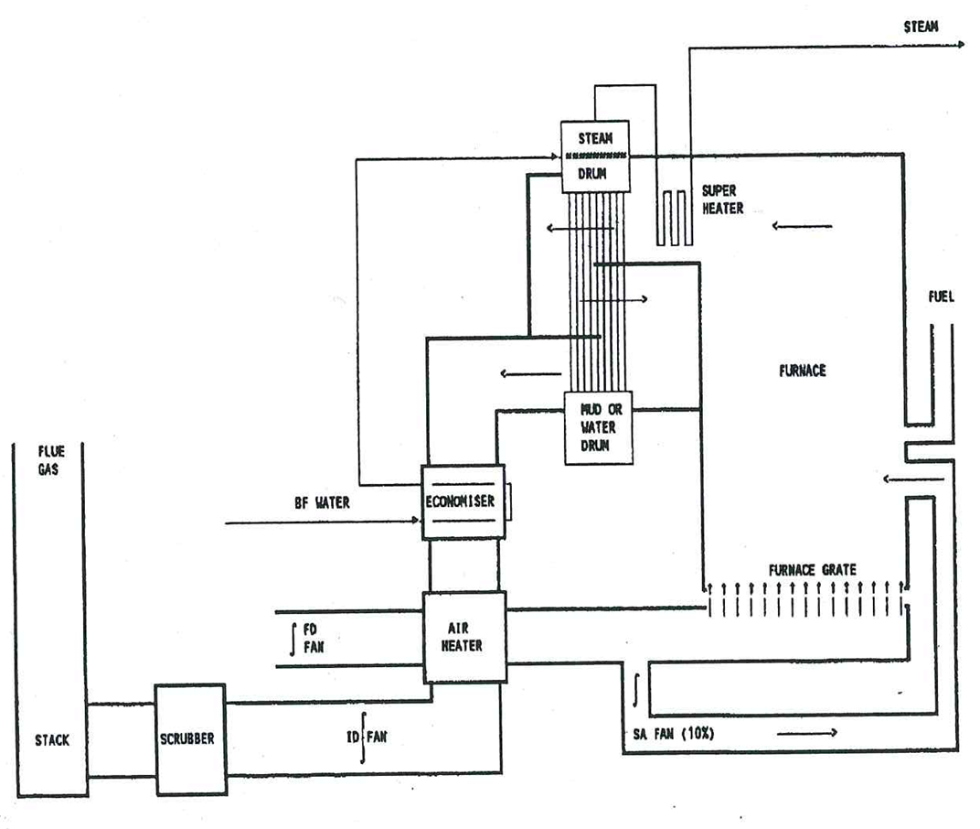
Principles of a Boiler
A boiler is used to evaporate water and produce steam.
Basic layout of a sugar mill boiler

Slide 3
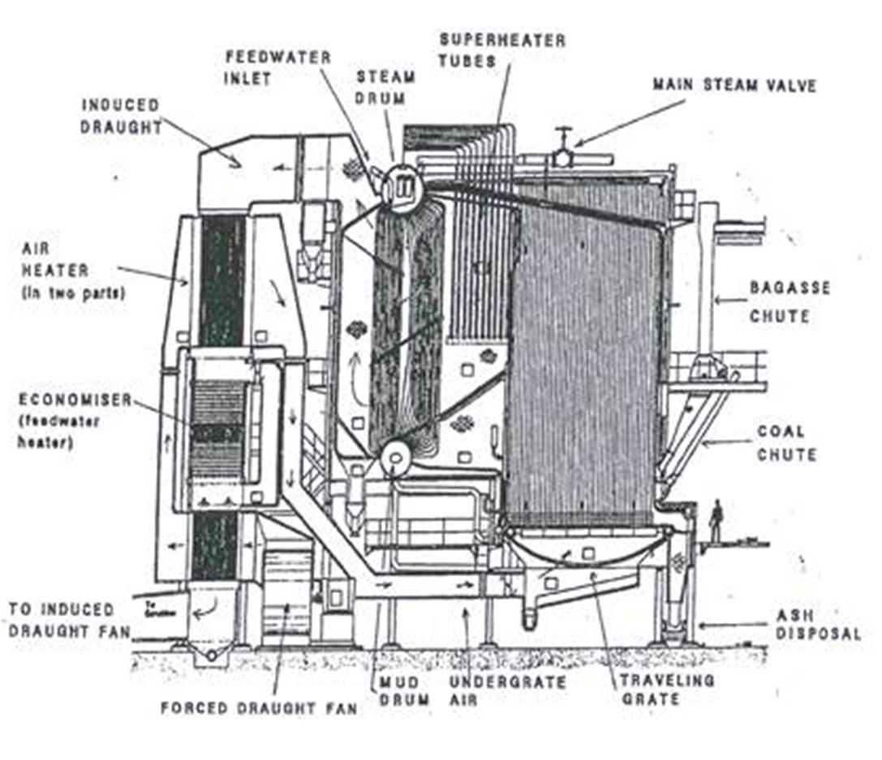
Principles of a Boiler (cont.)

Slide 4
Principles of a Boiler (cont.)
A sugar mill boiler has two drums connected by tubes.
  Top drum (steam drum) is half filled with water
  Bottom drum (mud drum) is completely filled with water.
The forced draft fan (FD Fan) blows air into the combustion chamber where a fuel (bagasse/coal) is burned to produce hot gases.
These gases are channelled so that they move between the tubes connecting the steam and mud drums.
In the process the water in the tubes is heated and the water in the steam drum boils to produce steam.
The steam produced in the top drum is extracted via tubing and is heated further (superheated) by piping this steam through superheater tubes placed in the path of the hot gases from the combustion chamber.

Slide 5
Principles of a Boiler (cont.)
After passing through the tubes the hot gases pass through an economiser where it heats the water fed to the boiler and then these gases pass through an air heater where it heats up the air before the air is fed to the combustion chamber.
After this temperature of the combustion gases is too low to be useful and these gases (called flue gasses) are extracted by the induced draft fan (ID fan) and fed to the stack for disposal to the atmosphere.
In summary, a boiler receives feedwater, adds heat to it from the burning of a fuel and converts it to steam.

Slide 6
Principles of a Boiler (cont.)
When water evaporates to produce steam, the steam coming off is much purer than the water.
This is because the dissolved substance/impurities present in the water do not evaporate.
The concentration of dissolved substances thus increases as more and more water is evaporated.
The term "cycle of concentration” is used to refer to the number of times that the solids in a given volume of water are concentrated.

Slide 7
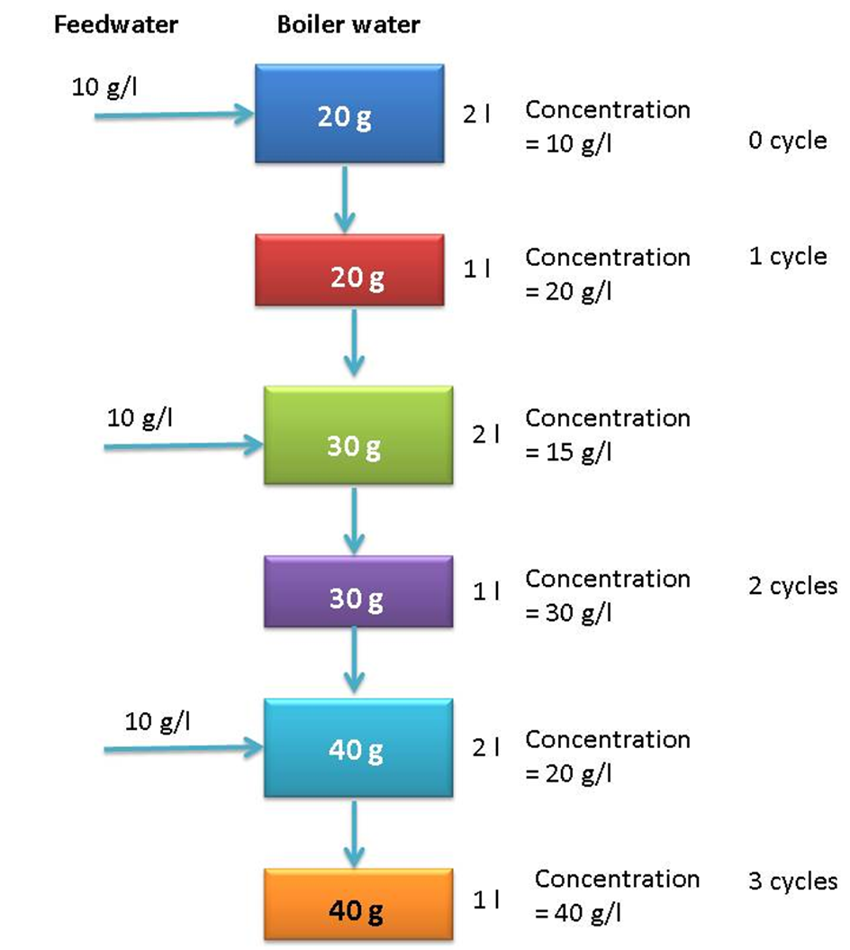
Principles of a Boiler (cont.)
Cycles of Concentration: Example

Slide 8
Principles of a Boiler (cont.)
The total amount of dissolved substances in boiler water is referred to as the “total dissolved solids” (TDS) and is measured using conductivity.
The TDS is expressed in ppm (parts per million) which is the mg of dissolved solids per litre of boiler water (mg/l)
If the dissolved solids in boiler water are allowed to become too concentrated, substances will precipitate and cause scaling of the tubes which will reduce the heat transfer.
To prevent the dissolved solids from becoming too concentrated, “blowdown” is practiced.
This involves draining off some of the boiler water.

Slide 9
Principles of a Boiler (cont.)
In the steam drum the blowdown is taken from just below the water surface because this is where the concentration of dissolved solids is greatest.
Since the water drained off during blowdown is replaced by boiler feedwater containing a lower concentration of dissolved substances, this is a method to keep the concentration of dissolved substances in boiler water at acceptable levels.
Blowdown is also done from the bottom of the mud drum.
This removes sediments and precipitates (mud) that have settled at the bottom this drum.

Slide 10
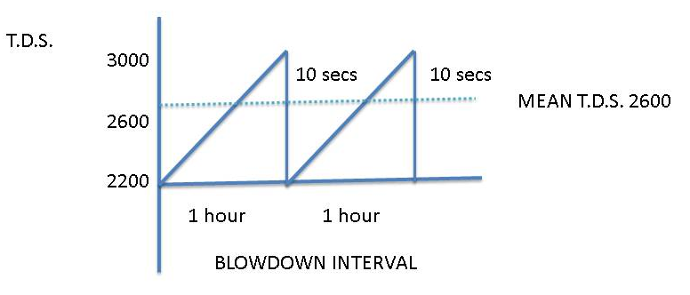
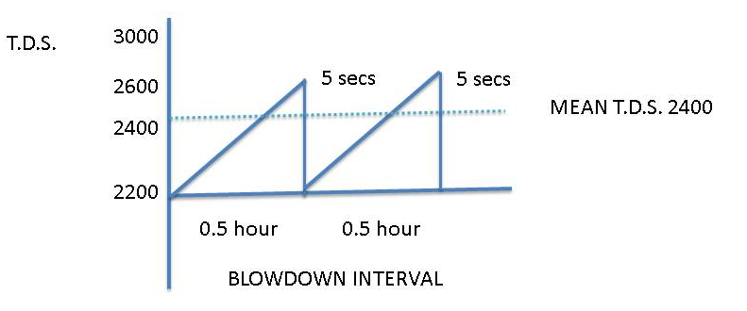
Principles of a Boiler (cont.)
Shorter more frequent blowdown is more beneficial in controlling the TDS than longer less frequent blowdown.

Slide 11
Principles of a Boiler (cont.)
Since the steam coming off the water is much purer than the water, the steam can, in theory, be condensed without contamination and be returned to the boiler as feedwater.
In practice, the system is not closed, condensates pick up foreign material and have to be dumped, leading to the need to use make-up water.
Impurities carried by the make-up are thus added to the boiler.
These impurities cause carryover, scaling and corrosion.

Slide 12
Carryover - Causes
Foaming
  Bubbles of froth form and leave with the steam.
  Very high concentrations of solubles or insolubles cause foaming e.g. oils, alkalis, organic matter like sugar, etc.
  Organic antifoams are used to control foaming.
Priming
  An increase in steam offtake can cause a surge in water level resulting in steam entraining water.
  This is called priming.
  Other causes are operating at too high a water level and faulty separating equipment used to separate water and steam.
  The rapid jetting of water out of the boiler may pass through the system so quickly that it may not manifest itself in the superheater header, but will pass directly to the turbines and settle out as a deposit on the turbine blades, mainly as caustic Soda which is the highest chemical constituent in the Boiler water.
  This will damage the turbine blades.

Slide 13
Carryover – Causes (cont.)
Droplet entrainment
  Droplets are thrown off into steam as the steam bubbles burst.
Silica Carryover
  Silica can enter steam in water carryover, or in volatile form at pressures above 3000kPa.
  Silica deposits on turbine blades and on tubes can cause serious damage.

Slide 14
Effects and Prevention of Carryover
Solids deposit on superheater tubes and turbines result in:
  overheating,
  corrosion and
  eventual failure
  contaminate the material being processed.
Carryover can be controlled by:
  Maintaining the recommended dissolved and suspended solids concentration
  Avoiding high water levels
  Steady boiler operation
  Dumping contaminated condensate
  Using antifoams and sludge conditioners
  Ensuring proper condition of steam/water separating equipment in the steam drum.

Slide 15
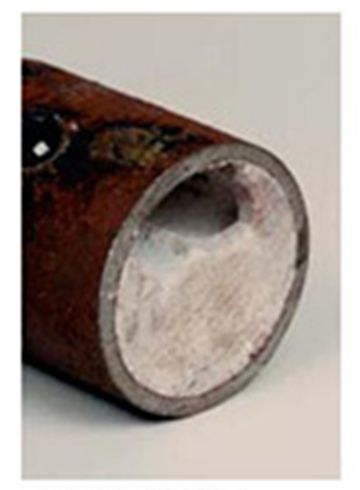
Scaling
Scaling results from impurities precipitating as their saturation levels are reached from suspended matter becoming hard and adherent.
Typical scales formed in boilers:
Calcium carbonate (CaCo₃) | Relatively hard deposit
Iron Silicate
Calcium silicate | Hard brittle deposit
Magnesium silicate
Calcium sulphate | Hard scale

Slide 16
Effects of Scaling
Scale acts as an insulator, reducing the rate of heat transfer.
Tube overheating and subsequent failure can result.
Tubes can even plug completely.
Scale also provides a cover which corrosion can occur.

Slide 17
Causes of Scaling
Hardness refers to the total concentration of calcium (Ca²⁺) and magnesium ions (Mg²⁺) in water.
Calcium and magnesium in water are the main causes of scaling.
They can deposit as phosphate, carbonate or sulphate scale.
Silica, suspended solids, products of corrosion, and low alkalinity also lead to scaling.
Where chemicals do not precipitate directly onto tubes, they may form sludges that subsequently become adherent.

Slide 18
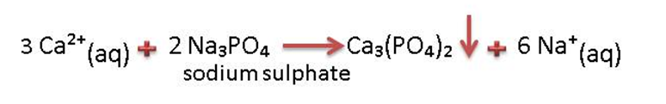
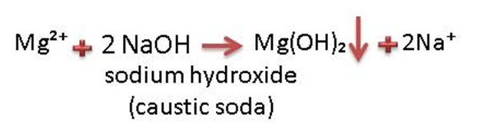
Prevention of Scaling
Sludge conditioners are chemicals that ensure that precipitates remain in the form of sludge and are used to control scaling.
Excess sludge is removed by blowdown.
Calcium (ca²⁺) ions can be removed by precipitating as calcium phosphate
Magnesium (mg²⁺) ions can be removed by precipitating as magnesium hydroxide
The Ca₃(PO₄)₂ and Mg(OH)₂ precipitates are very fine and are easily conditioned by the dispersants in the boiler chemical compounds and ultimately removed via blowdown.

Slide 19
Prevention of Scaling (cont.)
A chelant can be used to form a soluble complex with calcium and magnesium ions.
Common chelants are E.D.T.A. and N.T.A.
The use of chelants is limited by the following factors.
  High cost
  Corrosive nature
  Not suitable for high hardness levels

Slide 20
Prevention of Scaling (cont.)
Crystal habit modifiers like phosphonates tend to increase the solubility of scale forming substances.
On a cost effective basis the phosphate / phosphonate programme has been found to be most beneficial in the sugar industry and is very easy to control.

Slide 21
Prevention of Scaling (cont.)
Hardness (Ca²⁺ and Mg²⁺ ions) can be removed from boiler feedwater by using:
  ion exchange softener or
  de-mineralisation (cation/anion exchange)
Very expensive and is generally not cost effective in the sugar industry.

Slide 22
Corrosion - Effects
Corrosion is the reversion of a metal to its oxide.
For example, when iron corrodes (rusts) it forms iron oxide (Fe₂O₃).
Dissolved oxygen in water is the prime cause of corrosion.
Carbon dioxide in water, and alkalinities that are too high or too low can all cause corrosion.
Corrosion fatigue is a type of metal cracking that results from the concentration of cyclic (heating and cooling) stresses at points of high corrosion.
Caustic cracking results from the presence of caustic, stress, at least a trace of silica, and a mechanism (like a slight leak) that allows water to concentrate on the stressed metal.
Apart from shortening plant life, corrosion products can cause a scaling problem elsewhere in the boiler.

Slide 23
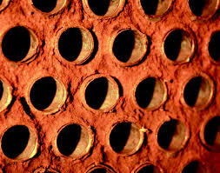
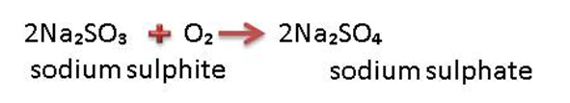
Corrosion Control Measures
Remove dissolved oxygen
Since the solubility of oxygen in water decreases with increase in temperature, a deaerator heats the water and thus expels oxygen, reducing its concentration down to 0.007 – 0.04ppm.
The basic principle of operation of a deaerator is as follows:
  A spray of water is created and steam is passed through it.
  The deaerator removes air in two ways.
    It heats the water which reduces the solubility of air.
    Since the concentration of air in the steam is very low, air diffuses (moves) from the water to the steam.
An oxygen scavenger is also used to consume the residual oxygen.
Scavengers must be applied upstream of economisers, so that economisers too can be protected.

Slide 24
Corrosion Control Measures (cont.)
Maintain alkaline condition pH > 11
Use neutralizing amines
  Attack corrosive gases in steam and condensate systems by using neutralising amines that increase condensate pH and filming amines that form protective films on metal surfaces.

Slide 25
Sugar in Boiler Water
Gross contamination of boiler water with sugar can be noted from:
  A considerable drop in pH as the sugar is degraded into other compounds including acids.
  The distinctive smell of burnt sugar.
Contamination of boiler water with sugar causes:
  Acid corrosion
  Scaling of tubes
  Carryover of sugar containing boiler water into the steam due to foaming

Slide 26
Sugar in Boiler Water (cont.)
Corrective action:
Dumping the contaminated sweet condensate that is used as boiler feedwater.
Increasing the caustic (NaOH) dosage to neutralise the acids formed due to sugar degradation.
Increasing the rate of blowdown.

Slide 27
Pre-Treatment
Raw water consists of:
  Suspended solids – silt
  Silica – dissolved and colloidal
  Dissolved solids – anions and cautions
The quality of the water must be improved before it can be used as boiler feedwater.

Slide 28
Pre-Treatment (cont.)
Clarification :
  Various types of clarifiers are used in conjunction with a suitable flocculant.
  The universal flocculant is Aluminium Sulphate (Alum).
  pH adjustment is done with Soda Ash (Sodium Carbonate) or Lime.
Water softener / de-ionisation – cation/anion exchangers :
  The water softener usually contains a cation exchange Resin or Zeolite Bead.
  This will remove calcium and magnesium hardness.
  Silica is not removed.
  De-ionisation will remove both cations and anions in the raw water.
  They are not normally used in the Sugar Industry because of high capital and operational costs.

Slide 29
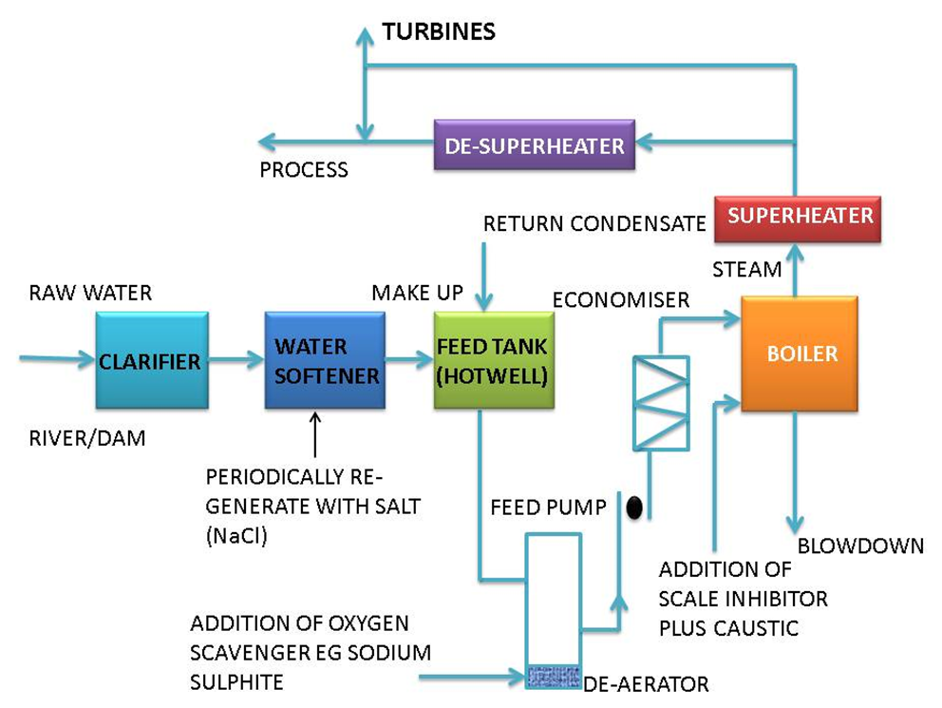
Boiler Feed Water Systems

Slide 30
Interpretation of Analytical Results
 | Control limits | Example (1) | Example (2)
Hardness | Nil | Nil | Nil
O. Alkalinity | 250-300 | 450 | 10
P. Alkalinity | 300-450 | 700 | 150
Total dissolved
Solids (T.D.S.) | Max. 2200 | 3500 | 2000
Suspended Solids | Max. 220 | 480 | 180
Silica | Max. 70 | 150 | 70
Phosphate | 20-60 | 80+ | 10
Sulphites | 20-60 | 80 | 15
Example 1
The T.D.S., Alkalinites, Phosphates, Suspended Solids and Silica levels are all too high. By doubling the blowdown rate all the parameters will be halved.
Example 2
The T.D.S. level is correct. However, the chemical levels are low. Therefore the corrective action is to increase chemical dosages.

Slide 31
Boiler Water Specifications
Boiler Pressure (MPa) | 0 – 2.0 | 2.0 – 3.5
Total Dissolved Solids mg/l | <3500 | <2500
Suspended Solids mg/l | <300 | <250
Hardness as CaCO₃ mg/l | <2 | <2
Phosphate as PO₄ mg/l | 30-60 | 30-60
Sulphite (SO₄) mg/l | 30-60 | 30-60
Hydrazine mg/l | 0.1-0.3 | 0.1-0.3
Oil mg/l | <7 | <7
Silica mg/l | <150 | <90
Total alkalinity as CaCO₃ mg/l | <700 | <500
Hydroxide ‘O’ alkalinity as CaCO₃ mg/l | >3 × silica | >3 × silica
pH range mg/l | 10.5-11.5 | 10.5-11.5

Slide 32
Boiler Feed Water Specifications
Boiler Pressure MPa | 0-1.5 | 1.5-3.5
Dissolved Oxygen (before oxygen scavenger is added) mg/l O₂ | <0.04 | <0.04
Total iron mg/l Fe | <0.100 | <0.050
Total copper mg/l Cu | <0.050 | <0.025
Total hardness mg/l | <0.300 | <0.300
pH range | 7.5 – 10.0 | 7.5 – 10.0
Non-volatile total organic carbon mg/l C | <1 | <1
Oil mg/l | <1 | <1

