Slide 1
KNOWLEDGE COMPONENT: MODULE 9:
WATER AND EFFLUENT TREATMENT: KT 4: WASTE WATER / EFFLUENT TECHNOLOGY

Slide 2
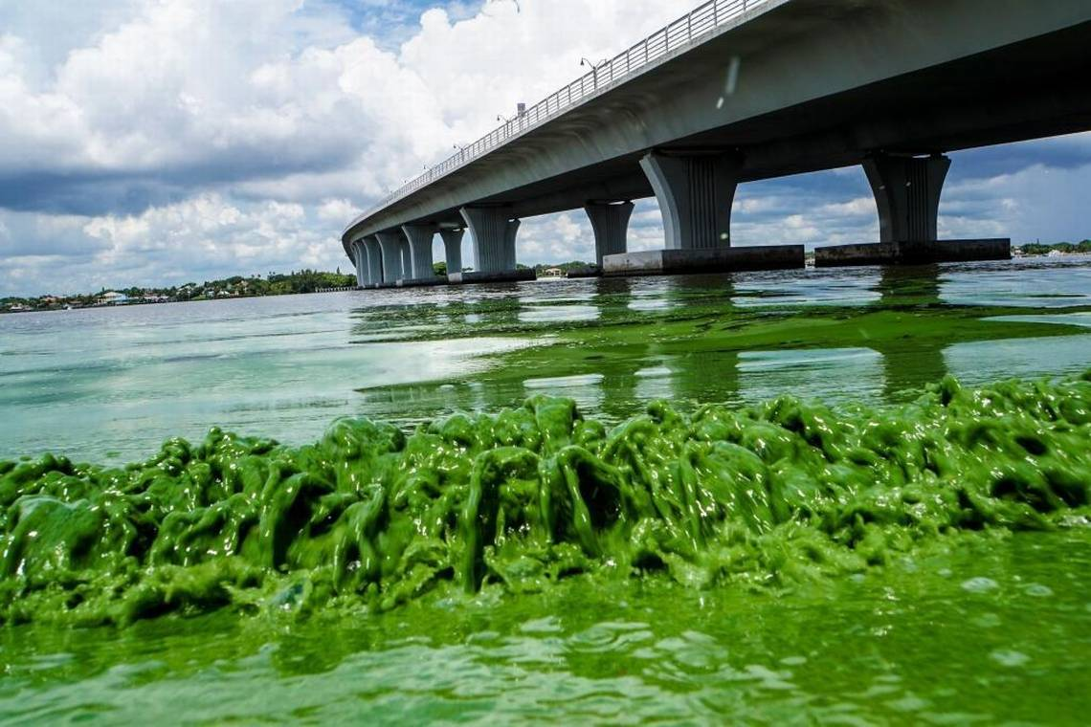
Legal Aspects
Initially, the Water Act of 1956 controlled water usage.
Its many weaknesses led to a decline in the quality of water.
The law presently in force is the Water Amendment Act (1984) and chief aspects of this legislation are:
  Plants handling over 150m³ intakes from all sources on any one day require a permit.
  The purification of effluents to prescribed quality standards shall be considered to form a part of the manufacturing process.

Slide 3
Legal Aspects (cont.)
All water (including rain water) draining from land on which industrial activity is carried out shall be deemed to be effluent.
Irrigation of effluents is considered to be a temporary measure.
Water pollution control officers are empowered to ensure that the Act is carried out.
A special standard applicable to specified areas and a General Standard (applicable in the sugar belt) are laid out.

Slide 4
General Standards
Colour, taste and odour : Shall not contain any substance in a concentration capable of producing colour, taste or odour
pH shall be between 5.5 – 9.5
Dissolved oxygen : Shall be at least 75% saturated
Typical (faecal) E. coli : Shall not contain any typical (faecal) E. coli per 100 ml
Temperature : Shall not exceed 35°C

Slide 5
General Standards (cont.)
Chemical oxygen demand : Shall not exceed 75 mgl⁻¹
Conductivity : Shall not be increased by more than 75 milli-Siemens per meter over that of the intake water
Suspended solids : Shall not exceed 25mgl⁻¹
Sodium: Shall not be increased by over 90mgl⁻¹ above that of the intake water
Soap, oil, grease : Shall not exceed 2.5mgl⁻¹

Slide 6
Mechanism of Pollution with Sugar
Sugar Mill effluent cannot be discharged directly into a river or stream.
Although sugar is non-toxic, it provides a food source for aerobic bacteria which consume the dissolved oxygen in the water faster than it can be replaced.
Fish and other aquatic life subsequently “suffocate” in the deoxygenated water.
When there is no more oxygen, anaerobic organisms begin to multiply, producing methane, hydrogen sulphide and ammonia.
The water stinks and tastes bitter.
Usually insoluble metals become soluble, turning the water black.
The sugar concentration in the water may only be in parts per million, but its effect on aquatic life is devastating.

Slide 7
Measurement of Pollution
Pollution is measured, broadly, by measuring the “food value” of the effluent to bacteria.
This involves measuring the organic contents of the effluent.
There are two types of measurements:
  Biological oxygen demand (BOD)
  Chemical Oxygen demand (COD)
The COD for an effluent sample is always greater than the BOD of the sample, since some compounds cannot be decomposed by bacteria.
For fresh sugar effluent it has been found that the COD is approximately twice the BOD.

Slide 8
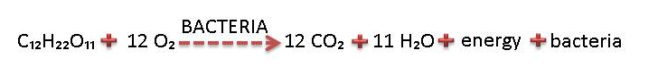
Biological Oxygen Demand (BOD)
This measures the level of Biological Oxygen Demand that the effluent will generate if released into the environment.
The BOD is measured in the laboratory by seeding a quantity of the effluent with bacteria and noting the oxygen consumption in milligrams oxygen per litre of effluent (mg/l).
However, biological processes are slow and it takes up to 5 days to measure the BOD, such as waiting period is of no use practically.
BOD measures the oxygen demand caused by substances degrading due to microbiological action.
Reaction:
342g sugar reducing requires 384g O₂
Approximate ratio - 1 part sugar: 1 part oxygen

Slide 9
Chemical Oxygen Demand (COD)
Here a sample of effluent is mixed with a quantity of H₂SO₄ (Sulphuric acid) and KMnO₄ (potassium permanganate) and the amount of oxygen used by the KMnO₄ is measured.
The COD is a measure of the “total organics content” i.e. degradable substances as well as the less easily degradable substances. COD results are available within hours.
The legal COD limit is 75mg O₂ per litre effluent.

Slide 10
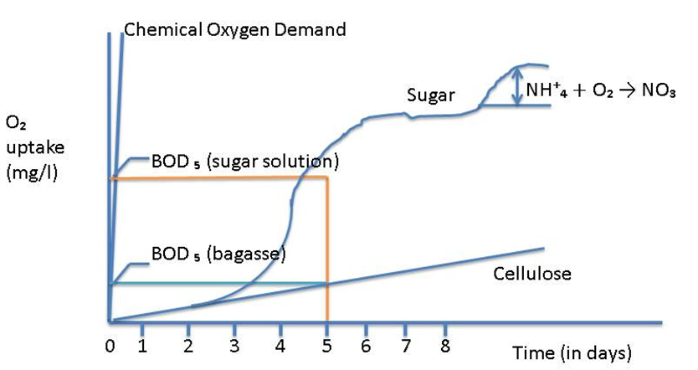
Chemical Oxygen Demand (COD)
Notice:
Rapid degradation of sugar (BOD after 5 days is high)
Relatively slow degradation of cellulose (BOD after 5 days is low)
Rapid increase in COD after a few hours

Slide 11
Sources of Pollution
Running losses occur continuously, to a greater or lesser extent.
Leaking joints and overflowing tanks are common examples.
Careful operation can all but eliminate running losses.
Cleaning losses occur only during cleaning operations.
Heater and evaporator scale are examples of this.

Slide 12
Sources of Pollution (cont.)
Running losses
Milling and Diffusion.
  Gutters should collect spillages and return it to process.
  Leaks must be attended to.
Clarification:
  Filter cake spills can be carried away in floor washings and overload the effluent plant.
Evaporation and Pan Boiling:
  Entrainment can contaminate the cooling water system, which could overload the effluent plant if some cooling water is bled off to the effluent plant.
Centrifugation:
  Leakages and overflowing gutters can be a source of pollution.

Slide 13
Sources of Pollution (cont.)
Running losses (cont.)
Drying:
  Sugar dust may not be a serious pollution hazard, but does represent a loss of pol.
Bagasse:
  Bagasse undergoes slow biological degradation.
Fly Ash:
  Scrubbers separate fly ash from boiler gases.
  Scrubber water (or smuts water) is high in suspended solids.
Lubricants:
  Drains from the crushing mills are the main sources of oil contamination.
Condensate:
  Though not of high purity, the high temperature is unacceptable.

Slide 14
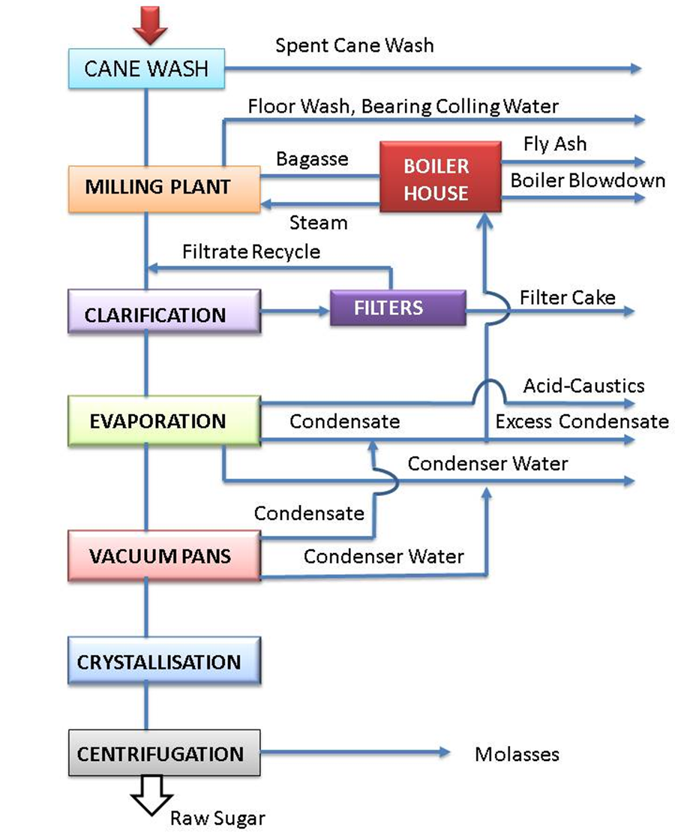
Sources of Pollution (cont.)
Simplified Waste water flow diagram for a raw sugar factory

Slide 15
Sources of Pollution (cont.)
Cleaning losses
Heaters:
  Scale can be handled by the solids disposal system, or the effluent plant.
Clarifier:
  Over long stops, stale juice may have to be dumped.
  Dumping should be spread over few days so as not to overload the effluent plant.
Evaporators, Pans and Boilers:
  When chemical cleaning is used, spent chemicals may be disposed of safely by being added very slowly to the effluent system.
  A specialist company must be used to handle hazardous waste e.g. Lead acetate waste from the laboratory and spent caustic soda from evaporator cleaning

Slide 16
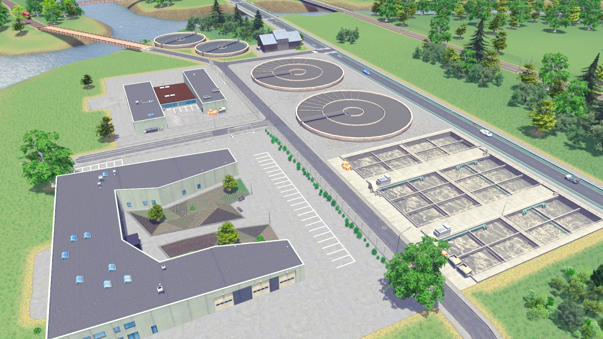
Dealing with Effluent
Irrigation
Using controlled degradation

Slide 17
Dealing with Effluent - Irrigation
When pumped onto fields as irrigation, sugar effluent is dispersed and its decomposition has no negative environmental impact.
Sugar effluent from an agricultural perspective only has value due to the water it contains – it has no nutritional value to plants.
Irrigation is a good method of effluent disposal, it cannot be used during rain when the fields are wet, since the effluent would simply run off into streams and rivers.
For this reason law requires a holding dam with 7 days capacity to be available.

Slide 18
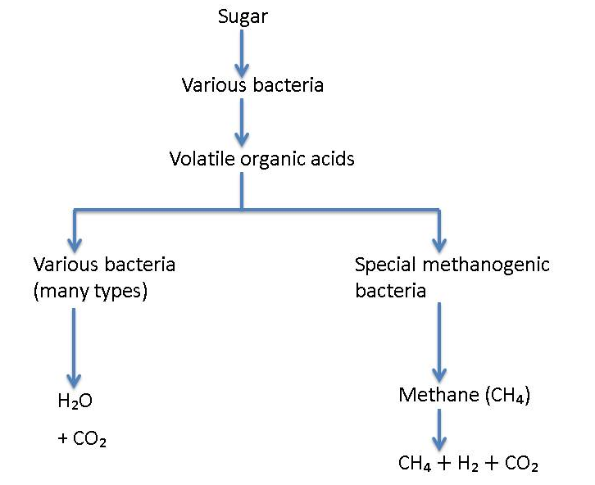
Dealing with Effluent – Controlled Degradation
Bacteria can be utilised to degrade effluent to a level that its BOD is so low that the effluent can be released into a river without causing harm.
This figure to the right clearly shows that once a sugar effluent has been decomposed to the acidic anaerobic (lack of oxygen) conditions only a few specialised effluent can reduce the bacteria into further harmless products.
Therefore the acidic partially decomposed effluent needs to be aerated so that it will readily decompose further.

Slide 19
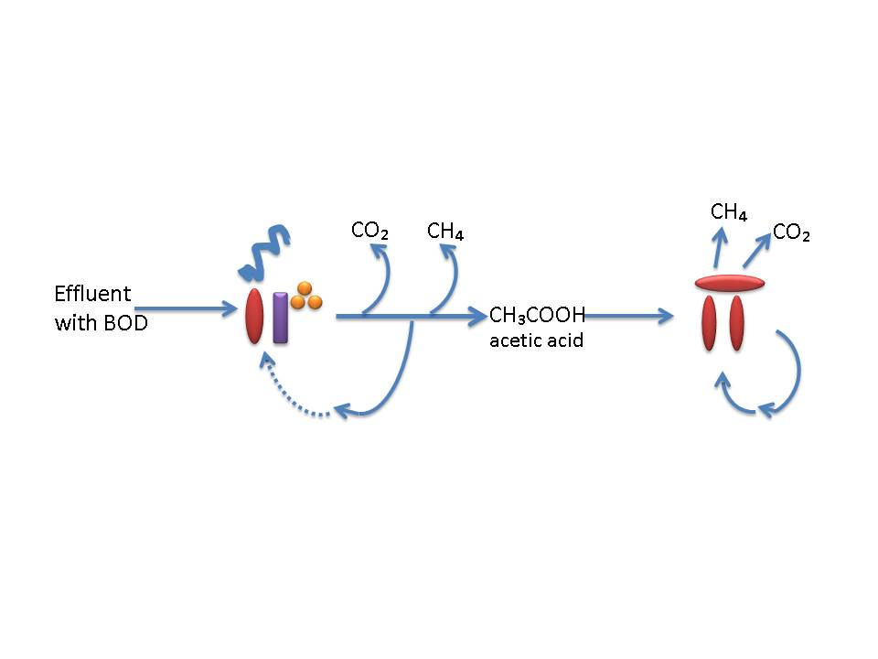
Anaerobic Digestion
Anaerobic digestion of effluent takes place in two stages.
  Bacteria first decomposes the effluent into Carbon dioxide (CO₂₎), methane (CH₄) and acetic acid.
  Specialised methanogenic bacteria then convert the acetic acid into methane and carbon dioxide.
If the effluent load is too big, the acidity increases to such a level that the second methanogenic decomposition step is inhibited and the whole process stagnates.
Using this process also requires a large volume of sludge to be maintained since the sludge contains the bacteria.
This is to protect and nurture the methanogenic bacteria that have a “long” doubling time.

Slide 20
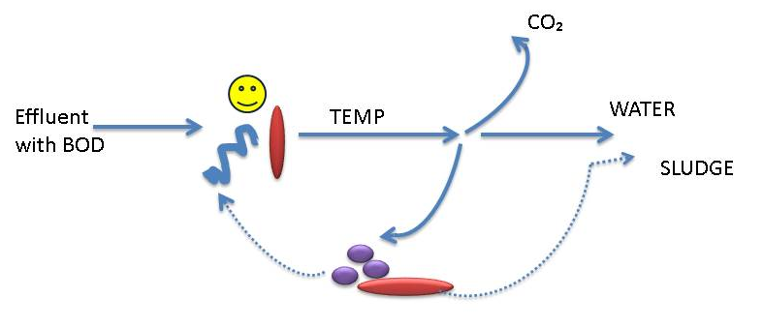
Aerobic Digestion
Involves oxygen consuming bacteria converting the sucrose in the effluent to carbon dioxide and water.
During aerobic digestion the bacteria multiply quite rapidly since these bacteria have a low “doubling time”.
The result is that a rich sludge forms that contains the bacteria.
In order to grow the sludge, nitrogen and phosphate must be added.
Oxygen is obviously essential and this is added to the water by mechanical aerators that “beat” the water surface.

Slide 21
Practical Effluent Treatment
Anaerobic Holding Dams:
Large holding dam into which the raw effluent is pumped.
Here bacteria readily decompose the effluent into acetic acid (CH₃COOH).
This overloads the anaerobic bacteria so that they are not able to cope with decomposing the acids.
The result is that the dam goes highly acidic and foul smelling.
We need to balance the system by continuously removing this acidic effluent, completing its decomposition into harmless products using aerobic bacteria.

Slide 22
Practical Effluent Treatment (cont.)
Anaerobic Holding Dams (cont.)
Removal of acidic effluent accomplished by pumping some of the acidic effluent to a trickling filter of a large tank packed with rocks.
Here aerobic bacteria grow and oxidise the effluent reducing the acid content.
Part of this is pumped back to the anaerobic holding dam to prevent it becoming too acidic and the rest acts as feed for the aerobic digestor.
The sludge that flakes off acts as a good feed stock for the aerobic digestor.
Anaerobic digestion is the cheapest method of treating effluent and it is capable of removing 60% of the effluent.
However, when overloaded only 5% of the effluent is decomposed.

Slide 23
Practical Effluent Treatment (cont.)
Anaerobic Holding Dams (cont.)
An anaerobic dam can take months to set up.
The effluent must be de-silted before being fed into the dam.
Since the anaerobic bacteria forms a sludge we do not want to de-silt the dam itself because this would result in a loss of bacteria.
To prevent the anaerobic dam from becoming overloaded the COD must be below 0.08 kg of COD per m³ of dam volume.
It is important to note that an anaerobic dam cannot deal with the effluent on its own.
The acidic effluent must be removed for further decomposition in an aerobic digestor.

Slide 24
Practical Effluent Treatment (cont.)
Aerobic Systems
Many bacteria are able to decompose effluent to harmless products if oxygen is present.
However for good effect these bacteria require a high energy input in the form of especially oxygen but also of nitrogen and phosphorus.
Systems include:
  Pasveer Ditches
  Activated Sludge Stirrer

Slide 25
Practical Effluent Treatment (cont.)
Aerobic digerstors - Pasveer Ditches
Aerobic digestors are usually in the form of a pasveer ditch.
This is a circular ditch in the form of a racetrack.
In a pasveer ditch the water moves around slowly “pushed” by the aeration disks that beat the surface.
The sludge containing the bacteria is carried in suspension.
Periodically some water is drawn off into a clarification zone, the sludge is settled and the treated effluent discharged.
The settling area is again flooded and the sludge returned to the system.
A brown colour indicates a “good” sludge that will settle well.

Slide 26
Practical Effluent Treatment (cont.)
  Aerobic digestors - Activated Sludge Stirrer
An activated sludge consists of micro-organisms that can oxidise (decompose) effluent.
Here the sludge is violently stirred in a tank thus keeping the sludge in suspension.
This system requires a separate clarifier for settling so that the sludge containing the bacteria can be returned to the tank.
The problem with these systems is that periodically the bacteria composition becomes such that the sludge will not settle.
The sludge is then lost with the discharged effluent.
This loss to bacteria greatly reduces the efficiency of the effluent treatment plant.
At times it is necessary to destroy all the unwanted bacteria by chlorination and to make a fresh start.
Turning off the aerators for 1 hour a day also tends to selectively destroy the bacteria that tend to float.

Slide 27
Combination (Ash Dam)
All new mills will employ a novel approach.
Here an “ash dam” needs to be created with alternate layers of sand and smuts (black).
Effluent is fed from the top, percolates through these layers and leaves at the bottom sufficiently digested for discharge into river or stream.
The top of the pile supports aerobic activity and the bottom anaerobic digestion.

Slide 28
Monitoring of Effluent Plant
To ensure effective effluent treatment the bacteria must be very active and must be kept within the system.
Several parameters need to be monitored:
  Mixed Liquor Volatile Suspended Solids (MLVSS)
  Sludge Volume Index (SVI)
  The food to micro-organism ratio (F:M ratio)
  Temperature
  Energy input
  Nutrients ratios
  COD Loading

Slide 29
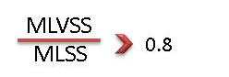
Monitoring of Effluent Plant (cont.)
Mixed Liquor Volatile Suspended Solids (MLVSS)
The MLVSS is that portion of suspended solids that consist of active micro-organisms.
For good performance 80% of the suspended solids (MLSS) must be organic (MLVSS).

Slide 30
Monitoring of Effluent Plant (cont.)
Sludge Volume Index (SVI)
The SVI is the volume in ml occupied by 1 g of activated sludge after settling for 30 minutes.
The SVI indicates how well the bacteria containing the sludge settle.
During bacterial decomposition of effluent, products are produced as well as more bacteria.
To keep the system functioning we need to keep some bacteria in the system.
Sufficient bacteria can be retained in the system if there are enough suspended solids for the bacteria to adhere to so that they will settle.
However, our bacteria do not contain many solids.
The bacteria thus tend to float and are lost with the discharge of treated effluent.
The SVI indicates how well the sludge containing the bacteria settles. This allows us to monitor the bacterial losses.

Slide 31
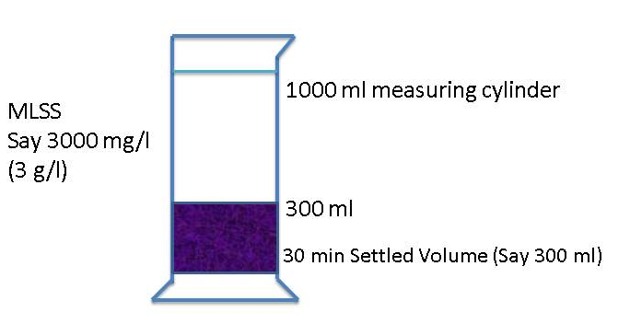
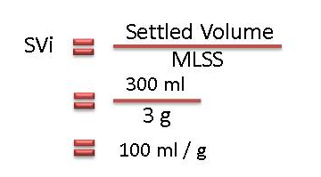
Monitoring of Effluent Plant (cont.)
Sludge Volume Index (SVI) (cont.)
The test is easy to perform.
1 litre of solution is taken and allowed to settle for 30 minutes.
The critical SVI is 120 ml/g, with the aim being 65 ml/g.
The SVI is thus the volume occupied by 1 g of sludge.
Dense sludge is more desirable because it settles well.
We thus seek to obtain a low SVI.

Slide 32
Monitoring of Effluent Plant (cont.)
Sludge Volume Index (SVI) (cont.)
Causes of a high SVI:
  Higher sugar content of the effluent
  Low pH
  High food: Microorganism ratio
  COD: Nitrogen: Phosphorus not correct
A bulking sludge is a voluminous sludge that carries over into the clear effluent discharged from the effluent plant.
This is highly undesirable as it constitutes a loss of bacteria.
Sludge with an SVI above 150 ml/g will probably result in bulking.

Slide 33
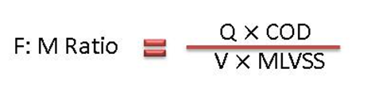
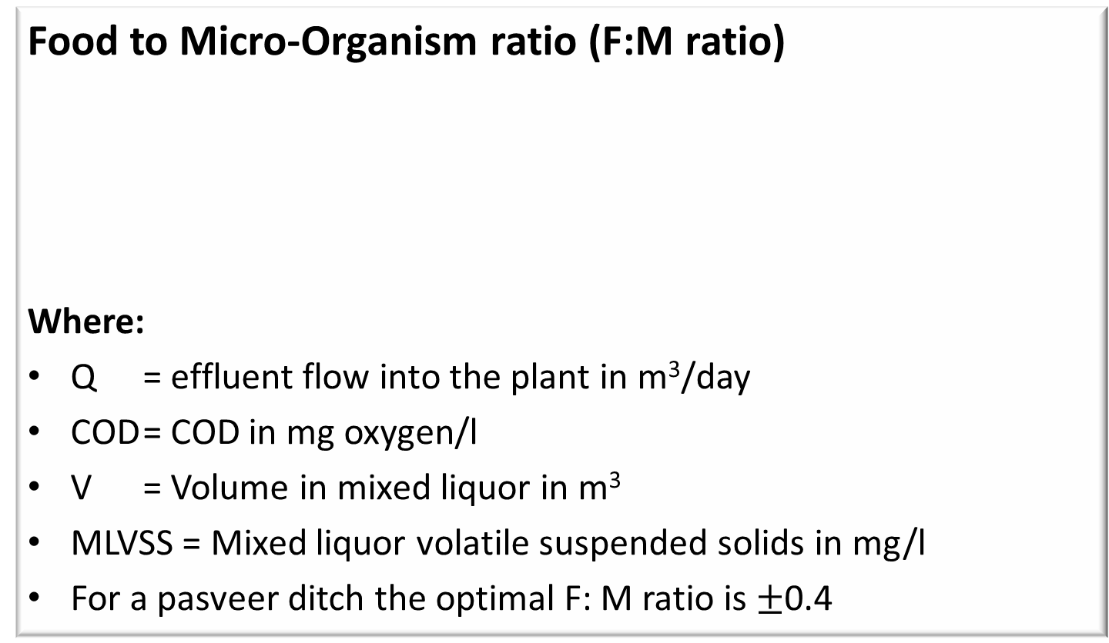
Monitoring of Effluent Plant (cont.)
Food to Micro-Organism ratio (F:M ratio)
Where:
Q = effluent flow into the plant in m³/day
COD = COD in mg oxygen/l
V = Volume in mixed liquor in m³
MLVSS = Mixed liquor volatile suspended solids in mg/l
For a pasveer ditch the optimal F: M ratio is $±$0.4

Slide 34
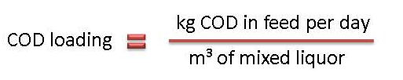
Monitoring of Effluent Plant (cont.)
Temperature
Temperature plays an important role. If it is too low the bacterial activity is impaired.
Energy input
The energy unit in the form of aeration is about 1 kWh for 1.5 to 2.4 kg of COD.
Nutrients Ratios
COD : Nitrogen : Phosphorous
100 : 0.6 : 1 for anaerobic digestion 1
100 : 2.00 : 0.4 for aerobic digestion
COD Loading
The COD loading is the ratio of COD in feed per day to the volume of mixed liquor.

Slide 35
Other Pollutants from Sugar Factories
Suspended solids:
  Not to exceed 25 mg/l
Soap, Oil or Grease:
  Not to exceed 2.5 mg/l
  Can be easily mopped up using bagasse as an absorbent.
Lead:
  Maximum concentration of 0.1 mg/l
  Lead acetate used as clarification agent in Mill laboratories.
  Cannot be discarded directly as the legal lead concentration would be greatly exceeded.
  Filter papers with the lead precipitate is collected in specially marked containers and disposed of via Wastetech.

Slide 36
Sewage Treatment
Sewage can be defined as water borne waste produced by a human community.
In S.A. sewage is piped through the sewage system to a sewage treatment works.
Rainwater is not allowed to mix with this system as this would enormously increase the load, especially in the summer months.
Factories not close to large municipalities will have their own sewage treatment works, often combined with their effluent treatment plant.

Slide 37
Sewage Characteristics
Omitting items like coins and cutlery and clothing (that inevitably get into the sewage system), domestic sewage contains about 1 g of organic matter per litre.
A small amount of mineral matter is present, coming mainly from pipe abrasion and (unwanted) stormwater.
Pollutants in sewage are found in three forms:
  Dissolved impurities:
  This is matter in true solution.
  Solid matter:
  Vegetable matter, faeces, paper, soil etc. are carried in suspension, most of it settling out in the sedimentation tank. This bottom sludge forms about 1% of the volume of the sewage and itself will contain 4% by mass of solids and 96% water (Compare this to underflow from a raw sugar clarifier).
  Colloidal matter:
  These are particles too small to settle out with the sludge.

Slide 38
Sewage Characteristics (cont.)
Quantity of sewage
The daily volume of sewage contributed per person varies widely from 100 – 300 litres.
The oxygen required for treating this sewage is 5.6 – 8.4 litres (or 5 times these volumes of air).

Slide 39
Sewage Characteristics (cont.)
Aims of sewage treatment
Make it hygienically safe
Eliminate bad smells and make it aesthetically pleasing
Make it safe for discharging to a river or dam with no resulting damage
Make it fit for reuse like irrigation, drinking, industrial purposes etc.

Slide 40
Basic Principles of Sewage Treatment
Modern sewage treatment relies mainly on processes that are carried out by living organisms called bacteria.
These processes occur naturally in streams, where pollution results only if the stream is over-loaded with waste.
In addition to biological processes, screening is carried out to remove solid material.
Treatment with chlorine is necessary to destroy disease causing bacteria that are found in large quantities in sewage.

