Slide 1
KNOWLEDGE COMPONENT: MODULE 10: SUGAR REFINING: KT 2: SUGAR REFINING TECHNOLOGY

Slide 2
Filtration
Filtration in refinery work differs considerably from the rawhouse.
In the rawhouse the underflow from the clarifier (mud) is mixed with a filter aid (bagacillo) and treated separately from the clarifier overflow (clear juice).
In the refinery, whole liquor (containing the precipitate) is forced through the cloth of a special filter.
The process is carried out at about 65% brix.

Slide 3
Filtration (cont.)
Precipitate deposits on the cloth and the precipitate itself serves as the filtering medium.
When the cake becomes too thick for easy passage of the liquor, it is de-sweetened and discarded.
The two most common filters are
  The Smith auto-filter (for use on carbonatation liquor)
  The plate and frame filter (sulphitation liquor).

Slide 4
Filtration (cont.)
Auto-filters with rotating leaves
A typical auto-filter consists of 56 leaves rotating in a horizontal tank of liquor.
A filtered liquor pipe connected to each leaf exits the ends of the tank, 28 on each side.
Each pipe has a glass section to enable the operator to check the condition of the filtered liquor.
The leaf is basically a rounded rectangle of metal, channelled on both sides.

Slide 5
Filtration (cont.)
Auto-filters with rotating leaves (cont.)
All the channels communicate with an outlet port on one edge.
An envelope of cloth covers the leaf entirely, except for the outlet port.
A rubber gasket seals the cloth in a groove running along the edge of the leaf.
During operation the leaf rotates; filtered liquor is forced through the cloth, collects in the channels and drains out through the outlet pipes.

Slide 6
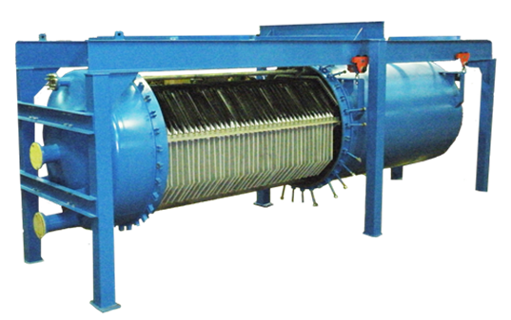
Filtration (cont.)
Auto-filters with rotating leaves (cont.)
Liquor becomes clear only after a layer of cake has formed on the clot.
Facilities exist therefore for separating cloudy liquor from clear liquor.
When the cake builds up sufficiently (after ±4 hours) it is sluiced out and desweetened in plate and frame filters.

Slide 7
Filtration (cont.)
Plate and frame filter presses
The plates and frames are rectangular, resting on two horizontal bars by lugs on their longer vertical edges.
During operation a hydraulically loaded ram squeezes the plates and frames together.
All the plates are channelled, and all channels communicate with outlet taps.
Two types of plates are found: liquor plates and water plates, and both types have cloths draped over their channelled surfaces.

Slide 8
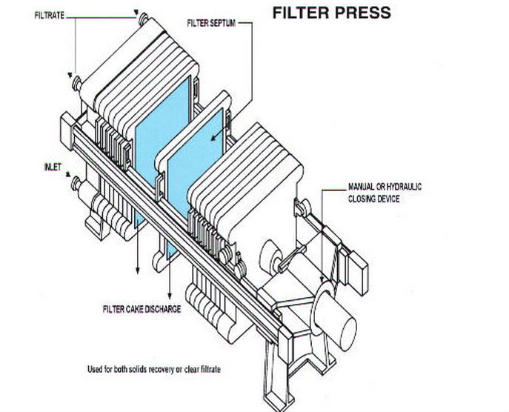
Filtration (cont.)
Plate and frame filter presses (cont.)

Slide 9
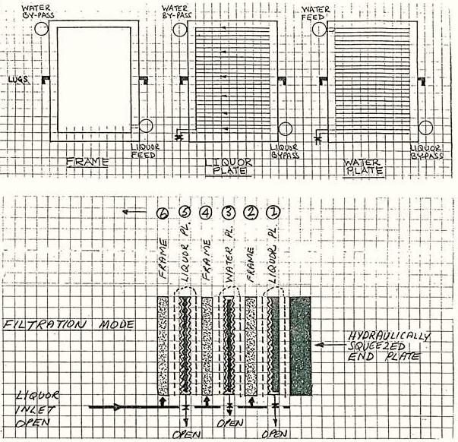
Filtration (cont.)
Plate and frame filter presses (cont.)

Slide 10
Filtration (cont.)
Plate and frame filter presses (cont.)
The frames (2,4,6,8 etc.) are rather like empty picture frames and simply form a space into which liquor is fed in at the bottom, and in which a cake layer will develop.
Filtered liquor passes through a layer of cake, through a cloth and enters the channels on the juice plate on one side and the water plate on the other.
Cake thus builds up from two cloth surfaces towards the centre.
From the channels the liquor exits through taps at the bottom of all the plates.

Slide 11
Filtration (cont.)
Plate and frame filter presses (cont.)
The liquor plates (1,5,9,13 etc.) have neither liquor nor water inlets and serve only to provide a channelled surface connected to an outlet tap to enable clear liquor removal (filtration mode) and sweetwater removal (washing mode).
Their by-pass ports allow water to feed adjacent water plates (at the top) and liquor to feed adjacent frames (at the bottom).
The water plates (3, 7, 11, 15 etc.) are similar to the liquor plates except for one vital difference; their channels can be fed with water from the top, in a direction counter to liquor flow.

Slide 12
Filtration (cont.)
Plate and frame filter presses (cont.)
This facility is used during cake de-sweetening.
The water plate thus serves a dual function; like the liquor plate it provides a channelled surface to support the cloth, but it also enables the cake to be de-sweetened.
During de-sweetening the outlet taps on all the water plates are shut to prevent short-circuiting.
The by-pass port at the bottom allows liquor to feed adjacent frames.

Slide 13
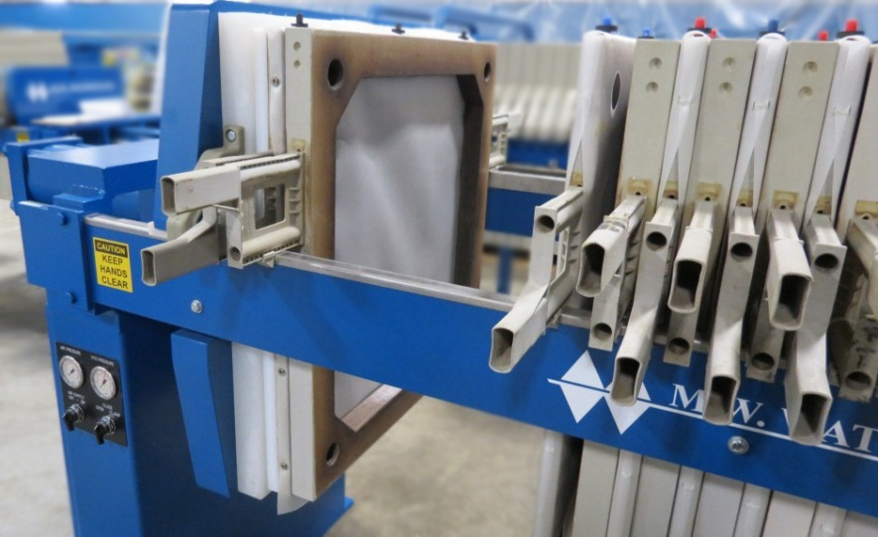
Filtration (cont.)
Plate and frame filter presses (cont.)

Slide 14
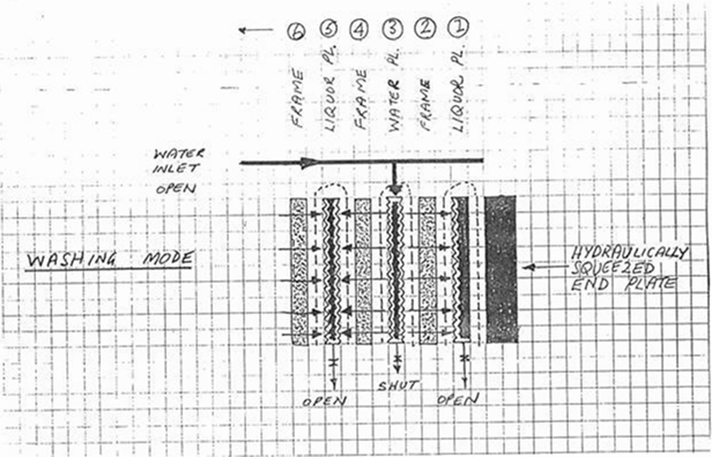
Filtration (cont.)
Plate and frame filter presses (cont.)
A plate and frame press in the washing mode.

Slide 15
Filtration (cont.)
Other filter types
Filtration technology continues to develop at a faster pace than other unit operations in the sugar factory.
The factory where you are employed may not have the types of filters described above
If this is the case you are encouraged to study your filter and write notes about it. Include basic diagrams.

Slide 16
Evaporation
Most purification stages in a refinery are carried out at about 60% brix.
Before crystallisation in vacuum pans the filtered liquor is concentrated to 70% brix, usually by double or triple effect evaporation.
Concentration in evaporators gives a steam saving and also reduces the boiling time in the pans, increasing pan capacity and saving energy.
Typical rawhouse evaporation runs at 85% on clear juice whereas refinery evaporation is merely around 14% on liquor depending on the brix increase required.
Vapour 1 is used as the heating medium, except in central refineries.
Some colour increase is inevitable during evaporation because of thermal degradation.
The liquor leaving the evaporators is referred to as white liquor, fine liquor or evaporated liquor.

Slide 17
Sugar Boiling
Boiling times in a refinery are much faster because the melt purity is much nearer to 100%.
However, conglomerates form easily and can cause problems in subsequent operations.
Higher purity liquors contain less impurities and hence have a lower electrical conductivity.
Conductivity is therefore not used to control white sugar pans.
Other techniques of measuring supersaturation, e.g. boiling point elevation, have to be employed.

Slide 18
Sugar Boiling (cont.)
Tube and plate calandria pans as found in the rawhouse are used, while pans with ribbon calandrias are also employed.
These use higher pressure steam but produce good circulation without the use of stirrers.
Establishment of grain by true seeding is near impossible as the various zones of supersaturation are extremely narrow.
Shock seeding, using varying amounts of powdered sugar, is carried out.

Slide 19
Boiling Schemes
Straight boiling
In this conventional system, (say) eight first strikes are boiled from liquor with about 47% of the brix in liquor remaining in the first run-off.
Four second strikes are produced from the first run-off, with 50% of the brix in the first run-off remaining in the second run-off.
Two third strikes are boiled from the third run-off, with 53% of the brix in the second run-off remaining in the third run-off.
One fourth strike is boiled from this run-off with 56% of the brix in the third run-off remaining in the fourth run-off.

Slide 20
Boiling Schemes (cont.)
Straight boiling (cont.)
The resultant blend of white sugar is thus made up of 8 parts first sugar, 4 parts second sugar, 2 parts third sugar and 1 part fourth sugar.
Although fourth sugar (and possibly third) may not on their own meet the colour specification, when blended in the above proportions no problem is experienced.
The fourth run-off, at purity of about 88% can be recycled to syrup (in a rawhouse) or can be used as a by-product.

Slide 21
Boiling Schemes (cont.)
Straight boiling (cont.)
An alternative scheme (practised by Hullet Refineries) is to boil further crops of crystals in the so-called “recovery house”, then remelt these crystals (after centrifugation) together with the incoming raw sugar.
Compared with the other boiling systems (see below), the straight boiling system has much more material in process as run-off must be accumulated for the next strike.
More equipment is needed as pans, run-off tanks, mixers and centrifugals have to be provided for each grade of strike.

Slide 22
Boiling Schemes (cont.)
In-boiling
In this system some first run-off is mixed with evaporated liquor and the first strikes are boiled from this mixture that consists of 60% evaporated liquor solids and 40% run-off solids. As no impurities leave the system, white sugar colour and ash continues to increase, this is allowed until the permissible limits are reached.
The run-off is then isolated and directed to rawhouse remelt and a new cycle commences.
In this system, the stock in process is minimal, as are the vessels required.

Slide 23
Boiling Schemes (cont.)
Back-boiling
Each pan is started on evaporated liquor and finished on 40% run-off from previous strikes.
This system differs from in-boiling in the point at which evaporated liquor enters the system.
Again, as no impurities are eliminated, colour and ash will increase.
As the colour limit is reached, run-off is accumulated and boiled into one “all syrup” pan.
This removes impurities from the system and a new cycle commences.

Slide 24
Boiling Schemes (cont.)
    Pan boiling: Review of crystallization theory
Review the following topics:
  Solution
  Sucrose solubility
  Effect of reducing sugars and ash on sucrose solubility
  Saturated solution
  Supersaturated solution
  Supersaturation co-efficient
  The three zones of supersaturation:
    The metastable zone
    The intermediate zone
    The labile zone
  The two basic ways in which crystals can be formed
    Primary nucleation
    Secondary nucleation

Slide 25
Boiling Schemes (cont.)
    Pan boiling: Review of crystallization theory
Crystals can be formed in a pan by:
  The waiting method
  Schock seeding
  True seeding
The two basic factors affecting the rate of crystal growth are:
  The diffusion rate
  The accommodation rate
The factors that affect the two rates of crystal growth are:
  Viscosity
  Temperature
  Supersaturation co-efficient
  Purity
The three factors that cause an increase in the boiling point of a sugar solution are:
  Brix
  Pressure above the liquid
  Hydrostatic head

Slide 26
Boiling Schemes (cont.)
    Pan boiling: Grain formation in refinery pans
In practise, varying quantities of slurry or sugar dust are added to the tightened fine liquor.
Whether this is true seeding (all crystals come from outside) or shock seeding (crystals are allowed to form spontaneously) is an argued point.
However, the more the number of added crystals, the more likely it is that the pan is being true-seeded.
The pan may be held on water for a few minutes to prevent conglomerate formation and to “harden” the crystal.

Slide 27
Boiling Schemes (cont.)
Pan boiling: Growth of the grain
In rawhouse work, this is carried out in two stages.
The first stage, in which crystals are grown on sucrose already in the mother liquor, is called “bringing the grain together”.
Because of the higher purities in refineries, bringing the grain together is a step rarely carried out.
Once the grain has been established, the pan is fed on liquor and crystal growth continues.

Slide 28
Boiling Schemes (cont.)
Pan boiling: Control of pans
(a) Boiling point elevation (BPE)
The temperature at the surface of a boiling massecuite is always higher than the temperature of water boiling under the same vacuum.
This is because of the brix in the mother liquor. As the SSC increases, the brix increases and so does the boiling point elevation.
Where this technique is used, a heated water pot is connected to the vapour space of the pan and two temperatures are measured: the temperature of the boiling water and the temperature of the massecuite.
An instrument computes the difference and this signal is used to control the feed valve

Slide 29
Boiling Schemes (cont.)
Pan boiling: Control of pans (cont.)
(b) Consistency
This term describes the combined effect of mother liquor viscosity and crystal content.
The current needed to turn a small impeller (in the massecuite) at constant speed is measured and varies with both viscosity and crystal content.
This reading is used for pan control.

Slide 30
Boiling Schemes (cont.)
Pan boiling: Control of pans (cont.)
(c) Radio Frequency Control
This is a recent development and consists essentially of measuring the electrical properties of a massecuite subjected to radio frequencies.
The electronics consists of a radio frequency generator, a probe and tuning circuit and a detector and amplifier that feeds signal to a control valve.
This technique can be used to measure crystal content and mother liquor brix simultaneously.
The probe is less affected by scaling.
The system is cheaper than nuclear density meters or refractometers and can be used to control syrup and molasses brix as well.

Slide 31
Boiling Schemes (cont.)
Pan boiling: Control of pans (cont.)
(d) Refractometer brix
A built-in pan refractometer is used to measure the brix of the mother liquor.
Like all the other techniques given above this too is an indirect way of measuring the SSC.

Slide 32
Drying and conditioning
Crystalliser and centrifugal work in a refinery are similar to rawhouse practise and will not be covered in detail.
The higher purities mean much shorter crystalliser retention times.
Refined sugar is produced exclusively by batch centrifugals because of the crystal breakage problem inherent in continuous machines.

Slide 33
Drying and conditioning (cont.)
Moisture associated with sugar crystals
Free moisture
This moisture is found in the sugar solution surrounding the crystals as they leave the centrifugal and is easily driven off in conventional dryers.
Inherent moisture
This consists of packets of sugar solution that have become trapped within the crystal during its growth.
Inherent moisture diffuses through the crystal at a very slow rate.
How much inherent moisture is driven off during conditioning is not known.

Slide 34
Drying and conditioning (cont.)
Moisture associated with sugar crystals
Bound moisture
In a sugar dryer the outer layer of free moisture is driven off, causing microscopic crystals to form in that layer.
This “skin” of crystals traps the remaining free moisture which is now referred to as bound moisture.
Caking of refined sugar occurs when this moisture migrates from hot to cold areas within the sugar mass.
Crystals dissolve wherever the moisture deposits, and when the moisture leaves, crystallisation again occurs.
This successive crystallisation knits the main crystals together causing the hardening referred to as caking.
During sugar conditioning it is bound moisture that is driven off.

Slide 35
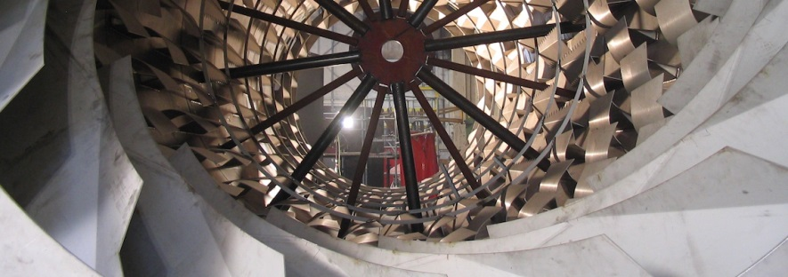
Drying

Slide 36
Drying (cont.)
Conventional drying using rotary louvre or fluidised bed dryers serves to remove free moisture, reducing the moisture content from around 1% (sugar leaving the centrifugals) to 0.1%.
VHP sugar dried in this way can be kept for years without significant deterioration.
Refined sugar, however, if transported over long distances or stored over long periods, will tend to cake because of the presence of bound moisture.
Removal of bound moisture is done by a process called conditioning.

Slide 37
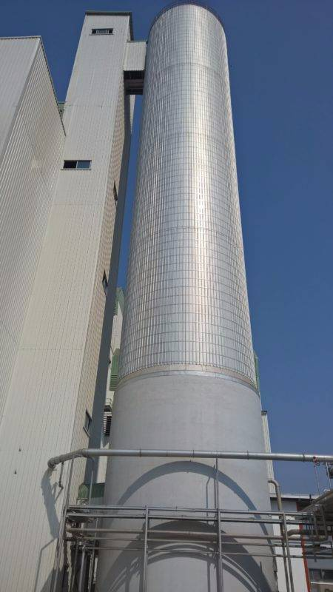
Conditioning
Conditioning is a longer and slower process than drying and consists basically of passing hot dry air through the sugar for about 40 hours.
The longer time is needed to allow movement of the moisture through the skin already referred to.
A typical conditioning silo may be 8m in diameter by 30m high. Sugar is introduced at the top and de-humidified air is blown in at the bottom.

Slide 38
Conditioning (cont.)
Air temperature is around 42°C at a relative humidity of 20%.
The moisture content of sugar entering the silo (dried sugar) is 0.1%.
Sugar leaves the silo at 0.045% moisture.
It must be noted that this is not oven-dried moisture as the moisture bound within the crystal is not released in an oven.
In the special procedure employed, the crystals are dissolved in formamide and the moisture content is measured by titration (This is the Karl Fischer method).
Conditioning silos are installed at Hullet Refineries, Noodsberg and Gledhow.
Conditioned sugar is transported in bulk to bottlers, canners and other bulk consumers both on the coast and inland.

Slide 39

Sugar as a Fire hazard
Any carbohydrates dust (sugar, flour, meal etc.) can burn and burn explosively.
Four conditions are necessary for an explosion to occur.
  The dust concentration must exceed 40g m³ of air (for a dust particle diameter of 0.08 microns).
  The air humidity must be below 60%.
  The oxygen content of air must be 10 – 125 (it is actually well above this).
  A source of ignition (electric or electrostatic spark, a cigarette, a naked flame etc.) of sufficient energy must be present.

Slide 40
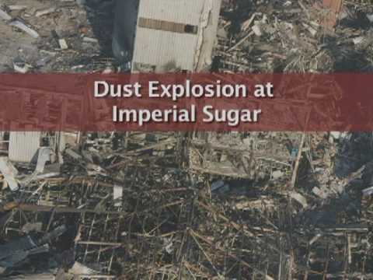
Sugar as a Fire hazard (cont.)
Operators working in areas where dry sugar is handled must
Be aware of the danger of dust explosions,
Be trained to use firefighting equipment
Always be alert for conditions that could cause an explosion.

