Slide 1
KNOWLEDGE COMPONENT: MODULE 10: SUGAR REFINING: KT 3: REFINERY BALANCE AND CALCULATION

Slide 2
Refinery Performance
It is difficult to arrive at accurate sucrose balances in high purity refinery products.
Impurity balances are often used to assess performance.

Slide 3
Yields based on Conductivity Ash
The impurity used is as measured by conductivity (CA).
CA is determined for all streams and reported relatively to brix (CA % brix).
The ash content stabilises from fine liquor onwards and is therefore useful in tracking crystallisation efficiency.
Two formulae are in use:
  Massecuite yield
  Overall refinery yield.

Slide 4
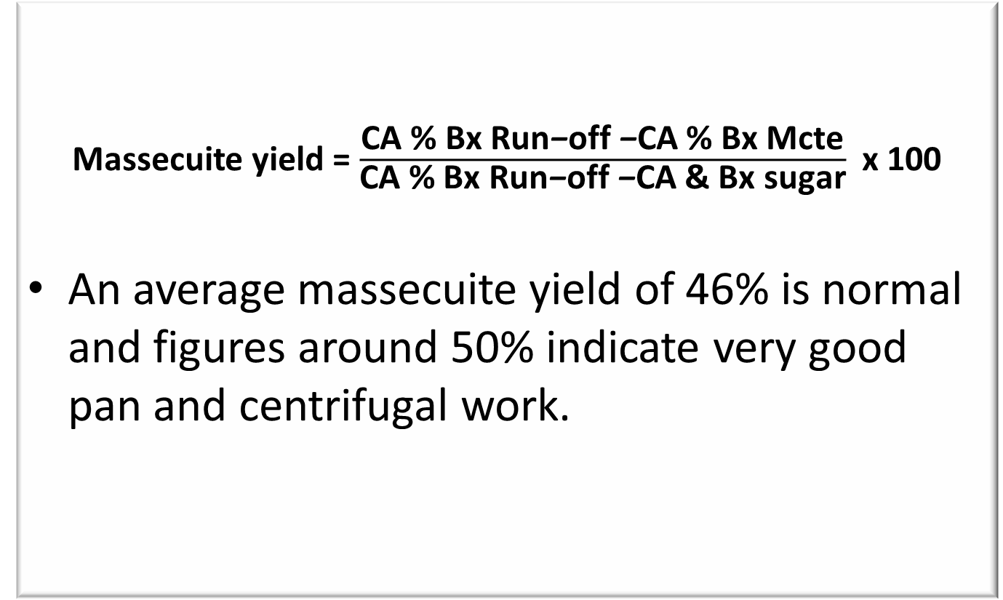
Yields based on Conductivity Ash
Massecuite yield = $\frac{\text{CA}\text{ \% }\text{Bx} \text{Run}\text{−}\text{off} \text{−}\text{CA}\text{ \% }\text{Bx} \text{Mcte}}{\text{CA}\text{ \% }\text{Bx} \text{Run}\text{−}\text{off} \text{−}\text{CA}\text{ \& }\text{Bx} \text{sugar}}$ x 100
An average massecuite yield of 46% is normal and figures around 50% indicate very good pan and centrifugal work.

Slide 5
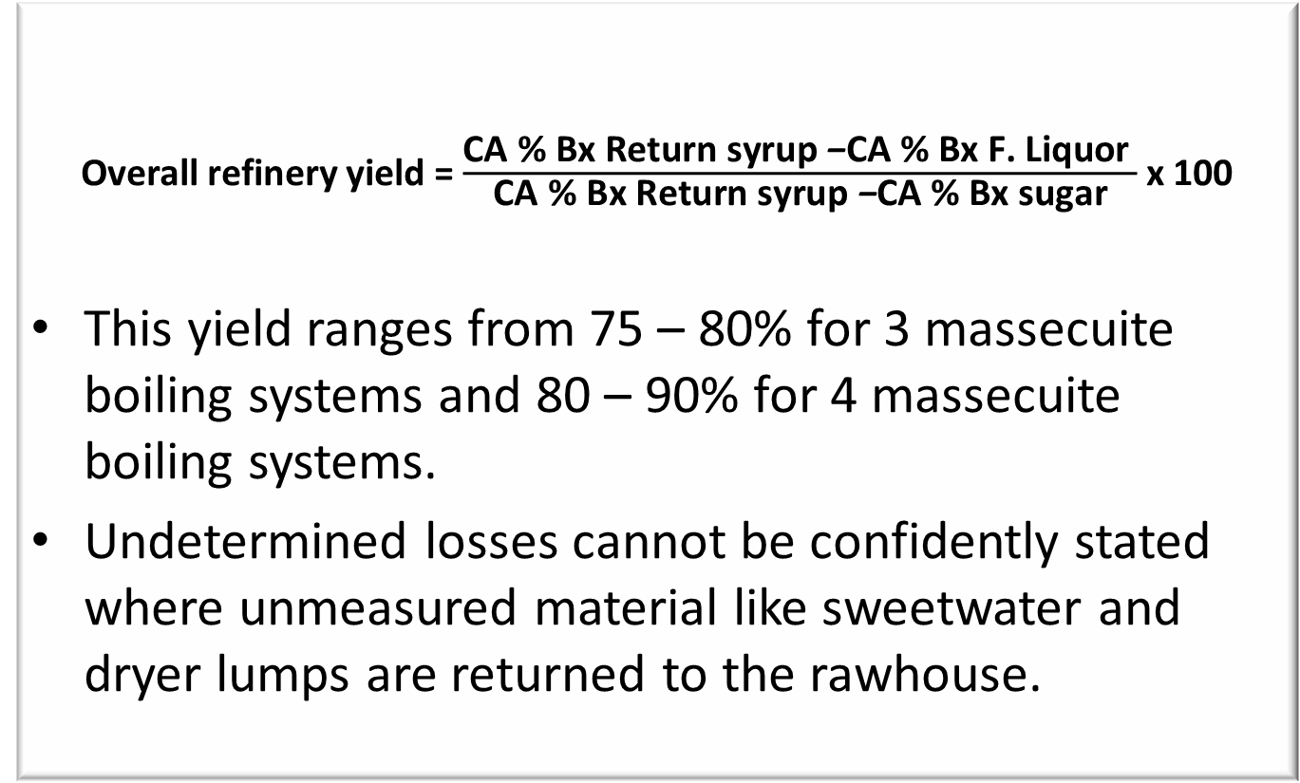
Yields based on Conductivity Ash
Overall refinery yield = $\frac{\text{CA}\text{ \% }\text{Bx} \text{Return} \text{syrup} \text{−}\text{CA}\text{ \% }\text{Bx} \text{F}\text{. }\text{Liquor} }{\text{CA}\text{ \% }\text{Bx} \text{Return} \text{syrup} \text{−}\text{CA}\text{ \% }\text{Bx} \text{sugar}}$ x 100
This yield ranges from 75 – 80% for 3 massecuite boiling systems and 80 – 90% for 4 massecuite boiling systems.
Undetermined losses cannot be confidently stated where unmeasured material like sweetwater and dryer lumps are returned to the rawhouse.

Slide 6
Sucrose and Colour Balances
An alternative scheme is to consider the yield of saleable product per unit of raw sugar processed.
Sucrose balances are done to account for the sucrose entering the refinery.
The balance involves:
  Inputs: Raw sugar, Other sugar
  Outputs: Refined sugar, Molasses and syrup, Speciality sugars
  Losses: Effluent, Filter cake, Packaging overweights, Condenser water
The overall yield is broken down into process and packing yields.
The process yield refers to how much product (refined sugar and others) could be produced from the raw sugar, the packing yield refers to the efficiency of the packaging of the sugar.

Slide 7
Sucrose and Colour Balances (cont.)
Refinery performance can also be assessed by colour balances.
A typical colour profile across Hullet Refineries is (figures are loss or gain in colour):
Melting | +15%
Carbonatation | -50%
Ion exchange | -60%
Evaporation | + 5%
Crystallisation | -92%

