Slide 1
KNOWLEDGE COMPONENT: MODULE 11: OPERATIONS MANAGEMENT: KNOWLEDGE TOPIC 1: GENERAL OPERATIONAL MANAGEMENT CONCEPTS

Slide 2
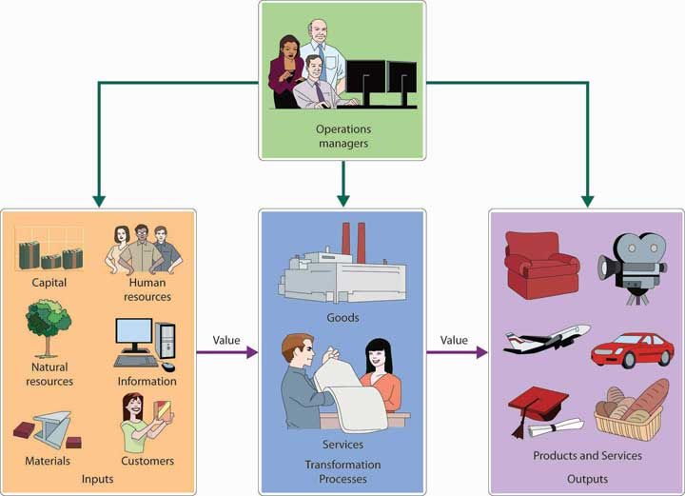
General Operational Management Concepts

Slide 3
Responsibilities of an Operational Manager
Planning and organising production schedules
Assessing project and resource requirements
Estimating, negotiating and agreeing budgets and timescales with clients and managers
Ensuring that health and safety regulations are met
Determining quality control standards
Overseeing production processes

Slide 4
Responsibilities of an Operational Manager
Re-negotiating timescales or schedules as necessary
Selecting, ordering and purchasing materials
Organising the repair and routine maintenance of production equipment
Liaising with buyers and marketing and sales staff
Supervising the work of junior staff
Organising relevant training sessions

Slide 5
Management Theories
Management theories are concepts surrounding recommended management strategies
Include tools such as frameworks and guidelines
Corporate structure refers to the organization of different departments or business units within a company.
Each of the departments usually performs a specialized function.

Slide 6
Planning
Planning provides the mode of operation to accomplish the objectives.
Planning involves selecting a particular strategy or course of action from among alternative courses of action
Planning can be defined as the determination of those future activities required to achieve the objectives.
Planning creates a framework for achieving specific objectives through the implementation and control of various production factors (or inputs) such as natural resources, capital and labour.
A plan must be developed before the manager can determine what kind of resources will be required to accomplish the goals.

Slide 7
Planning (cont.)
The components of planning include:
Determining and defining the objectives
Forecasting uncertainties
Specifying policy and procedures
Anticipating future problems and developing plans for unforeseen circumstances
Changing plans according to results of control task

Slide 8
Planning (cont.)
Planning is deciding in advance:
  What should be done
  How each task should be accomplished
  When the task should be done
  Who will be responsible for completing the task

Slide 9
Organising
Organising to implement the plan that has been developed in the planning process.
Implementation involves carrying out or putting into action the chosen plan.
Involves:
  Acquiring the personnel and other resources necessary to get the tasks done
  Organising the work load to complete the tasks on schedule
  Supervising and directing the accomplishment of the various tasks.
Implementation is more than the physical labour associated with getting the job done.
It also involves organising and directing the physical activities
Scheduling and organising are two elements of implementation.

Slide 10
Leadership
The functions of leaders
The leader must provide for the well-being of the led
Provide a social organization in which people feel relatively secure
Provide a set of beliefs

Slide 11
Leadership (cont.)
Characteristics of Leaders
Intelligence
Initiative
Self-assurance
Seeing the big picture
Other characteristics
(different from the characteristics required of Managers – but recommended)

Slide 12
Control
Involves measuring performance and correcting deviations from expected behaviour to ensure the accomplishment of the plans and achieving of the objectives.
Includes the management activity of record keeping
Includes comparing the actual outcome reported in the records with the projected budgets prepared during the planning process.
Taking corrective action if required.

Slide 13
Control (cont.)
Control is thus necessary for the following reasons:
Planning is often hampered by an uncertain environment and incomplete knowledge. Some of the assumptions made could easily be incorrect; therefore adjustments and modifications are often necessary.
Even if all planning data were basically correct, some of the objectives cannot always be achieved in full. The sooner these objectives are identified, the better.
Although everything may be going according to plan, the dynamic nature of the environment could result in a plan becoming outdated. Due to changing price ratios, other enterprises of the business may, for example, become more profitable.

Slide 14
Control (cont.)
Control consists of the following steps:
Establishing standards
Keeping the relevant records
Measuring performance against these standards
Correcting deviations from standards and plans

Slide 15
Production Reporting
Keeping records and providing documentary proof of:
  The quality
  The quantity of product manufactured
  Every day, week and the totals for each month.
Must be able to calculate the quantities and measure the qualities of product going into and coming out of each Sugar Processing step, until the final product is packaged.
Production reporting provides feedback :
  Management and
  Sales departments
  Sugar cane farmers

Slide 16
Production Reporting (cont.)
Each Sugar Mill will have its own Standard Operating Procedures on how this reporting needs to be done.
It will also have its own ways of how this information will be applied to improve performance, correct errors and increase efficiency.
Find out how this information is used
Understanding how this information is used will motivate you to provide accurate and consistent reporting to management.

Slide 17
Decision-Making
When a manager has to:
  Allocate or apportion limited resources (capital or labour),
  To several alternative uses,
  He/She is forced to make decisions
If decisions are not made, everything will grind to a halt.
Even leaving things as they are implies a decision; maybe not a good one, but a passive decision nevertheless.

Slide 18
Decision-Making (cont.)
The decision making process consists of the logical sequence of the following steps:
Identify and define problems or opportunities.
Gather and analyse relevant information, opinions and facts.
Identify and analyse alternative actions and solutions.
Make the decision – choose the best option.
Implement the decision.
Accept responsibility for the decision and its consequences
Evaluate the results of the decision.

Slide 19
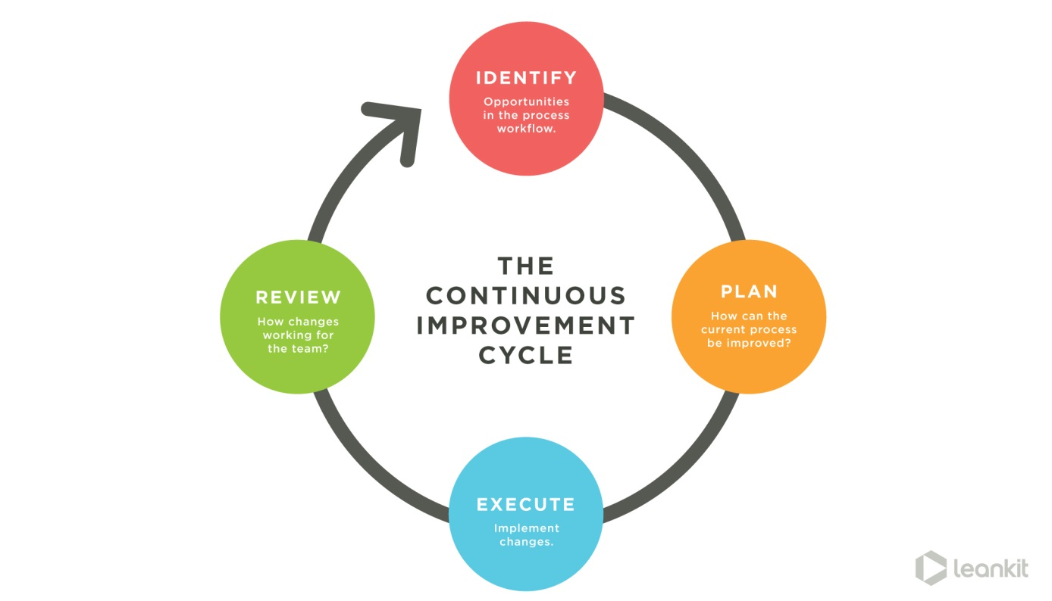
Continuous Improvement Models

Slide 20
Continuous Improvement Models
The ongoing improvement of products, services or processes through incremental and breakthrough improvements.
These efforts can seek:
  “Incremental” improvement over time
  “Breakthrough” improvement all at once.
Among the most widely used tools for the continuous improvement model is a four-step quality assurance method—the plan-do-check-act (PDCA) cycle, also known as the Deming Cycle or Shewhart Cycle:
  Plan: Identify an opportunity and plan for change.
  Do: Implement the change on a small scale.
  Check: Use data to analyze the results of the change and determine whether it made a difference.
  Act: If the change was successful, implement it on a wider scale and continuously assess your results. If the change did not work, begin the cycle again.
Some models
  Emphasize employee involvement and teamwork
  Work to measure and systematize processes
  Reduce variation, defects and cycle times

Slide 21
Delegation
Also called deputation
The assignment of authority and responsibility to another person to carry out specific activities
The person who delegated the work remains accountable for the outcome of the delegated work
Delegation empowers a subordinate to make decisions
It is a shift of decision-making authority from one organizational level to a lower one
Delegation, if properly done, is not abdication.
The opposite of effective delegation is micromanagement, where a manager provides too much input, direction, and review of delegated work.

Slide 22
Document Control and Administration
In any plan for improving efficiency or reducing losses, effective production control is important.
Many of the weaknesses of manufacturing units, such as:
  Excessive material stocks,
  Broken delivery promises,
  High non-productive time
  can be related to poor, or the absence of, production control.
Effective production control leads to increased output at lower costs.
The benefits of improved methods are often lost because of poor production control.

Slide 23
Document Control and Administration (cont.)
Record-keeping and reporting documents form part of operational management.
These differ from one Sugar Mill to the next.
A few examples of production documentation includes:
  Operator’s work record
  Job card
  Maintenance records
    Scheduled maintenance
    Emergency maintenance

Slide 24
Challenges of Operational Management
Operational managers must constantly strive to increase operational efficiency.
Operational Efficiency denotes the ability of a company to:
  Deliver products or services
  in the most cost-effective manner
  without hampering its high quality
Can also be defined by the ratio of input and output of a business operation.
If the operational efficiency improves in a business the ratio of output to input increases.
Streamlining the internal processes of a business can help in achieving the operational efficiency and it also enables the company to respond effectively to the ever-changing market forces in a profitable manner.

Slide 25
Challenges of Operational Management (cont.)
An operations manager can improve operational efficiency by:
  curtailing the waste and redundancy
  By influencing its human resources
An Operations Manager needs to know:
  His/her workforce,
  The technology being used and
  The business processes of the company
Constantly improving operational efficiency allows a company to gain higher profit by reducing internal costs and as a result become more successful in the competition outside.

Slide 26
Measuring Operational Efficiency
Operational efficiency can be improved by measuring it through the input and output ratio.
Often the management of a company measures the operational efficiency by measuring the input indicators only like:
  The man hours for a production, or
  Production cost per unit.
Though the input indicators are important but they must not be seen solely on the basis of indicators like unit production cost.

Slide 27
Measuring Operational Efficiency (cont.)
A company must track and define various indicators from both the input and output sides to measure the operational efficiency properly.
The efficiency of each process, or the entire factory process can be measured.
The efficiency measures of each Mill differ.
Determine which measures are important for your Mill and find ways of improving those ratios.

