Slide 1
KNOWLEDGE COMPONENT: MODULE 11: OPERATIONS MANAGEMENT: KNOWLEDGE TOPIC 2: EMPLOYMENT RELATIONS MANAGEMENT

Slide 2

Employment Relations Management

Slide 3
The Employment Relationship
The employment relationship is the legal link between employers and employees.
It is through the employment relationship, that:
reciprocal rights and
obligations are created
between the employee and
the employer

Slide 4

Legislative Framework
Some Acts of relevance:
The Basic Conditions of Employment Act, 1997 (Act No. 75 or 1997)
Employment Equity Act, 1998 (Act No. 55 of 1998)
Labour Relations Act, 1995 (Act No. 66 of 1995)
Skills Development Act, 1998 (Act No. 97 of 1998)
The Adult Basic Education and Training Act
The Agricultural Labour Act, 1993 (Act No. 147 of 1993)
Extension of Security of Tenure Act, 1997 (Act No. 62 of 1997)

Slide 5
Managing Workplace Discipline
Discipline in the workplace requires:
Rules,
Policies and
Procedures
That everyone agrees to follow
Discipline is necessary so that tasks are accomplished in an organised and structured manner.
If an employee decides to break any of the rules, or does not follow workplace policies and procedures and consequently causes loss of profit or harm to the enterprise, then disciplinary action may be required.
Every workplace should also have a disciplinary procedure in place, so that the problem can be sorted out in a fair and just manner.

Slide 6
Employee Code of Conduct
An Employee shall:
Perform his duties in a responsible and diligent manner
Protect and promote the interests of the company at all times to the best of his ability with due regard to the interests of management and his fellow employees
Obey and execute with due care and skill reasonable instructions which are given to him
Observe the company’s normal hours of work
Observe the safety rules and regulations prescribed by management and by law
Keep his vehicle, utensils, equipment and work place in a good, neat and tidy order and condition

Slide 7
Employee Code of Conduct (cont.)
An Employee shall (cont.):
Wear the prescribed clothing and safety apparel
Promptly report damage to the property of the company
Take all steps to ensure that no shortage in stock, materials or cash occurs
Change into working clothing before he clocks in
Be at his station of work at the commencing time of work
Report immediately to the production manager (and in his absence the general manager) any injury which occurs at the workplace.

Slide 8
Employee Code of Conduct (cont.)
An Employee shall not :
Commit any act or be guilty of any omission which undermines the industrial peace, growth or stability of the company or the maintenance and promotion of sound employee/management relationships
Absent himself from work without just cause
Report for duty under the influence of alcohol or drugs
Make use of drugs or consume intoxicating liquor whilst on duty or during breaks in the course of working hours
Use or be in unauthorised possession of a dangerous weapon
Willfully or deliberately damage or cause destruction to or attempt to damage or destroy the property of the company

Slide 9
Employee Code of Conduct (cont.)
An Employee shall not (cont.):
Embark upon or be involved in or conspire to commit any act of industrial sabotage or espionage
Absent himself from work without permission and in the case of absence on account of illness the failure to present a valid doctor’s or registered hospital certificate which certifies and justifies such absence
Commit or attempt to commit theft, fraud or forgery
Be in unauthorised possession of property of the company or any other person
Fight with or assault a fellow employee or attempt to do so
Use abusive or insulting language
Clock in any employee or allow an employee to clock in on his behalf
Change from working clothing before the sounding of the hooter in respect thereof.

Slide 10
Disciplinary Principles and Procedures
A company should have clearly defined principles and procedures that govern the disciplinary process and the sanctions involved
Formal and informal procedures should be established
Informal procedures include verbal reprimands for minor breaches by immediate supervisors
Formal procedures can include:
Written warnings
Final written warnings
Demotion, dismissal and summary dismissal norms

Slide 11
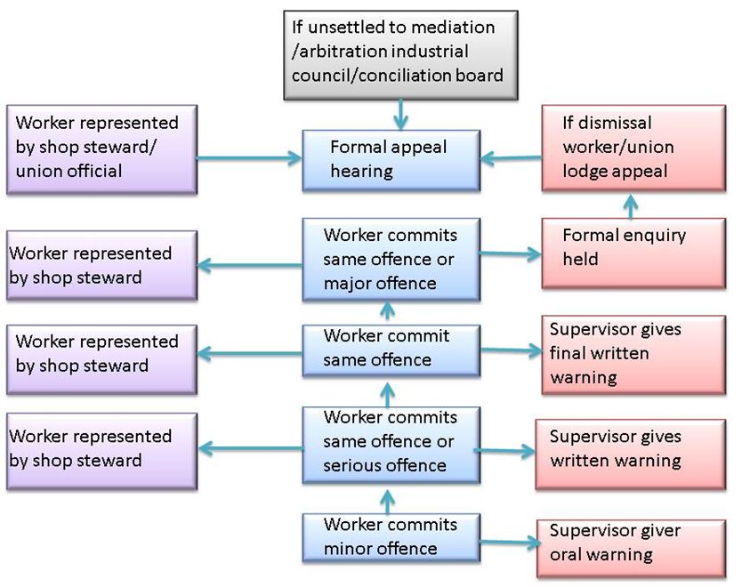
Managing Workplace Conflict and Grievances
A company should have clearly defined grievance principles and procedures
This assures employees that the employer is willing to listen

Slide 12
Managing Capacity Related Problems
Capacity management refers to the act of ensuring a business maximizes its potential activities and production output, at all times, under all conditions.
The capacity of a business measures how much companies can achieve, produce or sell within a given time period.
The age and condition of equipment has a direct effect on capacity, with older equipment usually reducing capacity (due to increased breakdowns and generally deteriorating performance).
Managers have to make decisions about the best time to replace equipment, generally balancing the costs of buying new equipment and continuing to operate older equipment.
These costs give a starting point for further analysis.

Slide 13
Managing Capacity Related Problems (cont.)
Very often the ability of an employee to achieve the capacity (work output) required is limited by their understanding of their job or because of a lack or limited skills to achieve this.
On many occasions this may be related to a change in technology and inadequate training to utilise this technology.
The best way of overcoming problems of capacity is by ensuring that employees are adequately trained for their tasks.
Training not only provides employees with the correct skills to undertake their tasks successfully, it also provides the employee with a sense of accomplishment and improves confidence.

Slide 14
Managing Capacity Related Problems (cont.)
If capacity problems exist because of shirking, insubordination or malice, then these issues need to be dealt with by following a disciplinary procedures as outlined before.
However, the root cause is often a lack of the necessary skills to do the job and this should first be investigated as a means of solving the problem.

Slide 15
Capacity Requirement Planning
Capacity planning can be undertaken in the following six steps:
Consider demand and translate this into a required capacity for the process (how much product can the process produce at maximum capacity? What factors will influence achieving this maximum capacity?)
Find the capacity already available in the process.
Identify mismatches between capacity needed and that available.
Suggest alternative plans for overcoming any mismatch (this may have to do with raw material inputs, logistics. technology available, labour skills, bottlenecks in the process).
Compare these plans and find the best alternatives
Implement the best alternatives and test the results.

Slide 16
Organised Labour
South Africa’s labour legislation is among the most progressive in the world, providing for institutions to settle disputes and ensure fairness in the workplace.
Labour legislation in South Africa is the product of extensive consultation between government, labour and employers, and has established institutions to nurture sound, co- operative industrial relations.
These institutions include:
Nedlac
CCMA
Commission for Employment Equity
Employment Conditions Commission
Productivity SA
National Skills Authority
Unemployment Insurance Board

Slide 17
Organised Labour - NEDLAC
National Economic, Development and Labour Council
Nedlac aims to allow inclusive and transparent decision making about labour issues.
Launched in 1995, it brings together representatives from all sectors of society who debate and try to reach consensus on social and economic policy issues in what the body terms “social dialogue’.
Funded by the Department of Labour, Nedlac’s work is conducted in four chambers:
The labour market chamber,
The trade and industry chamber,
The development chamber, and
The public finance and monetary chamber.
The chambers report to a management committee which oversees the work programme and administrative issues.

Slide 18
Organised Labour – NEDLAC (cont.)
The chambers report to a management committee which oversees the work programme and administrative issues.
Organised labour is represented in Nedlac by the three main labour federations:
The Congress of South African Trade Unions,
National Council of Trade Unions and
The Federation of Unions of South Africa.
There are 205 Trade Unions registered with the Department of Labour.
Each has a different purpose and membership.
The main aim of these trade unions is to ensure the fair and equitable treatment of their members in the workplace.

Slide 19
Organised Labour – CCMA
The Commission for Conciliation, Mediation and Arbitration (CCMA) was established in terms of the Labour Relations Act of 1995 as a dispute prevention and resolution body.
Although it is publicly funded, it is not controlled by any political party, trade union or business organisation.
Its policy-making structure is an 11-member governing body comprising three state representatives, three representatives of organised labour, three representatives of organised business, a chairperson and the director of the CCMA.
It replaced the Industrial Court.
The CCMA’s main brief is to:
Mediate to prevent and settle industrial disputes;
Conciliate workplace disputes;
Arbitrate disputes that remain unresolved after conciliation; and
Facilitate the establishment of workplace forums and statutory councils.

