Slide 1
KNOWLEDGE COMPONENT: MODULE 12: SAFETY, HEALTH, ENVIRONMENT, RISK AND QUALITY CONTROL (SHERQ): KNOWLEDGE TOPIC 3: CONTROLLING QUALITY

Slide 2
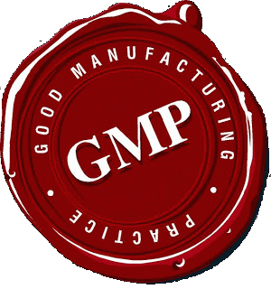
Quality Control Concepts

Slide 3
Quality Control vs. Quality Assurance
The terms "quality control" and "quality assurance" are not synonymous.
Quality assurance is meant to prevent problems
Quality control detects any problems that occur
Internationally recognized standards for both procedures come under the International Organization for Standardization (ISO standards).
Quality control describes a product-based approach rather than a process.
In a product life cycle, it comes after the product is made and before it is delivered to customers.
The quality control department checks that items conform to specific standards.
If changes are necessary, the quality control personnel state what is needed.
Compared with quality assurance, quality control is reactive, or corrective, in that it exists to identify defects and correct them.
Quality control is usually devised and supervised by engineers and inspectors, particularly in a manufacturing environment.

Slide 4
Good Manufacturing Practices
These guidelines provide minimum requirements that a food product manufacturer must meet to assure that the products are of a high quality and do not pose any risk to the consumer or public.
Good Manufacturing Practice guidelines provide guidance for manufacturing, testing and quality assurance in order to ensure that a food product (in this case) is safe for consumption

Slide 5
Good Manufacturing Practices (cont.)
GMP systems have the following general attributes:
Hygiene: The manufacturing facility must maintain a clean and hygienic manufacturing area.
Controlled environmental conditions in order to prevent cross contamination of product from other extraneous particulate matter which may render the product unsafe for consumption.
Manufacturing processes are clearly defined and controlled. All critical processes are validated to ensure consistency and compliance with specifications.

Slide 6
Good Manufacturing Practices (cont.)
GMP systems have the following general attributes:
Manufacturing processes are controlled, and any changes to the process are evaluated. Changes that have an impact on the quality of the product are validated as necessary.
Instructions and procedures are written in clear and unambiguous language. (Good Documentation Practices)
Operators are trained to carry out and document procedures.

Slide 7
Good Manufacturing Practices (cont.)
GMP systems have the following general attributes:
Records are made, manually or by instruments, during manufacture that demonstrate that all the steps required by the defined procedures and instructions were in fact taken and that the quantity and quality of the product was as expected. Deviations are investigated and documented.
Records of manufacture (including distribution) that enable the complete history of a batch to be traced are retained in a comprehensible and accessible form.

Slide 8
Good Manufacturing Practices (cont.)
GMP systems have the following general attributes:
The distribution of the product minimizes any risk to their quality.
A system is available for recalling any batch of product from sale or supply.
Complaints about marketed products are examined, the causes of quality defects are investigated, and appropriate measures are taken with respect to the defective product to prevent recurrence.

Slide 9
Control Measures
The control measures used to control risks in the sugar industry should be chosen according to their effectiveness.
The ‘hierarchy of control’ ranks the ways of controlling the risk from the highest level of protection and reliability to the lowest.
Duty holders must always aim to eliminate a hazard, which is the most effective control.
If this is not reasonably practicable, you should minimise the risk by working through the other alternatives in the hierarchy.
Several control options are often used in combination.
Personal protective equipment (PPE) is usually used in conjunction with other control measures.
Design controls involve the alteration of the work process or physical aspects of the workplace such as the equipment or the workstation.
Design controls are preferred as they are permanent and they can eliminate or minimise exposure to the risk factors.

Slide 10
Control Measures (cont.)
Design controls include:
Job design/redesign – altering the way a job is done or making changes to the work area, tools or equipment
Mechanical aids – providing mechanical aids to reduce the physical effort required by workers to do the job.

Slide 11
Control Measures (cont.)
Administrative controls focus on reducing the amount of time workers are exposed to a risk factor.
They are not preferred as they do not remove the cause of the problem, they may be forgotten under stressful conditions and they require ongoing supervision to ensure that they are used.
Administrative controls include:
  Work organisation – rotating workers, avoiding peaks in workflow, etc.
  Task-specific training – ensuring that workers are trained in their specific work including the use of tools or mechanical aids
  Maintenance programs – servicing and maintaining tools and lifting equipment on a regular basis
  PPE – providing PPE such as knee pads or gloves where needed.

Slide 12
Control Measures (cont.)
Develop and implement solutions that work by:
Finding and selecting the best control option. All control options should be considered, however design type controls are best. Interim controls may need to be chosen where permanent controls will take time to implement.
Implementing the chosen control. It is recommended that controls be tested prior to implementation where possible to ensure that they are suitable, and
Monitoring and reviewing the corrective measures to ensure they are working as planned and they have not created a new risk or problem.

Slide 13
Critical Control Points
Throughout this qualification emphasis has been placed on the quality requirements of the sugar product as it moves through the Sugar Mill or processing plant.
Every process has its own particular temperature, pH, pressure or viscosity (etc.) requirements which need to be maintained or met to ensure that the product will meet the desired quality requirements when it leaves a particular process.
Those parameters within a process which can have an irreversibly negative effect on the final product are identified as critical control points.

Slide 14
Critical Control Points (cont.)
Operators should pay particular attention that the parameters required by a particular process are kept within the recommended norms.
If these critical parameters are not adhered to there is a risk for:
  waste
  rework
  recall
Aside from the negative financial implication of spoilt product, there are also Health and Safety risks and Environmental risks (such as undue increase in pressure in a vessel, spillages due to leaking or bursting pipes etc.)

Slide 15
Quality Indicators at Critical Stages
The different steps of sugar production from cane are controlled by sampling and analyzing bagasse, juices, massecuites etc. and by observing readings of meters, gauges and recorders.
At the Milling train, for example, the steam pressure on and the revolution of the engines are recorded.
There are indicators which show the lift of the top rollers.
Juices from the first, second and last Mill are sampled and analysed.
Mixed juice is weighed and analysed.

Slide 16
Quality Indicators at Critical Stages
Of the juice heaters, the temperature is recorded.
Filter-cake is weighed and analysed.
Clear juice is also analysed continuously.
Of the evaporators the temperature of the juice and pressure of the vapour of all vessels is measured and the syrup concentration is checked.
Boiling is checked by means of conductivity, which is recorded for all the pans.

Slide 17
Quality Indicators at Critical Stages
Vacuum in the pan and steam pressure in the steam chest is measured.
All condensates are checked on sugar, as it is very dangerous to have sugar in the boiler feedwater.
There are a host of other meters in the factory and samples taken and analysed, which are not mentioned here.
One of the main duties of both day and night duty employees is the collection and analysis of samples for quality control.
Every operator is required to check the readings of the motors and gauges at his station regularly.

Slide 18
Quality Indicators at Critical Stages
For the Supervisor it would be impossible to perform their task of having the factory operate properly without meters, recorders, gauges and the laboratory.
These readings and measurements are recorded and reported by employees to supervisors continuously.
It is through these reports that quality can be monitored and maintained and corrective action taken when necessary.

Slide 19
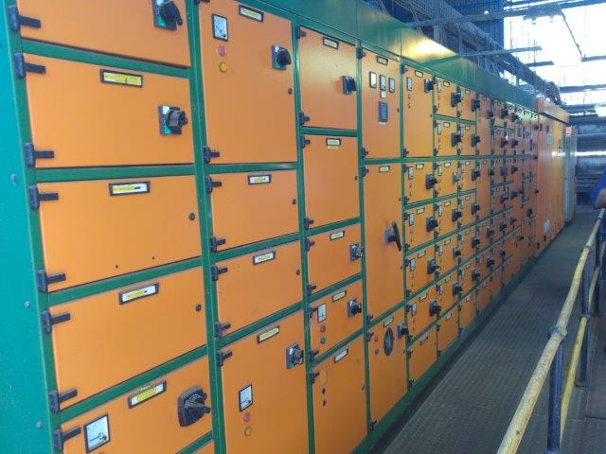
Quality Indicators at Critical Stages

Slide 20
Quality Problems and Remedial Actions
At each step of the sugar manufacturing process, quality must be managed.
Samples need to be taken and process parameters must be adhered to.
The sampling and process parameters differ for each process step.
The quality parameters of each process stage must be identified and adhered to.
You are invited to identify those quality guidelines for each of the other stages of the sugar manufacturing process.

