Slide 1
KNOWLEDGE COMPONENT: MODULE 12: SAFETY, HEALTH, ENVIRONMENT, RISK AND QUALITY CONTROL (SHERQ): KNOWLEDGE TOPIC 6: RISK CONTROL AND SAFETY PRACTICES

Slide 2

Risk Control

Slide 3
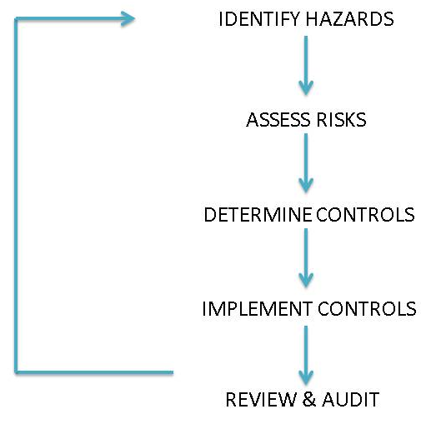
Risk Management
In recent years, OH&S legislation has moved from a prescriptive approach to one of risk management.
Essentially the risk management process can be represented as follows.

Slide 4
Risk Management (cont.)
Where exposure to machinery and equipment hazards cannot be eliminated or substituted for machinery and equipment of improved design, risk controls must be applied to the hazards to prevent or reduce the risk (chance) of injury or harm.
Workplace health and safety laws require the highest order control be applied.
Higher order machinery and equipment risk controls are preventative by nature, are effective and durable for the environment it is used in, and deal directly with the hazard at its source.
Lower order machinery and equipment risk controls, such as personal protective equipment (PPE), can prevent injuries, but are generally not as effective as higher order controls, as they rely more on worker behaviour, maintenance programs and supervision.

Slide 5
Risk Management (cont.)
Administrative controls use systems of work to reduce risk by providing a framework of expected behaviours. Examples are rotation of staff to reduce exposure to a hazard, or a documented safe system of work, such as ‘lockout tagout’.
These types of controls rely on extensive instruction, information, training and supervision.
In terms of time and ongoing administration by managers and employers to ensure the desired behaviour occurs, administrative controls can be the most expensive and least effective form of hazard control.
Note: The use of PPE and administrative controls are low or last order controls used to deal with any residual risk associated with the hazard. As such, these last order controls can be used in support of higher order controls that deal with a hazard at its source and should not be considered as the sole means of control. These types of risk controls require constant monitoring and reinforcement.

Slide 6
Risk Management (cont.)
There are four basic categories of warning and safety signs. The categories, their usage, colour and shape are shown below:

Slide 7
Risk Management (cont.)
Effective machinery and equipment risk controls reflect some or all of the following characteristics:
The hazard is controlled at its source
Contact or access to the hazard is prevented
Sturdy construction (correct materials with few points of potential failure)
Fail-safe (failure of the control system to be effective will result in machinery shut-down)
Tamper-proof design (as difficult as possible to bypass)
Presents minimum impediment to machinery and equipment operator
Easy to inspect and maintain
Does not introduce further hazards through the risk control action.

Slide 8
Equipment and Mechanical Safety
Mechanical hazards
Machinery and equipment have moving parts. The action of moving parts may have sufficient force in motion to cause injury to people.
When assessing machinery and equipment for possible mechanical hazards, consider:
Machinery and equipment with moving parts that can be reached by people
Machinery and equipment that can eject objects (parts, components, products or waste items) that may strike a person with sufficient force to cause harm
Machinery and equipment with moving parts that can reach people, such as booms or mechanical appendages (arms)
Mobile machinery and equipment, such as forklifts, pallet jacks, earthmoving equipment, operated in areas where people may gain access.

Slide 9
Equipment and Mechanical Safety
Mechanical hazards
Common mechanical hazards and associated risks for machinery and equipment are shown below.
Hazard | Risk
Rotating shafts, pullies, sprockets and gears | Entanglement
Hard surfaces moving together | Crushing
Scissor or shear action | Severing
Sharp edge – moving or stationary | Cutting or puncturing
Cable or hose connections | Slips, trips and falls (e.g. oil leaks)

Slide 10
Equipment and Mechanical Safety
Non-Mechanical Hazards
Non-mechanical hazards associated with machinery and equipment can include harmful emissions, contained fluids or gas under pressure, chemicals and chemical by-products, electricity and noise, all of which can cause serious injury if not adequately controlled.
In some cases, people exposed to these hazards may not show signs of injury or illness for years.
Where people are at risk of injury due to harmful emissions from machinery and equipment, the emissions should be controlled at their source.
When assessing machinery and equipment for possible non-mechanical hazards, consider how machinery and equipment can affect the area (environment) around them.

Slide 11
Unsafe Conditions
Faulty equipment such as machines, engines, pumps, vehicles, electrical apparatus and hand tools that could cause injury, and which in general, could have been corrected, create unsafe conditions.
Examples of unsafe conditions include:
Machines with unguarded pulleys, gears or other dangerous moving parts.
Slippery floors.
Sharp objects.
Unsafe storage.
Poor lighting.
Improper ventilation.
Noise.
If you see any hazardous conditions whilst doing your job, be sure to report it to your supervisor who will see that it is made safe.

Slide 12

Unsafe Acts
An unsafe act is that violation of a commonly accepted safety rule, which is sure to cause an accident or incident. Unsafe acts account for more than 80% of accidents and incidents.
Examples are:
Operating vehicles, tools or equipment without the necessary permission.
Working at unsafe speeds.
Making safety devices inoperative, or by removing machine guards.
Unsafe loading of vehicles.
Cleaning, adjusting or oiling moving machinery.
Failing to use personal protective equipment such as goggles, gloves, safety shoes, etc.
Most accidents CAN be prevented if everybody adheres to safety rules and takes care when the situation demands it.

Slide 13
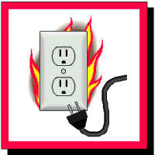
Basic Electrical Safety
The proper mixture of suspended sugar dust represents a potential explosive atmosphere that may result in a catastrophe.
The only missing ingredient is a source of ignition.
Any electrical equipment, that is improperly selected installed or maintained, can present that source of ignition.
Only electrical equipment that is specifically approved for use in atmospheres that may contain dust in explosive or ignitable mixtures should be used.
Electricity follows the path of least resistance.
The human body offers little resistance to electricity.
Electrical injury, including electrocution, can result from contact with electricity.

Slide 14
Basic Electrical Safety (cont.)
Even low voltages can cause serious injury or death, depending on the amperage and the path that the current takes through the body.
Electricity must be respected. Since a variety of electrical equipment is present in sugar plants, only qualified, certified electricians should install and maintain electrical equipment.
Such electrical equipment includes motors, controls, tools and lighting.
Employees without proper training and supervision by a knowledgeable person should not attempt to perform any electrical work.

Slide 15
Basic Electrical Safety (cont.)
Employees should:
Report broken or defective electrical equipment to their employer immediately; for example, broken conduits, exposed electrical conductors, missing covers or bolts in controls, and improper electrical equipment.
Reset a circuit breaker only once; if it trips a second time, consult a qualified electrician to determine the cause of the overload.

Slide 16
Basic Electrical Safety (cont.)
Employees should:
Do not bypass fuses; if a fuse blows, replace it with a fuse of the same (proper) size.
Do not use metal ladders around electrical equipment; use only nonconductive ladders, such as wood or fiberglass.
Ground all electrical equipment and systems properly.

Slide 17
Basic Electrical Safety (cont.)
Employees should:
Do not run extension cords under rugs, across walkways, through walls, etc.
Use extension cords rated for the service required.
Extension cords should be inspected before use for nicks cuts or breaks in the insulation; the ground prong on the extension cord should never be removed.

Slide 18
Basic Electrical Safety (cont.)
Employees should:
Electrical tools may provide a source of ignition and should not be used in ignitable or explosive atmospheres.
Electrical tools should be inspected before use for cracks in the housing or cord. Double-insulated electrical tools are preferred.
If you are wet or standing in water, never touch any electrical equipment.

Slide 19
Basic Electrical Safety (cont.)
Employees should:
Do not overload electrical circuits.
Stay away from power lines. Pay particular attention to moving equipment that may contact these lines. Remember that these lines are not insulated and current may arc to equipment that comes in close proximity to them.
Label electrical circuits and fuses to indicate the equipment they control.

Slide 20
Emergency Response
The purpose of an emergency plan is to prepare employees for anticipated emergencies, both natural and man‐made.
Natural disasters include: Fire, Flood, Storm, Earthquake, Tornado, Hurricane, Loss of Power or Water, and Gas Leaks.
The emergency plan should address both preparation and mitigation strategies as well as the response during a disaster and the recovery process after the disaster has passed.

Slide 21
Emergency Response (cont.)
Man‐made disasters are hazards resulting from human intent, negligence, error, or the failure of a man‐made system.
Examples include disasters from violent or criminal acts (active shooter, terrorist attacks) and chemical spills.
The emergency plan should address only the most relevant threats to a property.
It is highly recommended that all emergency plans are reviewed and vetted by local emergency service agencies, including those located on‐campus.

Slide 22
Supplies and Resources Checklist
An emergency plan should contain lists and contact details of the resources that need to be called on in an emergency.
Such lists can include:
Emergency services (Fire brigade, Police, Ambulance service, etc.)
List of supply sources and contacts (e.g. Maintenance contractors, building contractors etc.)
List of volunteer organizations active in disaster recovery
List of staff with specialized training (e.g. First AID, CPR, AED)

Slide 23
Buildings and Systems Checklist
Every area of the plant needs to have:
Fire sprinkler systems with…
Shutoff valves chained or locked open
Regular tests of inspector drains, fire pumps
Perimeter, entry security systems and locks
Protect against unauthorized entry to mechanical, electrical, sprinkler, generator rooms, fuel storage, chemical storage and other critical areas.
Fire alarm systems
Regularly tested
Off‐site monitored
Trouble signals and false alarms promptly corrected
If your fire alarm system communicates by a radio or other wireless signal, verify that the system communicates at 3G or 4G – 2G communication is being phased out by the wireless communication industry.

Slide 24
Communications Checklist
Consider installing communication boxes at areas of refuge that link the property directly to emergency services.
Annually test emergency lines to verify that they work and that emergency services have the correct location of the call.
Install a mass notification system (e.g. mass e‐mail or text message systems) that provides a timely means to notify all people in all the buildings of threats and give instructions as to responses.
Provide backup electric power (e.g., uninterruptible power supplies, backup generators) to run communications systems.

Slide 25
Communications Checklist (cont.)
Consider installation of a special panic alarm system in sensitive or critical areas.
Test systems regularly and train employees in the use of the various communications systems.
Have emergency communication equipment (e.g. special cell phones, emergency radios) available for use in the event that all primary communication channels are unavailable.
Train employees not to discuss sensitive information over communication channels that are not secure (e.g. cell phones).
Designate who is to contact whom within the building and with outside organizations.
Provide a contact list to all who might need it and keep the list up‐to‐date. Regularly test the notification protocol through drills and exercises.

Slide 26
Communications Checklist (cont.)
Develop a system to account for staff, occupants, tenants and contractors. Ensure that the information can be accessed offsite in the event of an emergency.
Provide occupants with information on how to report suspicious people or activities.
Develop a process for communicating to employees and occupants the current security situation and reminding them of steps that should be taken in the event of an incident.
Consider a contact information checklist to include owners, staff, tenants, law enforcement, other government agencies, hospitals, insurance providers, neighbors and emergency service contractors. For emergency service contact information checklists, include vendors in charge of electrical, Information Technology, elevators, generators, heating, air conditioning, plumbing, sewage, restoration companies, etc.

Slide 27
Emergency Supplies Checklist
Water.
Battery‐powered radio and extra batteries
Solar powered cell phone battery charger.
Flashlight and extra batteries
First Aid kit
Whistle to signal for help
Dust or filter masks, readily available in hardware stores, which are rated based on how small a particle they filter
Moist towelettes for sanitation
Wrench or pliers to turn off utilities
Plastic sheeting and duct tape to “seal the room”
Garbage bags and plastic ties for personal sanitation

Slide 28
General Preparedness Checklist
Establish a relationship with the local emergency authorities.
Locate the latest building plans, including Site, Architectural, Structural, Mechanical (HVAC and Plumbing), Electrical and major Improvements.
Store multiple copies of digital plans both on site and off site.
Consider “cloud” storage so that plans can be accessed from anywhere in case of local inaccessibility.
Plans will be essential for recovery activities.

Slide 29
Power Outage Preparation Checklist
If there is a history of outages, contact your electric service distribution utility and schedule a meeting with their customer relations representative to discuss the needs of your facility and what can be done to upgrade reliability.
Determine the critical loads in the building and investigate connecting them to existing emergency generators or consider installing a new one.
In addition to code required items and egress lighting, consider lights and receptacles in critical areas such as electric rooms, emergency operations posts, and management office; sewage lift pumps (if any); and one elevator per bank.

Slide 30

Dust Explosions
Any carbohydrates dust (sugar, flour, meal etc.) can burn and burn explosively. Four conditions are necessary for an explosion to occur.
The dust concentration must exceed 40g m³ of air (for a dust particle diameter of 0.08 microns).
The air humidity must be below 60%.
The oxygen content of air must be 10 – 125 (it is actually well above this).
A source of ignition (electric or electrostatic spark, a cigarette, a naked flame etc.) of sufficient energy must be present.

Slide 31
Dust Explosions (cont.)
Operators working in areas where dry sugar is handled must be aware of the danger of dust explosions, must be trained to use firefighting equipment and must always be alert for conditions that could cause an explosion.
The owner / operator of a sugar processing or handling facility is faced with choices in the safety measures that can be combined to meet the requirements of these Standards.

Slide 32
Dust Explosions (cont.)
One or more of the following approaches to safety must typically be employed:
Housekeeping Measures: Eliminate or minimize combustible dust accumulation by design or controlled operating procedures.
Equipment Grounding & Appropriately Rated Electrical Systems: Eliminate or minimize the build-up of static electricity and periodically inspect that such measures remain effective, combined with the use of electrical systems designed for the hazardous area in which they are applied
Equipment Venting: Discharge the products of combustion to atmosphere safely.

Slide 33
Dust Explosions (cont.)
One or more of the following approaches to safety must typically be employed:
Equipment Isolation: Introduce barriers to flame propagation that can prevent a primary dust explosion from amplifying into a typically much more severe secondary event.
Equipment Suppression: Prevent the development of a dust explosion by detecting its earliest stages and extinguishing its progress by the injection of an appropriate quenching agent
Spark Detection: Optically detect the presence of hot particles in a pneumatic air flow or conveyor belt before they reach process equipment within which they become a source of ignition

Slide 34
Dust Explosions (cont.)
The following types of process equipment are typically found where sugar dust is processed or handled:
Filters / Dust Collectors
Vertical Conveyors (e.g. bucket elevators)
Horizontal Conveyors (e.g. belt conveyors)
Silos, Bins & Hoppers

Slide 35
Dust Explosions (cont.)
Where sugar dust and air are mixed together in a confined space, the consequences of a dust explosion are the greatest.
Filtration equipment handling a combustible dust almost certainly contains a hazardous concentration of material under normal operating conditions.
Other items of equipment may only temporarily carry a ‘combustible load’ of hazardous material, perhaps during start up, shut down, loading or unloading.
However, while that combustible load is present, the risk is no less severe.
If the potential for a combustible load cannot be eliminated, protection measures are required.

Slide 36
Dust Explosions (cont.)
Typical sources of ignition
Dust Cloud Ignition Sources
High Probability of Occurrence | Low Probability of Occurrence
Hot bearings | Electrical
Welding and cutting | Static electricity
Belt slippage and misalignment | Lightning
Foreign objects caught in machinery | Metal and stone sparks
 | Spontaneous combustion

Slide 37
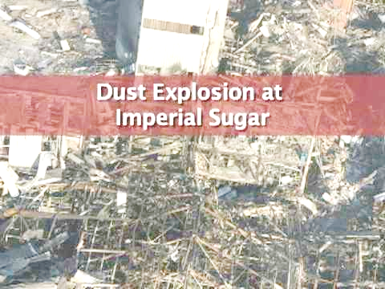
Dust Explosions (cont.)

Slide 38
Fire Risks
A fire or an explosion can have serious consequences for your company:
Injury and loss of human life
Damage to machines, transport facilities and storage space
Production interruptions
Loss of income
Repair / Replacement costs due to damaged machines
Loss of customers

Slide 39
Fire Risks (cont.)
Fire and explosion protection in the sugar industry
Sugar dust is highly explosive and requires good extraction systems and explosion protection.
The drying, cooling and conveying processes hold a high risk of fire.
Hot work (Welding and/or cutting operations)
A source of fires in mills is hot work or welding operations.
Hot work, by definition, means work involving electric or gas welding, cutting, brazing, or similar flame producing operations.
Since hot work has both fire and explosion potential, sugar mill employers must pay particular attention to welding, cutting and brazing.
Except under those conditions that require that hot work be conducted inside the facility, hot work should be conducted outside the facility.

Slide 40
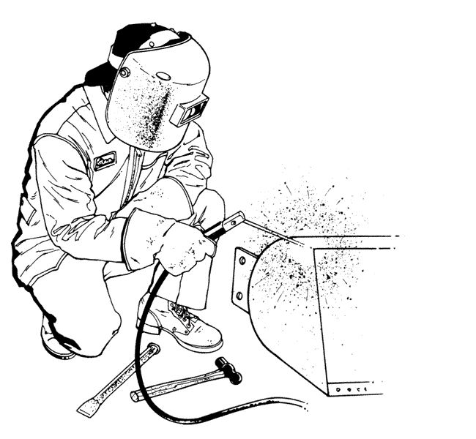
Fire Risks (cont.)
When hot work must be conducted at your mill, enforce these important rules:
Hot work is only performed by qualified artisans.
Ensure that a hot work permit is completed before any hot work commences and is signed off once the work is complete and the area deemed safe.
Keep welding or cutting equipment clean and in good operating condition.
Sweep floors clean for a 35-foot radius from the hot work operation; wet down combustible floors or cover them with an approved fire-retardant material.
Watch for fire in the hot work area for at least 30 minutes after the hot work is complete.
Supply the firewatcher with a standby fire extinguisher.

Slide 41
Fire Risks (cont.)
When hot work must be conducted at your mill, enforce these important rules (cont.):
Keep equipment on which hot work is being performed:
Cleared of all combustible materials
Protected by shields in flammable areas
Purged of all flammable vapor
Remove combustible materials from the opposite side of all heat-conducting materials receiving hot work.
Use approved shields to protect all combustible materials in hot work areas.
Close off all spouts, conveyors and elevator legs so that slag and sparks do not fall into other locations.
Use metal containers to catch molten metal from welding or cutting.
Maintain proper oxygen pressure when cutting to reduce the production of extra sparks and slag.

Slide 42
Access and Movement Control
The need for access control in any manufacturing facility is acknowledged.
Access control systems can be as basic as key entry systems or as complex as facial scanning.
The obvious benefit of access control systems is to limit the entry of unauthorized intruders or personnel into areas in which they are not allowed.
Access control assists to protect a business against damage and theft, protects employees from harm and provides a deterrent to acts of sabotage or malicious intent.
It is especially important to ensure that people, with no knowledge of the dangers of the factory, should be kept out of the manufacturing area.

Slide 43
Access and Movement Control (cont.)
Manufacturing enterprises have the further challenges of ensuring safe arrival and storing of parts and raw materials, secure manufacturing processes, protection against theft and casualties, and reliable delivery of finished goods to ensure customer satisfaction.
Controlling access to and within the site and protecting information and automation systems from breaches is also essential.
Physical or digital security lapses, whether accidental or malicious, can cause significant damage, particularly when those lapses harm personnel, the equipment or environment, or compromise quality.

Slide 44
Reasons for Access Control
Keeping a record of who is coming and going: Controlling your employee, vendor, visitor, and maintenance staff access.
Control access to highly secured areas or dangerous areas. For manufacturing facilities this means different areas of the manufacturing facility might need different security access in order to keep unauthorized people out. Examples include raw materials and parts inventory, work-in-process (WIP), staging areas, cleaning areas, inspection areas, testing areas, finished product areas.
You may need to keep out or provide limited access to cleaning people, vendors, employees from specific areas and fired employees.
Access is monitored. With some keyless entry systems, each authorized user can be assigned a specific code with which to gain access. Also, keyless entry systems provide a log so you can see who gained access to a secure area and when.

Slide 45
Access to Confined Spaces
The Sugar Mill factory consists of a range of vessels (bins, silos, tanks, evaporators), some of which require human entry for their maintenance and cleaning.
Entry into any confined space is hazardous because these spaces may contain harmful substances or represent oxygen deficient environments or there may be a bridging condition or a build-up of product on the sides which could fall and bury an employee, known as engulfment.

Slide 46
Access to Confined Spaces (cont.)
Most fatalities suffered by employees who have entered bins, silos or tanks, resulted when:
Employees entered bins, silos or tanks without authorisation (entry into confined space permit)
Employees entered bins, silos or tanks without proper personal protective equipment.
Employees entered bins, silos or tanks without following proper safety procedures.
Employees were in bins, silos or tanks while product was flowing and equipment was running, and were sucked under the product.
Employees were in bins or silos and fell through bridged areas (see the figure below).

Slide 47
Access to Confined Spaces (cont.)

Slide 48
Access to Confined Spaces (cont.)
No employee should ever enter bins, silos or tanks under a bridging condition.
Similarly, no employee should enter bins, silos or tanks where a build-up of product on the sides of the confined space could fall and bury the employee.
Product stuck to the sides of bins, silos or tanks should always be dislodged from above.
If a boatswain’s chair is used, it should never be positioned so that collapsing product could engulf the employee.
Before allowing entry into any confined spaces, the procedure for entering of confined spaces must be complied with at all times and a permit completed for each entry.
Similarly, all vessels should be checked for a person inside, before man-holes are closed and put into operation.

