Slide 1
KNOWLEDGE COMPONENT: MODULE 13: MECHANICAL MAINTENANCE: KNOWLEDGE TOPIC 2: PRINCIPLES OF PREVENTATIVE MAINTENANCE

Slide 2
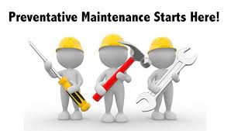
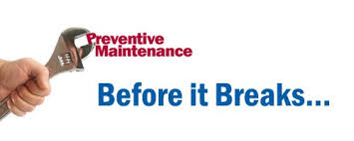
Preventative Maintenance

Slide 3
Aims of Preventative Maintenance
Preventative maintenance programs aim to prevent equipment failures before they occur.
Maintenance is regularly planned and performed on a piece of equipment while the equipment is still working, so that it does not break down unexpectedly.
Implementing a successful preventive maintenance program can be time consuming and costly, but the rewards are well worth the effort.
Planning involves thinking in terms of:
  what you see,
  what you are expected to do,
  what you know,
  what you have,
  what you are able to do,
  your interpretation and
  finally taking action.

Slide 4
Planning Principle 1
It is very important that the role of the planner/scheduler is identified to be independent of the other activities going on within a plant or facility.
Responsibilities of the planner/scheduler should include:
  Planning emergency work
  Acting as a relief supervisor
  Becoming a material expeditor
  Working on tools
  Becoming a “go-for” for the maintenance / operations supervisor

Slide 5
Planning Principle 2
A planner must focus on:
  Arranging current and future maintenance work,
  Allocating the appropriate resources, parts, finances, costs, and reliability information for each project.
  Emphasizing constant improvement for:
    Planning,
    Doing,
    Checking, and
    Acting on or adjusting schedules

Slide 6
Planning Principle 3
When implementing different components of your preventative maintenance schedule take advantage of the ISO Standards of relevance to your equipment, factory and industry for best practice tips and ease of compliance.
These standards may include guidance regarding work order histories, equipment registry, parts registry and more.

Slide 7
Planning Principle 4
Once tasks are identified, an important principle of maintenance planning is to ensure all instructions are documented and standardized.
The best planners have experience estimating time and comparing actuals of work done in bite size chunks in order to bring efficiencies into the next iteration of carrying out preventive maintenance.

Slide 8
Planning Principle 5
Sometimes it’s not best to reinvent the wheel for all pieces of equipment.
Planners should take advantage of standard plans and manufacturer’s guidelines and enhance them.
Plans will also take into account and recognize the skills of technicians and help determine whether manufacturer’s technicians rather than internal technicians should be used.

Slide 9
Planning Principle 6
Take advantage of data from past work to properly estimate appropriate and accurate plans for the future.
This will make maintenance time more available and the more maintenance time available, the more maintenance activity can be performed.
  Measuring how much time technicians actually spend on the job site versus other activities determines the effectiveness of the maintenance planning program: (Obtaining parts or tools, etc.).
  Delays are not part of a technician’s job and should be avoided.
  Sampling maintenance time periodically can be used to measure how effective planning can be.
  Use this as a metric to determine how effective your maintenance team is and look for ways to improve performance when gaps emerge

Slide 10

Scheduling Principles
If your organization is failing to plan, then you’re planning to fail. Maintenance planning and scheduling is a systematic approach to optimize efficiencies while maximizing work performance, and the most critical element to ensuring proactive maintenance.

Slide 11
Scheduling Principle 1
To set realistic goals and schedules, the planner/scheduler must look at the appropriate resources for the work to be performed and then estimate the hours and effort it will require.
To manage this process and avoid roadblocks, try to plan to the lowest required skill level available and work upwards.
If you work the opposite way, organizations may end up in a situation where skills are available, but the sort of work available is not appropriate for the priority level skill element.
As a best practice, at the beginning of a project, identify skills for:
  Persons
  Work hours
  Duration of work

Slide 12
Scheduling Principle 2
For the most effective scheduling, identifying job priorities in order of importance.
Determine what this measure of importance is – it could be:
  most downtime first (then lesser cost next),
  highest loss of profit first (then less profit loss next),
  lowest cost first (then higher cost next),
  highest safety impact first (then least impact on safety next),
  highest danger first (then less dangerous next), etc. as relevant.
Better yet, a weighting and scoring matrix could be used to prioritise using ALL these indices working with parties from management, sales and production.
Such prioritization is useful in terms of getting everyone to understand the importance of maintenance and its impact on the mill.

Slide 13
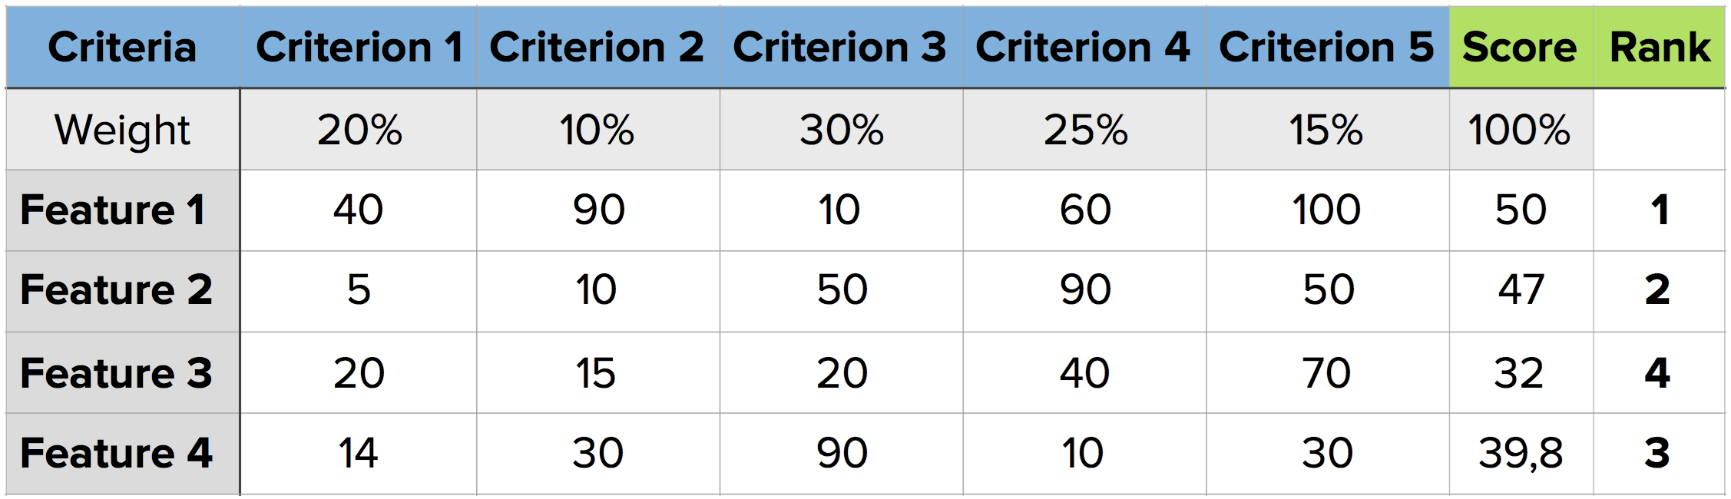
Scheduling Principle 2 (cont.)
An example of a decision-making matrix

Slide 14
Scheduling Principle 3
Scheduling from forecasts of the maintenance required helps to increase productivity.
If the work orders are generated 10 days in advance, then more details can be put into the scheduling.
These details include the resources required, the availability of parts, and the work to be done.
Consider what jobs can be put together, what jobs can be grouped, what condition monitoring work is outstanding and can it be bundled, and any proactive work that can be done in advance.

Slide 15
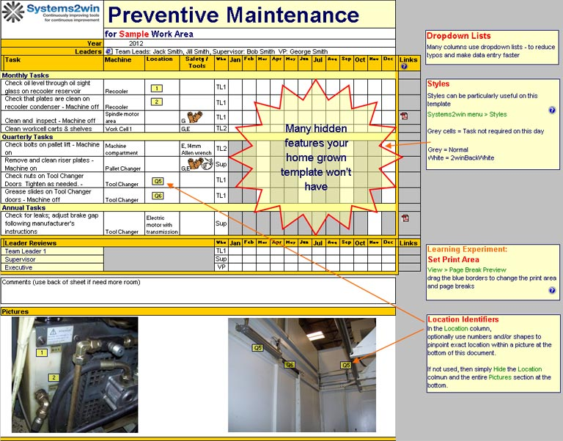
Scheduling Principle 4
To help set up an organization’s maintenance team for success, scheduling work for every hour available is a good rule of thumb, and allows for organizations to achieve practical goals.
Use scheduling software for this purpose if available.

Slide 16
Scheduling Principle 5
When it comes down to daily activities, the planner/scheduler should leave the detail of the planning and scheduling to a crew leader or technician supervisor.
With proper training, these crew members can use the plan and take advantage of their own functionality to realign the resources based on their priorities for the day.
This should be easy enough if the planning and scheduling is proactive, but knowing that potential emergencies and urgent activities might interrupt the day, there is still a chance that it can be done if 80-90% of the day is planned out.

Slide 17
Scheduling Principle 6
In order to keep employees engaged, begin measuring performance by analysis of scheduled success.
This measure avoids supervisors feeling the calculation gives an unfair poorer-than-actual view of their performance, and offers the crew any benefit of any doubt.

Slide 18
Principles of Preventative Maintenance
Designing and later on implementing a good PM program is one of the most challenging areas of maintenance management.
Very often, a significant part of the maintenance resources are wasted on inefficient tasks.
One of the main reasons is due to the fact that business owners are not using all the data coming from the equipment and providing valuable insight into their assets’ health.
Some of them don’t know how to use it or are simply overwhelmed.
Storing and analyzing the information coming from the equipment regularly is a great way of measuring the performance and evaluating both the strengths and the weaknesses of the facility.

Slide 19
Principles of Preventative Maintenance (cont.)
Another challenge is the lack of standards and direction, leading to longer time intervals between preventive interventions and resulting in equipment damage.
To have everything running as smoothly as possible, everybody should know his or her role.
A preventative maintenance plan can optimize the time of your maintenance staff and improve internal communication by encouraging technicians to provide and share on the platform feedback from their inspections.

Slide 20
Principles of Preventative Maintenance (cont.)
The following principles will help you ensure that your preventative maintenance program is set up and ready to identify potential problems before becoming a serious issue.
Planning
Discipline
Equipment Maintenance History
Preventative Maintenance Training

Slide 21
Principles of Preventative Maintenance (cont.)
Planning
Planning is one of the pillars of preventive maintenance.
When tasks are efficiently scheduled, delays between maintenance jobs are minimized and maintenance resources are maximized.
Scheduling maintenance tasks and creating a preventative maintenance management plan will list maintenance labour hours, materials, technicians and reasons for each work order.
This information can be used later on for reports for the establishment of overall improvement strategies.

Slide 22
Principles of Preventative Maintenance (cont.)
Discipline
The second pillar of an effective preventative maintenance programme is discipline.
Discipline means that the organization should stick to planned maintenance and reinforce the quality of maintenance work.
Collecting valid fault data is one of the preconditions for the establishment of an effective preventive maintenance system.
Therefore, to successfully implement preventive maintenance, it is important to have sufficient data on the failures to be evaluated.
When production deadlines are approaching, equipment utilization rates are high and interventions on machines may be difficult.
Furthermore, the objective of a preventative maintenance program is the regular inspections where access to equipment is scheduled in a timely manner.
Therefore, a good preventive maintenance program requires discipline and support of all involved teams to coordinate availability and create time for equipment inspection.

Slide 23
Principles of Preventative Maintenance (cont.)
Consider Equipment Maintenance History
As mentioned before, all data related to previous failures is of crucial importance for the creation of a preventative maintenance program.
Previous incidents, the type and operation of the machine, and the manufacturer’s recommendations should be considered when defining the type and frequency of the maintenance.

Slide 24
Principles of Preventative Maintenance (cont.)
Preventative Maintenance Training
Preventative maintenance training encourages autonomous maintenance and ensures that all machine operators and maintenance technicians are familiar with basic maintenance practices such as:
  lubrication of various crucial components,
  oil changes,
  cleaning,
  functional checks and
  repairing of some issues.

Slide 25
Reasons for Preventative Maintenance
Save Money
Unplanned downtime caused by equipment failure can cost a fortune in lost production revenue, not to mention emergency repair costs.
From paying technicians overtime to the cost of overnight parts delivery, everything is more expensive in an emergency especially when a production line goes down.
A preventive maintenance program is simply good business.

Slide 26
Reasons for Preventative Maintenance (cont.)
    Maximize Efficiency
Regular equipment maintenance optimizes operations so you can run at maximum efficiency.
Keeping your equipment running at optimal potential increases uptime, enhancing production while reducing costs.
Poorly maintained equipment uses a lot more power, resulting in increased energy costs that add up over time.
Well-maintained equipment also reduces scrap (waste, redo, recall) produced by machinery that’s operating at a sub-par performance level.

Slide 27
Reasons for Preventative Maintenance (cont.)
    Prolong Equipment Life
Predictive maintenance programs result in longer lasting, better-performing equipment.
According to Plant Engineering’s survey, aging equipment is the leading cause of unscheduled downtime.
Regular maintenance protects your investment and improves both your equipment’s lifespan and performance.
More efficient, effective equipment translates to higher profits.

Slide 28
Reasons for Preventative Maintenance (cont.)
    Reduce Maintenance Costs
Reactive maintenance is widely thought to be anywhere from 2 to 5 times more expensive than preventive maintenance.
Over a period of time, regularly scheduled maintenance minimizes breakdowns and makes for much quicker, easier repairs when issues do arise.
It’s simply smarter to replace components that wear down before they fail.
Preventing problems before they occur is always going to be less expensive than equipment failures.

Slide 29
Reasons for Preventative Maintenance (cont.)
    Improve Safety and Reliability
Poorly operating machinery can create hazards and unsafe working conditions.
Dulled and warped edges on equipment with grinding gears can be dangerous.
Regular maintenance inspections ensure that faulty equipment doesn’t cause injury.
And when your equipment is in safe working order, your employees stay safe as well.

Slide 30
Reasons for Preventative Maintenance - Summary
A successful preventive maintenance program improves the performance and safety of your company’s valuable assets.
Equally important, regularly scheduled maintenance helps you avoid unplanned downtime.
A preventive maintenance program can help you earn a reputation as a reliable partner in the Sugar Processing Chain.
Putting this proactive strategy in place goes a long way to helping you complete projects on time and deliver products without delay.

