Slide 1
KNOWLEDGE COMPONENT: MODULE 1: OCCUPATIONAL SAFETY, HEALTH AND ENVIRONMENTAL PROTECTION: KT 3: SUGAR PROCESSING SPECIFIC HEALTH, SAFETY AND ENVIRONMENTAL PROTECTION CONCEPTS

Slide 2

Feed Mill Risks - Electrical
Electrical risks in a sugar plant includes:
  Operation of plant around electrical lines and parts
  Electrical work
  Use of electrical equipment
  Failure of electrical equipment
Pay particular attention to:
  Exclusion zones
  Level of competency as regards electrical work and exclusion zones
  Level of authority as regards exclusion zones
Control measures include:
  Training
  Work procedures
  Authorised and instructed person
  Auditing

Slide 3
Feed Mill Risks – Electrical (cont.)
Ways to reduce electrical risks include:
Ensuring work does not encroach into the exclusion zone
Ensure there is a safety observer (or spotter) who’s job is to watch the worker and their equipment and warn them if they begin to get close to their exclusion zone around the power lines, and to keep people away from the area at ground level where falling items (e.g. branches etc.) may land.
Ensuring all injuries, electric shocks and near misses are reported.
The use of ‘tiger tails’ on power lines which act as a visual aid that assists in preventing contact by highlighting the location of the power line.
Limiting or warning devices to assist in preventing objects entering the exclusion zone.
Allowing for sway and sag of the overhead lines (sway is usually caused by wind and sag occurs when the temperature of the line fluctuates).

Slide 4

Slips, Trips and Falls
Can be caused by:
  Poor design
  Damage
  Poor lighting
  Poor weather conditions
  Poor housekeeping

Slide 5
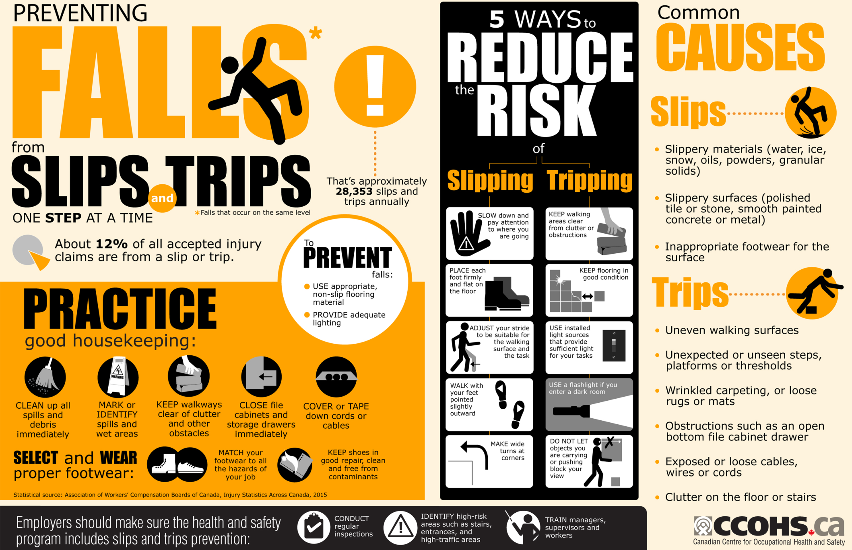

Slide 6
Slips, Trips and Falls (cont.)
Control measures include:
  Regular housekeeping inspections
  Maintenance (e.g. repair of leaking pipes, joints and vessels)
  Adequate lighting
  Barricading – short and long term
  Loss of sugar product reduction programs (e.g. dust, molasses, liquor and juice leaks)
  Regular floor repairs
  Replacement of flooring in susceptible areas with non-concrete materials
  Identification of hazards with appropriate markings.

Slide 7

Falling Objects
Sugar Mills are multi-level structures
When assessing the risk of falling objects, assess:
  The type of work being conducted
  What equipment is being used
  The number of people using the area below
  Whether special provisions are required for specific work (e.g. hot work)
  How far an object might fall and what the object might be
  The consequences of being struck.

Slide 8
Falling Objects (Cont.)
Control measures include:
  Establishing exclusion zones to prevent unauthorised persons from accessing high risk areas (this can be done by using barricading)
  Using catch nets or platforms
  Using lanyards
  Specifying pathways for workers and others
  Using head protection (e.g. helmets).
  Note: Helmets are a personal protective control measure only and guidance should be sought from the appropriate agencies as to what level of protection their helmets offer from falling objects.

Slide 9
Falling Objects (Cont.)
Remove the risk of being hit by moving objects (both plant, rolling stock, or falling objects), by separating people from these by using:
  Overhead walkways
  Yard fencing
  Underpasses
  Exclusion zones.
Other control measures include:
  Providing training
  Ensuring site rules are prepared and followed
  Wearing high visibility garments
  Ensuring machines are guarded to prevent flying objects from being produced, and if this cannot be achieved, then barriers installed to prevent them flying into the general work area
  Fitting reversing lights and beepers to mobile vehicles
  Clearing a designated walkway so that people and mobile plant/equipment are kept separate
  Install mirrors and other warning devices at intersections

Slide 10
Restricted Access Areas
Can be as basic as key entry systems or complex like facial scanning
Purpose is:
  To limit entry of unauthorised persons into an area in which they are not allowed
  To prevent damage and theft
  Protects employees (and others) from harm
  Acts as a deterrent to malicious intent
  Safe arrival and storage of parts and materials
  Secure manufacturing environment
  Ensures product quality (by limiting contamination)

Slide 11
Restricted Access Areas (Cont.)
Access control systems can:
  Keeping a record of who is coming and going (Employee, vendors, visitors, maintenance staff etc.)
  Control access to highly secured areas or dangerous areas.
  Different access to different areas (Raw materials and parts inventory, work-in-process (WIP), staging areas, cleaning areas, inspection areas, testing areas, finished product areas, etc.)
  Keep out or provide limited access to cleaning people, vendors, employees from specific areas and fired employees.
  Access is monitored. With some keyless entry systems, each authorized user can be assigned a specific code with which to gain access.
  Keyless entry systems provide a log so you can see who gained access to a secure area and when.

Slide 12
Access into Confined Spaces
The Sugar Mill factory has large vessels which require human entry for maintenance and cleaning:
  Bins
  Silos
  Tanks
  Evaporators
Risks in these spaces include:
  May contain harmful substances
  Represent oxygen deficient environments
  May be a bridging condition or a build-up of product on the sides which could fall and bury an employee, known as engulfment.

Slide 13
Access into Confined Spaces
Most fatalities suffered by employees who have entered bins, silos or tanks, resulted when:
  Employees entered bins, silos or tanks without authorisation (entry into confined space permit)
  Employees entered bins, silos or tanks without proper personal protective equipment.
  Employees entered bins, silos or tanks without following proper safety procedures.
  Employees were in bins, silos or tanks while product was flowing and equipment was running, and were sucked under the product.
  Employees were in bins or silos and fell through bridged areas

Slide 14
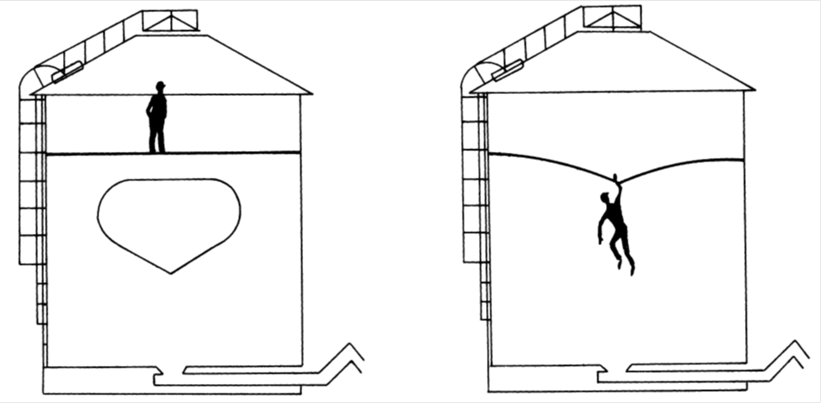
Access into Confined Spaces

Slide 15
Access into Confined Spaces (cont.)
No employee should ever enter bins, silos or tanks under a bridging condition. Similarly, no employee should enter bins, silos or tanks where a build-up of product on the sides of the confined space could fall and bury the employee.
Product stuck to the sides of bins, silos or tanks should always be dislodged from above. If a boatswain’s chair is used, it should never be positioned so that collapsing product could engulf the employee.
Before allowing entry into any confined spaces, the procedure for entering of confined spaces must be complied with at all times and a permit completed for each entry.
Similarly, all vessels should be checked for a person inside, before man-holes are closed and put into operation.

Slide 16
Environmental Pollution
Although the Sugar industry utilises some of its own by-products (bagasse as fuel for steam generation) there are several other pollutants:
  Air pollution
    Smoke from bagasse-fired boilers (sulfur dioxide, nitrogen oxide, carbon monoxide)
    Fly ash (fibrous and light particles)
    High temperature flue gases
    High moisture content of gases

Slide 17
Environmental Pollution (Cont.)
Water Pollution
Defined as a natural (or) induced change in the quality of water which renders it unstable (or) dangerous as regards, food, human and animal health, industry, agriculture, fishing (or) leisure pursuits.
Water or effluent released from a Sugar Mill must meet the following standards:
  Colour, taste and odour : Shall not contain any substance in a concentration capable of producing colour, taste or odour
  pH shall be between 5.5 – 9.5
  Dissolved oxygen : Shall be at least 75% saturated
  Typical (faecal) E. coli : Shall not contain any typical (faecal) E. coli per 100 ml
  Temperature : Shall not exceed 35°C
  Chemical oxygen demand : Shall not exceed 75 mgl-1
  Conductivity : Shall not be increased by more than 75 milli-Siemens per meter over that of the intake water
  Suspended solids : Shall not exceed 25mgl-1
  Sodium: Shall not be increased by over 90mgl-1 above that of the intake water
  Soap, oil, grease : Shall not exceed 2.5mgl-1

Slide 18
Hazardous Chemicals
Hazardous chemicals found within a sugar milling environment include:
  Petroleum products
  Caustic soda (sodium hydroxide)
  Hydrochloric, phosphoric, sulphuric and sulphamic acids
  Formaldehyde
  Lime (calcium hydroxide)

Slide 19
Hazardous Chemicals (Cont.)
Standard Operating Procedures are required for the following potentialities, to minimize risk of exposure:
  Unloading and bulk transfer
  Process or plant failure
  Operator error
Safety Data Sheets should be available for each chemical, these should contain:
  The ingredients of a product
  The health effects and first aid instructions
  Precautions for use
  Safe handling and storage information.

Slide 20
Hazardous Chemicals (Cont.)
Measures to decrease the risk of exposure of breathing, skin contact or ingestions of hazardous chemicals include:
  Ensuring a safety data sheet is readily available to anyone likely to be exposed
  A hazardous chemicals register containing a list of all hazardous chemicals on site plus a current copy of a safety data sheet for each chemical is maintained
  Labeling and storage comply with the appropriate standards and codes
  A risk assessment is completed and risks minimised for each hazardous chemical
  Workers are aware of the control measures to be implemented
  Appropriate PPE in accordance with the risk assessment is available and used as intended
  Adequate training is provided in the use of the hazardous chemical and the recommended PPE
  Monitoring or health surveillance is conducted if required
  Records are maintained for the specified time.

Slide 21
Hazardous Chemicals (Cont.)
Specific control measures should be developed such as:
  Isolating high risk areas with barriers and signage (e.g. under the effect stage while caustic boiling)
  Detailed and documented operating procedures
  Training
  Emergency response
  Provision of, and training with, appropriate PPE
  Provision of eye wash and safety shower facilities adjacent to the site but isolated from likely engulfment
  Access to safety data sheets and emergency procedures at the site.

Slide 22
Hazardous Chemicals (Cont.)
Laboratory chemicals
Laboratory staff have frequent exposure to a large range of hazardous chemicals in smaller quantities.
This exposure may result in acute and chronic health effects over the long term.
Handling, mixing and transferring hazardous chemicals such as hydrochloric and sulphuric acids, sodium hydroxide and flammable liquids including ethanol are some of the activities which are undertaken in sugar mill laboratories.
Users of chemicals should also be aware of any by-products or chemical reactions which may take place which could create additional hazards during laboratory processes.

Slide 23
Hazardous Chemicals (Cont.)
Laboratory chemicals (cont.)
For each specific analysis or chemical, the following control measures should be put in place:
  Detailed analytical procedures
  Training in the standard procedures to be followed
  Emergency response training and access to specialty first aid treatment
  Provision of, and training with, the recommended personal protective equipment for each activity
  Provision of eye wash and safety shower facilities adjacent to the site but isolated from likely engulfment

Slide 24
Hazardous Chemicals (Cont.)
Laboratory chemicals (cont.)
For each specific analysis or chemical, the following control measures should be put in place (cont.):
  Easy access to safety data sheet, information and emergency procedures in the laboratory
  Adequate labeling of all containers of hazardous chemicals
  Use of automatic pipettes
  Adequate ventilation
  A high standard of hygiene
  Disposal systems for used personal protective equipment
  Separate laundering of laboratory coats, hand towels, etc.
  Use of fume cupboards that comply with safety standards for such.

Slide 25
Hazardous Chemicals - Lead
All sugar factory laboratories use lead in the form of dry lead acetate and ‘wet lead’, which requires specific control measures to ensure workplace health and safety.
Lead can be absorbed by inhaling lead dust, fumes or mist and by ingesting lead that has contaminated hands, food or cigarettes.
Early symptoms of lead poisoning may include headache, loss of appetite, abdominal pain, constipation, nausea, fatigue, loss of weight and irritability.
Continued exposure can cause anaemia, kidney damage, and nerve and brain damage.

Slide 26
Hazardous Chemicals – Lead (cont.)
Risk control measures include:
Health monitoring can assist in minimising health risks by:
  Confirming that the absorbed dose of a substance is below the acceptable level
  Detecting adverse health effects at an early stage so that the worker can be protected from further injury, either by control of the process or by removal from exposure
  Evaluating the effectiveness of control measures.
Environmental monitoring (of contaminants in the air of the laboratory or other area where lead work is done)
Biological monitoring (Blood lead level)

Slide 27
Hazardous Chemicals – Lead (cont.)
Risk control measures include (cont.):
Labeling all containers in which any lead compound is stored
Avoiding generating dust when handling dry lead acetate
When transferring to smaller containers:
Use personal protective equipment (face shield, P2 dust respirator and gloves)
Transfer in a well-ventilated area free of strong air currents
High standards of personal hygiene
Not allowing drinking from laboratory taps
Training and supervision to ensure that the correct procedures are followed
Maintaining appropriate emergency response treatments
Providing automatic dispensers for wet lead.

Slide 28
Hazardous Chemicals – Welding and cutting fumes
The composition of the fume depends upon:
  Consumables : electrodes or filler metals, heating or shielding gases and fluxes
  Material: chemical composition of material being cut or welded and of any protective coating (e.g. galvanising) or primer paint (e.g. lead-based paints)
  Operating conditions (e.g. temperature and rod current).
The amount of fume generated depends on:
  Process and thermal conditions – amperage, voltage, gas and arc temperatures and heat input which may also vary with the welding position and degree of enclosure and the degree of skill of the welder
  Consumables
  Materials
  Duration of welding or cutting

Slide 29
Hazardous Chemicals – Welding and cutting fumes (cont.)
Possible control measures include:
Assess airborne concentrations of toxic metals such as chromium and nickel
Comply with individual exposure standards
Do not overlook fume concentration in the breathing zone (inside the welder’s helmet)
Identify routine tasks and develop generic risk reducing procedures for each, such as:
  Roller arcing
  Welding and cutting in dedicated workshop areas
  Railway maintenance.
Special consideration is also required for specific tasks such as:
  Hot work in confined space
  Welding in open spaces
  Tasks involving stainless steel, galvanised steel, etc.
Workplaces should maintain acceptable air quality standards
Workplaces whould have adequate exhaust appliance systems

Slide 30
Hazardous Chemicals – Methane Gas
Methane gas (CH₄) is a colourless, odourless gas
Forms when organic matter decomposes under oxygen-poor conditions (anaerobic – without oxygen).
High concentrations of methane gas can lead to a lack of oxygen in the air.
Can be produced as a result of fermentation of certain materials within the factory (e.g. mixed juice, liquor, molasses and messequite).
Methane can also result from fermentation of fibre products such as cush material (fibre separated from mixed juice prior to processing) or bagasse deposits mixed with water such as in mill boots, juice pits and within the cush-cush system.

Slide 31
Hazardous Chemicals – Methane Gas (cont.)
Mill operators should ensure that areas where these materials may remain following a shut down or mill closure are cleaned out before there is a risk of fermentation, thus avoiding methane build up.
If methane gas occurs in a confined space it can be explosive
The explosive range is between five percent and 15 percent methane in air
High concentrations of methane gas in the air can also be flammable.

Slide 32
Hazardous Chemicals – Methane Gas (cont.)
Operators should be aware of possible methane gas deposits after extended close downs in areas such as:
Molasses pipes
Hollow mill rollers
Between wear plates on pressure feeder chutes
Juice pipes
Pans
Effects
Mill boots
Juice pits
Rotary filter boots
Heaters
A range of tanks such as subsiders, mixed juice, incubators and flash tanks.

Slide 33
Hazardous Chemicals – Methane Gas (cont.)
Possible control measures include:
Training of personnel
Engineering controls (e.g. ventilation or flame proof equipment)
Sign posting and marking of areas where flammable atmospheres may exist to exclude ignition sources by a safe distance
Work procedures
Safe work permit systems for identified high risk processes (e.g. hot work permit systems including monitoring for flammable atmospheres in areas identified to be at risk).

Slide 34
Hazardous Chemicals – Methane Gas (cont.)
Monitoring of methane gas levels is required prior to an entry permit to a confined space
Monitoring of methane gas levels is required prior to hot work being conducted
Levels must be set at which no hot work, or no confined space entry will be permitted.

Slide 35
Hazardous Chemicals – Sugar Dust
There exists defined standards for inspirable sugar dust
Sugar dust can be explosive
Possible control measures for sugar dust should include minimising the likelihood of:
  An explosive dust/air mixture and combustible dust layers
  Any source of ignition.

Slide 36
Hazardous Chemicals – Sugar Dust (cont.)
If elimination of these hazards cannot be achieved then other control measures should be implemented:
  The use of appropriately rated equipment for operation within a combustible dust atmosphere
  Dust containment to reduce the ‘at risk’ area, such as identifying sources of release
  Dust reduction processes to maintain dust levels under the explosive point
  Minimising occurrences which may disturb dust layers creating dust clouds or removal of dust layers through good housekeeping practices
  Elimination of other sources of ignition such as hot work, smoking and naked flames
  Segregation of equipment
  Automatic disconnection of power supply and alarm initiations.
  Under no circumstances should battery chargers or low pressure sodium vapour discharge lamps be installed in hazardous locations.

Slide 37
Waste Handling
Solid waste
  Bagasse
  Filter cake
Manage waste by:
  Determining the origin of waste streams;
  Classifying waste into categories,
  Implementation of on-site waste management systems
  Managing the disposal of waste in accordance with NEM: Waste Act

Slide 38
Waste Handling (cont.)
Good housekeeping is the starting point for waste management
All waste materials produced by the Sugar Mill should be assessed according to the waste hierarchy wherever possible:
  Waste minimisation
  Reduce
  Re-use
  Recycle

