Slide 1
KNOWLEDGE COMPONENT: MODULE 1: OCCUPATIONAL SAFETY, HEALTH AND ENVIRONMENTAL PROTECTION: KT 4: ENVIRONMENTAL PROTECTION AND POLLUTION CONCEPTS

Slide 2
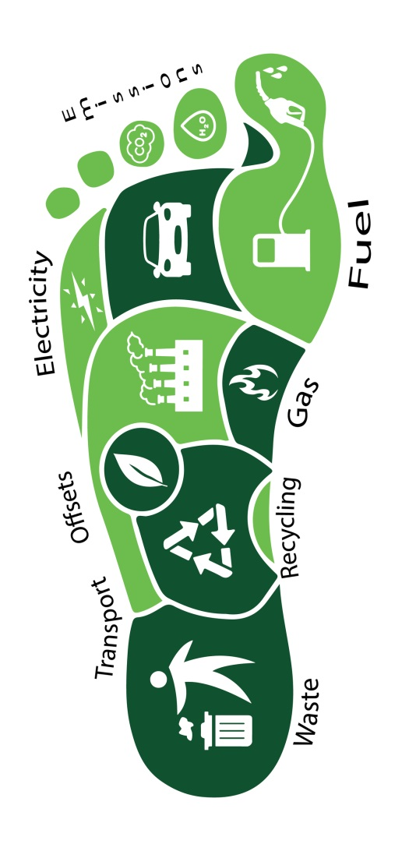
Carbon Footprint
Defined as “the total emissions caused by an individual, event, organization, or product, expressed as a carbon dioxide equivalent”.
Greenhouse gases (GHGs), including carbon dioxide, can be emitted through:
  land clearance
  production and consumption of food and fuels,
  Manufacture of goods and materials, wood, roads, buildings,
  Transportation and other services.
The total carbon footprint cannot be exactly calculated because of inadequate knowledge of and data about the complex interactions between contributing processes, including the influence of natural processes that store or release carbon dioxide.

Slide 3
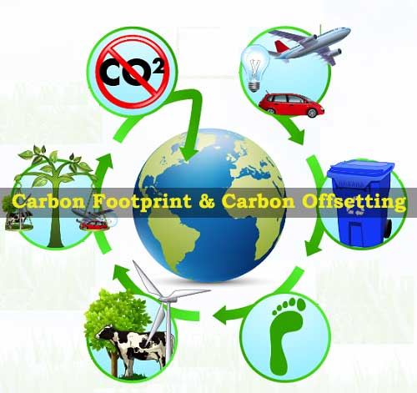
Carbon Footprint (cont.)
Can be defined as “A measure of the total amount of carbon dioxide (CO₂) and methane (CH₄) emissions of a defined population, system or activity, considering all relevant sources, sinks and storage within the spatial and temporal boundary of the population, system or activity of interest”.
Carbon Footprint is calculated as a carbon dioxide equivalent using the relevant 100-year global warming potential (GWP100).

Slide 4
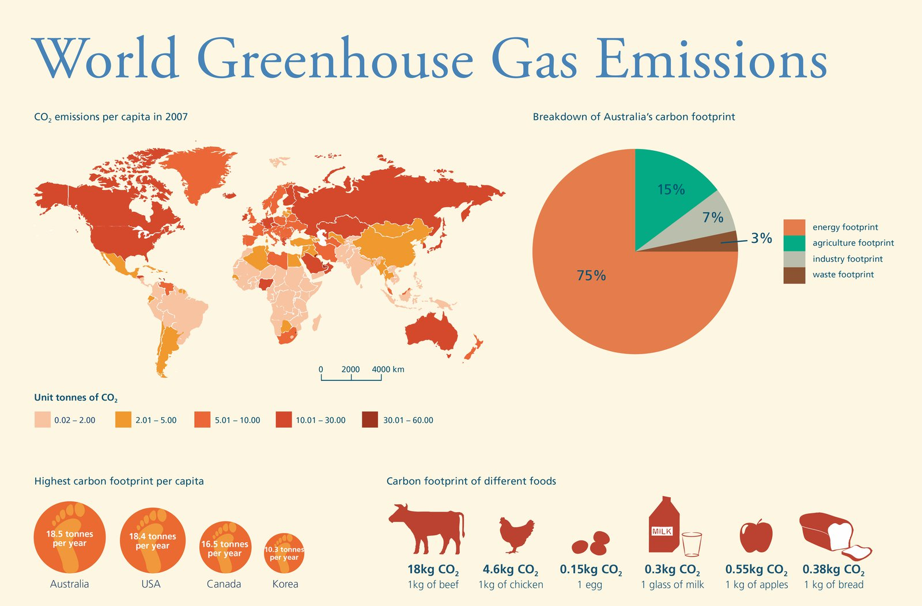
Effects of Excessive Carbon Footprint
Greenhouse gases accumulation
Climate change
Marine life depletion
Depletion of natural resources
Habitat destruction

Slide 5
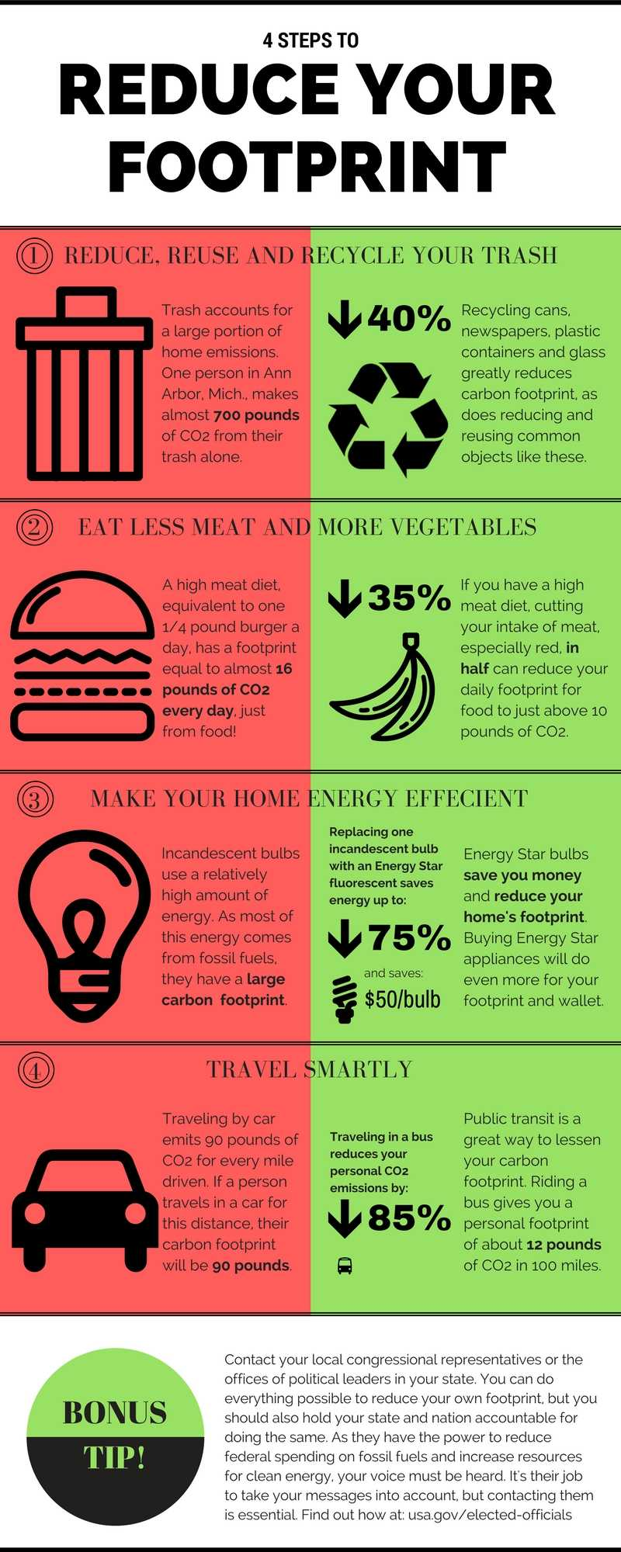
How to reduce your carbon footprint
Economical use of power in your house
Plant more trees
Drive less – rather cycle or walk
Save energy
Recycle – glass, metals, plastic, paper
Do not waste food – buy fresh not frozen
Buy local
Go solar
Conserve water

Slide 6
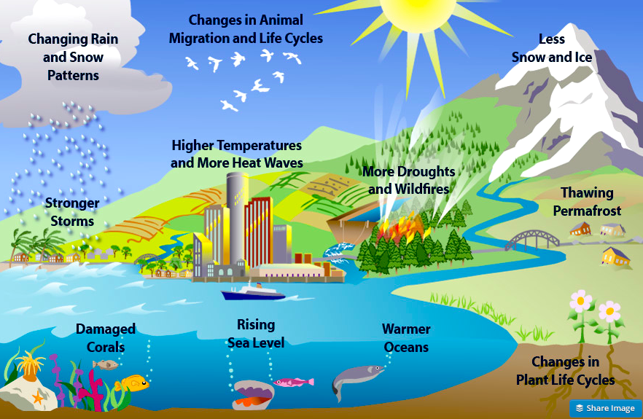
What is Global Warming?

Slide 7
What is Global Warming?
Defined as “a gradual increase in the overall temperature of the earth's atmosphere generally attributed to the greenhouse effect caused by increased levels of carbon dioxide, CFCs, and other pollutants.”
Temperatures today are 0.74 °C (1.33 °F) higher than 150 years ago.
The effects of global warming are the environmental and social changes caused (directly or indirectly) by human emissions of greenhouse gases.
There is a scientific consensus that climate change is occurring, and that human activities are the primary driver.

Slide 8
What is Global Warming?
Many impacts of climate change have already been observed, including glacier retreat, changes in the timing of seasonal events (e.g., earlier flowering of plants), and changes in agricultural productivity.
Future effects of climate change will vary depending on climate change policies and social development.
The two main policies to address climate change are reducing human greenhouse gas emissions (climate change mitigation) and adapting to the impacts of climate change.

Slide 9

Green Production
Green manufacturing is a new perspective of production processes and the establishment of environmentally-friendly operations within the manufacturing field.
Green manufacturers research, develop, or utilize technologies and practices to lessen their impact on the environment.
It is the creation of manufactured products by addressing:
  Social responsibilities
  Economically sound processes
  Conservation of energy
  Conservation of natural resources
  Prevents pollution
  Enhances employee, community and product safety
  Minimum negative environmental impacts
  Reduce or eliminates the use or generation of hazardous substances

Slide 10
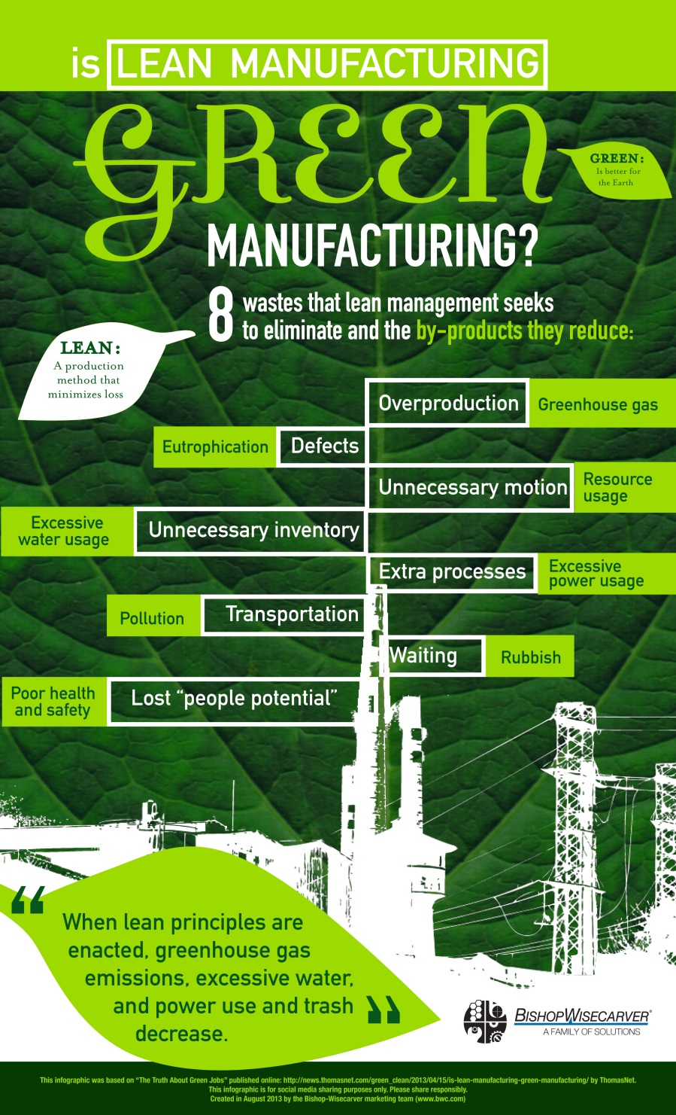

Slide 11
Sources and Impact of Contamination
Pollution is defined as “The state of contamination of different natural resources of the environment”
Types of pollution include:
  Land
  Water
  Air
  Noise
  Thermal
  Radioactive
  Light

Slide 12
Sources of Water Contamination
Suspended solids
Biodegradable organics (proteins, carbohydrates and fats)
Pathogens
Nutrients (Nitrogen, phosphorus, carbon)
Priority pollutants (highly toxic chemicals)
Refractory organics (pesticides, phenols, surfactants)
Heavy metals
Dissolved inorganics (nuisance chemicals)

Slide 13
Sources of Air Contamination
Decomposition of garbage that releases unwanted gases in the air.
Excessive use of fossil fuels that increases the particulate matter in the air.
Smoke coming out from thermal power plants, forest fires etc.
Use of leaded petrol in automobiles.

Slide 14
Sources of Soil Contamination
Solid waste
Flawed agricultural practices
Domestic waste
Municipal waste
Industrial waste
Chemical waste
Biological agents
Radioactive pollutants
Mining and smelting
Construction activities
Acid rain
Soil erosion

Slide 15
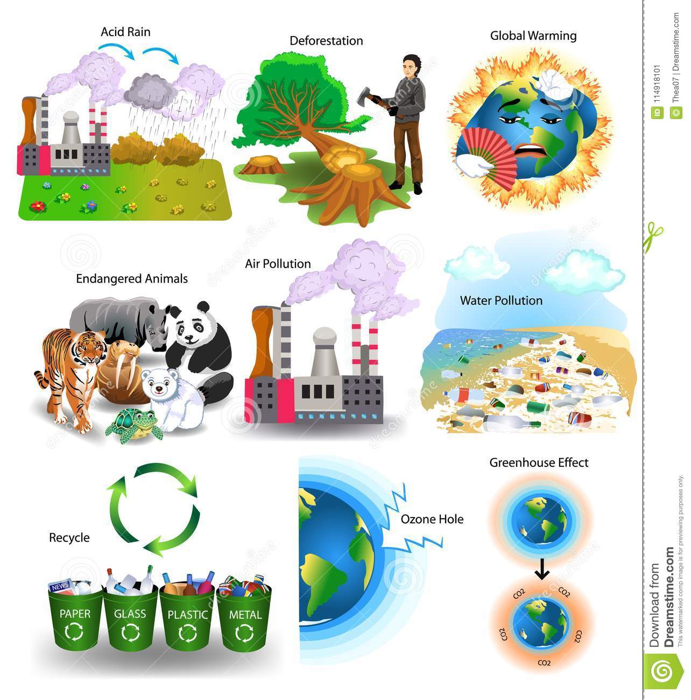
Negative Impact of Contaminants

Slide 16
Waste Control Measures
A waste is any solid, liquid, or contained gaseous material that is being discarded by disposal, recycling, burning or incineration.
It can be a byproduct of a manufacturing process or an obsolete commercial product that can no longer be used for its intended purpose and requires disposal.
Solid (non-hazardous) wastes generally include any garbage or refuse.
Hazardous waste shares the properties of a hazardous material (e.g. ignitability, corrosivity, reactivity, or toxicity), or other physical, chemical, or biological characteristics that may pose a potential risk to human health or the environment if improperly managed.

Slide 17
General Rules for Waste Control
Develop waste management priorities and plans
Create a waste management hierarchy that considers:
  Prevention (avoid or minimize the generation of waste)
  Reduction
  Reuse
  Recovery
  Recycling
  Removal
  Disposal of wastes (treating, destroying, and disposing in environmentally friendly manner)

Slide 18
General Rules for Waste Control (cont.)
Review all new waste sources during planning, siting and design
Review plans when equipment or processes are altered
Collect waste data (type, quantities, potential use/disposal)
Establish priorities based on risk analysis
Define opportunities for source reduction, reuse and recycling

Slide 19
Waste Prevention
Substitute raw materials and inputs with less hazardous or non-toxic materials
Apply processes that convert materials efficiently
Institute good housekeeping and operating practices
Implement procurement measures that allow for return of usable materials (containers, etc.)
Implement stringent waste segregation to minimize hazardous waste contaminating non-hazardous waste

Slide 20
Recycling and Reuse
Consider:
Evaluation of waste production processes and identification of potentially recyclable materials.
Identification and recycling of products that can be reintroduced into the manufacturing process or industry activity at the site.
Investigation of external markets for recycling by other industrial processing operations located in the neighborhood or region of the facility (e.g., waste exchange).
Establishing recycling objectives and formal tracking of waste generation and recycling rates.
Providing training and incentives to employees in order to meet objectives.

Slide 21
Treatment and Disposal
Consider:
On-site or off-site biological, chemical, or physical treatment of the waste material to render it nonhazardous prior to final disposal.
Treatment or disposal at permitted facilities specially designed to receive the waste. Examples include:
  Composting operations for organic non-hazardous wastes;
  Properly designed, permitted and operated landfills or incinerators designed for the respective type of waste;
  Other methods known to be effective in the safe, final disposal of waste materials such as bioremediation.

Slide 22
Hazardous Waste Storage
Hazardous waste should be stored so as to prevent or control accidental releases to air, soil, and water resources in area location where:
Waste is stored in a manner that prevents the commingling or contact between incompatible wastes, and allows for inspection between containers to monitor leaks or spills (E.g. sufficient space between incompatibles or physical separation such as walls or containment curbs)
Store in closed containers away from direct sunlight, wind and rain.
Secondary containment systems should be constructed with materials appropriate for the wastes being contained and adequate to prevent loss to the environment.

Slide 23
Hazardous Waste Storage (cont.)
Secondary containment is included wherever liquid wastes are stored in volumes greater than 220 liters.
The available volume of secondary containment should be at least 110 percent of the largest storage container, or 25 percent of the total storage capacity (whichever is greater), in that specific location.
Provide adequate ventilation where volatile wastes are stored.
Hazardous waste storage activities should also be subject to special management actions, conducted by employees who have received specific training in handling and storage of hazardous wastes

Slide 24
Hazardous Waste Storage (cont.)
Control Measures include:
Provision of readily available information on chemical compatibility to employees, including labeling each container to identify its contents.
Limiting access to hazardous waste storage areas to employees who have received proper training.
Clearly identifying (label) and demarcating the area, including documentation of its location on a facility map or site plan.
Conducting periodic inspections of waste storage areas and documenting the findings
Preparing and implementing spill response and emergency plans to address their accidental release.
Avoiding underground storage tanks and underground piping of hazardous waste.

Slide 25
Hazardous Waste Transportation
On-site and off-site transportation of waste should be conducted so as to prevent or minimize spills, releases, and exposures to employees and the public.
All waste containers designated for off-site shipment should be:
  Secured and labeled with the contents and associated hazards,
  Be properly loaded on the transport vehicles before leaving the site, and
  Be accompanied by a shipping paper (i.e., manifest) that describes the load and its associated hazards.

Slide 26
Thermal Waste Treatment
Incineration
  Combustion of waste material in the presence of oxygen.
  Can be used as a means of recovering energy for electricity or heating.
Gasification and Pyrolysis
  Decompose organic waste materials by exposing waste to low amounts of oxygen and very high temperature.
  Pyrolysis uses absolutely no oxygen
  Gasification uses a very low amount of oxygen
Open Burning
  Environmentally harmful.
  Release substances such as hexachlorobenzene, dioxins, carbon monoxide, particulate matter, volatile organic compounds, polycyclic aromatic compounds, and ash.
  Unfortunately still the most used method because it is an inexpensive solution

Slide 27
Biological Waste Treatment
Composting
  Controlled aerobic decomposition of organic waste materials by the action of small invertebrates and microorganisms.
  Techniques include
    static pile composting,
    vermi-composting,
    windrow composting and
    in-vessel composting.
Anaerobic Digestion
  Uses an oxygen and bacteria-free environment to decompose the waste material

Slide 28
Waste Disposal
Dumps and Landfills
Most commonly used waste disposal solution.
Landfills attempt to eliminate or reduce the risk of environmental or public health hazards due to waste disposal.
Sites situated where land features work as natural buffers between the environment and the landfill.
Presents the least health and environmental risk, but the cost of establishment is high

Slide 29
Waste Monitoring
Regular visual inspection of all waste storage collection and storage areas for evidence of accidental releases and to verify that wastes are properly labeled and stored.
When significant quantities of hazardous wastes are generated and stored on site, monitoring activities should include:
  Inspection of vessels for leaks, drips or other indications of loss.
  Identification of cracks, corrosion, or damage to tanks, protective equipment, or floors.
  Verification of locks, emergency valves, and other safety devices for easy operation (lubricating if required and employing the practice of keeping locks and safety equipment in standby position when the area is not occupied).
  Checking the operability of emergency systems.

Slide 30
Waste Monitoring (cont.)
Documenting results of testing for integrity, emissions, or monitoring stations (air, soil vapor, or groundwater).
Documenting any changes to the storage facility, and any significant changes in the quantity of materials in storage.
Regular audits of waste segregation and collection practices.
Tracking of waste generation trends by type and amount of waste generated, preferably by facility departments.

Slide 31
Waste Monitoring (cont.)
Characterizing waste at the beginning of generation of a new waste stream, and periodically documenting the characteristics and proper management of the waste, especially hazardous wastes.
Keeping manifests or other records that document the amount of waste generated and its destination.

Slide 32
Waste Monitoring (cont.)
Periodic auditing of third party treatment and disposal services including re-use and recycling facilities when significant quantities of hazardous wastes are managed by third parties.
Whenever possible, audits should include site visits to the treatment storage and disposal location.
Regular monitoring of groundwater quality in cases of Hazardous Waste on site storage and/or pretreatment and disposal.

Slide 33
Negative Impacts of Liquid Effluent
Effluents discharged by sugar factories must be treated correctly before discharge.
Sugar industry effluents are not highly toxic
However, suspended solids can cause:
  blockage of drains and ditches and
  delayed pollution effects due to the slow decomposition of the biological components of the suspended solids.
Effluents containing high salt concentrations are toxic to aquatic life and cannot be discharged directly into streams or rivers.

Slide 34
Negative Impacts of Liquid Effluent (cont.)
Odours can also be problematic with untreated effluents.
Contaminated water bodies often appear black due to the precipitation of iron and produces hydrogen sulphide gas which is bad for the surroundings.
Decomposition in water bodies results in the depletion of the oxygen content of water, making water unfit for fish and other aquatic life.
Soil fertility and productivity can also be reduced if contaminated with untreated effluents.

Slide 35
Negative Impacts of Solid Waste
Boiler ash discarded in landfill sites that are not adequately covered by soil (especially in the dry season) can cause seriously dusty conditions reducing breathable air quality.
Filter cake left to ferment in landfill sites causes a characteristic unpleasant sour odour if not provided with aeration.
Filter cake dumps also form leachates which are acidic and detrimental to ground water bodies causing odours and a yellowish colour.

