Slide 1
KNOWLEDGE COMPONENT: MODULE 2: SUGAR PROCESSING EQUIPMENT AND TECHNOLOGY: KT1: BACKGROUND AND EQUIPMENT HYGIENE AND CLEANING

Slide 2
Background to Sugar Technology and Equipment
The processing of Sugar Cane into Sugar entails several processing steps:
  Extraction of juice
  Clarification of juice
  Concentration and Crystallization
  Separation of crystals
  Refining of sugar
  Recovery of sugar molasses
Each of these steps utilises different types of equipment
Equipment found in Sugar Mills includes: conveyors, cranes, cutters, slicers, diffusers, mills, sugar centrifuges, boilers, evaporators, vacuum pans, crystallizers, shredders, agitators, mixers, driers, packaging equipment, pipes, valves, pumps and more
Because sugar is a food product, hygiene and cleaning are of utmost importance

Slide 3
Background to Sugar Technology and Equipment (cont.)
Processing equipment in a sugar mill includes:
  Laboratory Equipment
  Centrifugals
  Clarifiers
  Dryers and Coolers
  Evaporators
  Filter Press
  Cane Mud Filter
  Pan Instrumentation
  Entrainment Arrestor
  Magma Pumps
  Massecuite Pumps
  Screening Machinery
  Refinery machinery
Each of these pieces of equipment are made up of components such as pipes, gears, bolts, valves, motors, fittings, clutches etc.

Slide 4
Background to Sugar Technology and Equipment (cont.)
For each of these equipment components there are:
  Several types that function differently
  Different circumstances in which they could be used
  Different maintenance requirements

Slide 5
Background to Sugar Technology and Equipment (cont.)
As a Sugar Processing Machine Operator it is necessary to know:
  What the sugar processing steps are,
  What the equipment for each process is,
  How each piece of equipment works,
  What the components of the equipment are,
  How each component fits into the equipment,
  What the component’s purpose is in the equipment,
  How to maintain the component,
  How to maintain the equipment,
  How to operate the equipment,
  What quality parameters the equipment must attain,
  How all these components, equipment and processes fit together,
  How all these components, equipment and processes are monitored

Slide 6
Equipment Hygiene and Cleaning
Cleaning in Place (CIP) means cleaning that takes place without dismantling the system
Can be done either:
  After a processing run that has produced normal fouling, or
  When switching a processing line from one recipe to another (not common in a sugar mill)
Cleaning between production runs avoids contamination and improves quality standards

Slide 7
Equipment Hygiene and Cleaning (cont.)
Cleaning needs to take place so that:
  There is no contamination of the product with the chemicals used for cleaning
  There is minimal down-time
  It has a low cost
  It is done safely (chemicals may be harmful, effective lock-out practices must be in place to avoid accidently turning on the equipment while workers are busy cleaning)
  It has the least negative impact on the environment (using minimal amounts of water and detergents and maximising re-use of resources)

Slide 8
Equipment Hygiene and Cleaning (cont.)
In Cleaning in Place (CIP), the equipment is not dismantled, but is cleaned in the same set-up as it was used during production.
Cleaning fluids are then circulated through the equipment in a cleaning circuit.
In single-use cleaning, detergents and wash water are discarded after a single use because of very dirty plant
In recovery CIP, the plant is not very dirty, and the detergent and wash water can be re-used.

Slide 9
Equipment Hygiene and Cleaning (cont.)
Single-use cleaning:
  Cleaning solution is always fresh
  Equipment is inexpensive
  High cost
  High environmental load
Recovery CIP:
  Less cleaning detergent consumed
  Less water and energy consumed
  Less environmental load
  Equipment is more expensive

Slide 10
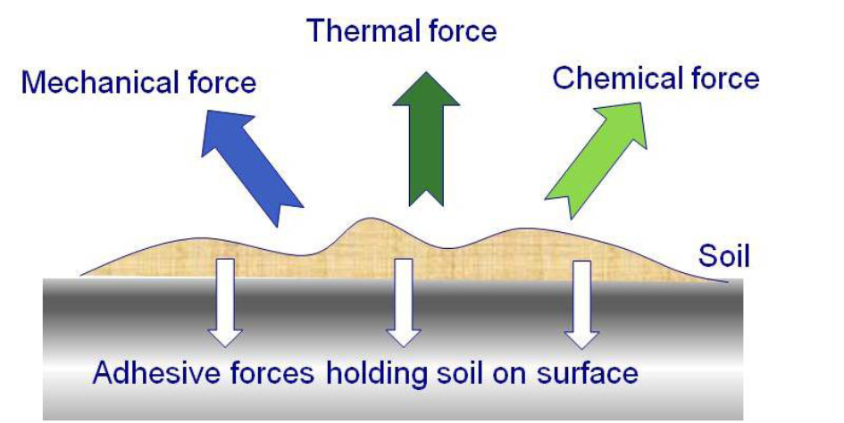
The 4 Parameters of Cleaning

Slide 11
Mechanical Force of Cleaning
The shear forces created by the flow
Imagine a hose nozzle that creates a “jet” of water with high pressure
In a plant the flow velocity of the cleaning liquids can be increased by pumping it faster
Flow must be turbulent to be effective
Flow must be at least 1.5 metres per second to be effective

Slide 12
Chemical Force of Cleaning
To clean effectively, chemical force is used in combination with mechanical force
Alkaline detergents are used first
Alkaline detergents dissolve protein, fats and sugars (i.e. organic “soil” (dirt))
Often pure sodium hydroxide (NaOH)
Sometimes a formulated detergent

Slide 13
Thermal Force of Cleaning
Molecules move faster at an elevated temperature
The effectiveness of a detergent is increased with increased temperature
Plant should be cleaned at the same temperature as it has been processing the food
If too high a cleaning temperature is used, it may cause denaturation of the soil/dirt particles, making it more difficult to remove

Slide 14
Procedure for Cleaning Plant

Slide 15
Cleaning Materials and Chemicals
Cleaning materials can be pure chemicals, such as:
  Sodium Hydroxide (lye)
  Nitric acid
  Phosphoric acid
Cleaning materials can be complex formulated detergents
  Use the recommended dosage
  Correctly calculate the concentrations required
  Dilute accurately with water
Cleaning materials can be a combination of the above

Slide 16
Detergent Alternatives
Pure chemical, formulated detergents or combination of the two
Main component of formulated detergents is either an alkali or and acid
Additional components include:
  Surfactants – wetting agents
  Sequestering agents – softens water
  Complex-forming agents – binds with metal-ions in molecules
  Oxidation agents – Boosts cleaning effects

Slide 17
Detergent Concentrations
Detergents need to be used at a certain concentration
The starting concentration must be known
The volume of water needed to achieve desired concentration must be known
The unit for concentration used in industry is percent (%)
Distinguish between weight % and volume %
Pure chemical concentrates are specified in weight %
Dosing recommendations for formulated detergents are often higher than dosing recommendations for pure chemicals
Recommendations from suppliers of formulated detergents should always be strictly followed

Slide 18
Preparation of Cleaning Liquids
Detergent concentrates must be diulted with water before they are used
Too low or too high concentrations will result in inadequate cleaning
Too high concentrations are a waste of money and can damage equipment
Single-use: The detergent concentrate is dosed directly into a water filled processing unit
Recovery: The detergent solution is prepared in a special cleaning station, pumped through the processing equipment and then returned to the cleaning station
Always add detergent or chemical to water – never the other way around!

Slide 19
Hygiene and Product Quality
Hygiene and cleanliness is required from the farm right through to the product delivery to the client
On the farm:
  Parts of sugar cane left in the planters or harvesters could be infected with diseases
  A wash-down facility should be provided away from the production areas of the farm
  The wash-down area should have a sealed surface with a sump to collect waste water and debris
  Mud, soil and plant material washed down must be kept away from crops, storage areas and waterways
  Remove pests and weeds around the wash-down area regularly
  Any equipment coming onto the farm from outside should be cleaned and disinfected
  Use high pressure water or compressed air to clean vehicles and equipment

Slide 20
Product Safety at the Sugar Mill
Good hygiene practice is part of on-going quality assurance
All production, packaging and storage must be carried out in a clean environment
Guarantee’s safe product for customers

Slide 21
General Product Safety Rules
Smoking, eating and drinking are allowed in designated areas only, never in production areas.
Always maintain good personal hygiene. Wash hands before starting work, and after using the toilet.
Never touch unpacked products unless absolutely necessary. If touched, the product must be discarded or reprocessed if possible.

Slide 22
General Product Safety Rules (cont.)
Plasters must be blue with a metal strip.
Earplugs must, if relevant, be metal detectable.
Keep doors and windows closed to prevent insects, birds or vermin from entering.
Before commencing repair work, the supervisor in charge should be consulted on how to carry out the work so that no products become contaminated.

Slide 23
General Product Safety Rules (cont.)
After repair work, production equipment should be restored and cleaned to avoid product contamination. Please make sure to follow the appropriate cleaning procedures.
Packaging materials must be used exclusively for the products for which they are intended.
Packaging materials, ingredients, processing aids and other chemicals must be stored to avoid contamination.

Slide 24
General Product Safety Rules (cont.)
Materials used in contact with food products or intermediate products must be intended for this purpose.
Waste containers must be marked and, where possible, covered.
Pets are not allowed anywhere at the factory.
Always inform your supervisor if you suffer from vomiting, diarrhea, infected wounds or any serious systemic infection, e.g. tuberculosis.

Slide 25
Sugar Cane Biosecurity Zones - 1
Zone 1
Hygiene zone 1 covers the handling of sugar cane and raw sugar until and inclusive of crystallization.
In zone 1, the general rules apply.

Slide 26
Sugar Cane Biosecurity Zones - 2
Zone 2
Covers areas for production and storage of food products. In zone 2, both the general and the following rules apply:
  Objects of glass or ceramics are not allowed in the zone. If you find splinters, immediately remove them and report to your superior or supervisor.
  Storage of personal items is not allowed.
  Cleaning procedures in certain areas may have to be documented. Ask your superior or supervisor.
  Storage of materials of animal origin is not allowed.
  Light fittings (whether for fluorescent tubes or glow lamps) and windows must be made of safety glass if there is a risk of glass splinters contaminating the products.
  Skylights must be of safety glass.

Slide 27
Sugar Cane Biosecurity Zones - 3
Zone 3
Hygiene zone 3 covers areas for production of food products with normally no direct access to the products. In zone 3, the general rules, zone 2 rules and the following rules apply:
  Always begin the working day with clean work clothes.
  Caps must be worn at all times.
  Snuff and chewing gum are not allowed.
  Zone 4 rules must be complied with if the work involves direct access to the product, for example, when operating machinery such as Centrifugals, sugar driers/coolers, sieves, magnets, packaging machinery and bagging equipment when packing and unpacking products.

Slide 28
Sugar Cane Biosecurity Zones – 3 (cont.)
Zone 3
Maintenance staff must:
  Use clean and protective clothing.
  Consult the supervisor in charge before commencing work to ensure that the job can be done without contaminating the product.
  Ensure that tools are cleaned before use.
  Return all tools, spare parts etc. when the job is done and clean the production equipment and the working area.
Effective protection against insects must be in place.

Slide 29
Sugar Cane Biosecurity Zones – 4
Zone 4
Hygiene zone 4 includes areas where products, ingredients or packaging are handled in open systems, including loading of bulk. In zone 4, the general rules, zone 2 and 3 rules as well as the following rules apply:
  Caps covering all hair must be worn.
  In the silo area, overshoes are mandatory.
  Employees with permanent work tasks in the silo area must use shoes specifically provided for this work.

Slide 30
Sugar Cane Biosecurity Zones – 4 (cont.)
Zone 4
Jewellery (smooth wedding rings excepted), watches and blue tooth units are not allowed. Earrings and piercings are allowed if fully covered by clothes or a plaster.
False nails or false eyelashes are not allowed.
Only eyewear with safety straps is allowed at inspection silos, bulk and containers.
Outside pockets above the hip are not allowed.
Tools must be completely clean.

Slide 31
Causes of Contamination
Equipment contaminants can be:
  gaseous
  fluid
  semi-solid
  solid
Particles as small as 5 microns can affect a hydraulic system, thus imposing much harsher contamination prevention requirements to keep systems running to acceptable performance.
Damage caused by contamination accumulates over time.
Dirt contamination can reduce the useful life of equipment to less than half of the manufacturer’s performance projections
Contamination is often caused by the lack of awareness and training of frontline operators and maintenance trades.

